Slide 1
Blood pressure
Physiology II – practice
Spring, weeks 7th-9th
Study materials were supported by the project: MUNI/FR/1474/2018

Slide 2
Arterial blood pressure curve
Blood pressure (BP): pressure of blood on the vessel wall (arterial BP – part of the energy of systole converted into lateral pressure on the vascular wall)
Mean arterial pressure (MAP): mean value of blood pressure in the inter-beat interval (IBI) – integral of the BP curve; area above MAP = area below MAP (MAP is an additional quantity, it is not the arithmetic mean of the systolic (SBP) and diastolic (DBP) pressure values, because the duration of systole and diastole during the cardiac cycle is different) aproximation: MAP = DBP + 1/3 PP (PP = SBP – DBP)
Definition:
SBP (systolic BP) maximal of BP in the inter-beat interval
DBP (diastolic BP) minimal BP in the inter-beat interval
Attention: Values of SBP and DBP vary in
different parts of the cardiovascular system
SBP
Dicrotic notch
PP
pulse pressure
MAP
DBP
Inter-beat interval

Slide 3
Blood pressure
MAP is a function of cardiac output (CO) and total peripheral resistance
SBP is determined mainly by CO
DBP is determined mainly by TPR
Arterial blood pressure
(BP)
Cadiac output
(CO)
Total peripheral resistance (TPR)
=
*
Heart rate
(HR)
Stroke volume
(SV)
*

Slide 4
Blood pressure regulation
Short-term – neural control, mainly baroreflex
Middle-term – hormonal regulation, renin-angiotensin-aldosterone system (RAAS)
Long-term – hormonal regulation of blood volume

Slide 5
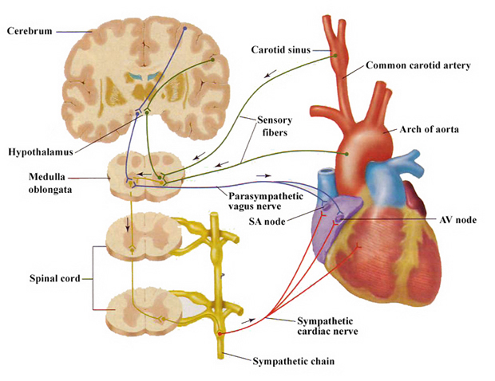
Short-term BP control – baroreflex
Autonomic nervous system: sympathetic nerves (↑ BP, HR, SV, TPR) X parasympathetic nerves (↓ BP, HR, SV, TPR)
Function: rapid regulation of BP via changes in HR and TPR
baroreceptors – sinus caroticus + sinus aorticus; afferentation: n. vagus, n. glossopharyngeus
Cardiac branch of baroreflex:
Parasympathetic efferentation: rami cardiaci n. vagus to SA node - ↓ HR and cardiac contractility
Sympathetic efferentation: n.cardiaci to SA node - ↑ HR and cardiac contractility
Peripheral branch of baroreflex:
Only sympathetic efferentation: sympathetic vascular innervation (mainly of arterioles) ↑ BP → ↓ TPR due to vasodilation in peripheral circulation and vice versa (↑TPR due to vasoconstriction)
(notice: vasoconstriction of small arteries and arterioles, venoconstriction – blood redistribution)

Slide 6
Blood pressure changes
Short-term influences
blood volume – influence on cardiac output (bleeding, dehydration)
external pressure to the vessels – intrathoracic and intraabdominal pressure (cough, defecation, childbirth, artificial ventilation)
position – orthostasis/clinostasis: redistribution of blood due to gravity
CNS – emotions, mental stress, …
physical exercise – BP changes depend on intensity, duration and type of exercise
heat (↓ TPR), cold (↑ TPR)
alcohol, medicaments,…
Long-term influences
age (the fastest changes during childhood and adolescence, in adults slow increase in SBP)
sex (men have higher BP)
genetics

Slide 7
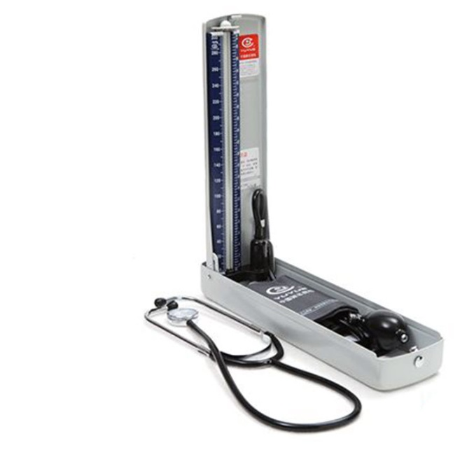
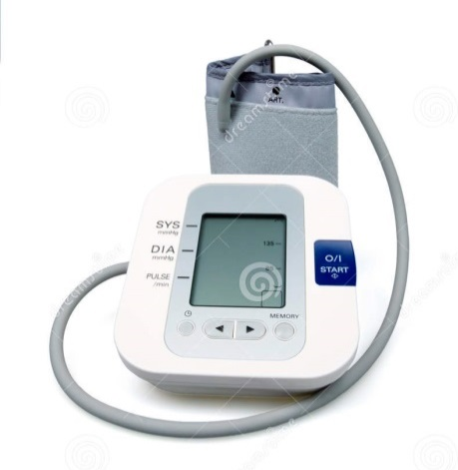
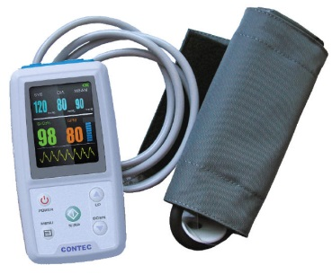
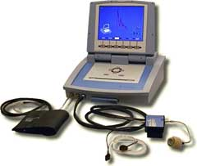
Methods of the arterial BP measurement
In practicals
Auscultatory
(sphygmomanometer,
stethoscope)
Palpatory
(sphygmomanometer)
Oscillometric
Another methods:
24-hour blood pressure monitoring
Photoplethysmografic (volume-clamp method, Peňáz)

Slide 8
Basic principle: Laminar / turbulent flow (Korotkoff sounds in auscultatory method; oscillation in oscilometric method).
$$Re=\frac{v∙S∙ρ}{η}$$
laminar flow Re < 2000
turbulent flow Re > 3000
Reynolds number Re: predicts the transition from laminar to turbulent of flow v: velocity of blood flow
S: area of vascular lumen (π.r²)
ρ: density of blood
η: viscosity of blood
(lower in anemia)
cuff
a. brachialis
Re₂
r₁
r₂
v₂
v₁
Re₁
laminar flow
turbulent flow
closely behind narrowing of the artery:
S₁ < S₂ a v₁≈ v₂ → Re₁ < Re₂ → turbulent flow

Slide 9
Principles of BP measurement
SBP
MAP
DBP
Korotkoff sound
(auscultatory method)
Pressure in the cuff
SBP
DBP
Pressure oscillations in the cuff
(oscillometric method)
Continually measured BP
Blood flow in the artery

Slide 10
Rules for BP measurement
Environment: pleasant room temperature, quiet surroundings
Position: the patient sits with his back leaning backwards, both legs are on the floor, forearm rests on a surface
Reasonable cuff size, correct positioning at heart level
The measurement happens at rest and starts after 5 – 10 minutes of sitting down
Measurement by auscultatory method
Inflate the cuff to a pressure 30 mmHg higher than the pressure at which the radial pulse disappeared
The pressure reduction rate in the cuff is 2 – 3 mmHg/s
The pressure value is determined with 2 mmHg accuracy
The BP should be measured 3 times at least five minutes apart and the final BP value is a mean value of the last two measurements

Slide 11
24-hour blood pressure monitoring
BP decrease during night: 10-15%
[mmHg]
heart rate
blood pressure
SBP
DBP
heart rate
[bpm]
140
120
100
80
60
120
100
80
60
awake
hours
8
9
10
11
12
13
14
15
16
17
18
19
20
21
22
23
24
1
2
3
4
5
6
7
sleeping

Slide 12
method | advantages | disadvantages | measured value
auscultatory | exact estimation of SBP/DBP easy, it doesn´t require electricity | subjective, experience is necessary SBP/DBP from different IBI | SBP and DBP
oscillometry | exact estimation of MAP automatic, fast BP can be measured by layman, cheap (home measurement) | DBP/SBP is calculated (dependence on model, influenced by a shape of pulse wave) SBP/DBP from different IBI false values during arrhythmia | MAP, sometimes SBP (it depends on a device)
24-hour BP monitoring | BP record from whole day diagnosis of white-coat hypertension | disruptive influence of measuring (during sleeping) SBP/DBP from different IBI | BP is measured each 15–60 min
photople-thysmography (Peňáz) | continual BP record possibility of beat-to beat SBP/DBP calculation (BP variability analysis) | measurement on a finger, brachial BP is calculated expensive device | continual BP record

Slide 13
Diagnosis of hypertension
 | blood pressure | SBP [mmHg] | DBP [mmHg] | possible complications
normal | optimal | <120 | <80
 | normal | 120 – 129 | 80 – 84
 | high normal | 130 – 139 | 85 – 90
hypertension | stage | 140 – 159 | 90 – 99 | without organ changes
 | 2. stage | 160 – 179 | 100 – 109 | hypertrophy of L ventricle, proteinuria, angiopathy, ...
 | 3. stage | > 180 | > 110 | morphological and functional changes of some organs, retinopathy, heart and renal insufficiency, ischemia of CNS, bleeding in CNS
Isolated systolic hypertension: SBP> 140 and DBP <90 mmHg
High normal BP – annual monitoring recommended
Home measurement to exclude white coat hypertension
Hypertension is diagnosed when:
average BP from 4–5 examinations is > 140/90 mmHg
BP during a home measurement repeatedly > 135/80 mmHg
mean BP from 24-hour monitoring is > 130/80 mmHg

Slide 14
Changes in blood pressure during exercise
Increase in BP depends on the type, intensity and duration of the exercise
Sympathetic activation: changes in the cardiovascular system serve to satisfy the metabolic needs of working muscle
Impact of exercise on blood pressure:
Increased cardiac output → ↑ SBP
Redistribution of blood in the body – metabolic vasodilation in muscle (increased blood flow in the muscle), vasoconstriction in the GIT, skin and kidneys → maintaining or slight change in DBP (depending on the extent of the TPR decrease)
Vasoconstriction in the skin is temporary, till thermoregulatory mechanisms dominate
DBP increases during isometric muscle work (e.g. weightlifting)
After exercise: decrease in BP to resting values or slightly lower values, the blood flow in the muscle remains elevated until recovery
Recovery interval is determined by the parasympathetic tone (can be increased by training)

Slide 15
In addition

Slide 16
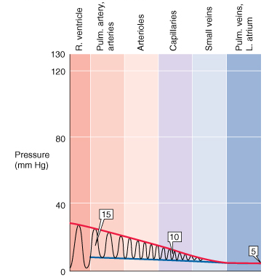
Large circle
Small circle
Blood pressure
Boron and Boulpaep, Medical physiology

Slide 17
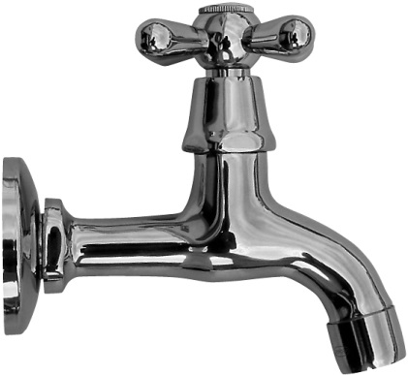
Arteries – „garden“ analogy
Baroreflex
A decrease in arterial pressure leads to sympathetic activation → an increase in heart rate (and cardiac output) and peripheral resistance An increase in arterial pressure leads to activation of the parasympathetic nervous system → a decrease in heart rate (and cardiac output) and, indirectly, in peripheral resistance
Heart
cardiac output
Carotids
perfusion pressure in the brain
Resistance vessels total peripheral resistance
Arteries, arterial BP
The primary purpose of BP neural regulation is to maintain constant perfusion pressure in the brain.

Slide 18
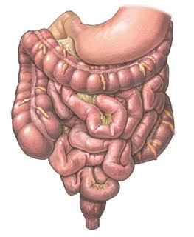
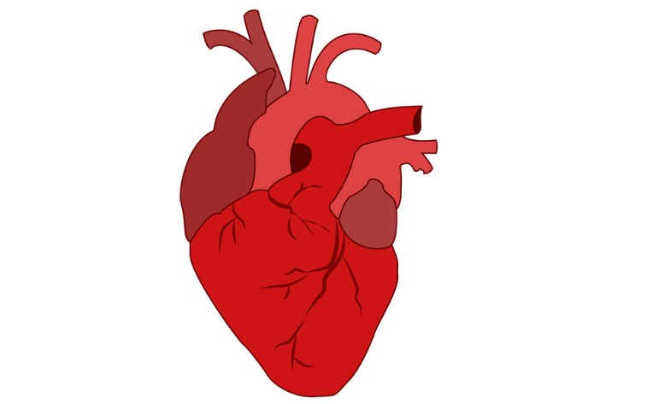
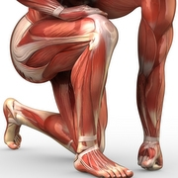
Changes in cardiovascular system during exercise
↑ Sympathicus → ↑CO due to ↑HR → ↑BP
↑ Sympathicus→ ↑ R(resistence – peripheral)
GIT, skin
Working muscle
↑ Venous return
Metabolic autoregulation → ↓R
Muscles can take up to 80% of CO (cardiac output) After the sudden termination of heavy exercise without slowing down – "bleeding out into the muscle" – the heart has already decreased CO, but the vessels of the muscle are still dilated – blood redistribution to the muscle – strong drop in BP – fainting

