Slide 1
Ergometry
Physiology II – practice
Spring, weeks 10th-12th

Slide 2
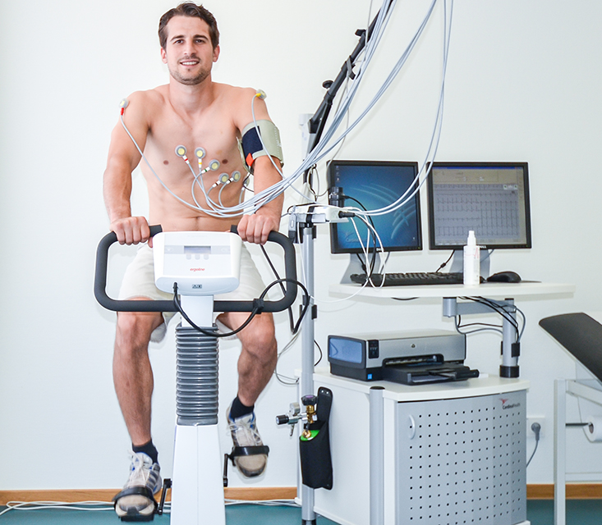
Ergometry (stress testing, exercise testing)
Work load examination – measurement of ECG and other parameters during the increasing degree of exercise on the ergometer
In addition to ECG, the following can be recorded:
O₂ consumption, CO₂ output, blood pressure, blood samples (mainly lactate)
Types of ergometers
Bicycle ergometer – load mainly on the lower half of the body
Rowing machine – upper body load
Rump ergometer – exercise bike for hands, para/quadriplegia
Master´s step
Treadmill
Can be used in:
Sports medicine
Rehabilitation medicine
Cardiology

Slide 3
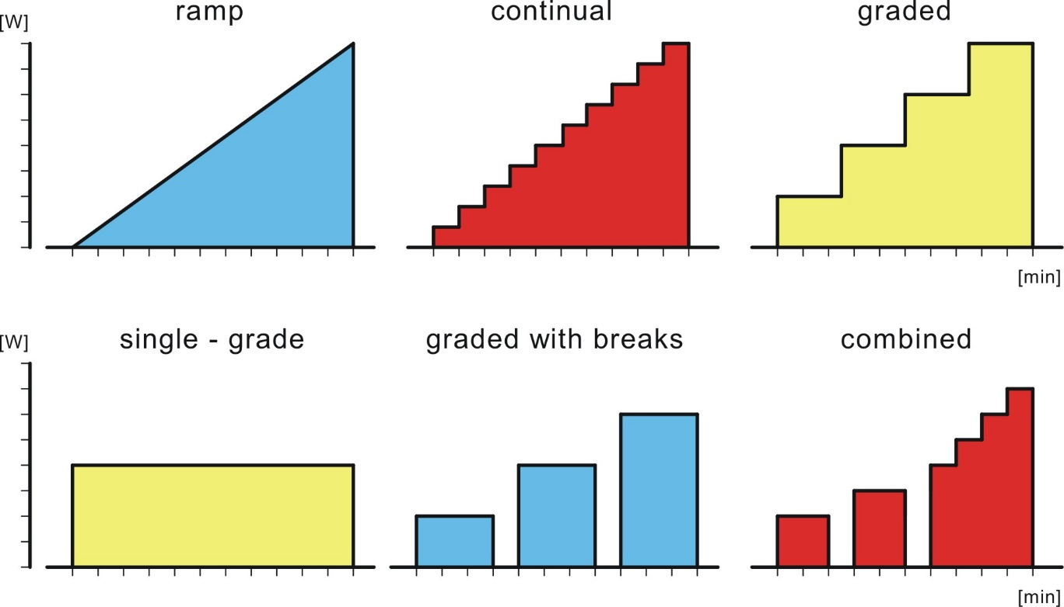
Basic types of protocols for ergometry
Ramp
Continual
Graded
Single-grade
Graded with breaks
Combined

Slide 4
Myocardial metabolism
It needs a high blood supply, rich capillarization
Blood supply occurs especially at the beginning of diastole because in systole the muscle is contracted and the vessels are closed. This is especially true for the left ventricle which exerts higher pressure – it is more vulnerable to hypoxia.
The heart is an „omnivore“, it processes what it gets
60% free fatty acids, triglycerides (60-90% acetyl-CoA from beta oxidation)
35% carbohydrates
5% ketones (starvation or untreated diabetes)
Under normal circumstances (outside ischemia and maximal performance) it metabolizes lactate
High oxygen consumption
Physiologically only oxidative phosphorylation – maximization of ATP production, a high number of mitochondria
Even a small degree of ischemia is sufficient to disrupt myocardial metabolism
Pathologically, under anaerobic conditions (ischemia), pyruvate is reduced to lactate – anaerobic glycolysis – it leads to the loss of contractile function, arrhythmia, and cell death. Release of troponin from cytoplasm to blood – a marker of myocardial infarction

Slide 5
Skeletal muscle metabolism
During physical exercise, the muscle vessels dilate (metabolic autoregulation) and the blood flow through the muscle increases
During an exercise, the blood supply to muscles occurs only after their relaxation
Rhythmic exercise leads to fluctuations in blood flow, but the blood flow still can be up to 20 times higher than at rest
If blood supply is sufficient, O₂ supply meats demands – aerobic processes are the source of ATP
If the load is too high then the demand for O₂ exceeds the supply – aerobic resynthesis of ATP is not sufficient
blood flow in muscle
Some O₂ is initially released from myoglobin
Initially, ATP resynthesis occurs from phosphocreatine
Anaerobic glycolysis – less efficient, formation of lactate
Accumulation of lactate → acidosis, inhibition of enzymes and muscle work
Short-term significant increase in muscle performance
100 m sprint – 85% energy from anaerobic glycolysis
2.5 km race, 10 min – 20% anaerobic
Run for more than an hour – 5% anaerobic
time

Slide 6
Heart rate and exercise, W₁₇₀
With increasing work, heart rate (HR) increases linearly to reach maximal heart rate – depends on the age
Estimation of max. heart rate = 220-age, there are also other equations
Limitation is the length of the refractory phase in myocardiocyte and also the shortening of diastole when the filling of ventricles and the blood supply to the myocardium occurs.
Resting heart rate – depends on training
In trained individuals it can be around 50 bpm at rest
W₁₇₀ index: working capacity at a heart rate 170 bpm
Max HR in untrained person 180 bpm, in trained person up to 220 bpm
Age (years) | < 30 | 31–40 | 41–50 | 51–60 | 61–70
Maximal heart rate (bpm) | 195 | 185 | 182 | 170 | 162

Slide 7
Heart rate and exercise, W₁₇₀
Up to 180 bpm, heart rate increases LINEARLY (if a level of exercise increases continually)
200
180
160
140
untrained individual
W₁₇₀: Index describing work capacity at the heart rate of 170 bpm. It is higher in trained individuals.
Heart rate [bpm]
120
trained individual
100
90
W₁₇₀
W₁₇₀
Trained
Power [W] or [W/kg]
Untrained

Slide 8
Respiratory quotient (RQ)
Ratio: CO₂ produced / O₂ consumed
Provides information about the utilized substrate
Saccharides: RQ = 1, lipids: RQ = 0,7; proteins: RQ = 0,8
Provides information about metabolism
Exercise or metabolic acidosis RQ > 1
Voluntary hypoventilation or metabolic alkalosis RQ < 0.7
It is affected by ventilation
Voluntary hyperventilation RQ > 1 – CO₂ is exhaled from the body
Voluntary hypoventilation RQ < 0,7
Intense physical work: RQ up to 2, after exercise RQ = 0.5
Anaerobic glycolysis – lactate formation, more CO₂ is exhaled than O₂ consumed
Restoration of energy sources after exercise – lactate processing, synthesis of ATP, creatine phosphate and myoglobin oxygenation – higher consumption of O₂ than CO₂ production
The change in the RQ curve depending on the intensity of exercise indicates the anaerobic threshold

Slide 9
Oxygen dept
Energy for muscle work = aerobic resources + anaerobic resources
If the demand for O₂ exceeds the supply, the muscle switches to anaerobic glycolysis (however, the lactate produced in a higher concentration inhibits enzymes and muscles)
Blood circulation in the muscle increases slightly after the work initiation – already at that time the oxygen debt begins, but it stays constant at low power and increases in high power.
Anaerobic sources: oxidized myoglobin, phosphocreatine, anaerobic glycolysis
Oxygen debt: oxygen needed for the restoration of phosphocreatine, the breakdown of lactate and the oxidation of myoglobin
It is the oxygen consumption after the exercise that exceeds the resting oxygen consumption
It is measured after exercise until it stabilizes at the resting value – oxygen debt is the difference between O₂ consumption after exercise and resting O₂ consumption
Oxygen debt can be up to 6 times higher than resting O₂ consumption – anaerobic glycolysis during exercise allows a significant increase in muscle performance

Slide 10
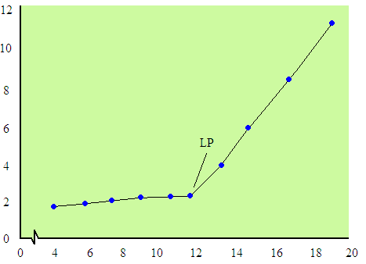
Threshold – anaerobic, lactate
Anaerobic threshold – the boundary between aerobic and anaerobic energy production – the level of exercise at which anaerobic glycolysis begins to dominate
It is determined according to the lactate, ventilatory or circulatory threshold and in the percentage of its maximal values
Lactate threshold
During the increasing intensity of exercise, blood samples are taken and lactate levels are detected. A curve is obtained from the values and we determine the breakpoint when lactate begins to accumulate = lactate threshold
Lactate in the blood (mmol/l)
Running speed (km/h)

Slide 11
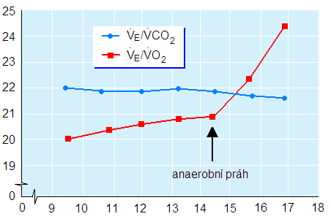
Threshold – ventilatory, circulatory
Ventilatory threshold
The curve of ventilation, consumption of O₂, respiratory quotient or ventilatory equivalent for oxygen depends on the level of exercise. Looking for the breakpoint (trend reversal)
(Ventilatory equivalent for oxygen: the amount of oxygen obtained from 1 litre of air)
Circulatory threshold
It is determined by the point where the increasing heart rate starts to slow down on the record of heart rate during exercise
In general, the ability to achieve maximum performance is limited by several factors: cardiovascular system, respiratory system, musculoskeletal system
Ventilatory equivalent
Anaerobic threshold
Running speed (km/h)

Slide 12
Ventilatory threshold
Respiratory quotient
Ventilation
Ventilation or O₂ consumption or CO₂ production
CO₂ production exceeds O₂ consumption
Respiratory equivalent for O₂

Slide 13
Termoregulation during physical exercise
Energy formed by muscles ≈ executed work + ATP production + heat
Muscle efficiency
Isotonic work – efficiency is about 50% (50% of energy is converted into kinetic, 50% into heat)
Isometric work – efficiency is almost 0%
Increased heat production in the muscle persists up to 30 minutes after exercise – metabolic processes in the muscle recovery
Excess heat needs to be released
The mechanisms involved in thermoregulation depend on the temperature of the core and the surroundings
Sweating and evaporation, conduction, convection, radiation
The blood supply in the superficial venous plexuses – initially, blood flow through the skin is restricted due to blood redistribution during exercise, until thermoregulatory mechanisms prevail
The heat production by the muscle is used to warm up the body during hypothermia – tremor thermogenesis

Slide 14
Physiological changes during exercise
The aim of cardiovascular changes during exercise is to increase blood flow and redistribution towards the working muscle. Therefore, the changes will depend on the intensity and type of exercise (dynamic or static).
↑venous return
↑heart filling
sympathetic activity
↑ heart rate
↑ contraction force
↑cardiac output
(blood flow in the system)
↑SBP
↑resistance in GIT (vasoconstriction)
decreased blood flow in these organs
dynamic work
redistribution of blood
↓total resistance
↓DBP
↑metabolic muscle activity
metabolic autoregulation in vessels (vasodilation)
↓resistance in muscle vessels
↑ blood flow in muscle

Slide 15
Physiological changes during exercise
Blood pressure values strongly depend on the intensity and type of exercise.
Dynamic exercise involving more muscles leads to an increase in systolic blood pressure (due to an increase in cardiac output) and a decrease in diastolic (due to a decrease in total peripheral resistance) – for example running, swimming
Blood flow in muscles increases up to 20 times, cardiac output increases (muscle can take up to 90% of cardiac output)
In isometric work, during muscles contraction both systolic and diastolic pressure increase – for example, in weightlifting (blood vessels in the muscle are closed during muscle contraction)
After the exercise, peripheral resistance is still low (blood vessels in the muscles and skin are still dilated), but venous return decreases (muscle no longer contracts) and cardiac activity decreases → hypotension → fainting (so-called "bleeding out into the muscle")
pH: lactate accumulation during heavy exercise causes metabolic acidosis, light exercise does not change pH
Respiratory system
The initial increase in activity is induced by the stimulation of proprioceptors in the muscles
With growing power and consumption of O₂, ventilation increases linearly. During heavy exercise, ventilation exceeds the consumption of O₂ – metabolic acidosis caused by lactate stimulates ventilation.
VO_{2max}: the maximum amount of oxygen that the body can use in 1 min – depends on age, constitution, health status, and training – it is limited by both the musculoskeletal system and the cardiovascular system
O₂ and CO₂ concentration values in arterial blood do not change during aerobic exercise – ventilation covers consumption. In heavy exercise, CO₂ levels in arterial blood decrease due to acidosis and hyperventilation.

Slide 16
Adaptation to exercise – heart
Higher parasympathetic influence on the heart, lower sympathetic effect
Athlet's heart – physiological enlargement of the heart
muscle hypertrophy (without an increase in the fibre numbers) – in speed and power sports
dilatation of cavities (especially of the left ventricle) – in endurance sports
Bradycardia in athletes – decrease in resting heart rate below 60 bpm
Reserves:
Chronotropic reserve = HR max/HR at rest (3–5)
Untrained: at rest 80 bpm, max 180 bpm
Trained: at rest 40 bpm, max 180 bpm
Systolic volume reserve = SV max/ SV at rest (1.5)
Untrained: rest 70 mL, max 100 mL
Trained: rest 140 mL, max 190 mL
Cardiac reserve = max cardiac output/resting cardiac output
Untrained (3): rest 5,6 L/min, max 18 L/min
Trained (6): rest 5,6 L/min, max 35 L/min
Coronary reserve (3.5)

Slide 17
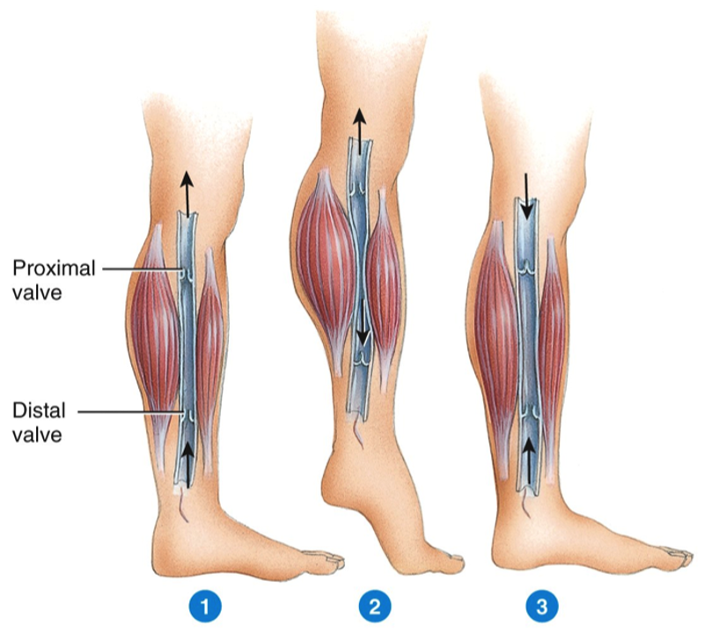
Venous return and its mechanism
Venous return is the return of blood to the right heart
Mechanisms:
Venous valves and muscle pump
Negative pressure in the chest during inhalation (and overpressure in the abdominal cavity)
Suction force of systole – systole of the ventricles changes the shape of the right atrium (pulling the tricuspidal valve into the ventricle), the atrium increases its volume and sucks in blood
Power from the behind (vis a tergo): remaining pressure from the MAP

