Slide 1
Examination of pulse by palpation
Physiology II – practice
Spring, weeks 4–6

Slide 2
Pulse (pulsus)
Aortal wall stretches in a forward direction
Mechanical manifestation of heart activity palpable in the periphery
Mechanical wave (pulse wave) arises after each contraction of LV and propagates along the arterial wall to the periphery
Easily palpable
Pressure (pulse) wave
Aortal wall contracts behind the pressure wave
Systolic blood pressure
Ejection phase of systole
(open aortal valve)
Diastole (closed aortal valve)
Diastolic blood pressure

Slide 3
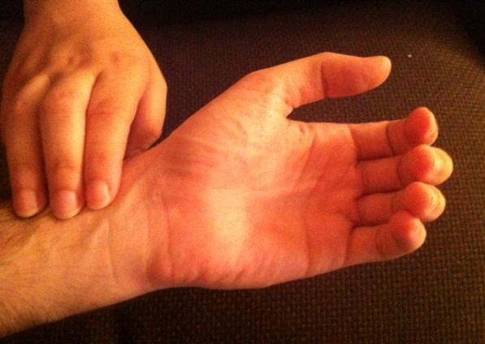
Palpation of a pulse
a. carotis
a. subclavia
Sites of palpaction:
A. radialis
A. carotis
A. femoralis
A. brachialis
A. poplitea
A. tibialis posterior
A. dorsalis pedis
a. axillaris
aorta abdominalis
a. brachialis
a. femoralis
a. radialis
a. poplitea
a. tibialis posterior
a. dorsalis pedis

Slide 4
Examination of pulse by palpation
Frequency: number of pulses (beats) per one minute (bpm) = pulse rate
Characteristics: regularity, compressibility, force, …
According to characteristics, we can describe:
Pulsus regularis
Pulsus irregularis
Pulsus celer – individual heartbeats have a short duration – peripheral vasodilation, aortic regurgitation (Corrigan‘s pulse: P. celer, altus, frequens)
Pulsus tardus
Pulsus durus – hardly compressible pulse – hypertension
Pulsus mollis – easily compressible pulse – hypotension
Pulsus magnus – high amplitude of pulse
Pulsus parvus – small amplitude of pulse
Pulsus filiformis – threadlike pulse – circulatory shock

Slide 5
Heart rate and pulse rate
Physiological values: 60–100 beats per minute (bpm) at rest
Tachycardia: increased heart rate (>100 bpm at rest)
Bradycardia: decreased heart rate (<60 bpm at rest)
Arrhythmia: an abnormality in the heart's rhythm or heartbeat pattern (except for respiratory sinus arrhythmia)
Heart rate vs pulse rate
Heart rate (HR) is a number of heart cycles in one minute. We accurately determine it from the ECG.
Pulse rate is a number of pulse cycles per minute (determined by palpation of artery). It is usually the same as heart rate (but in some pathologies, it is not!)

Slide 6
Modulation of HR by autonomic nervous system (ANS)
ANS modulates heart automaticity by modulation of SA node activity
Parasympathetic system – the vagus nerve – „nervi retardantes“
Via M2 receptors
Negative chronotropic effect
Decreased tonus of vagus nerve = increased HR and visa versa
Sympathetic system – sympathetic cardiac nerves – „nn. accelerantes“
Via β1 receptors
Positive chronotropic effect
Increased sympathetic activity = increased HR
Sympathetic and parasympathetic systems are active simultaneously, but with different intensities.

Slide 7
Baroreflex
Reflex for a short-termed control of arterial blood pressure. Optimal values of blood pressure are essential for optimal blood flow in the brain.
Mean arterial pressure (MAP) is detected by baroreceptors in the aortic arch and carotid sinus
stretch-receptors (mechanoreceptors)
Afferent fibres: vagus nerve (n. X) and glossopharyngeal nerve (n. IX)
Centre: rostral part of nucleus solitarius in the medulla oblongata
Efferent pathways:
Cardiac branch: parasympathetic fibres of n. vagus and sympathetic cardiac nerves – heart rate and contractility changes
Peripheral (vascular) branch: sympathetic vascular innervation – changes in total peripheral resistance (TPR)

Slide 8
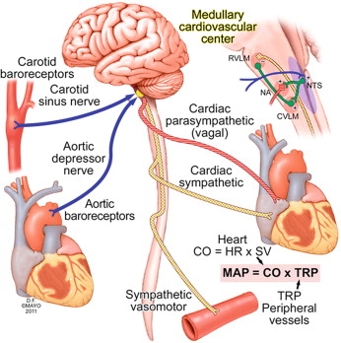
Baroreflex
medulla oblongata
baroreceptors in the carotid sinus
Mechanism:
↓MAP
↓afferentation from baroreceptors
processing in the reflex centre
↓vagus activity and ↑sympathetic activity
↑HR (and contractility) and ↑TPR (MAP = HR * SV * TPR)
↑MAP
… and conversely in case of MAP increase
n. glosopha-ryngeus
n. vagus
parasympathetic afferent fibres
efferentation
n. vagus
baroreceptors in the aortic arch
sympathetic cardiac fibres
vasomotoric sympathetic fibres

Slide 9
Respiratory sinus arrhythmia (RSA)
ECG
Changes of heart rate in accordance with breathing: increase of HR during inhalation, decrease of HR during exhalation
The most evident in young people, associated with vagal activity, it is not pathological.
RSA disappears with HR increase (stress, exercise, high age, sympathetic activity)
BP
ventilation
time [s]

Slide 10
Respiratory sinus arrhythmia (RSA)
Mechanisms possibly causing RSA:
Baroreflex: during inspiration – ↓ intrathoracic pressure → ↑venous return (due to ↑ pressure gradient) → ↑systolic volume → ↑MAP → baroreflex (2 s lag) → ↓HR → ↑ (balance of) MAP
Central origin: irradiation of stimuli from the respiratory centre to cardiomotoric centre in the medulla oblongata
Bainbridge reflex: ↑venous return during inspirium – a stretch of atria – activation of stretch-receptors – stimulation of n. vagus – stimulation of SA node
Local source: a mechanical stretch of the SA node accelerates its depolarization (weak RSA is presented also in the transplanted heart)
Other reflexes influencing vagal activity, chemoreflex (oscillation of pCO2, pO2, pH during respiration)

Slide 11
Heart rate during body posture changes (baroreflex demonstration)
Body posture changes in the gravity field cause blood pressure (BP) changes depending on the position in relation to the heart (effect of hydrostatic pressure). These changes are minimized by short-term BP regulation (baroreflex).
Clinostatic reaction – change of body position from standing (sitting) to lying:
↑venous return from lower part of body → ↑heart filling (preload) → ↑SV → ↑BP → baroreflex causes ↓HR and ↓ TPR
Orthostatic reaction – change of body position from lying to standing (sitting):
↓ venous return from lower part of body → ↓ heart filling (preload) → ↓SV → ↓BP → baroreflex causes ↑HR and ↑TPR
Cardiac branch of baroreflex is faster but less effective in BP maintenance - HR increases within 1 s after BP decrease, this prevents the decrease in brain perfusion
Peripheral branch of baroreflex is slower but more effective: TPR increases approximately 6 seconds after BP decrease and stabilizes BP → HR decreases during long-lasting standing to the resting value.

Slide 12
Heart rate changes due to physical exercise
Working muscle has higher metabolic demands – perfusion is increased (autoregulation of blood flow, metabolic vasodilatation)
Physical exercise increases sympathetic tonus („ergotropic system“)
Anticipation of exercise
There is compensatory vasoconstriction in those tissues which are not metabolically active (GIT, reproduction system, excretory system, skin) – resulting in the redistribution of blood.
It affects heart function:
Vasodilatation in muscles → ↓TPR → ↓BP → baroreflex → ↑HR
Sympathetic system: ↑HR
Athletes' heart – adaptation to frequent physical exercise – decreased HR at rest

Slide 13
Study how to record the pulse wave by the finger pulse transducer and how to estimate the heart rate
at rest,
during respiratory arrhythmia,
in changes of posture,
and during muscular load
See textbook Physiology and neuroscience practicals, 2013, pg. 32 – 34.

