Slide 1
Selected lectures from Physiology

Slide 2
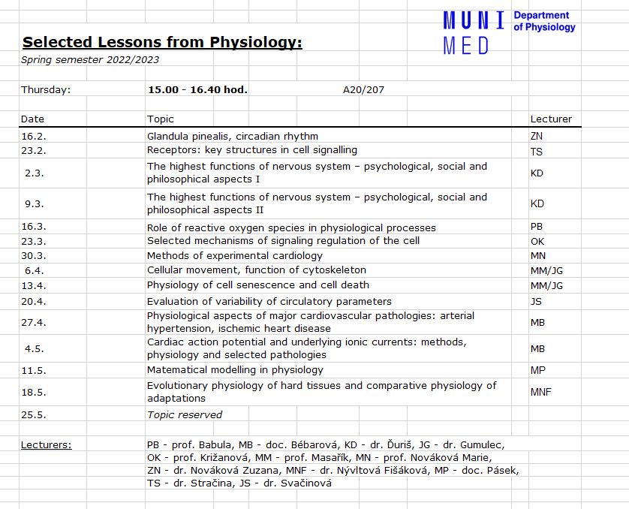


Slide 3
Children´s puzzle (riddle):
What is it?
It's still all around us; not to see or hear. You can not touch it, even to smell.
Life can not do without it. It forms part of each story.
It's as long as it takes, and it's happening everywhere.
What is it?
A house full of wheels

Slide 4

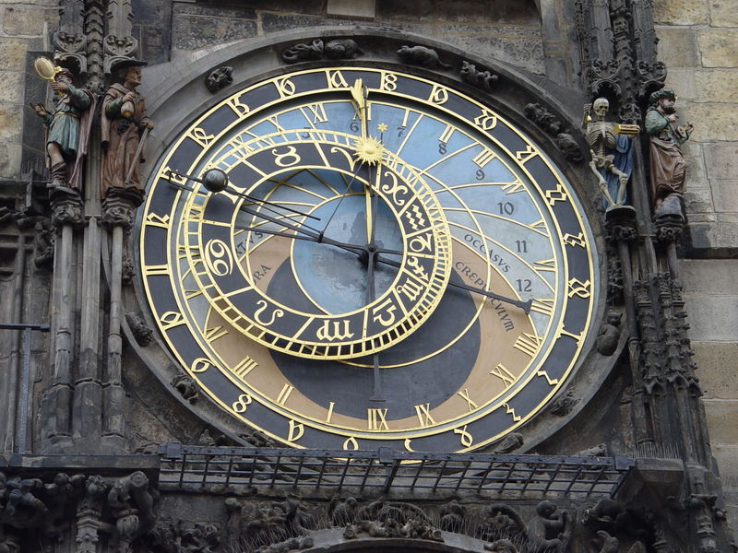
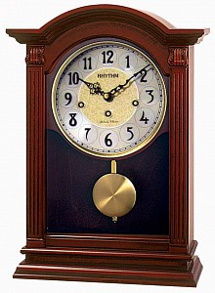
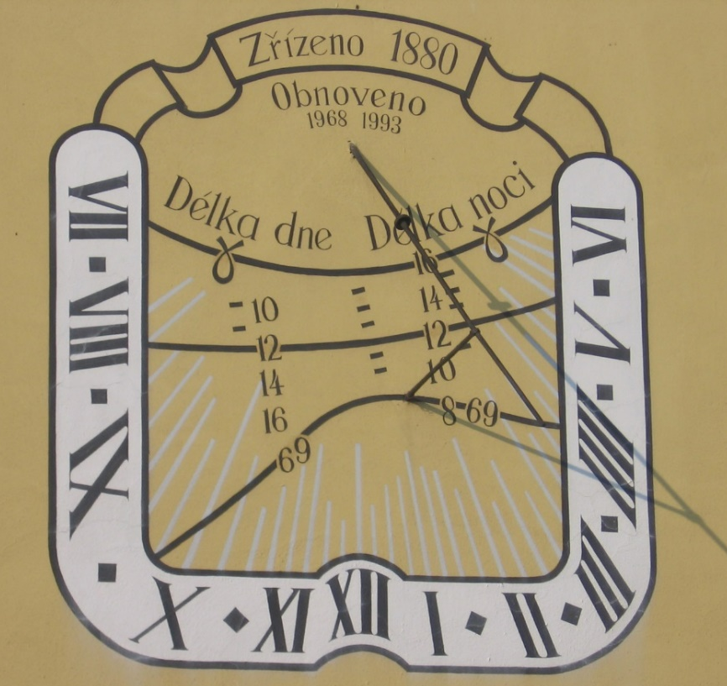
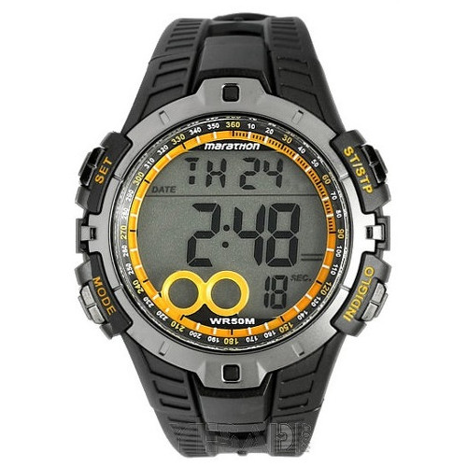

How can time be measured?
Prague
astronomical
clock
the image shows the different types of clocks, from the oldest - sundials, hourglasses after the very latest design - smart watch

Slide 5
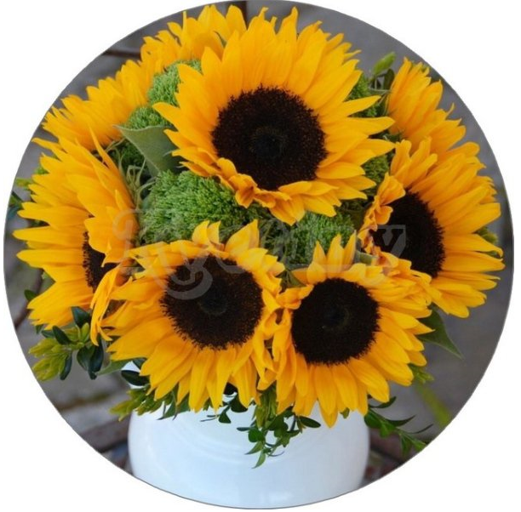
Perception of time
light and dark phases of the day
are known even in the plant
sunflower turns toward the light
(The flower withers – closes the petals for the night,
opens again in the morning
- example in the world of plants)
Notes:
dependence on phases over the course of one day exists even in the plant kingdom

Slide 6
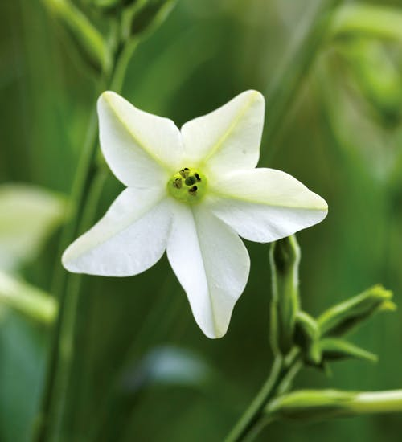
Nicotiana alata – "scented tobacco" - a plant originally from Iran, blooms and smells in the evening and overnight

Slide 7
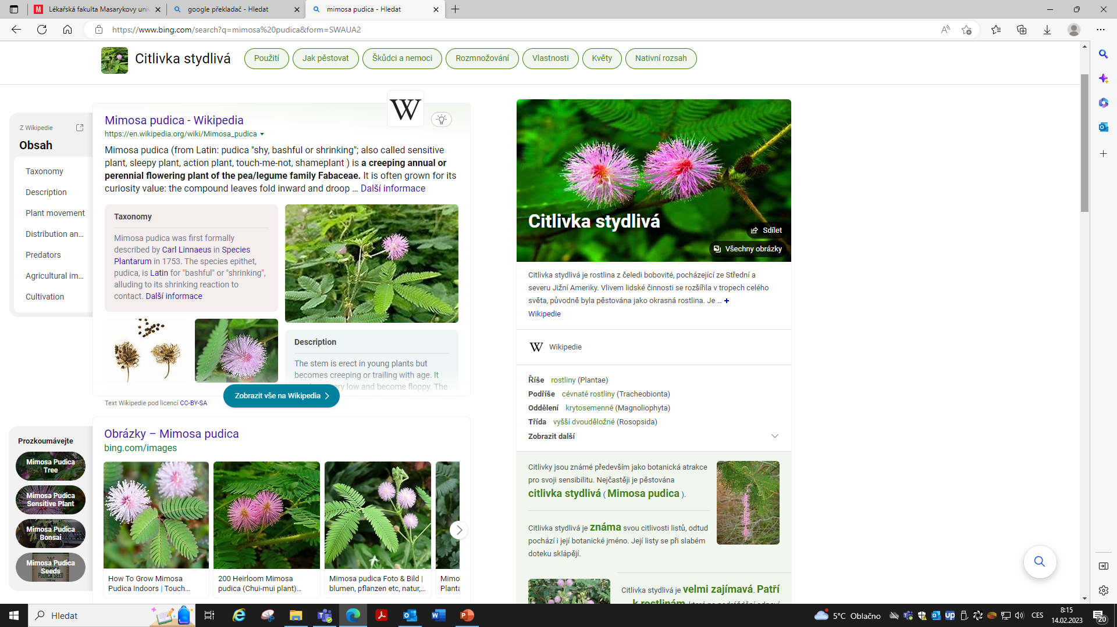
1729 Jean Jacgues d´Ortous de Mairan
French geophysicist
He conducted an experiment in which he gave evidence that plants create their own unique time
He locked the heliotropic plant Mimosa pudica (Sensitive Shy) in a box – even in this environment it kept its rhythm of leaves "as if flooded with light" and withered leaves (without light).
Mimoza is a plant that when touching the leaves is very visibly folded - swaddled
Literature: Matthew Walker Why do we sleep?, 2018,pp.25-27 figure: https://en.wikipedia.org/wiki/Mimosa_pudica

Slide 8
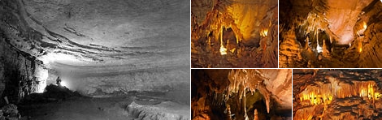

It took more than 200 years before this issue began to be considered in humans. The first pioneers were 2 men - researchers from the University of Chicago - Prof. Kleitman and his assistant Richardson - went to Mammoth Cave in Kentucky - deep, without light, and lived there for 32 days and showed that even without the presence of alternating of light and dark, we maintain our own internal cycle of alternating sleep and wakefulness, and which is longer than exactly 24 hours.

Slide 9
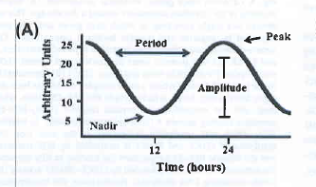
Biorhythms - studied by chronobiology as a special branch of physiology research
In humans and other mammals, processes such as sleep/awake and feed/fast cycles, body temperature oscillations, hormonal secretions and metabolic events occur in a circadian manner and are ruled by biological clock
rhythm period: the time that elapses
before a biological variable enters the same phase
- most often described as sinusoidal curve
Periods of rhythms (a frequency with which the parametr is repeated):
Ultradian period – period is shorter than 24hours (e.g.:10sec rhythm in breathing)
Circadian period – period is 24h (sleep/wakefulness…..from Latin circa diem -about a day)
Infradian period – period is longer than 24h (the menstrual cycle)
Notes:
Previous slides …there are examples which document our biorhythms…….. Not only women have their days, but men also have their days

Slide 10
Information from previous lectures:
Type of secretion of hormones - summary:
Constant secretion – hormones of glandula thyreoidea
Pulsatile secretion – GnRH (gonadoliberin)
circadian secretion (latin: circa diem = „approximately“/“around“ 24h) – hormons of adrenal cortex
monthly fluctuation – estrogens, testosteron in saliva
„en demande“ (according to need - demands) – e.g. Insuline and regulation blood glucose
Notes:
you received this information at a lecture last semester. You have spoken…

Slide 11
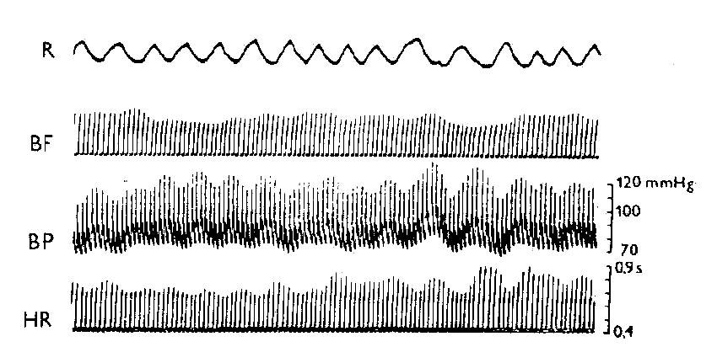
Records of breathing and circulatory parameters waves
(from plethysmomanometer - Peňáz method)
Notes:
We will talk about …

Slide 12
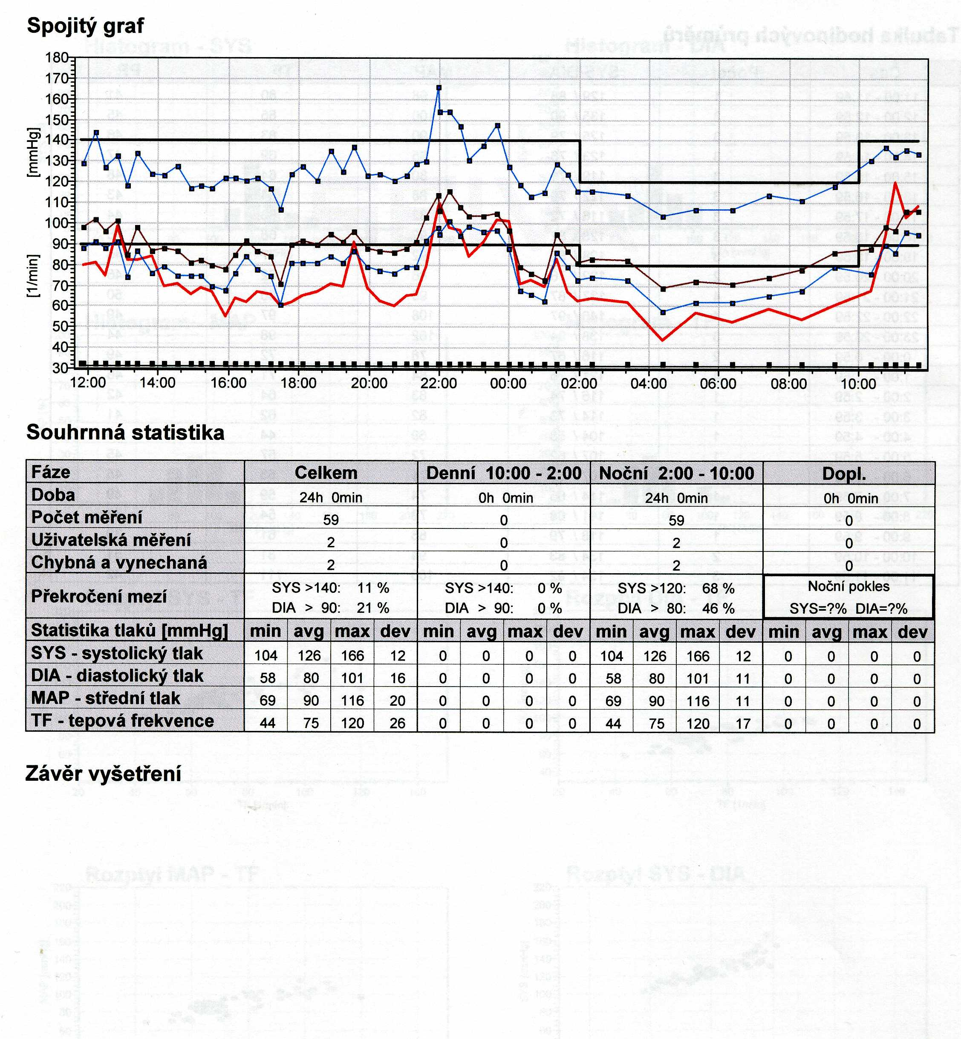

Slide 13
„Our internal clock“ – how it works

Slide 14
The molecular clockwork
Period genes (PER) was the first discovered clock gene which is conversed from fruit flies to humans………1971 (Konopka and Benzer)
In the past decades our knowledge of the molecular clockwork has been significantly expanded
Transcriptional-translation feed-back loop - simplified explanation
  Two helix-loop-helix transcription factors:
    CLOCK – circadian locomotor output cycles kaput
    + BMAL1 (ARNTL) – brain and muscle aryl hydrocarbon receptor nuclear translocator.
    Both form heterodimers via their PAS domein – PER-ARNTL-SIM binding.
    Activates E-box-element containing gens.
    Complexes CLOCK+BMAL1 activate transcription of PER and CRY genes during the day. PERs and CRYs translocate into the nucleus and forms inhibitory complexes, PER/CRY complexes accumulate and does their inhibitory effect on CLOCK-BMAL1 activity, shutting down Per and Cry transcription during the night.

Slide 15
PER – period gene
CLOCK – circadian locomotor output cycles kaput
BMAL1 (ARNTL) – brain and muscle aryl hydrocarbon receptor nuclear translocator
PAS domena – PER-ARNTL-SIM
E-Box –controlled genes
CRY genes – cryptochrome

Slide 16
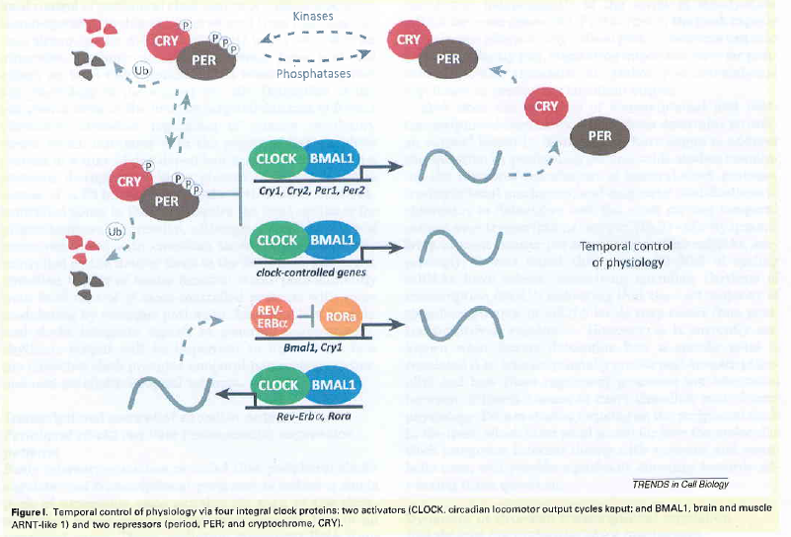

Slide 17
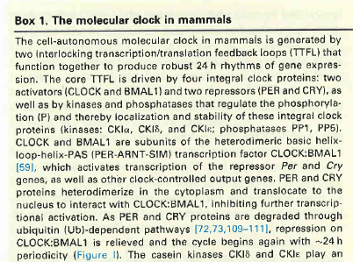

Slide 18
Where our internal clock is located ?
Master circadian pacemaker
Information about the external light-dark cycle was passed via the retinohypothalamic tract – sensory input integrating centers in the thalamus, but also to the hypothalamic suprachiasmatic nucleus
SCN – is a bilaterally paired structure with high cell body density located to the third ventricle and directly atop the optic chiasm.
  It comprises about 50 000 neurons in humans (in rodents 20 000)
  Plays critical role in generation of mammalian circadian rhythms
  (in experiments – animal with ablated SCN become behaviorally and physiologically arrhythmic. Critically, transplanting isolated SCN tissue into SCN-lesioned animals restores circadian rhythmicity)

Slide 19
In humans: circadian rhythm
Perioda of rhythm 25±1.5 hours
Synchronization via external conditions:
E.g. Light/dark phase of day
Or fluctuation of external temperature (e.g. in blind people)
Or cycle of food intake (experiment in caves)
Or social stimulus
Entry: retinal ganglionic cells – photopsine – melanopsin (blue wavelenght)- SCN – main oscilator
Pathway: neuronal and humoral

Slide 20
Pineal gland
The pineal gland coordinates circadian (daily) rhythms of dark/light (day-night) cycles by secreting the hormone melatonin. Darkness stimulates its release.

Slide 21
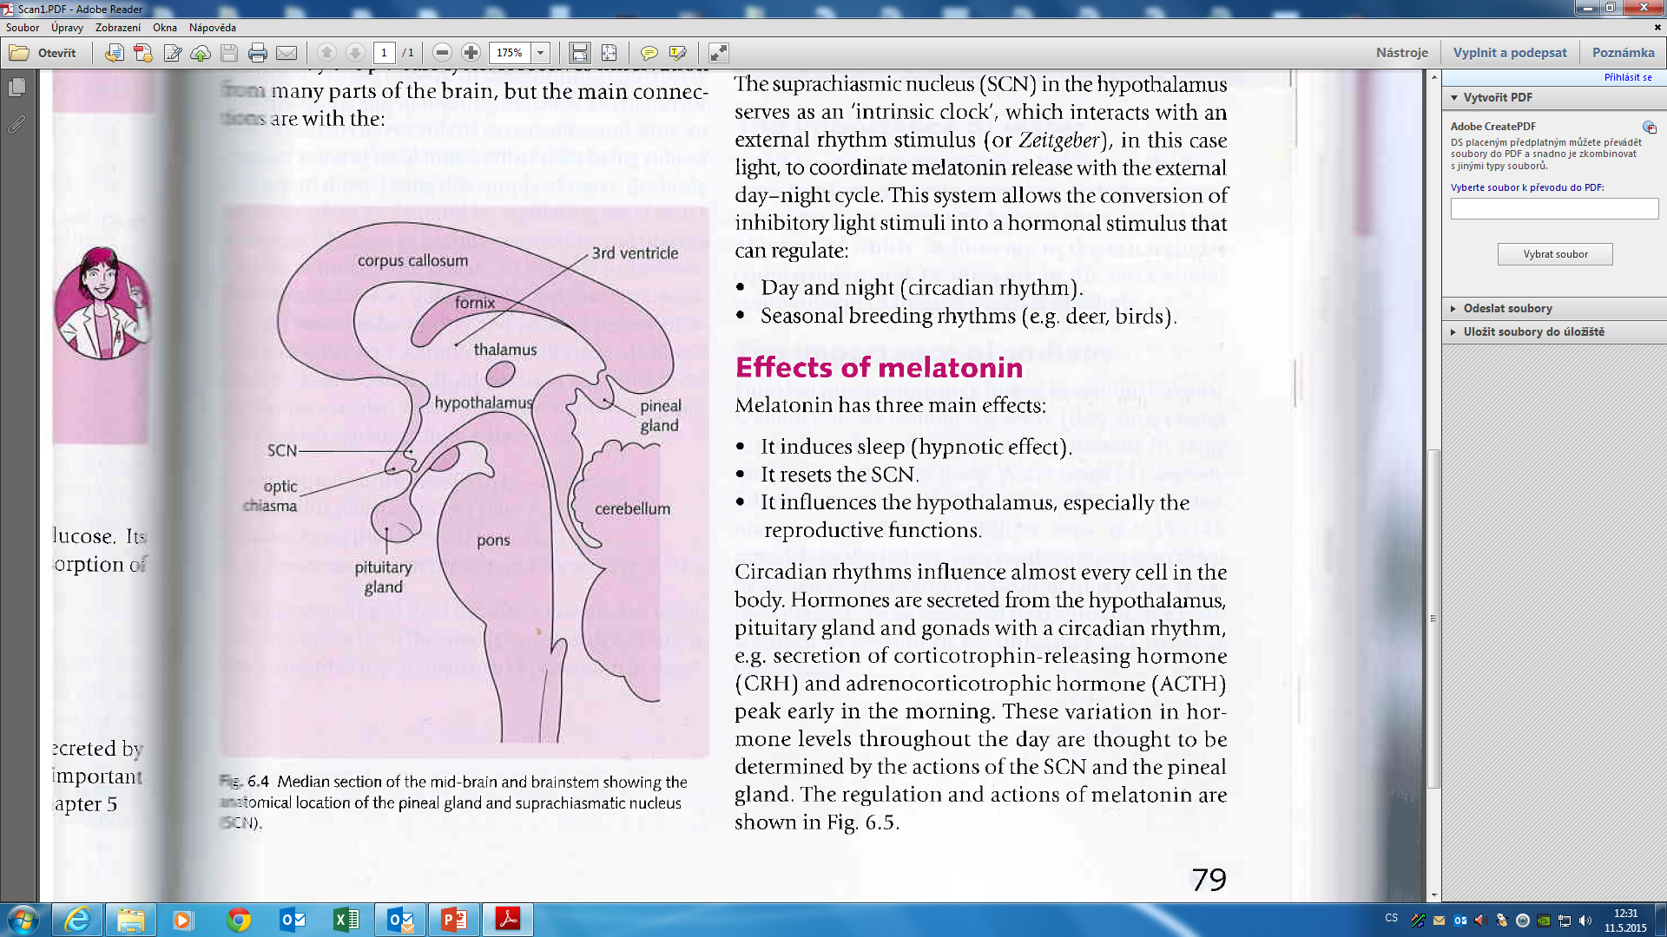
Macrostructure:
-it is a small gland found of posterior end of the corpus callosum, forming a section of the roof in the posterior wall of the third ventricle
repetition is the mother of wisdom

Slide 22
Microstructure of pineal gland
: - is composed of 2 types of neural cells: pinealocytes (specialized secretory neurons) + glial support cells
: - it has a very rich blood supply that forms a network of capillaries surrounded by the pinealocytes
: - it receives innervation from many parts of the brain, but the main connections are with:
Suprachiasmatic nuclei (SCN)
Retina
Sympathetic system (multisynaptic sympathetic way: paraventricular nucleus in hypothalamus + upper sympathetic cervical ganglion – SCG; releas norepinephrin-beta adrenergic receptors –stimulate cAMP-activate gene expression for gen coding AA-NAT=arylalkylamin-N-acetyltranspherase)

Slide 23
Pineal gland - Function:
The pineal gland synthesizes and secrets the hormone MELATONIN
(NOT melanin – the brown skin pigment)
Melatonin is modified form of the aminoacid tryptophan (4steps of biosynthesis - serotonin – enzyme AA-NAT=arylalkylamin-N-acetyltranspherase : activity on the night, light – inhibited – acetylation –methylation ….melatonin

Slide 24
Effects of melatonin – pleiotropic effect
Melatonin has 3 main effects:
It resets the SCN
It induces sleep (hypnotic effect)
It influences the hypothalamus, especially the reproductive function
Circadian rhythms influence almost every cell in the body. Hormones are secreted from the hypothalamus, pituitary gland and gonads with a circadian rhythm-e.g.: CRH, ACTH-peak early in the morning

Slide 25
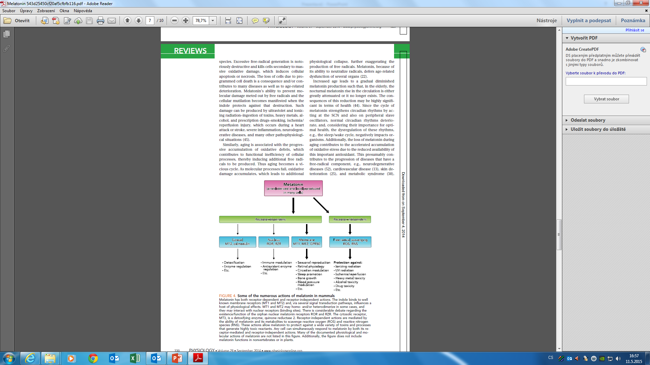

Slide 26
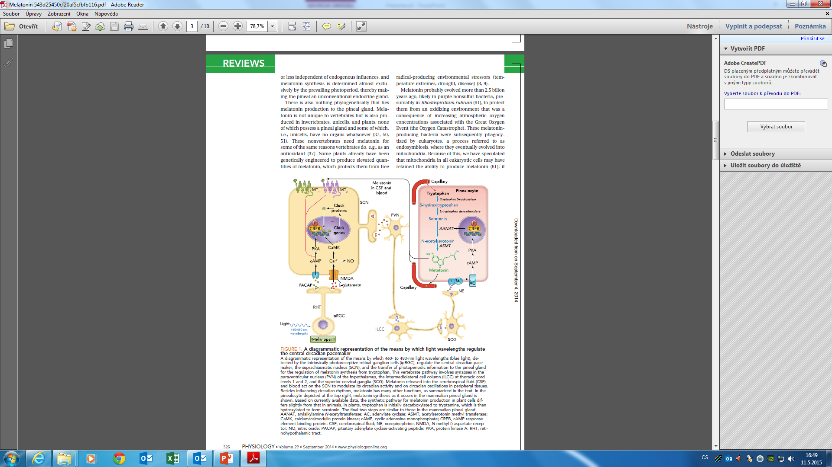
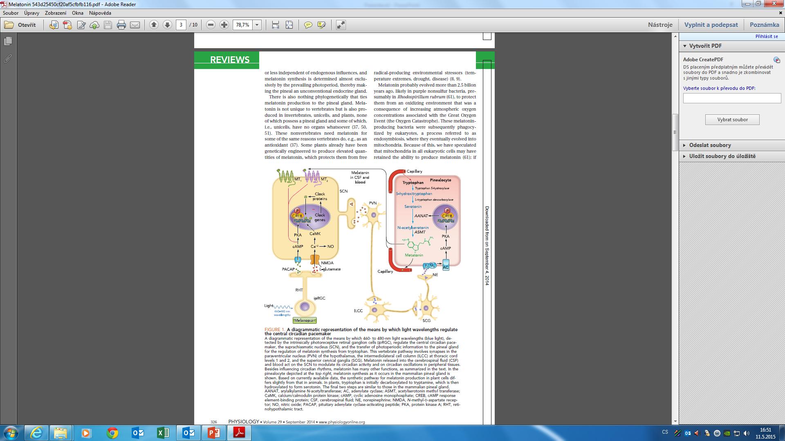

Slide 27
Conclusion
The suprachiasmatic nucleus in the hypothalamus serves as an „intrinsic clock“ which interacts with an external rhythm stimulus, in this case light, to coordinate melatonin release with the external day-night cycle
This system allows the conversion of inhibitory light stimuli into a hormonal stimulus that can regulate:
: Day-night (circadian rhythm)
: Seasonal breeding rhythms – sexual life of animals (conception of future pups) (e.g. deer, reindeer, birds)

Slide 28
Health issues

Slide 29
Jet lag syndrome
The pineal gland has evolved to allow adaptation to changing day length:
When people leaves his/her home country the SCN and pineal gland are synchronized: at night, darkness and SCN activation stimulate melatonin production, inducing sleep
If the person flies across time zones, the SCN continues to oscillate in accordance with the previous time zone, which means that the timing of melatonin production (and, therefore, tiredness) does not change
At a rate of adjustment of a couple of hours a day, the SCN adapts to a new time zone

Slide 30
Jat leg syndrome - treatment
Taking oral melatonin can shorten the period of jet lag
Melatonin should be taken at the times of darkness in the new time zone whilst on the plane and for several days at the destination
For shift work, the melatonin should be taken during the period of desired sleep
The SCN is reset more quickly and the body becomes resynchronized

Slide 31
Seasonal affective disorder
Effect of melatonin also on an anual rhythm
- season rhythm - in winter – a little light, elevated of concentration of melatonin – internal dyssynchronization …….. incresed incidence of depression

Slide 32
Sleep disorder
Sleep delay (problem to sleep at night - delayed sleep) –problem: sleep at night, wake up in the morning is wrong. Treatment: administered melatonin when he wants to sleep
Phase advance – go to sleep without any problems, but the waking up too early in the morning . Treatment: bright light exposure at a time when he wants to sleep, but it should still be awake)

Slide 33
Health problems are coming
transition to summer or winter time
shift work (porter, in hospital – nurse, doctor – working during the night time)
Resynchronisation internal clock system with the external part – acompanied with symptoms/diseases:
  fatique (tiredness) - sleep disruption - lack of appetite – gastric ulcers – stress – hypertension – obesity – behavioral changes

Slide 34
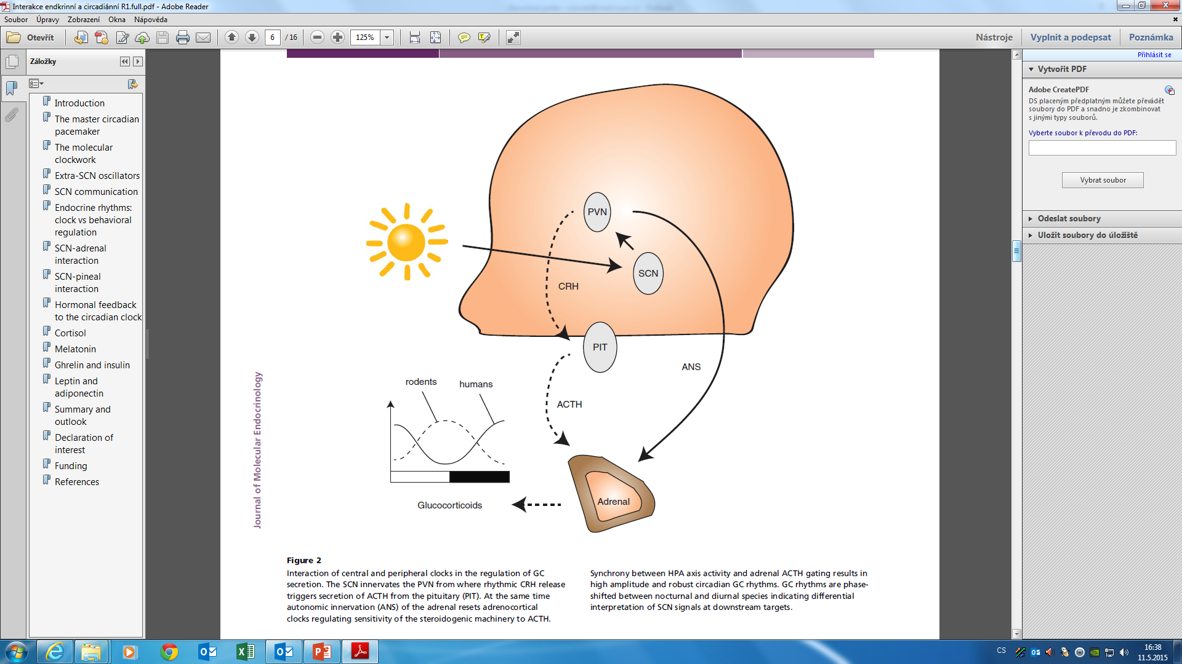

Slide 35
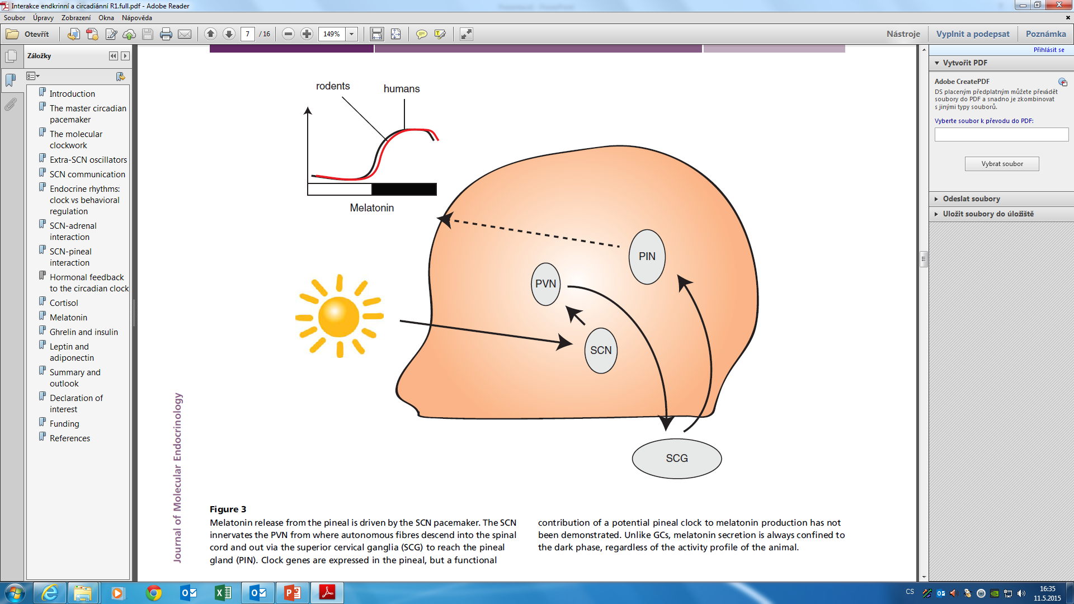

Slide 36
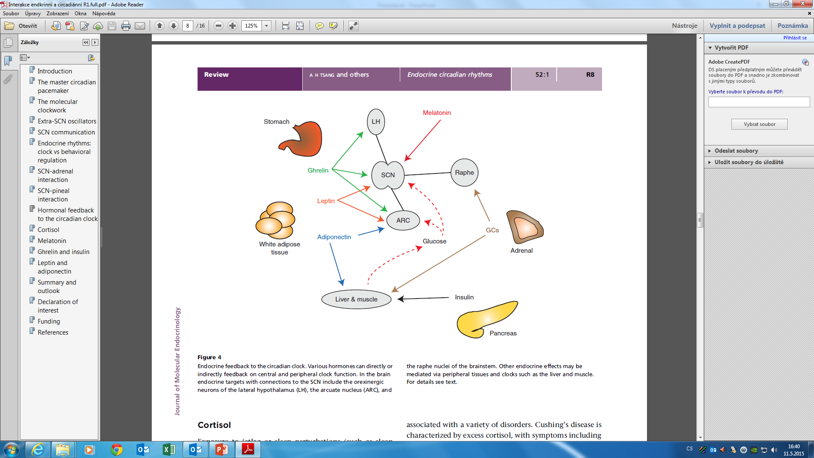
Anthony H Tsang et al.
Journal of Molecular
Endocrinology
(2014) 52, R1–R16

Slide 37
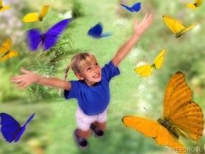
THANK YOU FOR YOUR ATTENTION

Slide 39
vyplachování

Slide 41
In the abscence of light signals, circadian rhythms still exist but are not synchronized with the day-night cycle.
The suprachiasmatic nucleus in the hypothalamus serves as an „intrinsic clock“ which interacts with an external rhythm stimulus, in this case light, to coordinate melatonin release with the external day-night cycle
This system allows the conversion of inhibitory light stimuli into a hormonal stimulus that can regulate:
: Day-night (circadian rhythm)
: Seasonal breeding rhythms (e.g. deer, birds)

Slide 42
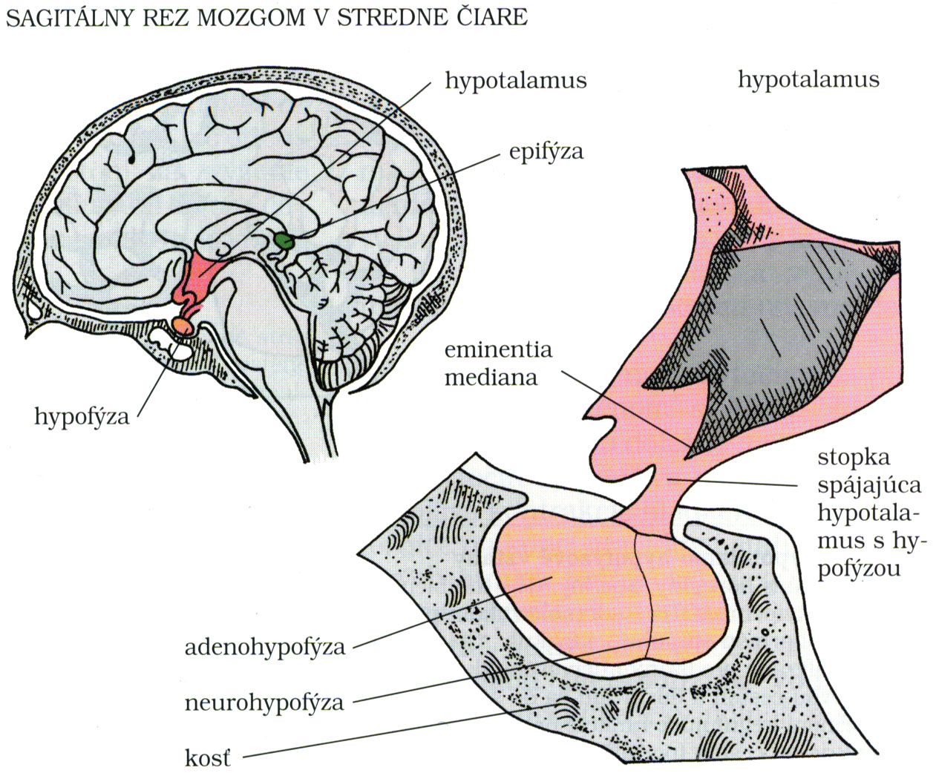
Sagital section of brain in central line
Hypothalamus

Slide 43
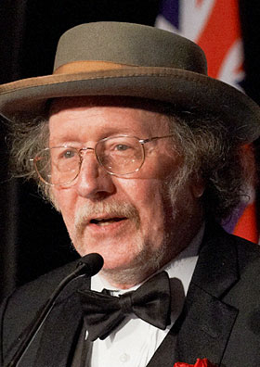
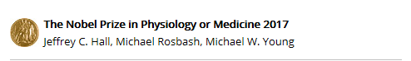

Slide 44


