Slide 1
Medical genetics – introduction
Michael Doubek

Slide 2
Learning outcomes
Basic concepts of contemporary genetics will be presented
The student will learn principles of heredity
Diagnostics of genetic diseases will be introduced

Slide 3
Lecture content
Basic concepts of genetics
Genome and its analysis
Modes of inheritance
Example from practice

Slide 4
Why medical genetics?
Genome role in diagnostics, therapy and prevention = application in medical practice It is possible to implement into practice only what I know and what I have in mind

Slide 5
What you should already know
What is a gene genes: structural
for functional RNAs - housekeeping genes - gene expression - exones, intrones, non-transcribed regions, promotors
Informational macromolecules
Transcription, alternative splicing, translation
Chromosomes

Slide 6
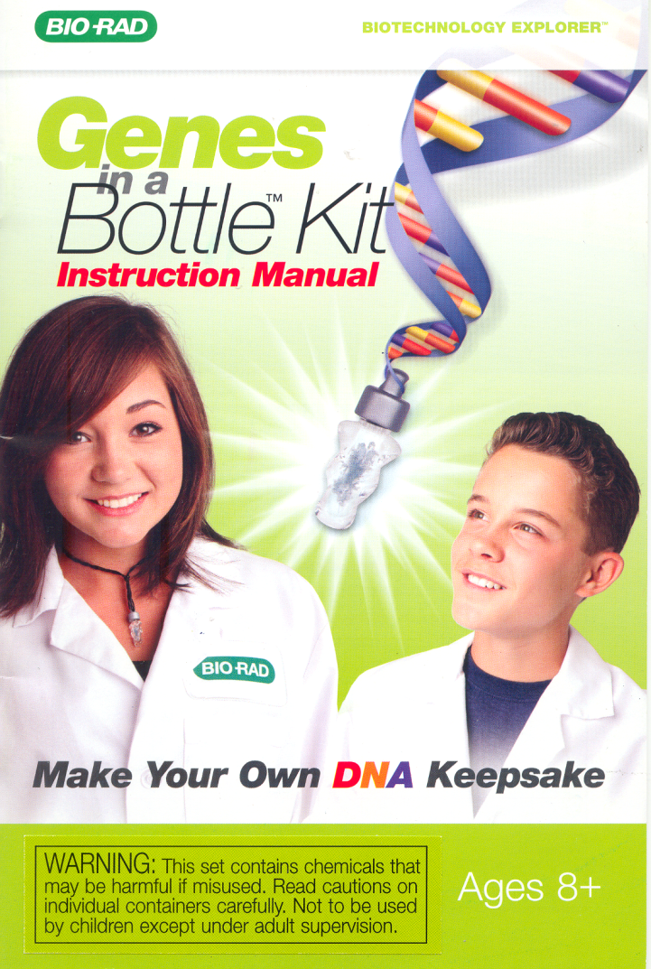
What is a DNA?
cold ethanol + salt + detergent
> 1 m DNA

Slide 7
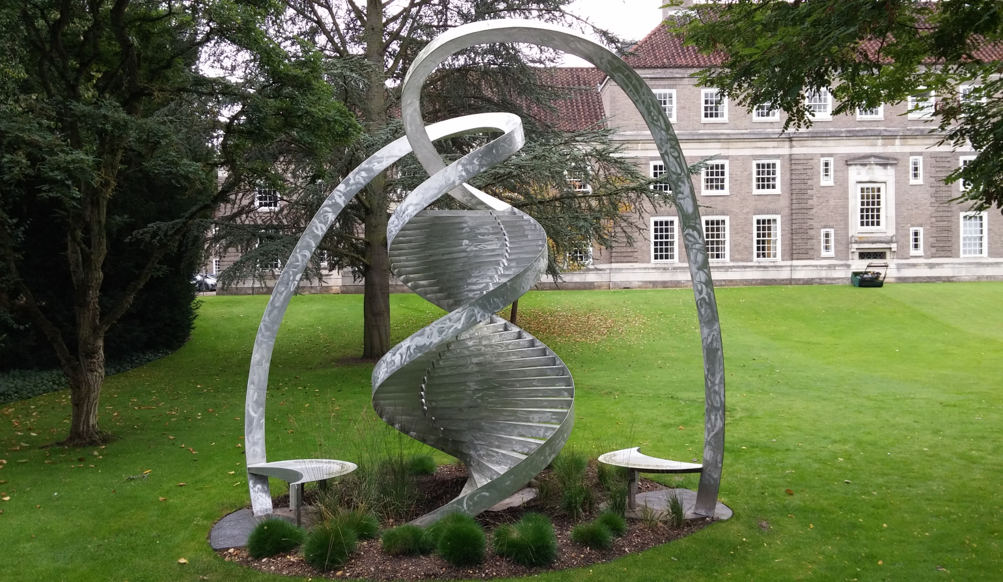
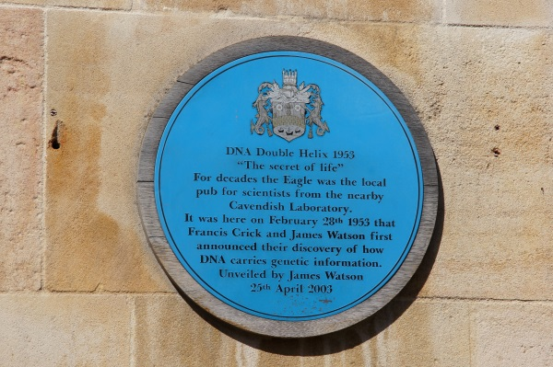
What is a DNA?
Cavendish Laboratory and The Eagle Pub
Watson + Crick + Wilkins + Franklin

Slide 8
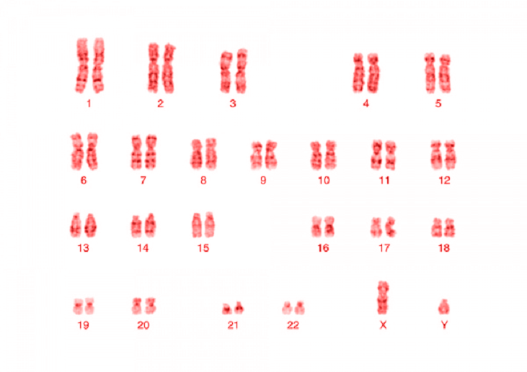
What is a DNA?

Slide 9
What is a DNA?

Slide 10
Chromosomes

Slide 11
Terminology
Genetics: study of genes, genetic variation, and heredity in living organism
Genome: complete set of DNA within a single cell of an organism
Genomics: focuses on the structure, function, evolution, and mapping of genomes

Slide 12
Terminology
Genome is more than just a sum of genes
Genetics
Genome
Genomics

Slide 13
Terminology
- Structural (DNA, chromosomes) - Functional (RNA, gene expression) - Comparative
Genetics
Genome
Genomics

Slide 14
Terminology
Genetics
Genome
Genomics
Microbiome
Transcriptome
Epigenetics

Slide 15
Terminology
Genetics
Genome
Genomics
Microbiome
Transcriptome
Epigenetics
Community of microorganisms inhabiting a particular environment

Slide 16
Terminology
Genetics
Genome
Genomics
Microbiome
Transcriptome
Epigenetics
Set of all RNA molecules in one cell or a population of cells in certain time

Slide 17
Terminology
Genetics
Genome
Genomics
Microbiome
Transcriptome
Epigenetics
Study of heritable changes in gene function that do not involve changes in the DNA sequence

Slide 18
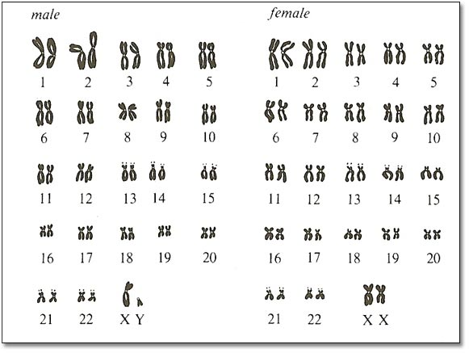
Genome
Human genome: 3.2 x 10⁹ bp, ~ 20,000 genes

Slide 19
Genome
Human genome: 3.2 x 10⁹ bp, ~ 20,000 genes
Genome Variability
Nucleotide polymorphism
- Single Nucleotide Polymorphisms - SNP
Structural variations
- Copy Number Variations – CNV
- Short Tandem Repeats – STR (2-5)

Slide 20
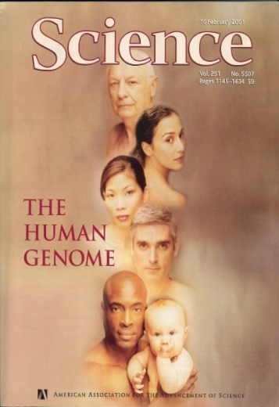
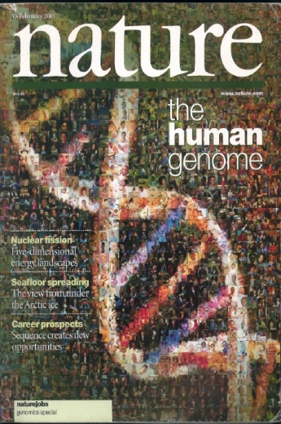
Genome
Human genome was published in 2001

Slide 21
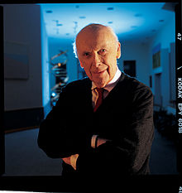
Genome
C. Venter
J. D. Watson
Individual sequences of human genomes were published in 2007 and 2008

Slide 22
Genome
C. Venter
J. D. Watson
Individual sequences of human genomes were published in 2007 and 2008
Difference in 7648 amino acid substitutions

Slide 23
Genome
C. Venter
J. D. Watson
Individual sequences of human genomes were published in 2007 and 2008
The 1000 genome project published in 2010

Slide 24
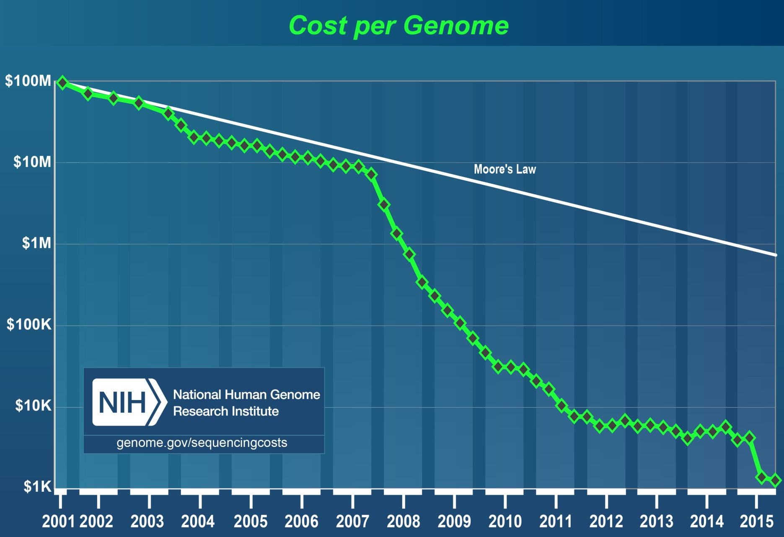
Genome

Slide 25
Postgenomic era
Genomes were described
Ongoing genomes annotations

Slide 26
Genetics today
from phenotype to genotype
DNA RNA protein phenotype
from genotype to phenotype

Slide 27
Modern techniques of genome analysis

Slide 28
NGS flexibility
whole genome
exome
targeted genes or hotspots
3 200 000 000 bp
30 x coverage
20 000 genes
100 x coverage
< 100 genes
≥ 1000 x coverage

Slide 29
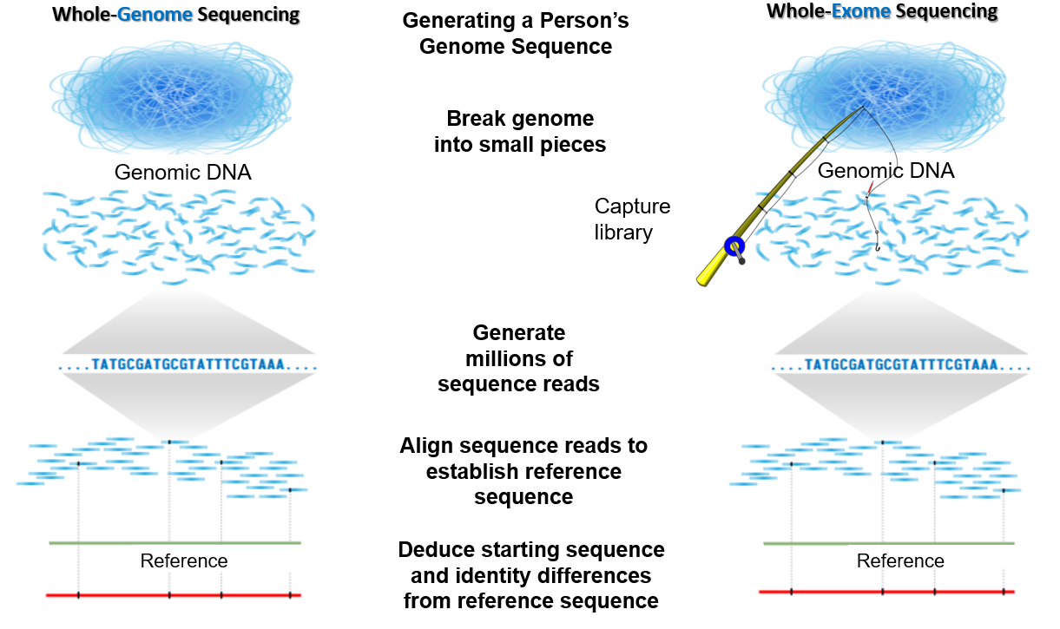
Modern techniques of genome analysis

Slide 30
Mutation vs. genome variability
Every 1000th base could be mutated ⇒ 3.2 x 10⁶ variants
One men has approx. 0.5 x 10⁶ variants
Exome analysis (1.5% of genome) ⇒ tens thousands of variants
Which of the found variants is the disease causing one?

Slide 31
Mutation vs. genome variability
Every 1000th base could be mutated ⇒ 3.2 x 10⁶ variants
One men has approx. 0.5 x 10⁶ variants
Exome analysis (1.5% of genome) ⇒ tens thousands of variants
Which of the found variants is the disease causing one?
mutations x polymorphisms

Slide 32
Mutation vs. genome variability
Mutations: spontaneous vs. induced
gene vs. chromosomal
Mutations: missense
nonsense (terminating triplet)
same sense
frameshift

Slide 33
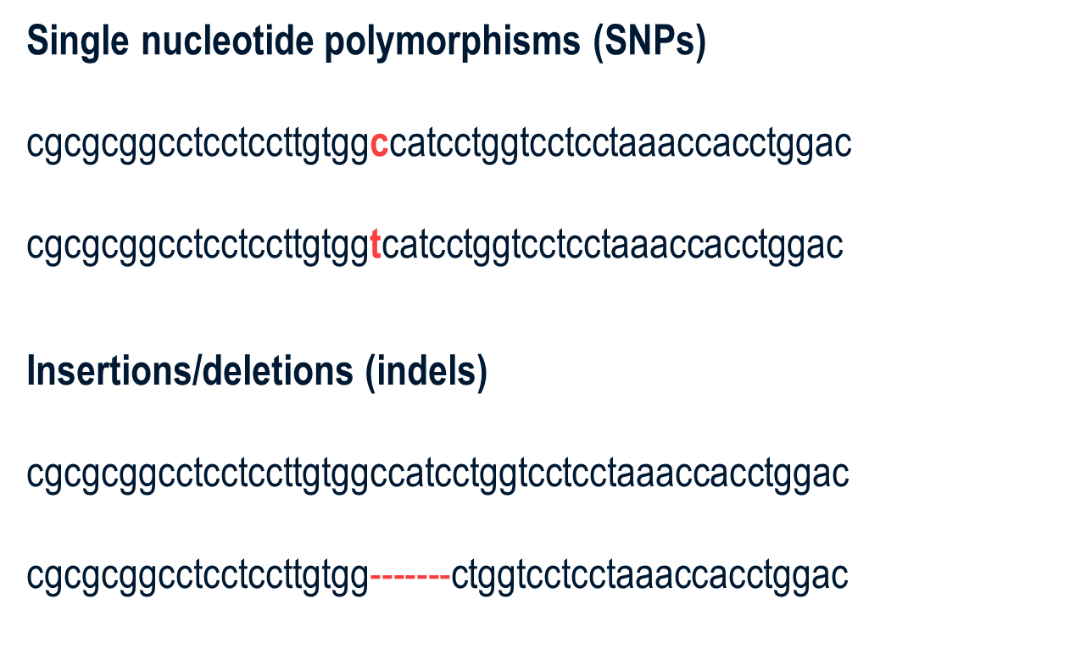
Mutation vs. genome variability

Slide 34
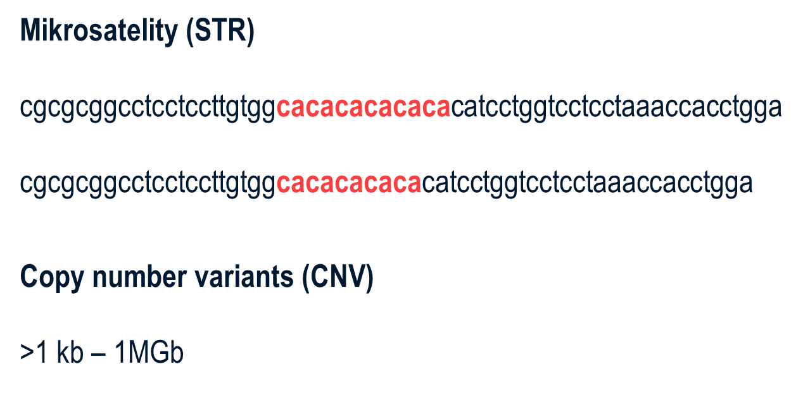
Mutation vs. genome variability
Microsatelites (STR)

Slide 35
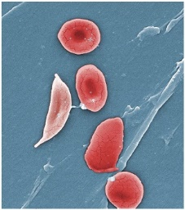
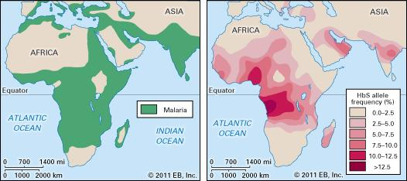
Mutation vs. genome variability
Sickle-cell anemia

Slide 36
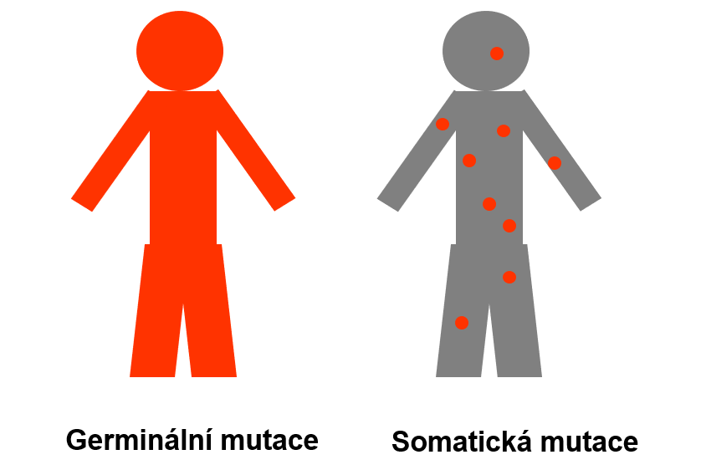
Germline vs. somatic mutations
Germline mutation
Somatic mutation

Slide 37
The role of genome in the disease onset
Mendelian hereditary diseases 8%
Multifactorial 90%
Other 2%

Slide 38
Inheritance types
Mendelian monogenic: one gene ⇒ one feature
X-linked and Y-linked (sex-linked disorders)
Polygenic
several genes ⇒ one feature
Mitochondrial
Environmental factors

Slide 39
What is the procedure of hereditary diseases tracing?
pedigree
disease frequency in population
molecular biology methods
functional tests

Slide 40
Pedigree

Slide 41
Pedigree
two common ancestors in previous generation: parents
4 grandparents, 8 great-grandparents
the number of ancestors in generation n is 2^{n}
40th generation (1000 years back): 2⁴⁰ = 1.09 x 10¹²
so many people didn’t live on this planet (7.0 x 10⁹)

Slide 42
Mitochondrial inheritance

Slide 43
Y chromosome inheritance

Slide 44
Autosomal dominant inheritance

Slide 45
Autosomal recessive inheritance

Slide 46
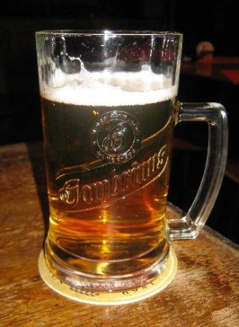
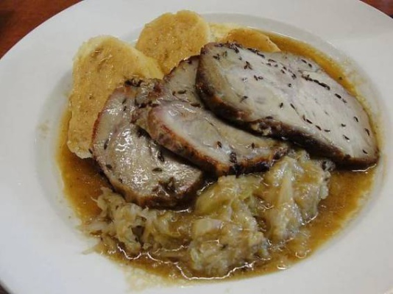
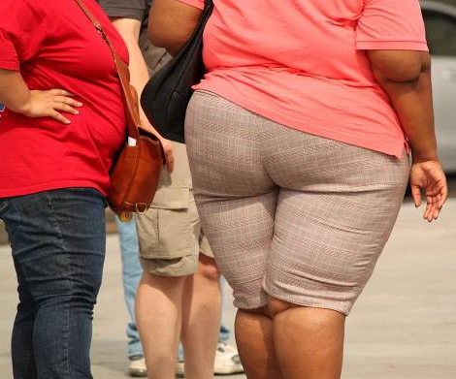
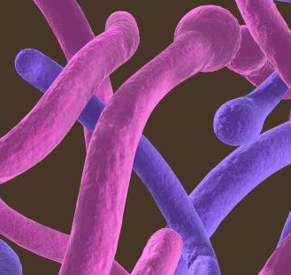
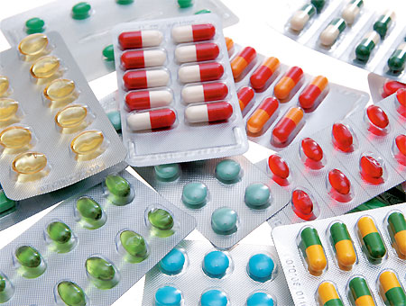
Enviromental factors

Slide 47
Monogenic disorders

Slide 48
Autosomal recessive disorders
hemochromatosis (1:10)
factor V Leiden mutation (1:20)
cystic fibrosis (1:25)
spinál muscular atrophy (1:40)

Slide 49
Autosomal recessive disorders
Founder effect
Small closed populations:
Ashkenazi Jews
franco-Canadiens
Iceland
surroundings od Maracaibo lake…
Marriages of relatives

Slide 50
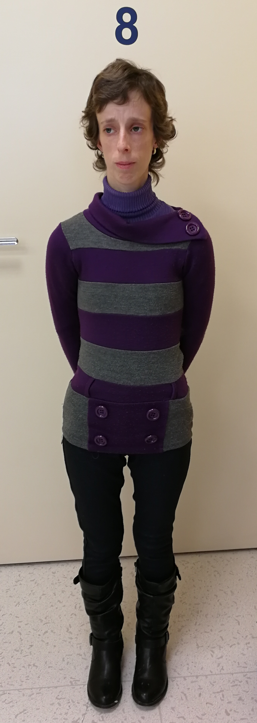
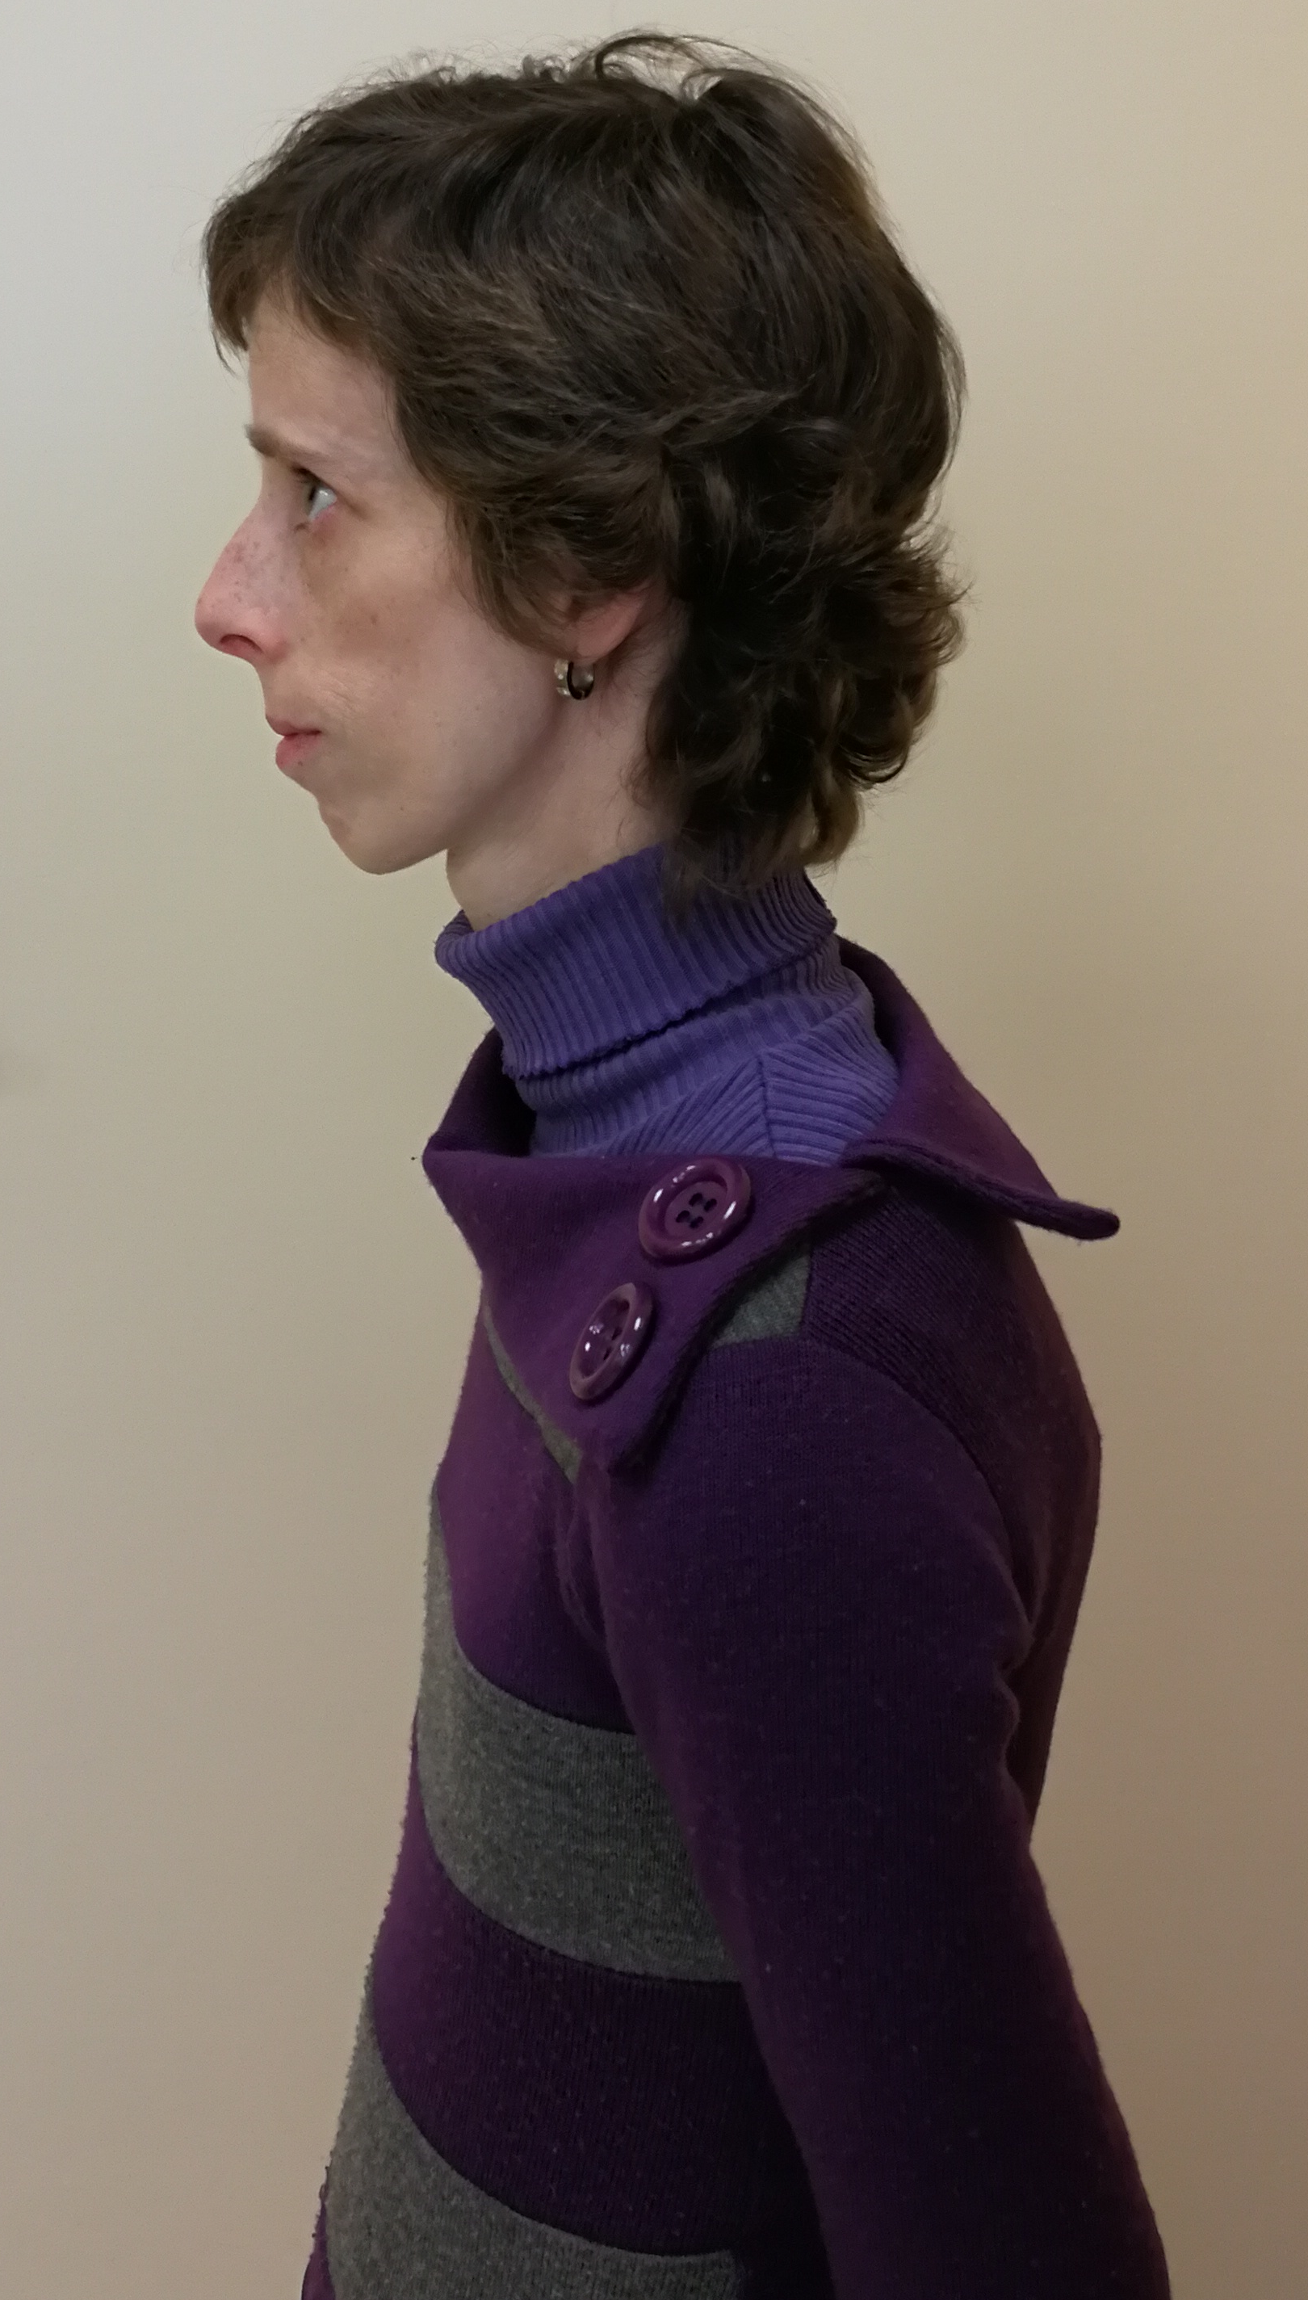
Consanguinity
Homozygous mutation BLM gene c.1642C>T, p.(Gln548*)

Slide 51
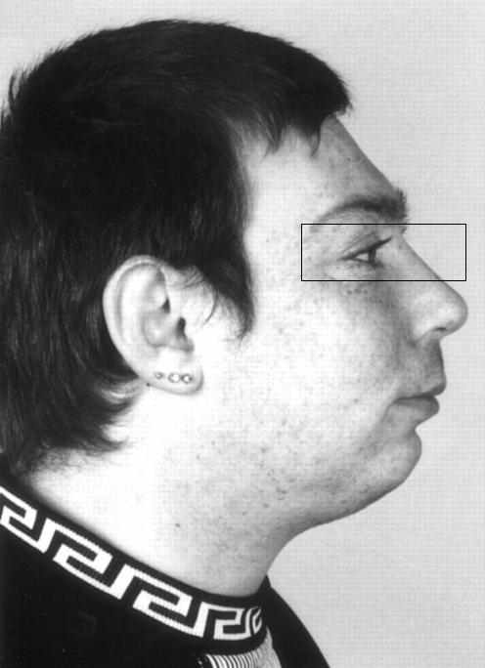
Syndrome Nijmegen breakage, NBS
NBN gene for nibrin in 8q21 Heterozygotes 1:130-150
Common ancestor
Seemanová, 1985

Slide 52
Autosomal dominant disorders
Achondroplasia
Huntington chorea
Marfan syndrome
Polycystic kidneys
Neurofibromatosis

Slide 53
Gonosomal disordres
Gonosomal dominant
- vitamin D resistant rachitis
Gonosomal recessive
- hemofilia A, B
- Duchenne muscular dystrophy

Slide 54
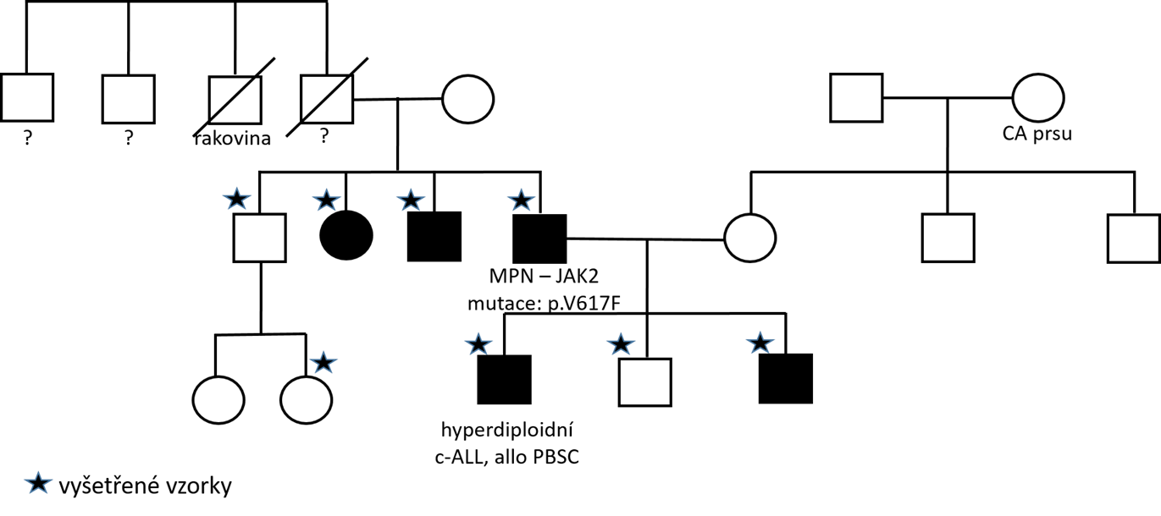
Clinical case from practice

Slide 55
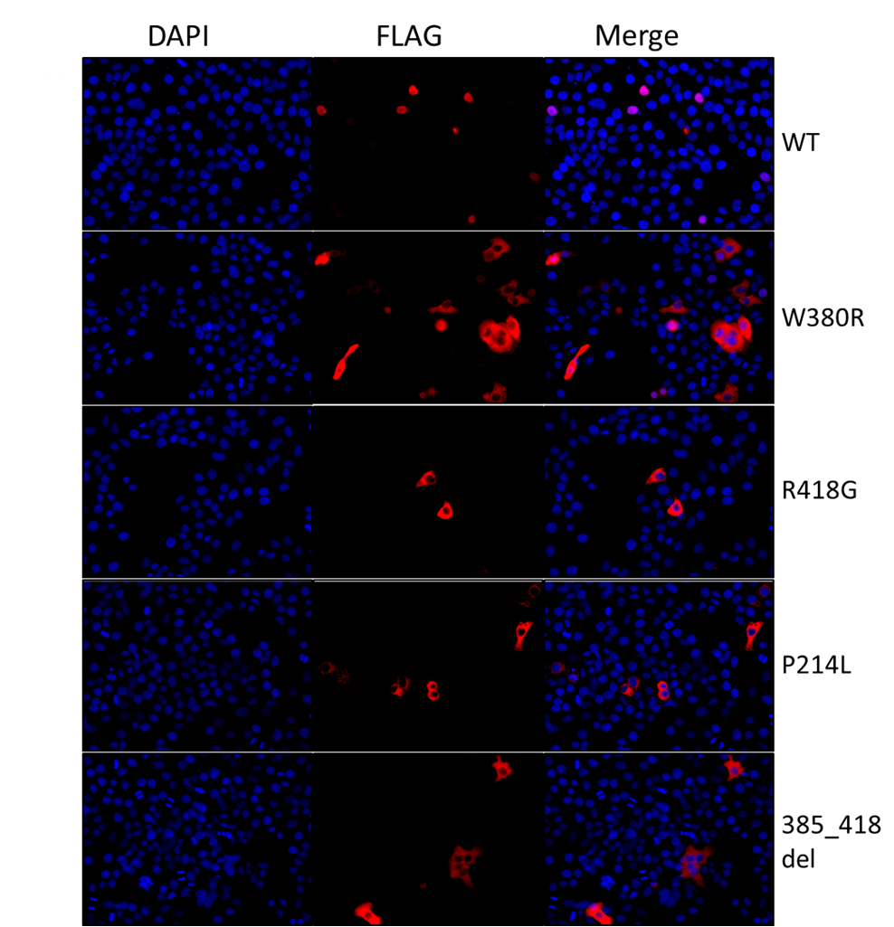
Clinical case
Functional analysis of ETV6 :
fluorescence microscopy

Slide 56
What are the skills of clinical geneticist?
complex examination
gene/s analysis indication - exome sequencing - genome sequencing - functional tests
results interpretation (from practitioners to clinical geneticists)
therapeutic and preventive intervenation proposal
- respecting wishes of affected individuals together with ethical aspects
Clinical genetics (aVLKG7X1c)

Slide 57
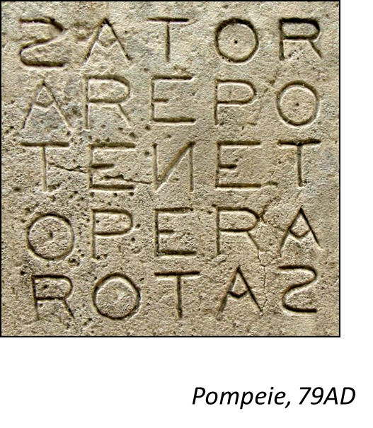
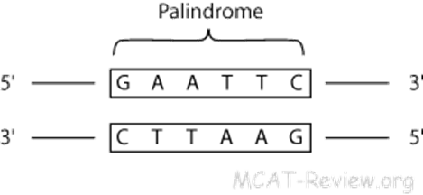
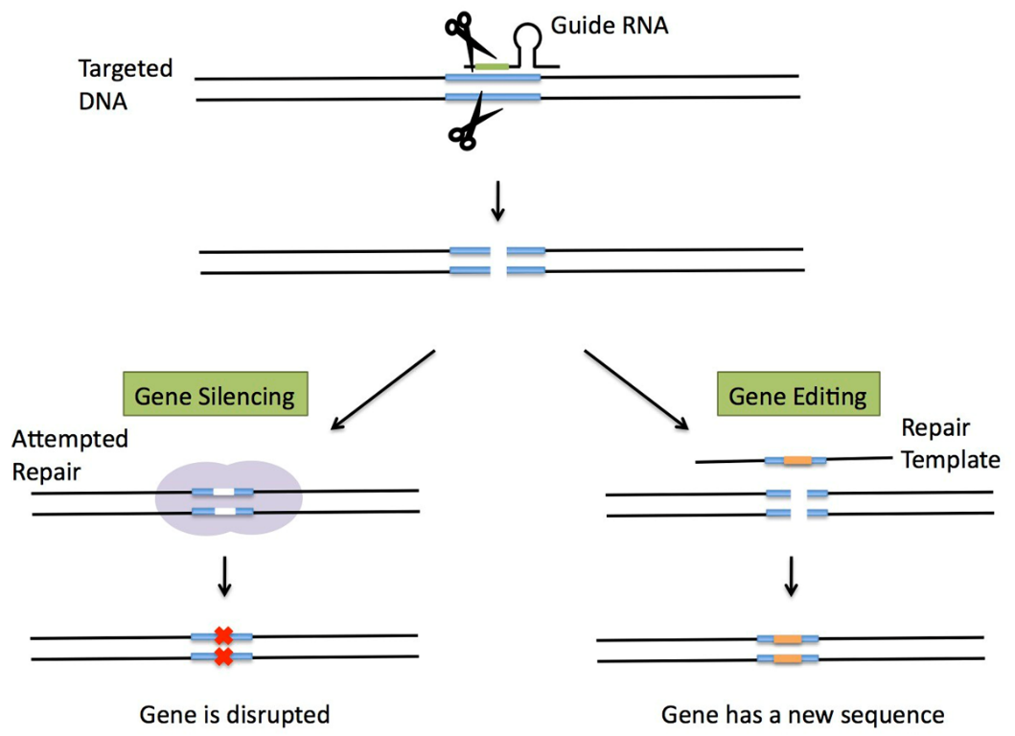
CRISPR/Cas9
Clinical genetics (aVLKG7X1c)

Slide 58
Take home message
The genome is all the DNA in a cell / organism
Exome is DNA coding sequence
We have about 20,000 genes
Modern methods of DNA analysis make it possible to analyze whole genomes
Human genome variability - what causes disease?
Genetics skills
Genome editing
Clinical genetics (aVLKG7X1c)

