Slide 1
Injury
Damage of tissues, organs and organ systems
Caused by external forces
Mechanical, physical, chemical
Monotrauma…polytrauma, life threatening
Life-limb-function
Influence on working and social life
Most common cause of death under 40years of age

Slide 2
Anamnesis
Common medical history :
risk factors
general status (morbidity, mortality)
drugs, allergies
pregnancy
Mechanism of injury:
Approximation of injury severity - triage
Approximation of type of injury

Slide 3
AMPLE + MIST
Allergies
Medication
Present medical history
Last meal
Events related to injury
Mechanism of injury
Injuries find and suspected
Signs + Symptoms
Treatment initiated

Slide 4
Triage criteria of polytrauma
Mechanism of injury
Falls > 6 meters (second floor)
High risk auto crash (ejection, intrusion, death of another passenger, telemetry)
Motorcycle crash > 30 km/h
Auto vs. pedestrian/bicyclist > 30 km/h
Consider special conditions
Age < 6y or > 55y
Cardiopulmonar comorbidity
Pregnancy
etc
Vital signs and level of consciousness
GCS < 13
Systolic blood pressure < 90
Respiratory rate < 10 or > 29 (or need for ventilatory support)
Anatomy of injury
All penetrating injuries
Pelvic fractures
Two or more proximal long-bone fractures
Crushed, degloved, mangled, or pulseless extremity
Amputation proximal to wrist or ankle
Open or depressed skull fracture
Paralysis

Slide 5
Mechanism type of injury

Slide 6
Associated trauma:
1st-3th rib…plexus brachialis, a.et v.subclavia, trauma of thoracic aorta (disection)
Scapula fracture – high energy trauma
Rib fracture in middle part…lung contusion…ARDS, PNO, hemothorax…
Distal ribs… liver, spleen
Pelvis…rectum, urinary bladder, venous plexus

Slide 7
Injuries:
Superfitial, deep, penetrating
Open, close
Soft tissues, skeletal trauma
Monotrauma
Combined trauma
Polytrauma

Slide 8
Fyzik. vyšetření
Primary survey ABCDE
Secondary survey
Targeted excamination
Simple…. complex
Physdical examiination

Slide 9
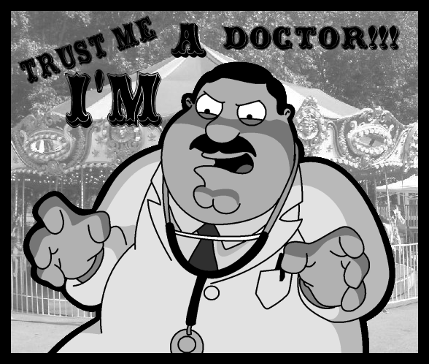
Physical examination
I am a people person really...
Inspection
Auscultation
Palpation
Percussion
Rectal exam

Slide 10
Inspection
Swelling
Hematoma, bleeding
Wound
Defiguration, devition of extremities
Breathing movements
Skin charakter (cyanosis, sweating, paleness)
Foreign bodies
……

Slide 11
Auskultation
Heart sounds
Lungs
Abdomen

Slide 12
Palpation
pain
Creppitation, fluctuation
Emphysema
Pathological movement
Peritoneal irritation
….
Extremities: neurocirculation!!!!

Slide 13
Percussion
Lungs
Abdomen
Soft tissues

Slide 14
Rectal exam?

Slide 15
Specific clinical syndromes
Beck´s trias: hypotension, increased load of cervical veins, decreased heart sounds
Hypotension, tachykardia, increased load of cervical veins, decreased breathing sounds
Kehr´s sign
Lucid interval
Hypertension, bradykardia, decreased GCS
……………

Slide 16
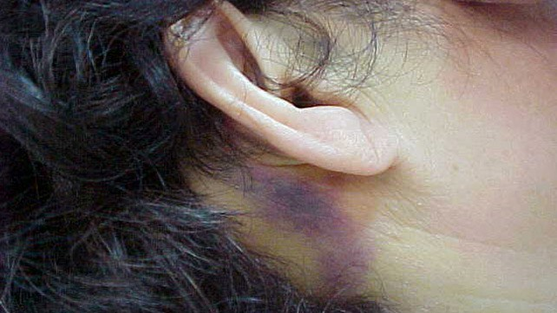
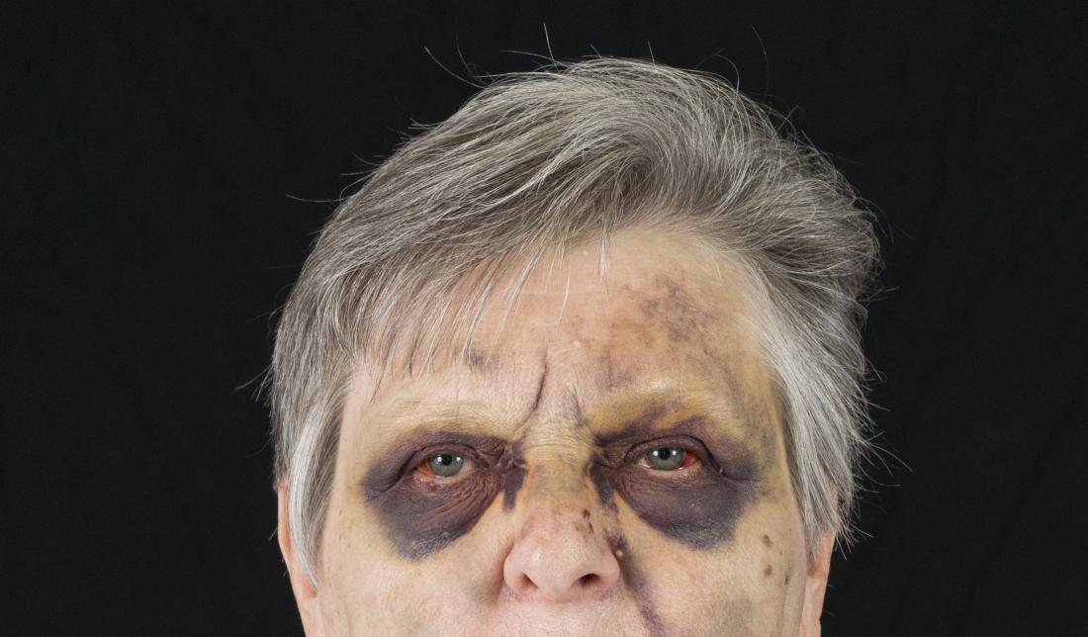
Battle´s sign & Racoon eyes

Slide 17
Fractures
Certain signs:
Visible bone – open fracture
Deformity
Pathological movement
Creppitation
Uncertain signs:
Pain
Swelling
Damaged function

Slide 18
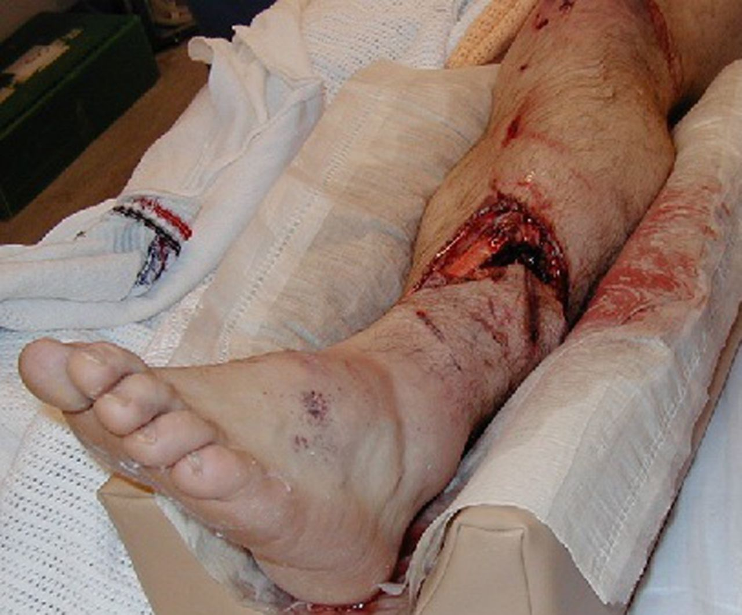

Slide 19
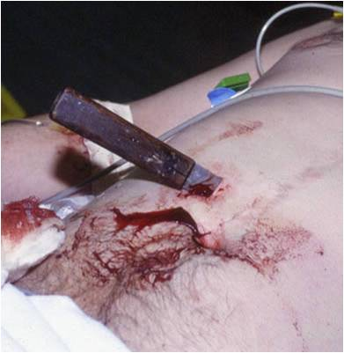

Slide 20
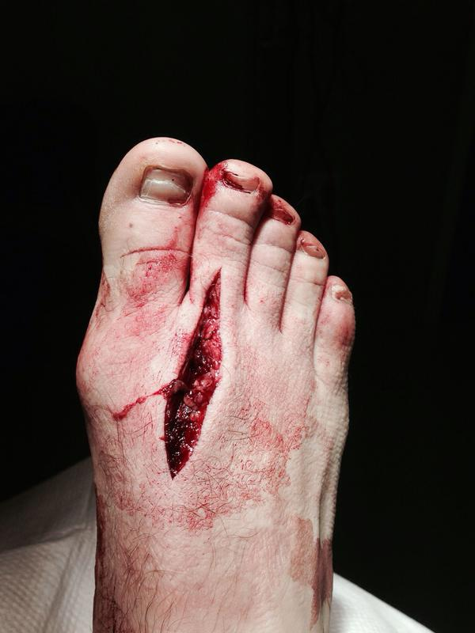

Slide 24
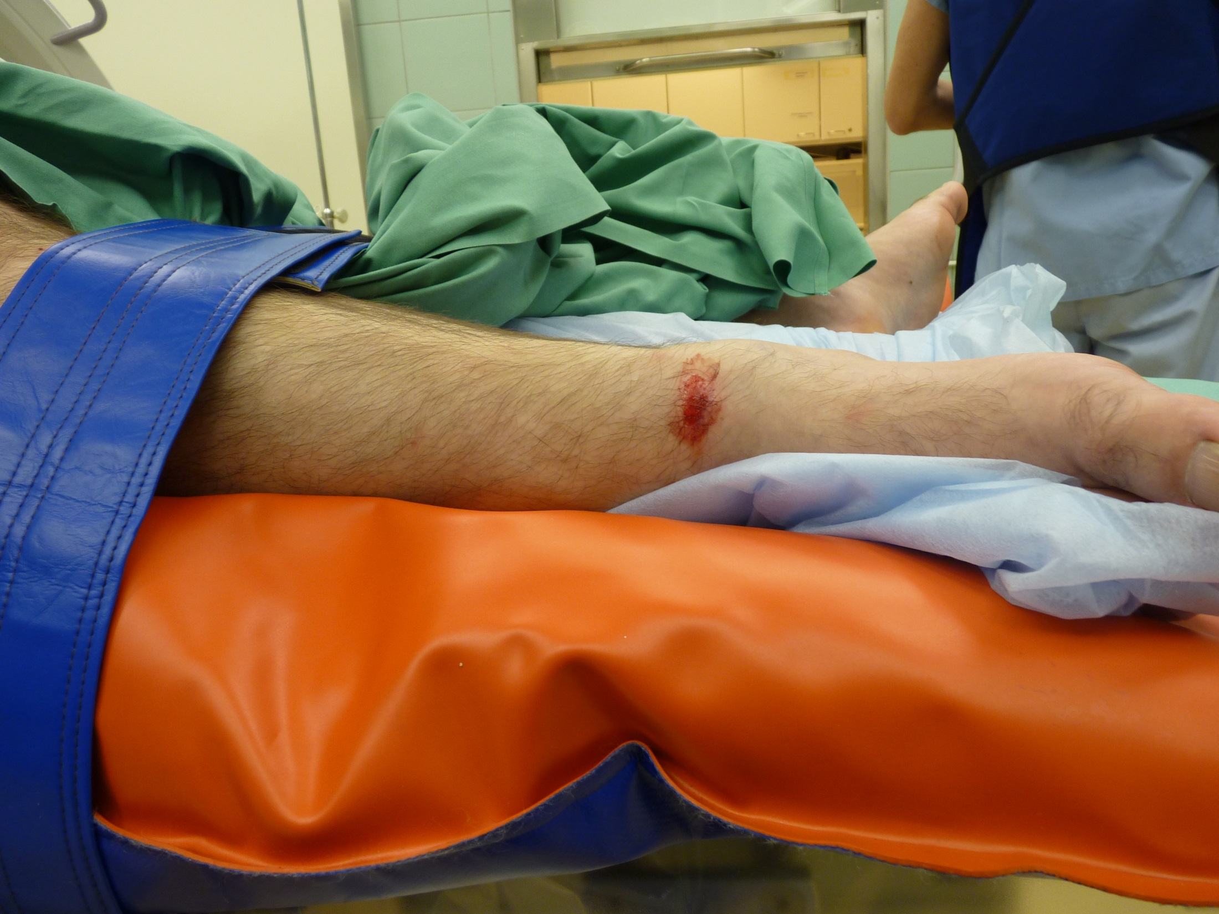

Slide 25
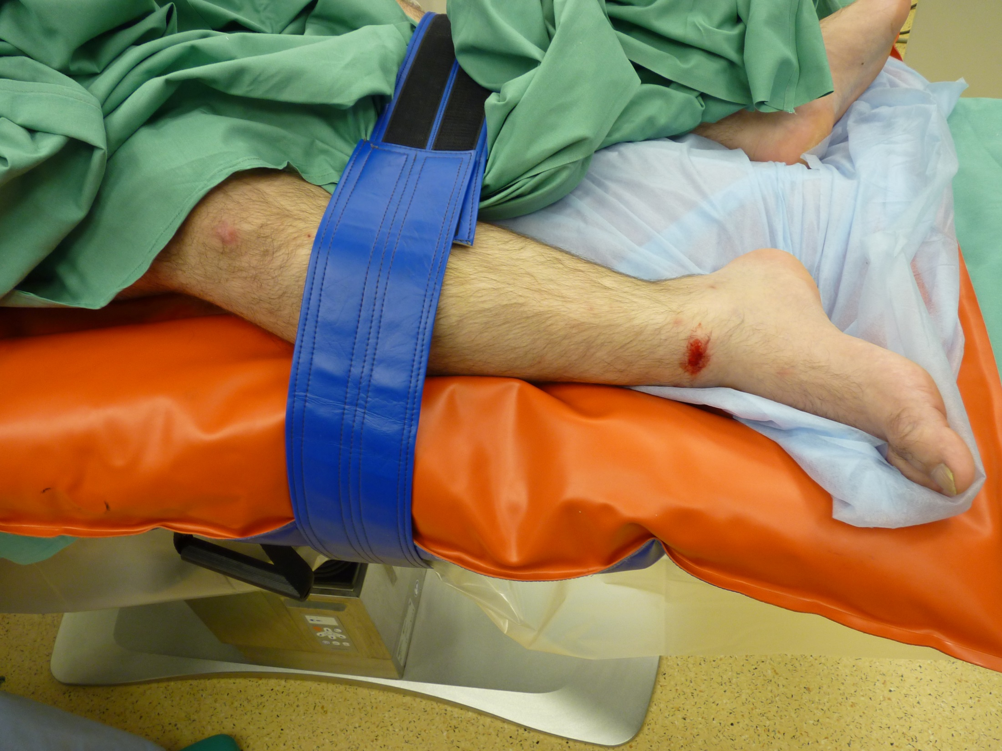

Slide 26
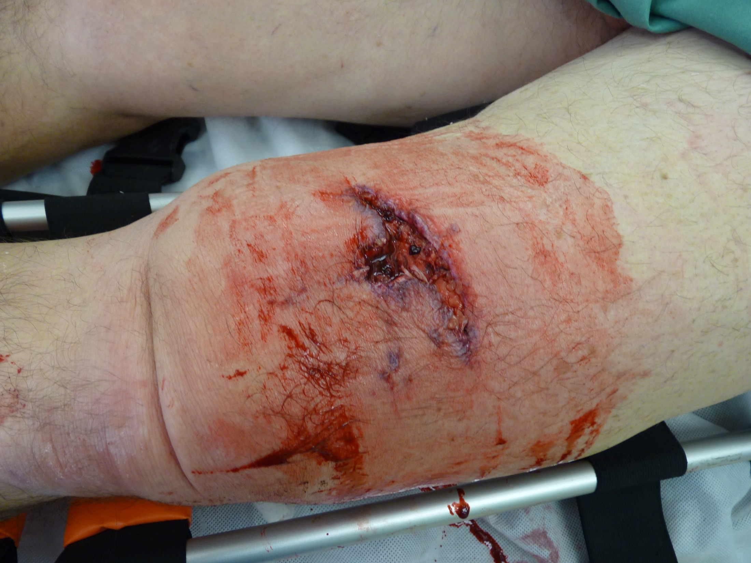

Slide 27
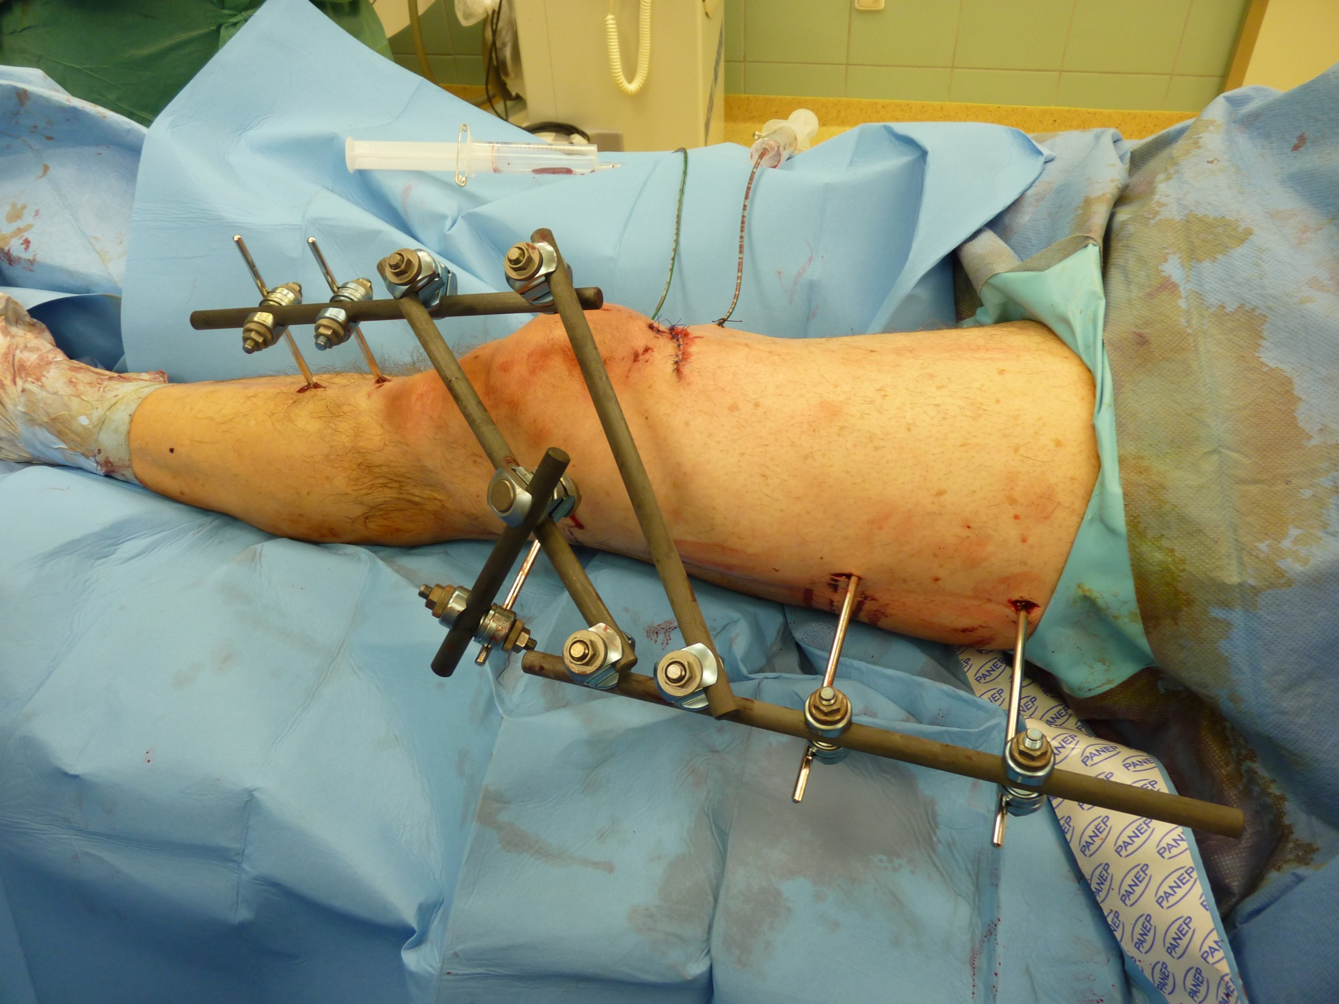

Slide 28
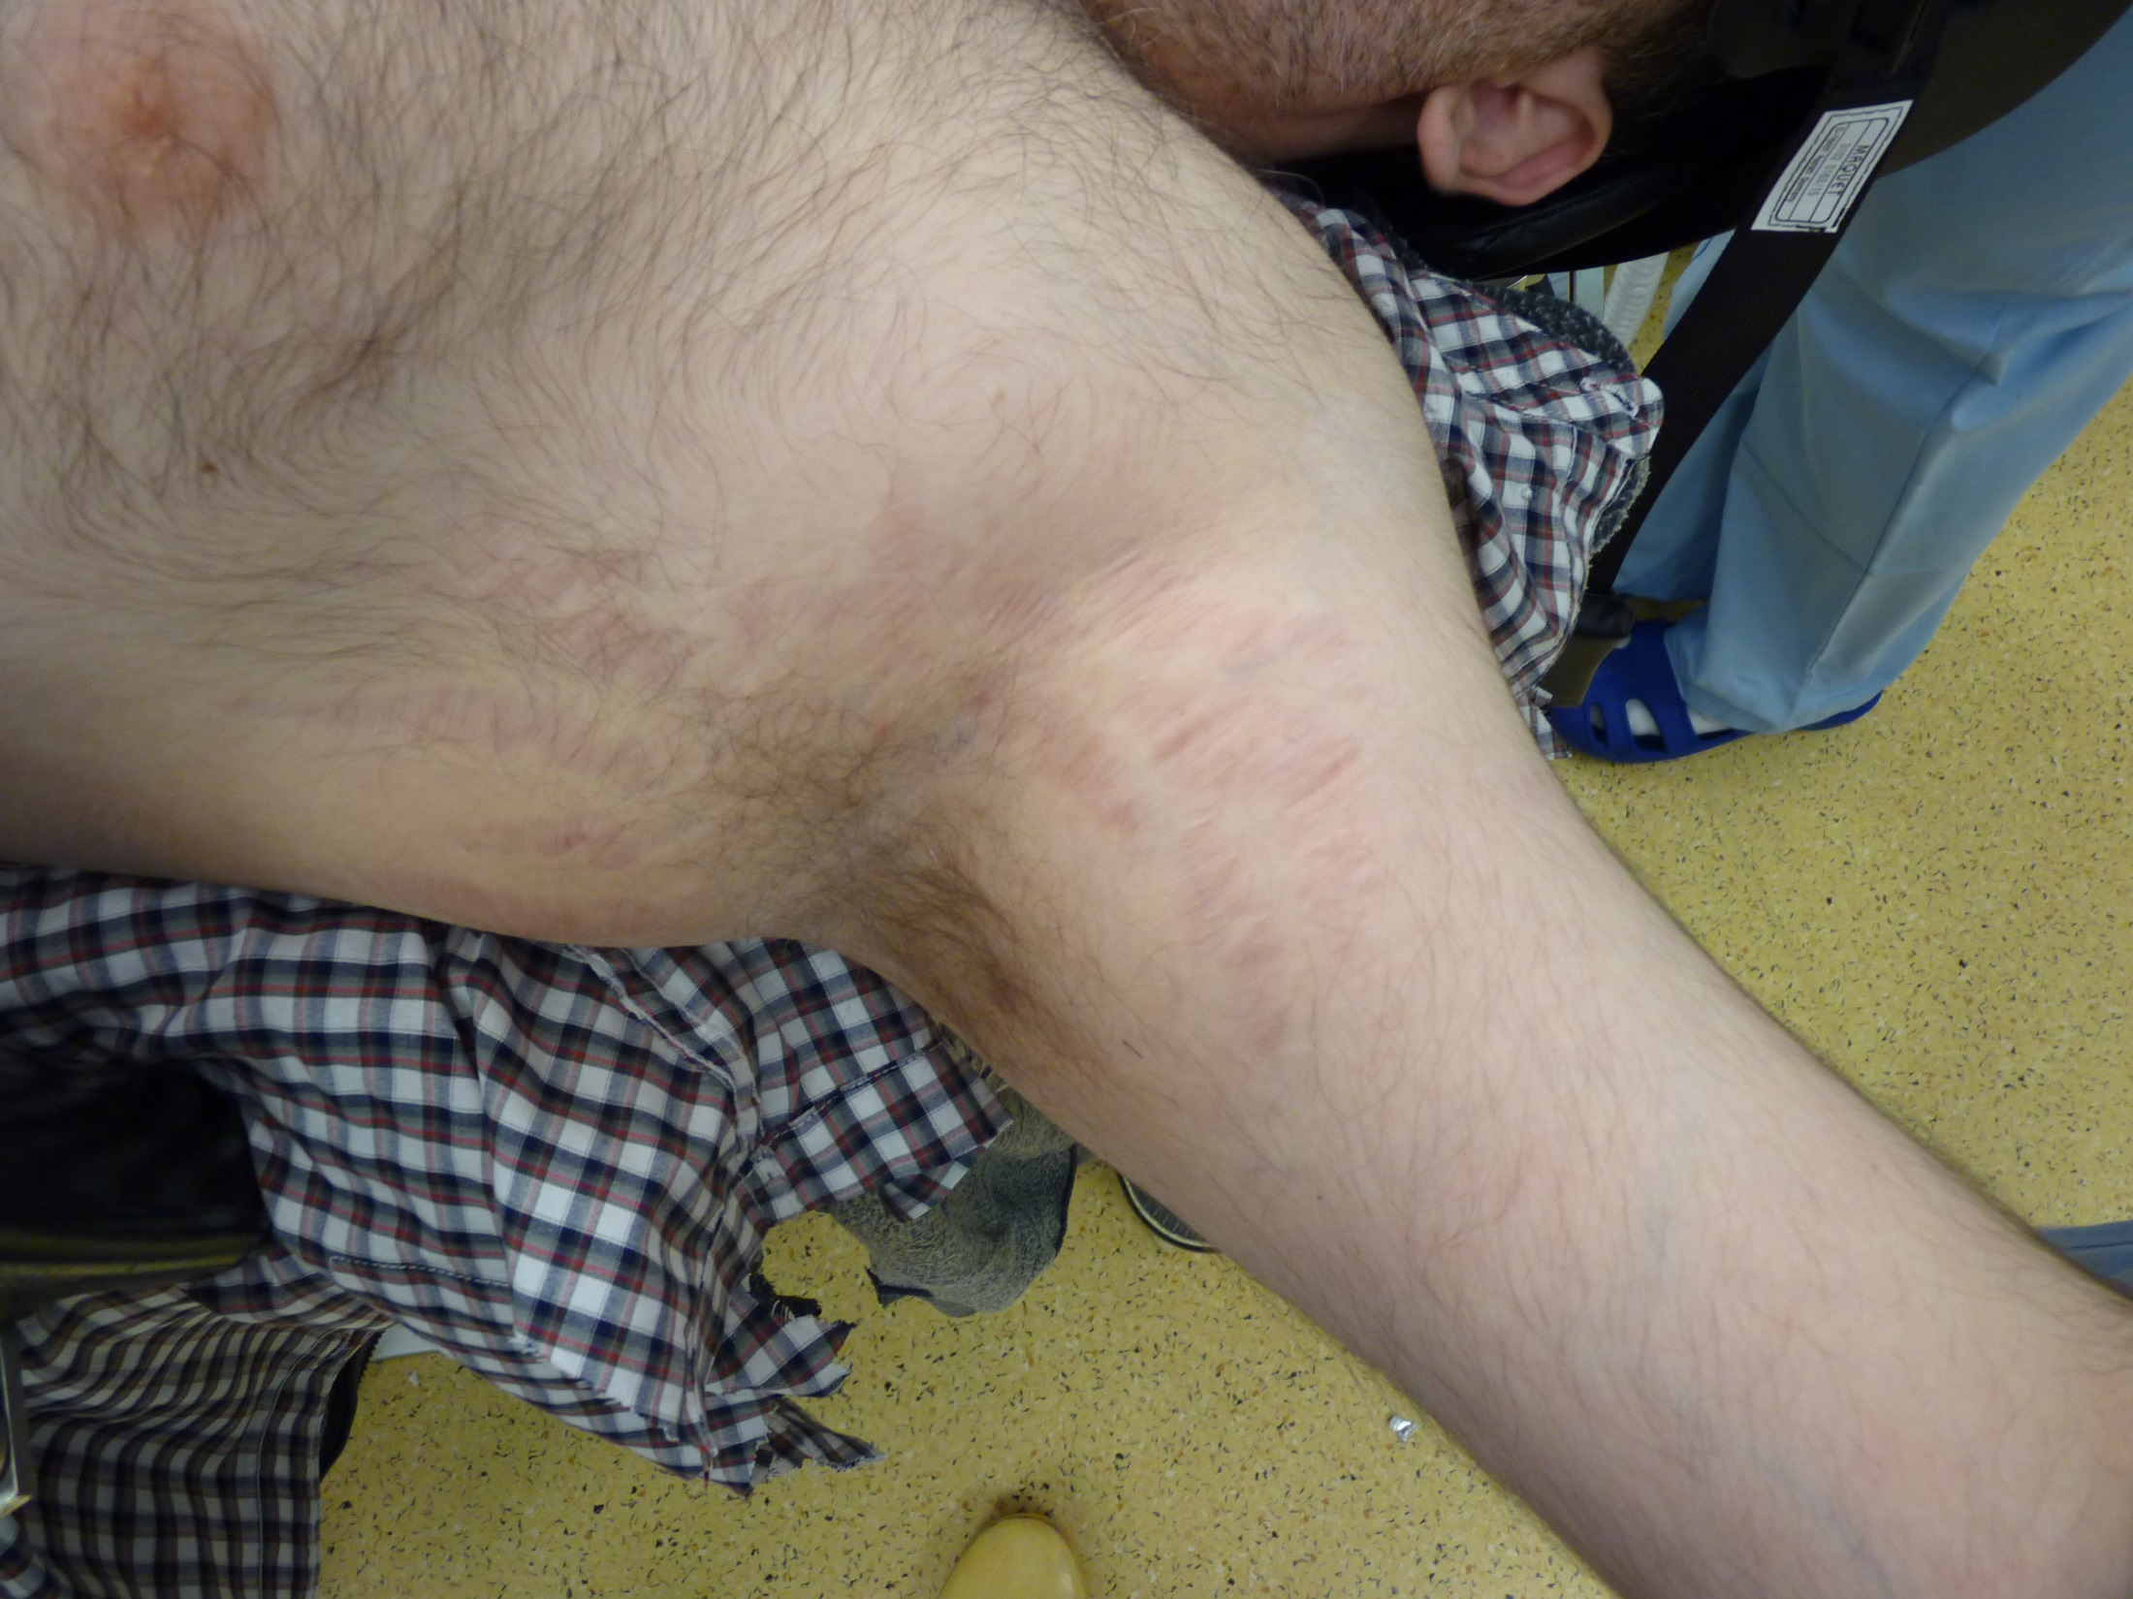

Slide 29
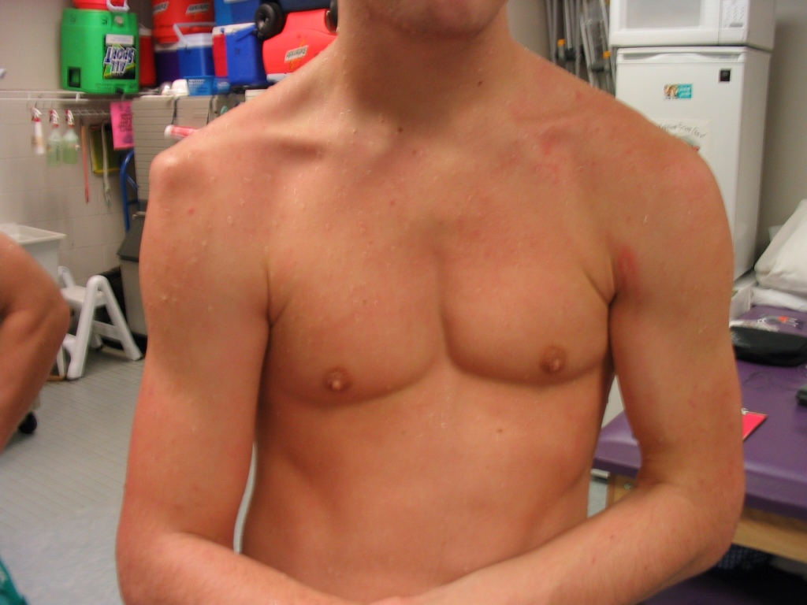

Slide 30
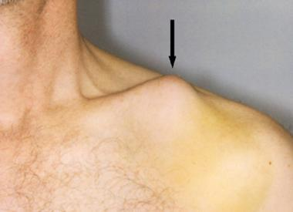

Slide 31
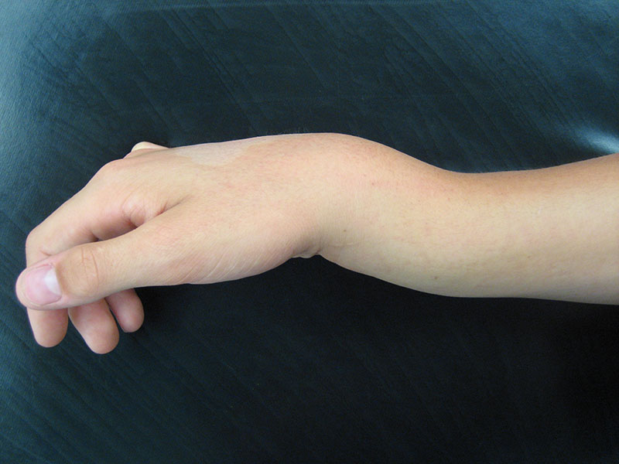

Slide 32
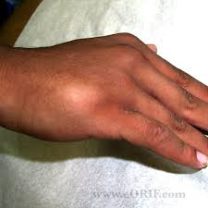

Slide 33
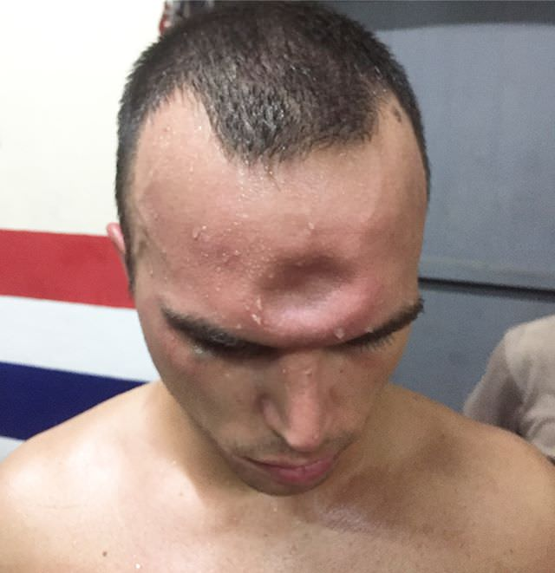

Slide 34
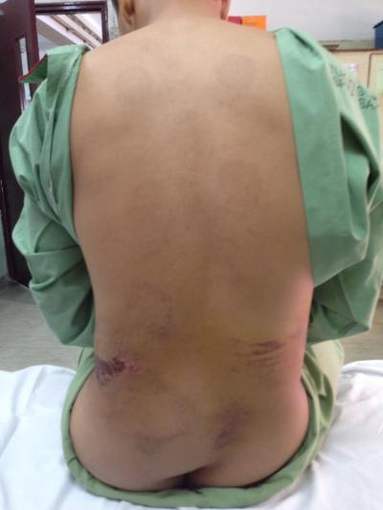

Slide 36
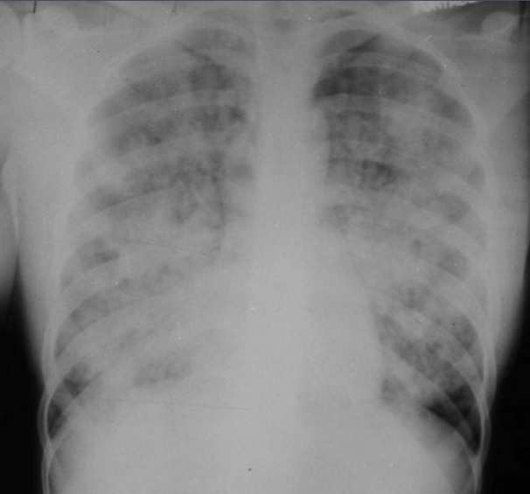

Slide 39
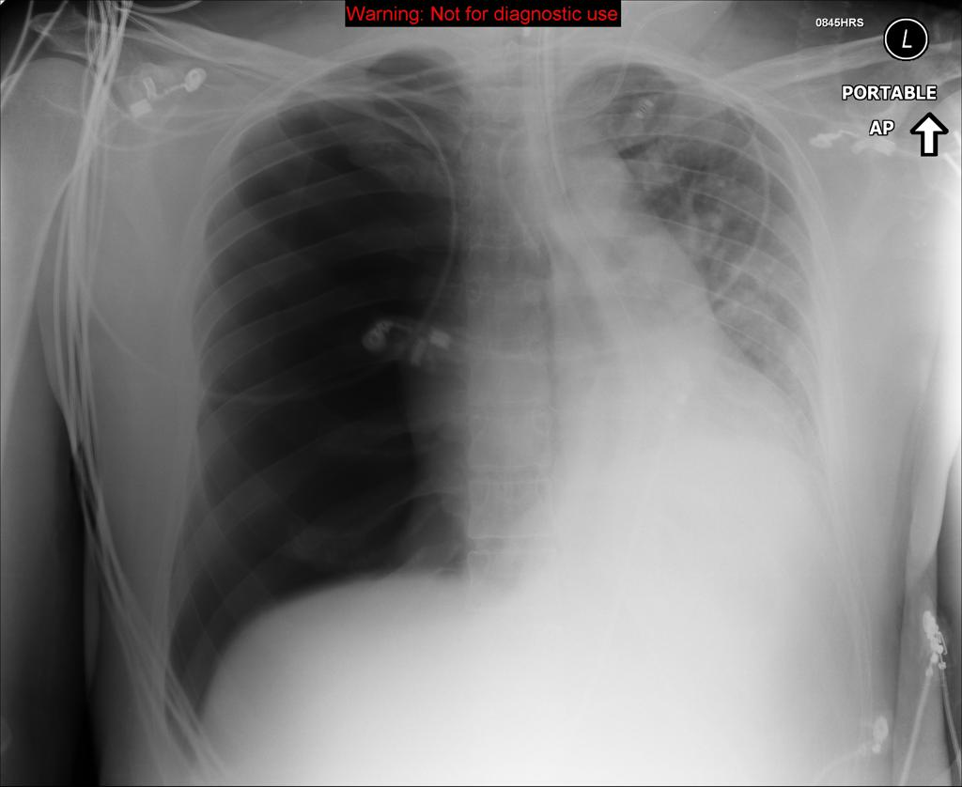

Slide 43
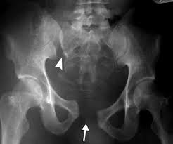

Slide 45
Thank you for attention

