Slide 1
Burns, forst bite, corrosion
1st Department of Surgery
University hospital of St. Anne
Brno

Slide 2
Thermal injuries
Effect of heat
Electricity, Radiation, Chemistry
Time of exposure
Type of energy

Slide 3
Mechanism of effect
Dehydratation
Formation of free radicals
Denaturation of proteins (60 C´)
Destruction of DNA mollecule
Cellular membrane destruction
Cellular death - apoptosis

Slide 4
Epidemiology and etiology
1% of population per year
97% ambulatory, 3% hospitalization
40% children
Hot fluids 60%
Open flame 25%
Electricity 3,5%
Chemical burns 4%
Radiation 1%

Slide 5
Types of burns
Thermal injuries
Electricity burns
Chemical burns -corrosions
Radiation burns

Slide 6
Types of burns –by depth of injury
Grade I
Grade II – Grade IIA
- Grade IIB
Grade III
Grade 4

Slide 7
Grade I - combustio erythematosa
Injury to the epidermis, dermis intact
Erythrema
Pain (48hours)
No scarrification
Time of healing 3-6 days

Slide 8
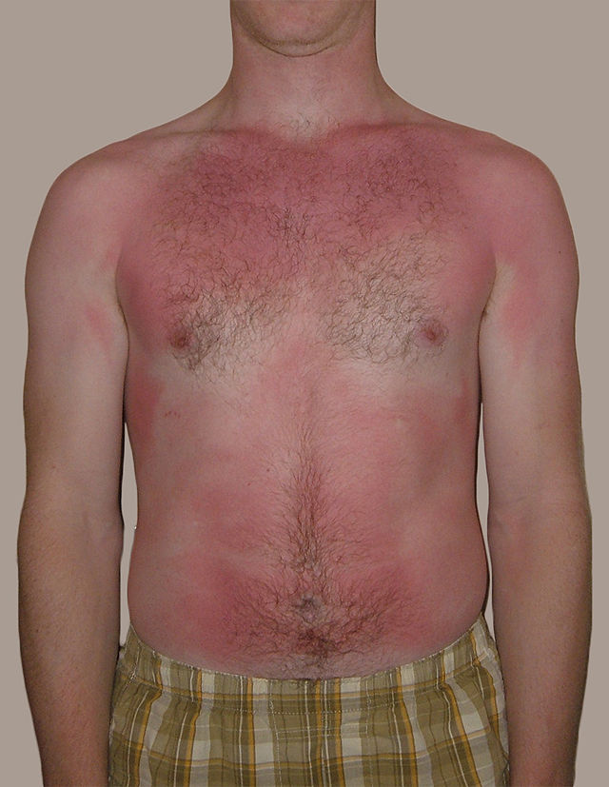

Slide 9
Grade II - combusti bullosa /vesiculosa/
Grade II A
Red undersurface of blister
Capillary refill intact
Healing time 7-14 days
No scar /hyperpigmantation
Grade II
Purple/white undersurface of blister
No capillary refill
Healing time 21 days
Scar

Slide 10
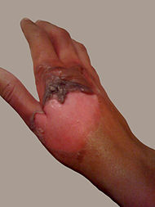
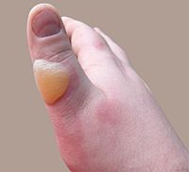

Slide 11
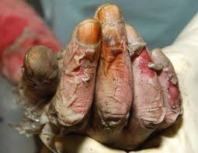
Grade III - combustio escharotica
Damage to all layers of skin
Pale, vax-like skin
Necrosis
No pain – destruction of nerves
Scar

Slide 12
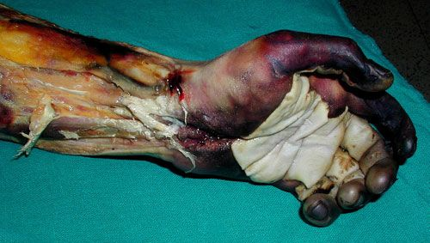
Grade IV - carbonation
Destruction of deep underlying tissues /fascias, muscles, bones/

Slide 13
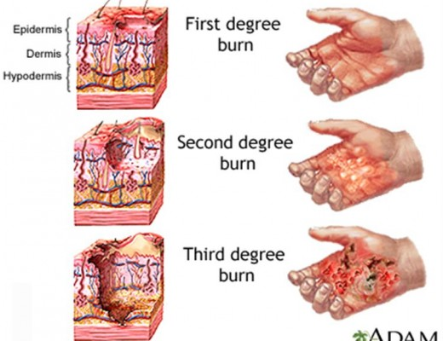

Slide 14
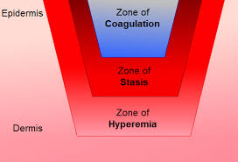
Jackson´s burn model
1. central zone of coagulation (irreversibile)
2. zone of stasis (partialy reversibile)
3. marginal zone of hyperaemia (reversible)

Slide 15
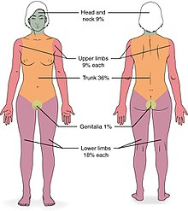
Area of burns
Estimation of burned area is vital for adequate treatment
"Rule of hand (1%)"
"Rule of 9"

Slide 16
Inhalation thermal trauma
Airways damage
Swelling/necrosis
Airways obstruction!
CO exposure!
ARDS
Rapid therapy!!!
Secure airways early

Slide 17
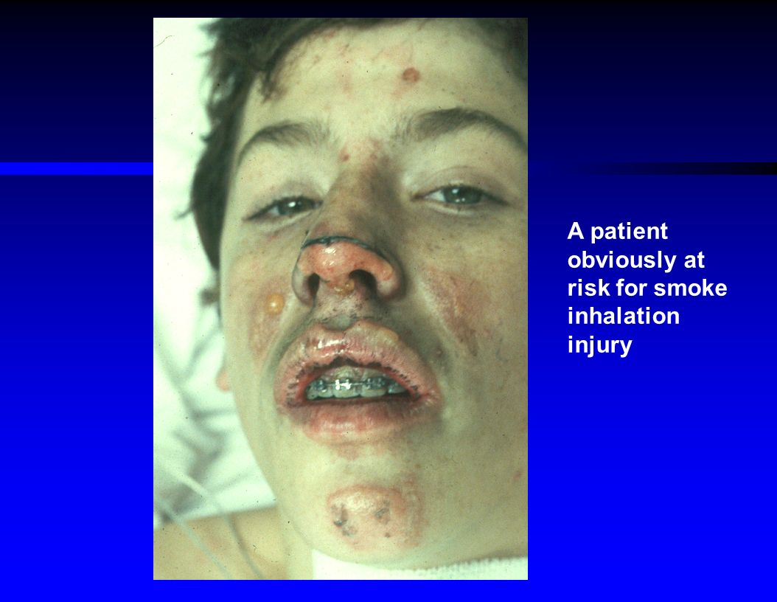
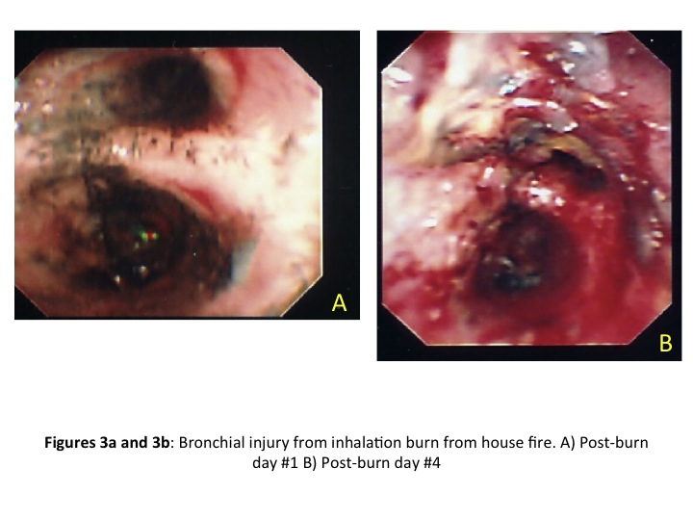
How do I identify inhalation injury?

Slide 18
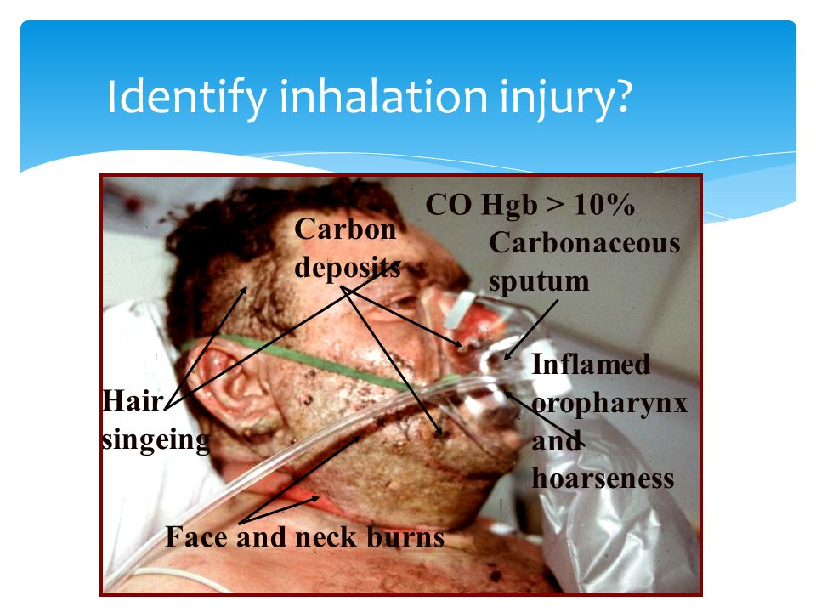

Slide 19
Barrier function of skin
Altered in Grade IIB and higher
Tissue necrosis
Swelling, hypoxia
Bacterial contamination and infection
Typically Pseudomonas aeruginosa
Sterile dressing, TAT, ev. ATB

Slide 20
Local damage
LIRS... SIRS
IL1,2, 6, 12, TNF alpha, Beta
Histamine
K+, myoglobin
Pain
Swelling
Ischaemia
Necrosis
infection

Slide 21
General answer
SIRS
Period of shock (24-14 days)
Acute period of burn dissease
Period of reconstruction
Loss of plasma, hemoconcentration
Hypovolemia, AKI
Toxines resorbtion
Hypoproteinemia
Infection, Curling gastric ulcer, liver dysfunction etc.

Slide 22
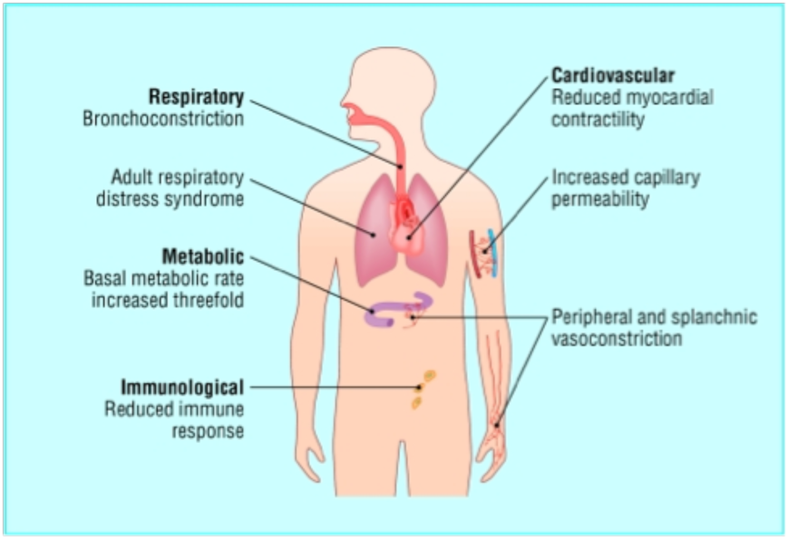

Slide 23
Treatment
II. less than 10%
III. Less than 2%
II. 10-24%
III. 2-10%
II: over 25%
III. Over 10%
Special cases
Ambulatory treatment
Hospitalization
traumacentre
Burn unit

Slide 24
Special cases
Head and face
Perineum + genital
Hands
Circular burns of chest, neck
Inhalation thermal injury
Children under 2yo, II. Type over 5%
Geriatric patients
electricity

Slide 25
Treatment - goals
Reduce local damage
Prevent/treat general answer
Prevent complications
Reconstruct
Proper treatment in proper time
Technical help
Pre-hospital help
Acute care
- symptomatic
- supportive
- surgical
Reconstruction and rehabilitation

Slide 26
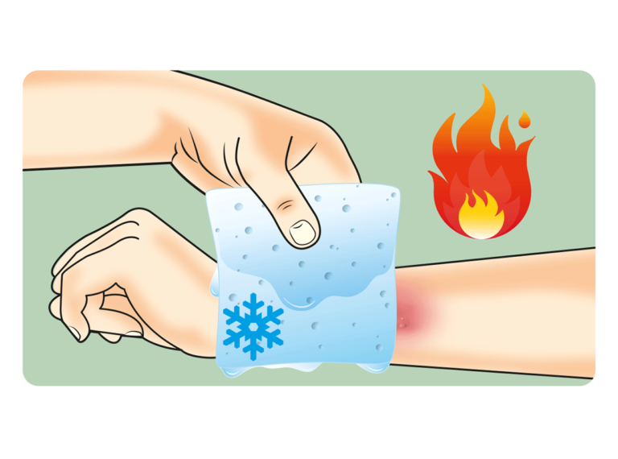
Symptomatic
Stop burning process
Analgesia
Local hypothermia
/cooling/
Sterile dressing
Prevention of hypothermy

Slide 27
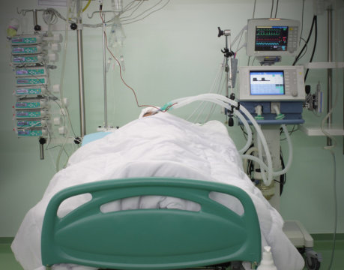
Supportive
Fluid resuscitation
Oxygenotherapy
TAT
ATB?
Urinary output
A,B,C,D

Slide 28
Fluid resuscitation
Min. 2 i.v. Lines
ASAP
Infants over 5%
Children over 10%
Adults over 15%
Crystaloids, coloids? aminoacids
Urinary output!!!
Parkland formula
RL 4ml x kg x %
Brook formula 1:3
(crystaloids:coloids)
0,5/1,5 ml x % x ...kg
Evans formula 1:1

Slide 29
Surgical
Urgent care:
Escharotomy
Fasciotomy
On-demand/ planed:
Necrectomy
Wound treatment

Slide 30
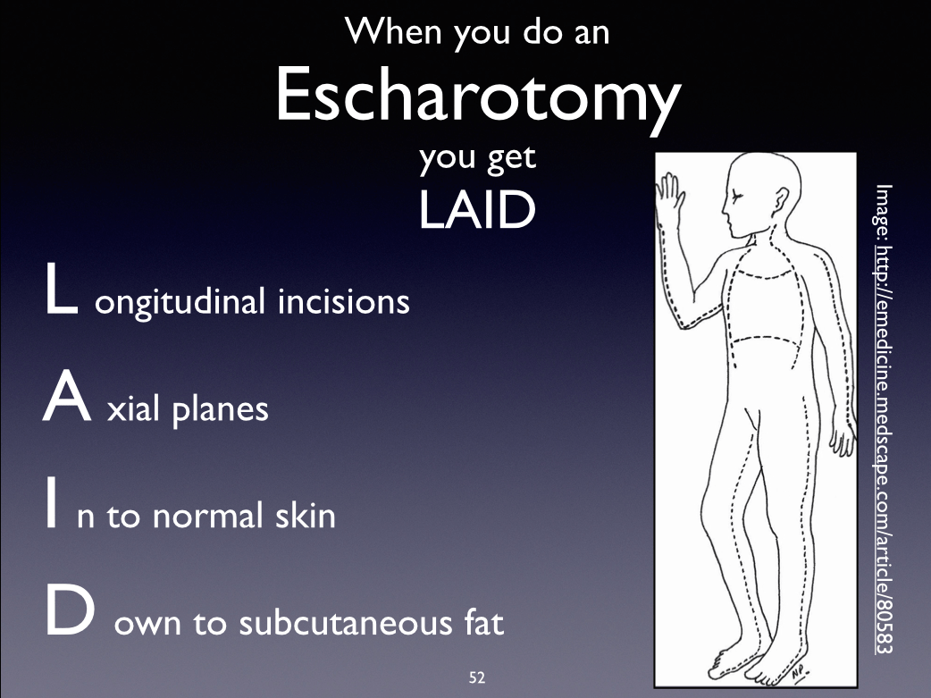
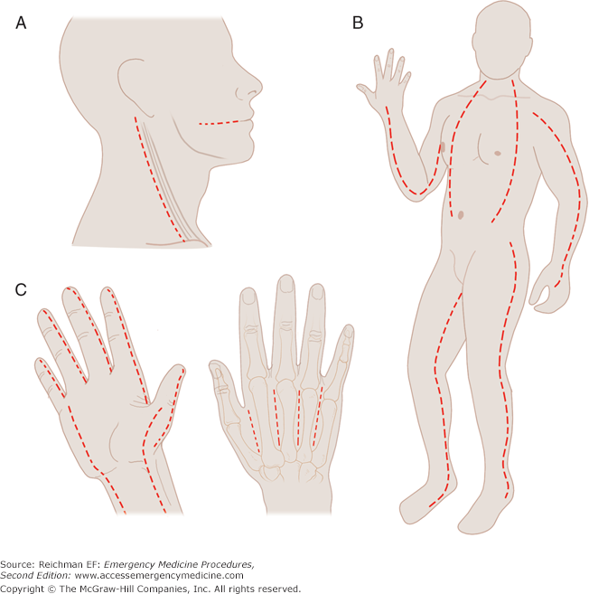

Slide 31
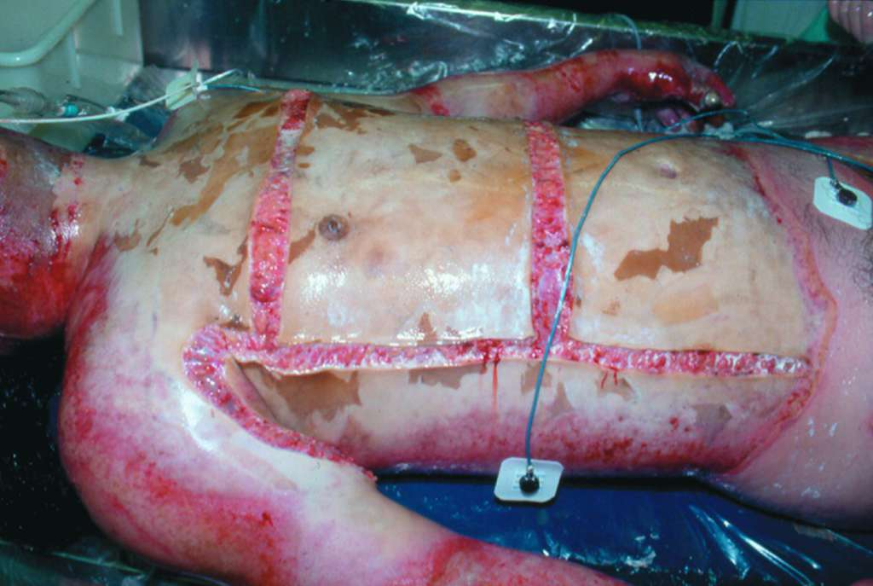
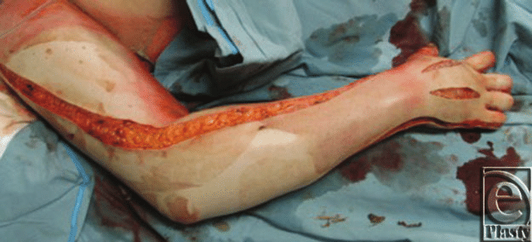

Slide 32
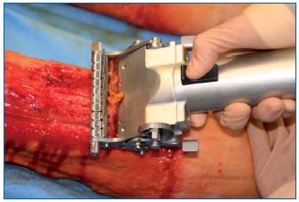
Necrectomy
Surgical
fascial vs. tangential
Chemical
40% benzoic acid
40% salicyle acid
Enzymatical - less
colagenase
protease

Slide 33
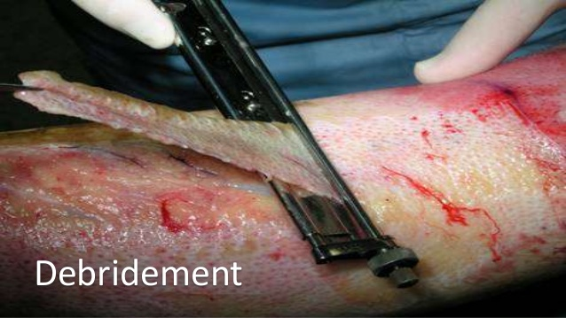

Slide 34
Reparation, reconstructive surgery
Plastic surgeons
Dermo-epidermal graft
Skin transplant
Musculofascial flaps
...
Autotransplant
Allotransplants
Xenotransplants
Synthetic materials
(bovinne collagene, Synkrit...)

Slide 35
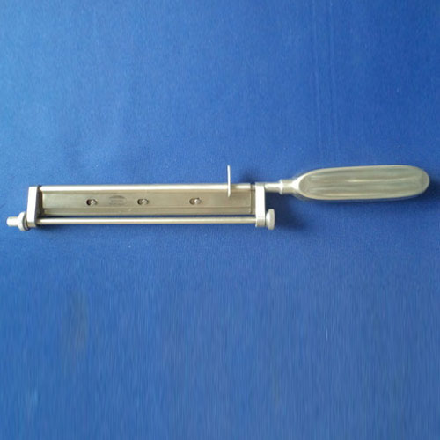
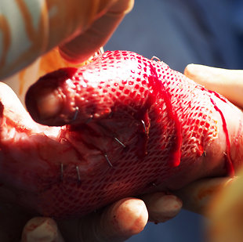

Slide 36
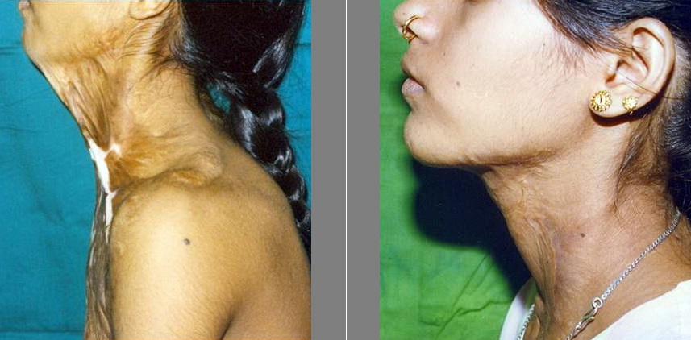
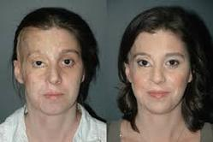

Slide 37
Frostbites - congelationes
Effect of low temperrature
Not neccesary below 0 C´
Wind, wet
Exposed skin
Peripheral areas /acra/
General state of patient

Slide 38
Types
Frostnip
Frostbite - 1st Degree
- 2nd Degree
- 3rd Degree
- 4th Degree
Non- freezing injury (Trench foot)
Hypothermia

Slide 39
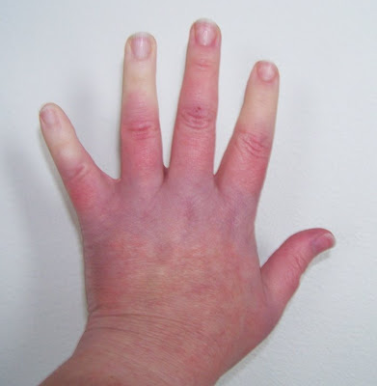
Frostnip
-mildest form of cold injury
-Initial pain, pallor, numbness
reversibile, no tissue loss
Th: rewarming

Slide 40
Frostbite
1st Degree: hyperemia, swelling, no skin necrosis
2nd Degree: clear blister formations, hyperemia, edema, partial-thickness skin necrosis
3rd Degree: full-thickness and subcutaneous tissue necrosis, hemorrhage vesicle formation
4th Degree: full-thickness skin necrosis + muscles, bones, gangrene

Slide 41
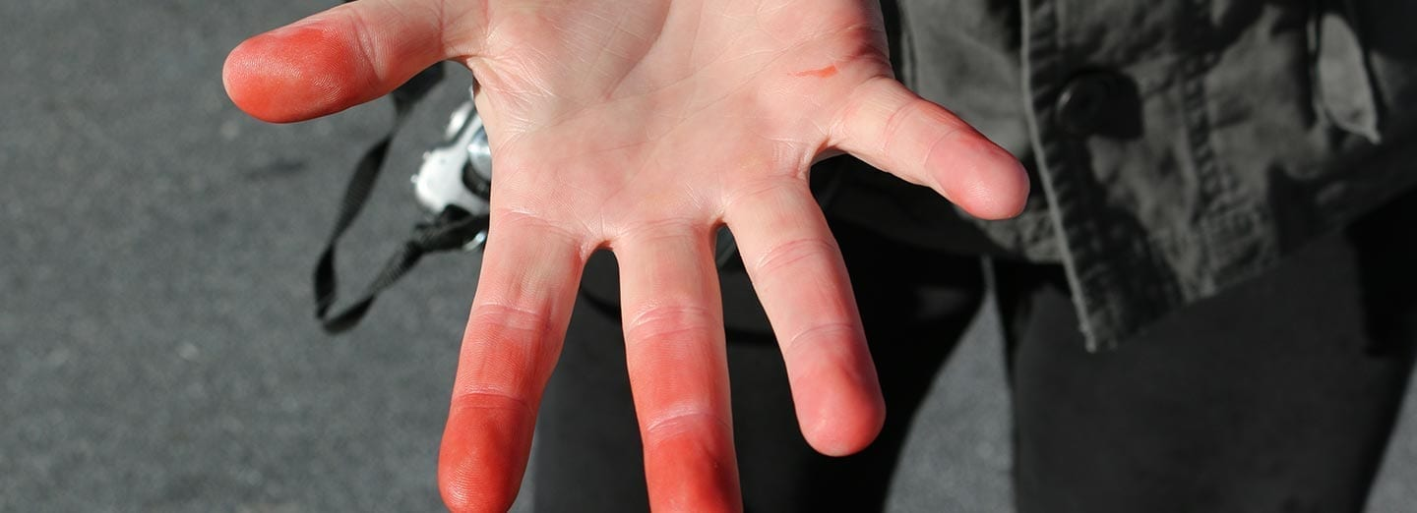
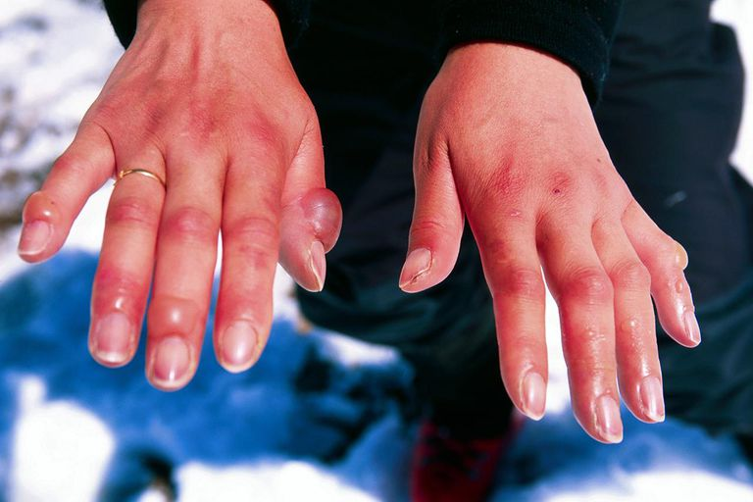
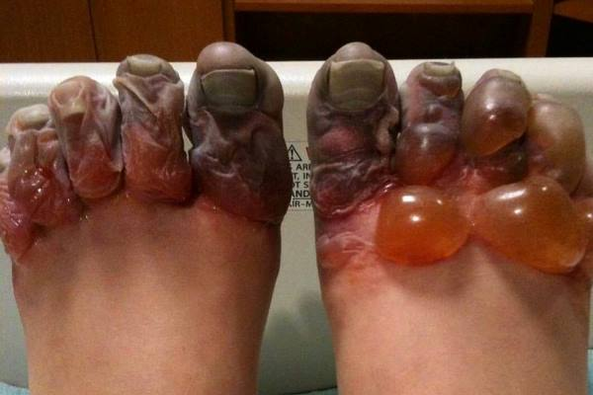

Slide 42
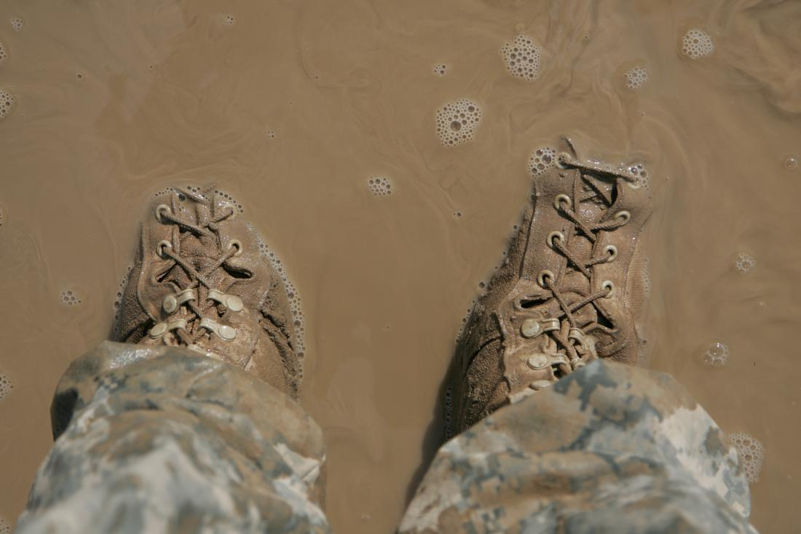
Trenchfoot
endothelial damage, stasis, vascular occlusion
Long-term exposure to wet conditions, temperatures just above freezing point
Soldiers, sailors, fishermen…

Slide 43
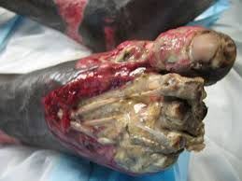
Trenchfoot
Cold and numb tissue /24hours/ - due to arterial vasospasm
progressing to hyperemia, pain, hysestesia
Edema, blisters, redness, ulcerations
Local infection, cellulitis, gangrena

Slide 44
Local and general answer
Vasospasm
Ischemia
Swelling
Necrosis
Secondary complications
Infections
Sepsis
Hypothermia - less than 36 C´
Mild - 32-35C´
Moderate – 30-32 C´
Severe- less than 30C´
Neurological problems
Arytmia
Cardiac arrest

Slide 45
Treatment
Exposure!
Re-warm
Local/circulating water 40C´/
(no dry heat, no rubbing!!!, pain management)
Systematic – hot drinks, i.v. fluids
Wound care
Goal – prevent infection, preserve damaged tissue
elevation, avoid opening clear blisters, imobilisation, TAT, ATB?

Slide 46
Corrosion - chemical burns
Exposure to acids, alkalies, petroleum products
Acids - coagulation
Alkalies – colliquation (deeper penetration )
Injury influenced by:
- Type, amount, concentration, time of exposure
Treatment: rapid removal, neutralization(?), irriigation, sterile dressing, TAT, ATB?

Slide 47
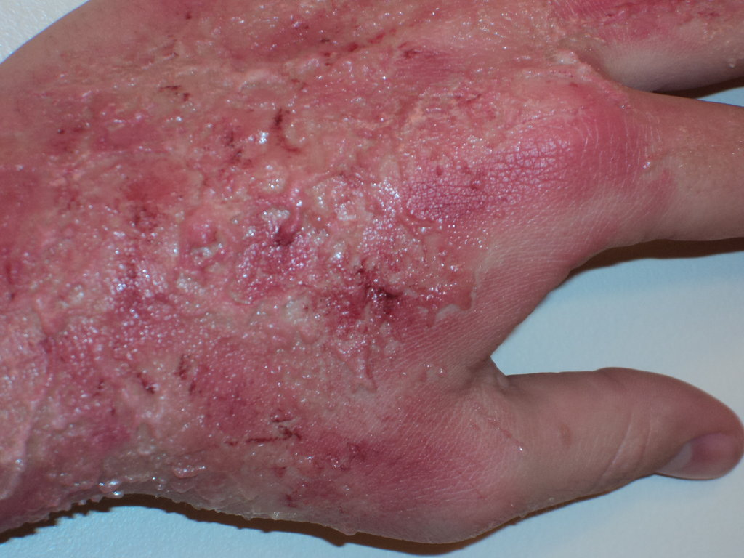
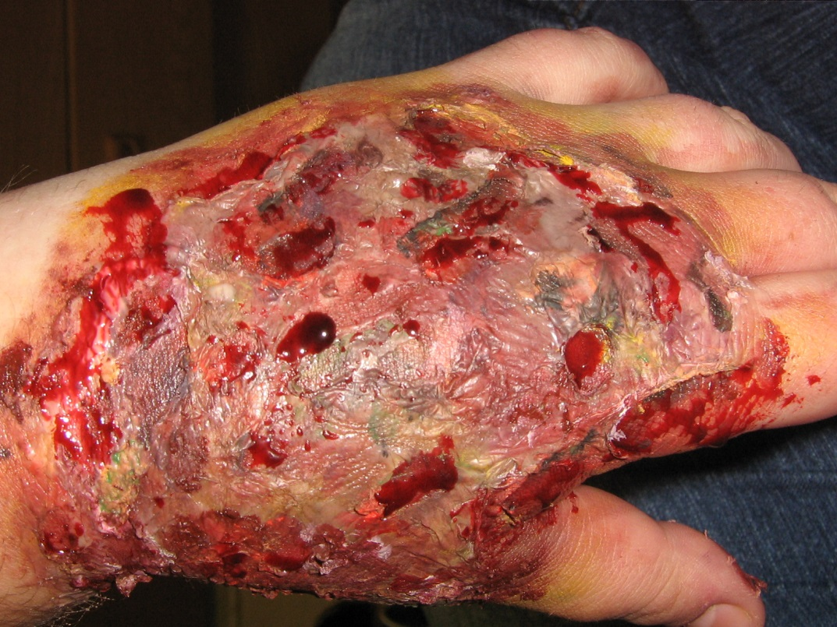

Slide 48
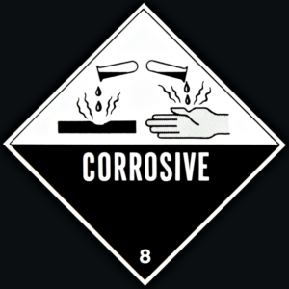
Internal use of chemicals
Accidental, suicidal
Alkalies, acids /
Hyperemia, flegmona, necrosis, ulcers, perforation… chroniicity - stenosis
Dyspnoe, odynophagia, hoarseness, pain, laryngeal spasm, metabolic disorder
GFS? PPI, NGT, irrigation, ATB, PEN

Slide 49
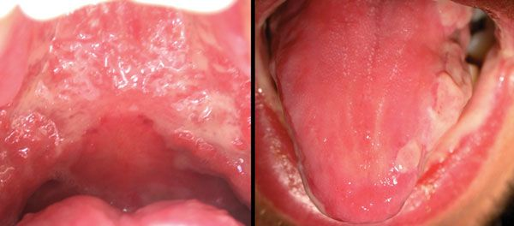
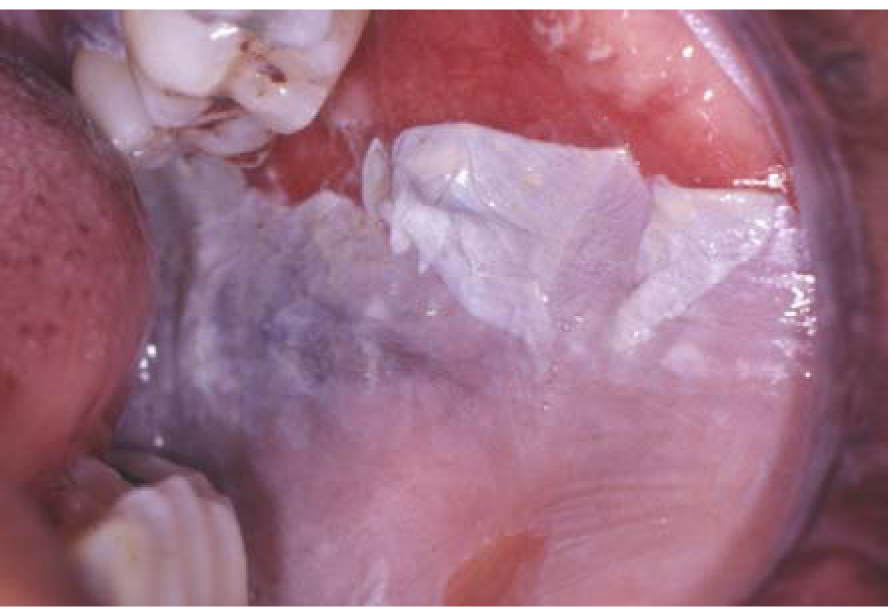
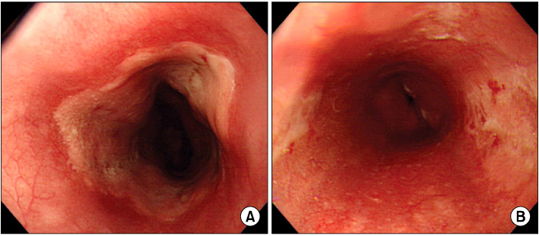

Slide 50

Thank you

