Slide 1
1st practical lesson

Slide 2
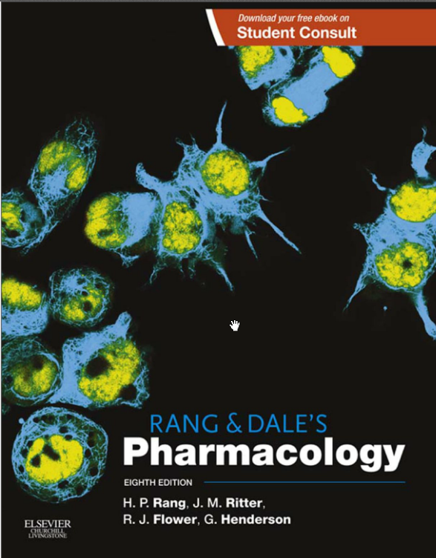

Slide 3
Literature
Practicals in Pharmacology, 2006
Hadasova, Novakova, Pistovcakova,
Vinklerova, Sulcova, Starobova
Pdf available at: IS.muni.cz

Slide 4
„GENERICS“
Drug which is produced and distributed after ending of patent protection - mostly manufactured by other company which has not developed the original drug (the same active substance!)
Mostly cheaper than original preparation
Assumed to be identical in dose, strength, route of administration, safety, efficacy, and intended use
Bioequivalent trials are needed before registration
Registration procedures are much easier than in orig. preparation
Drug patents give 10 years of protection, but they are applied for before clinical trials begin, so the effective life of a drug patent tends to be between 7 and 12 years

Slide 5
„GENERIC PRESCRIPTION“
prescription of the generic name (INN) on Rx formulary
+ dose, number of doses
Pharmacist will chose apropriate ready-mady preparation after consultation with the patient
„ GENERIC SUBSTITUTION“
  substitution of the prescribed preparation with another one (generic)

Slide 6
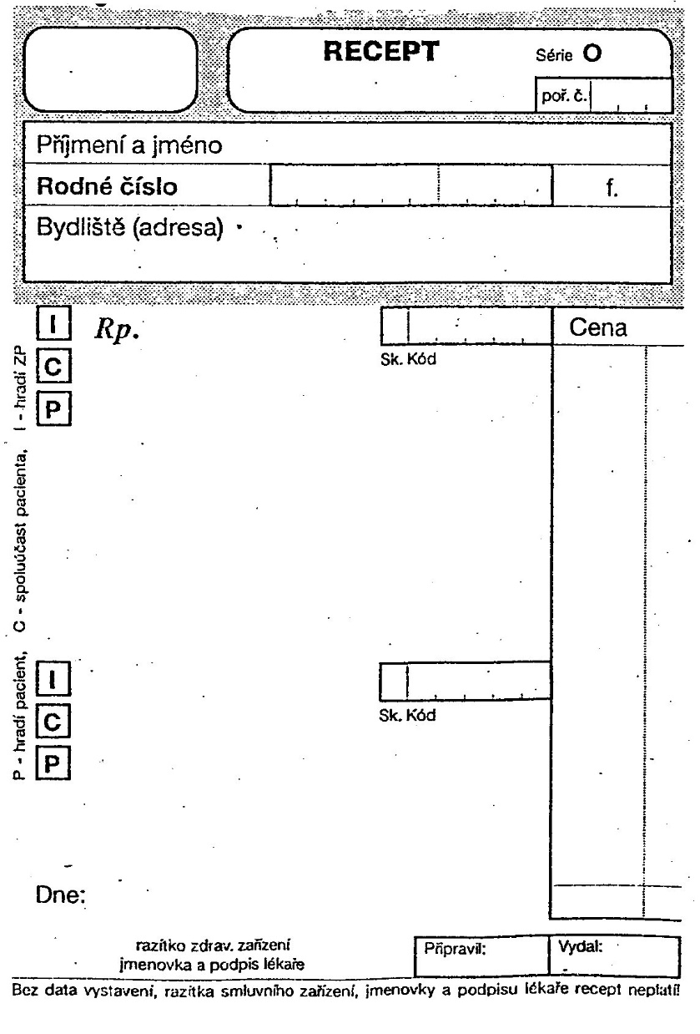
Latin terminology in drug prescription

Slide 7

Pharmacopoeia
pharmacon = drug
poieo = prepare
Substances in pharmacopoeia- called officinal drugs

Slide 8
Definition
basic reference work for pharmaceutical drug specifications
published by the authority of a government or a medical or pharmaceutical society
book containing directions for the identification of samples and the preparation of compound medicines
assures quality, efficacy, safety, standards

Slide 9
Pharmacopoeias may be:
National e.g. Brazilian, British, Chinese, Indian, Japanese, Mexican, Spanish, United States
Regional e.g. European (Ph.Eur.)
    The 7th Edition of the European Pharmacopoeia
International The International Pharmacopoeia

Slide 10
National and regional pharmacopoeias
Cover medicines used in the relevant country or region
Are legally binding "official" in the relevant country or region
Are prepared by a national or regional authority

Slide 11
International Pharmacopoeia
A few dates…
The history of the International Pharmacopoeia dates back 1874…
→ 1948 First World Health Assembly established
Expert Committee on Unification of Pharmacopoeia
→ 1950 WHA approved publication of Pharmacopoeia Internationalis

Slide 12
International Pharmacopoeia
→implementation: “ready for use” by Member States
"The Ph.Int [… ] is intended to serve as source material for
reference or adaptation by any WHO Member State wishing to establish pharmaceutical requirements. The pharmacopoeia, or any part of it, shall have legal status, whenever a national or regional authority expressly introduces it into appropriate legislation."
[World Health Assembly resolution WHA3.10, WHO Handbook of Resolutions and Decisions, Vol. 1, 1977, p. 127]

Slide 13
International Pharmacopoeia
A collection of monographs and requirements for:
→ Drug substances
→ Excipients
→ Finished dosage forms
→ General methods and requirements:
dosage forms, e.g. tablets, liquid preparation for oral use
dissolution testing
→ Supplementary information, e.g. General guidelines for Chemical Reference Substances
→ Infrared reference spectra

Slide 14
Specifications of substances
Description, Chemistry, Solubility, Storage, Labelling
Definition, with information on polymorphism if relevant
Identification
Assay
Specific tests (sulphated ash, optical rotation, loss on drying…)
Related substances

Slide 15
Specifications of substances
Precise description of analytical methods
Impurities (chemical names, structures, origin)
Any relevant information on
Performance testing (e.g. dissolution)
Stability
Validation of analytical methods

Slide 16
International Pharmacopoeia
current: 4th Edition + 1st Supplement
→ Consolidated in : 2 Volumes
Vol. 1: pharmaceutical substances (A-O)
Vol. 2: pharmaceutical substances (P-X)
+ dosage forms + radiopharmaceuticals
+ methods of analysis + reagents
1st Supplement - new requirements and revisions

Slide 17
PHARMACOPOEIA BOHEMICA
3 volumes + CD, 2017
Translation of 7th ed. of Eur. Pharmacopoieia
Issued by The Czech Ph. Comm. Of Ministry of Health

Slide 18
Vol. 1 General methods and requirements
Vol. 2 Monographs A-N
  Medicines, excipients
Vol. 3
Monographs N-Z
  Medicines, excipients
  National part
General methods and requirements
Tables (I-XII)
  Medicines, excipients

Slide 19
PHARMACOPOEIA
WHAT we can not find there !
  pharmacological properties of drugs, their pharmacodynamics,
  pharmacokinetics
  indications, contra-indications
  toxic effects

Slide 20
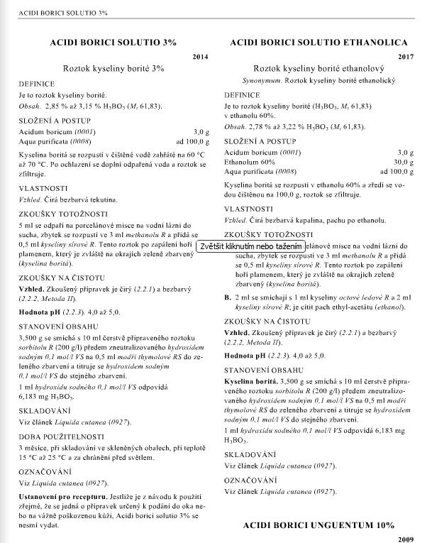
Compounded medications
Examples:
Acidi salicylici unguentum
Aluminii acetotartratis otoguttae
Aqua carminativa
Chloramphenicoli oculoguttae
Hartmanni infusio
Iodi solutio ethanolica
Natrii tetraboratis globulus
Paracetamoli suppositorium
Salia pro gargarismate pulvis
Sirupus simplex
Zinci oxidi pasta

Slide 21
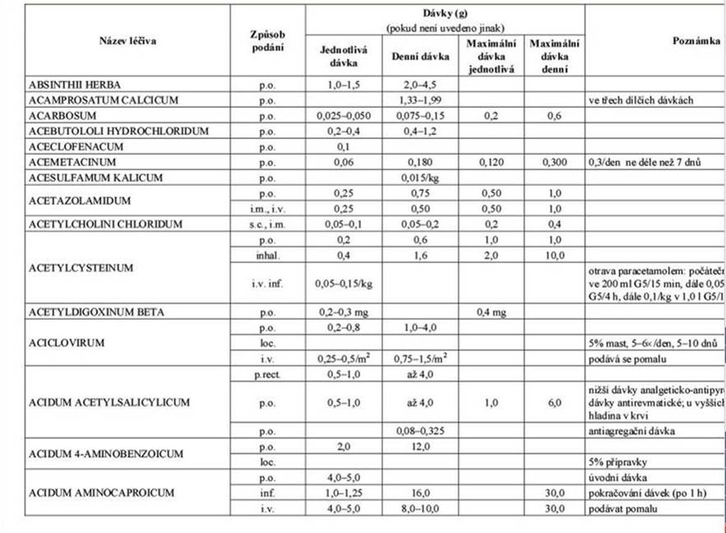

Slide 22
ATC classification system
Active substances – hierarchy with five different levels
14 main anatomical/pharmacological groups or 1st levels
Each main group divided into 2nd levels (pharmacological or therapeutic groups)
The 3rd and 4th levels are chemical, pharmacological or therapeutic subgroups
5th level is the chemical substance

Slide 23
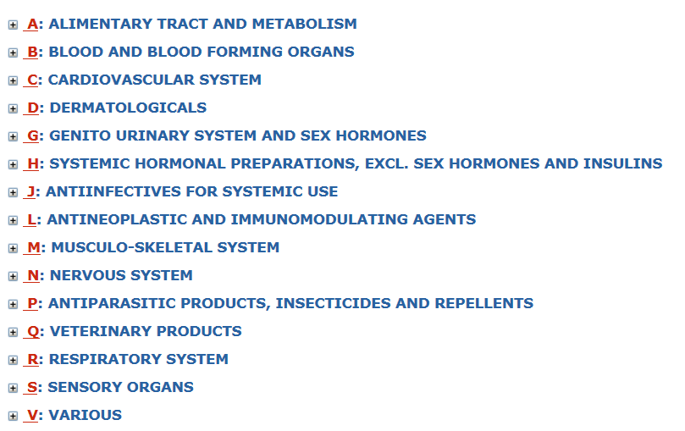

Slide 24
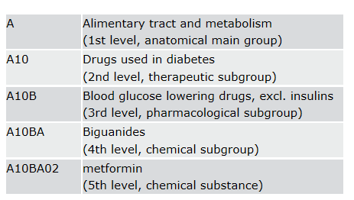
ATC DRUG CLASSIFICATION SYSTEM
ATC code = international alphanumerical code for every individual pharmaceutical substance in defined indication group – see metformin:

Slide 25
