Slide 1
INTRODUCTION TO THE STUDY OF PHARMACOLOGY

Slide 2
Types of treatment
Causal treatment
Targeted against the disease causative
E. g., antibiotics – infections
Symptomatic treatment
Removes or alleviates symptoms only
E. g., antihypertensives – high blood pressure
Substitution treatment
Supplements missing substances
E. g., hormone replacement, coagulation factors
Pharmaco
therapy

Slide 3
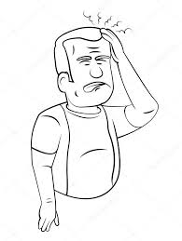
BASIC TERMINOLOGY – repetition of the lecture
The patient suffers from headaches ... TERMS - INDICATION AND CONTRAINDICATIONS The doctor prescribes ... TERM – DRUG, MEDICINES, ACTIVE COMPOUND, EXCIPIENT… What painkillers do you know for headache? Students: "Paralen, Ibuprofen, Ibalgin, Aspirin ..."
TERMS - PHARMACOKINETICS, PHARMACODYNAMICS
Notes:
Pro případ tápání v názvech léčiv lze promítnout slide 20-22 ke zopakování.
https://www.youtube.com/watch?v=Ytiqg2nnzpo

Slide 4
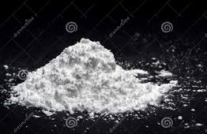
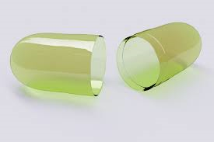
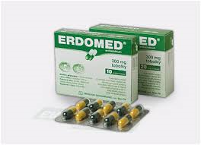
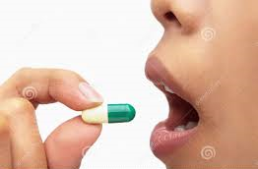
PractiCe
Active pharmaceutical ingredient (API)
Dosage form
Medicinal product
Drug
for a pharmaceutical contains the API, which is the drug itself, and excipients, which are the substances of the tablet, or the liquid the API is suspended in, or other material that is pharmaceutically inert.
Medicinal product administered to a patient
Any substance or combination of substances presented as having properties for treating or preventing disease in human beings
The ingredient in a pharmaceutical drug that is pharmacologically active
Excipient – without its own therapeutic effect, facilitates the manufacture, storage or preparation and administration of API.
Consider: Could an excipient have a pharmacological effect?

Slide 5
BASIC TERMINOLOGY – MEDICINAL PREPARATIONS IN THE CZECH REPUBLIC
Fully reimbursed
RMP
By payment
By the place of formation
Partly reimbursed
IMP
MEDICINES
Non-reimbursable
E-Rx
Prescription drugs
By way of delivery
Paper Rx
Over-the-counter
Over-the-counter with restrictions
Notes:
Dialog se studenty – schéma možno postupně kreslit na tabuli

Slide 6
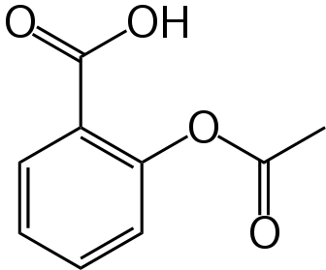
DRUGS NAMES
2-acetyloxybenzoic acid
Acylpyrin,
Aspirin etc.
„tablet needed to be quartered to blood dilution“
acidum
acetylsalicylicum
Acidum acetylsalicylicum
Acetylsalicylic acid
Notes:
Pokud by studenti tápali v názvech léčiv, lze promítnout slide 20-22 ke zopakování

Slide 7
DRUGS NAMES
Chemical name – IUPAC nomenclature
(2-acetoxybenzoic acid)
Generic name – simplified chemical name or trivial names usually with national influence
(acetylsalicylic acid)
International Nonproprietary Name (INN) – for scientific literature and international communication
(acidum acetylsalicylicum)
Pharmacopeial names – similar or same as to INN but in latin
Brand names – registered trade names and marks
(ASPIRIN®)

Slide 8
Some drug-family names
-olol betareceptor antagonists
-caine local anaestethics
-tidine histamine receptor antagonists
-dipine calcium channel blockers of dihydropyridine type
-statin inhibitors of HMG CoA transferase

Slide 9
Prepare:
Presentation – rules of drug prescription in your country

