Slide 1
Essential rules for drug prescription in czechia
Act No. 378/2007 Coll., on Pharmaceuticals | Decree No. 54/2008 Coll., on Prescription
Act No. 167/1998 Coll, on Addictive substances |
Government regulation No. 463/2013, on the List of addictive substances

Slide 2
TYPES OF MEDICinAL PRODUCTS
Manufacturing /
Preparation
RMP
Reimbursement
from health insurance
IPP
Medicinal products
Fully imbursed
Partially imbursed
Not imbursed
Rx
Dispensation
OTC
Restricted distribution OTC

Slide 3
CZECH PRESCRIPTION RULES
Electronic prescription
  Identification of e-Rx = alphanumeric code → QR/bar code
Free of charge for the patient
1 e-Rx covers max 3 months of therapy
Max 2 types of medicines on 1 e-Rx
RMPs can be prescribed using trade name of the preparation or INN of the active substance (rarely used in CZ)

Slide 4
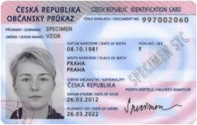
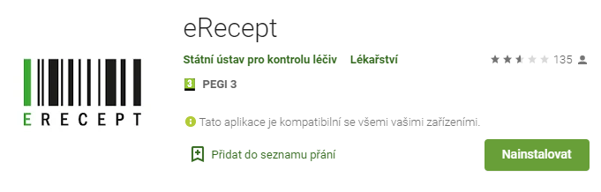
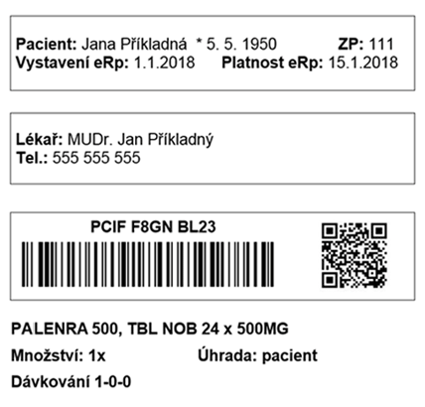
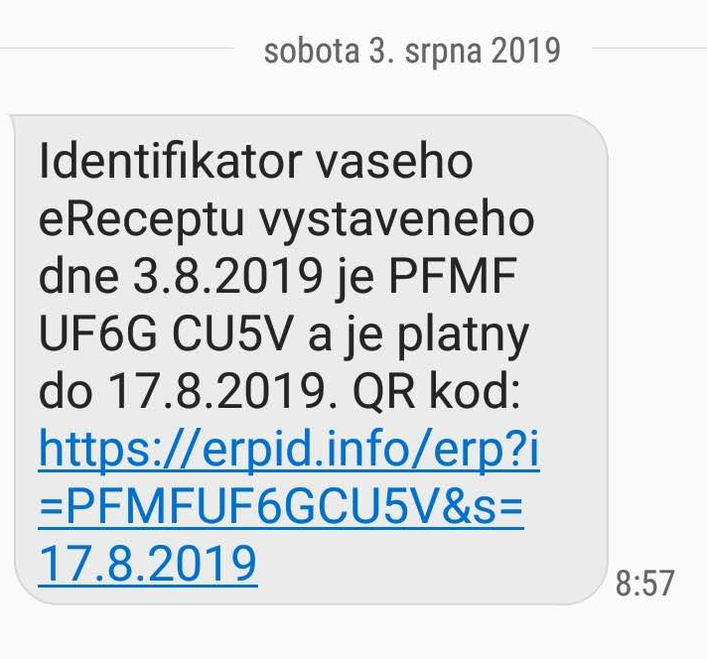
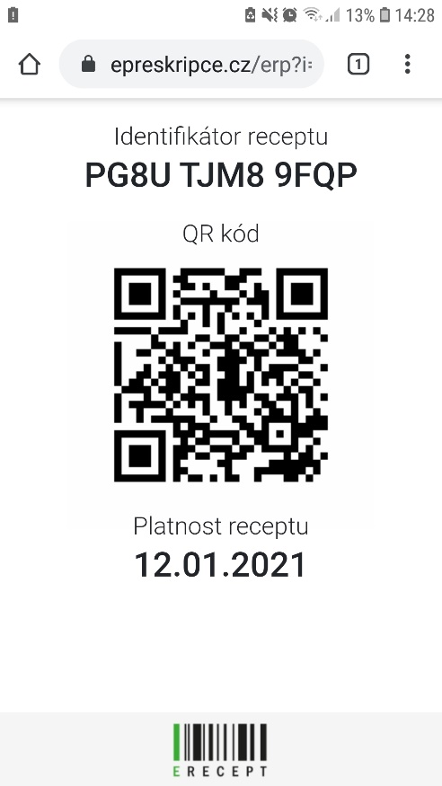
e-Rx TYPES
e-Rx on ID card
e-Rp App
E-mail
Paper „dispatch note“
e-Rp by sms

Slide 5
PAPER Rx
Exceptional, only in justified cases
Not for repeated use
Pharmacist needs to digitalize it – record into the e-Rx system
Only 1 type of medicine
Valid without doctor‘s stamp, but the identification of the doctor need to be present („IČZ“ – identification number of medical facility)
Which situations can justify the use of paper Rx?
Obligatory – specified addictive substances (Rx „with blue strip“)

Slide 6
SIGNS & SYMBOLS
For repeated use (paper Rx: REPETATUR)
Emergency (POHOTOVST)
Ad usum proprium / For family (PRO POTŘEBY RODINY)
No reimbursement (HRADÍ PACIENT)
Higher reimbursement (ZVÝŠENÁ ÚHRADA)
Do not change (NEZAMĚŇOVAT)
Exceeding dose (PŘEKROČENÍ; Paper Rx: !)
Non-authorized medical preparation (NEREGISTROVANÝ)

Slide 7
OVERVIEW OF RX VALIDITY
e-Rx
  14 days + day of issue
  Doctor can extend validity up to 1 year, pharmacist can add another 14 days
Emergency – end of the day following the day of issue
Rx for repeated use – 6 months, max 1 year
Paper Rx – 14 days + day of issue
Rx „with blue strip“ – 14 days + day of issue; extension up to 30 days

Slide 8
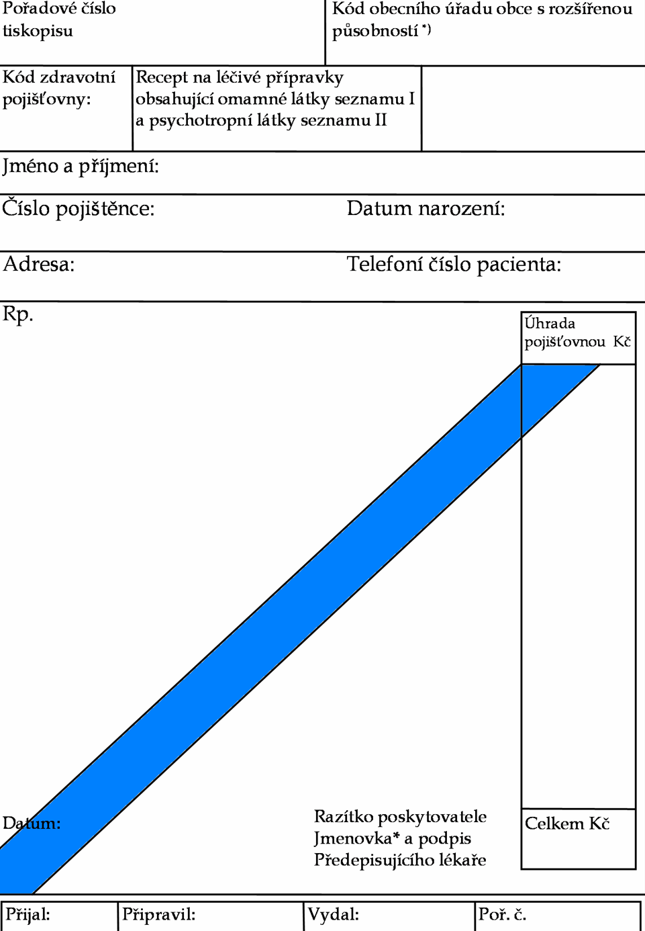
ADDICTIVE SUBSTANCES
Prescription according to the substance classification (Gov. Reg. No. 463/2013, on the List of addictive substances – Appendices 1-8)
Rx „with blue strip“
Appendix 1 + 5 = narcotics (list I), psychotropics (list II) specified in Single Convention on Narcotic Drugs (1961), and Convention on Psychotropic Substances (1971)
Rx is a paper form, 3 pages (1 original, 2 copies)
1 Rx = 1 type of medicine
Specimen of the form is stated in legislation
Validity 14 days + day of issue

Slide 9

ABXY
111
Jan Horák
24.12.1968
6812243234
24. 12. 1968
Kamenice 5, Brno 625 00
549 490 000
VENDAL RETARD 10 mg por. tbl. ret.
POR TBL RET 30×10 mg
Exp. orig. No I (unam)
D.S. Každých 12 hod užít 1 tabletu.
MUDr. Petr Horák
Ambulance ORL
Pekařská 18, BRNO
tel. 543 210 123
IČZ: 720001
26. 10. 2020

Slide 10
SYSTEM OF SHARED MEDICATION RECORDS („LÉKOVÝ ZÁZNAM“)
New healthcare IT system activated on 1st June 2020
Contains all issued e-Rx for an individual patient
Doctors, pharmacists and clinical pharmacists are allowed to look for all e-Rx of a patient whom they take care of (no free browsing/searching in the data)
Doctors: 5 years history; pharmacists: 1 year
Check for prescription duplicities, drug interactions, contraindications, adverse effects…
Taking pharmacological anamnesis is easier – doctor is not relying solely on the information from the patient

