Slide 1
Factors influencing drug effects. Influence of accompanying diseases on drugs effects.

Slide 2
Copyright notice The presentation is copyrighted work created by employees of Masaryk university. Students are allowed to make copies for learning purposes only. Any unauthorised reproduction or distribution of the presentation or individual slidesis against the law.

Slide 3
Overview of factors
A. Factors related to drug:
Physical and chemical properties
Dose
Drug form
Combination of drugs
Food administered together with a drug
Repeated administration
B. Factors related to organism:
Age
Gender
Weight and body constitution
Circadian rhytms
Pathological state of organism
Genotype/fenotype
(Race group/ethnic group)

Slide 4
A. Factors related to drug
Physical and chemical properties
Drug dose
III. Drug dosage form
IV. Drug combination with other drugs
V. Food administered together with a drug

Slide 5
I. Physical and chemical properties of drug
Influence on the transport trough membranes
Chemical configuration
Size and shape of the molecule
Solubility in water and fats
Acidobasic properties

Slide 6
Relationship of chemical structure to PK
ISMN
ISDN
ISDN is more lipophilic than ISMN
ISDN may be administrated sublingually
ISMN is almost not subject to the hepatic FPE
Another example: atenolol x metoprolol

Slide 7
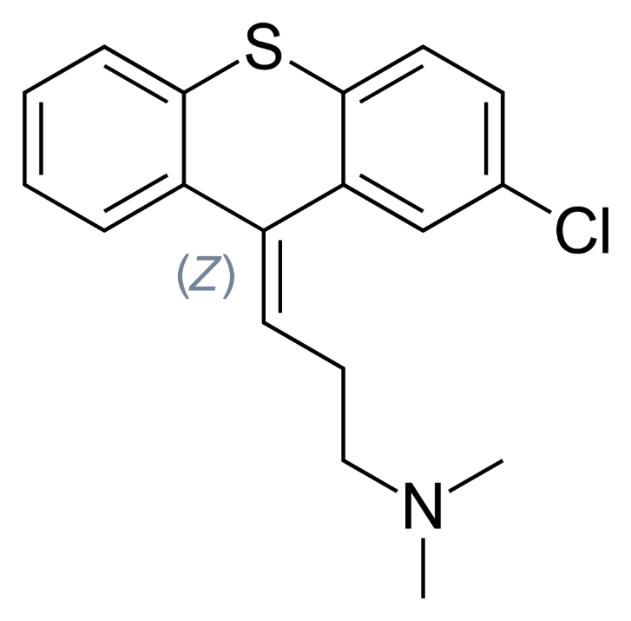
Stereoisomerism
Cis-trans isomerism: only the cis form of chlorprothixene is efficient

Slide 8
II. Drug dose - dosage
In preclinical trials
In clinical trials phase I: MTD (maximal tolerated dose)

Slide 9
Drug information sources
SPC = summarizing information about MP
(Summary of Product Characteristics)
part of the marketing authorisation of a medicinal product
AISLP - electronic drug information database for MP
SÚKL MP database (state authority for control of drugs)
Czech pharmacopoeia

Slide 10
III. Drug dosage form
definition:
a substance or combination of substances presented as having therapeutic or preventive properties administered to set the medical diagnosis.

Slide 11
III. Drug dosage forms
1st generation – conventional DDF
2nd generation with controlled release
with prolongated release (SR,XR...)*
transdermal therapeutic system (TTS)
gastrointestinal therapeutic system
3rd generation with targeted drug delivery
*SR=sustained release, slow release
LA=long acting, SA=slow acting, XR=extended release
CR=continuous (controlled) release, retard atd.

Slide 12
IV. Combinations of drugs
The effect is
S y n e r g i s m
Summation: both drugs have the same (similar) effect and, if we combine them, the final effect is a sum of all effects, which the drugs would have when administered in monotherapy
one-sided : analgetics anodynes + narcotics
two-sided : combination of cytostatics
Potentiation
one-sided : Ca²⁺ + digoxin
two-sided : digoxin + thiazide diuretics

Slide 13
IV. Combinations of drugs
The effect is
A n t a g o n i s m
pharmacological (histamine x cetirizine)
physiological (histamine x salbutamol)
chemical (heparin x protamin sulfate)
(metals x dimerkaprol, EDTA)

Slide 14
V. Food intake
PD interactions
- non-selective inhibitors of monoaminooxidase increase the bioavailability of tyramine from food (fermented food is risky, e.g. some cheese, red wine, smoked meat, bananas) -> risk of excessive wash out of catecholamines and hypertensive crisis
- food with high content of vitamin K (e.g. broccoli) can decrease the effect of warfarin (vitamin K antagonist)
PK interactions
- more often- influence at the level of absorption, but also in metabolism and excretion

Slide 15
V. Pharmacokinetic interactions with food
Food can:
slow down drug absorption without changing its bioavailability (inappropriate in analgetics, hypnotics…)
decrease bioavailability
increase bioavailability

Slide 16
B. Factors related to organism
Age
Gender
Weight and body constitution
Circadian rhythms
Pathological conditions of organism
Genotype/phenotype

Slide 17
Age
Administration of medicinal product (MP)
to children
to elderly people

Slide 18
Administration of MP to children
approximate dose for children =
body surface area (m²) x dose for adult/1,7 (m²)

Slide 19
Administration of MP to children
A child is not a miniature of an adult
particularities of PD
particularities of PK

Slide 20
Particularities of PK of drugs in child
Particularly on newborns (especially premature):
relatively bigger volume of extracellular liquor
lower binding on plasma proteins
unfinished development of hematoencephalic barrier
immaturity of enzymatic systems
Immaturity of renal functions

Slide 21
Administration of MP to old people
60 – 74 older person
75 – 89 elderly
> 90 longevity
physiological changes
multimorbidity
polypragmasia (administration of many drugs together, risk of drug interactions is increasing)
higher incidence and severity of adverse effects

Slide 22
Changes of PK of drugs in old age
absorption (passive diffusion of subacid substances thanks to hypoacidity, active transport is decreasing)
binding on plasma proteins
elimination: decrease of blood flow through kidneys and GFR, flow through liver and activity of redox enzymes
=> Prolongation of t_{1/2}
(e.g. digoxin, aminoglykoside atb)

Slide 23
Changes of PD in old age
Very variable
Tissue hypoxia
Dysfunction of regulatory mechanisms
Change of sensibility of target structures
= hyperergic reaction

Slide 24
Changes of PD in old age
Examples:
ATB aminoglycosides: lower doses in case of lower GF
Antihypertensives: orthostatic hypotension, psychical alternations (confusion)
Anticoagulants: bleeding from GIT (decreased absorption of vitamin K and decreased synthesis of prothrombin)
NSAID: in 25% hematemesis
Anticholinergic drugs: higher toxicity, depression, confusion

Slide 25
Gender
Women are in general more sensitive to effects of some drugs, e.g. because of lower weight, but also of lower CL
Specific periods are:
menstruation
gravidity
lactation
menopause

Slide 26
Pregnancy
slowed stomach and intestinal motility
increased volume of plasma, body water can be raised up to 8 litres
hypoalbuminemia, occupancy rate of plasma proteins by hormones
increased blood flow through kidneys and increase of GFR

Slide 27
Weight and body constitution
In many cases drugs are dosed in consideration to the weight of the patient (it’s recommended to use dosing per 1kg of body weight, respecting the patient’s age)

Slide 28
Pathological state of organism
Influence of lesion/renal dysfunction, liver and thyroid gland on pharmacokinetics
Influence of pathological state on pharmacodynamics

Slide 29
Hypofunction of kidneys
The most common reason for a drug dose adjustment
Customisations of dosage in accordance to the tables – GFR is a clue
For the majority of drugs, the customisation of the dosage means prolongation of intervals (AMG, vancomycin)
In drugs with very long t_{1/2} we keep the same interval, but administer a lower dose (digoxin)

Slide 30
Influence of liver diseases
No reliable quantitative criteria is available for measuring impaired liver elimination capacity (analogy CL_{cr} in kidney dysfunctions)
Liver function tests (aminotransferases, albumin, blood coagulation factors) are not a good clue for the dosage of drugs

Slide 31
In persons with liver diseases
Prefer drugs eliminated mostly by kidneys, if possible (or those whose kinetics is not disturbed by liver hypofunction) e.g. atenolol
Prefer drugs acting directly – without activation of biotransformations in liver (lisinopril x enalapril)
Think about the possibility of increased biol. availability when drugs with high first-pass effect are administered orally (e.g. metoprolol)

Slide 32
Genetic factors
The drug response varies among individuals qualitatively and quantitatively
interindividual variability – polymorphism
Genetic factors influence PD and also PK

Slide 33
Genetic factors
Genetic polymorphism = existence of several (at least two) alleles for a concrete gene, the least frequent one of which has the population frequency at least 1%
Pharmacogenetics
focused on studies of genetically conditioned variability in response of the organism to a drug
(Pharmacogenomics investigates the relationship of drug effect at the level of the whole genome)

