Slide 1
Analyze of the genome – GWAS and GRS

Slide 2
Structure
Terminology
The human genome project
HapMap
GWAS
GWAS and oral cavity disease
GRS

Slide 3
Terminology
Allele
Locus
Single nucleotide polymorphism (SNP)
Haplotype
Linkage disequilibrium (LD)
Imputation
Genome wide association studies (GWAS)
Genetic risk score (GRS)

Slide 4
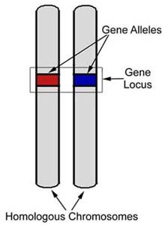
Allele a locus
Allele is specific variant of the gene
Locus determine specific position on
the chromosome

Slide 5
Single nucleotide polymorphism (SNP)
One nucleotide change with frequency higher than 1% in given population. This change does not have to impact function of the gene or protein.

Slide 6
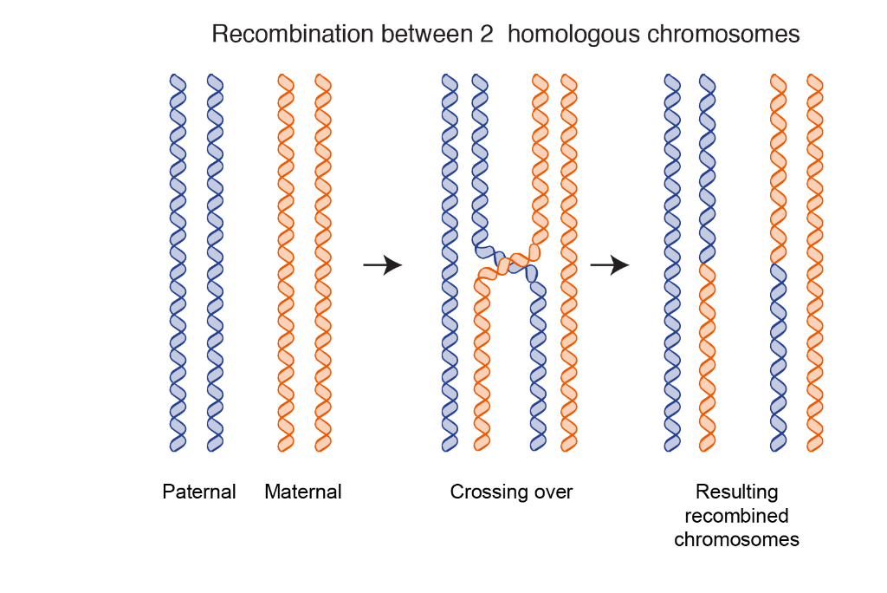
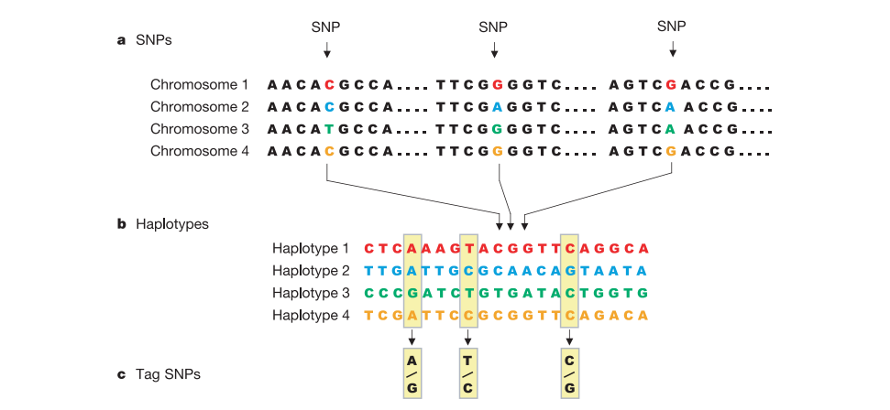
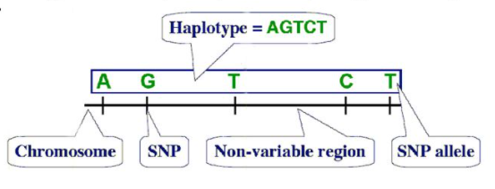
Haplotype
It is combination of alleles on different parts of the DNA
(usually one chromosome or its part) which are inherited
together
Kombinace SNP, které se společně dědí

Slide 7
Linkage disequilibrium (LD) and imputation

Slide 8
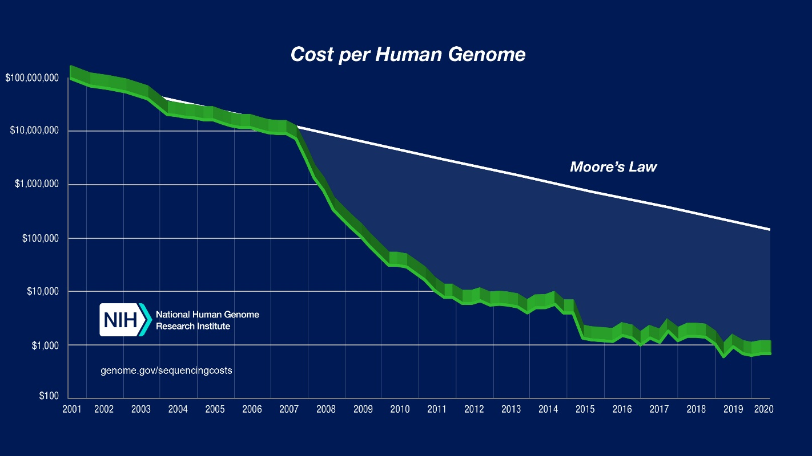
Human genome project
Started in 1980´s, results published in 2001
Estimated cost approx. $3 billions and 50 thousand „man-years“
Approx. 1/3 of cost for moon landing
At the beginning under the jurisdiction of Department of Energy of the USA (labs and scientist all over the world
were enrolled), later private company
started to compete (Celera Genomics)
Race in the sequencing has begun

Slide 9
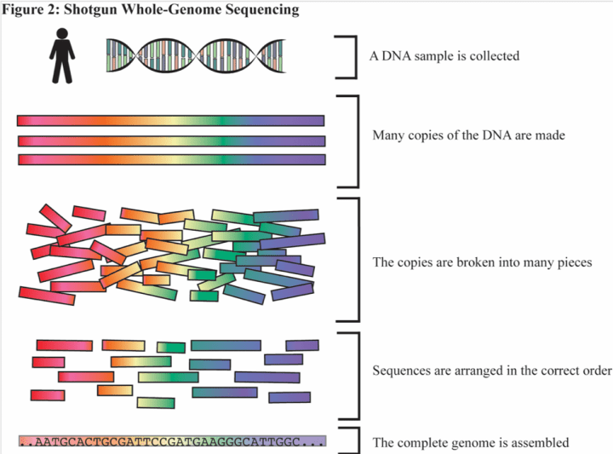
Human genome project
Celera wanted to keep its result private and
sell them for profit – in the contrast to
the government project
Results were published at 15.2.2001 in the
Nature (gov.) and 16.2.2001 in the Science
(Celera project)
Map of human genome was established,
but without variability between individuals

Slide 10
The HapMap Project
DNA between each other is different in only about 0.1% of nucleotides - most commonly SNPs, which is known about 10 millions. These SNPs represents about 90% of total genome variability (rest are mutation, deletion and insertion)
Based on math and statistic approx. 45 unrelated samples should be able to find 99% of all haplotypes with frequency higher than 5%

Slide 11
The HapMap Project
Started in 2002 – two phases – at first production of „blank map“ and then fill up the blank spaces
In the first phase was found about 1 mil of SNPs – results in 2005
Second phase found another 2 mil of SNPs – results in 2007
Discovery of approx. 1 mil of LD blocks
Scientists from all over the world were enrolled
Samples from USA, China, Japan, Kenya, UK, Canada

Slide 12
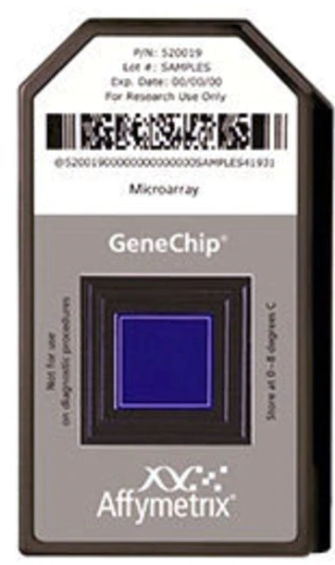
Genome-wide association studies (GWAS)
Combination of epidemiologic studies and new possibilities of genotyping
Ten thousands up to hundred of thousands of SNPs are determined (+ imputation and LD)
Need for huge set of patients, thousands more likely tens of thousands (control group + group with studied phenotype)
Necessary to proper describe phenotype of both, patients and control group

Slide 13
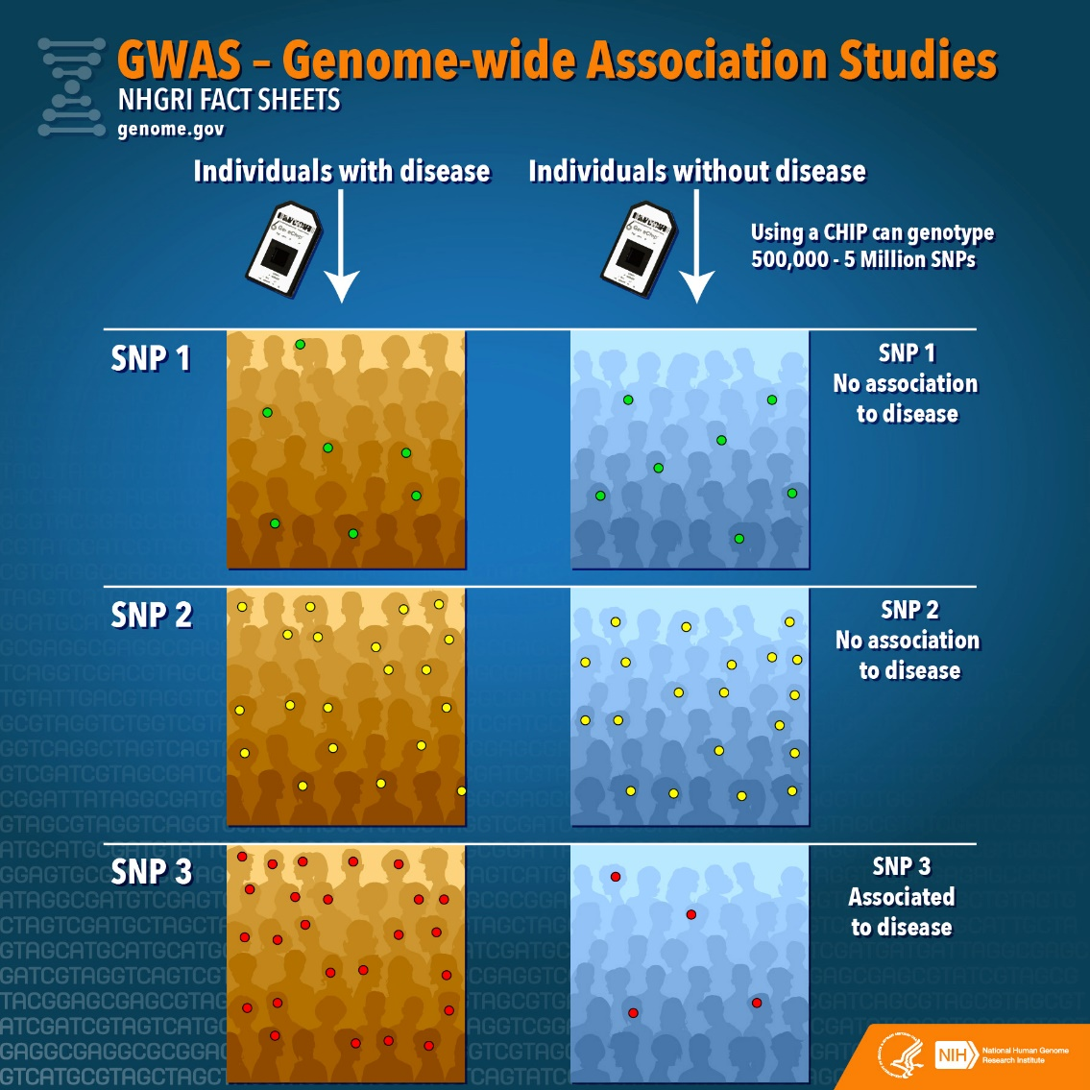
GWAS

Slide 14
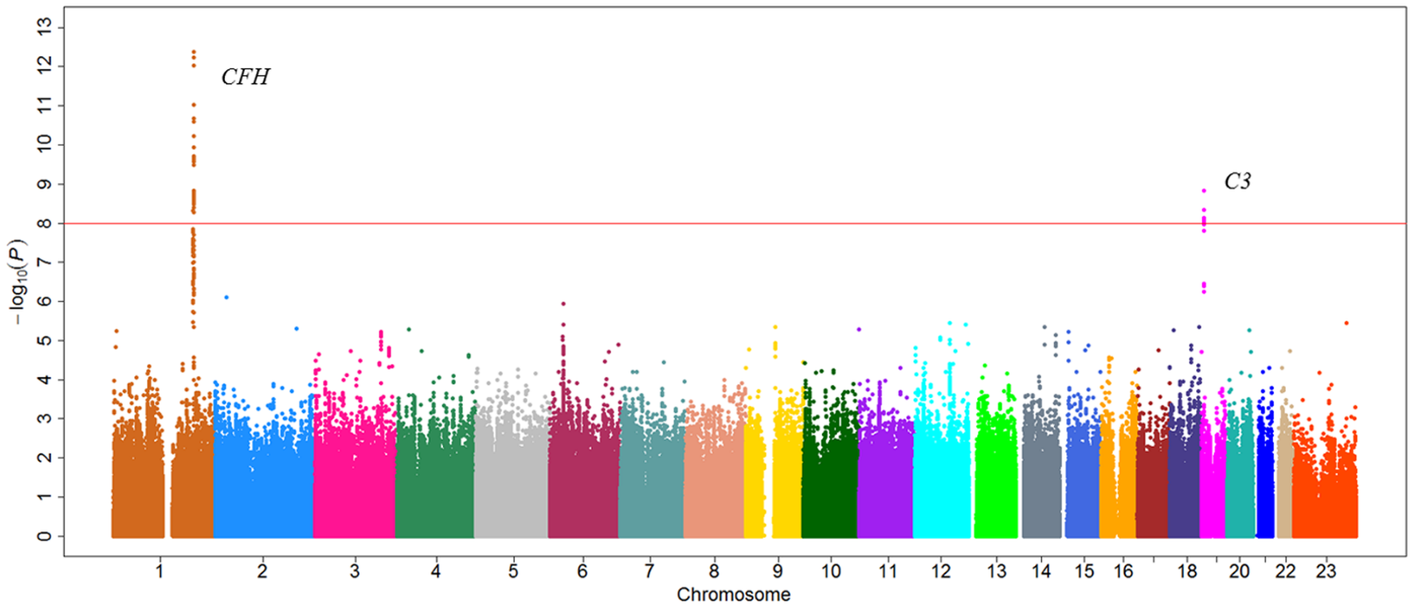
GWAS
Great computing power is necessary for evaluation (approx few GBs for one patient and approx. 15 TB for 10 000 patients)
As statistically significant is
considered P < 5*10⁻⁸
P values between
1*10⁻⁶ to 5*10⁻⁸ are further
replicated for possible
association

Slide 15
GWAS – pros and cons
+
-
Successful method for findings of new variants associated with given phenotype
Approx. 40 000 SNPs associated with different traits (cancers, T2DM, anorexia, depression, schizophrenia, BMI, insomnia,…)
Could lead to discovery of new biological mechanism
Study of associated SNPs and their function
Wide clinical application
Identification of risk groups of patients
Genetic risk score
GWAS are able to explain differences between various ethnics in the complex trait
E.g. T2DM
Each variant, by itself, have very limited indicative power
Huge amount of patient is needed
Due to high demand for statistical power
SNPs associated in GWAs represent only portion of inheritability of complex diseases
It is estimated that 1/3 to 2/3 of total heritability of complex diseases
GWAS are able to find only locus associated with trait, not specific SNP
Another steps for determination of specific SNP are needed
Can not find all variants associated with defined trait
Hard to find common variant with low effect or very rare variants with big impact

Slide 16
GWAS – pros and cons
+
-
Can find genetic variants with low frequency in population
Bigger set of patients, rarer SNPs can be associated
Data can be used in another use
Determination of ancestry, estimate place of birth, forensic analysis, paternity,…
Data can be loaded and shared to public databases
Data presented so far represent only tip of the iceberg
Bigger set of patients the better information we can get
Reliable genotyping technology
Cheap method (price/performance ratio)
Population stratification
Differences in allele frequency between patient and controls can be caused by different ancestry rather than association for the gene with specific trait
Limited clinical predictive ability
Rare to predict disease based on specific variant
GRS
Need to know genetic background of investigated population
LD can differ between ethnics
Could be problem in native Americans, island nation in Pacific, Pygmy
Does not count with gene-environment interaction
Big team with various expert is needed for this kind of study

Slide 17
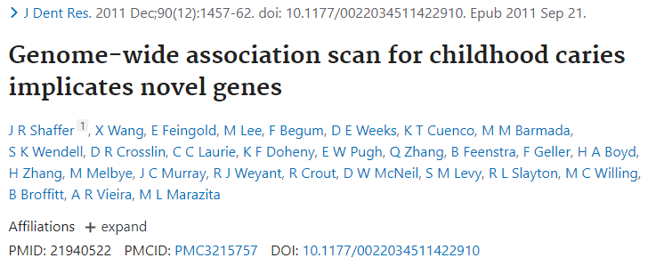
What does the studies say?
First GWAS studying childhood caries
1305 children at age 3-12 years
Genotyped 580 000 SNPs, with imputation 1,4 M SNPs
No significant SNPs found

Slide 18
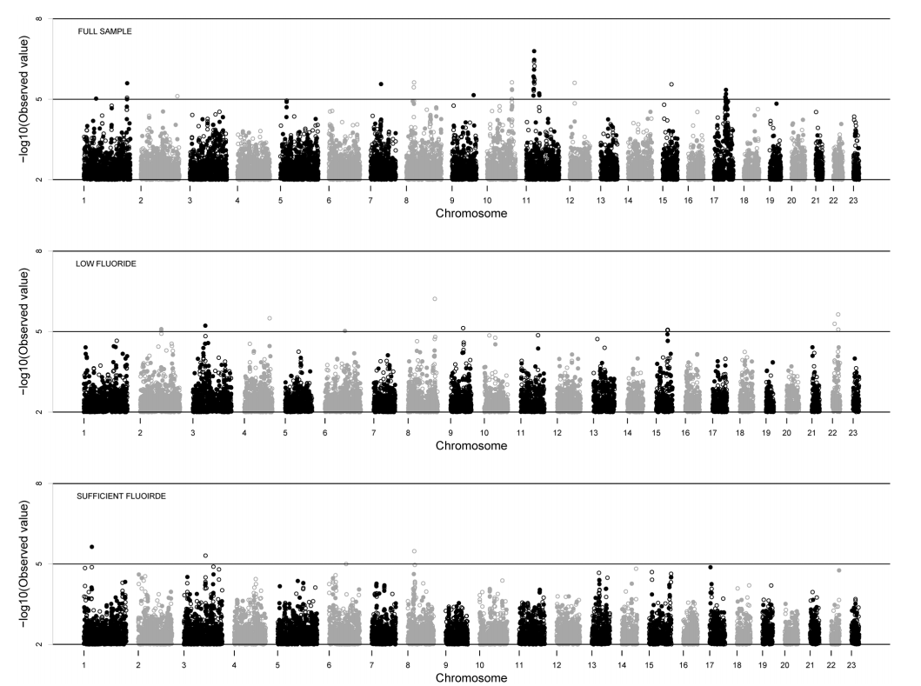
Shaffer et al.
No significant SNPs were found

Slide 19
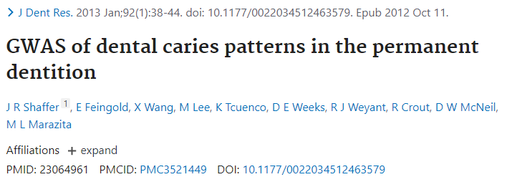
Shaffer et al.
920 participants at age18-75 years
520 000 SNPs
Patients were divided into groups based on DMFS (decay-missing-filled surface index)

Slide 20
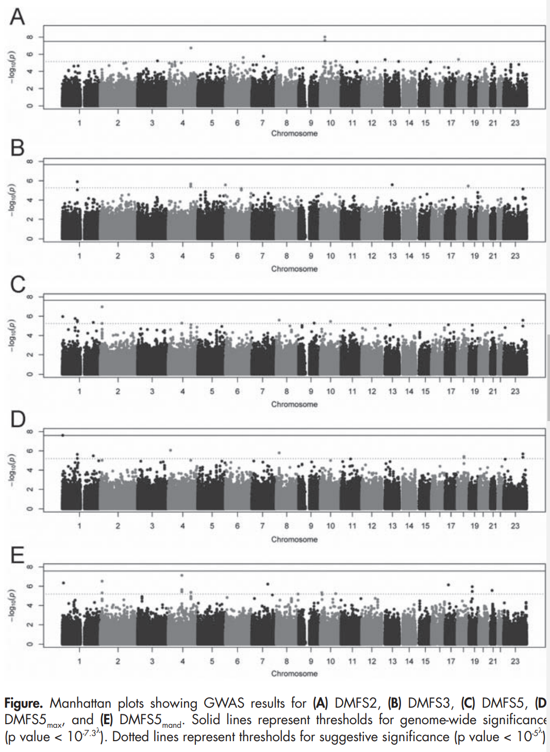
Two significant locus were found
AJAP1 – involved in development of the tooth together with MMP
LYZL2 – lysozyme-like gene, bacteriolytic factor
Another 31 „suspicious“ loci

Slide 21
Zeng et al.
Two sets of patients – 1006 children at age 3-12 (SM) and 979 children at age 4-14 (PF)
DMFS divided into two phenotypes – smooth teeth surface and teeth with fissure
Genotyped 530 000 SNPs, with imputation 1 200 000 SNPs

Slide 22
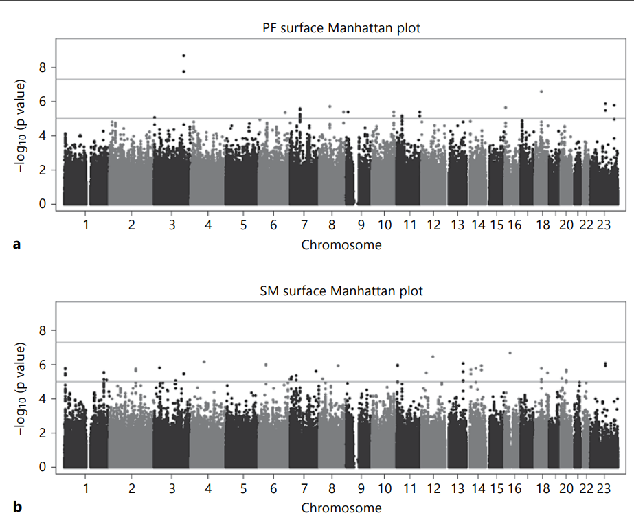
In PF group KPNA4 gene was
significantly associated
No statistically significant association
in SM group
Another 5 suspicious loci

Slide 23
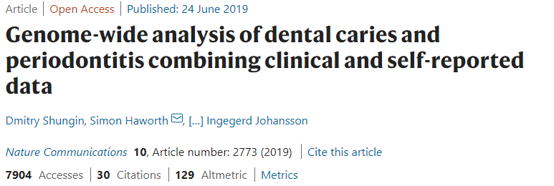
Shungin et al.
Two biobanks were used – UKB and GLIDE (Gene-lifestyle interactions in dental endpoints)
Over 500 000 patients
Genotyped approx. 500 000 SNPs + imputation (together 8.9M SNPs)
47 new variants were associated with dental caries

Slide 24
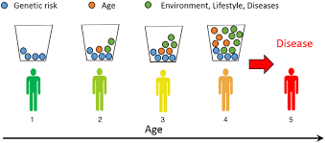
Genetic/polygenic risk score (GRS/PRS)
Number, determining risk of development of observed phenotype
Weighted and unweighted

Slide 25
Genetic/polygenic risk score (GRS/PRS)

Slide 26
Morelli et al.
40 most strongly associated SNPs from the GWAS and they constructed unweighted GRS
Theoretical values 0-80, mean 37,1 ± 3,9; range of values 24 – 52
European-American population

Slide 27
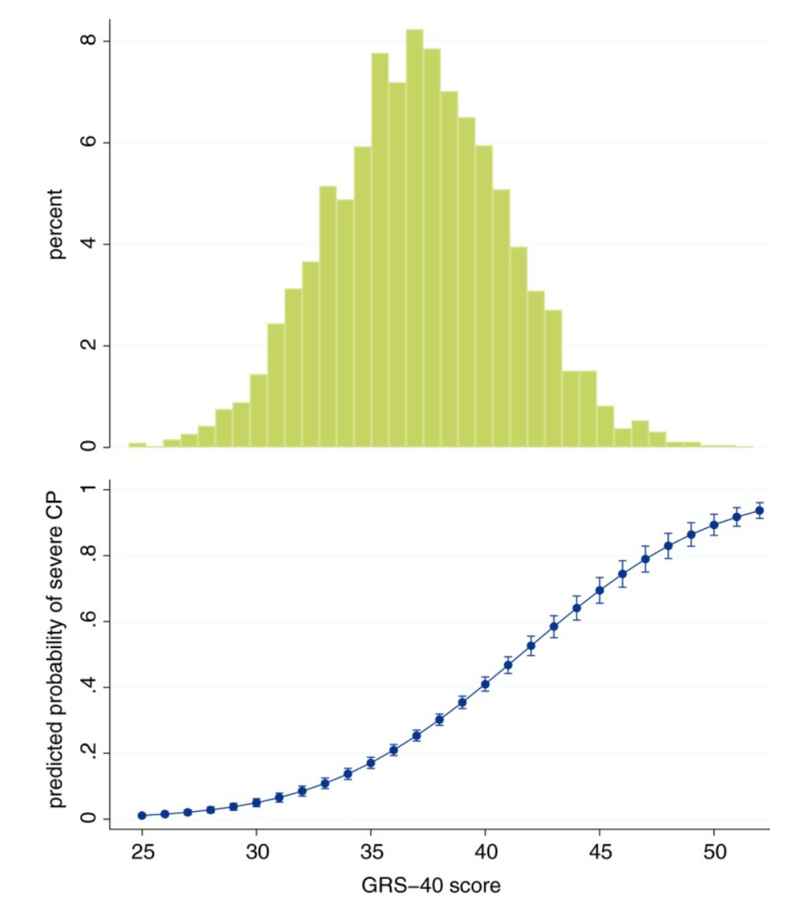
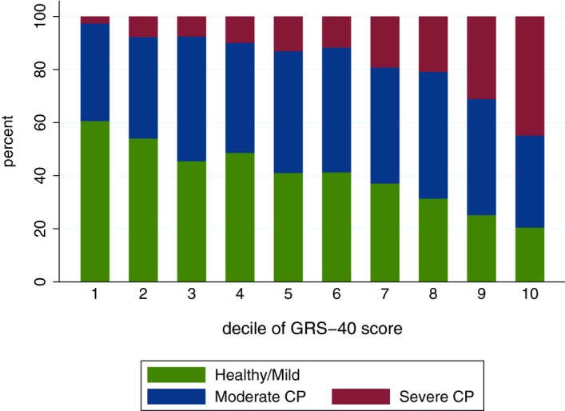

Slide 28
Morelli et al.
Authors posted three reasons why these score need further adjustment
SNPs used in this study were associated only on one set of patients – does not have to be true for other ethic groups. At first validation ad replication of the results are needed
Participants were at middle age and only European-American ancestry
Other factors than genetic may play a role on progression of diseases in the oral cavity (habits, socio-economical status, dental care access)
Tendency to create universal GRS for all people capable of determining individual risk for particular disease. These individuals could be under more frequent screening, they could alter their habits,…

Slide 29
Conclusion
Era before GWAS
What are the GWAS – pros and cons
Summarizing of recent GWAS studies
Construction of GRS

Slide 30
Recommended literature
Interview with Eric Lander:
https://www.ceskatelevize.cz/porady/10441294653-hyde-park-civilizace/220411058090919/

