Slide 1
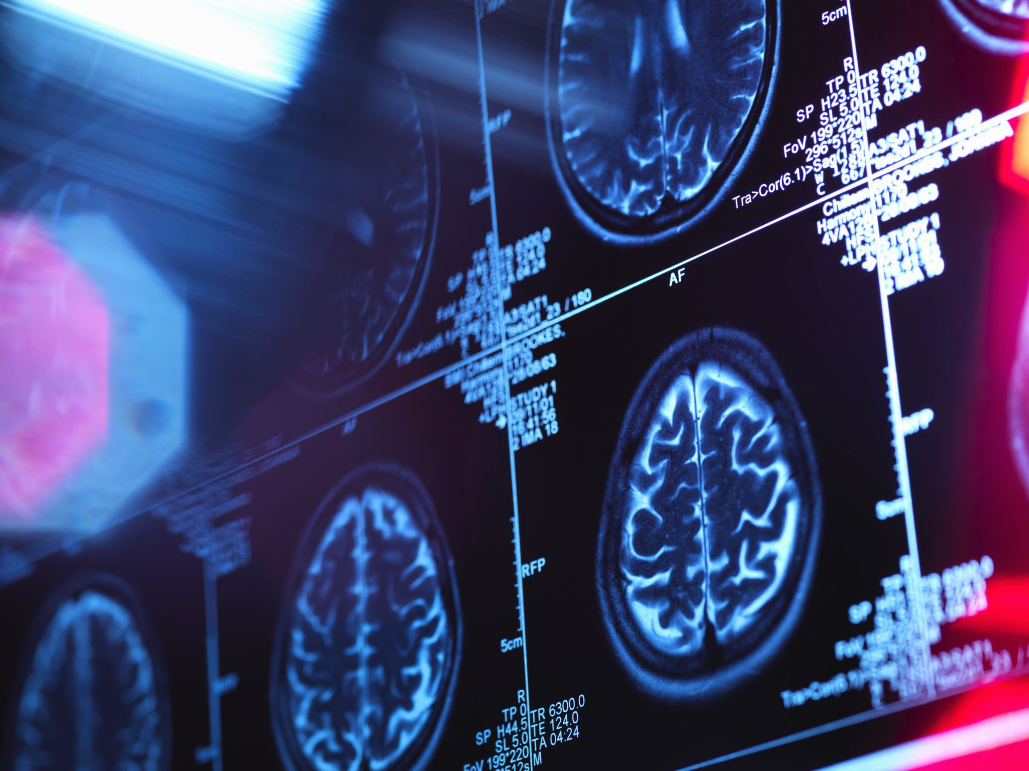
Clinical anatomy of cranial nerves
MUDr. Erik Kročka

Slide 2
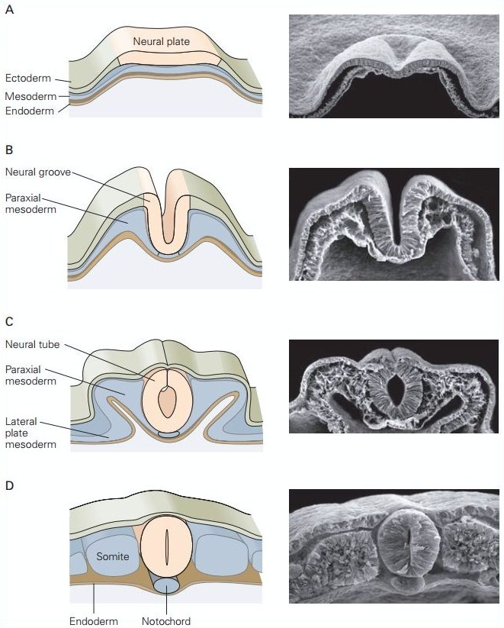
Development of the CNS – neural tube
Neural plate
Neural groove
Neural tube

Slide 3
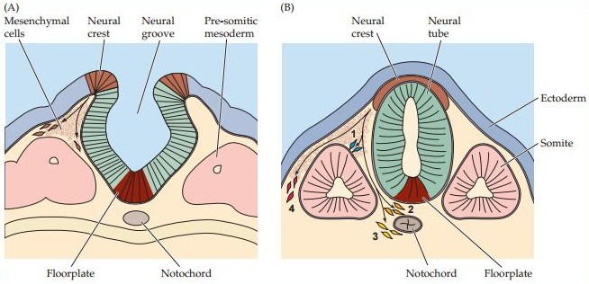
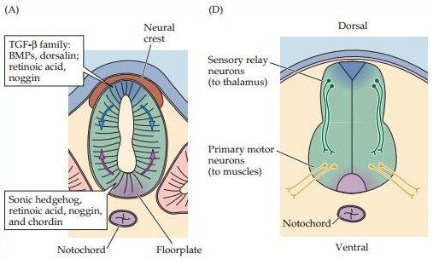
Development of the CNS – neural tube
Basal plate (roof plate)
Alar plate (floor plate)
Sulcus limitans
Neural crest
Ventricular (ependymal) layer
Intermediate (mantle) layer
Marginal layer

Slide 4
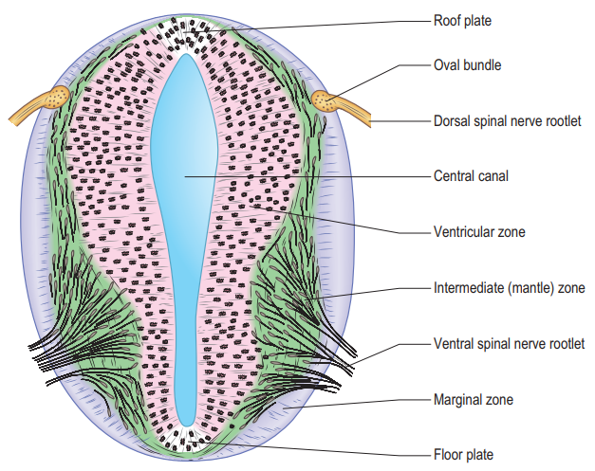
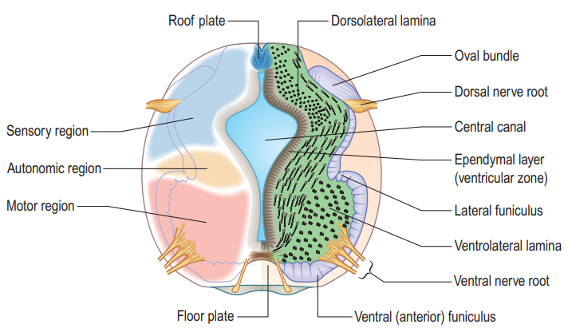

Slide 5
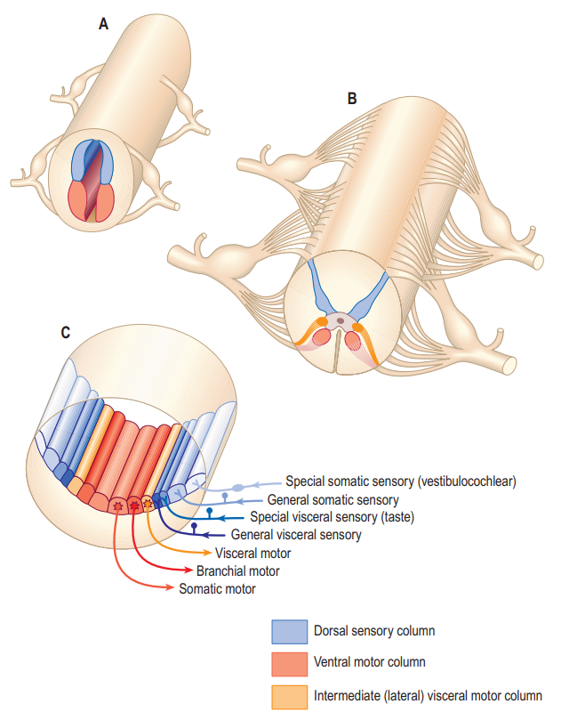
General visceral afferent column
Special visceral afferent column
Dorsal column
(Alar plate)
General somatic afferent column
Special somatic afferent column
General somatic efferent column
Ventral column
(Basal plate)
Branchial efferent column
General visceral efferent column

Slide 6
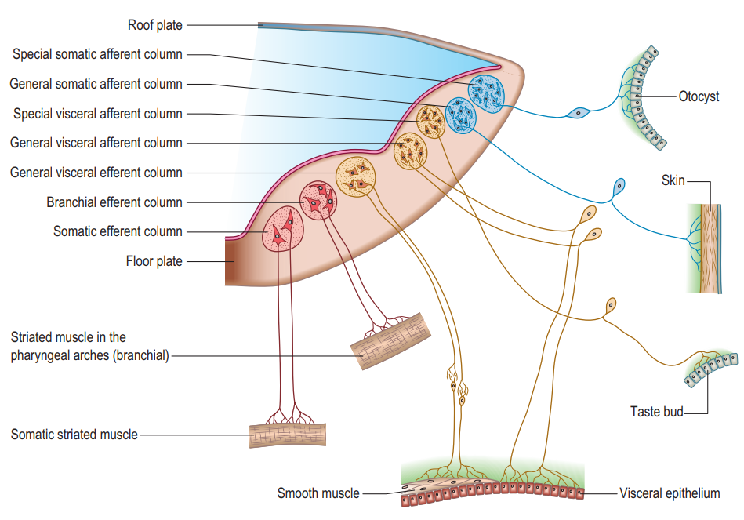

Slide 7
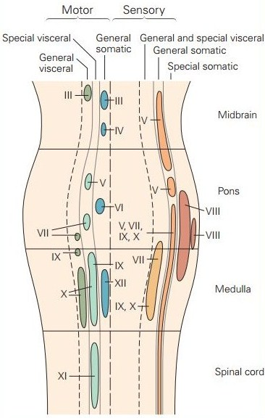
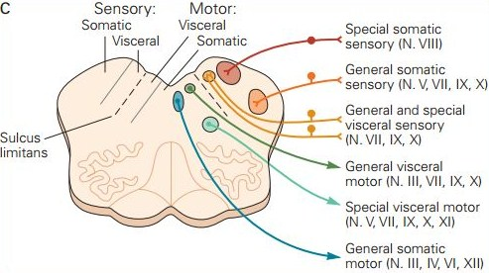

Slide 8
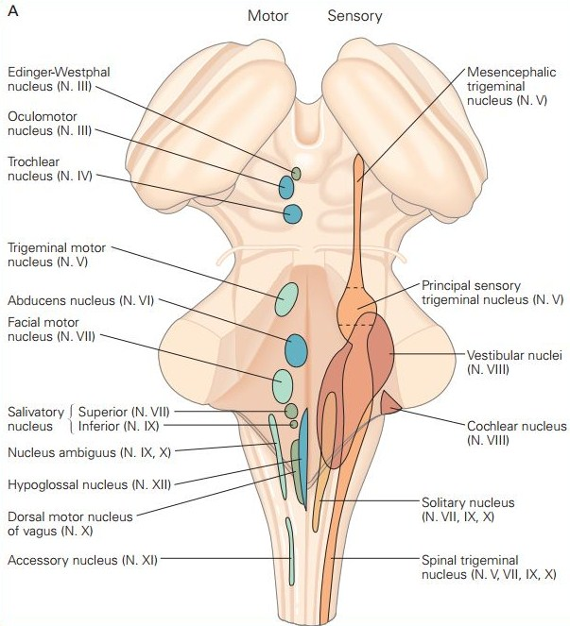
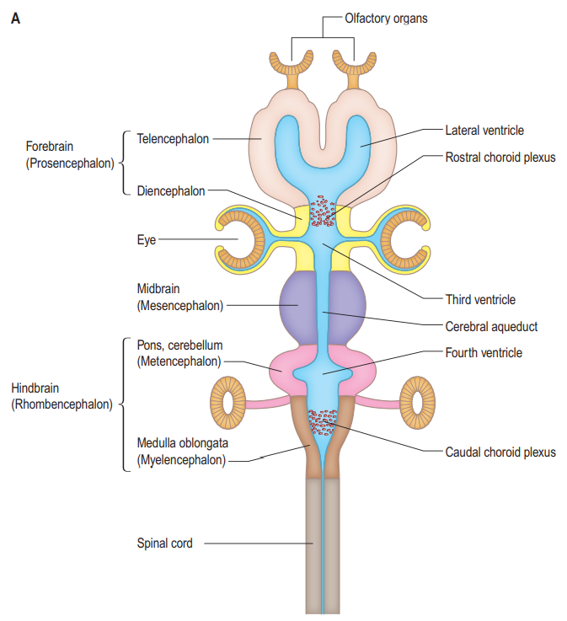

Slide 9
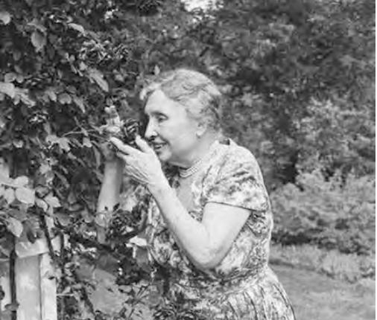
Olfactory nerve (n. I)

Slide 10
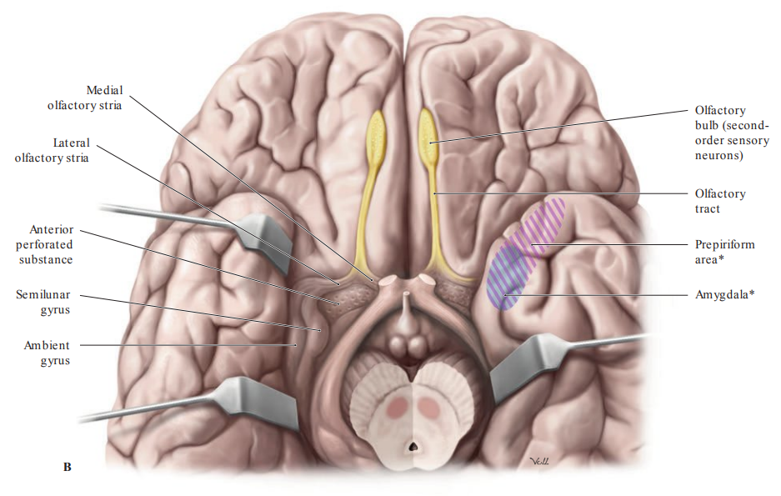
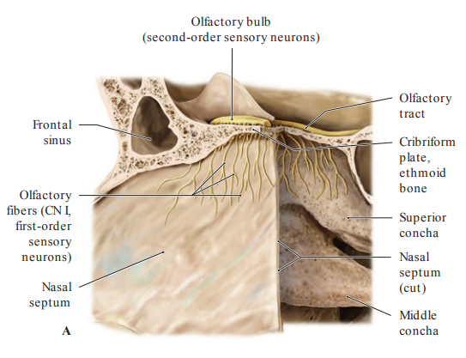
part of the telencephalon, not really a cranial nerve in the conventional sense
humans belong to microsmatic vertebrates → a poor sense of smell
olfactory area is approximately 5 cm² (10⁷ olfactory cells)
humans can distinguish ca. 10 000 smells
the olfactory neurons can regenerate

Slide 11
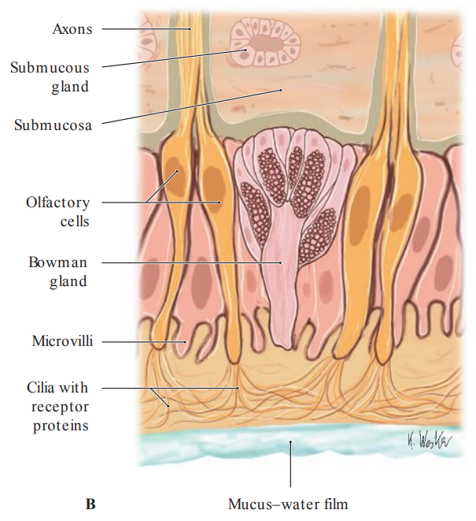
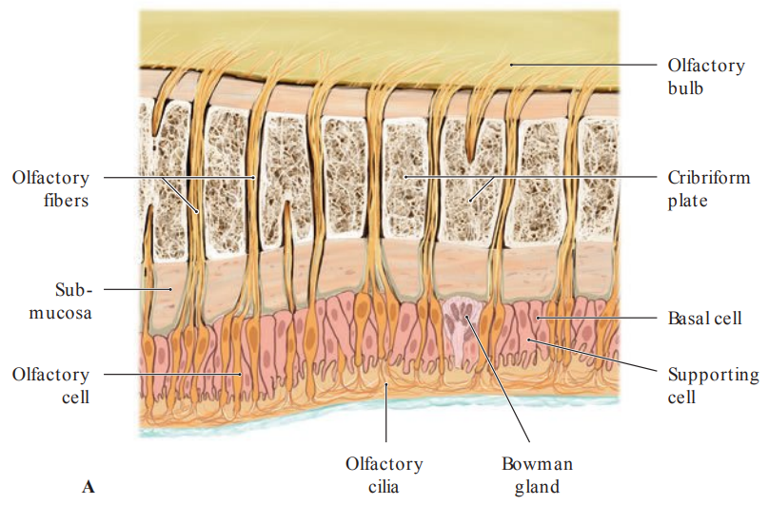

Slide 12
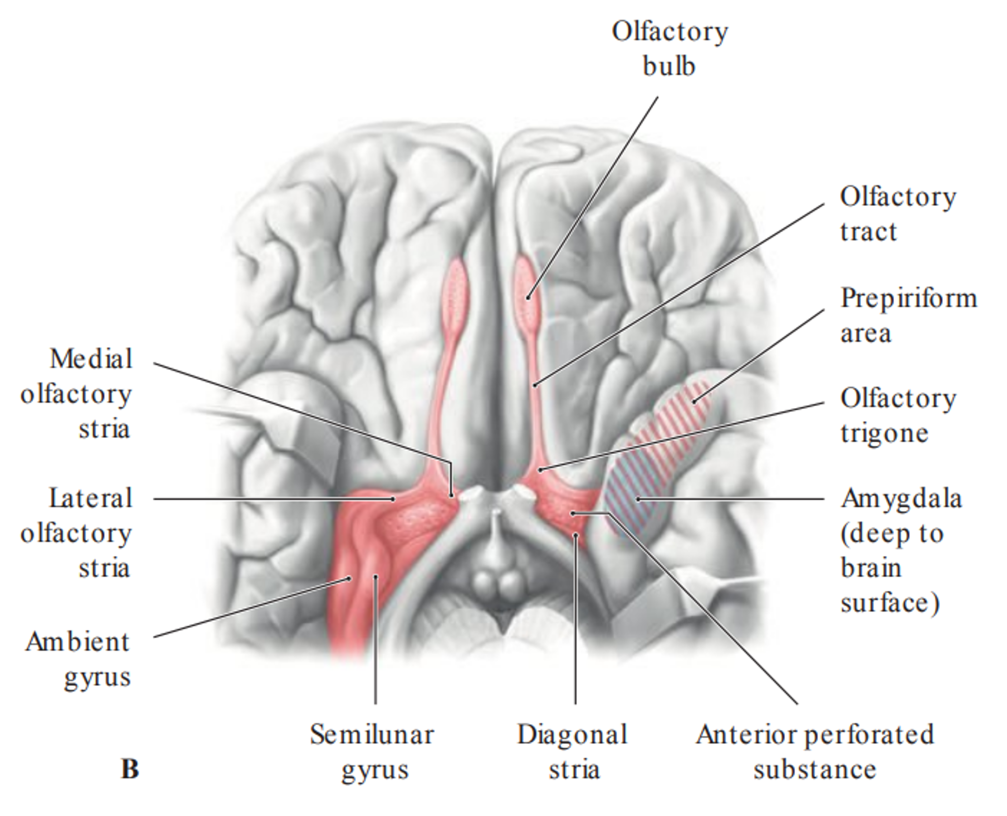
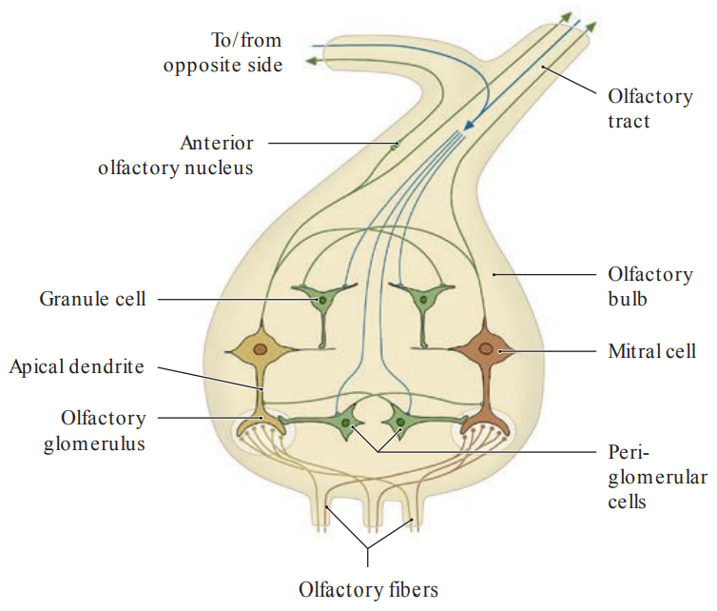

Slide 13
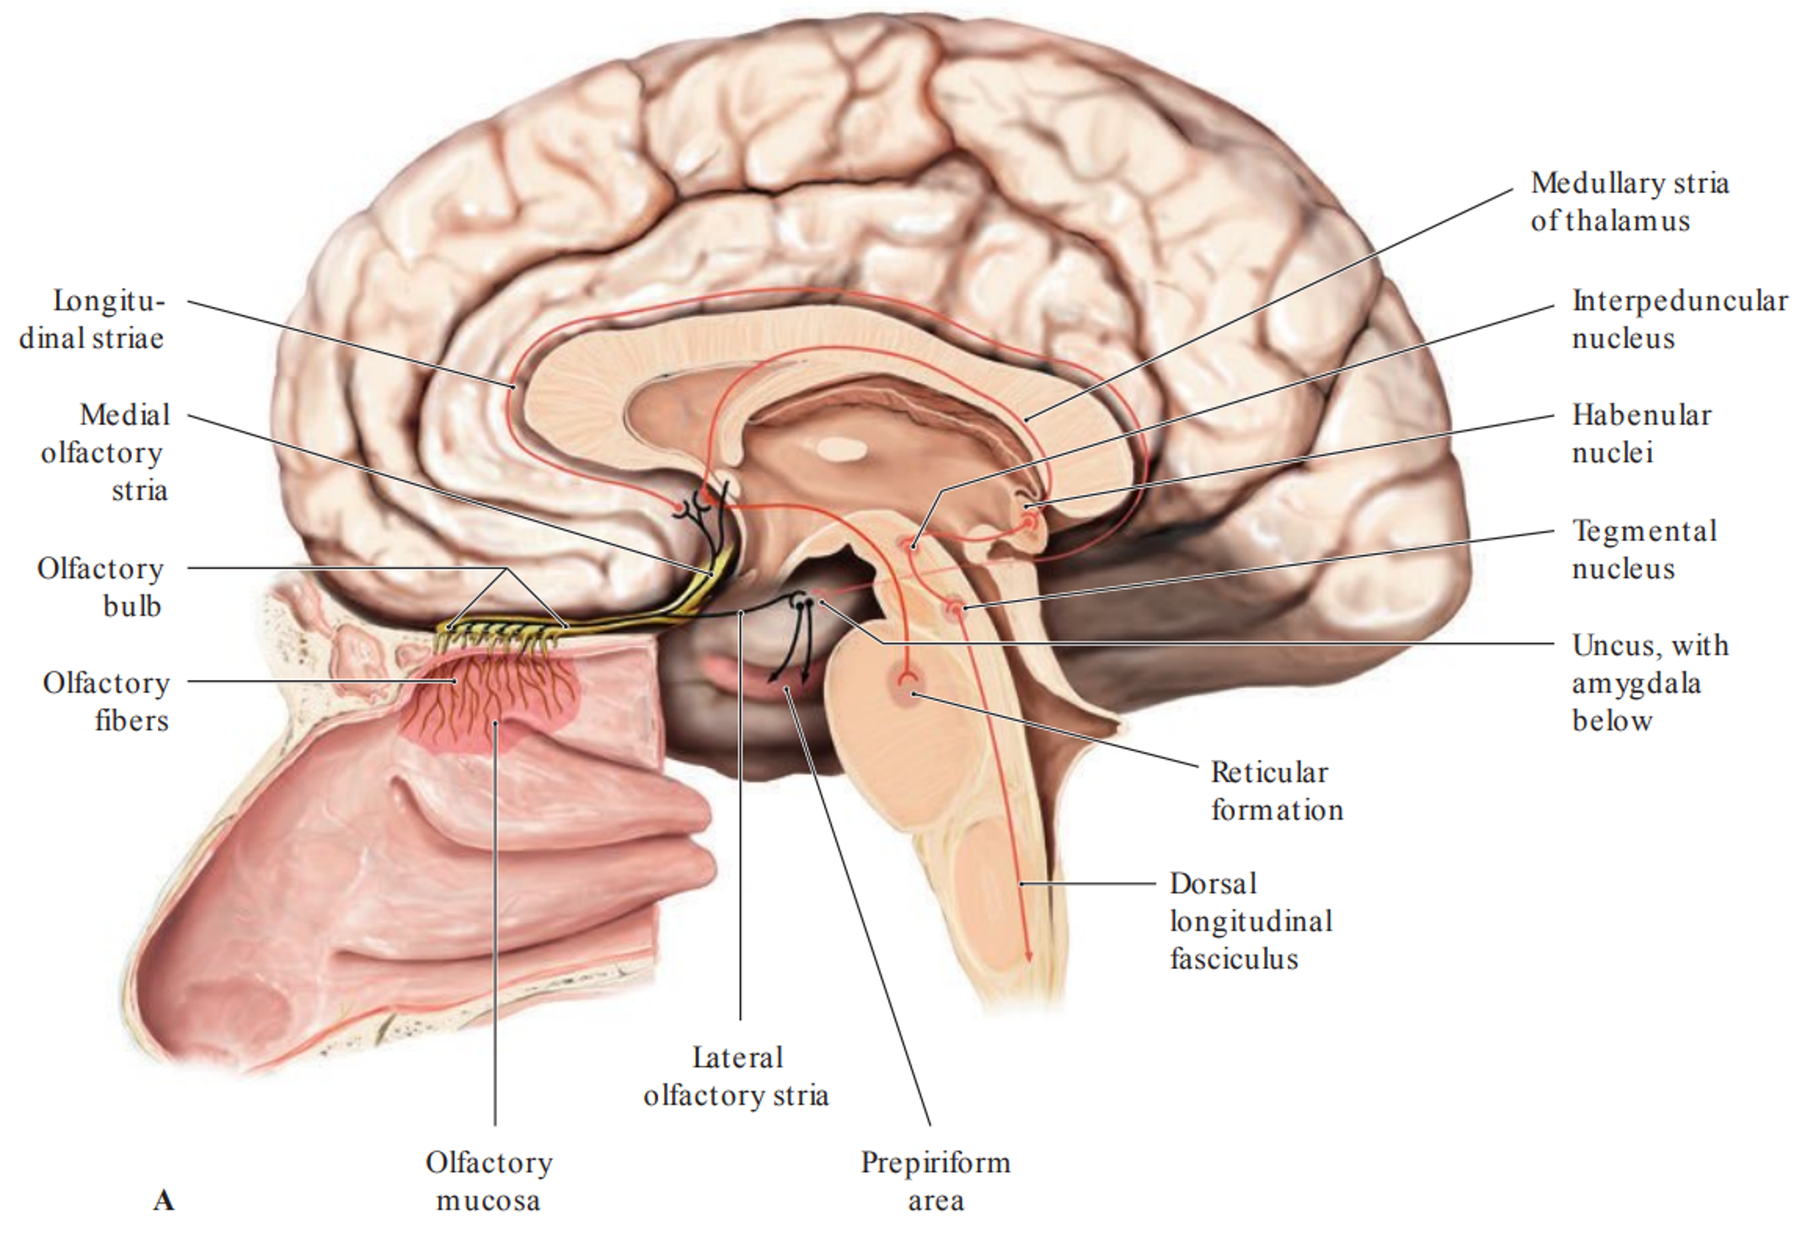

Slide 14
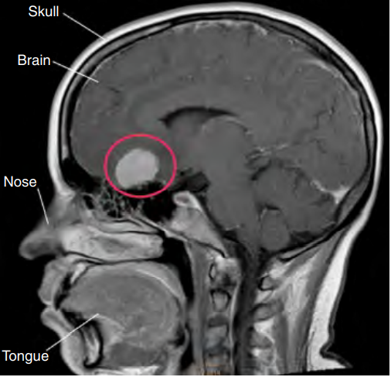
SYMPTOMS OF OLFACTORY NERVE
LESION
hyposmia/mikrosmia
anosmia
parosmia (cacosmia)
uncinate seizure

Slide 15
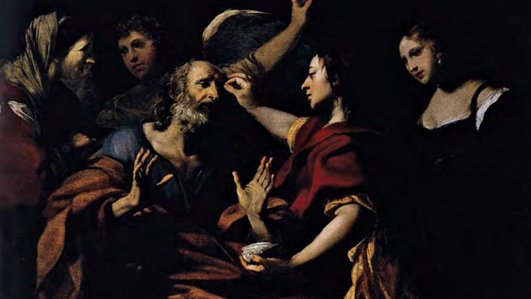
Optic nerve (n. II)

Slide 16
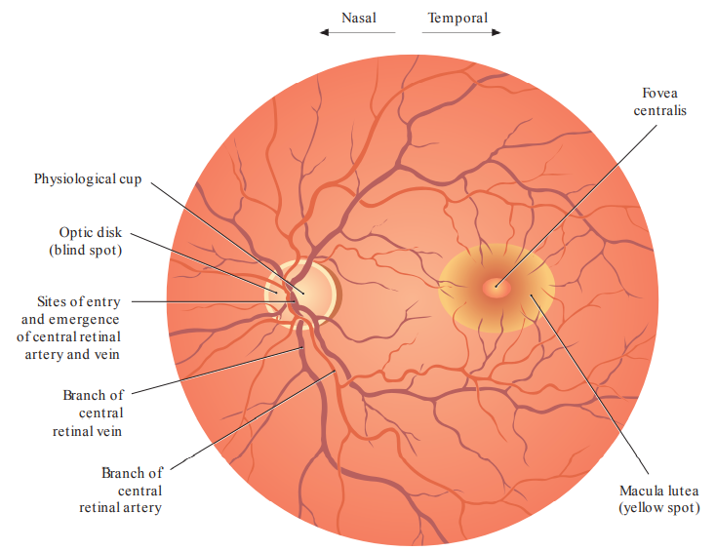
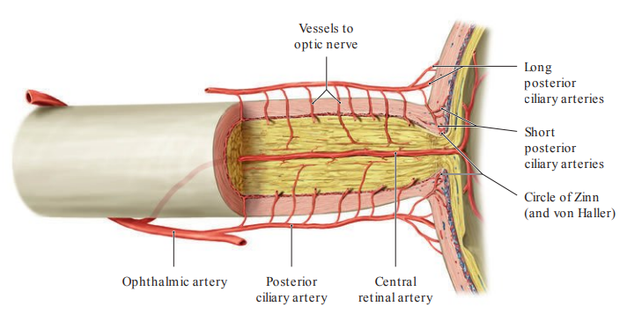
part of the diencephalon, not really a cranial nerve in the conventional sense
doesn´t regenerate after injury
is formed from the central processes of the ganglionic cells (3th neuron of the optic pathway)
contains approximately 1,2 milions of the afferent fibers (1/3 come from central 5° of the retina)
80% fibers ends in the lateral geniculate nucleus, remain fibers leads to the mesencephalon and hypothalamus

Slide 17
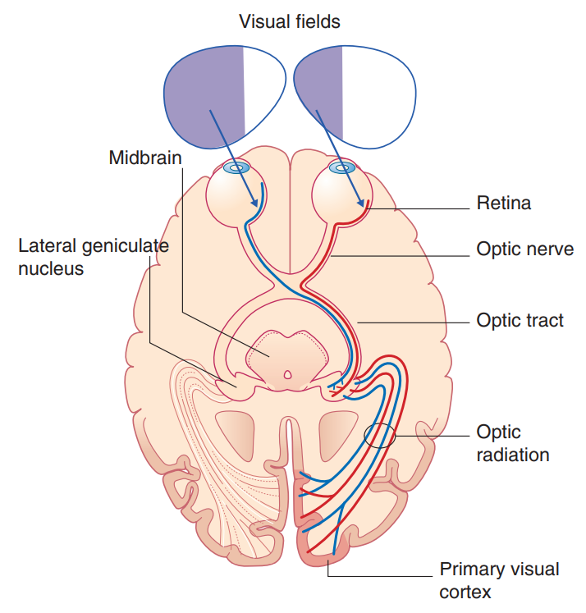
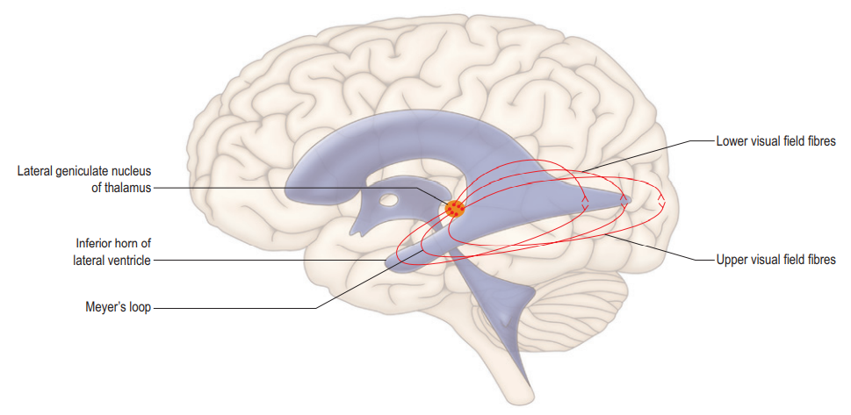

Slide 18
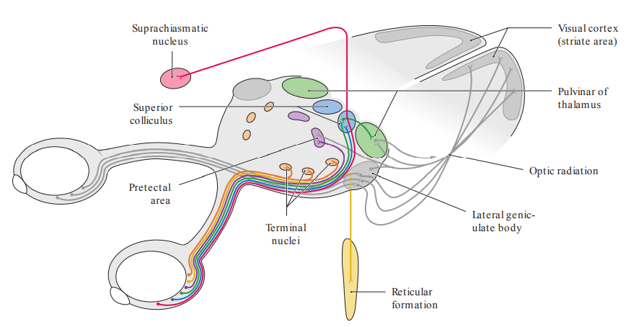
The extrageniculate visual pathway
10-20% fibers
radix optica mesencephalica
radix optica hypothalamica
- retinohypothalamic tract

Slide 19
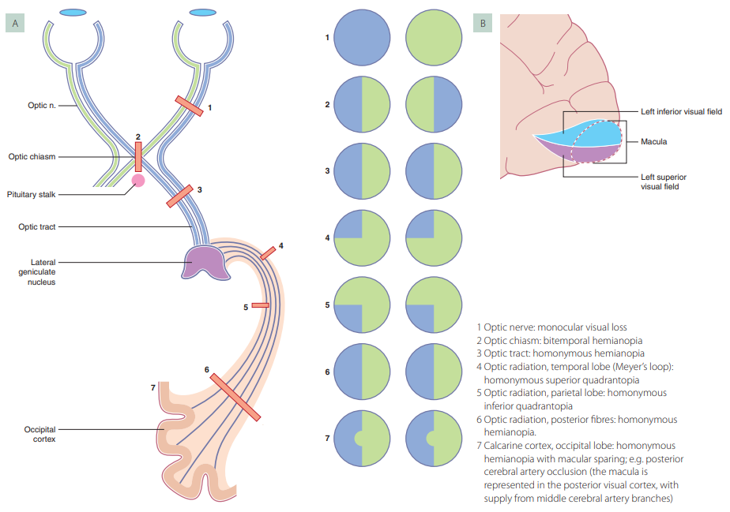
SYMPTOMS OF OPTIC
NERVE LESION
amaurosis
heteronymous hemianopsia
homonymous hemianopsia
quadrantopsia
scotoma
phosphene

Slide 20
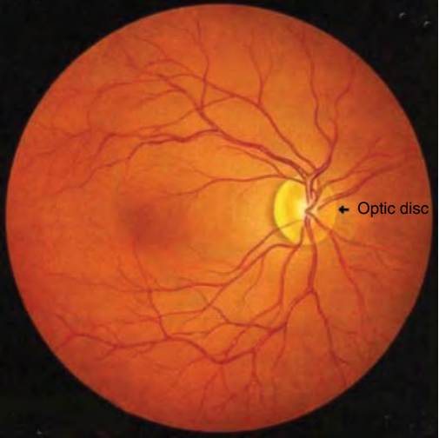
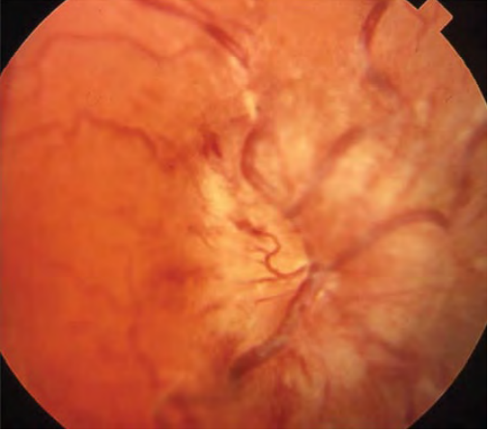
Physiological finding
Papilledema (optic disc swelling)

Slide 21
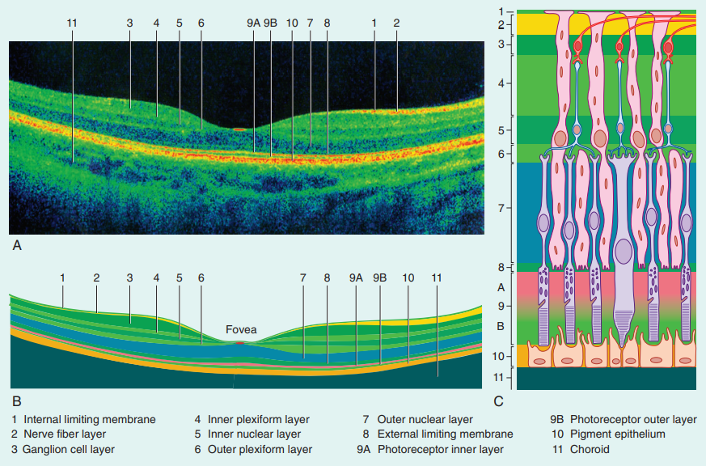
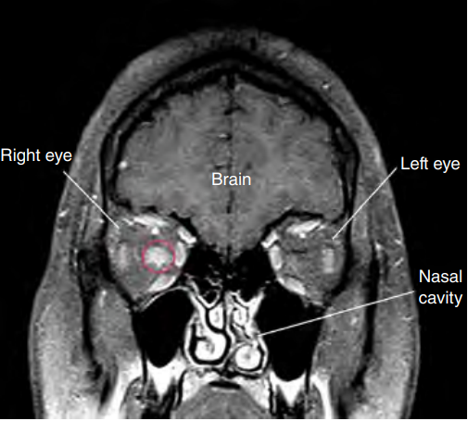
Optic coherence tomography – physiological finding

Slide 22
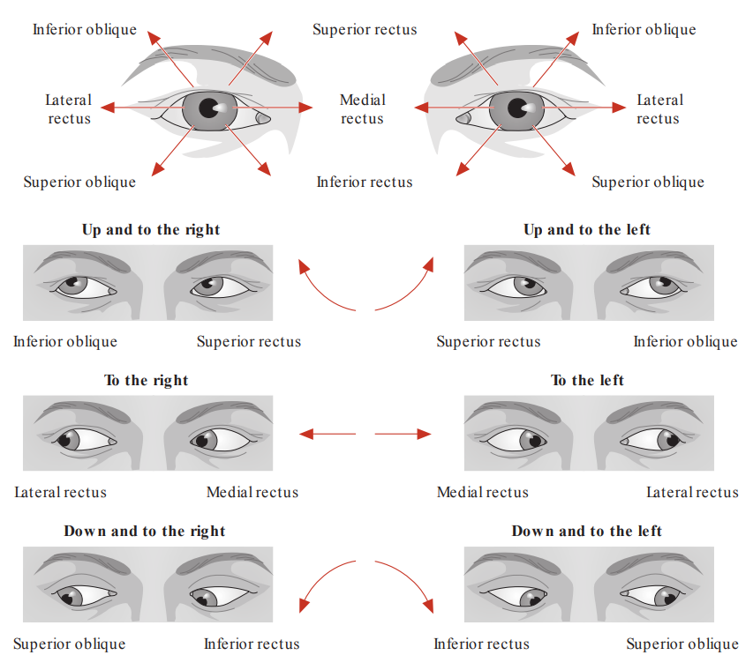
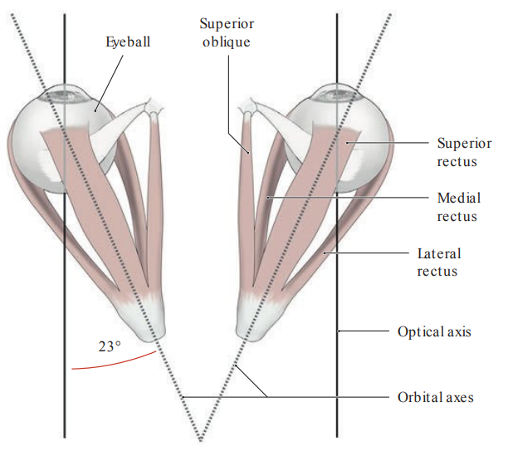
INTRODUCTION TO EYE MOVEMENT I

Slide 23
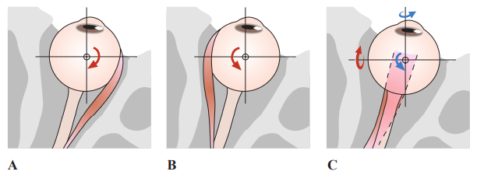
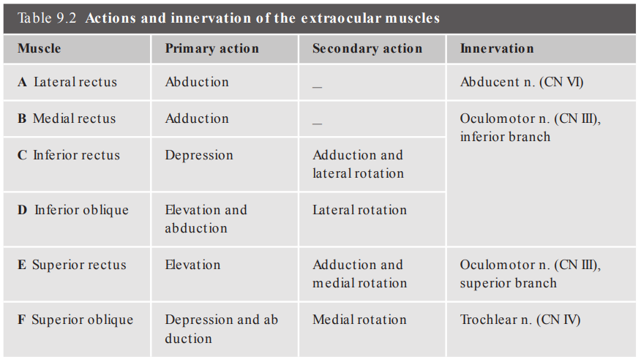
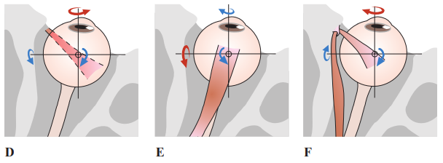
INTRODUCTION TO EYE MOVEMENT II

Slide 24
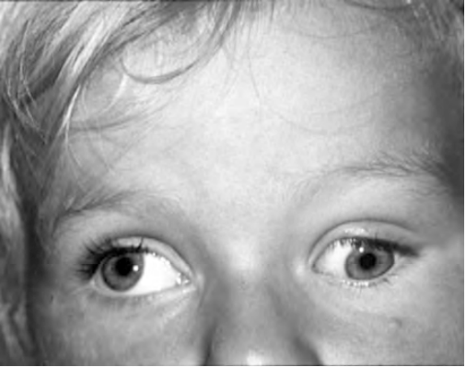
Oculomotor nerve
(n. III)

Slide 25
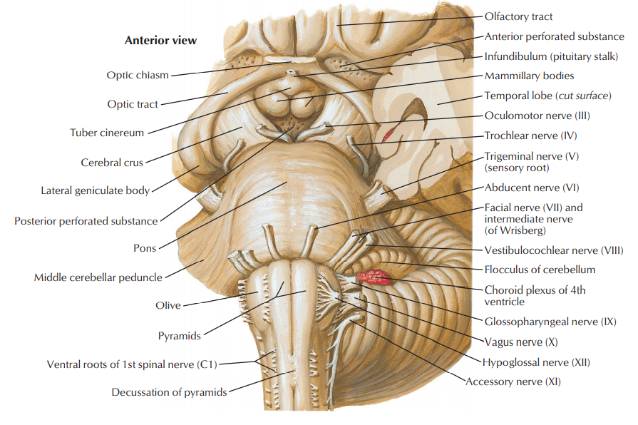
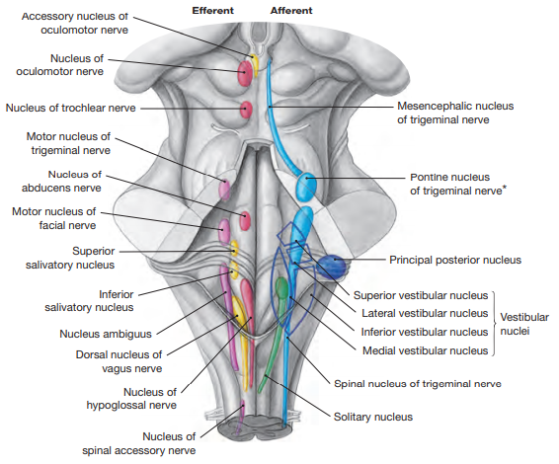
arises from the interpeduncular fossa (sulcus nervi oculomotorii) of the midbrain
innervates all of the extraocular muscules except superior obliquus muscle and lateral rectus muscle
preganglionic parasympathetic fibers from the accessory nucleus of n. III (Edinger-Westphali) synapse
in the cilliary ganglion and supply sphincter pupillae muscle (miosis) a ciliary muscle (accommodation)

Slide 26
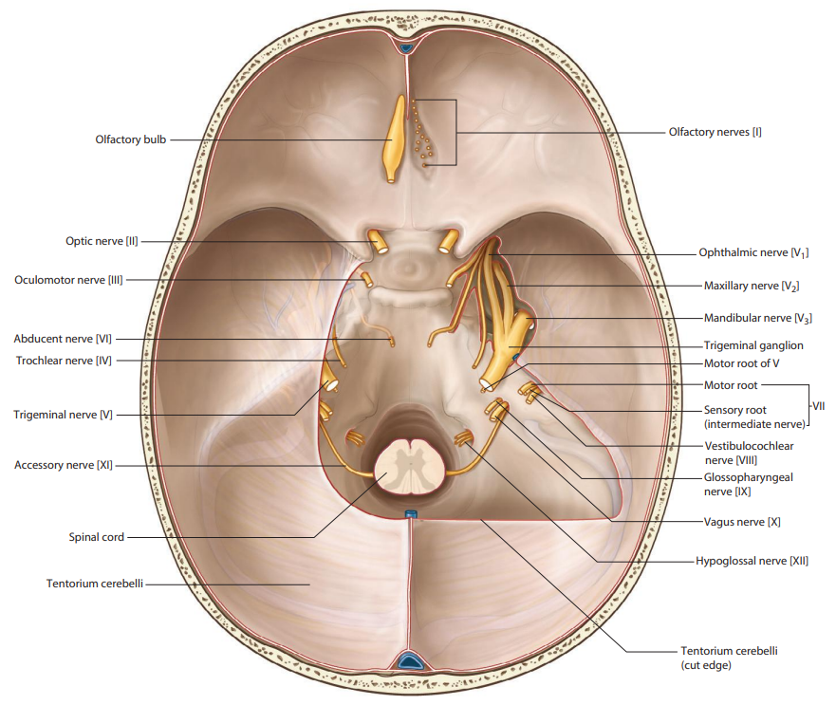
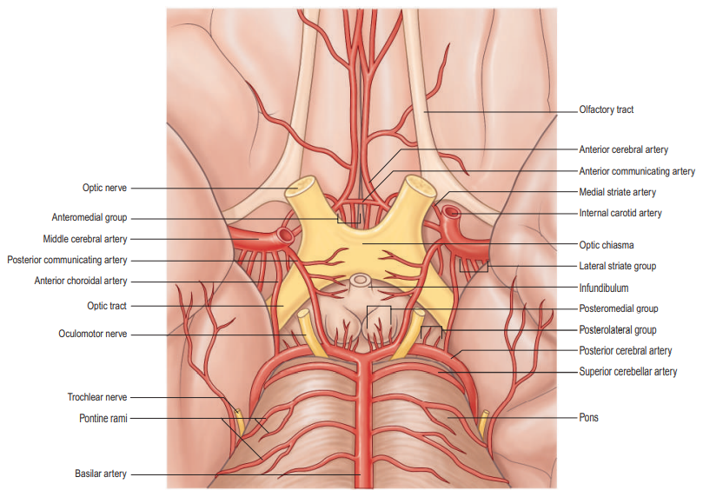
passes through subarachnoid space (interpeduncular cistern) lateral to the posterior communicating artery
pierces dura mater lateral from the posterior clinoid process a enters the cavernous sinus
CAVE: oculomotor nerve palsy caused by posterior communicating artery aneurysm!

Slide 27
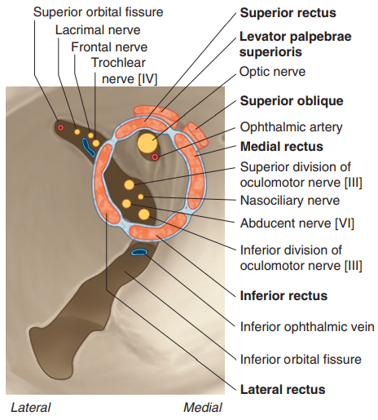
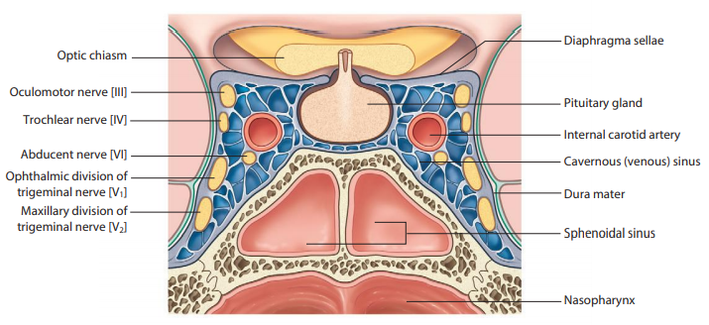
In the cavernous sinus:
receives sympathetic branches from internal carotid plexus for innervation of superior tarsal muscle
(ncl. intermediolateralis Th1-Th5 → ganglion cervicale superius → n. caroticus internus → plexus caroticus internus)
proprioceptive fibers hitchhike along the ophthalmic nerve to the mesencephalic trigeminal nucleus

Slide 28
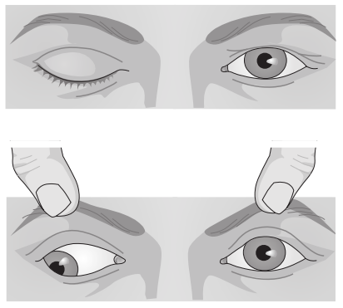
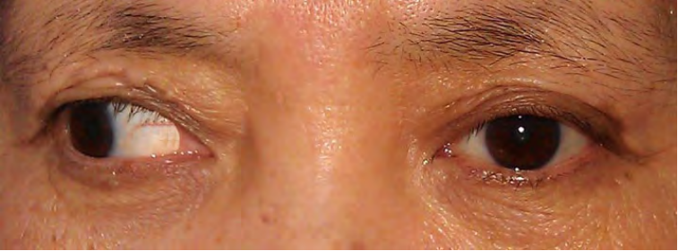
SYMPTOMS OF OCULOMOTOR NERVE LESION
ptosis
exotropia (outward) and hypotropia (downward)
limitations of eye movements
diplopia
mydriasis

Slide 29
OVERVIEW OF THE OCULOMOTOR NERVE BRANCHES
1. Ramus superior (innervation of m. levator palpebrae superioris a m. rectus superior)
rr. orbitales
2. Ramus inferior (innervation of m. rectus medialis, m. rectus inferior a m. obliquus inferior)
ramus ad ganglion ciliare / radix parasympathica (oculomotoria) ganglii ciliaris
nn. ciliares breves

Slide 30
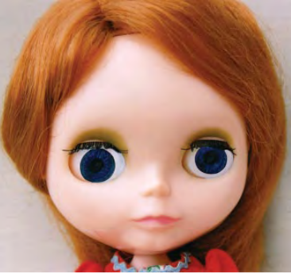
Trochlear nerve (n. IV)

Slide 31
the trochlear motor nucleus in the midbrain
fibers decussate within the brainstem
arises as only cranial nerve from the dorsal aspect of the brainstem
innervates the superior oblique muscle

Slide 32
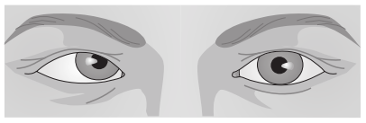
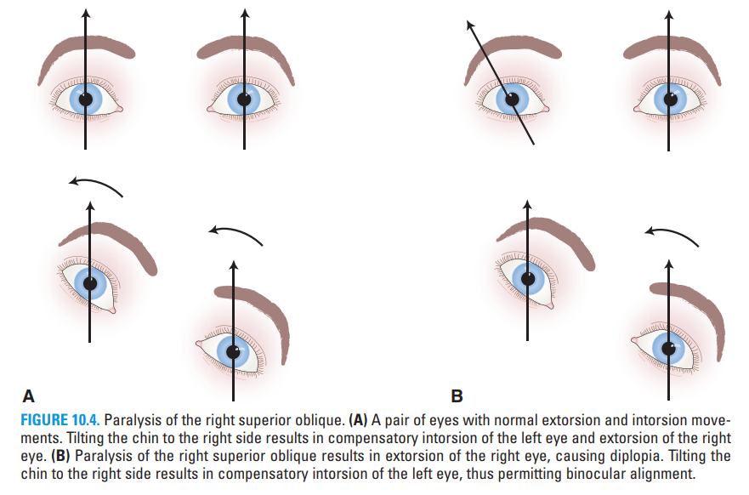
SYMPTOMS OF TROCHLEAR NERVE LESION
central (contralateral) x periferal (ipsilateral) palsy
endotropia (inward) and hypertropia (upward)
mediocaudal limitation of eye movement
diplopia

Slide 33
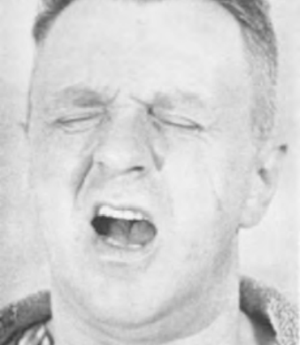
Trigeminal nerve (n. V)

Slide 34
the biggest cranial nerve
mixed nerve with large nuclear complex
1. Motor nucleus of trigeminal nerve (masticatory)
branchiomotor nucleus supplies muscules derived
from 1th pharyngeal arch (muscles of mastication,
m. mylohyoideus, venter anterior m. digastrici,
m. tensor tympani, m. tensor veli palatini)
2. Principal sensory nucleus of trigeminal nerve (pontine)
somatosensory nucleus, receives discriminative sensations,
proprioception, light touch and vibration
3. Spinal nucleus of trigeminal nerve
somatosensory nucleus for perception of cold, heat, pain
and partial proprioception from n. V, VII, IX, X
4. Mesencephalic nucleus of trigeminal nerve
ganglion with pseudounipolar neurons, receives proprioception
from periodontium, hard palate, temporomandibular joint and
from extraocular, masticatory, mimic and lingual muscles too

Slide 35
Spinal nucleus of the trigeminal nerve

Slide 36
Somatotopic arrangement of spinal nucleus of n. V
termination of the Aδ and C fibers
Subnucleus (pars) oralis
Subnucleus (pars) interpolaris
Subnucleus (pars) caudalis

Slide 37
arises from the middle part of pons
enters the trigeminal cave (Meckel´s cave), a dura mater
pouch containing trigeminal ganglion (semilunare, Gasseri)
motor root (portio minor trigemini) underruns the ganglion
and joins the mandibular nerve directly

Slide 38
Ophthalmic nerve
1th branch of the trigeminal nerve
counts approx. 26 000 myelinated fibers
the most medial branch of the trigeminal ganglion
passes through the lateral wall of cavernous sinus
supplies (somatosensory):
orbit with periosteum, ocular bulb, lacrimal gland
conjunctiva of the upper eyelid
skin of nasal dorsum and tip, upper eyelid and
forehead to the interauricular line
ethmoidal cells mucosa, sphenoid sinus
and ventral part of nasal cavity

Slide 39
Ophthalmic nerve
divides in superior ophthalmic fissure to:
nervus frontalis
nervus lacrimalis
nervus nasociliaris
Nervus frontalis
n. supraorbitalis
→ r. medialis
→ r. lateralis
n. supratrochlearis
Nervus lacrimalis
r. communicans cum nervo zygomatico
Nervus nasociliaris
r. communicans cum ganglio ciliari
nn. ciliares longi
n. ethmoidalis posterior
n. ethmoidalis anterior
→ rr. nasales
→ r. nasalis externus

Slide 40
Ophthalmic nerve
lacrimal nerve carries also autonomic fibers for innervation of lacrimal gland
(plexus caroticus internus → n. petrosus profundus → n. canalis pterygoidei → rr. ganglionares → n. zygomaticus →
r. communicans cum nervo zygomatico → n. lacrimalis)
(n. VII → n. petrosus major → n. canalis pterygoidei → ganglion pterygopalatinum → rr. ganglionares → n. zygomaticus →
r. communicans cum nervo zygomatico → n. lacrimalis)

Slide 41
a small number of the meningeal
branch supplying dura mater
of the cranial venous sinuses
pass through cranial sutures
and innervate extracranial
periost
ANATOMICAL BACKROUND
OF THE TENSION HEADACHE !

Slide 43
Corneal reflex (trigeminofacial)
differential diagnosis of bulbar vs. pseudobulbar syndrome
hyperreflexia: supranuclear lesion of the corticobulbar tract
hypo/areflexia: lesion of spinal nucleus of trigeminal nerve, facial motor nucleus,
pontine fibers or trunks of n. V / n. VII

Slide 44
Herpes zoster ophthalmicus

Slide 45
OVERVIEW OF THE OPHTHALMIC NERVE BRANCHES
1. Ramus meningeus recurrens / ramus tentorius (tentorii)
2. Nervus lacrimalis
r. communicans cum nervo zygomatico
3. Nervus frontalis
n. supraorbitalis
r. lateralis
r. medialis
n. supratrochlearis
4. Nervus nasociliaris
r. communicans cum ganglio ciliari (radix sensoria / nasociliaris ganglii ciliaris)
nn. ciliares longi
n. ethmoidalis posterior
r. meningeus anterior
n. ethmoidales anterior
rr. nasales interni
rr. nasales laterales
rr. nasales mediales
r. nasalis externus
n. infratrochlearis
rr. palpebrales

Slide 46
Maxillary nerve
2nd branch of the trigeminal nerve
counts approx. 50 000 myelinated fibers
passes through the lateral wall of cavernous sinus,
enters fossa through the
foramen rotundto the pterygopalatine um
supplies (somatosensory):
dura mater in the middle cranial fossa
cheek skin between the palpebral and oral fissure
mucosa of the upper cheeks
mucosa of the maxillary sinus and posterior
2/3 of the nasal cavity
mucosa of the palate, isthmus faucium,
nasopharynx and adjacent part of the Eustachian
tube
maxilla and upper teeth

Slide 51
Percutaneous intervention
on the Gasserian ganglion

Slide 52
Neurosurgeric decompression of the trigeminal nerve

Slide 54
OVERVIEW OF THE MAXILLARY NERVE BRANCHES
1. R. meningeus
2. Rr. ganglionares ad ganglion pterygopalatinum / radix sensoria ganglii pterygopalatini
rr. orbitales
rr. nasales posteriores superiores laterales
rr. nasales posteriores superiores mediales
n. nasopalatinus (incisivus)
n. pharyngeus
n. palatinus major
rr. nasales posteriores inferiores
nn. palatini minores
rr. tonsillares
3. N. zygomaticus
r. communicans cum nervo lacrimali
r. zygomaticotemporalis
r. zygomaticofacialis
4. N. infraorbitalis
rr. alveolares superiores posteriores
r. alveolaris superior medius
rr. alveolares superiores anteriores
plexus dentalis superior
rr. dentales superiores
rr. gingivales superiores
rr. palpabrales inferiores
rr. nasales externi
rr. nasales interni
rr. labiales superiores

Slide 55
Mandibular nerve
3th branch of the trigeminal nerve
counts approx. 26 000 myelinated fibers
the most lateral branch of the trigeminal ganglion
receives motor root
enters to the infratemporal fossa through the
foramen ovale
supplies (somatosensory):
dura mater near the posterior branches of
middle meningeal artery
skin of temporal region and around mandibula
mucosa of the lower cheeks, isthmus faucium,
palatine tonsil and the floor of the oral cavity
mucosa of the ventral 2/3
mandible and lower teeth
innervates (branchiomotor):
masticatory muscles (m. masseter, m. temporalis,
m. pterygoideus medialis et lateralis)
m. mylohyoideus, venter anterior m. digastrici
m. tensor tympani, m. tensor veli palatini

Slide 60
Jaw jerk (masseter) reflex
differential diagnosis of bulbar vs. pseudobulbar syndrome
hyperreflexia: supranuclear lesion of the corticobulbar tract
hypo/areflexia: lesion of mesencephalic nucleus of trigeminal nerve, motor nucleus of trigeminal nerve,
pontine fibers or trunk of n. V

Slide 61
OVERVIEW OF THE MANDIBULAR NERVE BRANCHES
1. Ramus meningeus (nervus spinosus)
2. Nervus pterygoideus medialis
3. Rami ganglionares ad ganglion oticum / radix sensoria ganglii otici
4. Nervus musculi tensoris veli palatini
5. Nervus musculi tensoris tympani
6. Nervus massetericus
7. Nervi temporales profundi
8. Nervus pterygoideus lateralis
9. Nervus buccalis
10. Nervus auriculotemporalis
n. meatus acustici externi
rr. membranae tympani
rr. parotidei
rr. communicantes cum nervo faciali
nn. auriculares anteriores
rr. temporales superficiales
11. Nervus lingualis
rr. isthmi faucium
rr. communicantes cum nervo hypoglosso
chorda tympani
n. sublingualis
rr. linguales
rr. ganglionares ad ganglion submandibulare / radix sensoria ganglii submandibularis
rr. ganglionares ad ganglion sublinguale / radix sensoria ganglii sublingualis
12. Nervus alveolaris inferior
n. mylohyoideus
plexus dentalis inferior
rr. dentales inferiores
rr. gingivales inferiores
n. mentalis
rr. mentales
rr. labiales inferiores
rr. gingivales

Slide 62
Abducens nerve (n. VI)

Slide 63
the abducens motor nucleus in the pons
arises from the bulbopontine groove medial to the n. VII
innervates the lateral rectus muscle

Slide 64
runs upward between the pons and the clivus
pierces the dura at the tip of petrous bone
runs alongside the internal carotide artery in the cavernous sinus

Slide 65
→ fissura orbitalis superior → anulus tendineus communis Zinni

Slide 66
SYMPTOMS OF ABDUCENS NERVE LESION
endotropia
lateral limitation of eye movement
diplopia
Etiology:
→ trauma
→ tumor compression
→ internal carotide artery aneurysm
→ arteriovenous fistula of the cavernous sinus
→ intracranial hypertension
→ iatrogenic (after lumbal puncture)
→ Tolosa-Hunt syndrome
→ meningitis, basal tuberculosis, sarkoidosis
→ Guillan-Barré syndrome
→ diabetic poly(mono)neuropathy
→ sclerosis multiplex
→ febrile state in children
→ thrombophlebitis of the cavernous sinus

Slide 67
Facial nerve (n. VII)

Slide 68
1. Motor nucleus of facial nerve
branchiomotor nucleus for innervation of muscles derived from 2nd pharyngeal arch (mimic muscles, platysma, m. stylohyoideus, m. stapedius a venter posterior m. digastrici)
2. Superior salivatory nucleus
visceromotor nucleus for parasymphatic innervation lacrimal / submandibular / sublingual glands, glands in nasal mucosa, nasopharynx and isthmus faucium
3. Solitary nucleus (gustatory)
viscerosensory nucleus (rostral part) for taste from ventral 2/3 of the lingua
4. Spinal nucleus of trigeminal nerve
somatosensory nucleus for perception from auricle, external auditory meatus
5. Mesencephalic nucleus of trigeminal nerve
ganglion with the pseudounipolar neurons, receives proprioception from mimic muscles

Slide 69
Arising of the n. VII
trigonum pontocerebellare (cerebellopontine angle)
fibers turn around the nucleus of abducens nerve as
genu nervi facialis (base of facial colliculus)
intermediate nerve carries parasymphatic and
gustatory fibers

Slide 70
enters the pyrimid through fundus meatus acustici interni
(area nervi facialis ventrocranial)
receives fibers from the intermediate nerve

Slide 71
Course of the facial nerve
in the petrous bone I

Slide 72
Course of the facial nerve in the petrous bone II

Slide 73
exit from the petrous bone: stylomastoid foramen
enters the parotid gland
runs dorsally and laterally from the retromandibular vein
and external carotid artery
creates the (intra)parotid plexus

Slide 74
1. Temporal branches
- muscles of the frontal and temporal region
2. Zygomatic branches
- m. orbicularis oculi, mm. zygomatici and
muscles of the nose
3. Buccal branches
- muscles of the upper lip and buccal region
4. Marginal mandibular branches
- muscles of the chin and lower lip
5. Cervical branches
- m. platysma, ansa cervicalis superficialis

Slide 76
Symptoms
mimic muscles palsy
lagophthalmos
ageusia, hyposecretion of saliva
hyperacusis
hyposecretion of tears

Slide 77
Peripheral palsy of n. VII
2. Ipsilateral mimic muscles palsy + ageusia (anterior 2/3 of the tongue)
+ hyposecretion of saliva and tears + hyperacusis
3. Ipsilateral mimic muscles palsy + ageusia (anterior 2/3 of the tongue) + hyposecretion of saliva + hyperacusis
4. Ipsilateral mimic muscles palsy + ageusia (anterior 2/3 of the tongue) + hyposecretion of saliva
5. Ipsilateral mimic muscles palsy

Slide 78
Central and peripheral palsy of n. VII
… or why seems the peripheral palsy of n. VII more dramatic?

Slide 79
Central palsy
→ oral commissure
drooping
Peripheral palsy
→ oral commissure
drooping
→ ptosis

Slide 80
„BELL´S SIGN“

Slide 81
OVERVIEW OF THE FACIAL NERVE BRANCHES
1. Nervus petrosus major / radix parasympathica (intermedia) ganglii pterygopalatini
n. canalis pterygoidei (vzniká spojením s n. petrosus profundus)
vede pregangliové parasympatické (n. petrosus major) a postgangliové sympatické vlákna (n. petrosus profundus) do ganglion pterygopalatinum
inervace glandula lacrimalis a malých žláz nosu a patra
2. Nervus stapedius
3. Chorda tympani
pregangliové parasympatické vlákna do ganglion submandibulare (inervace glandula submandibularis a glandula sublingualis)
senzorické (chuťové) vlákna z předních 2/3 jazyka skrze ganglion geniculi
4. Ramus communicans cum plexu tympanico
5. Ramus communicans cum nervo vago
6. Ramus communicans cum nervo glossopharyngeo
7. Nervus auricularis posterior
r. occipitalis
r. auricularis
8. Ramus digastricus
9. Ramus stylohyoideus
10. Plexus (intra)parotideus
rr. temporales
rr. zygomatici
rr. buccales
r. marginalis mandibulae
r. colli

Slide 82
Vestibulocochlear nerve (n. VIII)

Slide 83
Nervus cochlearis
Area cochlae (tractus spiralis foraminosus)
central fibers of the spiral ganglion

Slide 84
Nervus facialis
Nervus utriculoampullaris
Nervus ampullaris posterior
Nervus saccularis
Nervus cochlearis
(tractus spiralis foraminosus)

Slide 85
Screening sluchu novorozenců
definovaný ve vyhlášce č. 70/2021 Sb.
o preventivních prohlídkách ve znění pozdějších
předpisů (nabytí účinnosti zákonu č. 45/2021 Sb.
dne 24.2.2021)
fáze screeningu:
screeningové vyšetření sluchu novorozenců
(TEOAE, AABR)
screeningové vyšetření sluchu dětí metodou
tónové audiometrie ve věku 5 let

Slide 88
Vestibular nerve
→ utriculoampullary nerve
utricular nerve
anterior ampullary nerve
lateral ampullary nerve
→ saccular nerve
→ posterior ampullary nerve
Area vestibularis superior → n. utriculoampullaris
Area vestibularis inferior → n. saccularis
Foramen singulare → n. ampullaris posterior

Slide 89
Vestibulum
Recessus ellipticus (utriculi)
macula cribrosa superior
aqueductus vestibuli
Recessus sphericus (sacculi)
macula cribrosa media
Recessus cochlearis
macula cribrosa inferior

Slide 90
Perception of head orientation

Slide 91
Canales semicirculares ossei
3 bony semicircular canals in the petrous temporal bone
occupy 3 planes in space
Anterior (superior) semicircular canal
transversely to the long axis of the petrous bone
dorsal angulation by 30 degrees
Posterior semicircular canal
parallel to the long axis of the petrous bone
Lateral (horizontal) semicircular canal
transversely to the anterior semicircular canal
dorsal angulation by 30 degrees

Slide 92
Perception of head rotation

Slide 93
SYMPTOMS OF VESTIBULOCOCHLEAR NERVE LESION
vertigo
nystagmus
nauzea, vomitus
Dix-Hallpikeův test

Slide 94
Acustic neurinoma
benign tumor from the Schwann´s cells
symptoms: hypacusis, tinitus, vertigo,
peripheral palsy of n. VII,
hypesthesia of the n. V

Slide 95
OVERVIEW OF THE VESTIBULOCOCHLEAR NERVE BRANCHES
NERVUS COCHLEARIS
Ganglion spirale cochleae
aferentní vlákna (95%)
bipolární neurony (90%, dendrity inervují vnitřní vláskové buňky)
pseudounipolární neurony (10%, periferní raménka inervují zevní vláskové buňky)
eferentní vlákna (5%)
tractus olivococlearis lateralis (synapse na dendritech bipolárních buněk)
tractus olivocochlearis medialis (synapse na zevních vláskových buňkách)
NERVUS VESTIBULARIS
Ganglion vestibulare
pars superior
n. utriculoampullaris
n. utricularis
n. ampullaris anterior
n. ampullaris lateralis
pars inferior
n. ampullaris posterior
n. saccularis

Slide 96
Glossopharyngeal nerve (n. IX)

Slide 97
1. Nucleus ambiguus (rostral part)
branchiomotor nucleus for innervation of the muscles
derived from the 3rd – 4th branchial arch
(muscles of the pharynx, soft palate except of
m. tensor veli palatini)
2. Dorsal nucleus of glossopharyngeal nerve
(salivatorius inferior)
visceromotor nucleus for parasympathetic innervation
of the parotide gland
3. Solitary nucleus (gustatory)
viscerosensory nucleus (rostral part) for taste perception
from dorsal 1/3 of the tongue
4. Spinal nucleus of trigeminal nerve
somatosensory nucleus for perception from the pharynx,
palatine tonsil, dorsal 1/3 of the tongue, tympanic cavity
and adjacent part of the Eustachian tube

Slide 99
OVERVIEW OF THE GLOSSOPHARYNGEAL NERVE BRANCHES
1. Nervus tympanicus
plexus tympanicus (ganglion tympanicum)
r. tubarius
n. petrosus minor → ganglion oticum (innervation of glandula parotis through n. auriculotemporalis → rr. parotidei)
r. communicans cum ramo meningeo
r. communicans cum nervo auriculotemporali
r. communicans cum chorda tympani
2. Ramus communicans cum ramo auriculari nervi vagi
3. Ramus communicans cum trunco tympanico / nervus jugularis
4. Ramus stylopharyngeus (ramus musculi stylopharyngei)
5. Rami pharyngei
6. Ramus sinus carotici
7. Rami tonsillares
8. Rami linguales

Slide 100
Vagus nerve (n. X)

Slide 101
1. Nucleus ambiguus (middle part)
branchiomotor nucleus for innervation of the muscles
derived from the 3rd – 4th branchial arch
(muscles of the pharynx, esophagus and m. cricothyroideus)
2. Dorsal nucleus of vagus nerve
visceromotor nucleus for parasympathetic innervation
of the digestive tract to flexura coli sinistra, thyroid gland,
lungs, heart, kidneys and gonads
3. Solitary nucleus (gustatory)
viscerosensory nucleus (rostral part) for taste perception
from the epiglottis and epiglottic valleculae
also for viscerosensoric afferents from mentioned
innervation zones
4. Spinal nucleus of trigeminal nerve
somatosensory nucleus for perception from the root of the tongue,
small part of the posterior and inferior wall of the external auditory
canal and upper part of the auricle

Slide 102
DYSPHONIA
APHONIA

Slide 103
„PŘÍZNAK OPONY“

Slide 104
Vagal stimulation

Slide 105
OVERVIEW OF THE VAGUS NERVE BRANCHES
1. Ramus meningeus
2. Ramus auricularis (Arnoldův nerv)
3. Ramus communicans cum nervo glossopharyngei
4. Ramus pharyngeus
5. Ramus glomi carotici
6. Nervus laryngeus superior
r. externus
r. internus
r. communicans cum nervo laryngeo recurrenti (Galen´s anastomosis)
7. Rami cardiaci cervicales superiores
8. Rami cardiaci cervicales inferiores
9. Nervus laryngeus reccurens
rr. tracheales
rr. oesophagei
rr. pharyngei
n. laryngeus inferior
10. Rami cardiaci thoracici
11. Rami bronchiales / pulmonales
12. Plexus oesophageus
13. Truncus vagalis anterior
plexus gastricus anterior (rr. gastrici anteriores)
n. curvaturae minoris anterior
r. pyloricus
rr. hepatici
rr. coeliaci
14. Truncus vagalis posterior
plexus gastricus posterior (rr. gastrici posteriores)
n. curvaturae minoris posterior
rr. coeliaci
rr. hepatici, rr. pancreatici, rr. lienales, rr. renales, rr. suprarenales, rr. intestinales, rr. ovarici, rr. testiculares

Slide 106
Accessory nerve (n. XI)

Slide 107
1. Nucleus ambiguus (caudal part)
branchiomotor nucleus for innervation of the muscles
derived from the 3rd – 4th branchial arch
(muscles of the larynx except of m. cricothyroideus)
fibers create cranial root of the n. XI
2. The spinal accessory nucleus (C1-C4/C6)
somatomotor nucleus for innervation of
the sternocleidomastoid and trapezius muscles
fibers create spinal root of the n. XI

Slide 109
OVERVIEW OF THE ACCESSORY NERVE BRANCHES
1. Radix cranialis (pars vagalis)
2. Radix spinalis (pars spinalis)
3. Truncus nervi accessorii
ramus internus
motor fibers for n. vagus (rr. pharyngei and n. laryngeus reccurens)
ramus externus
rr. musculares for m. sternocleidomastoideus a m. trapezius

Slide 110
Hypoglossal nerve (n. XII)

Slide 111
1. The hypoglossal nucleus
somatomotor nucleus for intrinsic and extrinsic
muscles of the tongue (except of m. palatoglossus)
2. Dorsal nucleus of vagus nerve
visceromotor nucleus for parasympathetic innervation
of the lingual vessels
3. Mesencephalic nucleus of trigeminal nerve
ganglion with the pseudounipolar neurons, receives
proprioception from the muscles of the tongue

Slide 114
PALSY
PALSY
ATROPHY
FASCICULATION

Slide 115
OVERVIEW OF THE HYPOGLOSSAL NERVE BRANCHES
1. Spojka z ansa cervicalis prima (ventrální větve C1 a C2)
2. Spojky z truncus sympathicus a nervus vagus
3. Radix superior ansae cervicalis (ramus descendens nervi hypoglossi)
motorické vlákna z ansa cervicalis prima
spojením s radix inferior ansae cervicalis (ventrální větve C2 a C3) vzniká ansa cervicalis sekunda
inervace některých infrahyoidních svalů
4. Rami musculares
inervace m. geniohyoideus a m. thyrohyoideus (vlákna původem z ansa cervicalis prima)
5. Rami communicantes cum nervo hypoglosso
somatosenzorické a propriocepční vlákna z n. lingualis
6. Rami linguales
inervace intraglosálních svalů a m. genioglossus, m. hyoglossus a m. styloglossus

Slide 116
References:
HOMBACH-KLONISCH, S., T. KLONISCH and J. PEELER. Sobotta: Clinical Atlas of Human Anatomy. Munich, Germany: Elsevier Science, 2019, 680 s. ISBN 978-0-7020-5273-6.
STANDRING, S, et al. Gray's Anatomy: The Anatomical Basis of Clinical Practice. 41st. Philadelphia: Elsevier, 2016, 1562 s. ISBN 978-0-7020-5230-9.
DRAKE, R. L., A. WAYNE VOGL and A. W. M. MITCHELL. Gray's Anatomy for Students. 4th. Philadelphia: Elsevier, 2020. ISBN 978-0-323-39304-1.
DRAKE, R. L., A. WAYNE VOGL, A. W. M. MITCHELL, R. M. TIBBITTS and P. E. RICHARDSON. Gray's Atlas of Anatomy. 2. Philadelphia: Churchill Livingstone, 2015,
648 s. ISBN 978-1-4557-4802-0.
VILENSKY, J. A., W. M. ROBERTSON and C. A. SUÁREZ-QUIAN. The Clinical Anatomy of the Cranial Nerves: The Nerves of "On Old Olympus Towering Top.
Wiley-Blackwell, 2015, 336 s. ISBN 978-1-1184-9201-7.
NETTER, F. H. Atlas of Human Anatomy. 6. Philadelphia: Saunders, 2014, 624 s. ISBN 978-1-4557-0418-7.
ELLIS, H. and V. MAHADEVAN. Clinical anatomy: applied anatomy for students and junior doctors. Fourteenth edition. Hoboken, USA: Wiley-Blackwell, 2019.
ISBN 978-111-9325-536.
GOULD, D. J. and J. D. FIX. Neuroanatomy (Board Review Series). 5. Baltimore: Lippincott Williams & Wilkins, 2014, 368 s. ISBN 978-1-4511-7609-4.
ROPPER, A. H., M. A. SAMUELS, J. P. KLEIN, S. PRASAD, et al. Adams and Victor's Principles of Neurology. 11. New York: McGraw-Hill Education Medical, 2019,
1664 s. ISBN 978-0-07-184262-4.
GOSLING, J. A., P. F. HARRIS, J. R. HUMPHERSON, I. WHITMORE, P. L. T. WILLAN et al. Human Anatomy, Color Atlas and Textbook. 6. Philadelphia: Elsevier,
2017, 456 s. ISBN 978-0-7234-3827-4.
BAKER, E. W., M. SCHUENKE, E. SCHULTE, U. SCHUMACHER, et al. Anatomy for Dental Medicine. Second Edition. Thieme Medical Publishers, 2015. ISBN 978-1-62623-085-9.
GLEESON, M. J., R. C. CLARKE, et al. Scott-Brown’s Otorhinolaryngology: Head and Neck Surgery (3 volume set). 7th edition. CRC Press, 2008. ISBN 978-0-340-808-931.
CHROBOK, V., J. DRŠATA, M. JANOUCH, P. KOMÍNEK, et al. Příručka pro praxi: Screening sluchu novorozenců [online]. Praha:
Česká společnost otorinolaryngologie a chirurgie hlavy a krku ČLS JEP, 2019 [cit. 2022-03-21].
Dostupné z: https://www.otorinolaryngologie.cz/content/uploads/2020/02/ppp-screening-sluchu-novorozencu.pdf
ČIHÁK, Radomír. Anatomie 3. Třetí, upravené a doplněné vydání. Praha: Grada, 2016, 832 s. ISBN 978-802-4756-363.

Slide 117
PARENT, A. and M. B. CARPENTER. Carpenter's Human Neuroanatomy. 9th Edition. Providence: Williams & Wilkins, 1996. ISBN 0-683-06752-4.
AUGUSTINE, J. R. Human Neuroanatomy. 2nd Edition. New Jersey: Wiley-Blackwell, 2017. ISBN 978‐0‐4709‐6161‐2.
STRASSMAN, A. M., Y. MINETA and B. P. VOS. Distribution of fos-like immunoreactivity in the medullary and upper cervical dorsal horn produced by stimulation of dural blood vessels in the rat.
The Journal of Neuroscience. 1994, 14(6), 3725-3735. ISSN 0270-6474. DOI:10.1523/JNEUROSCI.14-06-03725.1994
BURSTEIN, R., P. BLAKE, A. SCHAIN and C. PERRY. Extracranial origin of headache. Current Opinion in Neurology. 2017, 30(3), 263-271. ISSN 1350-7540. DOI:10.1097/WCO.0000000000000437

