Slide 1
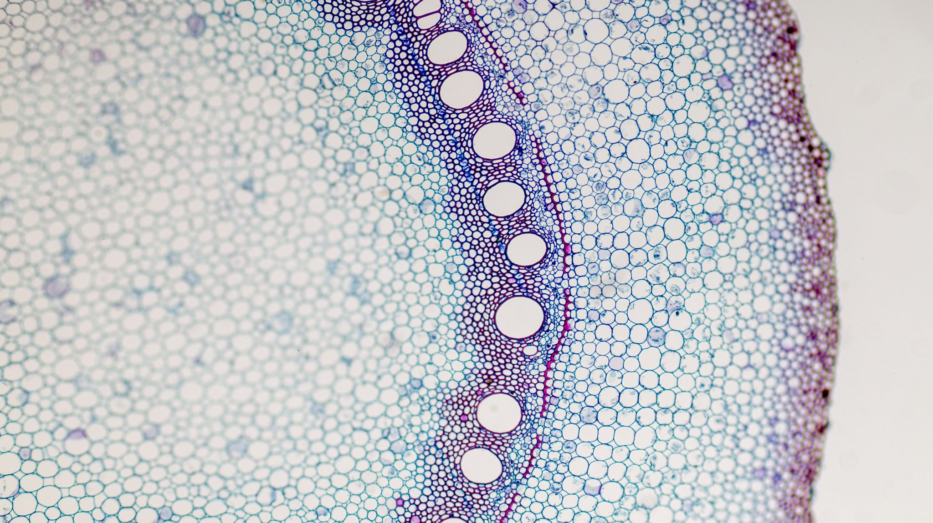
Clinical anatomy of head and neck vessels. Lymphatic drainage
MUDr. Erik Kročka

Slide 2
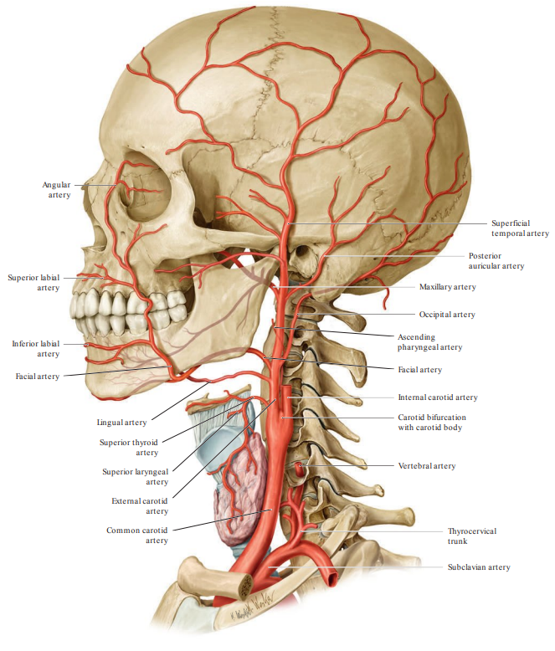
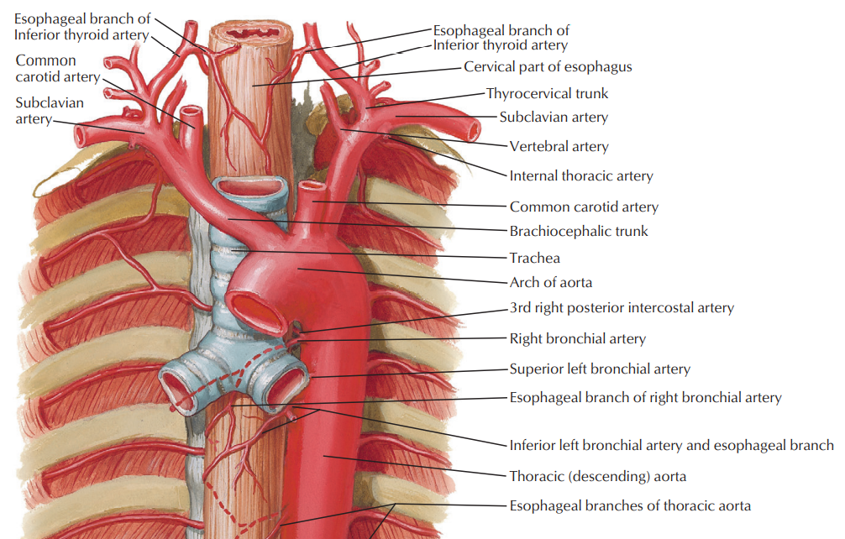
COMMON CAROTID ARTERY
main artery of head and bigger part of the brain
most often branch of brachiocephalic trunk (right) and aortic arch (left)
without branches usually

Slide 3
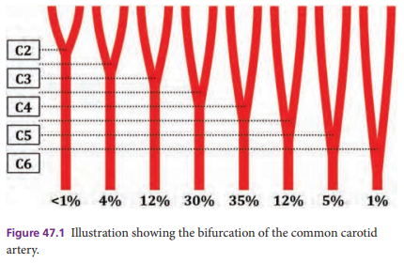
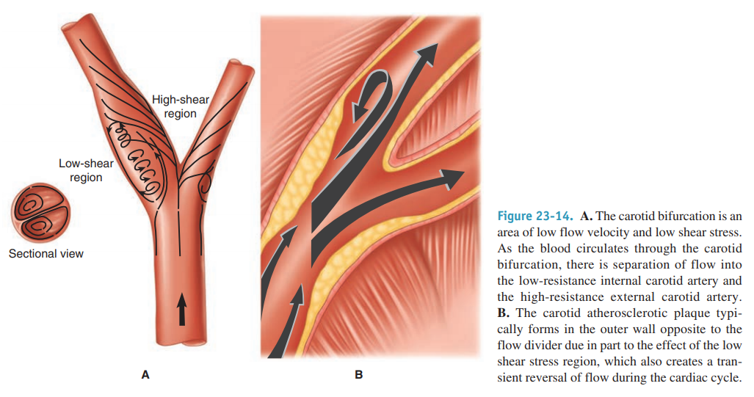
The carotid bifurcation → side predilection of an atherosclerosis

Slide 4
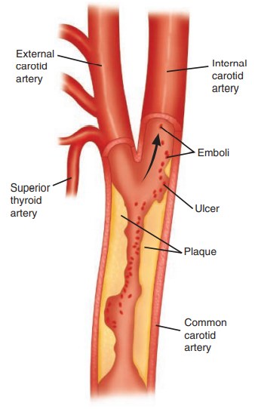
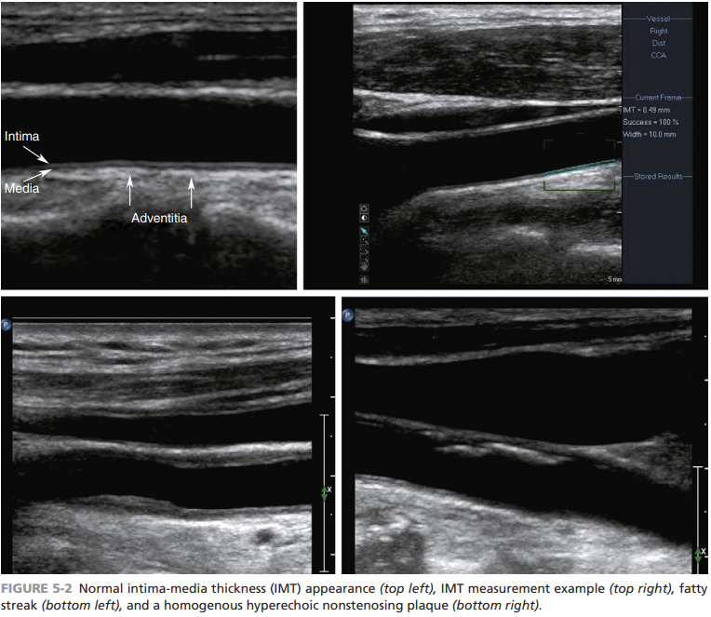

Slide 5
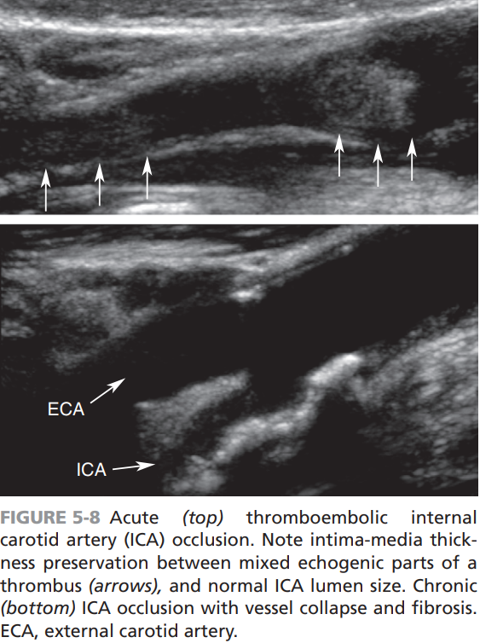
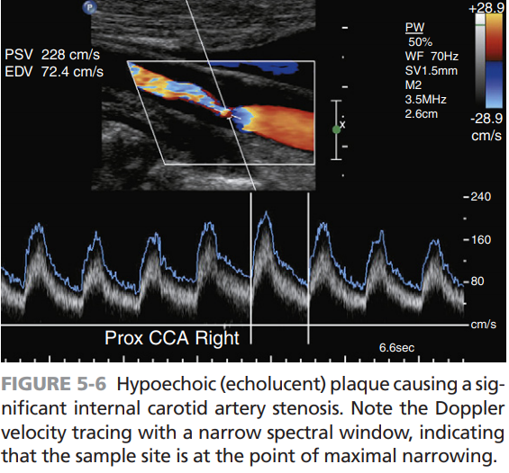

Slide 6
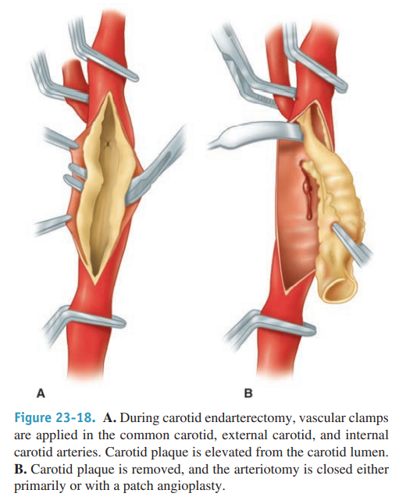
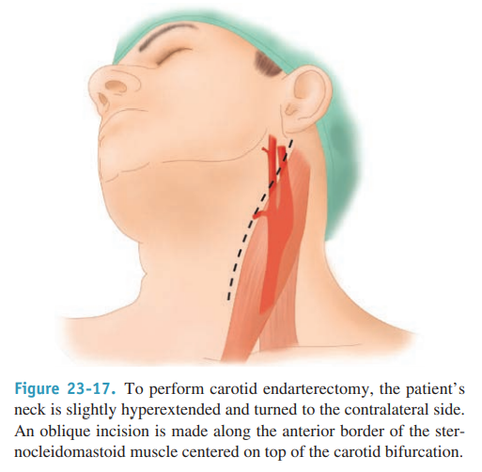
CAROTID ENDARTERECTOMY

Slide 7
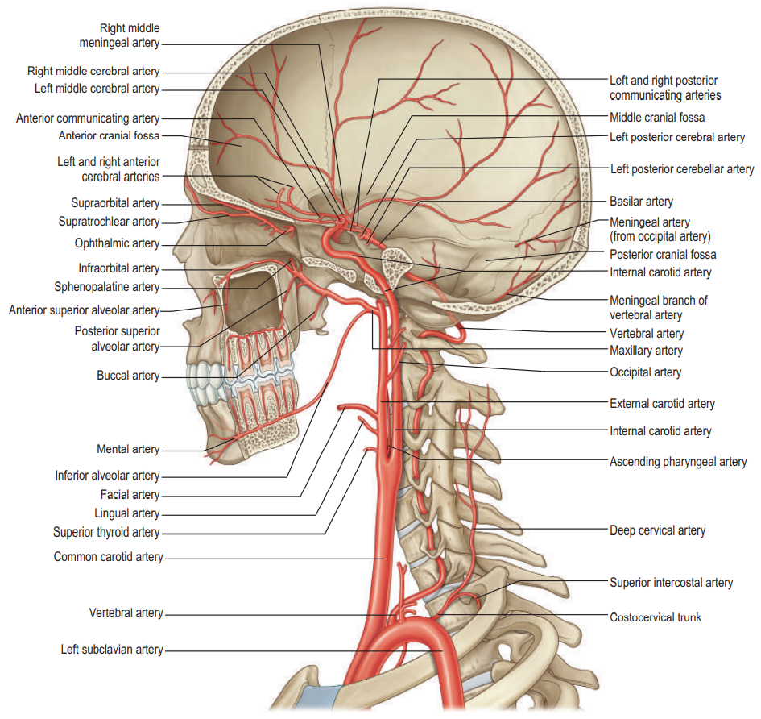
INTERNAL CAROTID ARTERY
Petrous segment
Caroticotympanic arteries
Cavernous segment
Tentorial basal branch
Tentorial marginal branch
Meningeal branch
Branches to nerves
Branches to trigeminal ganglion
Capsular branches (cavernous sinus)
Inferior hypophyseal artery
Cerebral segment
Superior hypophyseal artery
Ophthalmic artery
Anterior choroidal artery
Anterior cerebral artery
Middle cerebral artery
Posterior communicating artery

Slide 8
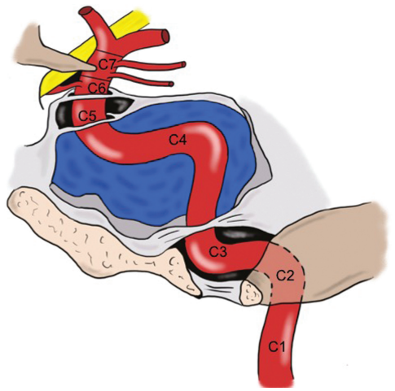
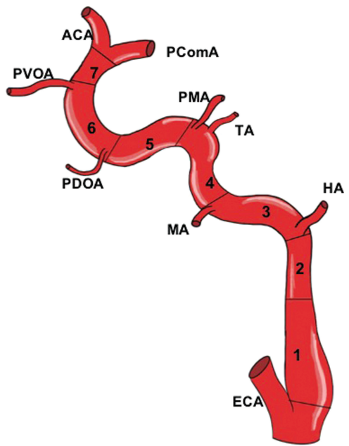
Lasjaunias and Santoyo-Vasquez
classification - embryologic (1984)
Bouthillier´s classification (1996)

Slide 9
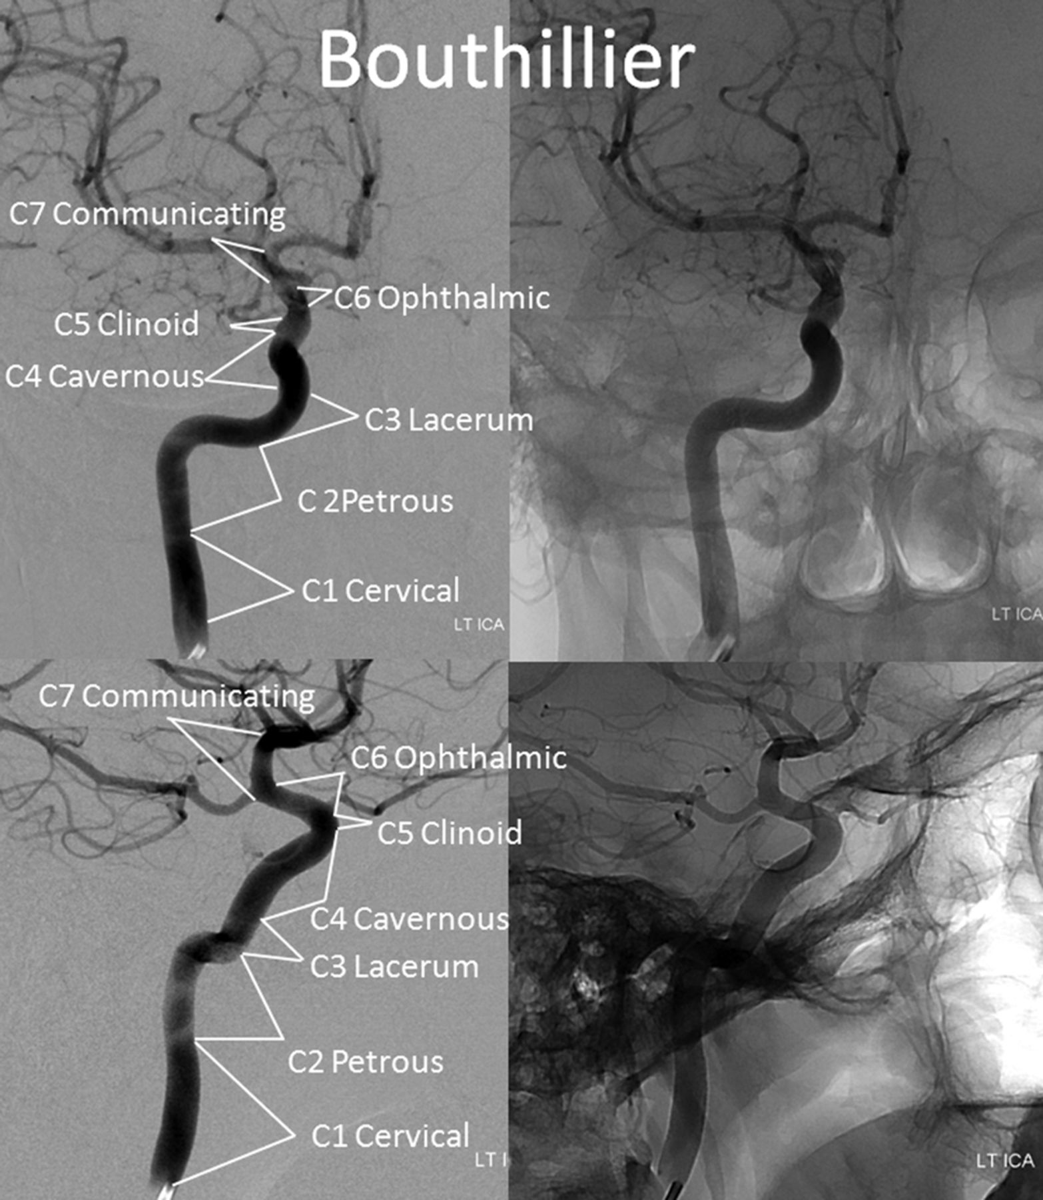
C1 (cervical segment)
without branches
C2 (petrosus segment)
Caroticotympanic arteries
Artery of pterygoid canal
C3 (lacerum segment)
without branches
(or artery of pterygoid canal)
extradural
C4 (cavernous segment)
Meningohypophyseal trunk (MHT)
Inferolateral trunk (ILT)
Capsular arteries
C5 (clinoid segment)
without branches
C6 (ophthalmic segment)
Ophthalmic artery
Superior hypophyseal artery
intradural
C7 (communicating segment)
Anterior choroidal artery
Posterior communicating artery

Slide 10
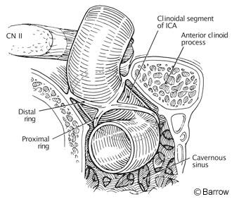
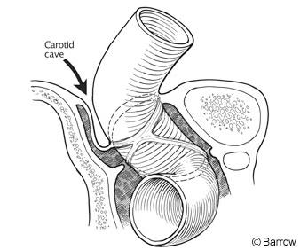

Slide 11
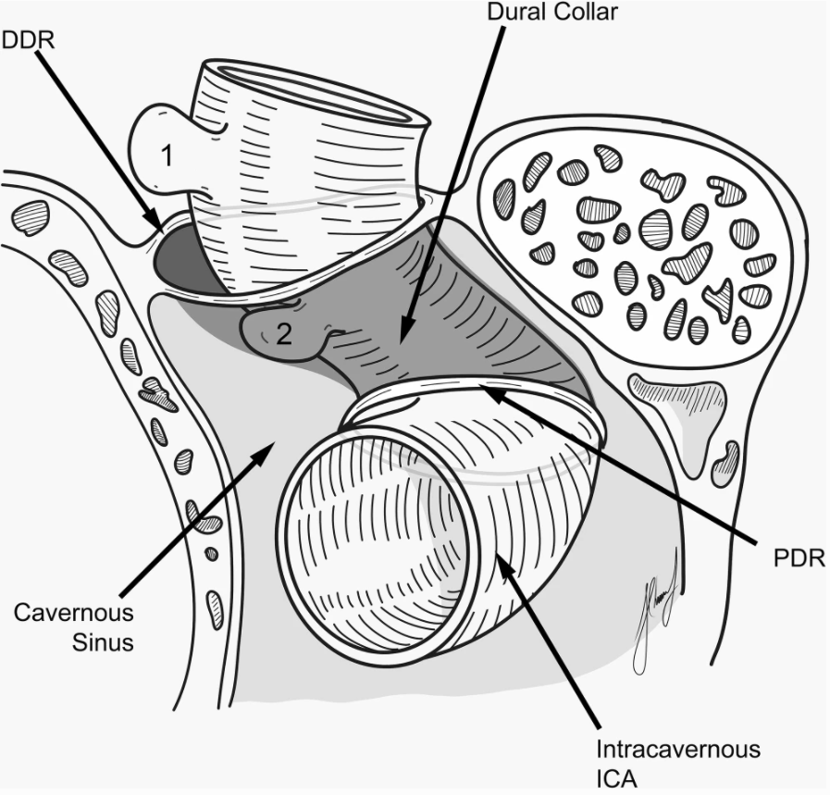
C5 segment aneurysm
Intradural aneurysm: above DDR
risk of subarachnoid hemorrhage (SAH)
Extradural aneurysm: under DDR
CONVENTIONAL BOUNDARY
(existence of „Carotid cave“!)

Slide 12
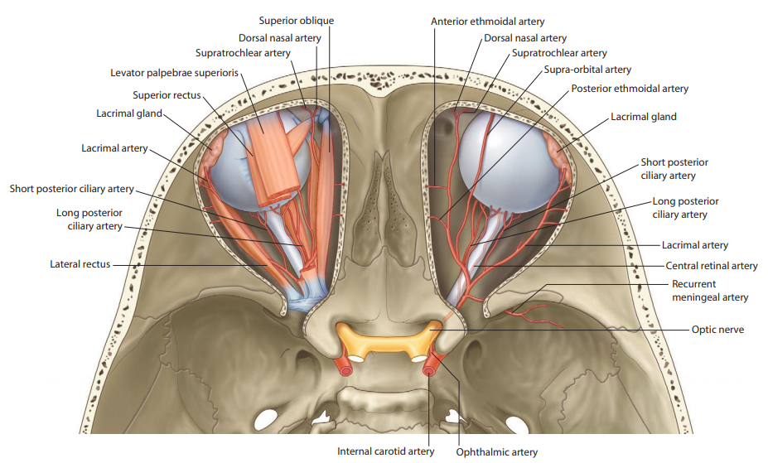
ARTERIES OF THE ORBIT
Ophthalmic artery
Central retinal artery
Lacrimal artery
Anterior ciliary arteries
Lateral palpebral arteries
Short posterior ciliary arteries
Long posterior ciliary arteries
Anterior ciliary arteries
Muscular arteries
Supraorbital artery
Posterior ethmoidal artery
Anterior ethmoidal artery
Anterior meningeal branch
Medial palpebral arteries
Supratrochlear artery
Dorsal nasal artery

Slide 13
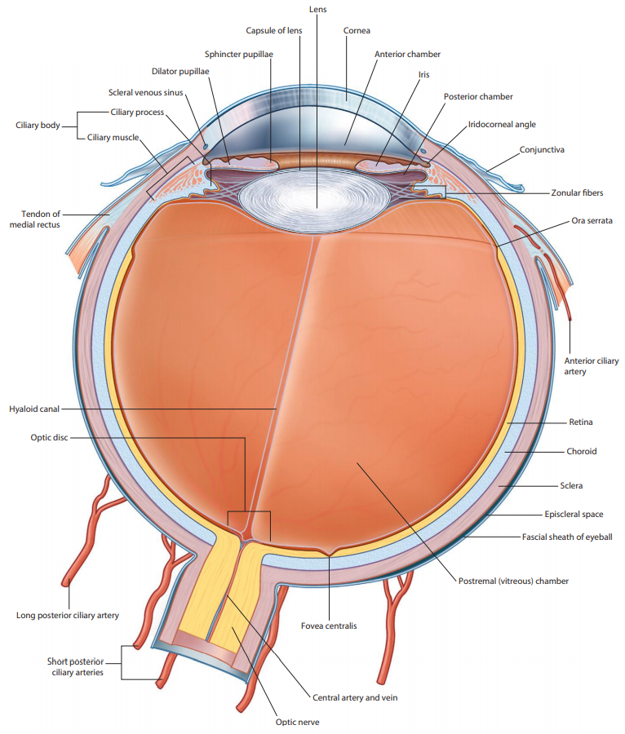
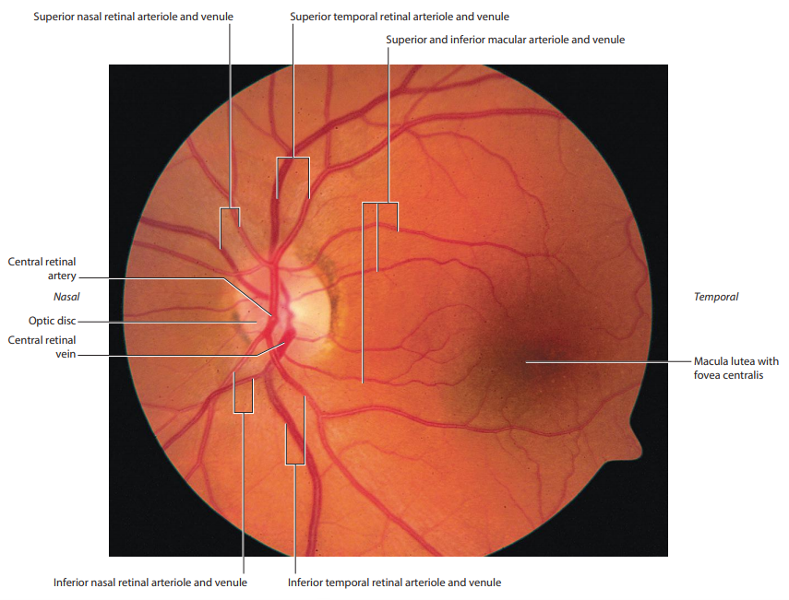

Slide 14
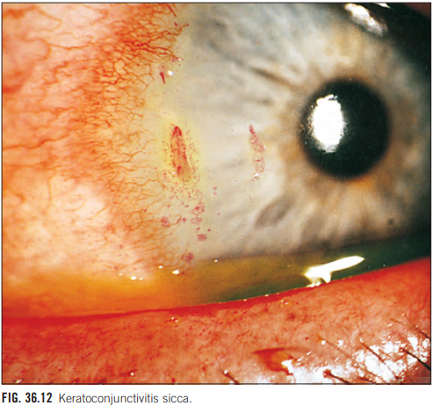
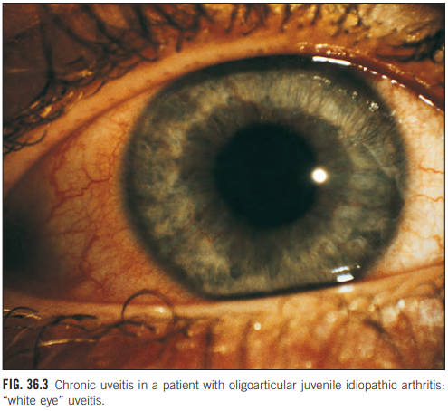

Slide 15
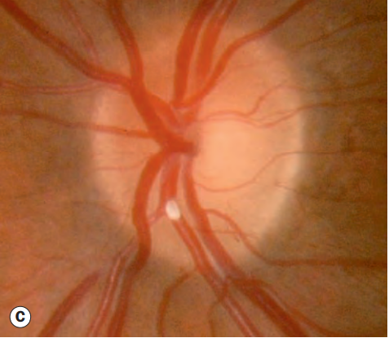
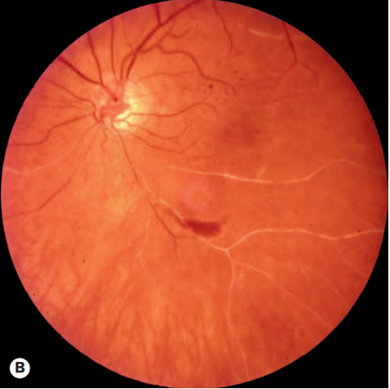
RETINAL ARTERY OCCLUSION

Slide 16
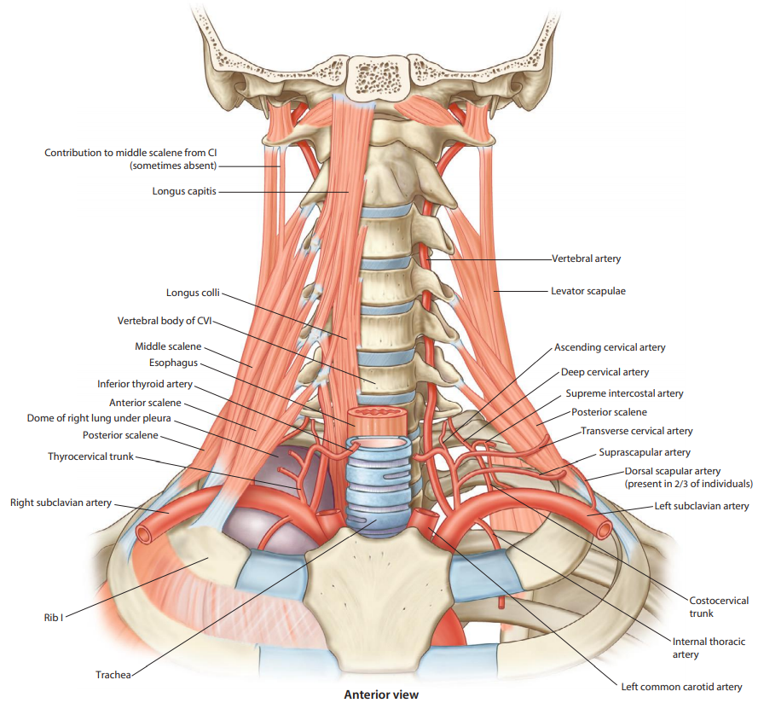
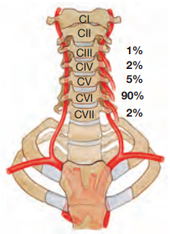
VERTEBRAL ARTERY
Cervical branches
Spinal branches
Muscular branches
Meningeal branches
Cranial branches
Basilar artery
Posterior cerebral arteries

Slide 17
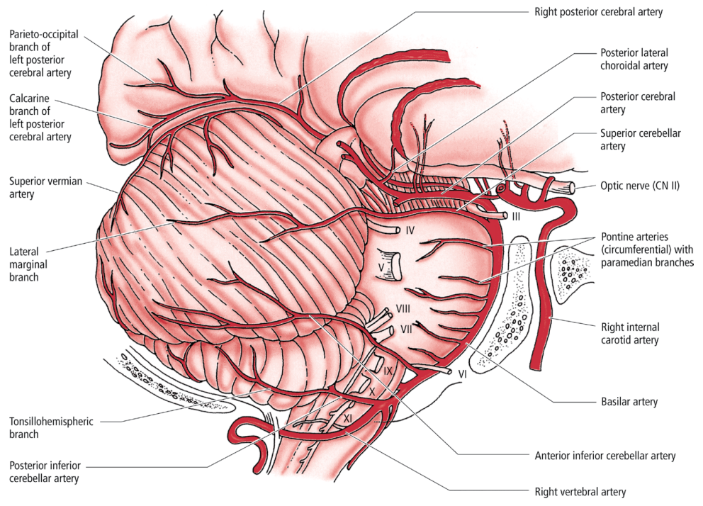

Slide 18
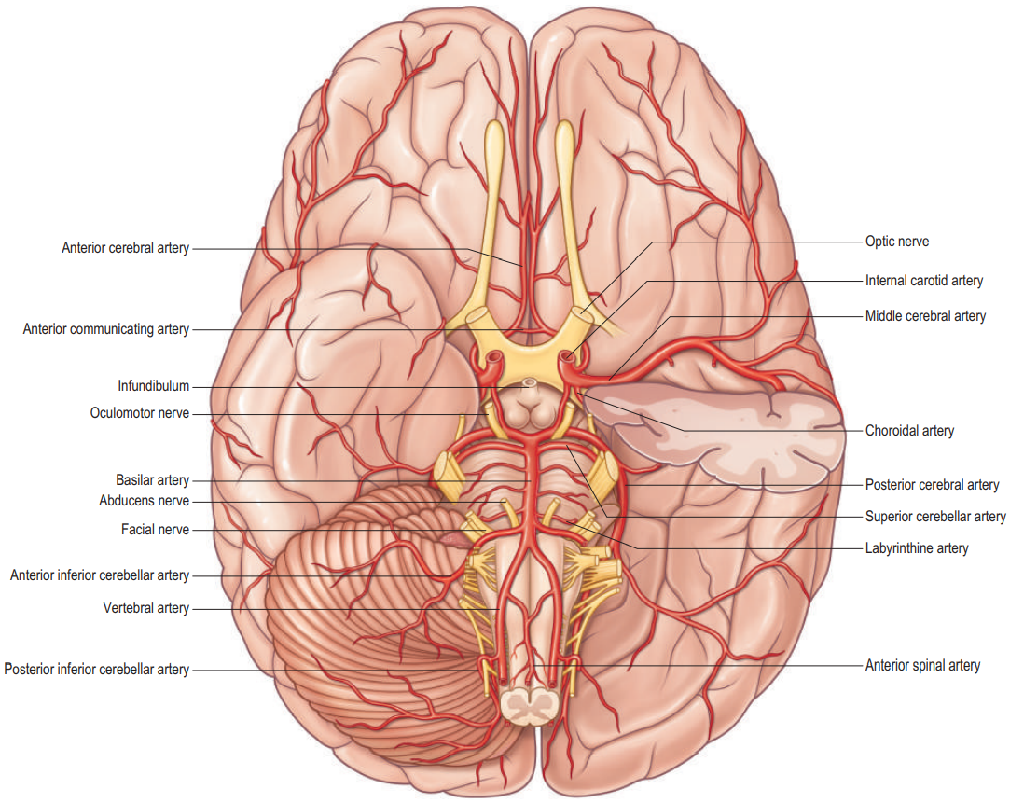
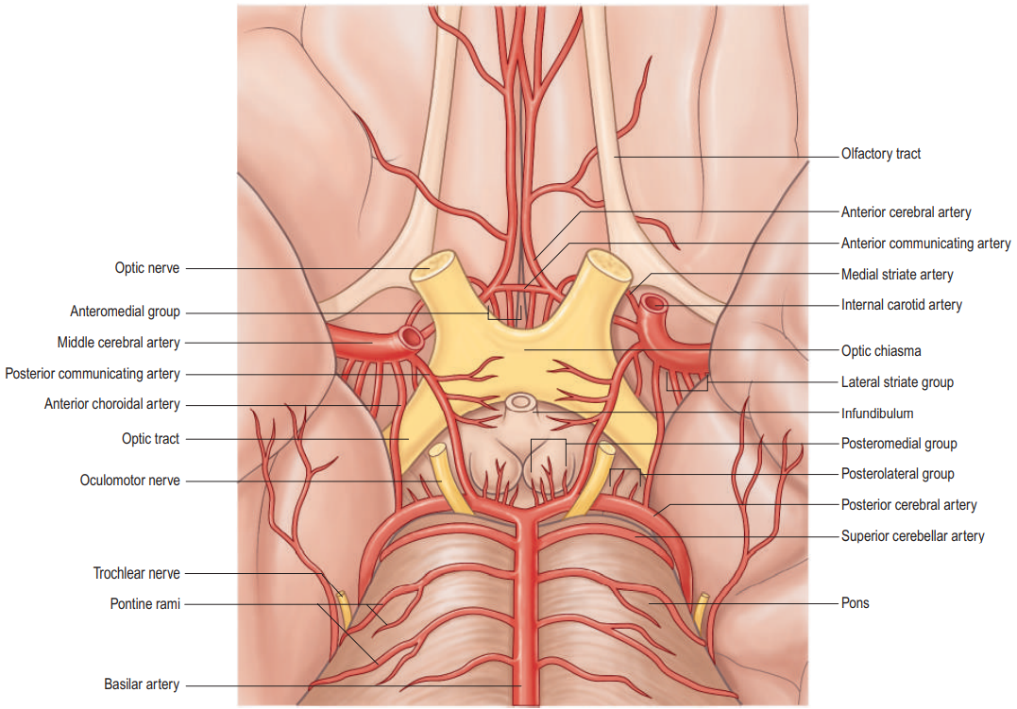
CIRCULUS ARTERIOSUS CEREBRI WILLISI

Slide 19
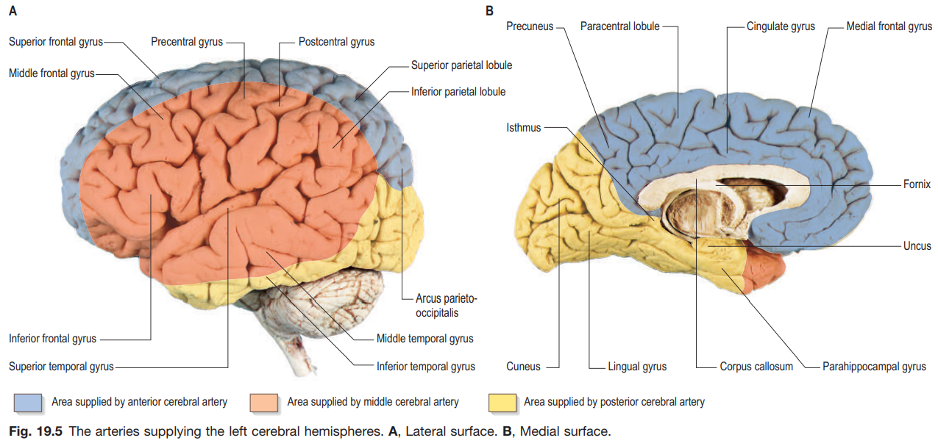
ARTERIAL SUPPLY OF THE BRAIN
Anterior 2/3 → internal carotid artery
Posterior 1/3 → vertebral artery

Slide 20
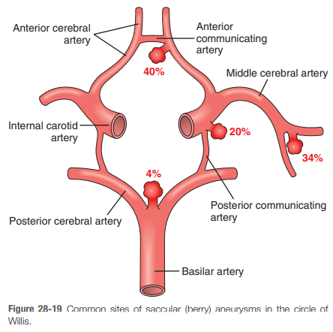
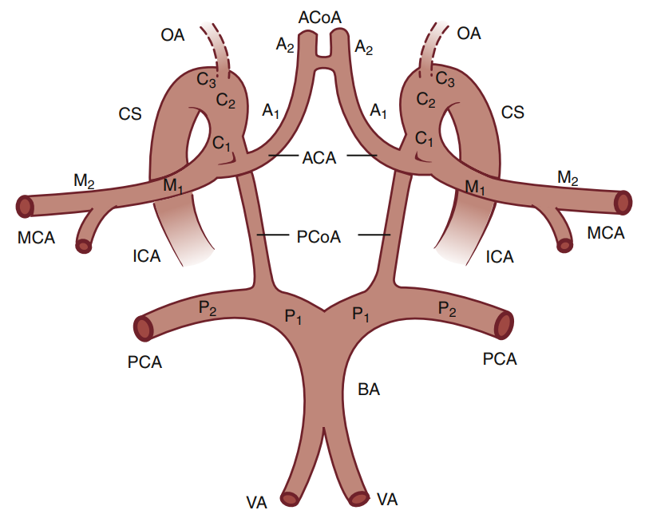
ANEURYSMS IN THE CIRCLE OF WILLIS

Slide 21
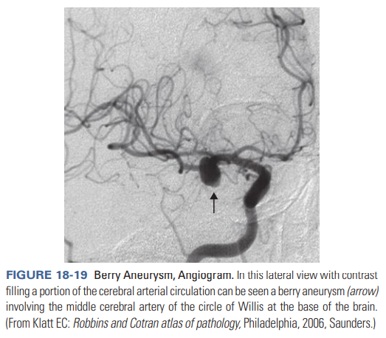
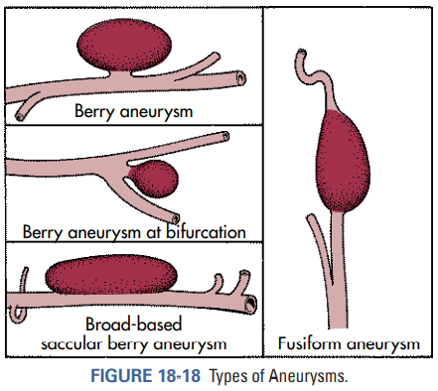

Slide 22
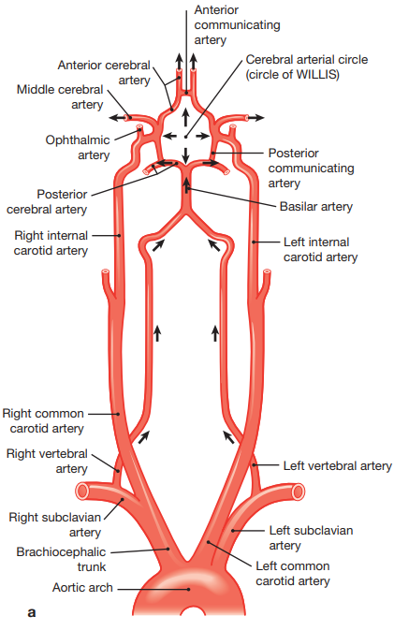
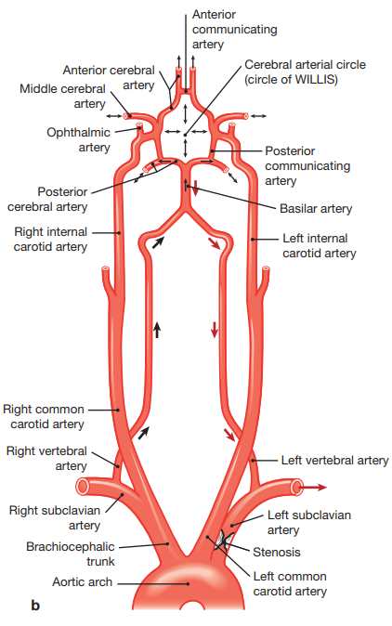
SUBCLAVIAN STEAL SYNDROM

Slide 23
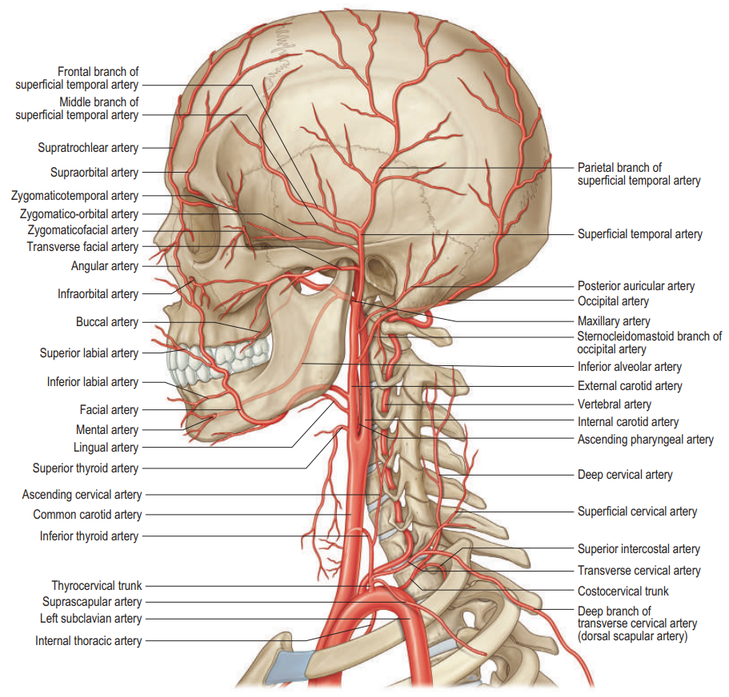
EXTERNAL CAROTID ARTERY
Ventral branches
Superior thyroid artery
Lingual artery
Facial artery
Medial branches
Ascending pharyngeal artery
Dorsal branches
Occipital artery
Posterior auricular artery
Terminal branches
Maxillary artery
Superficial temporal artery

Slide 24
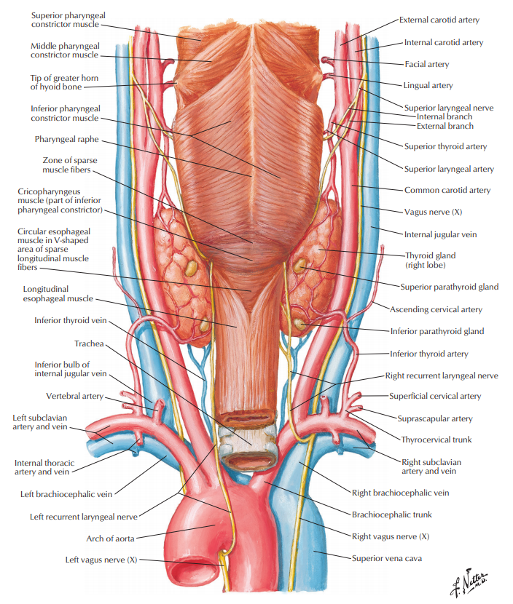
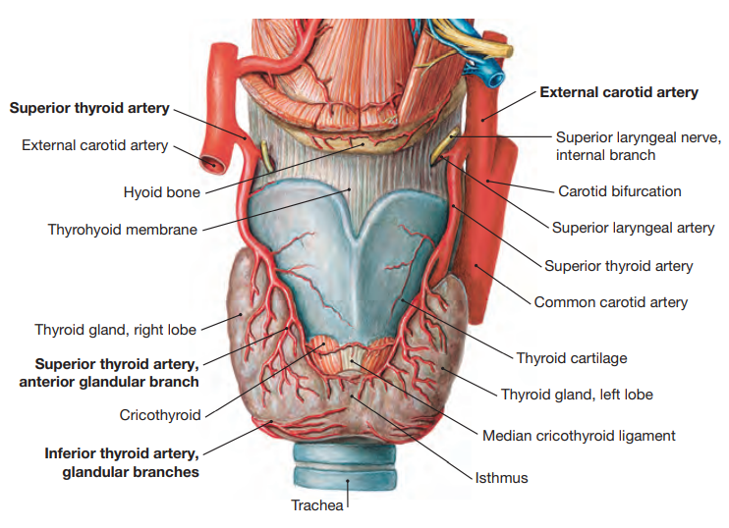
SUPERIOR THYROID ARTERY
Superior laryngeal artery
Cricothyroid artery
Infrahyoid branch
Sternocleidomastoid branch
Glandular branches (anterior, lateral and posterior)

Slide 25
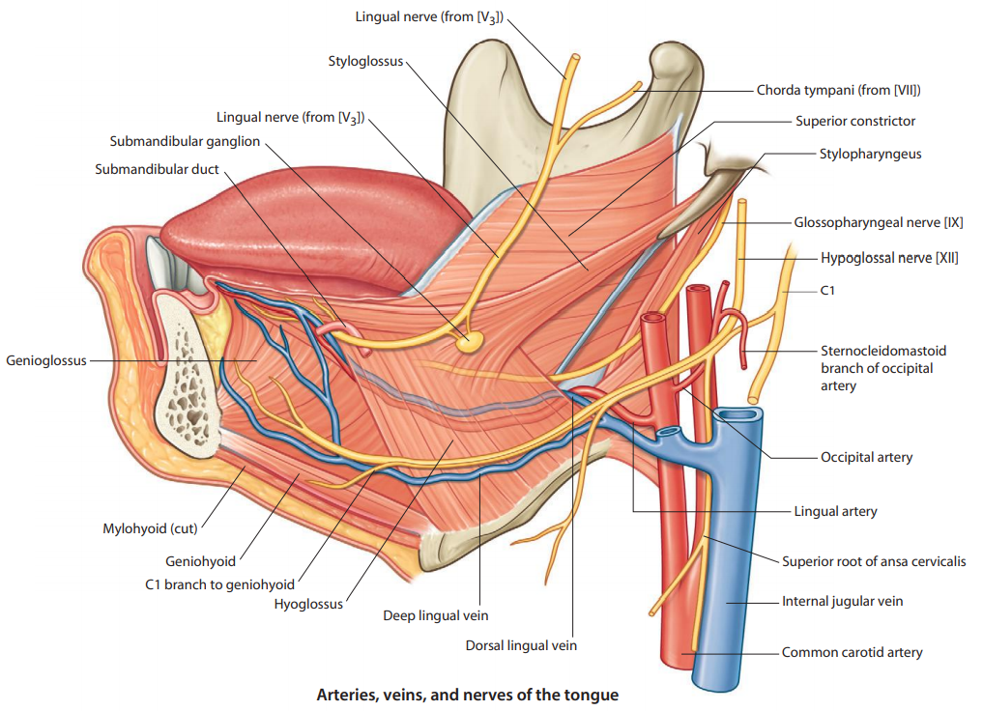
LINGUAL ARTERY
Suprahyoid branch
Sublingual artery
Dorsal lingual branches
Deep lingual artery

Slide 26
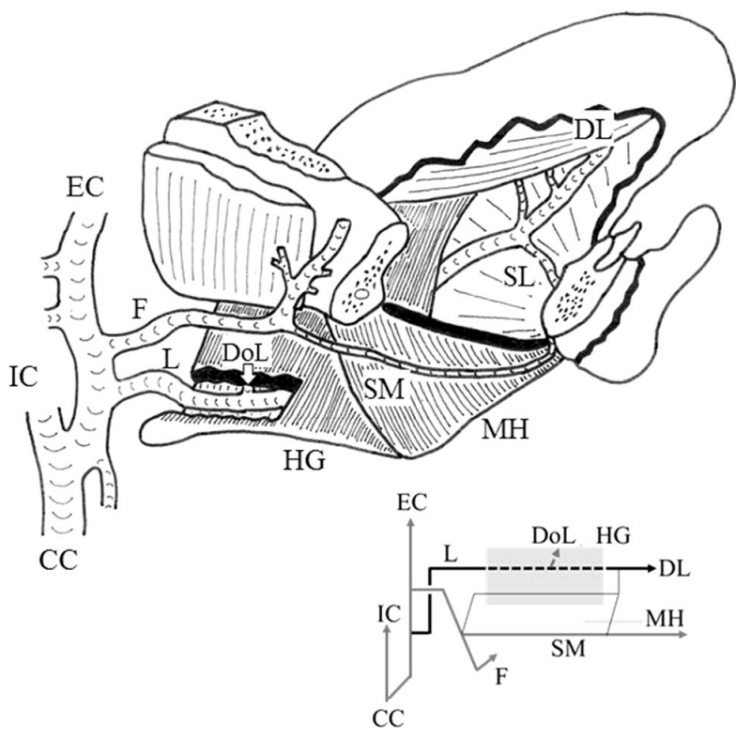
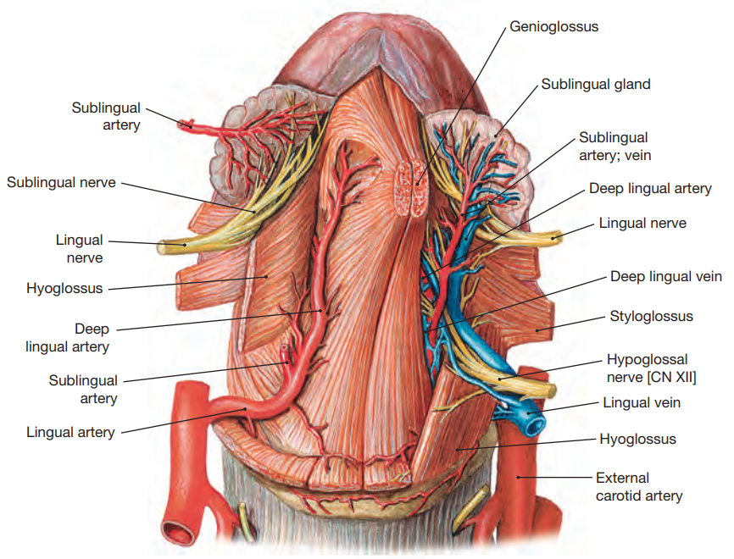
Lingual artery - M type
the main route type
courses between hyoglossus and genioglossus muscles

Slide 27
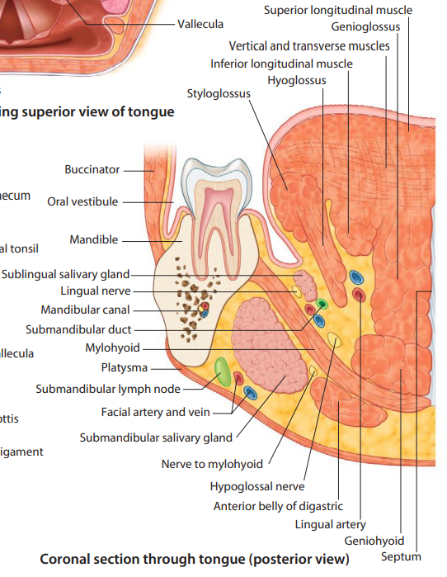
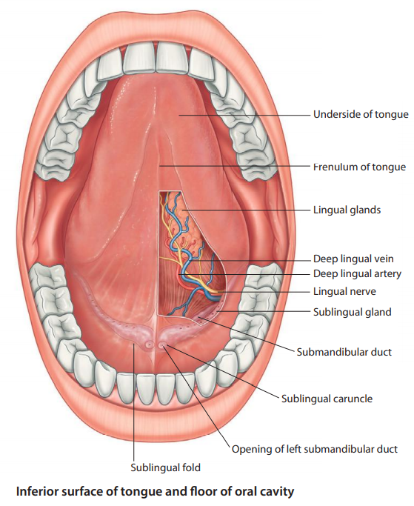

Slide 28
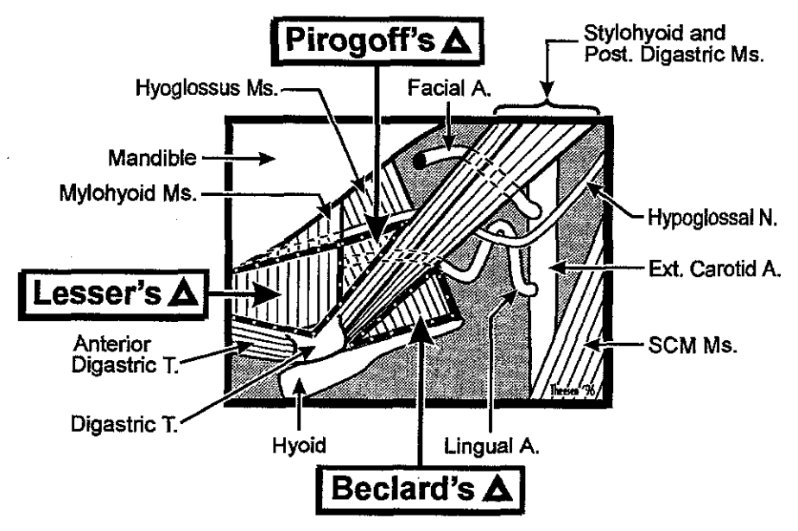
The lingual artery ligation
The Béclard´s angle
caudal: the greater horne of the hyoid bone
cranial: the posterior belly of the digastric muscle
2. The Pirogov triangle
the posterior border of the mylohyoid muscle
the intermediate tendon of the digastric muscle
hypoglossal nerve
3. The Lesser´s triangle
hypoglossal nerve
the anterior and posterior belly of the digastric muscle

Slide 29
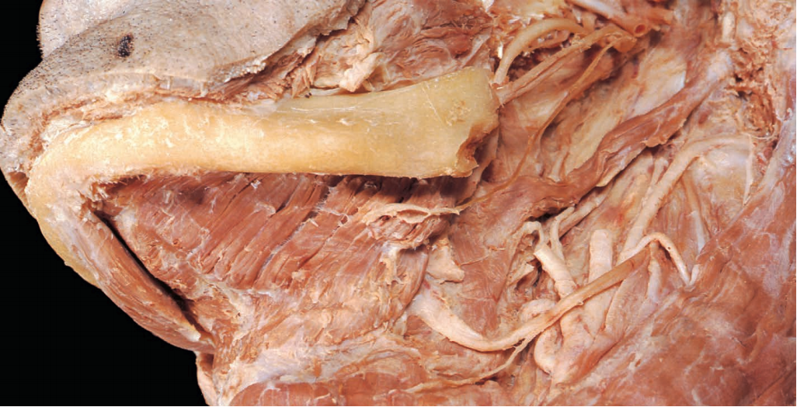

Slide 30
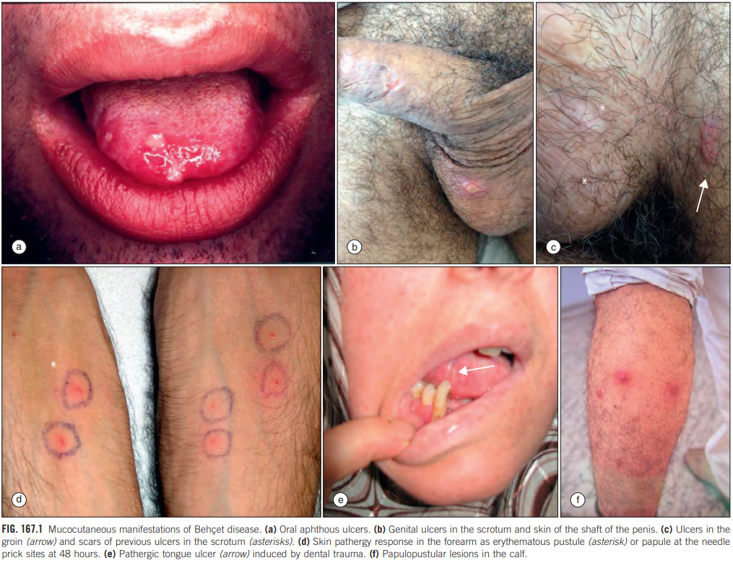
BEHCET´S DISEASE

Slide 31
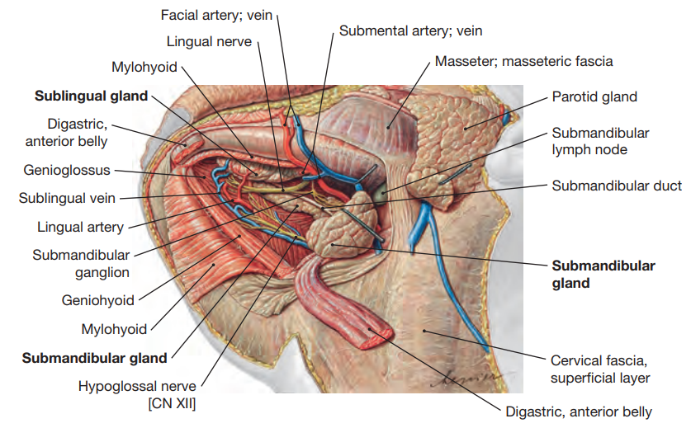
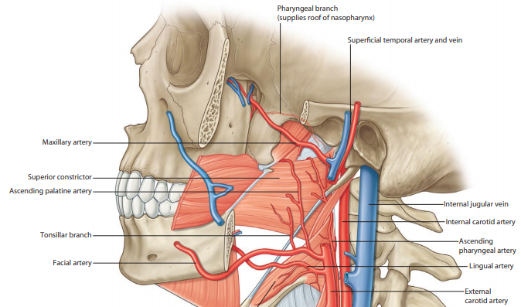
FACIAL ARTERY
Ascending palatine artery
Submental artery
Tonsillar branch
Glandular branches
Superior and inferior labial artery
Lateral nasal branch
Angular artery

Slide 32
FACIAL ARTERY
Ascending palatine artery
Submental artery
Tonsillar branch
Glandular branches
Superior and inferior labial artery
Lateral nasal branch
Angular artery

Slide 34
POSTERIOR AURICULAR ARTERY
Muscular branches
Glandular branches
Auricular branch
Stylomastoid artery
Posterior tympanic artery
Mastoid branches
Stapedial branch
Occipital branch
OCCIPITAL ARTERY
Sternocleidomastoid branch
Auricular branch
Mastoid (meningeal) branch
Occipital branches

Slide 35
ASCENDING PHARYNGEAL ARTERY
Pharyngeal branches
Posterior meningeal artery
Inferior tympanic artery

Slide 36
SUPERFICIAL TEMPORAL ARTERY
Parotid branches
Transverse facial artery
Anterior auricular branches
Zygomatico-orbital artery
Middle temporal artery
Frontal branch
Parietal branch

Slide 37
TEMPORAL ARTERITIS

Slide 39
MAXILLARY ARTERY
1. MANDIBULAR PORTION
Deep auricular artery
Anterior tympanic artery
Middle meningeal artery
Frontal branch
Parietal branch
Orbital branch
Superior tympanic artery
Inferior alveolar artery
Mylohyoid branch
Dental branches
Gingival branches
Mental artery
2. PTERYGOID PORTION
Masseteric artery
Pterygoid arteries
Deep temporal arteries
Buccal artery

Slide 41
3. PTERYGOPALATINE PORTION
Posterior superior alveolar artery
Dental branches
Gingival branches
Infraorbital artery
Anterior superior alveolar arteries
Dental branches
Gingival branches
Artery of pterygoid canal
Descending palatine artery
Greater palatine artery
Lesser palatine arteries
Sphenopalatine artery
Posterior lateral nasal arteries
Posterior septal branches
Nasopalatine branch

Slide 43
VENOUS DRAINAGE OF THE HEAD AND NECK
Cerebral veins
Meningeal veins
Dural venous sinuses
Diploic veins
Veins of labyrinth
Emissary veins
Retromandibular vein
Superficial temporal vein
Middle temporal vein
Transvers facial vein
Maxillary veins
8. Ophthalmic veins
9. Pharyngeal veins
10. Facial vein
11. Lingual vein
Sublingual vein
Vena comitans nervi hypoglossi
12. Superior thyroid vein
13. Middle thyroid vein
14. External jugular vein

Slide 45
CENTRAL RETINAL VEIN OCCLUSION

Slide 47
PTERYGOID PLEXUS
Middle meningeal veins
Venous plexus of foramen ovale
Internal carotide venous plexus
Venous shunt in the foramen rotundum
Deep temporal veins
Vein of pterygoid canal
Anterior auricular veins
Articular veins
Tympanal veins
Stylomastoid vein
Parotide veins
Pharyngeal veins
Sphenopalatine vein
Inferior ophthalmic vein
Infraorbital vein
Deep facial vein
Descending palatine vein
Posterior superior alveolar veins
Inferior alveolar vein

Slide 48
INTERNAL JUGULAR VEIN
Sigmoid sinus + Inferior petrosal sinus
Pharyngeal veins (pharyngeal venous plexus)
Retromandibular vein
Facial vein
Lingual vein
Sublingual vein
Vena comitans nervi hypoglossi
Superior thyroid vein
Superior laryngeal vein
Sternocleidomastoid vein
Middle thyroid vein (inconsistent)
External jugular vein
Anterior jugular vein

Slide 49
LYMFATIC SYSTEM - OVERVIEW

Slide 50
OVERVIEW OF THE HEAD
AND NECK LYMPH NODES

Slide 51
LYMPH NODES OF THE HEAD
Occipital nodes
afferents: scalp in the occipital region
efferents: superficial cervical nodes and deep cervical nodes
Mastoid nodes
afferents: scalp behind the auricle, posterior side of the auricle
efferents: superficial cervical nodes and deep cervical nodes
Superficial and deep parotide nodes
afferents: scalp in the temporal and frontal region, lateral part of
the eyelids, buccal region, anterior side of the auricle
and external auditory meatus, middle ear, parotide gland,
soft palate
efferents: superficial cervical nodes and deep cervical nodes
Submandibular nodes
afferents: lower eyelids, nose, upper lip, cheeks, paralingual region,
hard palate, floor of mouth, teeth
efferents: deep cervical nodes
Submental nodes
afferents: lower lip, chin, anterior floor of mouth, anterior teeth,
tip of tongue
efferents: superficial cervical nodes and deep cervical nodes

Slide 52
Nodi retropharyngei
afferents: pharynx, middle ear, Eustachian tube,
posterior and superior nasal cavity, paranasal
sinuses
efferents: nodi cervicales profundi

Slide 53
LYMPH FROM THE TONGUE
Apical collecting vessels
→ juguloomohyoid node or via submental nodes
External marginal collecting vessels
→ submental nodes
Internal marginal collecting vessels
→ internal jugular nodes from anterior tongue
→ jugulodigastric node from posterior tongue
Central collecting vessels
→ submandibular nodes and juguloomohyoid node
Basal collecting vessels
→ internal jugular nodes and jugulodigastric node
+ lingual nodes in the lingual base

Slide 54
Lateral superficial cervical nodes
external jugular nodes
Lateral deep cervical nodes
a. internal jugular nodes
tonsillar node (Wood´s node)
jugulodigastric node (Küttner´s node)
b. spinal accessory nodes
c. supraclavicular nodes
Wirchov´s nodes on the left side
Anterior superficial cervical nodes
anterior jugular nodes
Anterior deep cervical nodes
praelaryngeal nodes
thyroid nodes
preglandular nodes
pretracheal nodes
paratracheal nodes

Slide 55
References:
HOMBACH-KLONISCH, S., T. KLONISCH and J. PEELER. Sobotta: Clinical Atlas of Human Anatomy. Munich, Germany: Elsevier Science, 2019, 680 s. ISBN 978-0-7020-5273-6.
STANDRING, S, et al. Gray's Anatomy: The Anatomical Basis of Clinical Practice. 41st. Philadelphia: Elsevier, 2016, 1562 s. ISBN 978-0-7020-5230-9.
DRAKE, R. L., A. WAYNE VOGL and A. W. M. MITCHELL. Gray's Anatomy for Students. 4th. Philadelphia: Elsevier, 2020. ISBN 978-0-323-39304-1.
DRAKE, R. L., A. WAYNE VOGL, A. W. M. MITCHELL, R. M. TIBBITTS and P. E. RICHARDSON. Gray's Atlas of Anatomy. 2. Philadelphia: Churchill Livingstone, 2015,
648 s. ISBN 978-1-4557-4802-0.
NETTER, F. H. Atlas of Human Anatomy. 6. Philadelphia: Saunders, 2014, 624 s. ISBN 978-1-4557-0418-7.
BRUNICARDI, F. Ch., D. K. ANDERSEN, T. R. BILLIAR, D. L. DUNN, J. G. HUNTER, L. S. KAO, J. B. MATTHEWS and R. E. POLLOCK. Schwartz’s Principles of Surgery.
11. New York: McGraw-Hill Education, 2019, 2448 s. ISBN 978-1-25-983537-7.
PELLERITO, J. S. and J. F. POLAK. Introduction to vascular ultrasonography. 6. Philadelphia: Saunders, 2012, 704 s. ISBN 978-1-4377-1417-3.
GOSLING, J. A., P. F. HARRIS, J. R. HUMPHERSON, I. WHITMORE, P. L. T. WILLAN et al. Human Anatomy, Color Atlas and Textbook. 6. Philadelphia: Elsevier,
2017, 456 s. ISBN 978-0-7234-3827-4.
KANSKI, J. J. and B. BOWLING. Kanski's Clinical Ophthalmology: A Systematic Approach. 8. Philadelphia: Saunders, 2016, 928 s. ISBN 978-0-7020-5572-0.
HOCHBERG, M. C., A. J. SILMAN, E. M. GRAVALESSE, J. S. SMOLEN, M. E. WEINBLATT, M. H. WEISMAN et al. Rheumatology. 7. Philadelphia: Elsevier, 2019,
2048 s. ISBN 978-0-7020-6865-2.
SIEGENTHALER, W. et al. Differential Diagnosis in Internal Medicine: From Symptom to Diagnosis. New York: Thieme Medical Publishers, 2007, 1140 s.
ISBN 978-3-13-142141-8.
MCCANCE, K. L., S. E. HUETHER et al. Pathophysiology: The Biologic Basis for Disease in Adults and Children. 7. St. Louis: Mosby, 2014, 1840 s. ISBN 978-0-323-08854-1.
ČIHÁK, Radomír. Anatomie 3. Třetí, upravené a doplněné vydání. Praha: Grada, 2016, 832 s. ISBN 978-802-4756-363.
PÁČ, Libor. Anatomie člověka II: splanchnologie, kardiovaskulární systém, žlázy s vnitřní sekrecí. Brno: Masarykova univerzita, 2012, 192 s. ISBN 978-802-1042-919.

