Slide 2
Age (General Information)
aetās, aetātis, f
In English: lifetime, age
third declension
It follows the model word DOLOR
BY: Ahmed and Iacopo
Notes:
Aetas, follows DOLOR

Slide 3
Declension Table
 | Singular | Plural
Nominative | Aetās | Aetātēs
Genitive | Aetātis | Aetātum
Accusative (Direction) | Aetātem | Aetātēs
Ablative (Location) | Aetāte | Aetātibus

Slide 4
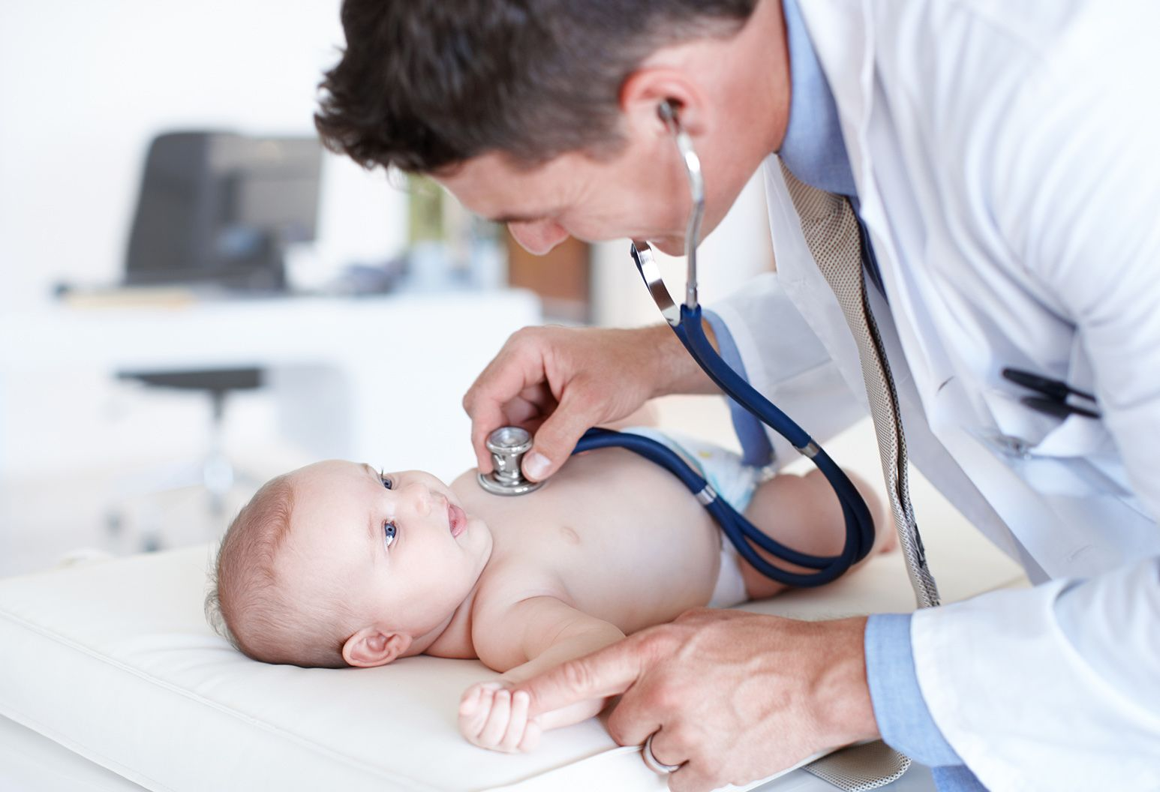
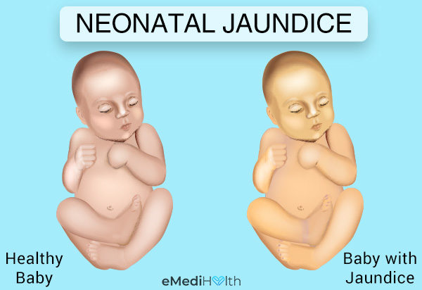
Terms related to childhood
Neonatus, i, m
2nd declension (Derived terms - neonatal , neonatologist, neonatology)
Translation: Newborn, babies anywhere from birth to 1 month old.
Ex: icterus neonatorum (neonatal jaundice) -Yellowing of a newborn’s skin during the neonatal period, which is caused by an increased bilirubin level in the blood, due to immaturity of liver function plus destruction of red cells. Neonatal jaundice appears between days 2 and 5 and clears by 2 weeks, and is more common in premature infants.

Slide 5
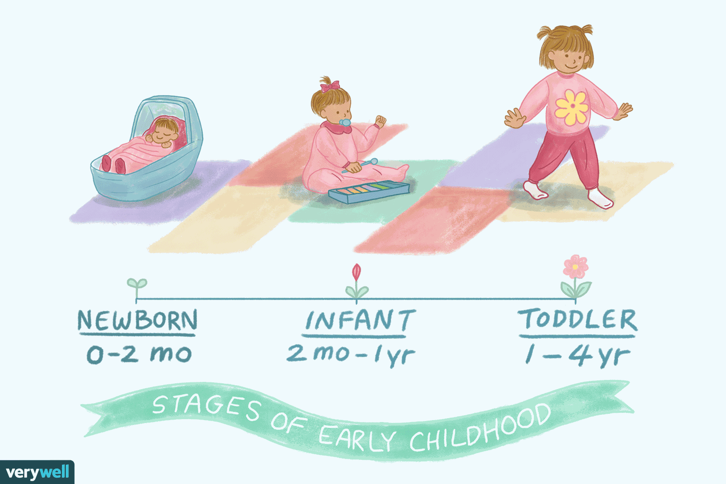
Infans, ntis, m
3rd declension (Derived term- infant)
Translation: Infants can be considered children anywhere from birth to 1 year old.
Ex: dosis pro infantibus (dosage drugs for infants)

Slide 6
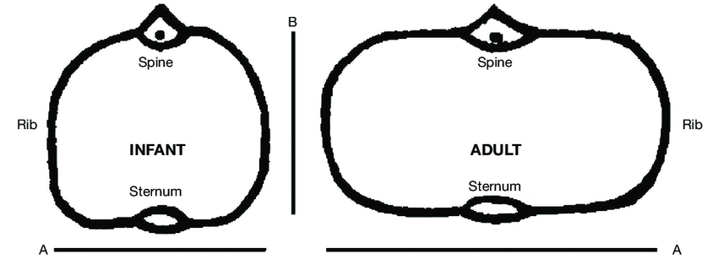
Infantilis, e
3rd declension (Derived term. Childish behavior, infant )
Ex. thorax infantilis (infant chest)

Slide 7
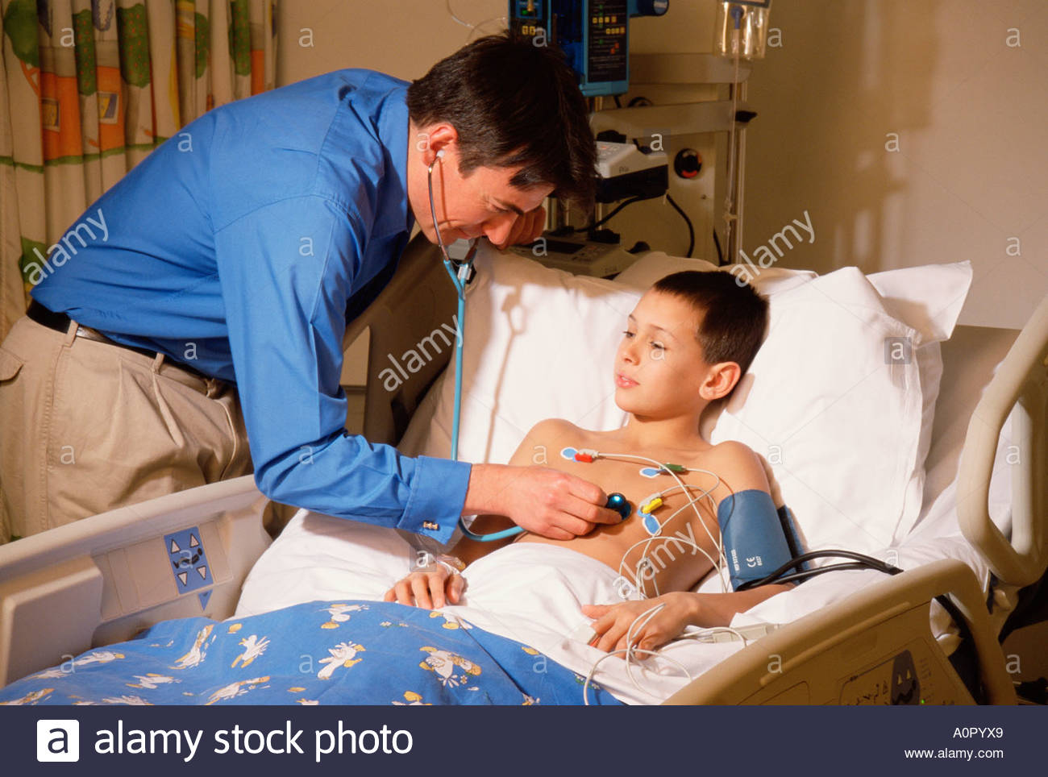
Greek Component (Childhood)
Paed-
in relation to children
ex. paediatria (pediatrics) - Pediatrics (also spelled paediatrics or pædiatrics) is the branch of medicine that involves the medical care of infants, children, and adolescents.

Slide 8
Terms related to adolescence and young adulthood
Pubertas, atis, f,
3 declension (derived term- puberty)
Translation: puberty
Ex. pubertas praecox (Premature puberty) - Premature puberty is an abnormally early onset of puberty, the process of sexual maturation being managed by the chemistry of the brain, which usually begins in late childhood and results in reproductive maturity and growth completion. Premature puberty is a change in normal development, it can be due to a disease or abnormal exposure to hormones.

Slide 9
Precocious puberty is when a child's body begins changing into that of an adult (puberty) too soon. When puberty begins before age 8 in girls and before age 9 in boys, it is considered precocious puberty

Slide 10
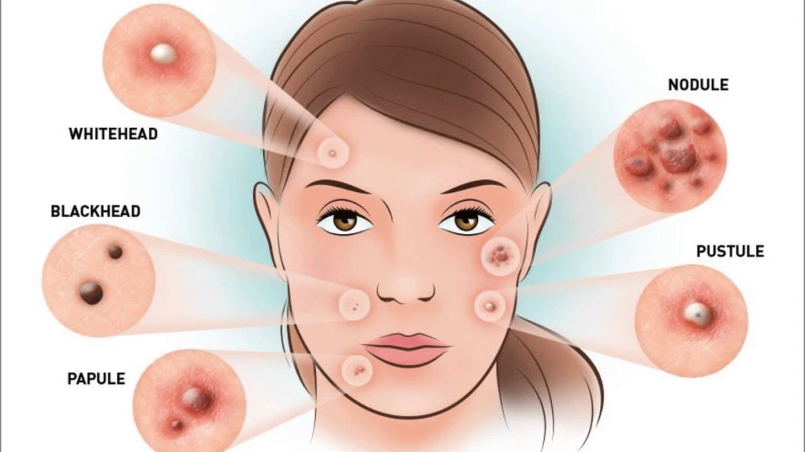
juvenis, e / juvenilis, e
3 declension ( derived term- youth)
Translation: young
Ex. acne juvenilis (juvenile acne)- Juvenile acne is one of the most common types of acne. It generally occurs between the ages of 12 and 18. It is defined as "polymorphous" because on the face of the sufferer there are simultaneously comedones (blackheads and whiteheads), papules (inflamed elements) and pustules (pimples with a white or yellow upper edge).

Slide 11
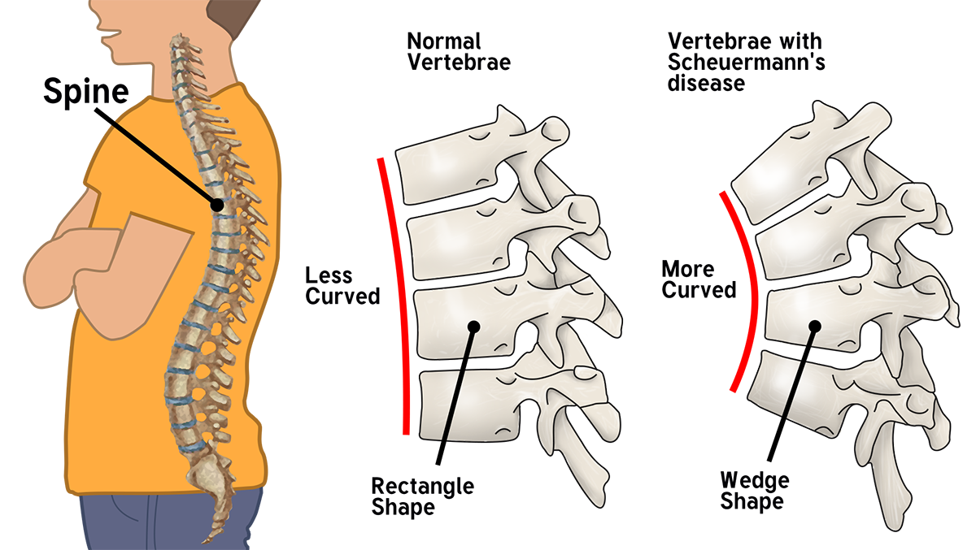
Adolescens, ntis, m.
3rd declension (derived term- adolescence)
Translation: teenager
Ex: cyphosis adolescentium (kyphosis adolescent) - cases of kyphosis in adolescents have increased by 700%, excessive use of technological devices (smartphones, tablets, notebooks) is to blame for this, as they cause a great deal of damage to the development of the spinal column in teenagers.

Slide 12
Greek Component (Adolescence)
Hebe- “young maturity,” or “bloom of youth”
ex : hebephrenia (Hebephrenia )Hebephrenia (also known as the psychosis of youth) is one of the forms in which schizophrenia can occur, This psychiatric disorder generally occurs in young people. The hebephrenic form is characterised by confusing and incoherent behaviour; the hebephrenic reveals a desire to give up the fight, not to grow psychologically so as not to have to compete and be subjected to the judgement or disapproval of others or to confront their aggressiveness; as he grows older, he deteriorates mentally.

Slide 13
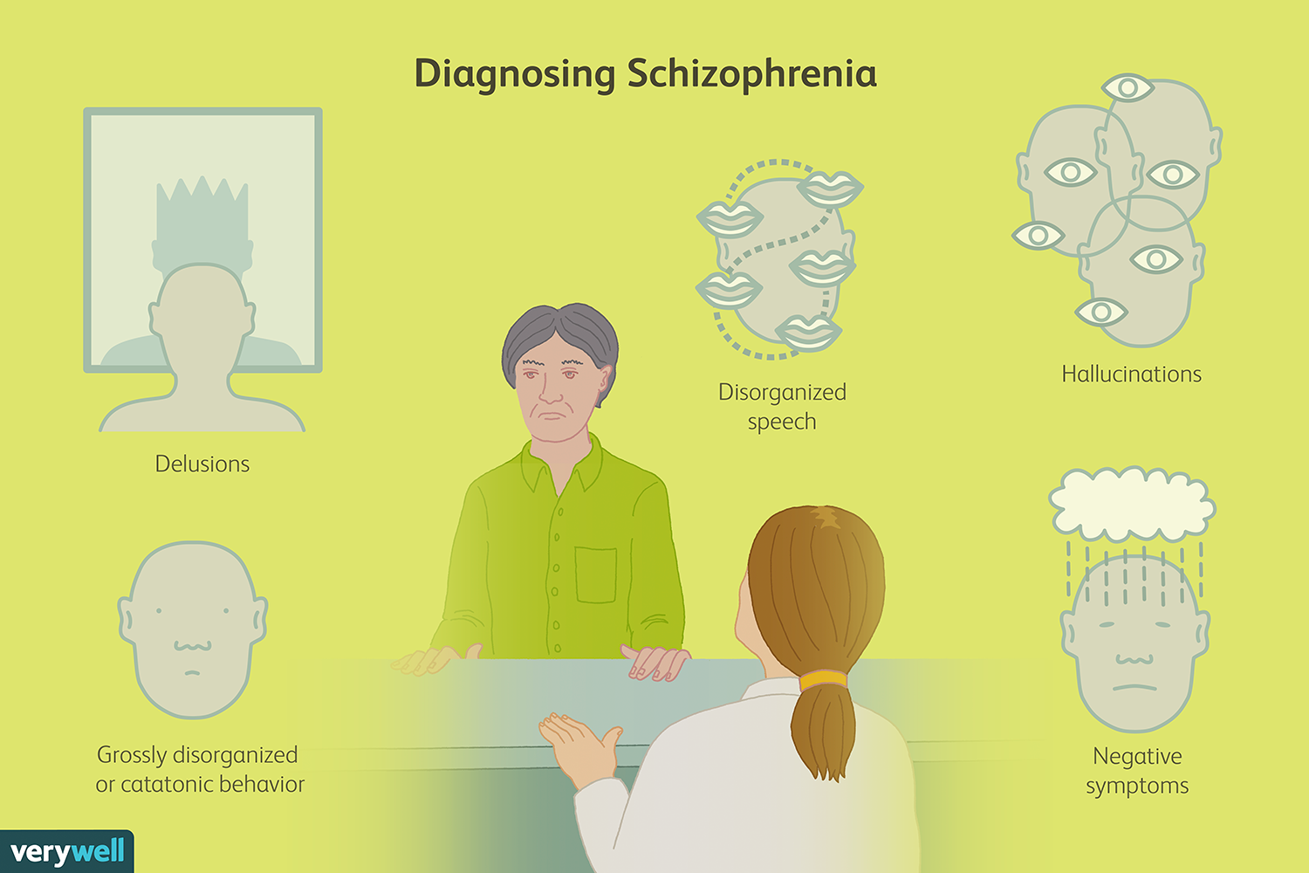

Slide 14
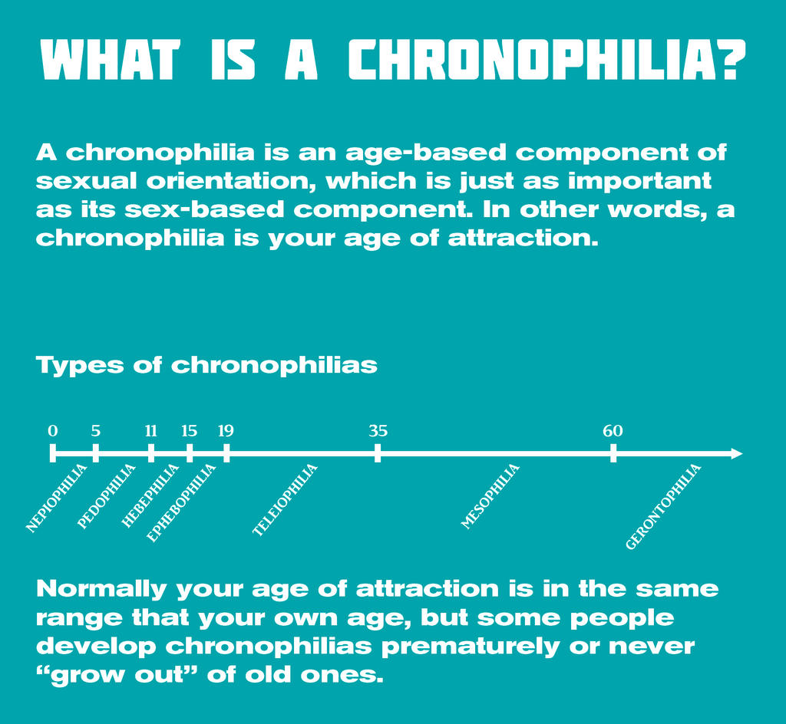
Epheb- A young man, especially an 18-20 year old in ancient Greece undergoing military training.
ex.Ephebophilia is the primary sexual interest in mid-to-late adolescents generally ages 15 to 19. It is one of a number of sexual preferences across age groups subsumed under the technical term chronophilia.

Slide 15
Nymph- in ancient Greek folklore is a female nature deity
Ex. nymphomania, Nymphomania is a mental disorder marked by compulsive sexual behavior. Compulsions are unwanted actions, or rituals, that a person engages in repeatedly without getting pleasure from them or being able to control them. Uncontrollable or excessive sexual desire in a woman

Slide 16
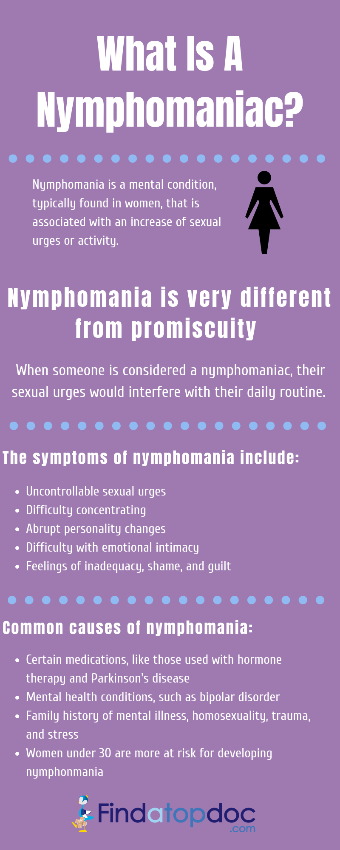

Slide 17
Terms related to adulthood
adultus, a, um is a first/second declension adjective
Example: progeria adultorum (Werner’s syndrome)

Slide 18
Terms related to old age
Praesenium, ii, n.
2nd Declension
(period before senior age) derived term: presenile,
Translation: presenile
Before the age of 65

Slide 19
Praesenilis, e
3rd declension
Ex. dementia praesenilis ( presenile dementia)- Dementia, which affects individuals between the ages of forty and sixty, the causes of which are unknown, linked to degenerative changes in the nervous tissue that lead to brain atrophy. There are two forms: Alzheimer's disease and Pick's disease. Traditionally, dementia was divided into 'presenile' or 'senile'. Presenile dementia has an onset before 65 years of age.
Senium, ii, n.
2 declension ( derived term- older)
Translation : Senior, Feebleness of age (state of being very weak)

Slide 20
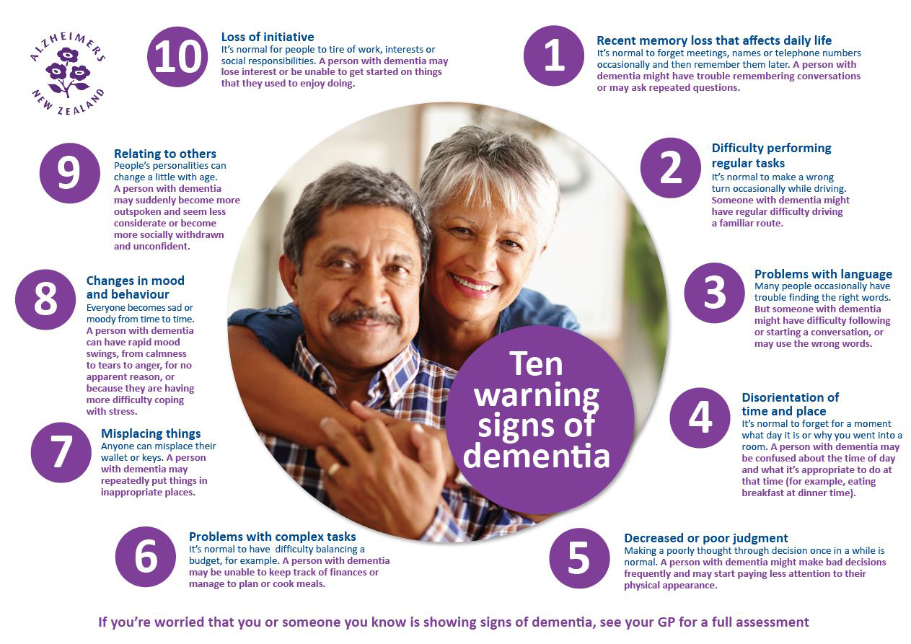

Slide 21
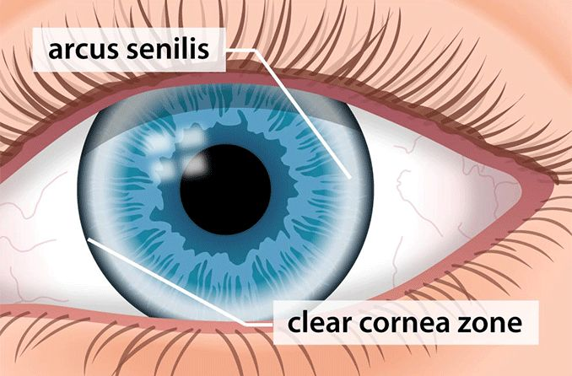
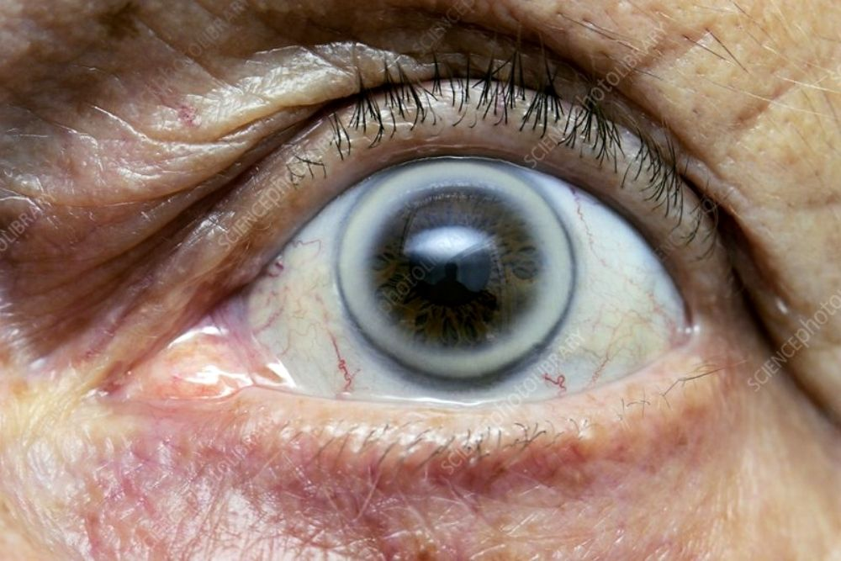
Senilis, e
3 declension ( derived term- seniliter ) transaltion: Senile
Ex: arcus corneae senilis (Arcus senilis) - is a depositing of phospholipid and cholesterol in the peripheral cornea in patients over the age of 60 which appears as a hazy white, grey, or blue opaque ring (peripheral corneal opacity).

Slide 22
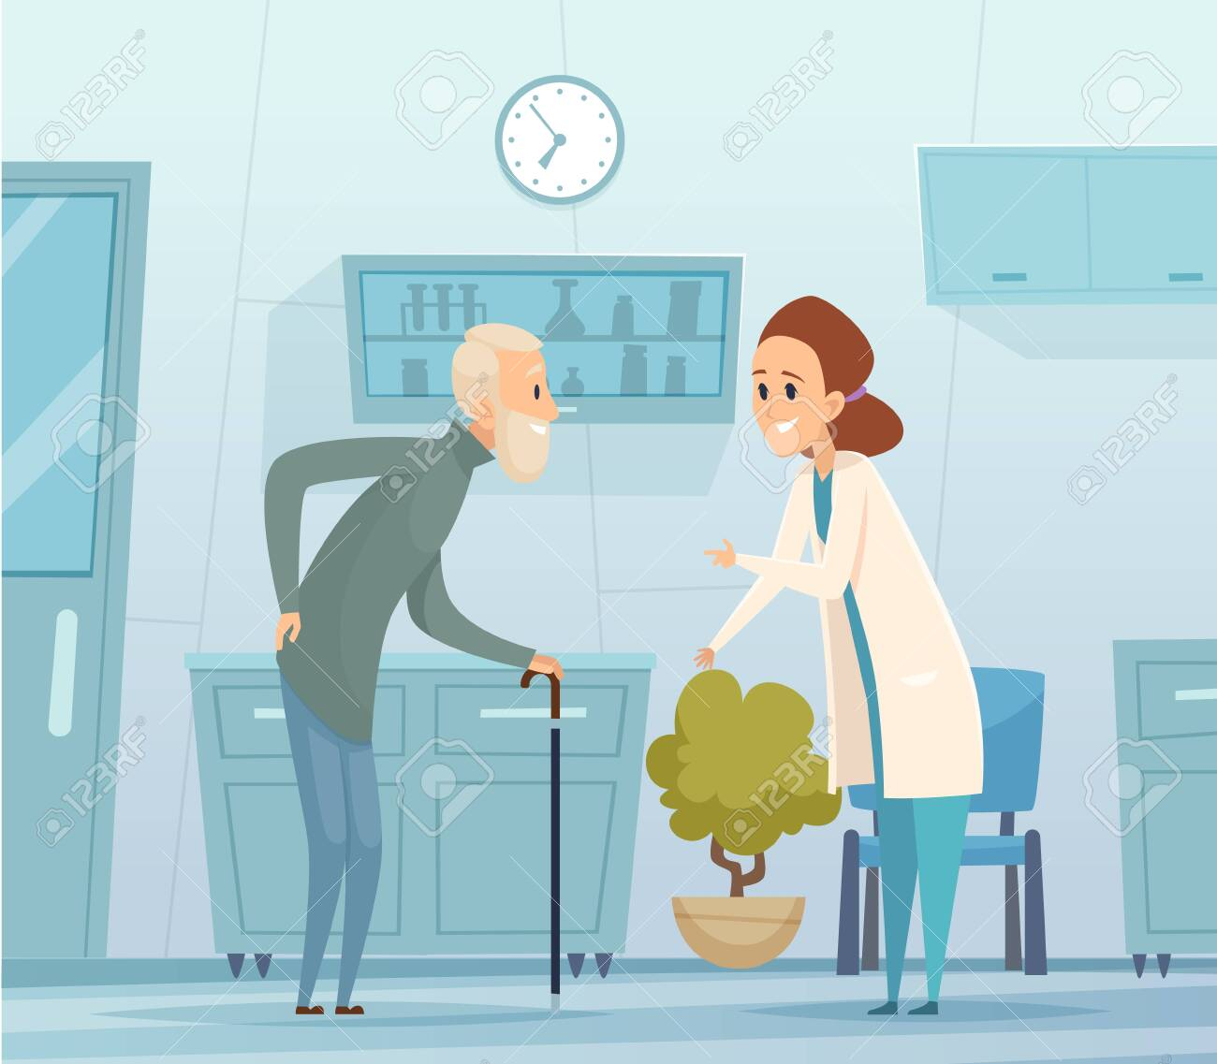
Greek Component (Old Age)
Ger(ont)o- (Old age)
Geriatria;(geriatrics) is the branch of medicine addressed to the treatment of a certain disease of the elderly.
Gerontologia (Gerontology) - is the study of the social, psychological, cognitive and biological aspects of aging.

Slide 23
https://wordwall.net/resource/14256099

Slide 24
Thank you for your attention!

