Slide 1
Oral Epidemiology (2/2)
Public Health in Dentistry I

Slide 2
Lecture Outline I. Causation in Epidemiology II. Measurement of Health III. Mortality Measures IV. Morbidity Measures V. Clinical Indices: Use, Characteristics, and Limitations VI. Dental Indices

Slide 3
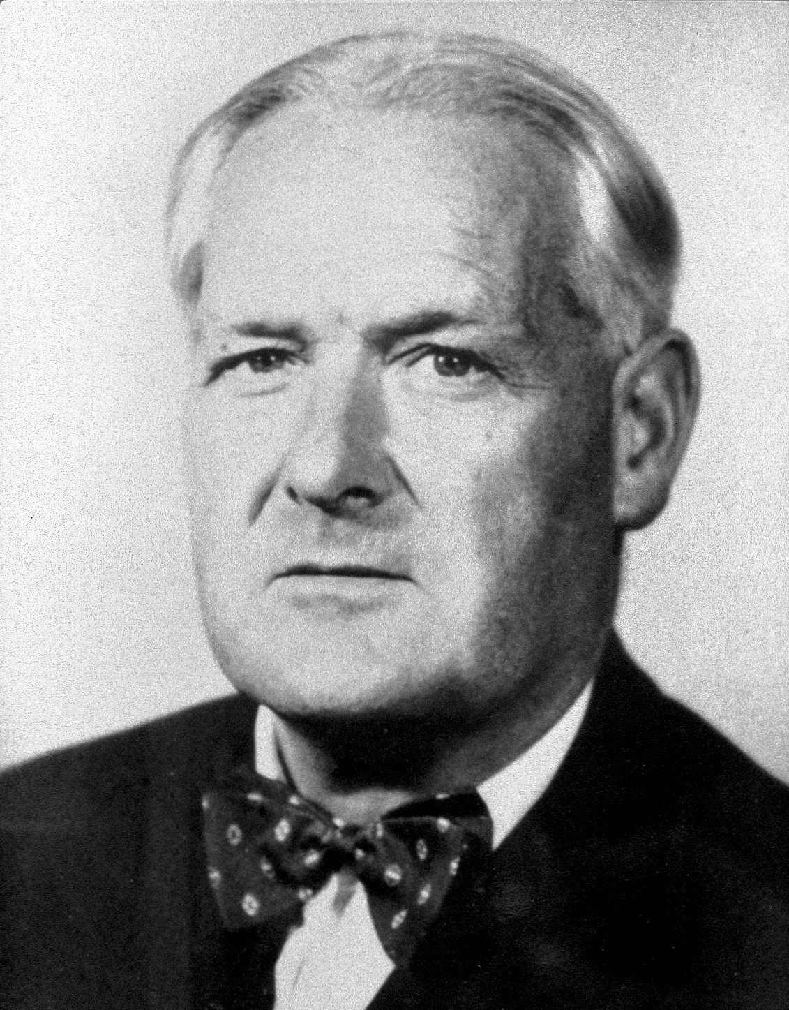
Causal Inference
Strength (Effect Size)
Consistency (Reliability)
Temporal Relation
Dose-response Relationship
Plausibility
Reversibility
Study design
Judging the Evidence
Strength
Consistency
Specificity
Temporality
Biological gradient
Biological plausibility
Coherence
Experiment
Analogy
Reversibility
Bradford Hill (1897 – 1991 )

Slide 4
Causal Inference
Temporal Relation
The cause must precede the effect.
This is usually self-evident, although difficulties may arise in case-control and cross-sectional studies when measurements of the possible cause and effect are made at the same time.
Dose-response Relationship
A dose–response relationship occurs when changes in the level of a possible cause are associated with changes in the prevalence or incidence of the effect.
Strength (Effect Size)
A strong association between possible cause and effect, as measured by the size of the risk ratio (relative risk), is more likely to be causal than is a weak association, which could be influenced by confounding or bias.
Relative risks greater than 2 can be considered strong.
Plausibility
An association is plausible, and thus more likely to be causal, if consistent with other knowledge.
However, biological plausibility is a relative concept, and seemingly implausible associations may eventually be shown to be causal.
Consistency (Reliability)
Consistency is demonstrated by several studies giving the same result.
This is particularly important when a variety of designs are used in different settings, since the likelihood that all studies are making the same “mistake is thereby minimized.
Reversibility
When the removal of a possible cause results in a reduced disease risk, there is a greater likelihood that the association is causal.

Slide 5
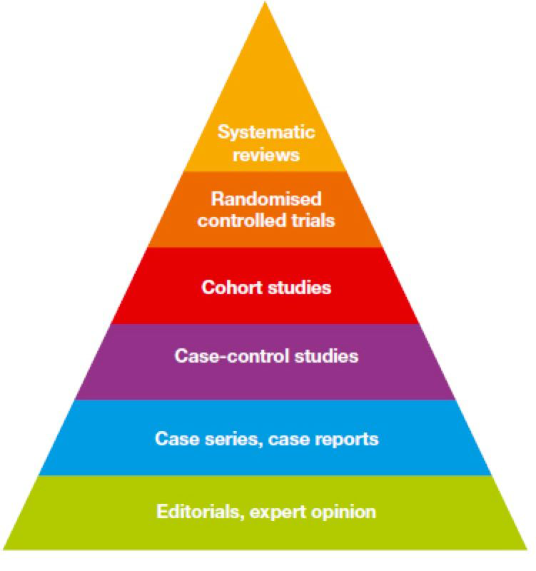
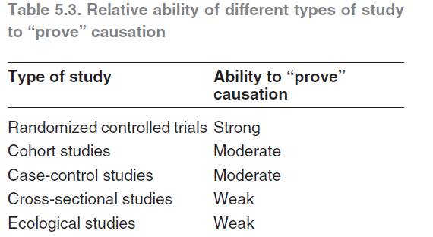
Causal Inference
Study Design
Judging the Evidence
There are no completely reliable criteria for determining whether an association is causal or not.
Evidence is often conflicting and due weight must be given to the different types when decisions are made. In judging the different aspects of causation referred to above, the correct temporal relationship is essential; once that has been established, the greatest weight may be given to plausibility, consistency and the dose–response relationship. The likelihood of a causal association is heightened when many different types of evidence lead to the same conclusion.

Slide 6
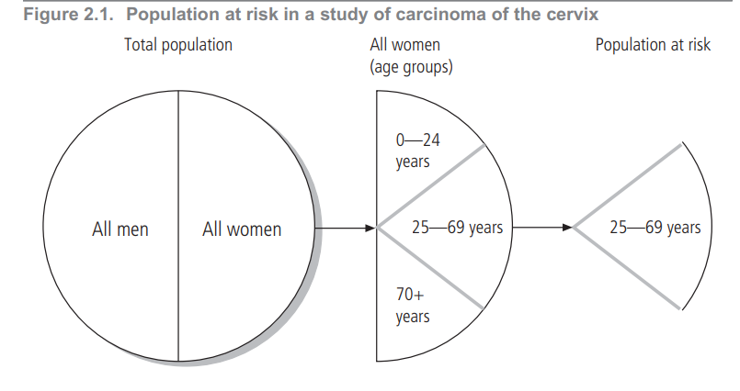
Measurement of Health
Population at Risk
Ratio vs. Rate
Incidence vs. Prevalence

Slide 7
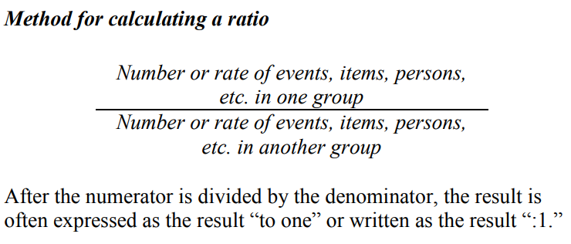
Ratio
A ratio is the relative magnitude of two quantities or a comparison of any two values.
It is calculated by dividing one interval- or ratio-scale variable by the other.
The numerator and denominator need not be related.

Slide 8
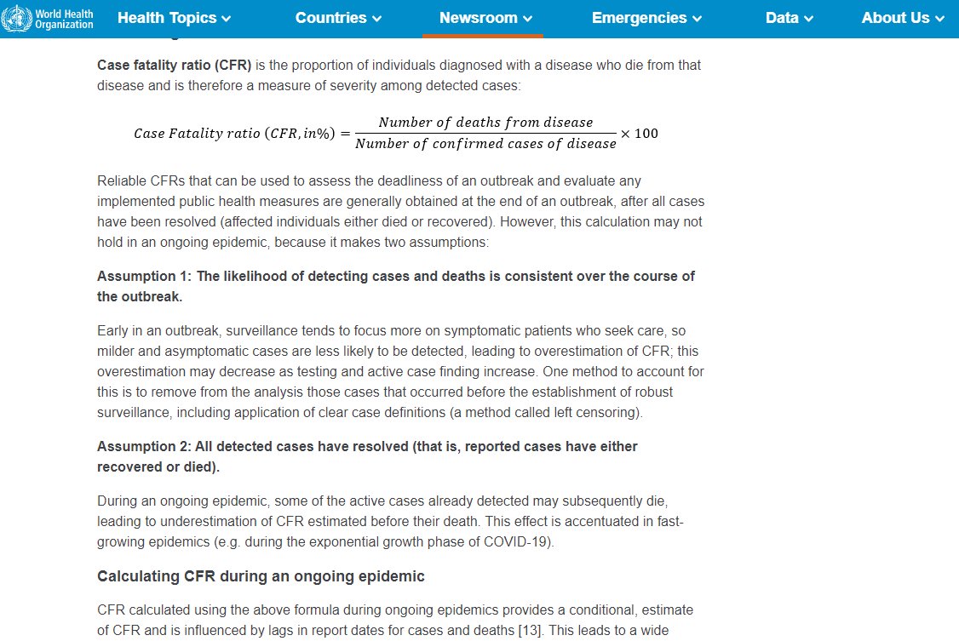
Case-to-death Ratio (Case-fatality ratio)
https://www.who.int/news-room/commentaries/detail/estimating-mortality-from-covid-19

Slide 9
Rate
Incidence Rate
Attack Rate
Incidence Proportion
In epidemiology, a rate is a measure of the frequency with which an event occurs in a defined population over a specified period of time.
Because rates put disease frequency in the perspective of the size of the population, rates are particularly useful for comparing disease frequency in different locations, at different times, or among different groups of persons with potentially different sized populations; that is, a rate is a measure of risk.

Slide 10
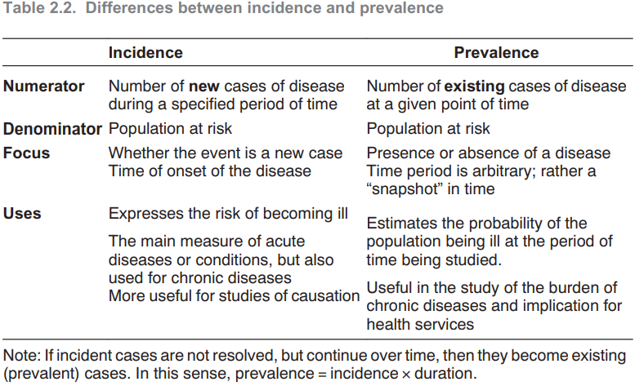
Incidence
The incidence of disease represents the rate of occurrence of new cases arising in a given period in a specified population
Prevalence
Prevalence is the frequency of existing cases in a defined population at a given point in time.

Slide 11
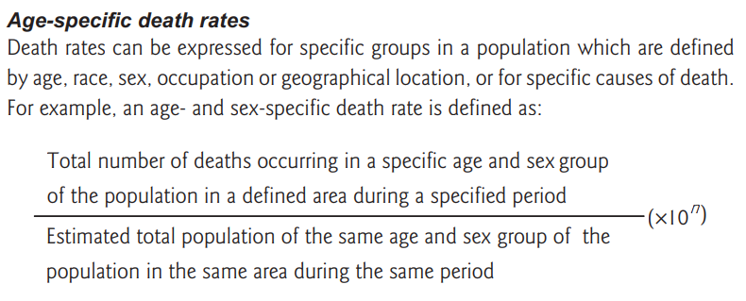
Mortality Measures
Crude Mortality
Age-specific vs. Age-standardized Mortality
Proportionate Mortality
Infant Mortality
Maternal Mortality
Adult Mortality
Life Expectancy

Slide 12
Proportionate Mortality
Occasionally the mortality in a population is described by using proportionate mortality, which is actually a ratio: the number of deaths from a given cause per 100 or 1000 total deaths in the same period. Proportionate mortality does not express the risk of members of a population contracting or dying from a disease.
Unless the crude or age-group-specific mortality rates are known, it may not be clear whether a difference between groups relates to variations in the numerators or the denominators.
Example: Proportionate mortality rates for cancer would be much greater in high-income countries with many old people than in low- and middle-income countries with few old people, even if the actual lifetime risk of cancer is the same.

Slide 13
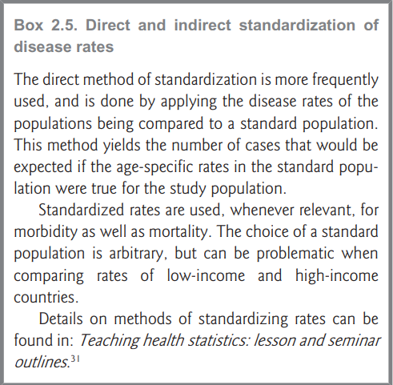
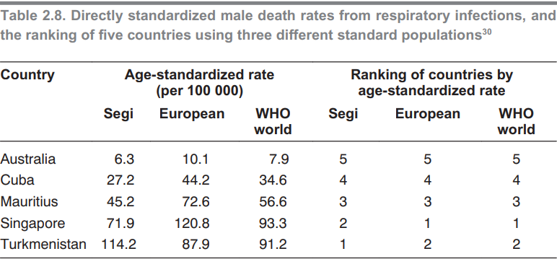
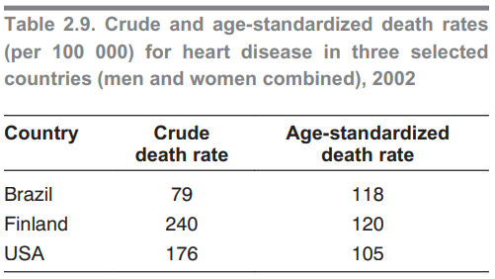
Age-standardized Rate
Age-adjusted rate

Slide 14
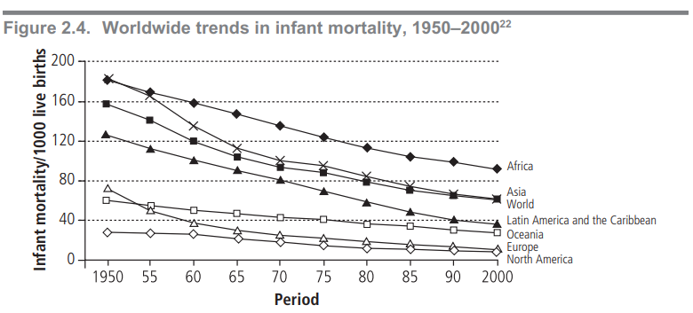
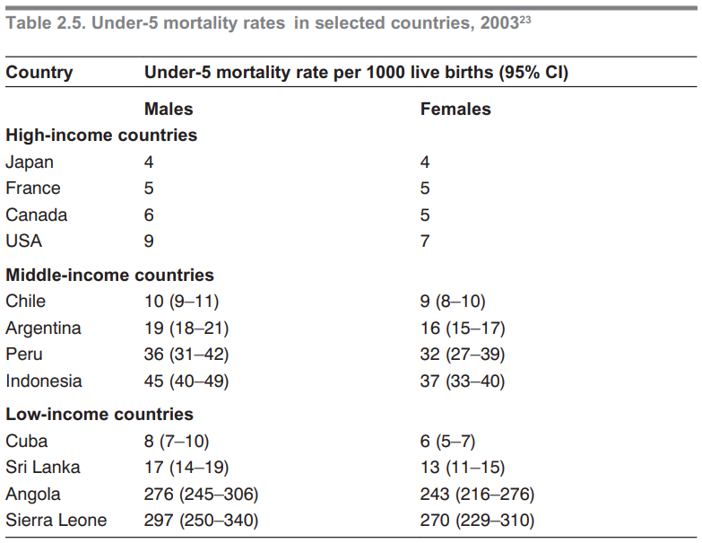
Infant Mortality
Rate
Rate
Child Mortality
The child mortality rate (under-5 mortality rate) is based on deaths of children aged 1–4 years, and is frequently used as a basic health indicator.
Injuries, malnutrition and infectious diseases are common causes of death in this age group.
The under-5 mortality rate describes the probability (expressed per 1000 live births) of a child dying before reaching 5 years of age.

Slide 15
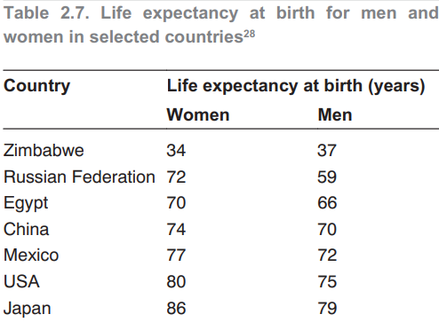
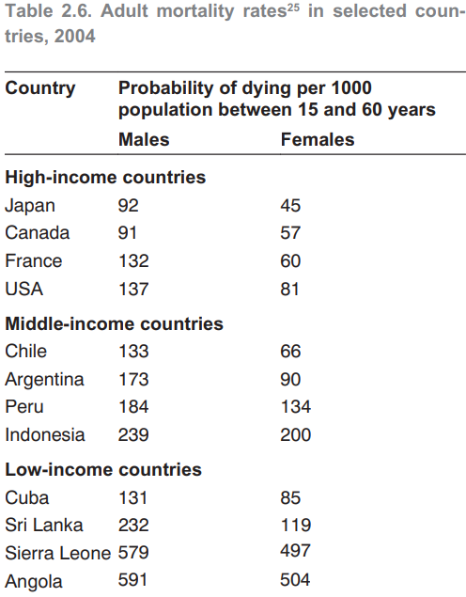
Maternal Mortality
Rate
Rate
Adult Mortality
Life Expectancy
is defined as the average number of years an individual of a given age is expected to live if current mortality rates continue.

Slide 16
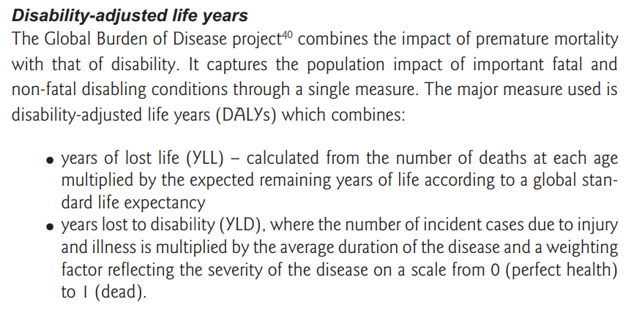
Morbidity Measures
Common Measures of Morbidity
Years of potential life lost (PLL) based on the years of life lost through premature death (before an arbitrarily determined age);
Healthy life expectancy (HALE);
Disability-free life expectancy (DFLE);
Quality-adjusted life years (QALYs);
Disability-adjusted life years (DALYs).
Sources of Morbidity Data

Slide 17
Oral Health Related Quality of Life

Slide 18
Clinical Indices
Simple
Objective
Valid
Reliable
Reproducible
Quantifiable
Sensitive
Acceptable

Slide 19
Dental Indices
DMFT / DMFS
dmft / dmfs
CPITN
CPI
Dental Caries
Periodontal Disease
Fluorosis
Erosion
Trauma
Dean’s Index
Horowitz Index
BEWE Index
Trauma Index of O’Brien

Slide 20
DMF Limitations
Were all missing teeth (M) carious?
Are all filled teeth (T) clinically equivalent?
Relevance
Treatment decisions
Quality of teeth
Benefit of treatment
Irreversible
Should missing (M), filled (F), and decayed (D) teeth treated equally?

Slide 21
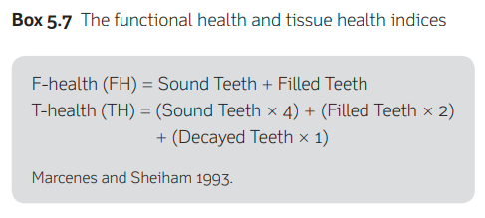
How to Hack Dental Indices Limitations?

Slide 22
THANK YOU
abanoub.riad@med.muni.cz
Office Consultation (A21/315)

