Slide 1
Evidence-Based Dentistry (2/2)
Dental Public Health I

Slide 2
Lecture Outline I. Systematic Reviews: Critical Appraisal II. GRADE & Meta-Analysis III. Effect Size IV. EBP Limitations V. EBD Resources

Slide 3
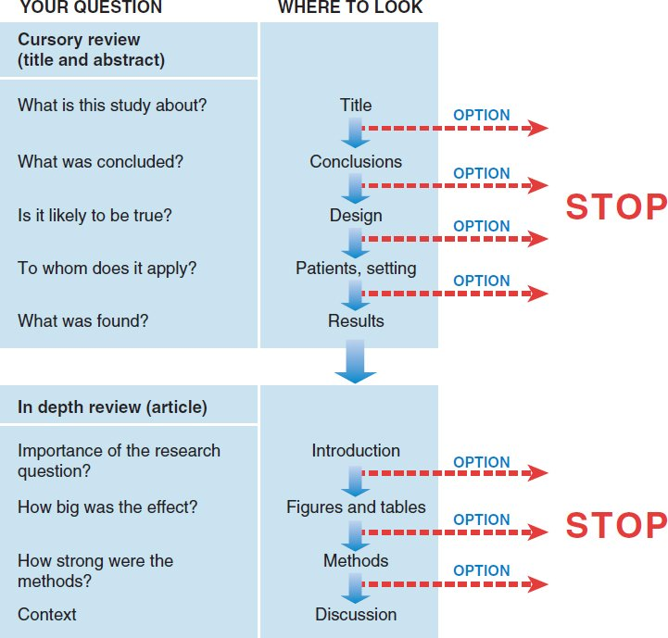
Screening
Approaches to streamlined reading vary.
It is a good idea to at least survey the titles and abstracts of all articles in an issue to decide which articles matter most to you.
For those that do, you might read more deeply, adjusting the depth as you go.

Slide 4
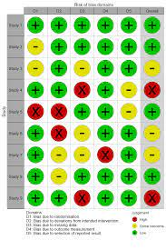
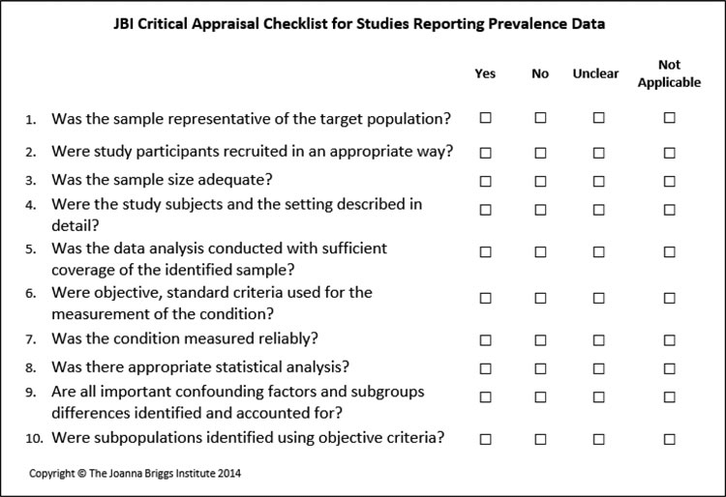
Critical Appraisal
Once the literature has been surveyed, appropriate literature should be selected and the quality and usefulness of the literature should be appraised.
Appraisal of the quality of literature enables decisions to be made regarding whether to accept the conclusions drawn.
Tools of appraisal are classified as scoring system or checklist system, e.g. RoB 2.0, ROBINS-I, JBI Checklists
Checklists of critical appraisal are composed of signalling questions, each question is related one or more sources of potential bias.

Slide 5
Critical Appraisal

Slide 6
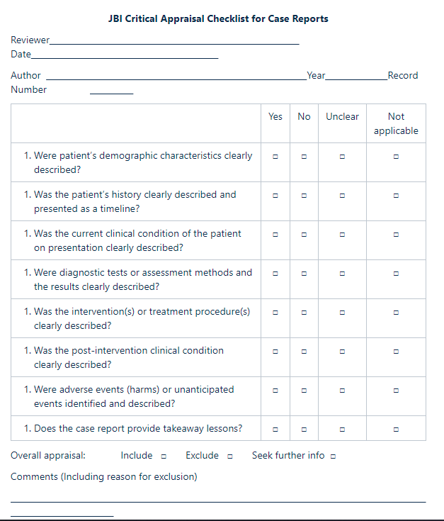
Critical Appraisal Tools
RoB 2.0
JBI Checklists
etc

Slide 7
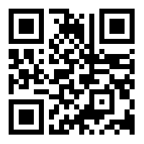
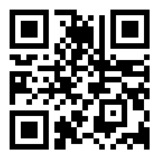
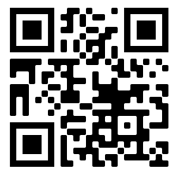
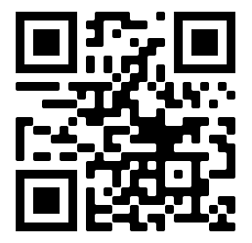
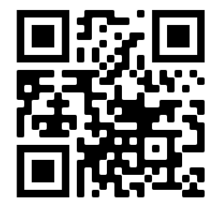
Exercise VII
Critical Appraisal
Critical Appraisal
Each group will assess one of the following studies (10 minutes)
Case Report No. 1
(Amorim dos Santos et al. 2020)
Case Report No. 2
(Chaux-Bodard et al. 2020)
Cross-sectional No.1
(Chipwaza et al. 2014)
Cross-sectional No.2
(Waggoner et al. 2017)
Cohort No.1
(Bertoia et al. 2015)

Slide 8
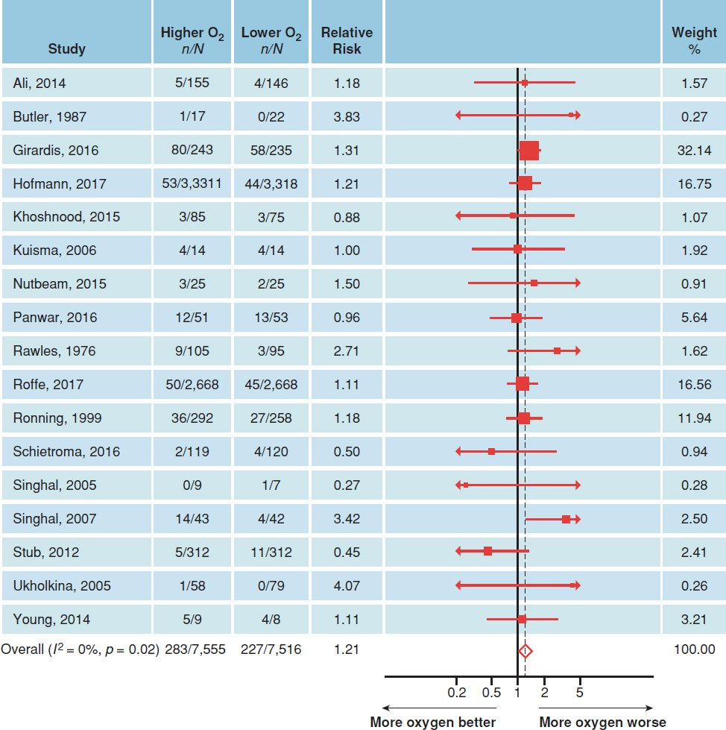
Meta-Analysis
Forest Plot
How to read?
https://s4be.cochrane.org/blog/2016/07/11/tutorial-read-forest-plot/

Slide 9
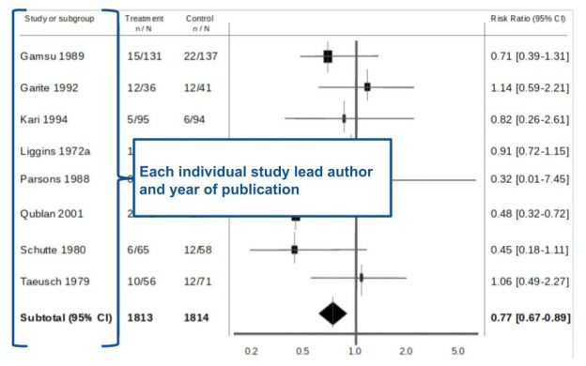
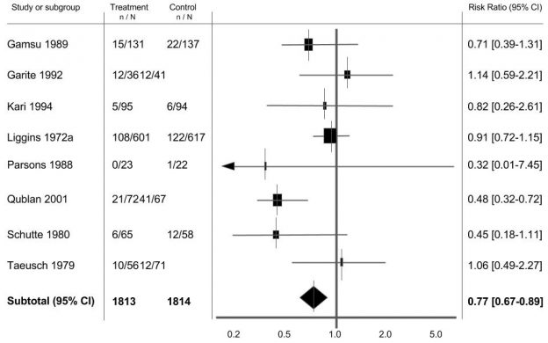
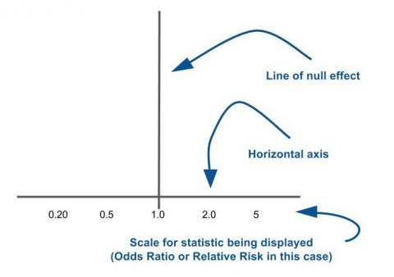
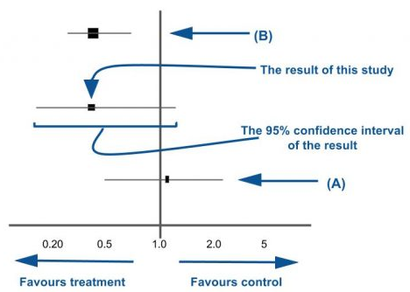
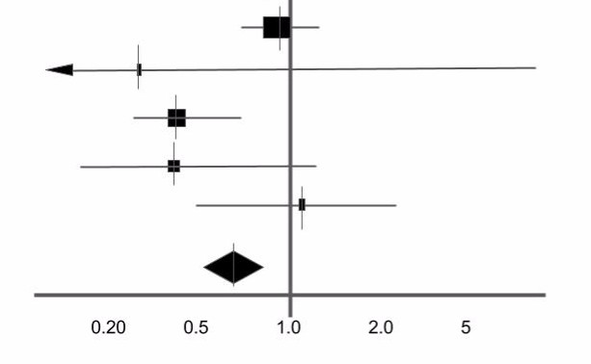
Meta Analysis
https://s4be.cochrane.org/blog/2016/07/11/tutorial-read-forest-plot
How to interpret forest plot?

Slide 10
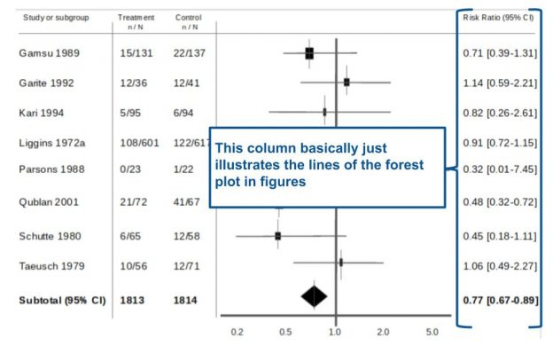
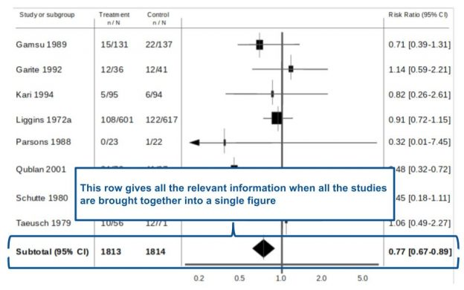
Meta Analysis
How to interpret forest plot?
https://s4be.cochrane.org/blog/2016/07/11/tutorial-read-forest-plot

Slide 11
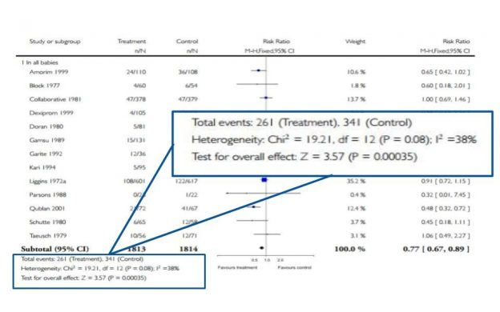
Meta Analysis
How to interpret forest plot?
https://s4be.cochrane.org/blog/2016/07/11/tutorial-read-forest-plot

Slide 12
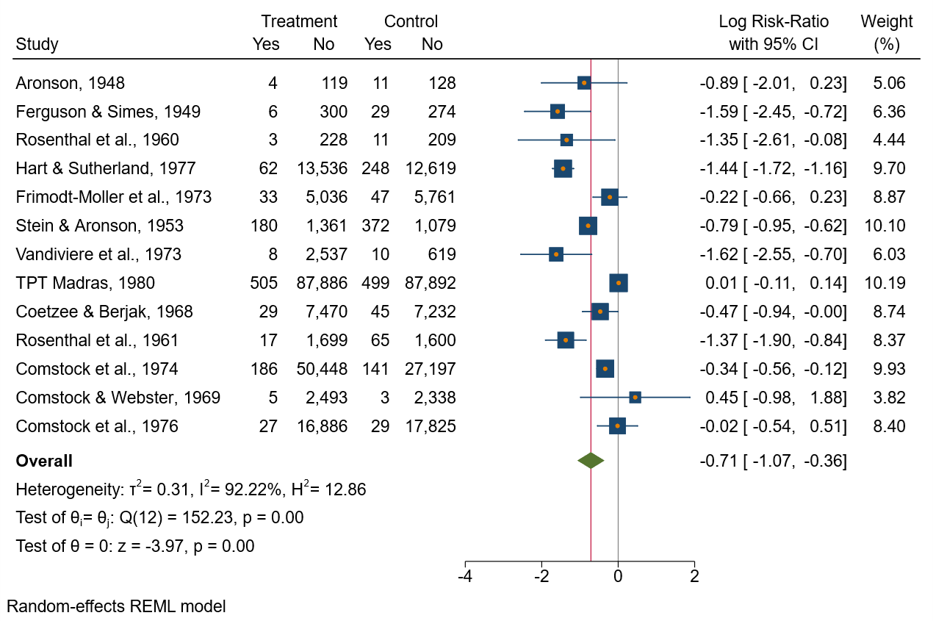
Exercise VIII
Forest Plot
refers to …. ?
refers to .... ?
… is the study with the highest weight.
… is a study without significant effect size.
The overall effect size is …
Treatment or control?
Fixed-effect or random-effect model?

Slide 13
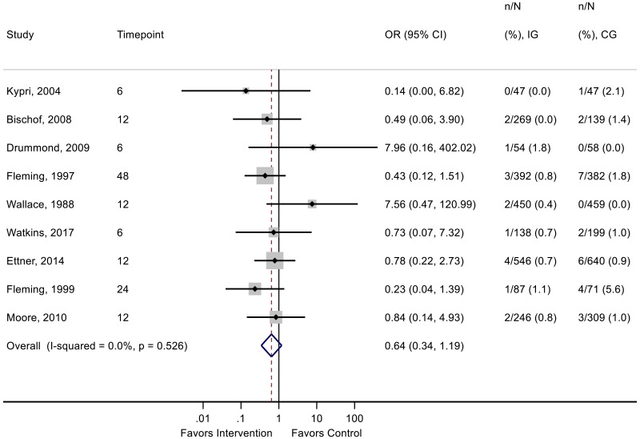
Exercise VIII
Forest Plot
refers to …. ?
refers to .... ?
… is the study with the highest weight.
… is a study without significant effect size.
The overall effect size is …
Treatment or control?
Fixed-effect or random-effect model?

Slide 14
EBP Limitations
EBP itself displays three of the shortcoming of medical sciences:
a shortage of coherent and consistent evidence;
difficulties in applying global evidence to an individual patient;
and barriers to the practice of high quality clinical care
There are three further limitations particular to EBP itself:
the need to possess searching and critical appraisal skills;
the limited time clinicians have to develop and practise these skills;
and the resources to allow immediate access to information in clinical settings are few
14

Slide 15
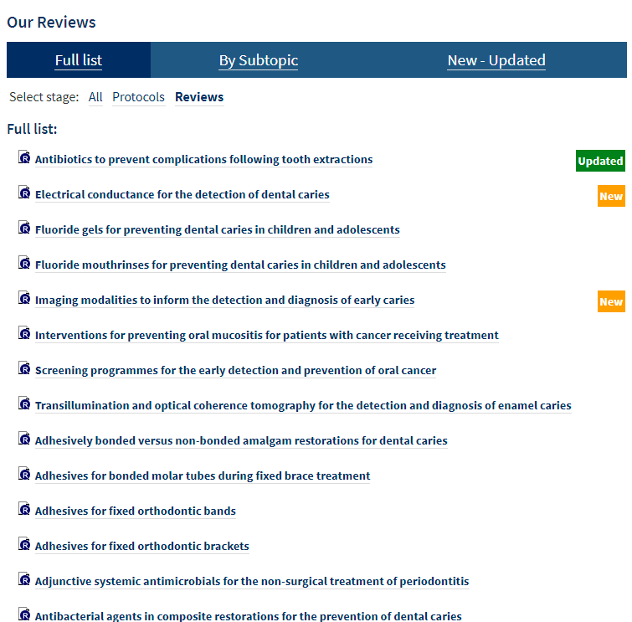
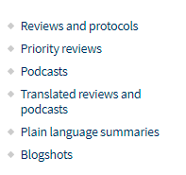
EBD Resources
Cochrane: Oral Health
15

Slide 16
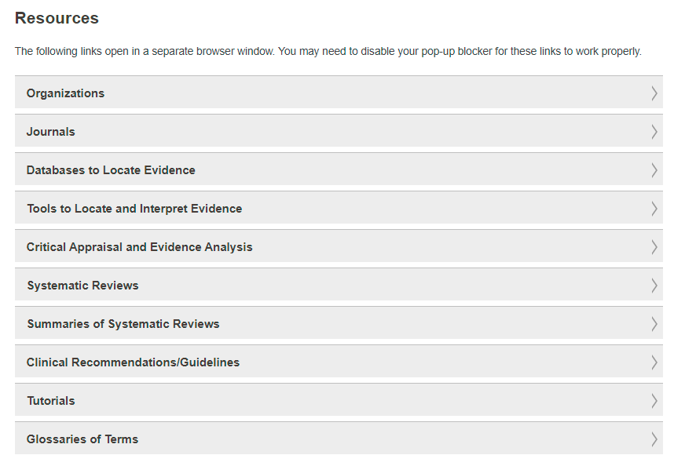
EBD Resources
ADA: Center for EBD
16

Slide 17
EBD Resources
https://www.journals.elsevier.com/journal-of-evidence-based-dental-practice
17

Slide 18
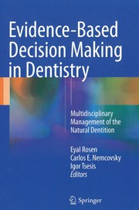
EBD Resources
https://www.cebd.org/
https://www.nature.com/ebd
https://www.springer.com/gp/book/9783319457314
18

Slide 19
THANK YOU
abanoub.riad@med.muni.cz
Office Consultation (A21/315)

