Slide 1
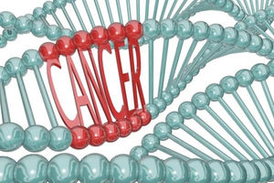
Malignant Transformation
Topics
Hallmarks of cancer cells
Oncogenes and tumor suppressors
Stages of tumor development
Metastases
Interaction of tumor and organism
Cancer biomarkers
RNDr. Jan Balvan Ph.D.

Slide 2
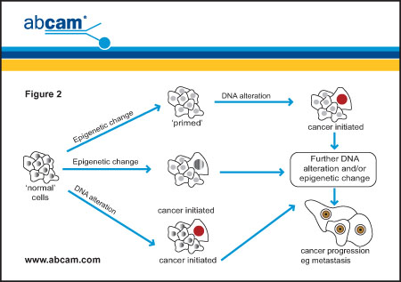
Malignant transformation
The process of tumor formation is a complex involving multiple alterations of cells and their physiologic control mechanisms.
The complexity of this process is reflected in the long time periods required for most human cancers to develop.
Multi-step tumor progression can be depicted as a form of Darwinian evolution occurring within tissues.
Some of the critical changes occurring during tumorigenesis are epigenetic and the rate of genetic diversification can occur very rapidly.
Genetic alteration can appear
– (1) due to internal errors during DNA
replication and cell division
– (2) as a consequence of exposure to the
external factors (carcinogens)
physical – e.g. UV and ionising light
chemical – organic substances, toxins, heavy
metals
biologic – some RNA and DNA viruses

Slide 3
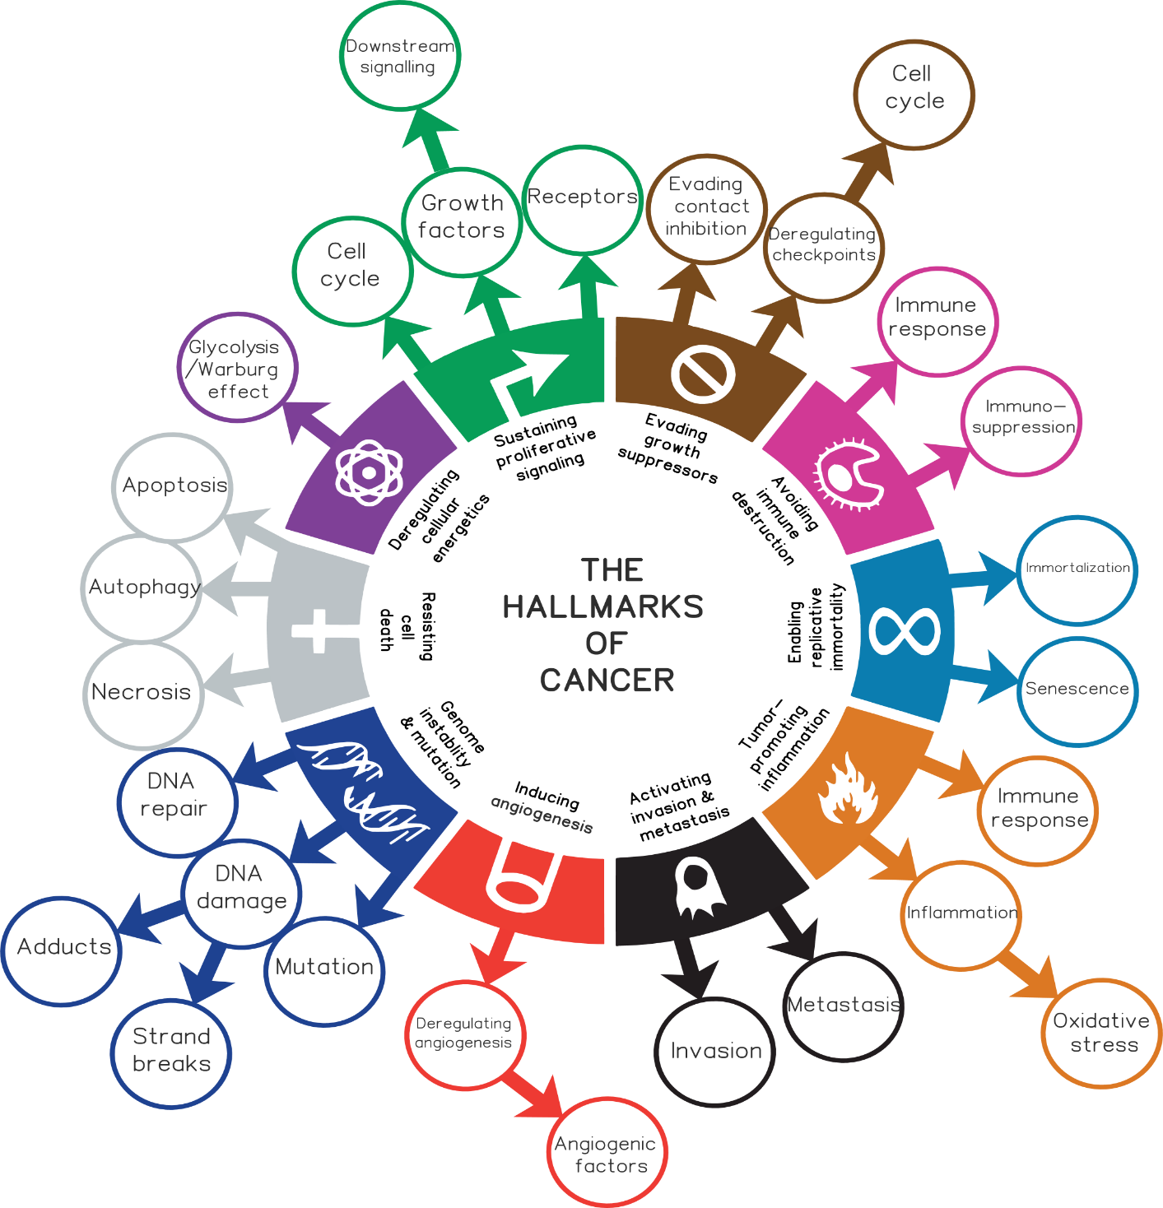
Hallmarks of cancer
Continual unregulated proliferation of cancer cells (sustaining proliferative signaling and evading growth suppressors)
Replicative immortality
Genome instability
Resisting cell death and senescence
Inducing angiogenesis
Inflammation
Avoiding immune destruction
Altered metabolism
Invasion and metastasis
All these features do not have to be newly evolved, because they are part of physiological processes such as embryogenesis and wound healing. Cancer cells only use these processes in wrong intensity, time, and place. Cancer is a disease of regulation.

Slide 4
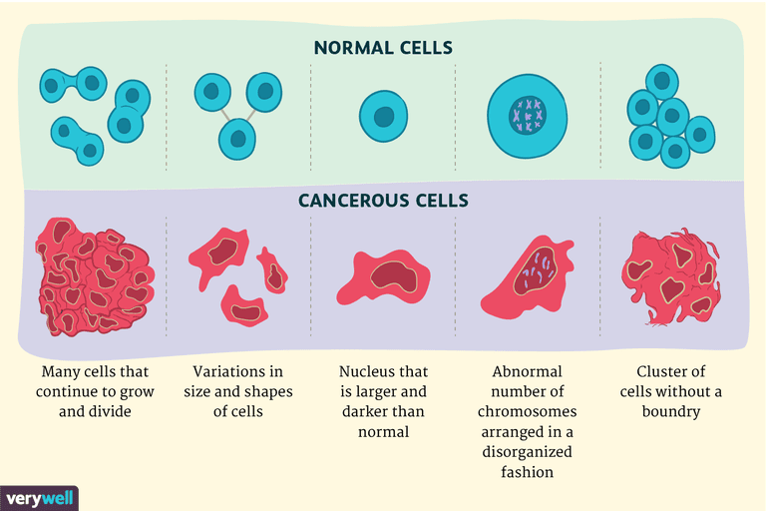
Cancer cell
Cancer cells divide excessively - they have too many “GO” signals or not enough “STOP” signals and can also ignore “DIE”, “ DIFFERENTIATE “, or “GROW OLD” signals.

Slide 5


Oncogenes
Proto-oncogenes – Genes whose products encode components of the molecular cascades that mediate the “GO” response to mitogenic signals and pro-survival proteins.
The abnormal, mutated form of the proto˗oncogenes that lead to excessive cell proliferation and cancer are called oncogenes.

Slide 6
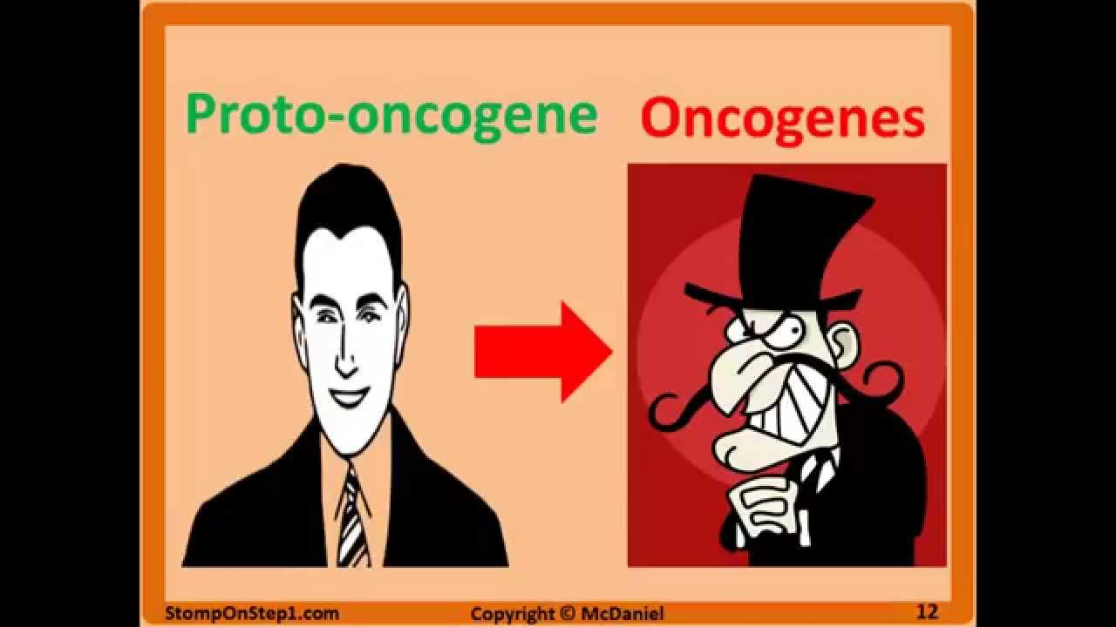
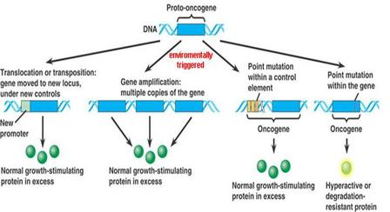
Oncogenes
Oncogenes differ from proto-oncogenes in three basic ways:
1. timing and quality of expression
2. structure and function of protein products
3. degree to which their protein products are regulated by cellular signals

Slide 7
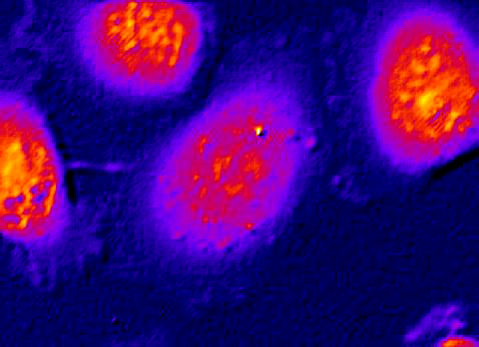
Uncontrolled growth
In cancer cells, a number of alternative mechanisms operate to ensure that cell proliferation is not constrained.
Cancer cells produce growth factors that stimulate their own proliferation (autocrine growth stimulation) and hijack cellular mitogenic signals.

Slide 8
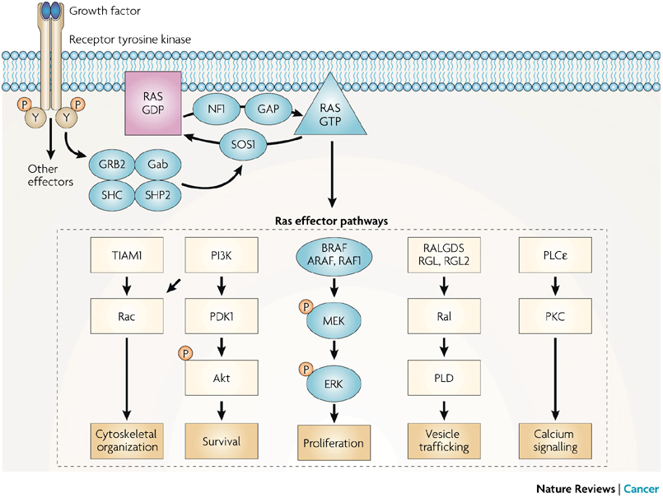
Uncontrolled growth - “GO” signals
“GO” signals = main mitogenic signals include:
1. growth factors (e.g. EGF, VEGFA, PDGF)
2. growth factor receptors (e.g. the receptors for epidermal growth factor EGF (EGFR) and its close homologue HER2/neu (ERBB2)
3. receptor-coupled signal transduction molecules (RAS family)
4. proteinkinases (SRC,ABL)
5. transcription factors (MYC, MYB, FOS, JUN)
6. cyclins
7. cyclin-dependent kinases (cdk)

Slide 9
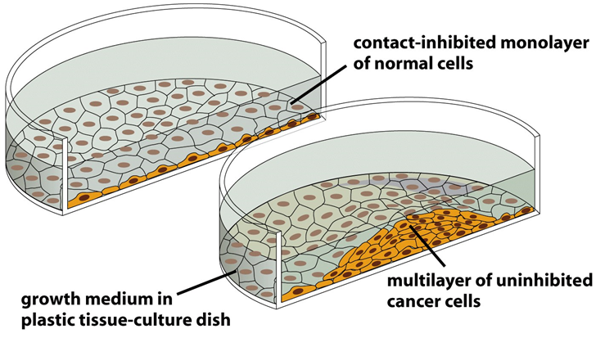
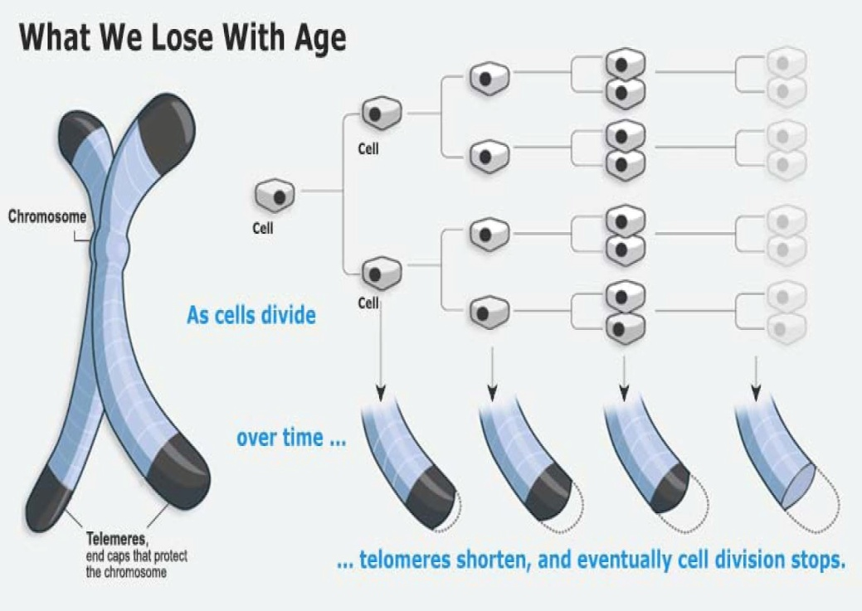
Contact inhibition and immortalization
Proliferation of many normal cells is inhibited by cell-cell contact (contact inhibition) and by erosion of telomeres (Hayflick limit), but cancer cells are characteristically insensitive to such inhibition of growth.
Most pre-malignant cells escape from Hayflick limit by stabilizing their telomeres (telomerase, hTERT).
Cells that have stabilized their telomeres can proliferate indefinitely and are therefore said to be immortalized. Immortal cells are not necessarily transformed (tumorigenic) cells.

Slide 10
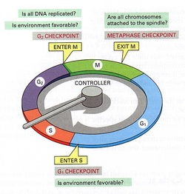
Uncontrolled growth – loss of “STOP” signals
The critical decisions concerning growth versus quiescence are made in the G1 phase of the cell cycle.
Growth of normal cells is controlled by signals from the external environment (extracellular matrix, surface of adjacent cells) and from the inside of the cell (DNA damage, cell damage, mitotic spindle damage).

Slide 11
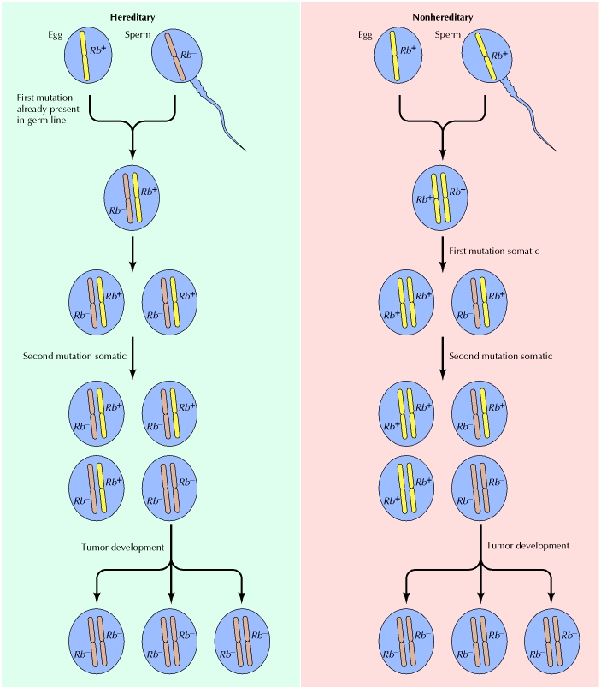
Tumor suppressors
Proteins encoded by tumor suppressor genes inhibit cell proliferation or survival.
In many tumors are lost or inactivated.
Tumor suppressor proteins inhibit the same cell regulatory pathways that are stimulated by the products of oncogenes.
Most familial cancer syndromes are inherited as a recessive trait, and correspond to the constitutive inactivation of an important tumor suppressor gene
Tumor suppressors are often named according to the type of tumor developing due to their loss of function.
Rb (= retinoblastoma)
WT (= Wilm’s tumor)
NF1 and NF2 (= neurofibromatosis)
APC (= Adenomatous Polyposis Coli)
DCC (= Deleted in Colon Cancer)
VHL (= von Hippel-Lindau syndrome)
“two hits” hypothesis explain the inheritance of retinoblastoma, a rare childhood tumor type (1971, Knudsen)

Slide 12
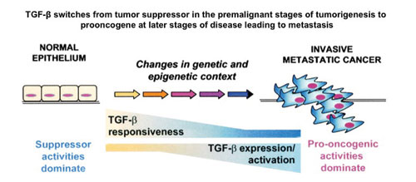
Will you be my tumor suppressor for ever?
TGF-β (transforming growth factor-β) has antiproliferative effect and maintain genomic stability. As cancer progresses, tumor cells alter their responsiveness to TGF-β. At late-stage tumors, TGF-β promotes cell migration, promotes invasion of cancer cells, and becomes a pro-survival factor.

Slide 13
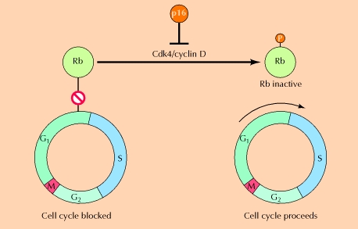
Rb protein - true tumor suppressor
Rb is a main inhibitor of cell cycle and controls the transition from G1- to S˗phase.
Rb inhibits the transcription factor E2F, which upon release from Rb ↑ expression of S phase genes (e.g. DNA replication enzymes)
Rb is present all the time, its activity is modulated by phosphorylation
– phosphorylated Rb = inactive
– dephosphorylated Rb = active
Rb mutations are also involved in tumors of adults (bladder, breast, and lung carcinomas).
The significance of the Rb tumor suppressor gene thus extends beyond retinoblastoma

Slide 14
Other “STOP” signals
p53 protein (ch. 17p13)
“guardian of the genome” – active in G1 and G2 checkpoints
DNA damage increases expression of p53
acts as a transcription factor for DNA repair and apoptosis genes
inhibitors of cyclin-dependent kinases (e.g. p21, p27, p16, etc.)
p21 is the main target of p53 = inhibitor of Cdk – cell cycle arrest in G1 phase by inhibition of Cdk2/cyclin E complex

Slide 15
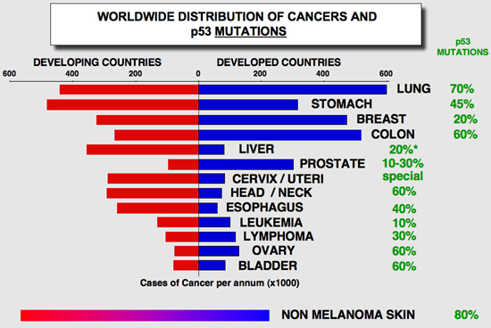

Slide 16
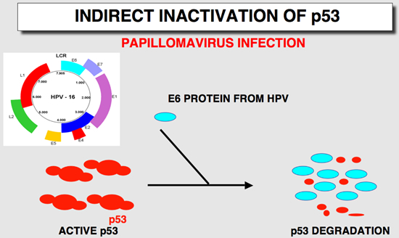
The E6 viral protein expressed by HPV specifically binds to the p53 protein and induces its degradation. This observation explains the rarity of p53 mutations in cervical cancers.

Slide 17
Genomic instability - new oportunities for evolution
DNA damage may predispose individuals to increased tumorigenesis.
An increase of copy number of chromosomes or genes allows cells to overexpress certain genes or mutate the extra copies to acquire growth, survival, or metastasis advantage.
Genomic instability is a characteristic of most cancer cells due to over-replication.
Excessive DNA damage is associated with problems in DNA replication (broken chromosomes and aneuploidy).
Genomic integrity is closely monitored by several surveillance mechanisms, DNA damage checkpoint, DNA repair machinery and mitotic checkpoint.
DNA methylation status is also important for genomic integrity.

Slide 18
DNA repair genes/proteins
MMR genes/proteins (“Mismatch repair”)
defect in respective genes leads to the microsatellite instability (MSI). Variable length of microsatellites (e.g. (CA)n repetition) leads to the DNA replication errors. MSI is most prevalent in colon cancers.
Nucleotide excision repair genes/proteins (“single strand break repair”)
NER-defects cause xeroderma pigmentosum (XP). XP patients show severe sun sensitivity and develop skin cancers during childhood.
Genes/proteins of homologous recombination (“double strand break repair”)
BRCA1 and BRCA2 “breast cancer susceptibility genes”
ATM and ATR (ATM-related) kinases (“mutated in ataxia-telangiectasia”)

Slide 19
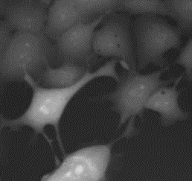
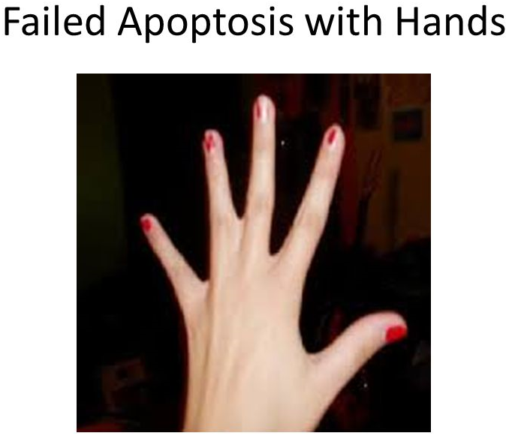
Cell Death – Apoptosis, Pyroptosis, Necroptosis, Ferroptosis,…
Apoptosis (non-lytic cell death)
Energy dependent programmed cell death. The action of caspases and other apoptotic enzymes (proteases and nucleases) leads to cell fragmentation to apoptotic bodies (caspase 3/7) that are removed by macrophages.
Necroptosis
Controlled form of necrosis driven by kinases RIP1 and RIP3. Lytic cell death type with inflammatory effect.
Pyroptosis
A form of inflammatory programed cell death pathway activated in response to bacterial, viral, fungal or protozoan pathogens. Lytic cell death with release of proinflammatory cytokines IL-1β, IL-18.
Ferroptosis
Ferroptosis is an iron- and ROS-dependent form of regulated cell death (RCD). It is characterized by robust lipid peroxidation (e. g. smaller mitochondria with ruptured outer membrane). Lytic type of cell demise.
Accidental necrosis
Accidental cell death caused mainly by external factors (infections, toxins, pH, mechanical forces, etc.). Cellular content is released into the environment and damages surrounding tissues.

Slide 20
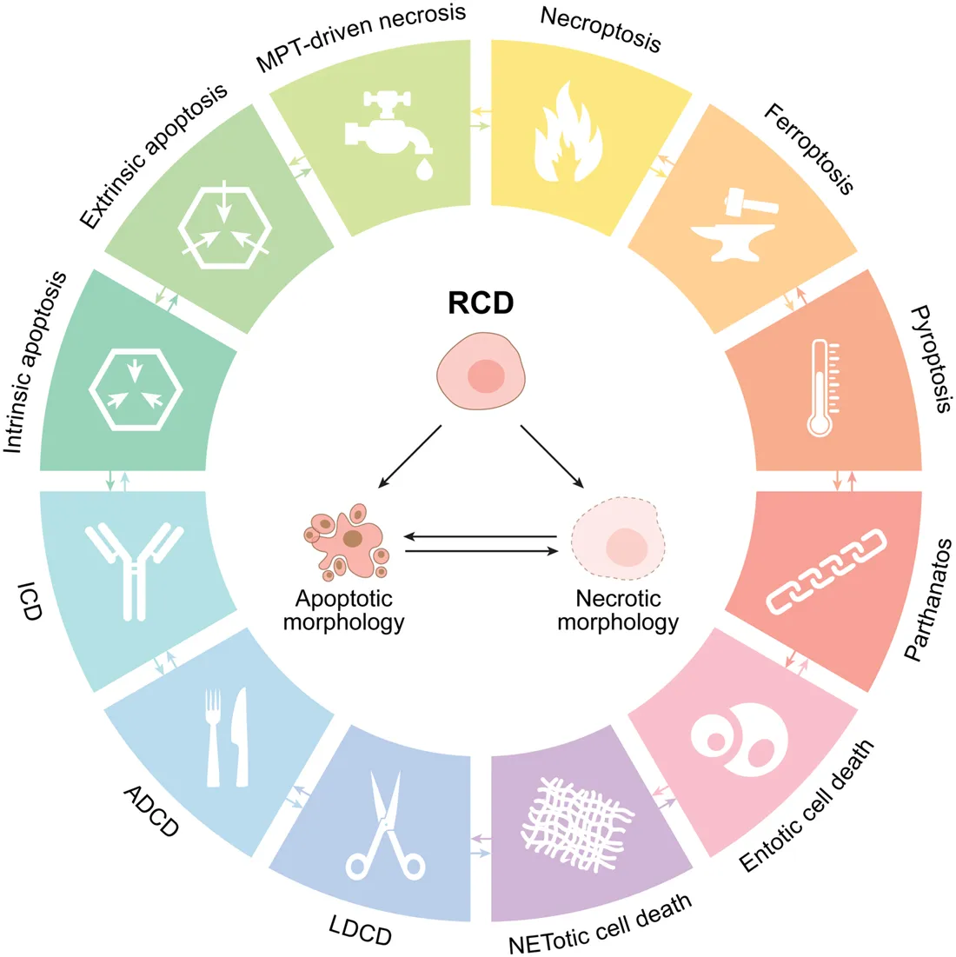
Cell death – apoptosis, pyroptosis, necroptosis, ferroptosis, …

Slide 21
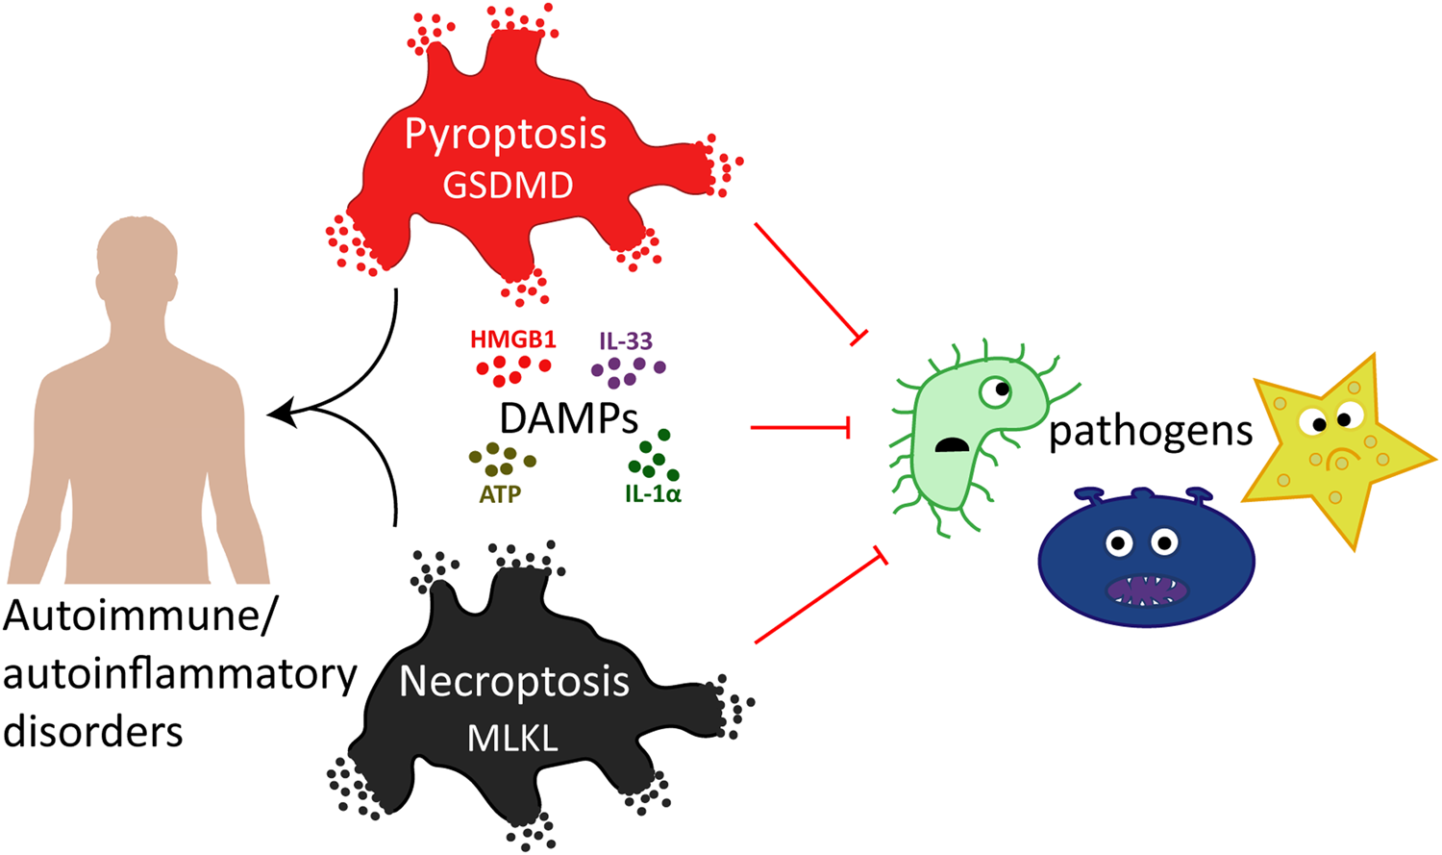
Pyroptosis – The control of pathogens
A form of inflammatory programed cell death pathway activated in humans by caspase-1, caspase-4 and caspase-5. These inflammatory caspases are used by the host to control bacterial, viral, fungal or protozoan pathogens.
Pyroptosis requires cleavage and activation of the pore-forming effector protein gasdermin D by inflammatory caspases.
Physical rupture of the cell causes release of the pro-inflammatory cytokines IL-1β and IL-18, alarmins and endogenous death-associated molecular patterns, signifying the inflammatory potential of pyroptosis.

Slide 22
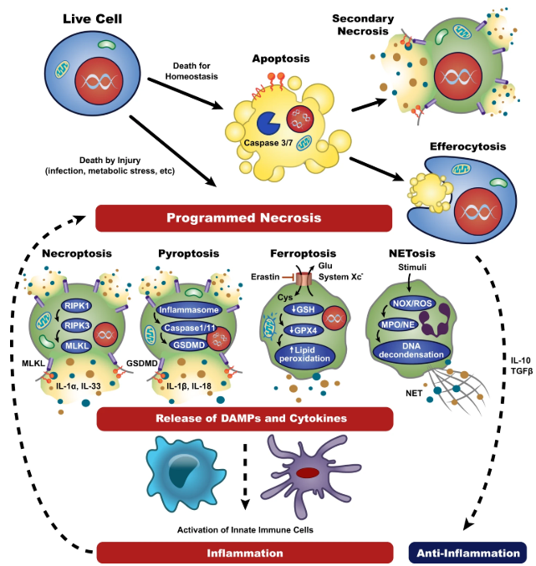
Necroptosis
Necroptosis is regulated necrosis mediated by death receptors
This form of necrosis works against pathogen-mediated infections
Morphologically characterized by cell swelling followed by rupturing of the plasma membrane.
In the case of apoptosis, secretion of cytokines is absent or very less, while during necroptosis, it is a primal event leading to robust inflammation.
RIPK3 activates the formation of inflammasome which is formed in response to cellular stress or microbial infection to activate caspase-1 and caspase-11. Further, caspase-1 cleaves IL-1β into a mature form.

Slide 23
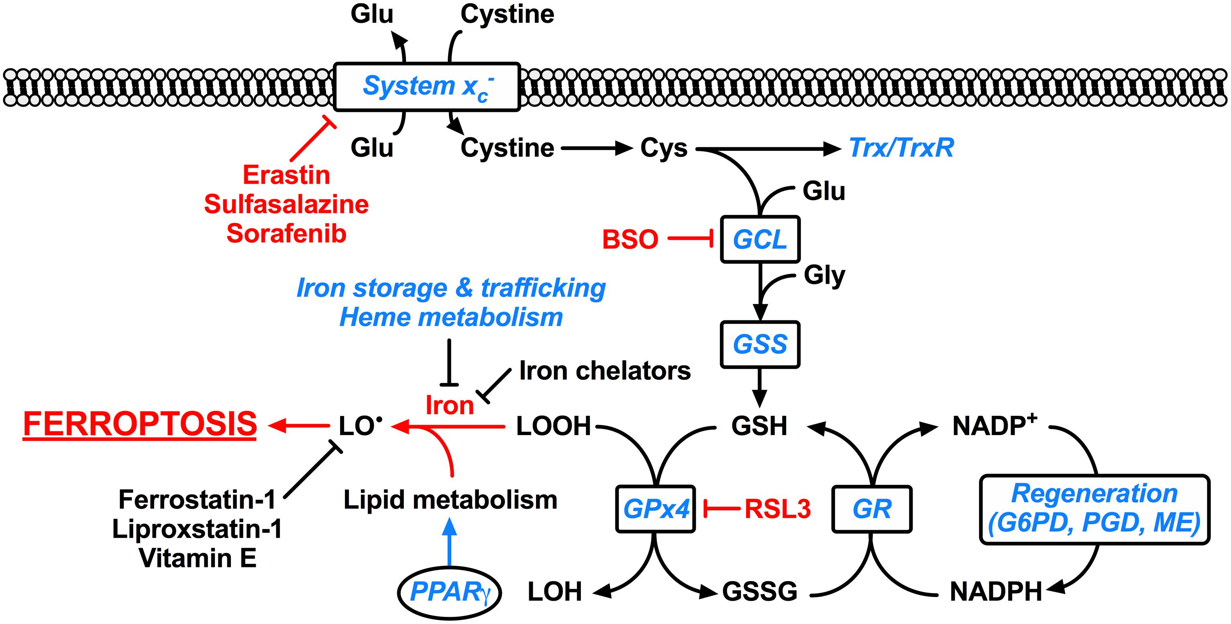
Ferroptosis
Ferroptosis is an iron- and ROS-dependent form of regulated cell death (RCD).
Ferroptosis is induced by disruption of glutathione synthesis or inhibition of glutathione peroxidase 4, exacerbated by iron, and prevented by radical scavengers.
Ferroptosis terminates with mitochondrial dysfunction and toxic lipid peroxidation.
Misregulated ferroptosis has been implicated in multiple physiological and pathological processes such as cancer cell death, tissue injury, and T-cell immunity.

Slide 24
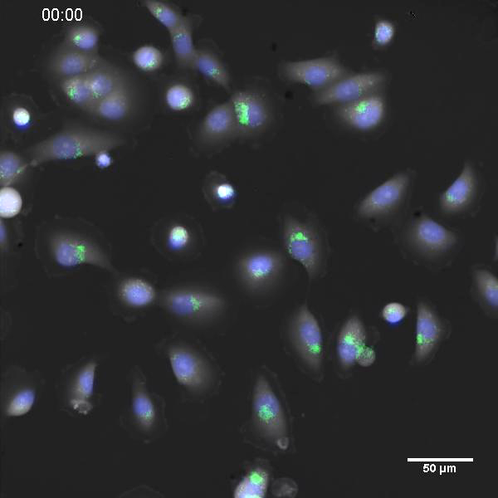

Slide 25
Resisting cell death
Tumor cells evolve a variety of strategies to limit cell death. Most known are:
  loss of p53
  increased expression of antiapoptotic regulators (Bcl-2, Bcl-xL) and survival signals (insulin-like growth factors; Igf1/2)
  downregulating of proapoptotic factors (Bax, Bim, Puma)
  opportunistic modes of behavior (cell fusion)

Slide 26
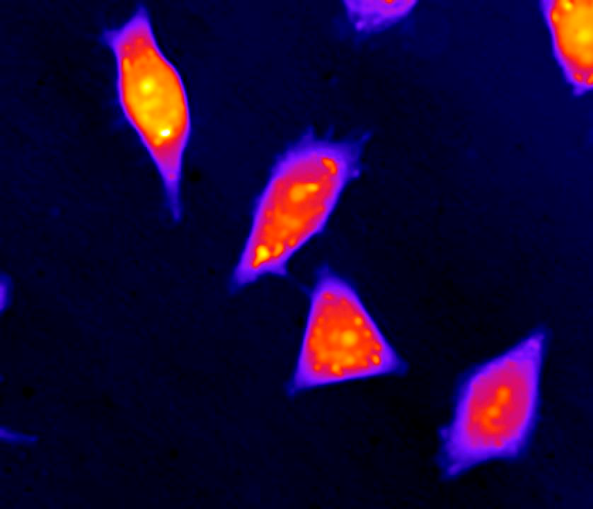
Notes:
in this time lapse a communication of two cells exist. during 48h stress of cells, all neighbouring cells die by necrosis. however, these two cells survived distinctly longer time; they fused by proces designated as „entosis“. as a result, one cell with two nuclei morphologically equal resulted.
A chart on the lower right illustrates a trajectory of these two cells. apparently, the lower right cell was more active and directional („intentional movement“ – „wanted“ to fuse with the other cell). using multimodal holographic microscopy a morphological characteristics of cells was performed; distinctive changes in cell area and mass happened. Mechanistic characterization of engulfed and engulfing cells in entosis. (A) Trajectory travelled of both engulfing and engulfed cell until cell fusion. See differences in the travelled distance and in directionality of individual cells. Directionality describes "purposefulness" of the movement where 0% indicate random movement and 100% indicate straight line trajectory between starting and ending position. Position (0.0, 0.0) indicate place of cell fusion. (B) Changes in cell mass and (C) cell area of engulfed and engulfing cell.
Apart from morphological changes, a changes in the expression of autophagy-associated protein LC3 was verified by western blotting prior the cell fusion (thus cells gained energy).
captured by multimodal holographic microscope, pseudocolored

Slide 27
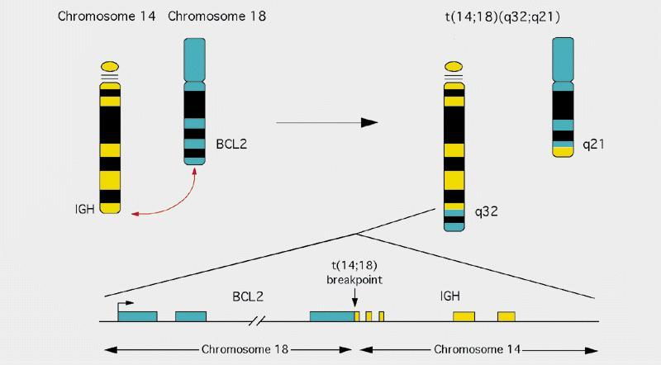
Resisting cell death
Chromosomal translocation associated with B-cell lymphomas.
The Bcl-2 gene is translocated behind a potent immunoglobulin gene promoter. Increased expression of Bcl-2 gene is associated with inhibition of apoptosis.

Slide 28
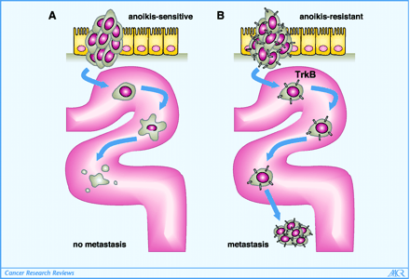
Resistence to cell death - anoikis
Anoikis is a form of programmed cell death that occurs in anchorage-dependent cells when they detach from the surrounding extracellular matrix.
barrier to metastasis
circulating tumor cells are anoikis resistant
TrkB (neurotrophic receptor) overexpression protects disseminated, circulating tumor cells from undergoing anoikis.

Slide 29
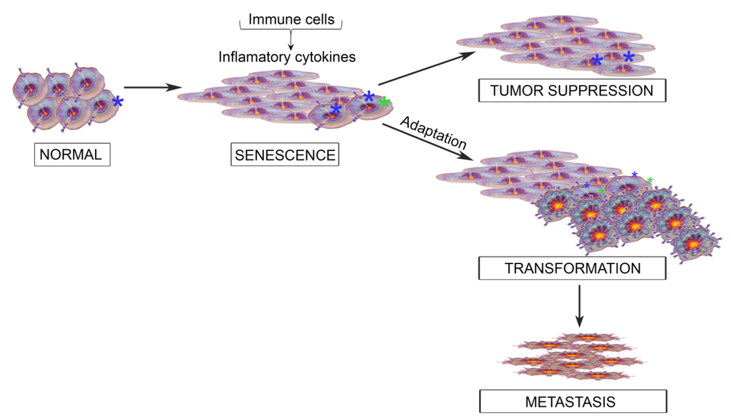
Resisting oncogene-induced senescence
Cellular senescence is a growth˗arrest program that limits the lifespan of cells and prevents unlimited cell proliferation.
Certain mitogenic oncogenes or the loss of anti-mitogenic tumour˗suppressor genes induce senescence. This is known as oncogene-induced senescence.
Many cancer cells either do not have fully active senescence programs or develop bypass mechanisms to regain proliferation capabilities (c-myc overexpression).

Slide 30
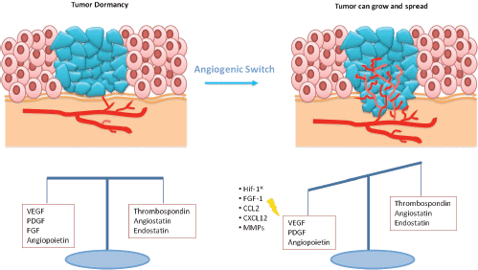
Inducing angiogenesis
Like normal tissues, tumors need nutrients and oxygen.
Tumor without blood circulation grew to 1–2 mm³. In the absence of vascular support, tumors may become necrotic.
Up-regulation of the activity of angiogenic factors is not sufficient for angiogenesis of the neoplasm. Negative regulators of vessel growth need to be downregulated.
New vessels enable invasion of tumor cells into circulation and creation of distant metastases.

Slide 31
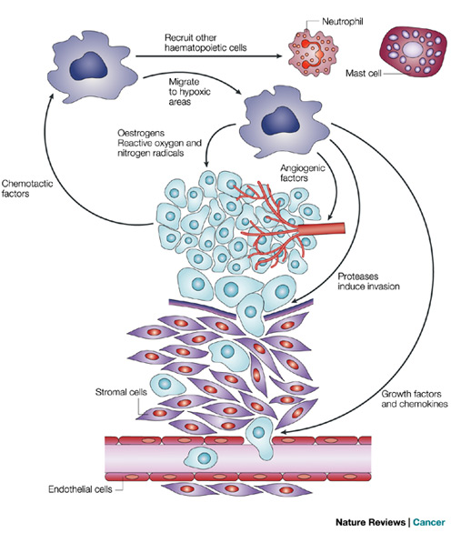
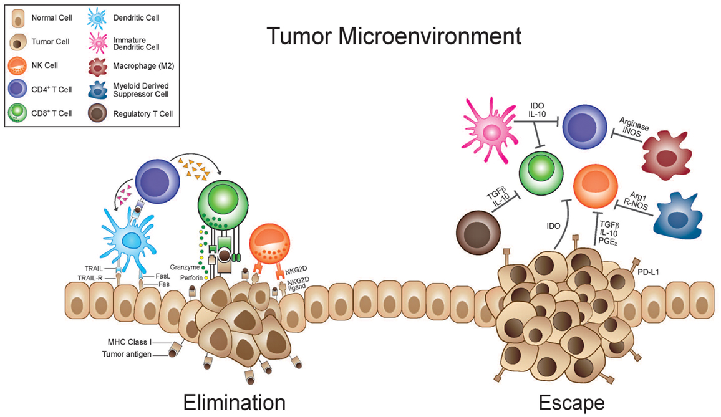
Inducing angiogenesis
Cells of the innate immune system (macrophages, neutrophils, mast cells, and myeloid progenitors) can infiltrate premalignant lesions and contribute to tumor angiogenesis.

Slide 32
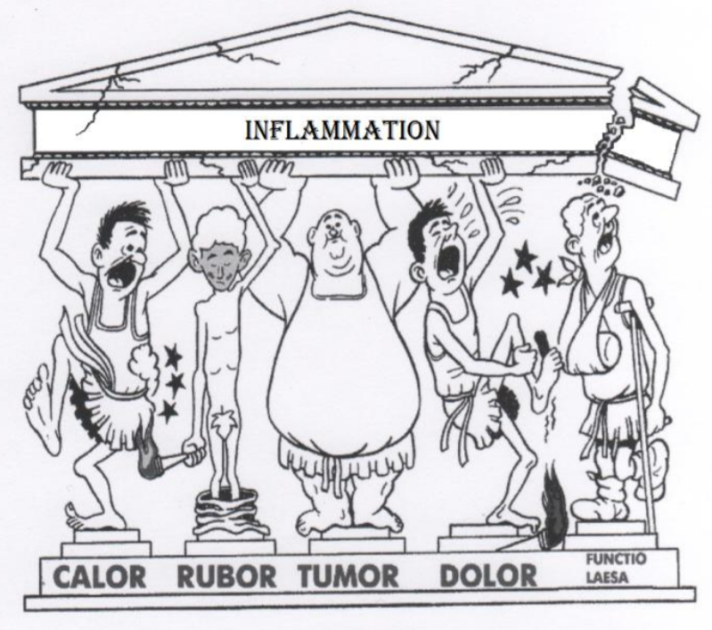
Inflammation
There are important similarities between tumors and the inflammatory response associated with wound healing.
“Tumors: Wounds that do not heal”
Many cancers arise from sites of infection, chronic irritation and inflammation.
Anti-inflammatory medications, such as aspirin or non-steroidal anti-inflammatory drugs, reduce the risk of cancer.
(Celsus)

Slide 33
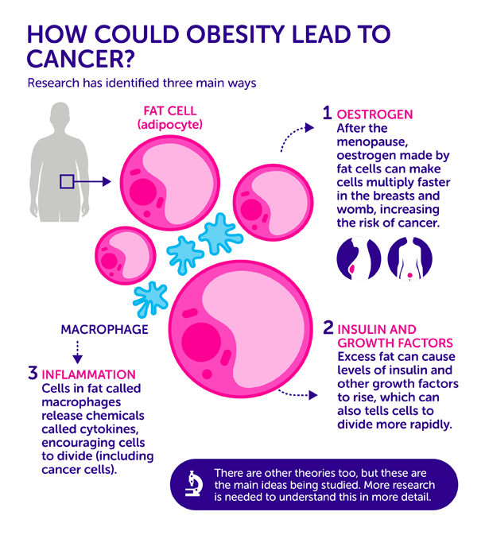
Inflammation and obesity
As people become obese more fat cells are build up in their tissues and macrophages are recruited to clear up dead fat cells. The number of macrophages in obese fatty tissue can be substantial - four in 10 cells.
Macrophages release cocktail of cytokines that can trigger chronic inflammation.
Obese people tend to have higher levels of inflammatory cytokines in their blood.
Fat isn’t just padding: it’s like another organ it is essentially a huge gland sending out biological information that affect the rest of body. Oestrogen and growth factors produced by fat cells increase the risk of cancer.

Slide 34
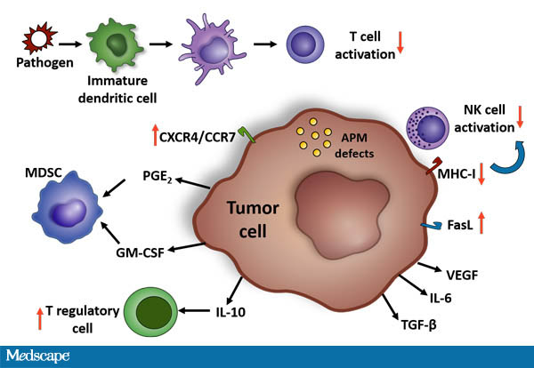
Evading immune destruction
Defective antigen presentation due to down-modulating antigen presenting machinery (↓ major histocompatibility complex, MHC)
Immune suppression in the tumor microenvironment, mediated by CD4+CD25+ FoxP3+ regulatory T cells (Tregs), or other types of suppressive cells.
Paralyzing cytotoxic T lymphocytes (CTLs) and natural killer (NK) cells via production of immune suppressive cytokines (by the cancer cells or by the non-cancerous cells in the tumor microenvironment). TGF-β is a chief mediator of this activity.
Down regulation of death receptors prevents death ligand-mediated killing of tumor cells by both CTLs and NK cells.

Slide 35
Cancer Neoantigens: A Promising Source of Immunogens for Cancer Immunotherapy
Somatic mutations in tumor genes could be reflected in proteins. Missense or frameshift mutation has the potential to generate tumor-specific antigens (TSAs), which are theoretically recognized as “non-self” by the host immune system.
TSAs, also known as “cancer neoantigens”, have the potential to be utilized as biomarkers predicting clinical responses to immunotherapy and outcomes, as well as serving as targets for immunotherapy.
Neoantigens are also expressed by fetal organs. Older fetal organs (21 weeks) and adult organs do not express an immunogenic neoantigens.

Slide 36
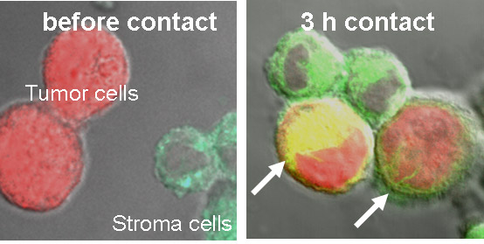
Oncological trogocytosis - the way how to get rid of antigens
Intercellular exchange of intact membrane patches.
Exchange of membrane molecules/antigens.
Human epidermal growth factor receptor 2 (HER2) could be transferred from cancer cells to monocytes via trogocytosis

Slide 37
Altered metabolism
The ability to acquire necessary nutrients from a nutrient-poor (low glucosis) and hostile (hypoxia, oxidative stress) environment and utilize these nutrients to maintain viability and build new biomass.
Cancer-associated metabolic reprogramming have profound effects on gene expression, cellular differentiation, and the tumor microenvironment.
These adaptations involve an ability to access normally inaccessible nutrient sources.

Slide 38
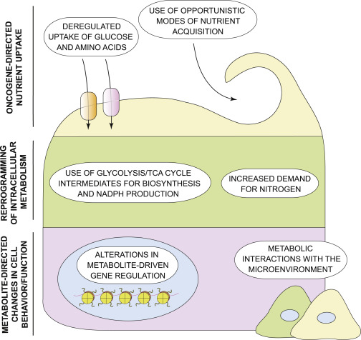
Hallmarks of cancer metabolism
deregulated uptake of glucose and amino acids
use of opportunistic modes of nutrient acquisition
use of glycolysis/TCA cycle intermediates for biosynthesis and NADPH production
increased demand for nitrogen
alterations in metabolite-driven gene regulation – metabolites influence enzymes involved in deposition and removal of epigenetic marks.
metabolic interactions with the microenvironment.

Slide 39
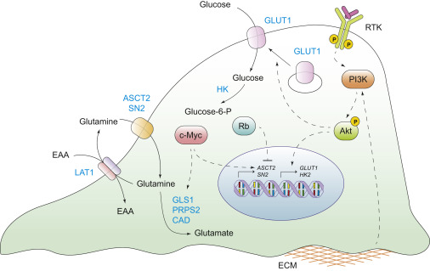
Altered metabolism
Two principal nutrients that support survival and biosynthesis are glucose and glutamine.
Glutamine provides the nitrogen required for the biosynthesis of purine and pyrimidine nucleotides and nonessential amino acids.
Warburg effect - a markedly increased consumption of glucose by some tumors in comparison to the nonproliferating normal tissues.
Positron emission tomography (PET)-based imaging of the uptake of a radioactive fluorine-labeled glucose analog, ¹⁸F˗fluorodeoxyglucose (¹⁸F-FDG) has been successfully used in the clinic for tumor diagnosis.
Oncogenic signaling proteins - Ras upregulate GLUT1 mRNA expression and increase cellular glucose consumption.

Slide 40
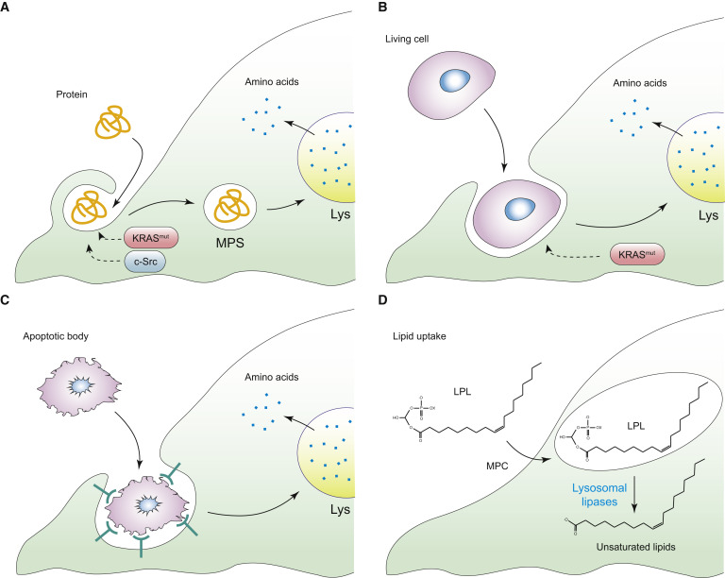
Use of opportunistic modes of nutrient acquisition
Ras or c-Src oncogenes allow to recover free amino acids through the lysosomal degradation of extracellular proteins.
Macropinocytosis.
Macroautophagy (autophagy cannot supply cells with new biomass and thus cannot support proliferation in nutrient-poor conditions).
Phagocytosis of apoptotic cellular corpses.
Canibalism.

Slide 41
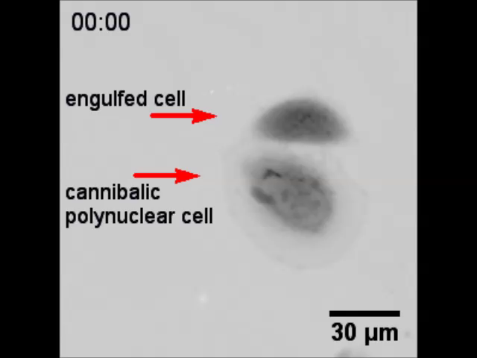
Notes:
Time-lapse imaging of cannibalism with the cell fusion (digestion of engulfed cell, detail). Target-cell is gradually engulfed by active cannibalic polynuclear cell. Bird eye structure typical for cannibalism appears. Then the target cell dies off.

Slide 42
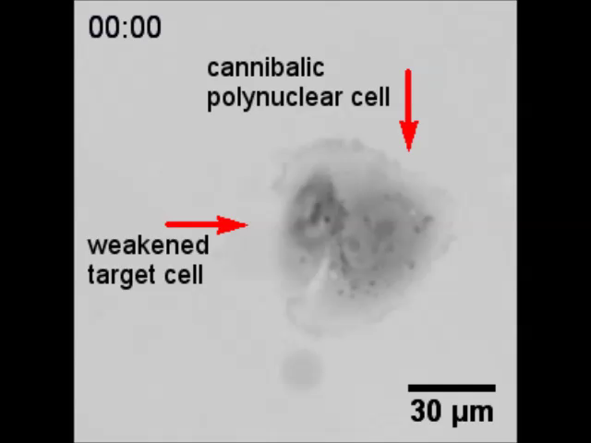
Notes:
Time-lapse imaging of cannibalism without the cell fusion (detail).Weakened target- cell is contacted by cannibalic cell, exploited and left to die.

Slide 43
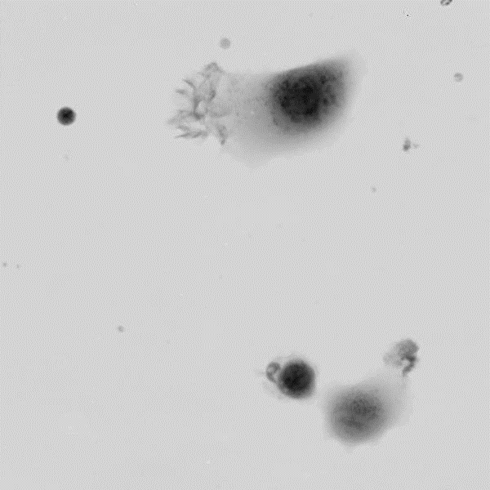
Notes:
Time-lapse imaging of cannibalism with the cell fusion (digestion of engulfed cell, detail). Target-cell is gradually engulfed by active cannibalic polynuclear cell. Bird eye structure typical for cannibalism appears. Then the target cell dies off.

Slide 44
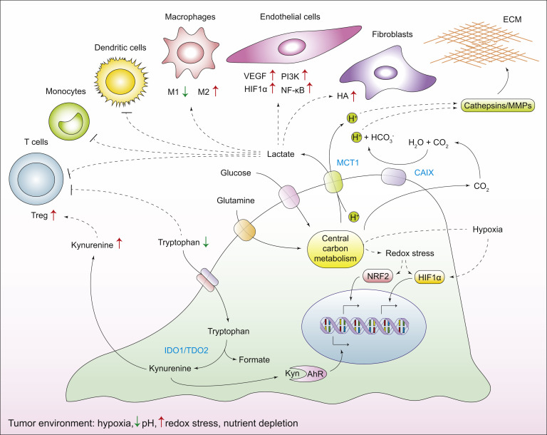
Metabolic interactions with the microenvironment
Cancer cells alter the chemical composition of the extracellular milieu, which exerts pleiotropic effects on the phenotypes of normal cells that reside in the vicinity of the tumor.
Reciprocally, the microenvironment affects the metabolism and signaling responses of cancer cells.
The high metabolic demand of cancer cells leads to an accumulation of H+ ions in tumor microenvironment – acidosis.

Slide 45
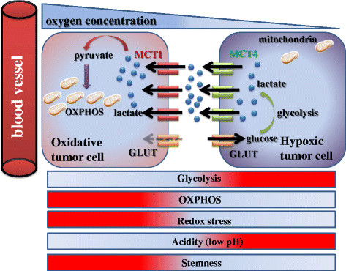
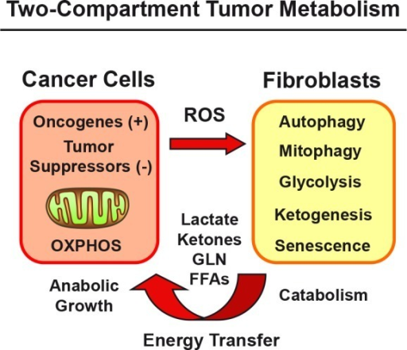
Metabolic symbiosis
Catabolic fibroblasts are rich source of energy and biomass for the growth and survival of anabolic cancer cells.
A linear path of clonal succession oversimplifies the reality of cancer; number of genetically distinct subclones of cells coexist within a single tumor mass: intra-tumor heterogenity - oxidative and glycolytic tumor cells in one tumor.

Slide 46
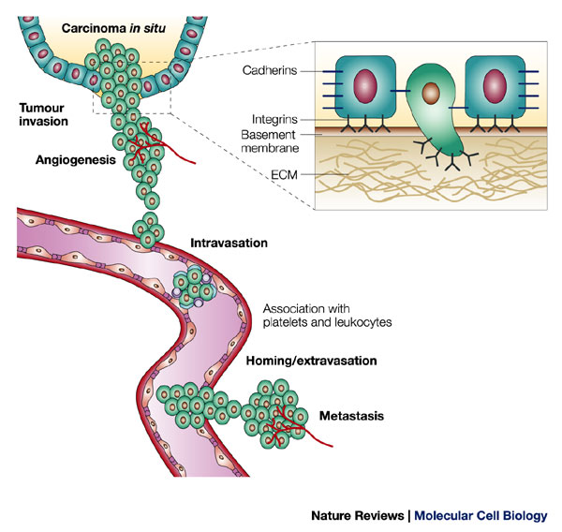
Invasion and metastasis
Cancer cells lose E-cadherin dependent intercellular adhesions, acquire a migratory phenotype (anoikis resistence, epithelial˗mesenchymal transition, EMT), penetrate the basement membrane, and invade the interstitial matrix (production of MMPs).
Tumour angiogenesis allows cancer cells to enter the bloodstream (circulating tumor cells), either directly or through the lymphatic system, by a process called intravasation.
In the circulation, tumour cells form small aggregates with platelets and leukocytes.
After stopping in the microcirculation of the target organ, tumour cells exit the bloodstream, by a proces called extravasation, and undergo local expansion.

Slide 47
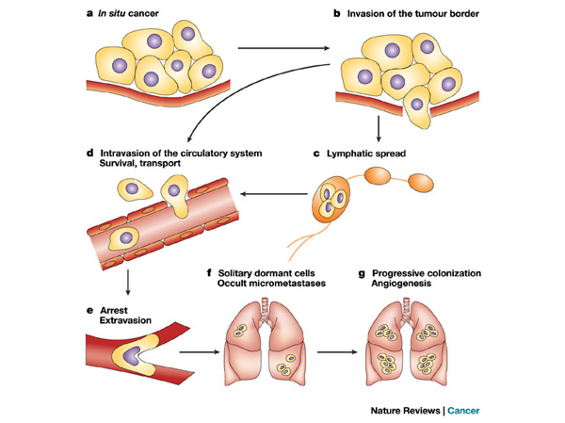
Invasion and metastasis
Tumors that breach the basement membrane and invade underlying tissue are malignant. An even further degree of abnormality is metastasis, the seeding of tumor colonies to other sites in the body. Metastasis requires not only invasiveness but also motility and adaptation to foreign tissue environments.
Several ways of spreading:
  blood (very often in the direction of flow: from GIT to the liver, by venous blood to the lungs, from lungs by artery blood to bones and brain)
  lymphatic (first neighbouring lymph nodes, than distant)

Slide 48
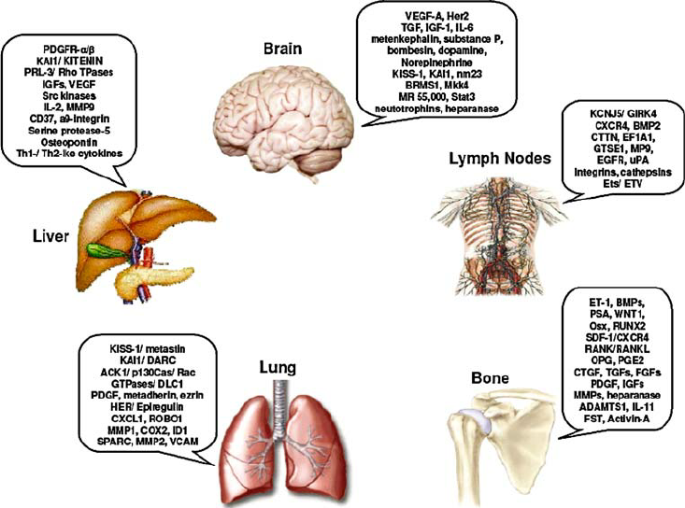
Seed and soil hypothesis –permissive microenvironment
Tumor cell-intrinsic metastatic propensities are not sufficient for metastatic seeding.
Metastasis is dependent on the interactions between 'seeds' (the cancer cells) and the 'soil' (the host microenvironment).
Different cancers have preferential sites of metastasis = organotropism (prostate cancer - the bone and the liver).
Tumour-secreted factors and tumour-shed extracellular vesicles enable the 'soil' at distant metastatic sites to encourage the outgrowth of incoming cancer cells.
Pre-metastatic niches (PMNs) are sites of immune deregulation, owing to the presence of a pro-tumorigenic, inflammatory milieu induced by tumour-secreted factors, which creates immunosuppression and coagulation disorders.
factors influencing organ-specific metastases to the liver, lung, brain, bone and lymph nodes

Slide 49
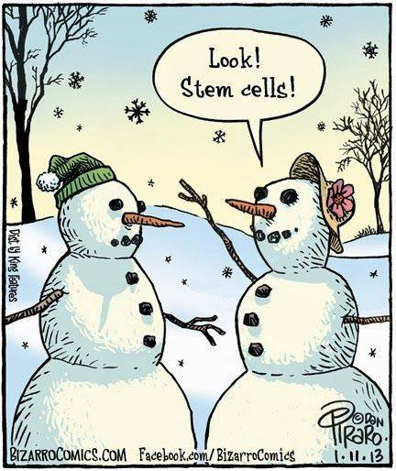
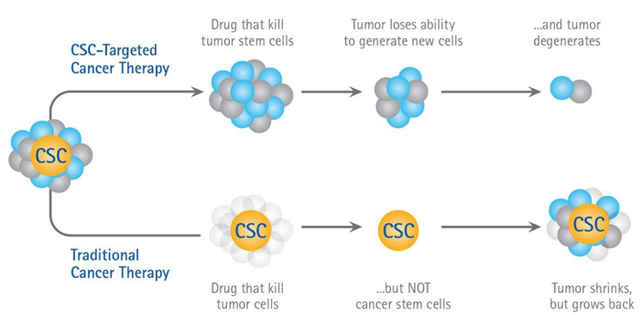
Cancer stem cell (CSC) hypothesis
Cancer stem cells are rare immortal cells within a tumor that can both self-renew by dividing and give rise to many cell types that constitute the tumor.
CSCs are tumorigenic, associated with metastasis and relapse.
Enhanced resistance to therapy and cell stress.
Such cells have been found in various types of human tumors and might be attractive targets for cancer therapy.

Slide 50
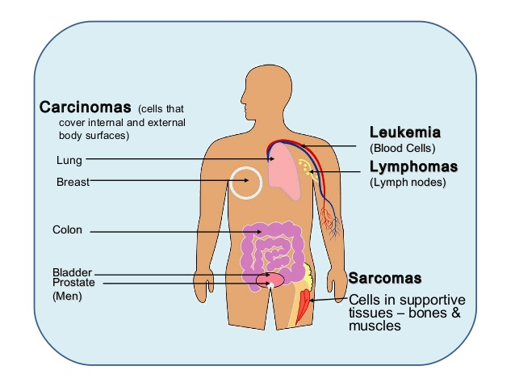
Tumor classification
The most common human cancers are of epithelial origin - the carcinomas. two main categories: squamous cell carcinomas (from epithelia that form protective cell layers) and adenocarcinomas (from secretory epithelia).
Nonepithelial malignant tumors include: sarcomas (from mesenchymal cells); hematopoietic cancers (from the precursors of blood cells); and neuroectodermal tumors (from components of the nervous system).

Slide 51
Tumor classification
If a tumor’s cells have dedifferentiated (lost all tissue˗specific traits), its origin can not be readily identified; such tumors are said to be anaplastic.
Benign tumors may be hyperplastic or metaplastic. Hyperplastic tissues are normal except for an excessive number of cells, whereas metaplastic tissues show displacement of normal cells by normal cell types not usually encountered at that site.
Dysplastic tumors contain cells that are cytologically abnormal. Dysplasia is a transitional state between completely benign and premalignant.
Adenomas, polyps, papillomas, and warts are dysplastic epithelial tumors that are considered to be benign because they respect the boundary created by the basement membrane.

Slide 52
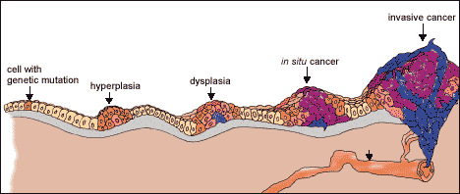
Tumor classification
typing = histological type
grading = benign × malignant
staging = TNM classification (T = tumor, N = node, M =metastasis)

Slide 53
Interaction of tumor with the host
local effects of tumor
mechanical compression (eg. brain tumors)
obstruction (e.g. carcinoma of the ductus choledochus)
bleeding, bruising (leukaemia)
chronic blood losses into GIT (gastric and intestinal tumors)
oedema (e.g. lymphomas)
coughing (lung carcinoma)
thromboses
difficult swallowing (oesophageal carcinoma)
loss of vision (compression of optic nerve by hypophyseal adenoma)
voice changes (laryngeal carcinoma)
pathological fractures (myeloma)

Slide 54
Interaction of tumor with the host
systemic effects of tumor
anemia (supression of bone marrow) – effect of proinflammatory cytokines
fever - production of cytokines (pyrrogens) by tumor (IL-1, TNFα)
tumor cachexia – anorexic mediators (TNFα)
paraneoplastic syndromes – some tumors produce hormones (adenomas); important diagnostically!
– pigmentation
– endokrinopathy (Cushing sy., hypercalcaemia)

Slide 55
Cancer biomarkers
Cancer biomarkers are substances that are produced in response to cancer processes.
These substances can be found in the blood, urine, stool, tumor tissue, or bodily fluids.
Most cancer biomarkers are proteins. However, patterns of gene expression and changes in DNA can be used.

Slide 56

Cancer biomarkers
Cancer biomarkers can be classified into the categories based on their usage:
Predictive biomarkers predict response to specific therapeutic interventions (positivity/activation of HER2 that predicts response to trastuzumab in breast cancer).
Prognostic biomarkers aim to inform regarding the risk of clinical outcomes such as cancer recurrence or disease progression.
Diagnostic biomarkers are used to identify whether a patient has a specific disease.

Slide 57
Cancer biomarkers - examples
Alpha-fetoprotein (AFP)
Cancer types: Liver cancer and germ cell tumors
Tissue analyzed: Blood
How used: To help diagnose liver cancer and follow response to treatment; to assess stage, prognosis, and response to treatment of germ cell tumors
BCR-ABL fusion gene (Philadelphia chromosome)
Cancer type: Chronic myeloid lukemia, acute lymphoblastic leukemia, and acute myelogenous leukemia
Tissue analyzed: Blood and/or bone marrow
How used: To confirm diagnosis, predict response to targeted therapy, and monitor disease status
Cancer antigen (CA) 15-3
Cancer type: Breast cancer
Tissue analyzed: Blood
How used: To assess whether treatment is working or disease has recurred

Slide 58
Cancer biomarkers - examples
HER2/neu gene amplification or protein overexpression
Cancer types: Breast cancer, gastric cancer
Tissue analyzed: Tumor
How used: To determine whether treatment with certain targeted therapies is appropriate
Prostate-specific antigen (PSA)
Cancer type: Prostate cancer
Tissue analyzed: Blood
How used: To help in diagnosis, assess response to treatment, and look for recurrence
Carcinoembryonic antigen (CEA)
Cancer types: Colorectal cancer and some other cancers
Tissue analyzed: Blood
How used: To keep track of how well cancer treatments are working or check if cancer has come back

Slide 59

Thank you for your attention

