Slide 1
Introduction to Transfusion Medicine

Slide 2
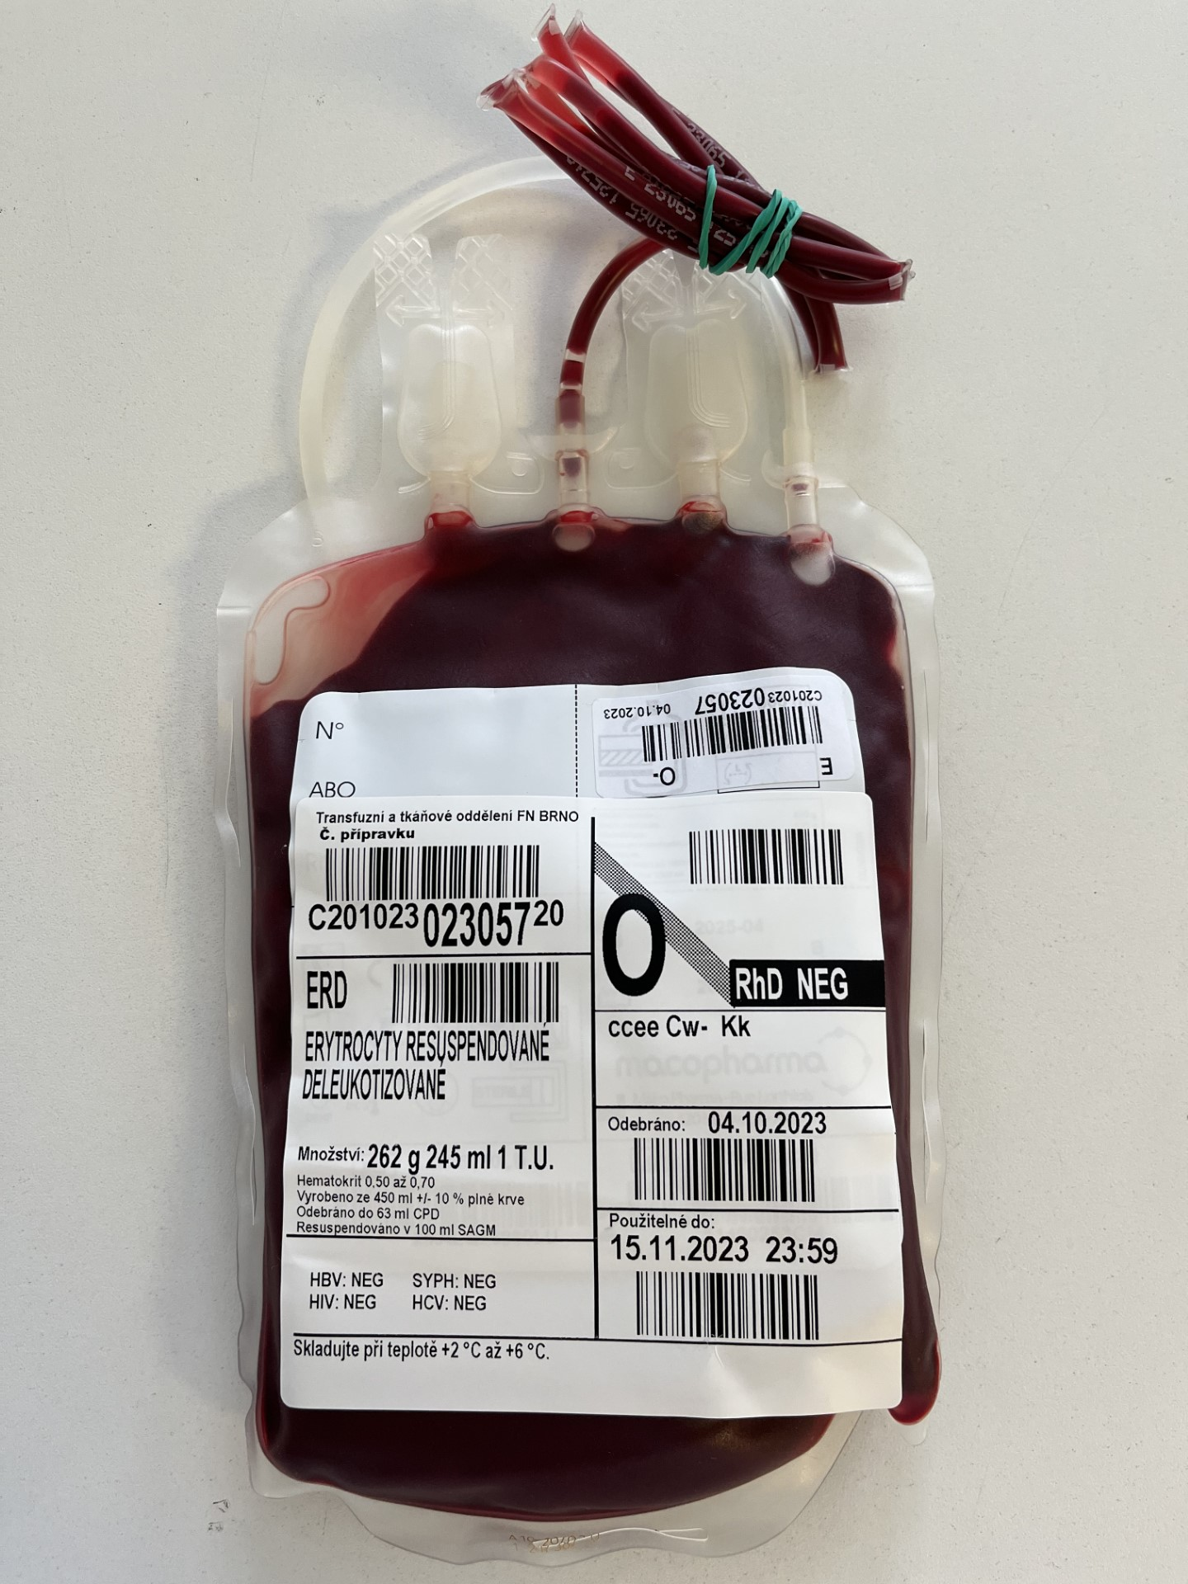
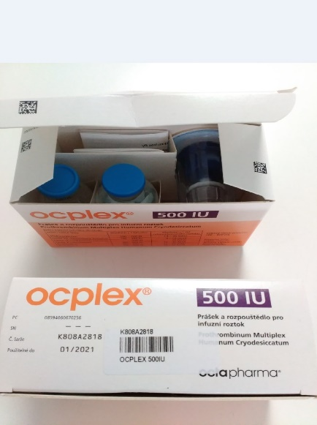
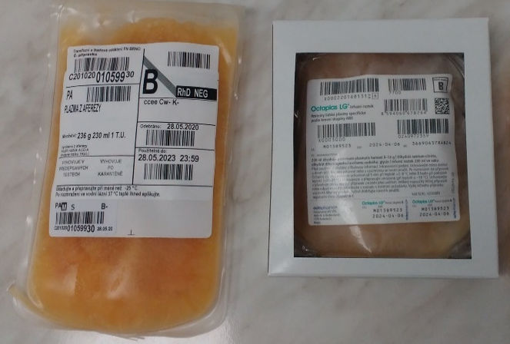
Blood component
1 – 10 donors
↑ risk of infection transmission
Blood establishments (within ČR)
Red Blood Cells, Platelets, Plasma, Granulocytes
Blood derivative
pooled plasma (thousands donors)
↓ risk of infection transmission – Pathogen Reduction Technology
Plasma fractionation centers (abroad)
Solvent/detergent-treated plasma, Coagulation factor concentrates, Immunoglobulins, Albumin…

Slide 3
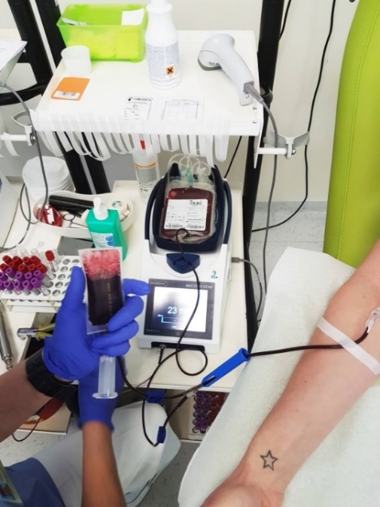
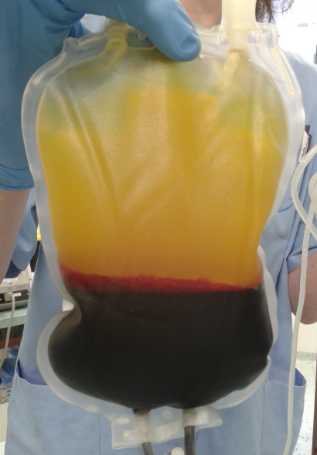
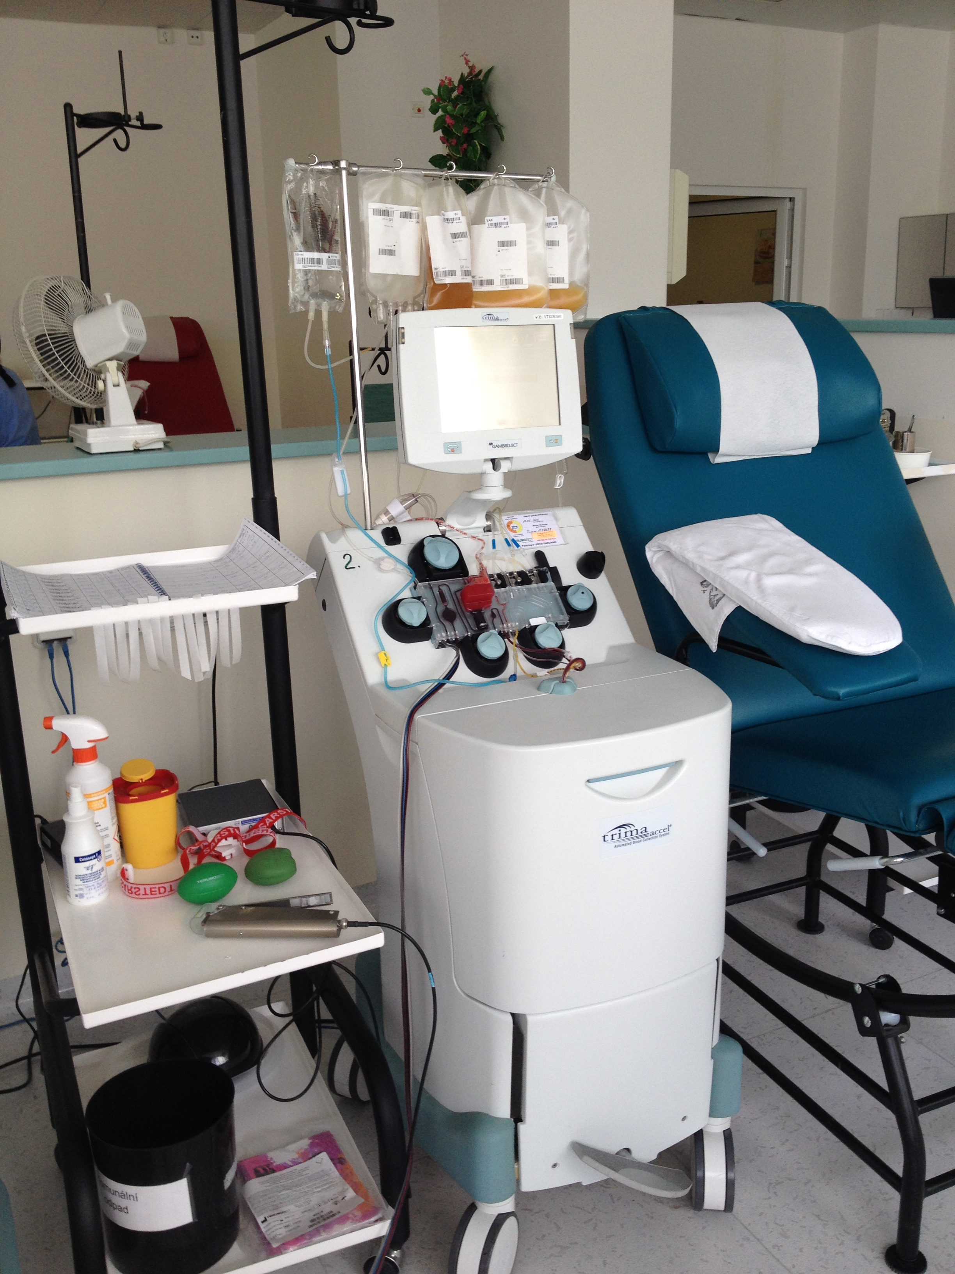
Blood components may be obtained:
whole blood donation
  → centrifugation
  → separation into its constituent elements
apheresis
  only the desired component is collected, while the remaining blood is returned to the donor
  usually further processing not needed

Slide 4
blood components

Slide 5
Whole Blood
source material for component preparation
not used for transfusion (usually)
  storage conditions and shelf life are specific for each component type
  patients should receive only the component required to correct their specific deficiency
whole blood may be indicated in limited clinical settings

Slide 6
Red blood cells
Shelf life: 42-49 days
Storage temperature: 2-6°C
ABO/Rh(D) compatibility between donor and recipient necessary, pre-transfusion testing

Slide 7
Decision to transfuse
…is complex:
Cause of anaemia
Severity of anaemia
In case of haemorrhage: the rate and amount
Ability to compensate for the blood loss
Presence of comorbidities affecting compensatory mechanisms

Slide 8
Indication
The aim of red blood cell transfusion is to provide oxygen delivery to organs and tissues when there is evident hypoxia caused by severe anaemia.
Haemoglobin > 100 g/l: no indication
Haemoglobin 70-100 g/l: individual evaluation
Haemoglobin < 60 - 70 g/l: indication almost sure
1 TU of RBCs is expected to raise haemoglobin by 10 g/l

Slide 9
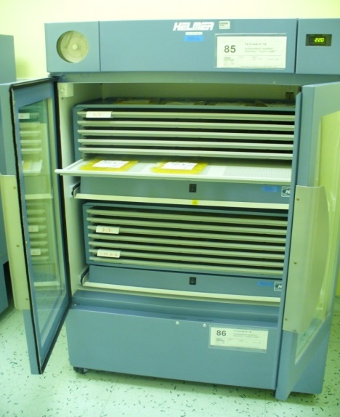
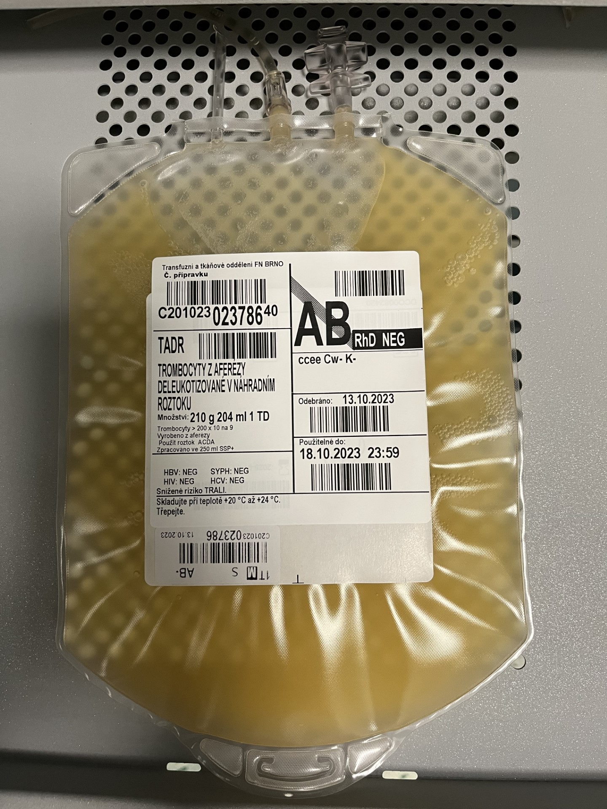
Platelets
Shelf life: 4 to 5 days
  7 days in case of sterility control or use of PRT
Storage conditions: at 20-24°C with continuous agitation
ABO/Rh(D) compatibility recommended
no pre-transfusion testing

Slide 10
Indications
Thrombocytopenia or thrombocytopathy
  Therapeutic: active platelet-related bleeding
    platelet count trigger for transfusion is not strict: evaluate bleeding severity, cause, suspected dynamics
  Prophylactic: as prevention of bleeding
    < 10 x 10⁹/l to prevent spontaneous bleeding
    < 50 x 10⁹/l in case of invasive and major surgical procedures, cardiac or intracranial surgery 80-100 x 10⁹/l
    1 TD increases platelet count by 20-40 x 10^{9/l}

Slide 11
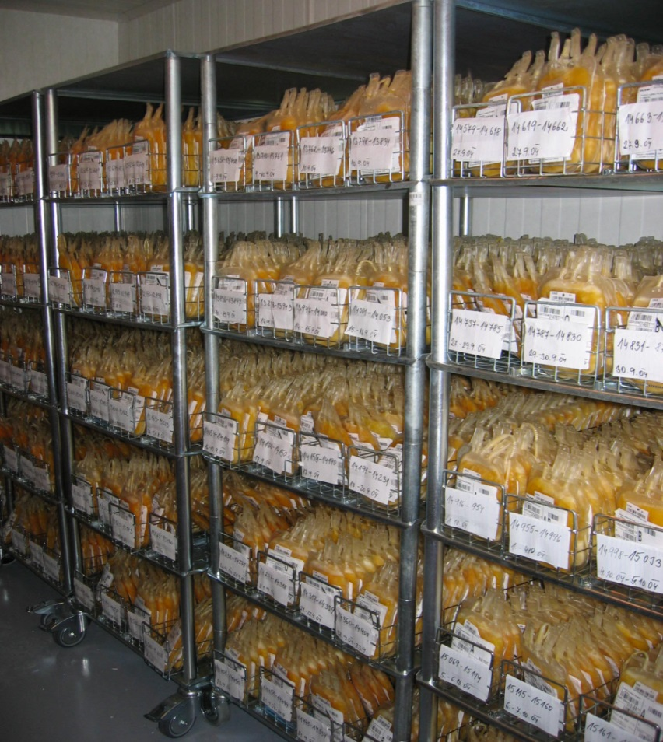
Plasma
Storage: 36 months at -25°C
3 months at -18°C
balanced amount of coagulation factors and coagulation inhibitors (and other plasma proteins)
ABO compatibility necessary
RhD not relevant
no pre-transfusion testing

Slide 12
Indications
use of plasma (FFP) less frequent - replaced:
  coagulation factor concentrates
  pooled plasma solvent detergent treated (OctaplasLG)
massive bleeding
DIC with active bleeding
TTP (plasma exchange)
Vitamin K deficiency associated bleeding (+ vit K)
Dosage: 10 – 15 ml/kg

Slide 13
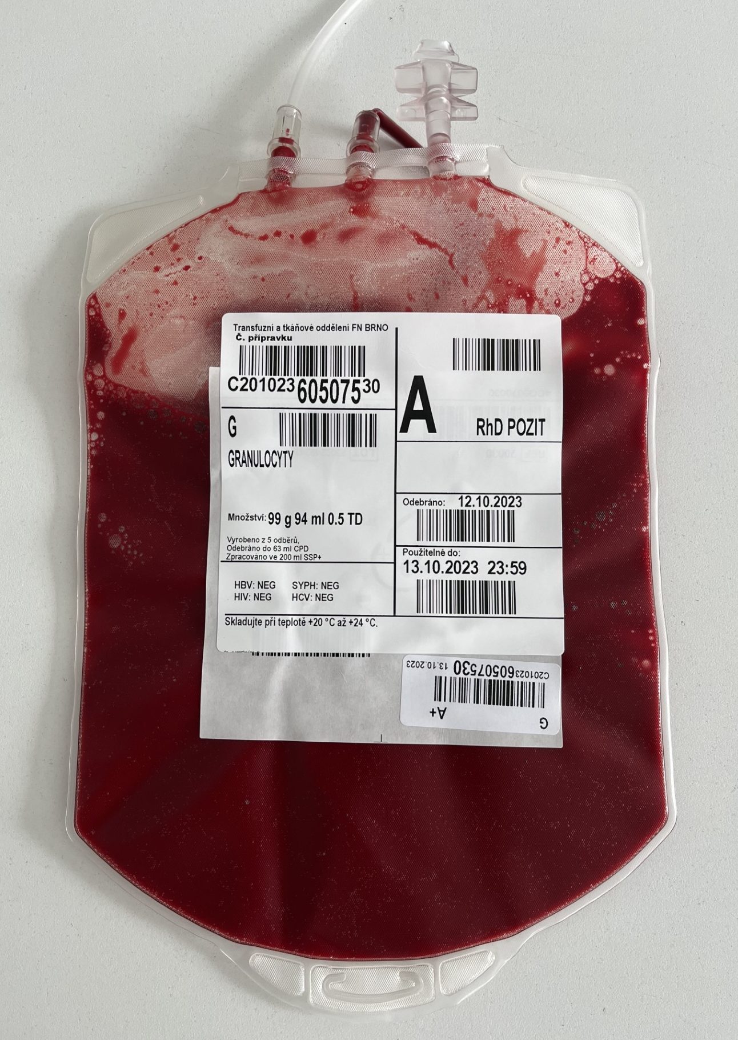
Granulocytes (rare use)
Shelf life: short – administrated as soon as possible
Storage temperature: 20-24°C
ABO/Rh(D) compatibility between donor and recipient necessary, pre-transfusion testing
Indication: severe inf. + neutropenia
Irradiation always

Slide 14
Blood component adjustment

Slide 15
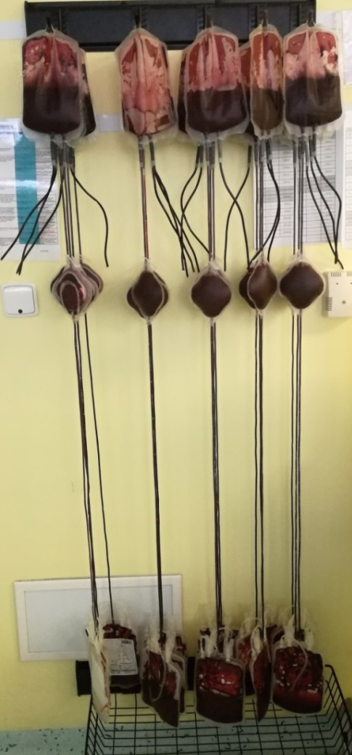
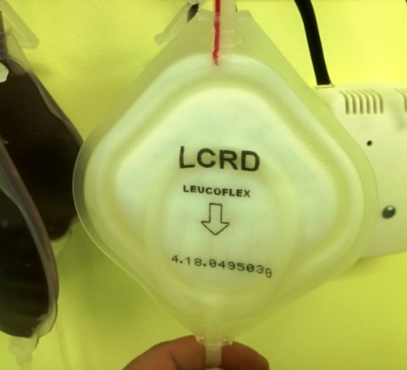
Leucocyte depletion
without indication limitation (safer)
leucocytes < 1x 10⁶
prevention/reduction
  ↓ adverse transfusion reactions
  ↓ alloimunisation
  ↓ haemotherapy-associated immunosuppression
  ↓ pathogen transmission (EBV, CMV) - alternative of CMV negative blood component

Slide 16
Irradiation
prevention of TA-GvHD
γ rays of 25-50 Gy inactivate T lymfocytes
indications:
  immature or altered immune system
  transfusions from relatives / of HLA-matched blood components
doesn´t replace leucodepletion neither destroys pathogens

Slide 17
Washing
indications:
  repeated severe allergic reactions due to plasma proteins
  selective IgA deficiency
shortened shelf life
anaphylactic reaction prevention
performed by additive solution or saline
goal: total protein < 0,5 g / TU

Slide 18
Smaller amount needed?
- blood component may be divided
Red blood cells – according to childs weight
Platelets – standard pediatric dose = 1/2 of adult TD
Plasma – production of pediatric dose possible, usually not cost effective

Slide 19
Immunohaematology
(just basics..)

Slide 20
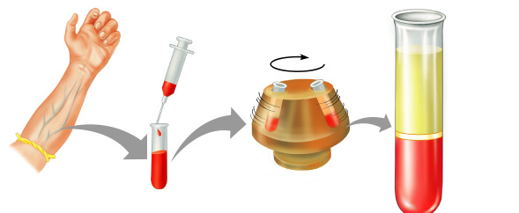
Pre-transfusion testing
compulsory serological tests done before erytrocyte blood component administration
valid for 3 days
100% safety not guaranteed

Slide 21
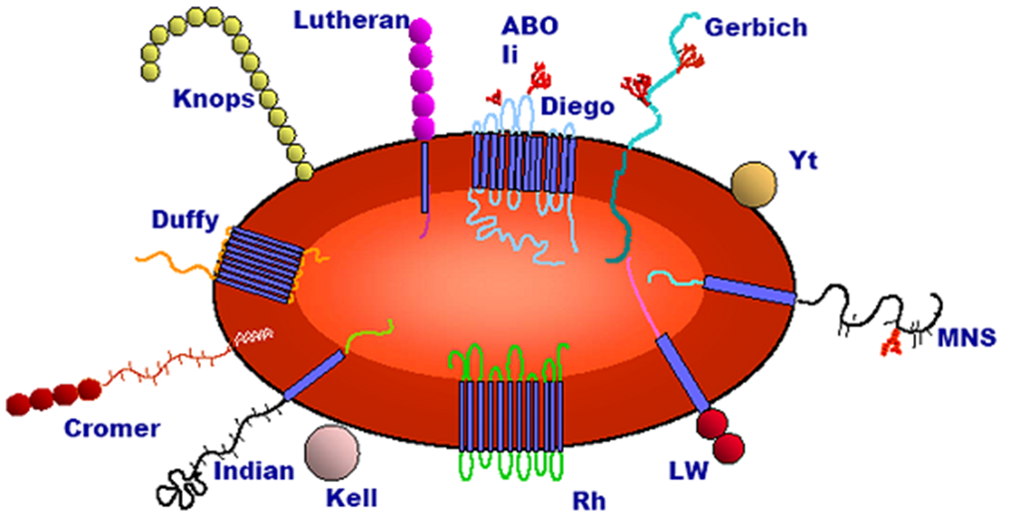
Pre-transfusion testing comprises:
blood group testing: ABO and RhD
screening for red cell antibodies (non-ABO)
compatibility test

Slide 22
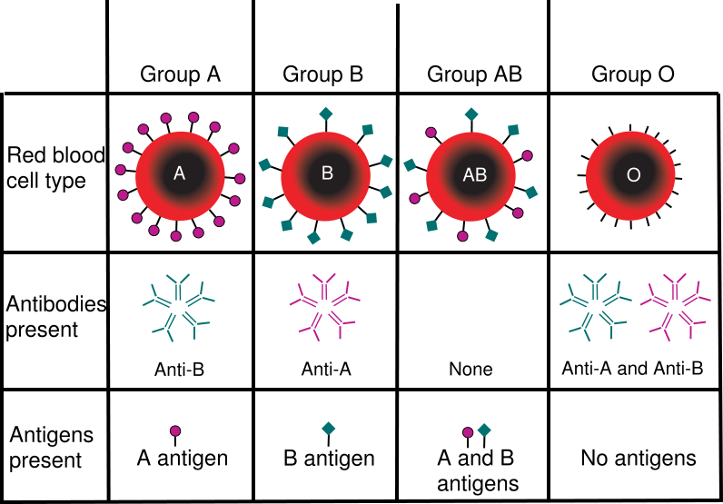

Slide 23
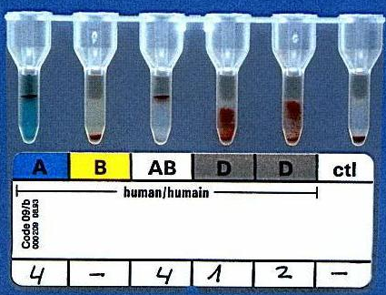
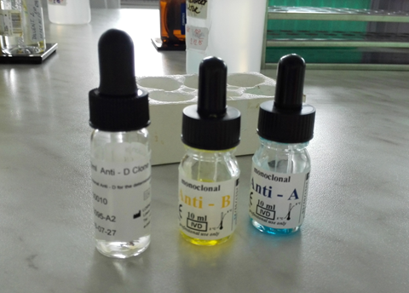
ABO and RhD testing of recipient
ABO
ABO antigens (aglutinogens)
  monoclonal anti-A and anti-B diagnostic serum
ABO antibodies (aglutinins) – reverse grouping
  diagnostic A1 and B erytrocytes
RhD
using 2 different diagnostic anti-D (IgM) sera

Slide 24
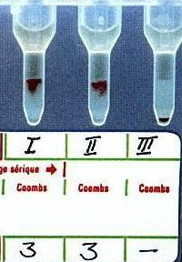
Screening for red cell allo-antibodies

Slide 25
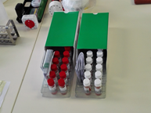
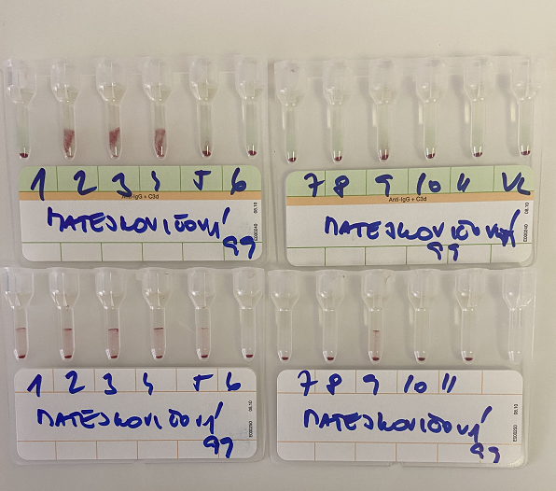
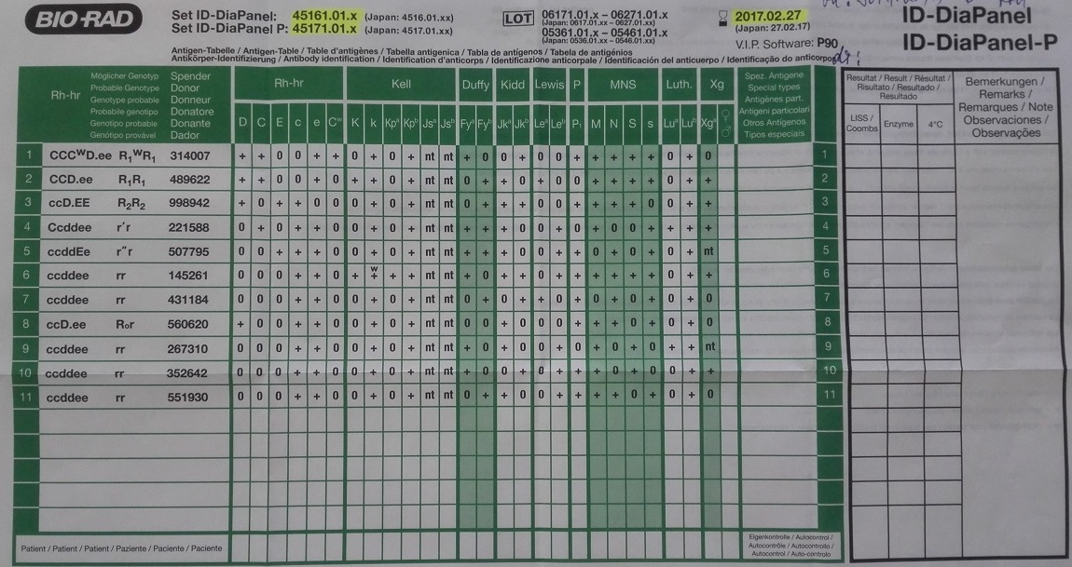
Antibody identification

Slide 26
Compatibility testing
recipient serum x donor erytrocytes

Slide 27
Emergency red cells
insufficient time for pre-transfusion testing
blood sampling for additional testing
O negative or patient´s blood group if known
adverse transfusion reaction risk due to possibility of pre-existing antibodies!

Slide 28
PRINCIPLES OF haemotherapy

Slide 29
General principles of haemotherapy
Transfusion when indicated!
Consistent compliance with guidelines
effective haemotherapy and restrictive transfusion strategy – always consider possible alternatives to transfusion
procedures to increase safety of haemotherapy
Patient education about benefits and risks of transfusion

Slide 30
Alternatives to transfusion
Patient blood management
Optimization of patient´s endogenous red cell mass:
  screening and treating for anaemia - iron substitution, erytropoetin
  autotransfusion
↓ blood loss and optimization of coagulation
  medication correction (with bleeding risk)
  surgical techniques
  haemostatic agents (tranexamic acid, tissue adhesives)
  controlled intraoperative hypotension
  reduction of diagnostic blood sampling
  coagulation factor concentrates
↑ tolerance of anaemia

Slide 31
Transfusion administration
within 6 hours
monitored (patient blood pressure, pulse, temperature before and after; adverse reactions)
Bed side test
administration through transfusion set (filter), separately
rest of the blood component should be left for 24 hours

Slide 32
Haemotherapy complications

Slide 33
Mandatory testing of blood donations
Infection markers serologically
  HBV (HBsAg)
  HCV (anti-HCV)
  HIV (dual tests)
  Syphilis (antibodies against T.P.)
Imunohaematology
  Blood group testing (ABO and RhD typing)
  Antierytrocyte antibody screening

Slide 34
Most complications are due to:
Leucocytes
Plasma
solution:
    leucocyte depletion
    irradiation
  solution:
    selection of clinical plasma donors (without history of immunisation)
    using of additive solutions for blood component preparation
    washing
    coagulation factor concentrates
    Solvent/detergent-treated pooled plasma (OctaplasLG)

Slide 35
Complications of transfusion - classification
etiology
time-to-onset
severity

Slide 36
Etiology
Infection transmission
Cardiovascular and metabolic complications
  circulatory overload, hypothermia, hyperkalemia, hypocalcemia, transfusion haemosiderosis, hypotension, hypertension
Immune-mediated complications
  Transfusion-related immunomodulation – associated with dose of transfused leucocytes and storage time of blood component
  Allo-imunisation
  Immune-mediated transfusion reactions
    acute and a delayed haemolytic reaction, FNHTR, allergic reaction, anaphylactic, TRALI, TA-GvHD, posttransfusion purpura

Slide 37
Transfusion complications according to time of their development
Acute
  < 24 h after transfusion
  e.g. acute haemolytic reaction, FNHTR, TRALI, allergic, cardiovascular and metabolic complications
Delayed
  > 24h after transfusion, days to weeks
  e.g. delayed haemolytic reaction, Ta-GvHD, infection, allo-imunisation, transfusion haemosiderosis (iron overload)

Slide 38
Transfusion complications according to severity
Nonserious
  mild clinical course
  usually fade away soon after the transfusion is stopped
  symptoms are mild and reversible
Serious
  severe symptoms, may be life-threatening
  require vital signs monitoring

Slide 39
Frequent cause of transfusion complications is administrative error!
sample change
error in identification data
error in blood group testing
change of blood component
not respecting standard procedures

Slide 40
Acute haemolytic reactions
Cause:
    Immune: incompatible transfusion – mostly administrative error!
    Non-immune: temperature, mechanical, bacterial contamination
Symptoms:
    chills/fever, dyspnoea, back pain or chest pain, tachycardia, hypotension, shock, anxiety, vomiting
Diagnosis:
    ↑ bilirubin, ↑ LDH, ↓ haptoglobin, haemoglobinemia, haemoglobinuria
    blood group verification of patient and blood component, DAT (positive), compatibility test (positive)
Treatment/management:
    stop the transfusion, vital signs monitoring
    intensive care may be needed to prevent shock, kidney failure (maintain urine output, haemodialysis), DIC

Slide 41
Delayed haemolytic reaction
Cause:
    Immunisation in the past (prior transfusion, pregnancy)
Symptoms:
    fever, icterus, development of anaemia in 5 to 14 days – extravascular haemolysis, kidney failure not so often
Diagnosis:
    anaemia, ↑ bilirubin, ↑ LDH, ↓ haptoglobin, haemoglobinuria, positive DAT, identification of anti-erytrocyte allo-antibodies
Treatment/management:
    supportive
    transfusion of compatible RBCs lacking the antigen against which is the patient immunised
Prevention:
    respecting standard/safe procedures (documentation)

Slide 42
Febrile non-haemolytic transfusion reaction
one of more fequent transfusion complications
Cause:
    cytokines released from leucocytes during storage
    HLA antibodies
Symptoms:
    fever, chills, shivering during or shortly after transfusion (usually occurs in 30-60 minutes from beginning of transfusion)
Diagnosis:
    temperature rise ≥ 1˚C from baseline
    FNHTR is a diagnosis of exclusion! Symptoms of FNHTR also occur in other more serious reactions – acute hemolysis, bacterial contamination, TRALI
Treatment/management:
    antipyretics
Prevention:
    leucocyte depletion (occurence in countries with widespread leucocyte depletion has significantly decreased).

Slide 43
Transfusion-associated sepsis
Cause:
    bacterial contamination of blood component
    highest risk have platelets stored in room temperature
Symptoms:
    fever, chills, vomiting, diarrhoea, tachycardia, hypotension, shock
Diagnosis:
    blood culture (patient), sterility testing (blood component)
    bacterial contamination should be excluded in all serious reactions with fever and hypotension
Treatment:
    antibiotics, symptomatic/supportive
Prevention:
    visual control of the blood component
    respecting of the storage conditions

Slide 44
Allergic and anaphylactic
Cause:
    most often after blood components with plasma content
    antibodies against plasmatic proteins in blood components
    anaphylaxis – selective IgA deficiency patients with anti-IgA antibodies
Symptoms:
    urticaria, itching, vomiting, diarrhoea, hypotension, shock, dyspnoea
Diagnosis:
    patient´s IgA level should be examined if severe allergic transfusion reaction repeates
Treatment:
    symptomatic, antihistamines
Prevention:
    washing of cellular blood components (for patients with severe reactions), premedication with steroids and/or antihistamines

Slide 45
TRALI
Transfusion Related Acute Lung Injury
Cause:
    anti-HLA or anti-HNA antibodies (prior immunisation) - activating neutrophiles → sequestration in lung microcirculations - endothelium damage - capillary leakage - ARDS
Symptoms:
    fever, hypotension, respiratory failure with bilateral pulmonary infiltrates, without symptoms of circulatory overload
    onset ˂ 6 hours from transfusion
Diagnosis:
    oxygen saturation, chest X-ray, anti-HLA / anti-HNA antibodies
Treatment:
    oxygen, ventilation
    leucodepleted blood components
Prevention: restriction on female-donor plasma

Slide 46
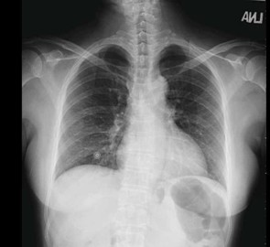
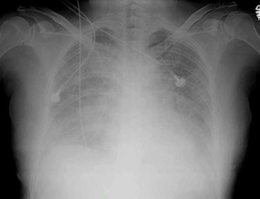
TRALI
Before transfusion
After transfusion

Slide 47
TACO
Transfusion Associated Circulatory Overload
Cause:
    after high volume transfusions – acute hypervolemia
Symptoms:
    dyspnoea, cough, acute pulmonary oedema, tachycardia, cyanosis
    onset < 12 hours after transfusion
Diagnosis:
    development of acute dyspnoea, low oxygen saturation
    chest X-ray of cardiac decompensation
Treatment:
    oxygen therapy, diuretics
Prevention:
    transfusion rate should be 2-4ml/kg/hour, 1ml/kg/hour in high risk patient

Slide 48
TA – GvHD (Transfusion-associated Graft versus Host disease)
Cause:
    donor lymphocyte proliferation in immunocopromised or HLA similar recipient
    rare, but usually fatal
Symptoms:
    fever, erythema, vomiting, diarrhoea, lymphadenopathy, hepatopathy, pancytopenia
    onset 4 – 30 days after transfusion
Diagnosis:
    biopsy consistent with GvHD
    evidence of donor and recipient lymphocyte chimerism
Prevention:
    irradiation, not administering transfusion from relatives

Slide 49
Hypothermia
body temperature drop to 32 – 34˚C
usually after massive transfusions (rather than single unit transfusion)
Prevention: preheating of blood components

Slide 50
Hyperkalemia
abnormal increase of blood potassium level after transfusion
fast RBCs administration (> 60 ml/min.)
longer storage time / irradiation of RBCs
could be serious - cardiac arrest
fastest diagnosis - ekg

Slide 51
Hypotension
blood pressure drop ≥ 30 mmHg within 4 h
other causes should be excluded

Slide 52
Hypertension
blood pressure raise ≥ 30 mmHg within 4 h with exclusion of other causes

Slide 53
Post-transfusion purpura
Cause:
    specific anti-platelet antibodies (e.g. anti-HPA 1a)
Symptoms:
    severe thrombocytopenia, bleeding
    serious transfusion complication
Diagnosis:
    identification of anti-platelet antibodies
Treatment:
    IVIG

Slide 54
Post-transfusion hemosiderosis
iron overload caused by multiple transfusions (transfusion-dependent patients)
hemosiderin = large aggregates of ferritin → tissue dammage (liver cirrhosis, cardiomyopathy, endocrinopathy,…)
1 TU contains approx 230 mg of iron

Slide 55
Material for investigation of transfusion complications:
pre-transfusion blood sample
post-transfusion blood sample
rest of the blood component (5-10 ml)
transfusion reaction reporting form

Slide 56
Take home message
follow guidelines
respect indications – restrictive transfusion politics – consider bloodless alternatives
use procedures to increase haemotherapy safety
interdisciplinary cooperation

Slide 57
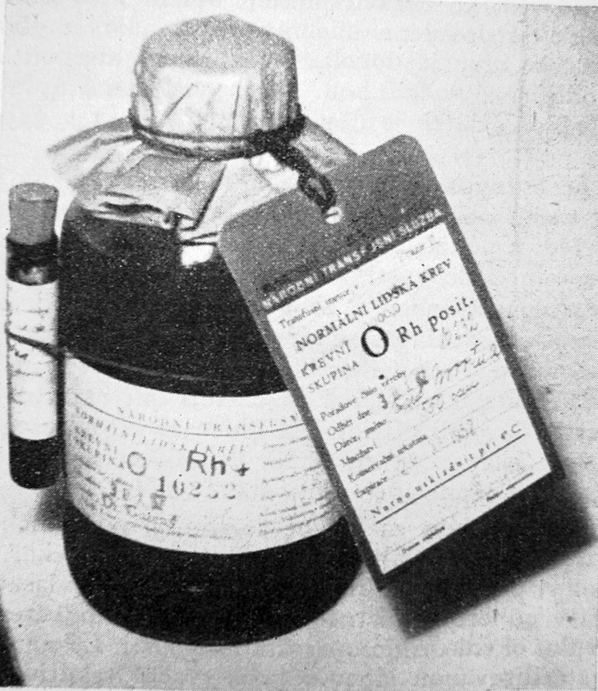
Thank you for your attention.

