Slide 1
BLOOD PRESSURE
Blood pressure – the most important parameter in cardiovascular system – „high-profile“ parameter

Slide 2
Blood pressure (BP) means the force exerted by the blood against any unit area of the vessel wall
Systolic blood pressure - SBP
Diastolic blood pressure -SBP
Mean arterial pressure - MAP
Pulse pressure - PP
BP = CO x R CO – cardiac output, R – resistance
CO = SV x HR SV – stroke volume, HR – heart rate
Notes:
Blood pressure (BP) means the force exerted by the blood against any unit area of the vessel wall (other definition: it is the lateral pressure of the blood column on the arterial wall).
Systolic BP: is defined as the highest pressure during one cardiac cycle (more precisely… during the ejection phase of systole, see the Pressure-Volume loop of the cardiac cycle)
Diastolic BP: is defined as the lowest pressure during one cardiac cycle (more precisely… during the filling phase of diastole, see the Pressure-Volume loop of the cardiac cycle).
Another definition DBP talking about diastolic pressure as the filling pressure. ATTENTION -At numerical values - it is necessary to distinguish which part of the cardiovascular system we are filling - cardiac (cardio) or arterial (vascular). DBP in the filling phase of the diastole during the cardiac cycle (ie, filling the right or left ventricle) is about 0 mmHg (the pressure must be lower than in the atria to meet the pressure gradient condition - that is, the blood flows from the atria to the ventricles) ). When the aortic valve opens and during the ejection phase of the systole we fill the arterial system, the DBP is around 80mmHg.
Mean arterial pressure (MAP) - this is the mean pressure during the heart cycle. BUT CAUTION - numerically is not calculated as the arithmetic mean (ie SBP + DBP / 2), but because the systole and diastole have different duration – value of diastolic BP (diastole takes longer) is taken as the basis and 1 3 difference between SBP and DBP (pulse pressure). MAP = 93mmHg.
Pulse pressure - difference between SBP and DBP = 40 mmHg
Generally, BP is determined by the content of the bloodstream, which is dependent on cardiac output (CO) and total periphery resistance (TPR).
And cardiac output is calculated as the product of stroke volume and heart rate.
The systolic blood pressure is dependent on the cardiac output parameter (and thus the stroke volume and heart rate), the DBP is dependent on the total peripheral resistance.

Slide 3
Arterial blood pressure curve during a pulse cycle
Blood pressure (BP): pressure on vascular wall – arterial BP: part of the systole's energy converted into lateral pressure acting on the vessel wall)
Mean arterial pressure (MAP) : mean value of blood pressure in the inter-beat interval (IBI)
  area under MAP = area above MAP (pulse curve integral)
  aproximation: MAP≈ DBP + 1/3 PP (PP = SBP – DBP)
Definition:
SBP - maximum of BP in the inter-beat interval
DBP – minimum of BP in the inter-beat interval
Attention: Values of SBP and DBP varies in different parts of cardiovascular system
SBP
Systolic blood pressure
area above MAP
MAP
Mean arterial pressure
PP
pulse pressure
DBP
Diastolic blood pressure
area under MAP
inter-beat interval

Slide 4
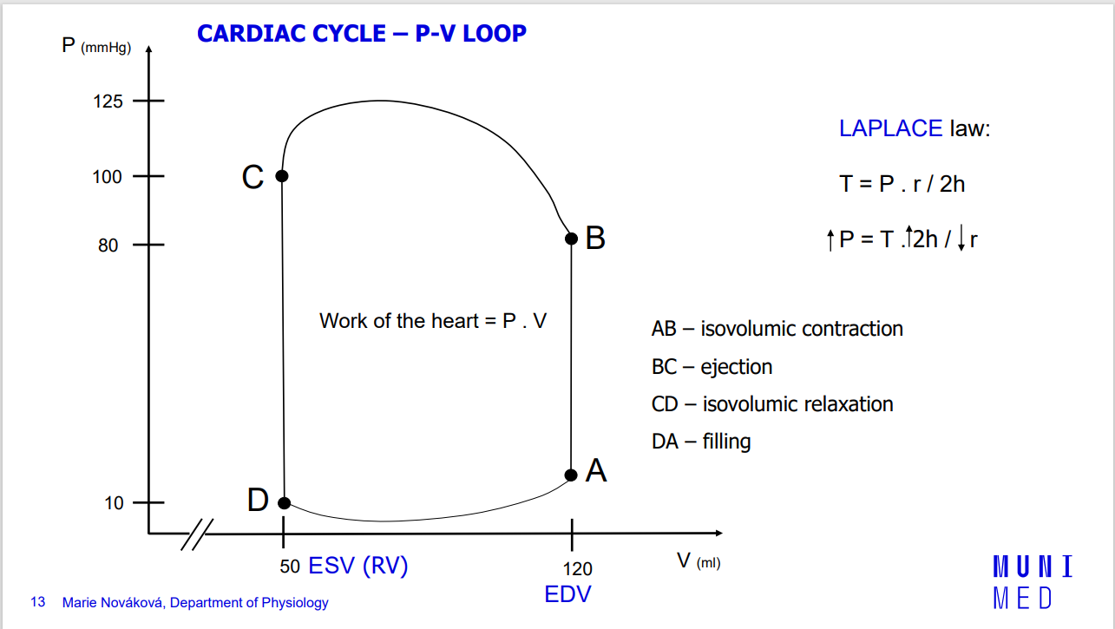

Slide 5
Blood pressure is a function of cardiac output and total peripheral resistance
BP
=
Cardiac output
(CO)
*
Total peripheral resistance
(TPR)
Heart rate
(HR)
Stroke volume
(SV)
*
SBP is given mainly by CO
DBP is given mainly by TPR

Slide 6
Blood pressure is a very important parameter in clinical practice for assessing the health or disease of the cardiovascular system, and generally for assessing the overall health of a person.
Every 2-5 years, cardiovascular disease specialists and researchers from all over the world meet to discuss what could be improved and what values should be counted as "still physiological" and where there is a "non-physiological" for diagnosis: hypertension. This is determined in Europe at 140 mmHg for systolic blood pressure and 90 mmHg for diastolic blood pressure.
The following 2 tables - you can see that the numerical boundaries have not changed for a long time (one table is from 2013, the following from 2018), however, the environment in which BP is measured has been more specified

Slide 7
Classification BP values
category | Systolic BP | Diastolic BP
 | (mmHg) | (mmHg)
optimal | < 120 | < 80
normal | 120 – 129 | 80 – 84
high normal pressure | 130 – 139 | 85 – 89
Hypertension - mild | 140 – 159 | 90 – 99
Hypertension - moderate | 160 – 179 | 100 – 109
Hypertension - severe | ≥ 180 | ≥ 110
Izolated systolic hypertension | ≥ 140 | < 90
According the Guidelines of European Society of Cardiology 2013
Notes:
Blood pressure is a very important parameter in clinical practice for assessing the health or disease of the cardiovascular system, and generally for assessing the overall health of a person. Every 2-5 years, cardiovascular disease specialists and researchers from all over the world meet to discuss what could be improved and what values should be counted as "still physiological" and where there is a "non-physiological" for diagnosis: hypertension. This is determined in Europe at 140 mmHg for systolic blood pressure and 90 mmHg for diastolic blood pressure.
From this and the following picture you can see that the numerical boundaries have not changed for a long time (this table is from 2013, the following from 2018), however, the environment in which BP is measured has been more specified….continued on next slide

Slide 8
Classification BP values: „officer BP“
category | Systolic BP | Diastolic BP
 | (mmHg) | (mmHg)
optimal | < 120 | < 80
normal | 120 – 129 | 80 – 84
high normal pressure | 130 – 139 | 85 – 89
Hypertension – mild: grade 1 | 140 – 159 | 90 – 99
Hypertension – moderate: grade 2 | 160 – 179 | 100 – 109
Hypertension – severe: grade 3 | ≥ 180 | ≥ 110
Isolated systolic hypertension | ≥ 140 | < 90
According the Guidelines of European Society of Cardiology 2018
Notes:
In the headline above the table we have marked "according to office BP" - these numerical values for classification of onset of hypertension and differentiation of its severity in degrees (1, 2 or 3 degree of hypertension) are intended for persons who are measured pressure in doctor's office by nurse or by doctor. … .See next slide …

Slide 9
Classification of BP
It is recommended that BP be classified as
optimal, normal, high–normal, or grades
1–3 hypertension, according to officer BP.
Notes:
next slide

Slide 10
2018 ESC/ESH Guidelines for the management
of arterial hypertension
The Task Force for the management of arterial hypertension of the
European Society of Cardiology (ESC) and the European Society of
Hypertension (ESH)
Authors/Task Force Members: Bryan Williams* (ESC Chairperson) (UK),
Giuseppe Mancia* (ESH Chairperson) (Italy), Wilko Spiering (The Netherlands),
Enrico Agabiti Rosei (Italy), Michel Azizi (France), Michel Burnier (Switzerland),
Denis L. Clement (Belgium), Antonio Coca (Spain), Giovanni de Simone (Italy),
Anna Dominiczak (UK), Thomas Kahan (Sweden), Felix Mahfoud (Germany),
Josep Redon (Spain), Luis Ruilope (Spain), Alberto Zanchetti† (Italy), Mary Kerins
(Ireland), Sverre E. Kjeldsen (Norway), Reinhold Kreutz (Germany),
Stephane Laurent (France), Gregory Y. H. Lip (UK), Richard McManus (UK),
Krzysztof Narkiewicz (Poland), Frank Ruschitzka (Switzerland),
Roland E. Schmieder (Germany), Evgeny Shlyakhto (Russia), Costas Tsioufis
(Greece), Victor Aboyans (France), and Ileana Desormais (France)
European Heart Journal (2018) 39, 3021–3104
Notes:
As you can see, the whole document has 83 pages and its recommendations further state that people who have an automatic pressure device and measure their blood pressure at home, the threshold for diagnosis: high blood pressure (hypertension) is 5 mmHg lower- ie. already 135mmHg for SBP and 85mmHg for diastolic pressure, and if these values are measured and shown to doctors in the office, treatment should be started - usually starting with a recommendation to change the lifestyle (less salt, more exercise), if this is within 1 -2 months without effect, it is recommended to use medical treatment (of course, taking into account the general condition of the patient, their other diseases, etc.)
If the blood pressure is measured in the doctor's office, the value for the diagnosis of hypertension given in the table (SBP = 140mmHg and above, DBP = 90mmHg and above) applies, if this value is measured in 3 consecutive measurements within 1 week - is again it is necessary to mark the person with a diagnosis of hypertension and start treatment (again via lifestyle and then medically).

Slide 11
As you can see, the whole document has 83 pages and its recommendations further state that people who have an automatic pressure device and measure their blood pressure at home, the threshold for diagnosis: high blood pressure (hypertension) is 5 mmHg lower- ie. already 135mmHg for SBP and 85mmHg for diastolic pressure, and if these values are measured and shown to doctors in the office, treatment should be started - usually starting with a recommendation to change the lifestyle (less salt, more exercise), if this is within 1 -2 months without effect, it is recommended to use medical treatment (of course, taking into account the general condition of the patient, their other diseases, etc.)
If the blood pressure is measured in the doctor's office, the value for the diagnosis of hypertension given in the table (SBP = 140mmHg and above, DBP = 90mmHg and above) applies, if this value is measured in 3 consecutive measurements within 1 week - is again it is necessary to mark the person with a diagnosis of hypertension and start treatment (again via lifestyle and then medically).

Slide 12
BLOOD PRESSURE MEASUREMENT
Direct invasive method
  1726 Stephan Hales – horse
  Today – during catheterization
  Indirect non-invasive measurement
  Palpation method
  Auscultation method
  Oscilometric method
Notes:
It follows from the above that it is necessary to measure blood pressure correctly ...
Stephan Hales was the first demonstrable blood pressure measurement (see picture in the next slide), in a horse. This measurement belongs to the methods of direct BP measurement, which is carried out today, for example during cardiac catheterization (invasive examination, when a thin specially made tube (catheter) is inserted through venous or arterial input inside the selected vessel up to the heart sections - we can directly determine/measure the current BP values ​​... everything will be discussed in a lecture on: Examination methods in cardiology). A major disadvantage of this direct measurement is the risk of infection.
Therefore, they are much more common to use indirect measurements, using instruments that lay only on the body surface and sense parameters from the body surface. This type of blood pressure measurement has also undergone some historical development depending on technical possibilities.

Slide 13
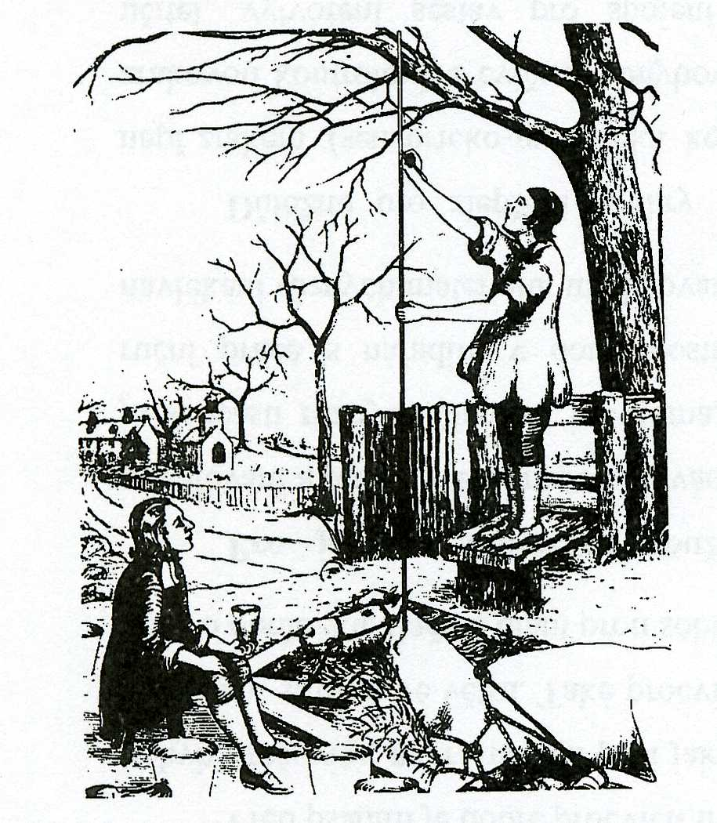
Notes:
Stephan Hales – first invasive measurement of blood pressure – in horse

Slide 14
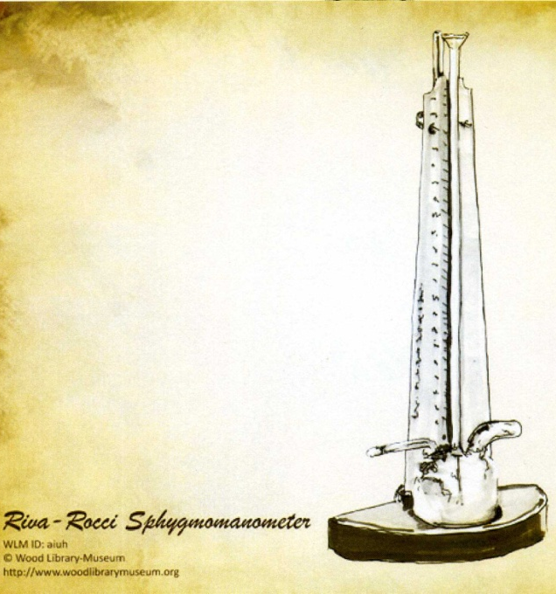
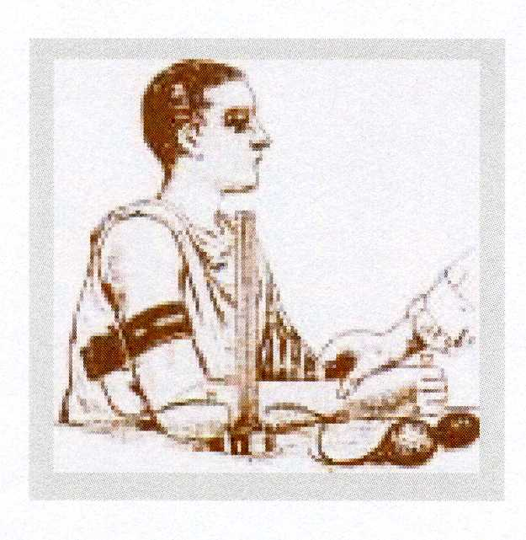
Palpatory methods
Italian physician
Riva Rocci
„mercury sfygmomanometr“
The cuff on the arm
1896
Notes:
Historians highlighted the measurement of Italian physician Riva Rocci, who using his sphygmomanometer with a balloon inflated the cuff on the arm above the expected SBP (I describe according to today's information), thereby stopping blood flow to the limb and thus not a palpable wrist pulse. Then he decreased the pressure in the cuff while palpating the radial artery at the wrist. He evaluated the moment when the cuff pressure had fallen below the systolic pressure - the pulse wave had recovered, and the investigator began to feel the pulse… at this point, we could see a value that corresponded to the systolic blood pressure on the scale. No more, diastolic pressure is not determined by this method.

Slide 15
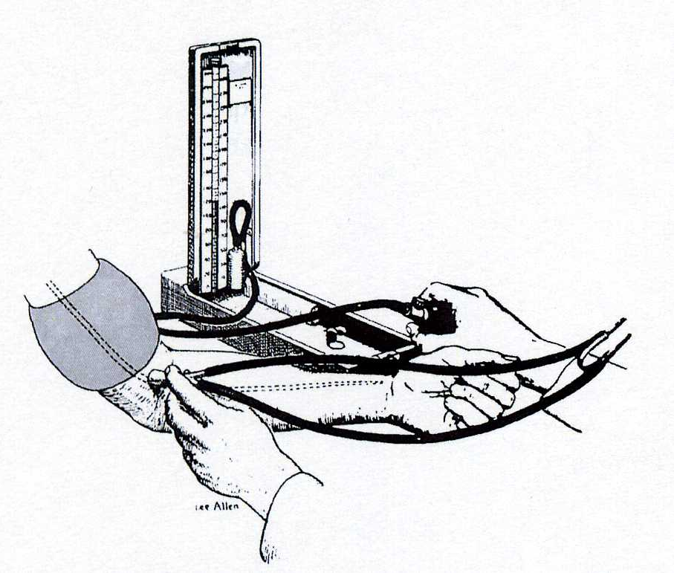
Auscultatory method
A Russian army surgeon
Nikolai Korotkoff
1904
„mercury sfygmomanometr“
The cuff on the arm
Stethoscope at the elbow
Notes:
Russian army surgeon Nikolai Korotkoff has improved the method by using a stethoscope that is placed in the area of ​​the elbow (where the a.brachialis is closest to the body surface). Again, an arm cuff, a balloon, a mercury manometer, and a stethoscope (enclosed in the area of ​​the elbow) are used. Inflate the cuff again to a value higher than systolic BP (today is in the rules 20-30mmHg higher than the presumed pressure of the person measured), in the stethoscope we hear nothing. Slowly release (at a rate of 2 mmHg per second) and focus on the sounds in the stethoscope. At some point we will hear regular sounds reminiscent of tapping (sometimes we see the mercury rhythmically “hopping” in the manometer column). At the moment of listening to this sound for the first time we evaluate the systolic pressure from the scale. As the cuff is further deflate, one can hear a gradual increase and decrease in the intensity of these sounds, referred to as Korotkoff's phenomena. When the phenomena disappear, the diastolic BP is evaluated from the scale. (note: this is a description of the method-procedure how to measure of BP. This is not the principle of the method).

Slide 16
Oscilometric method
Based on the same principle as auscultation: changes of laminar to turbulent flow
During instrument testing it has been repeatedly shown that the point of maximum oscillations corresponds to the mean arterial pressure measured invasively.
Oscillations begin around systolic pressure values and continue after cuff release = both systolic and diastolic pressure are estimated only indirectly based on empirical derived algorithms
Notes:
The oscillometric method of blood pressure measurement uses the same measurement procedure as the auscultatory method - the cuff wrapped on the arm and the device that inflates and deflates it automatically.
The basic principle of both auscultatory and oscillometric methods is to change the laminar to the turbulent flow in the vessel, which is compressed in the wrapped cuff section of the arm and changes its radius, thus changing the blood flow conditions in the arteries distally from the compressed area, the Reynolds number changes (see Lecture Blood flow in blood vessels, doc.Pásek) and the laminar flow becomes turbulent - these turbulences, which are the basis of vibration or oscillation of the vessel wall, we are able to detect the device.
The older method - the auscultation - is based on the physical definition of sound (sound is mechanical waves) - turbulence creates waves - that is, sounds - that is what we hear as Korotkoff's phenomena; the moment we start to hear the sound is equal to the systolic pressure, the moment we stop to hear (the sound disappears) = the diastolic pressure…. in this case, both SBP and DBP are really measured.
The oscillometric method has a technically different possibility - it captures turbulence on the principle of vibrations-oscillations in the vessel wall. It is technically more complicated, oscillations begin already around the values ​​of systolic pressure and continue after the cuff is released. The moment that is most clearly defined is the moment of highest oscillations, which corresponds to mean arterial pressure (found during testing - comparison of values ​​achieved by indirect and direct / invasive methods). This implies that the SBP and DBP values ​​are estimated by this method only indirectly based on empirical derived algorithms (ie calculated). This disadvantage, however, is obscured by the advantage that a person can measure their blood pressure by themselves without going to the doctor's office.
Nowadays, the technique goes further and there are instruments on the market in which both the auscultatory and the oscillometric method are combined.

Slide 17
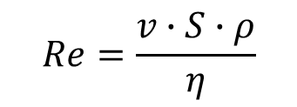
Laminar / turbulent flow, Korotkoff sounds
$$Re=\frac{v∙S∙ρ}{η}$$
laminar flow Re < 2000
turbulent flow Re > 3000
Reynolds number Re: predicts the transition from laminar to turbulent flow
v: velocity of blood flow
S: area of vascular lumen (π.r²)
ρ: density of blood
η: viscosity of blood
cuff
a. brachialis
Re₂
r₁
r₂
v₁
v₂
Re₁
laminar flow
turbulent flow
closely behind narrowing of the artery:
S₁ < S₂ a v₁≈ v₂ → Re₁ < Re₂ → turbulent flow

Slide 18
Principles of blood pressure measurement
SBP
MAP
DBP
Korotkoff sound
(auscultatory method)
Pressure in the cuff
SBP
DBP
Pressure oscillations in the cuff
(Oscillometric method)
Continually measured BP
Blood flow in the artery

Slide 19
The size of the cuff in adults
Cathegories | Circumference of arm (cm) | Cuff width x length (cm)
Small adult cuff | 22 - 26 | 10 x 24
Adult cuff | 27 - 34 | 13 x 30
Large adult cuff | 35 - 44 | 16 x 38
Tight adult cuff | 45 - 52 | 20 x 42
Notes:
Rules for correct blood pressure measurement:
start the measurement after a period of at least 5 (preferably 10) minutes at rest, not to talk to the patient during the measurement;
we measure the pressure 3 times with an interval of at least 2 (preferably 5) minutes (we ignore the highest value obtained, we calculate the average of the other two),
the cuff and the instrument should be in one plane ( ATTENTION when measuring bed pressure - make sure that the tonometer is not “somewhere on the cabinet and the patient is lying 2 m below it”).
The hand of the measured person should be laid freely on the table, with his hand slightly turned upwards.
The width of the cuff is also very important - see slide (important for obese patients as well as athletes).
If measured by auscultation methods - inflate the cuff to values ​​20-30mmHg higher than the expected value of SBP, deflate the cuff slowly (at a rate of 2 mmHg/s).
Beware of sport pressure devices located on the wrist - when measuring, the hand position must be at the same level with the heart to measure blood pressure correctly. Rules for correct blood pressure measurement: start the measurement after a period of at least 5 (preferably 10) minutes at rest, not to talk to the patient during the measurement; we measure the pressure 3 times in a row with an interval of at least 2 (preferably 5) minutes (we ignore the highest value obtained, we calculate the average of the other two), the cuff and the instrument should be in one plane ATTENTION when measuring bed pressure - make sure that the tonometer is not “somewhere on the cabinet and the patient is 2 m below it”). The hand of the measured person should be laid freely on the table, with his hand slightly turned upwards. The width of the cuff is also very important - see picture (important for obese patients as well as athletes). If measured by auscultation - inflate the cuff to values ​​20-30mmHg higher than the expected value of MOT, deflate the cuff slowly (at a rate of 1-2 mmHg / s).
Beware of sport pressure gauges - wrist pressure gauge - when measuring, the hand position must be level with the heart to measure blood pressure correctly.

Slide 20
Noninvasive continuously beat-to-beat measurement of finger arterial pressure
Prof. Jan Peňáz, MD, PhD
Teacher and researcher on the Department of Physiology, Masaryk university, Brno
Patent 1969
Notes:
Another non-invasive method of measuring blood pressure comes from the 1970s. It is based on the principle patented by the physiologist from the Department of Physiology of Masaryk University in Brno, Czech Republic - Professor Jan Peňáz. His method of measurement started a whole new era to understand the dependence of blood pressure on time and other parameters - pulse rate, blood flow, breathing, etc. - using his method it was first shown that blood pressure is a dynamic variable, changing from beat to beat. On the principle of photoplethysmography, it is possible to measure blood pressure continuously, beat-to-beat (previous methods: inflate the cuff, measure the pressure, deflate the cuff, end of measurement; then again - inflate-measure-deflate-end measurement - these are intermittent measurements).

Slide 21
Notes:
In the picture you can see Professor Peňáz in his small laboratory at the Department of Physiology of the Faculty of Medicine, then situated in the third building of the courtyard complex of buildings on Komenského square number 2 in the center of Brno city.
The method is non-invasive, blood pressure from finger arteries is measured by photoplethysmography.
The principle of this method is to ensure a constant flow of blood through the finger around which the cuff is wrapped (see image of the professor's hand). The device (the picture shows the first prototypes made at the Department of Physiology) for continuous measurement of blood pressure has a feedback control system that, in conjunction with changes in blood pressure during fluctuations during the cardiac cycle in the artery can very quickly change the cuff pressure to the passage of light through the examined finger remained constant and the volume of blood in the distal part of the finger remained unchanged.
The only one measurement problem occurs – when people have cold hands (vasoconstriction of blood vessels on the periphery).

Slide 22
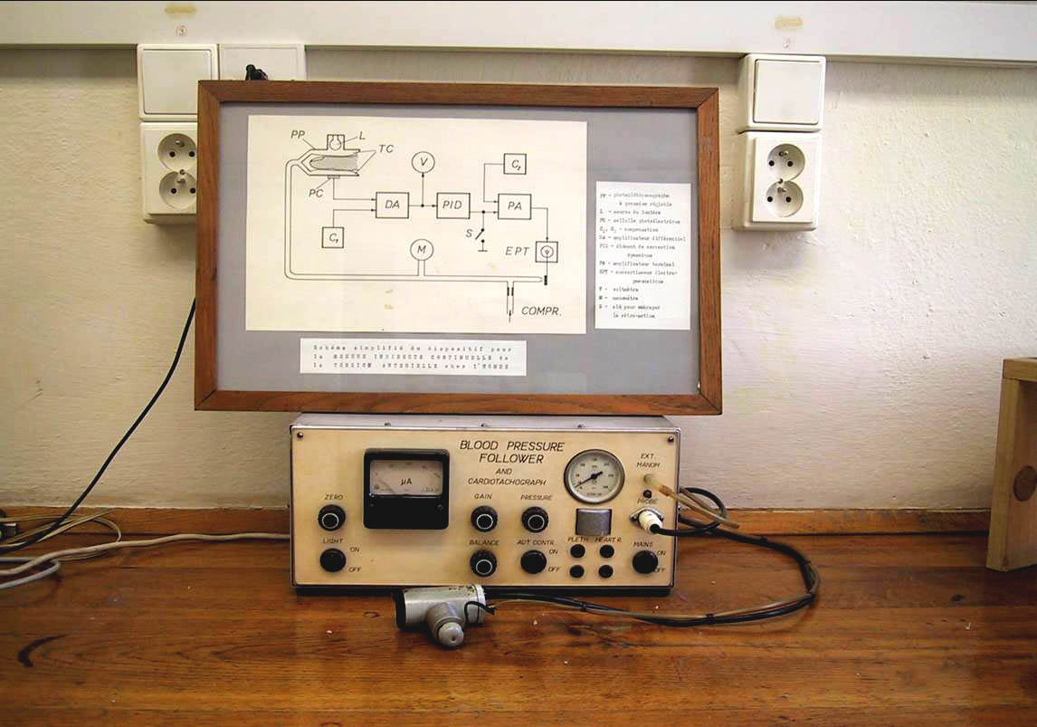
Non-invasive continuously blood pressure measurement beat-to-beat by Peňáz
Notes:
The picture shows the device constructed by professor Peňáz with the scheme of its connection

Slide 23
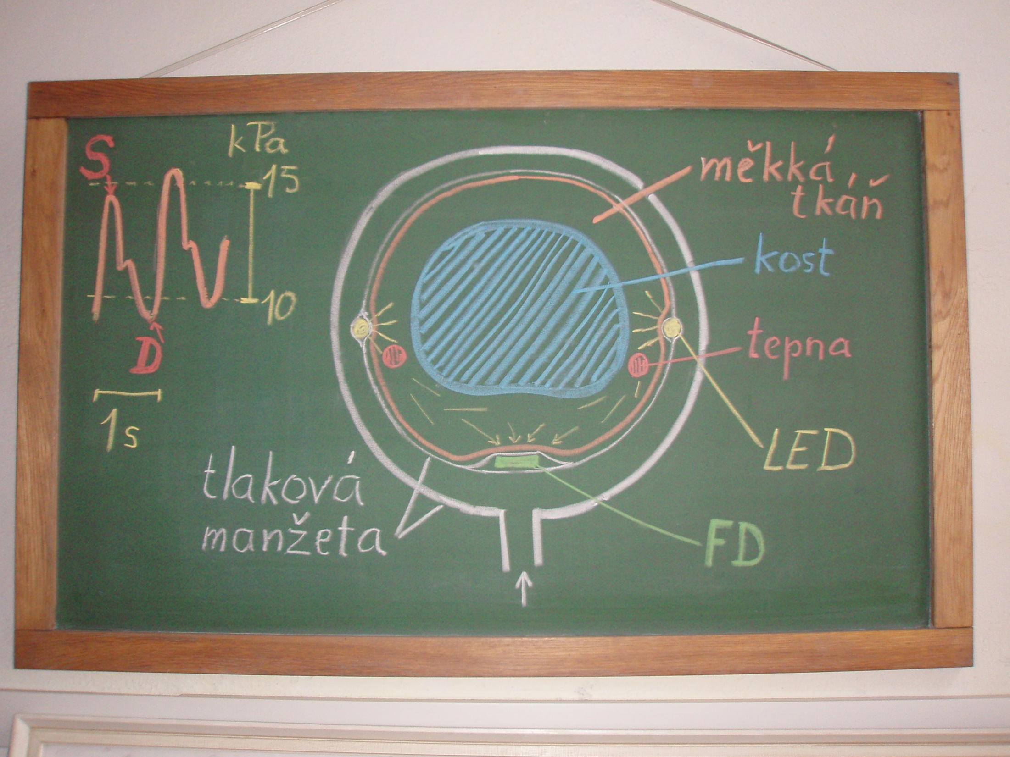
Notes:
This is an original surviving board from the 1980s with a scheme of cuffs for measuring continuous beat-to-beat monitoring. The author of the diagram on the board is directly Professor Peňáz.
You can see photocells on the inside of the cuff (yellow, LED)

Slide 24
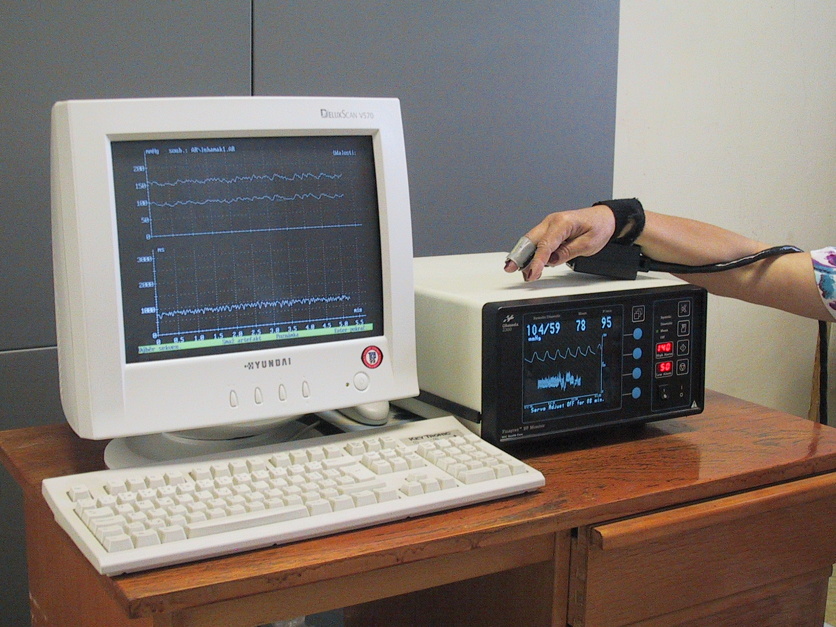
Finapres (Ohmeda, USA)
Notes:
This picture shows the first device constructed on Peňáz patent – Finapres (finger arterial pressure) from company Ohmeda, USA

Slide 25
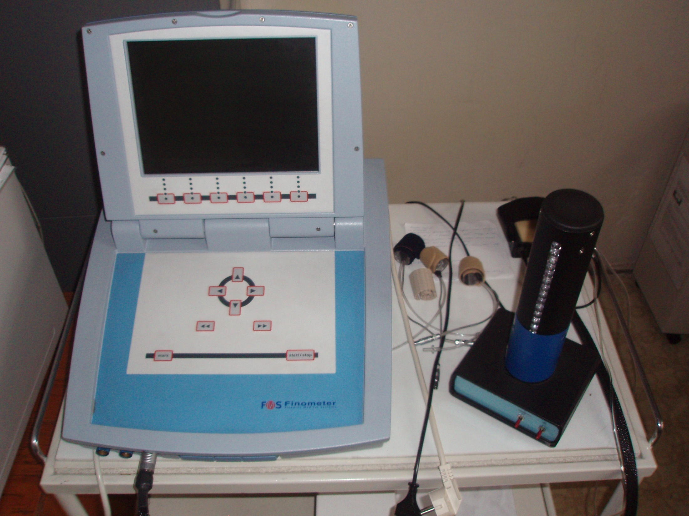
Finometr (FMS, Nizozemí)
Notes:
This picture shows other (younger) device from company FMS, Netherlands

Slide 26
Peňáz method
photopletysmography (Recorded photoelectric plethysmogram)
(volume-clamp method – method of „lightway artery system“)
It is based on clamping the volume of finger arteries by fast changes of pressure in a special cuff equipped with a photoelectric plethysmograph to measure the vascular volume.
based on the fact- - we need than pressure in the cuff corresponds to the pressure in the digital artery
The new term: Transmural pressure – Pt (the pressure across the wall of the artery)
So, we know following parameters:
BP=Blod pressure inside of digital artery, Pc = pressure in cuff, Pt =transmural pressure
We estimated: BP = Pc it is mean, that Pt = 0 … photoplethysmogram registered the highest amplitude of oscilation --- we measure the MAP
This situation comming at the beginning of measurement, when the cuff is inflated step by step (5 mmHg) and Pc increase. In the moment of the highest amplitude is registered – feed-back loop started for obtained the constant volume of the finger. This feed-back control is based on record amount of the light from photocells

Slide 27
Peňáz patent (1969)
He used a photocell signal to control the outer cuff pressure so that the finger volume did not change

Slide 28
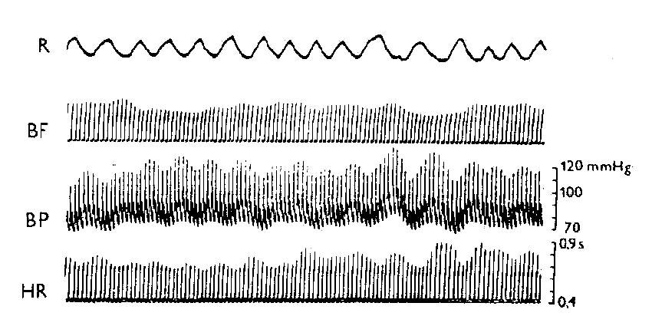
Records of circulatory parameters
Notes:
This picture shows an original record of measurements of basic circulatory parameters (BF-blood flow; BP-blood pressure; HR-heart rate) in relation to the respiratory record (R-respiration). It is one of the first records in the world demonstrating fluctuations in blood pressure at individual beats.

Slide 29
24-hour ambulatory blood pressure monitoring (ABPM)
Circadial rhythm – fluctuation of blood pressure during 24 h (physiological)
The highest values - the morning, 6 –10h a.m. - the afternoon, 4 – 6h p.m.
The lowest values – 3 – 4h a.m.
Diurnal rhythm – differences between day – night - physiological
Dippers (at night comes physiological decreasing of BP) Nondippers (there is no reduction of BP at night - pathological)
Notes:
For a review, I present a 24-hour blood pressure measurement - it is again a non-invasive but intermittent blood pressure measurement based on an oscillometric measurement method. The device is used by the patient in specialized workplaces in hospitals or outpatient cardiology clinics (NOT in the general practice doctor office). The device is programmed to measure blood pressure with an interval of 15-20 minutes at daytime and an interval of 30-60 minutes at night before deployment. The next day the instrument returns, the data is downloaded to the computer and the program analyzes the data, creates a numerical table of individual measurements, builds a graph and statistics - see other slides.

Slide 30
ABPM - record of BP during 24 h (or 48h or 7 days is now also possible)
Dif.dg. : white coat hypertension or
masked hypertension
+ Control of treatment of hypertension
Evaluation: Physiological values
Mean values during 24 h: less than 125/80mmHg
Mean values during day period:less than 135/85mmHg
Mean values during night period:less than 120/70mmHg
Hypertension:
  More than 40% values above 140/90 at day, 120/80 at night
Notes:
This method is very useful in clinical practice, it helps in the diagnosis of hypertension in persons who have the so-called white coat syndrome=white-coat hypertension (in the home environment the blood pressure is in the physiological range - at the time of coming to the doctor, or in general to the medical environment … So if only the values ​​measured in the doctor's office were measured according to the rules mentioned above, the person would have been diagnosed with hypertension, but only by using 24-hour monitoring, the so-called white coat syndrome is diagnosed. On the other hand, when a person has masked hypertension (elevated BP at home, BP increased at doctor office.) From a physiological view of the blood pressure profile during day and night, a significant decrease in BP values ​​during the night is important. The patient with night dips are so-called "dippers" . On the contrary, non-dippers - it is necessary to find out the reason why there is no decrease - it is pathology (the most common cause - adrenal cortex tumor - pheochromocytoma).
24-hour blood pressure monitoring is also important for monitoring the control of hypertension treatment - sufficient dose of the drug to maintain blood pressure within the physiological range throughout the day, as well as to control the time of drug administration, how long the drug works… .the patient writes in the prepared “diary” what he did during the day and night).

Slide 31
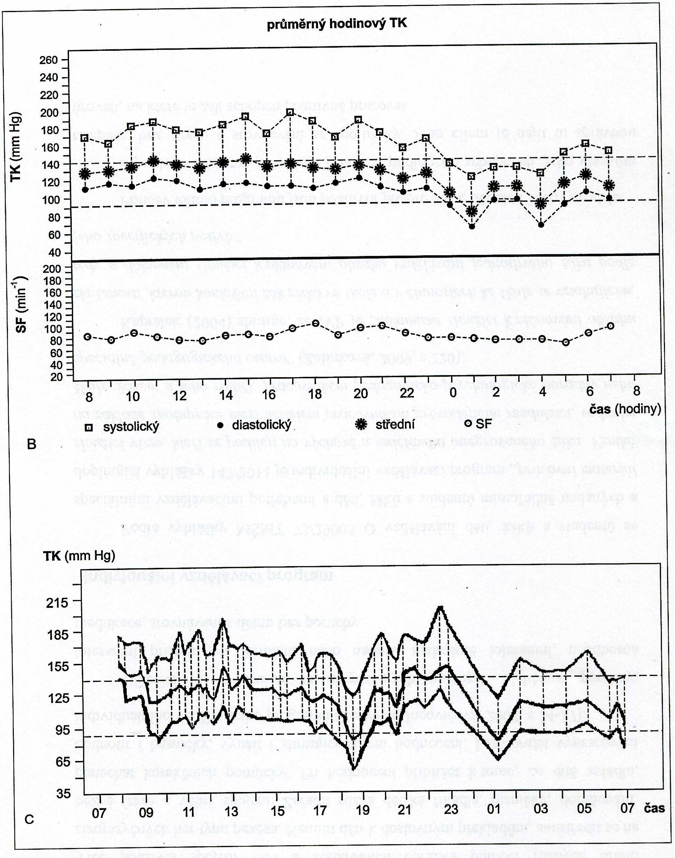
Notes:
Example of graphical representation of blood pressure profile and heart rate in 24-hour ambulatory blood pressure monitoring

Slide 32
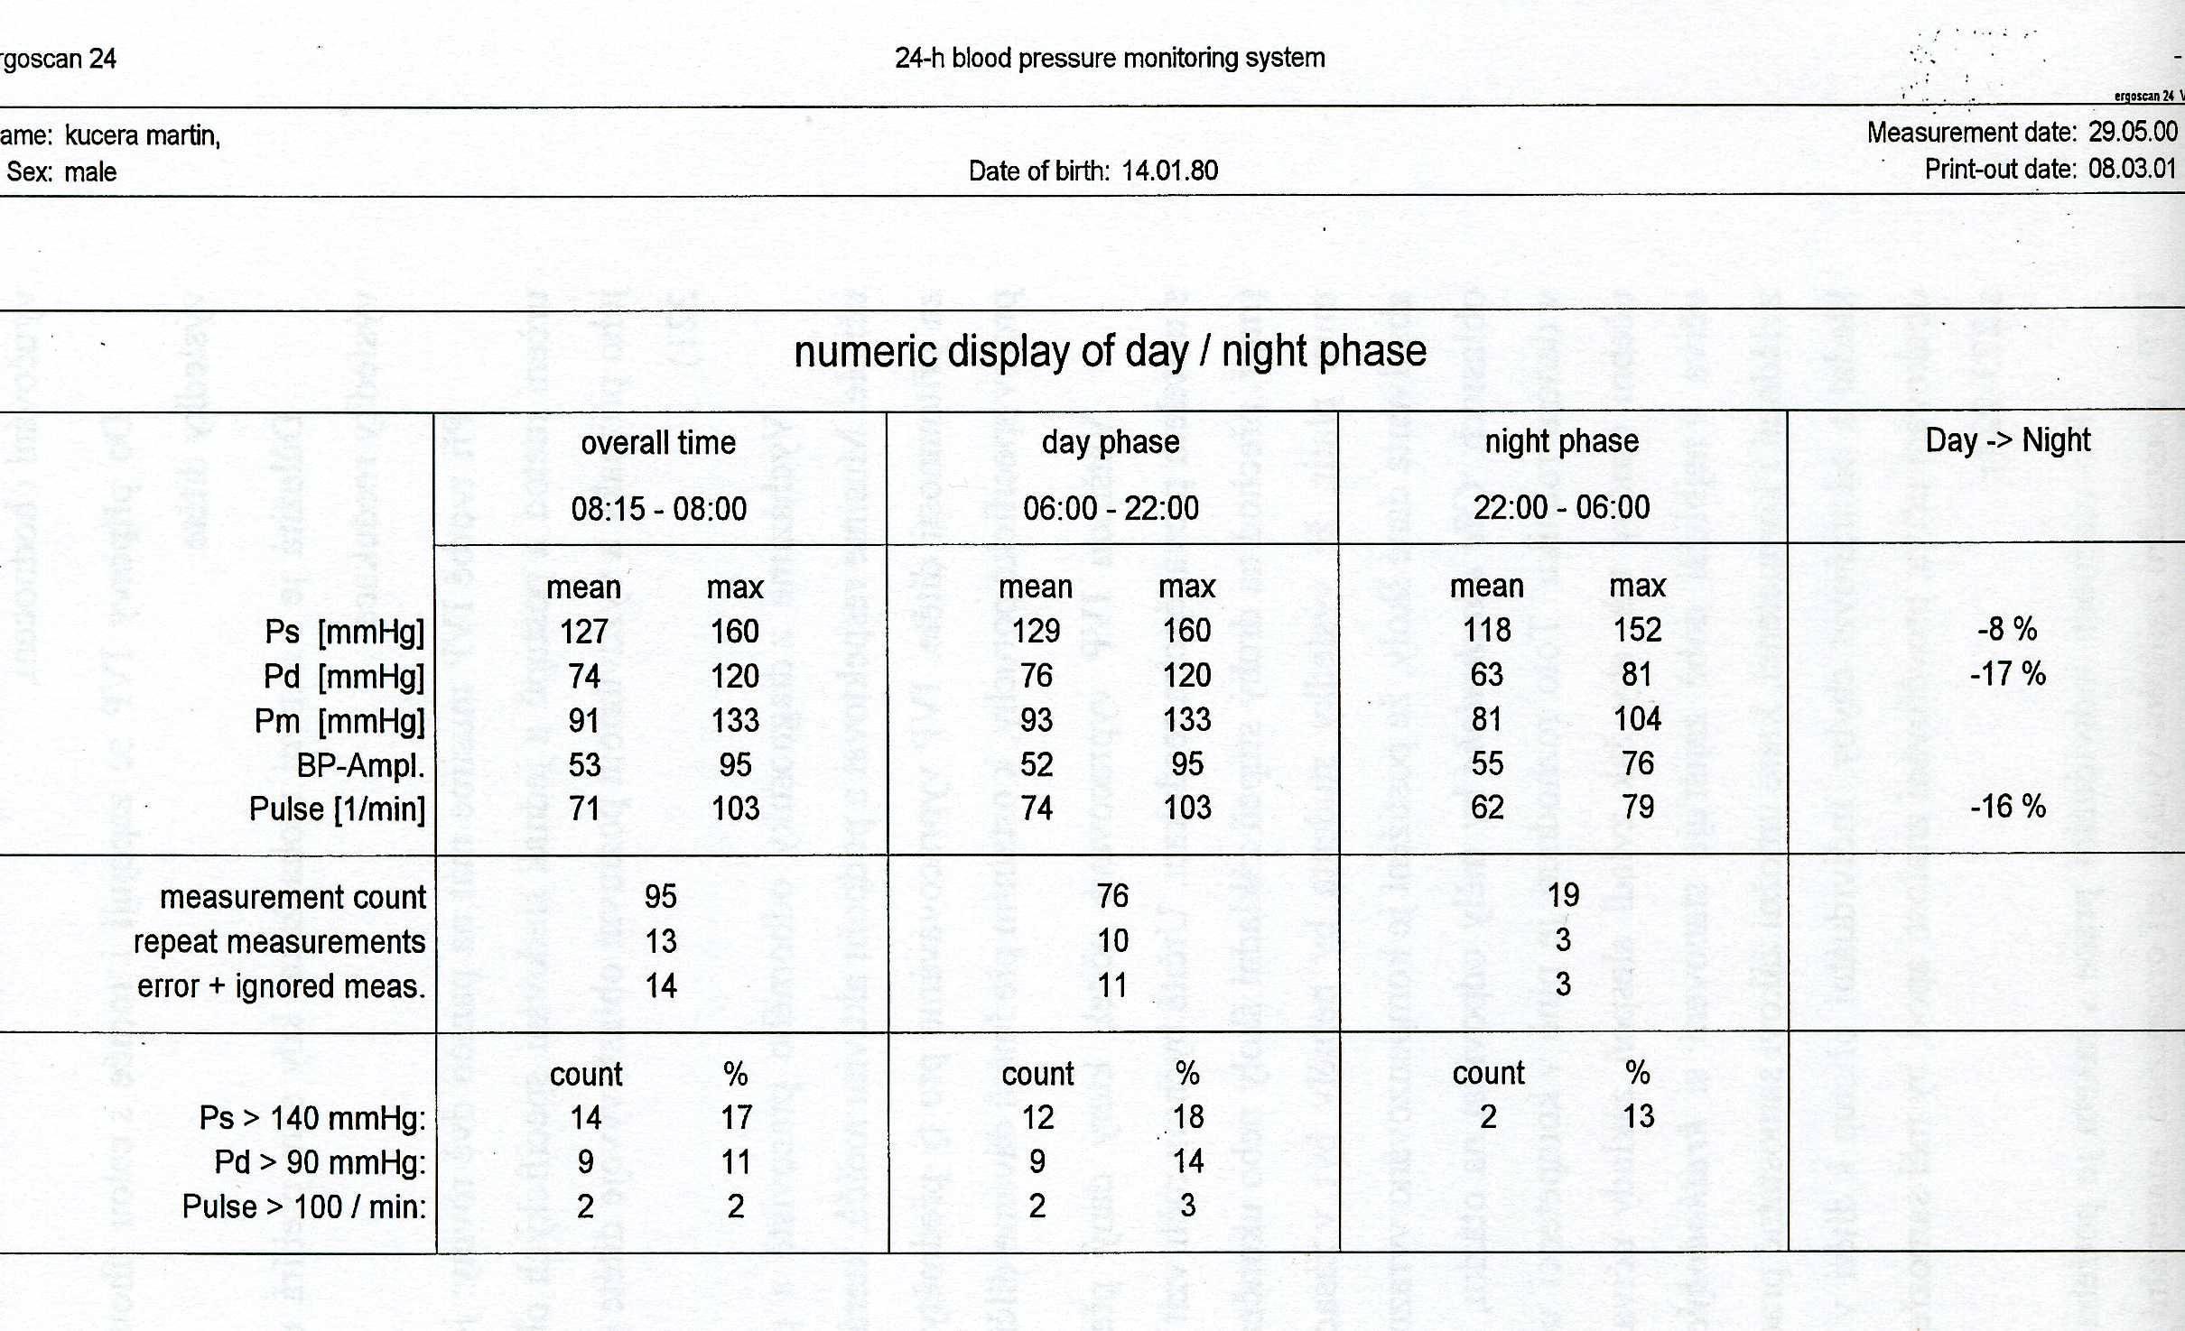
Notes:
Example of numerical evaluation with statistics in the form of a table - again the result of measurement by 24-hour ambulatory blood pressure monitoring.

