Slide 1
GENERAL EMBRYOLOGY 1
Meiosis. Development of gamets. Fertilization. Cleavage.
Implantation. Changes in blastocyst during implantation.
Differentiation of embryoblast and trophoblast.
Germ disc. The axial organs of embryo. Development of embryonic mesoderm and notochord.

Slide 2
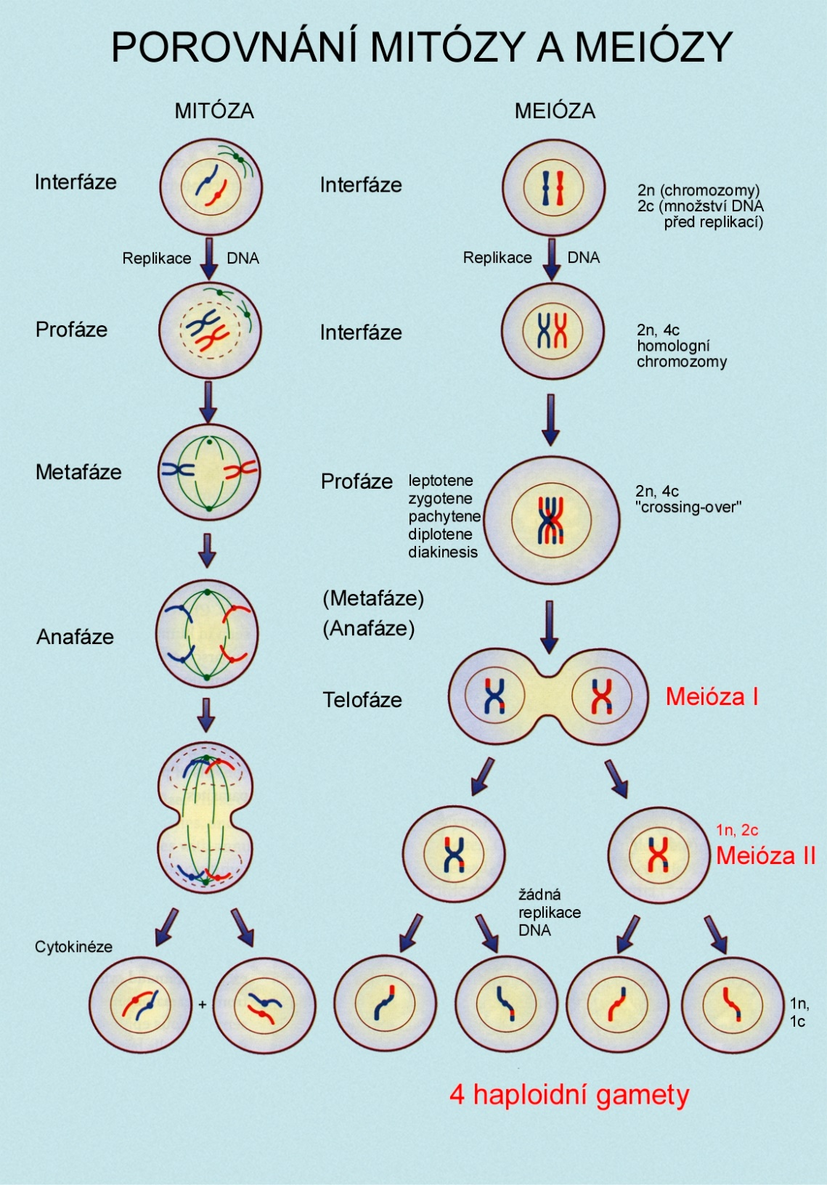
MITOSIS and MEIOSIS – the main differences
Notes:
2

Slide 3
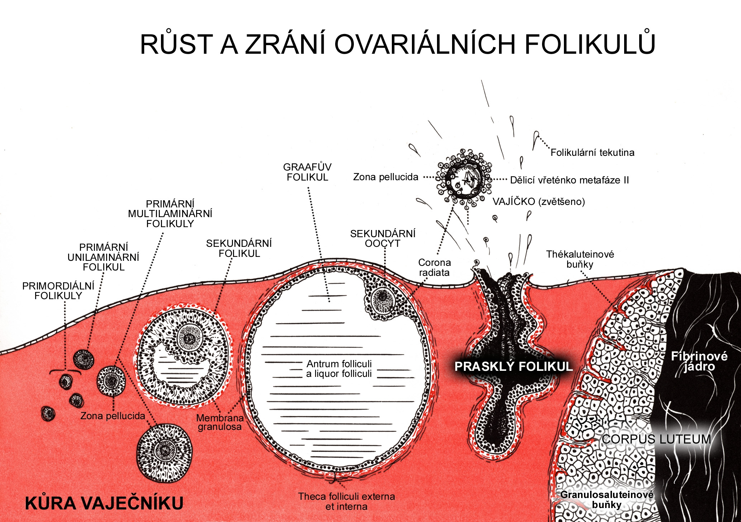
GROWTH AND MATURATION OF OVARIAN FOLLICLES
OVULATION
PRIMARY
OOCYTE
in these follicles
Follicular fluid
GRAAFIAN
FOLLICLE
Zona pellucida
Mitotic spindle in metaphase 2
PRIMARY
MULTILAMINAR
FOLLICLES
SECONDARY
OOCYTE
PRIMARY
UNILAMINAR
FOLLICLE
SECONDARY
FOLLICLE
Corona
radiata
Thecalutein cells
PRIMORDIAL
FOLLICLES
Ruptured follicle
Fibrin clot
Zona pellucida
Membrana
granulosa
CORPUS LUTEUM
CORTEX OVARII
Theca folliculi
externa and interna
Granulosa lutein cells
Notes:
3

Slide 4
Oocyte Sperm

Slide 5
Acrosomal and cortical reaction
Acrosomal vesicle

Slide 6
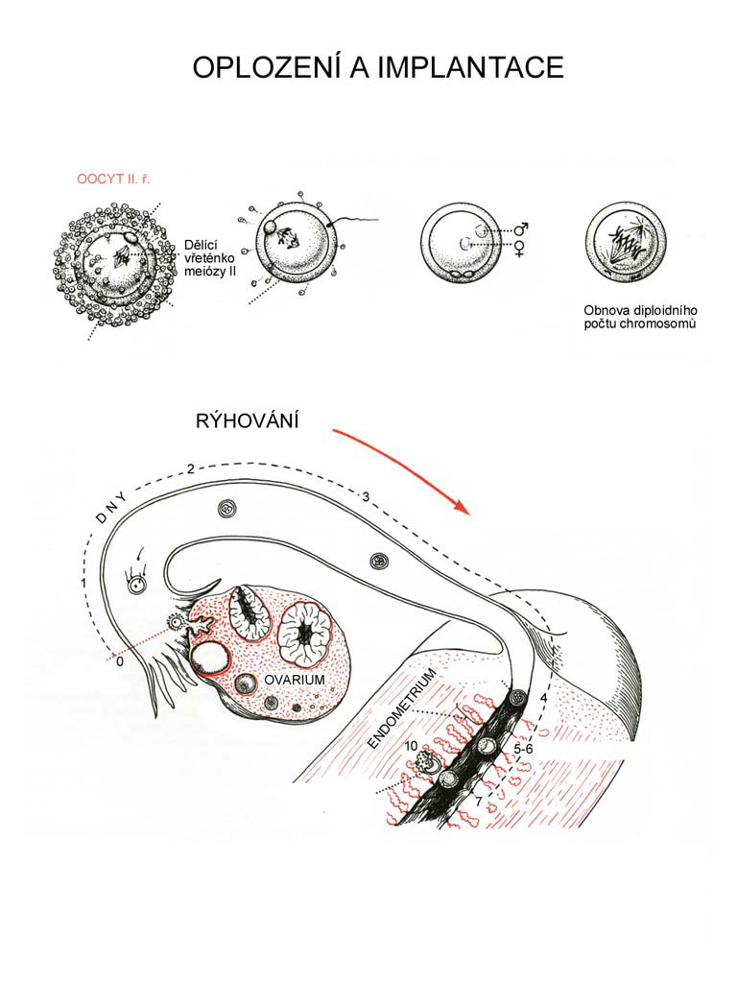
FERTILIZATION AND IMPLANTATION
oocyte II sperm penetration zygote
polar body
meiotic
spindle
zona
pellucida
pronuclei diploid set of chromosomes
cumulus
oophorus
cleavage
secondary oocyte in metaphase 2
morula
blastocyst
implanted
blastocyst

Slide 7
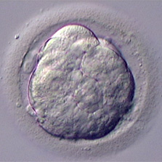
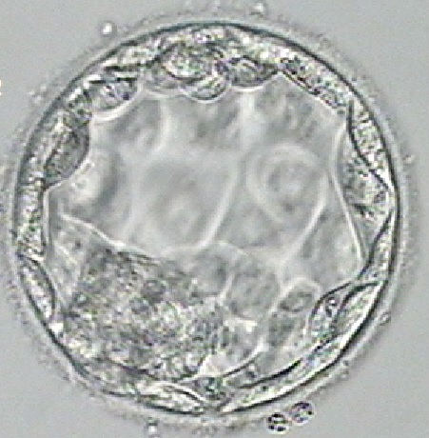
FERTILIZATION
zygote
– 18 h after fertilization 24 h 45 h
morula - 72 h morula – 96 h
blastocyst

Slide 8
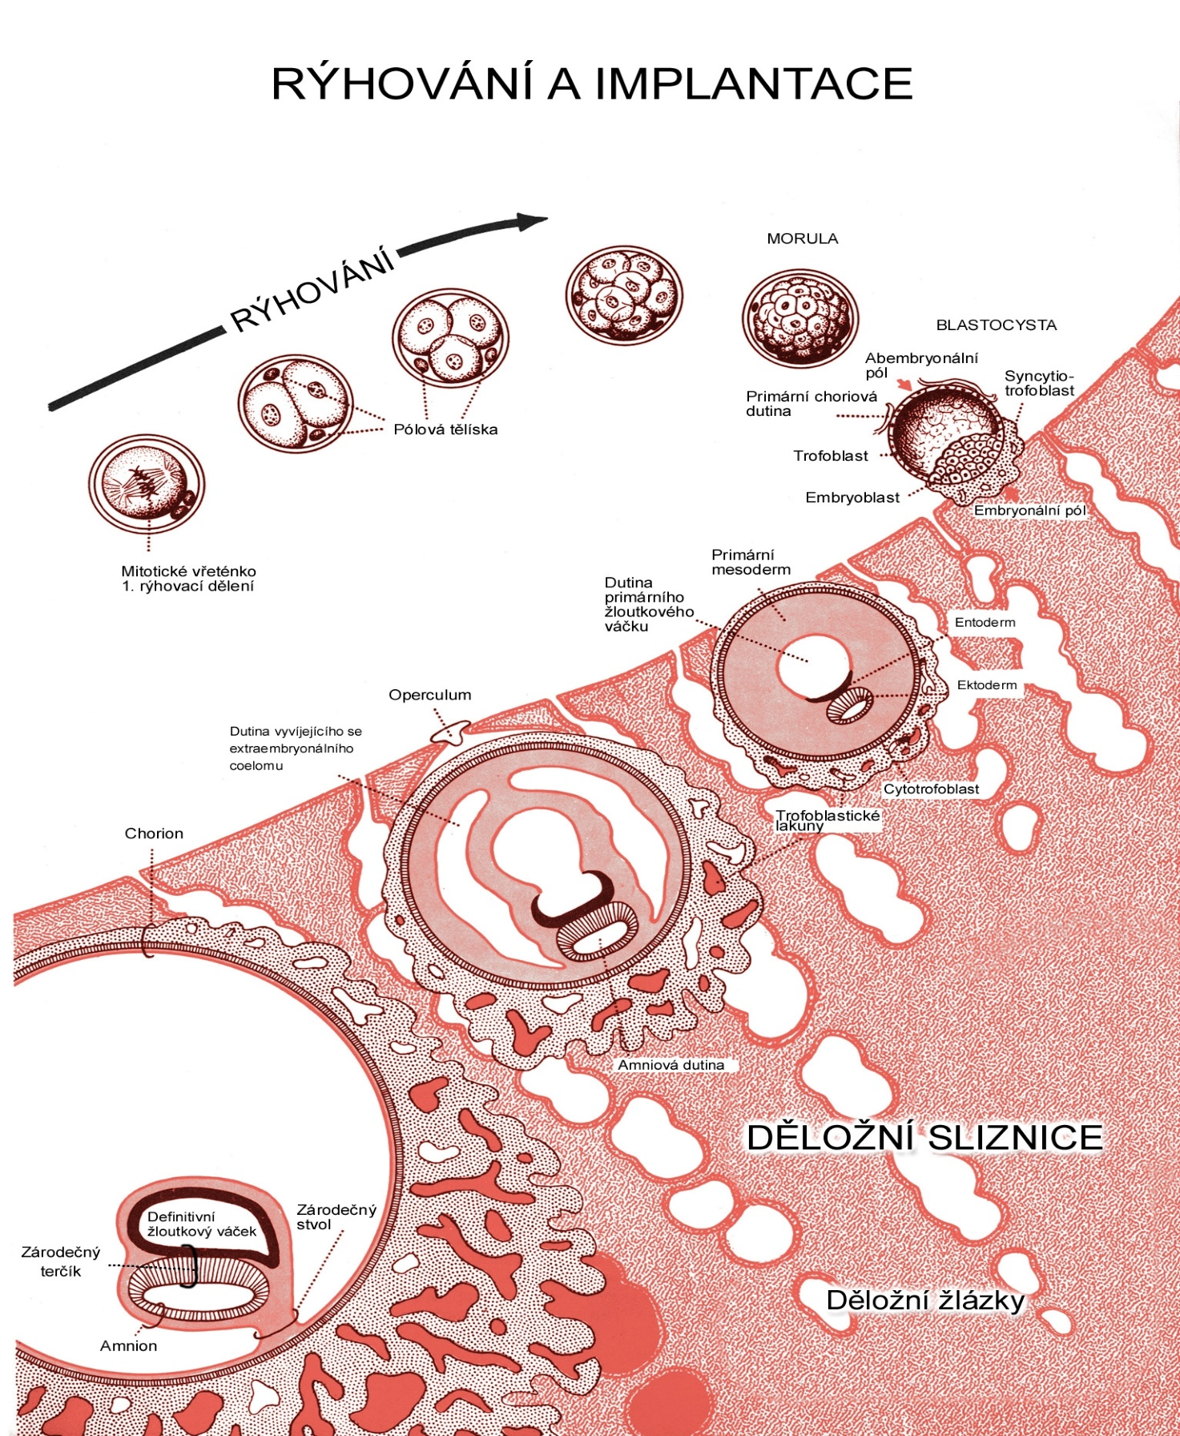
CLEAVAGE AND IMPLANTATION
MORULA
cleavage
BLASTOCYST
Blastocyst cavity
Syncytiotrophoblast
Polar bodies
Trophoblast
Embryoblast (ICM)
Mitotic spindle
within zygote
Extraembr.
mesoderm
Primitive
yolk sac
Hypoblast
Operculum
Epiblast
Extraembryonic
coelom
Cytotrophoblast
Chorion
Trophoblastic
lacunae
Chorionic cavity
Amniotic cavity
Definitive
yolk sac
ENDOMETRIUM
Connecting stalk
Germ disc
UTERINE GLANDS
Amnion

Slide 9
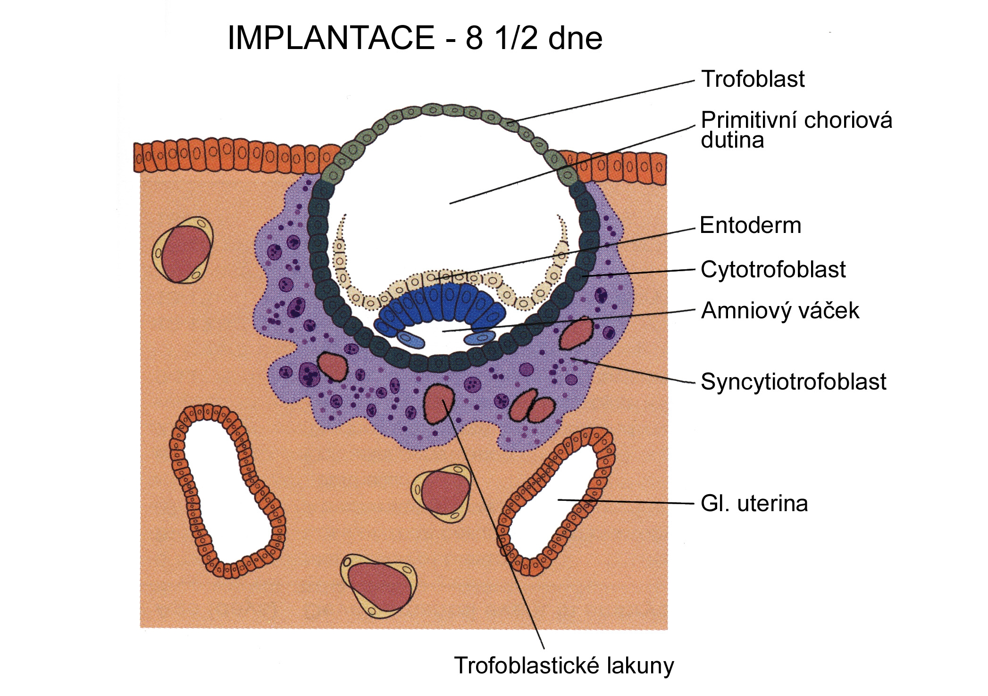
IMPLANTATION – DAY 8 1/2
Trophoblast
Blastocyst
cavity
Hypoblast
Cytotrophoblast
Amniotic sac
Syncytiotrophoblast
Uterine gland
Trophoblastic lacune

Slide 10
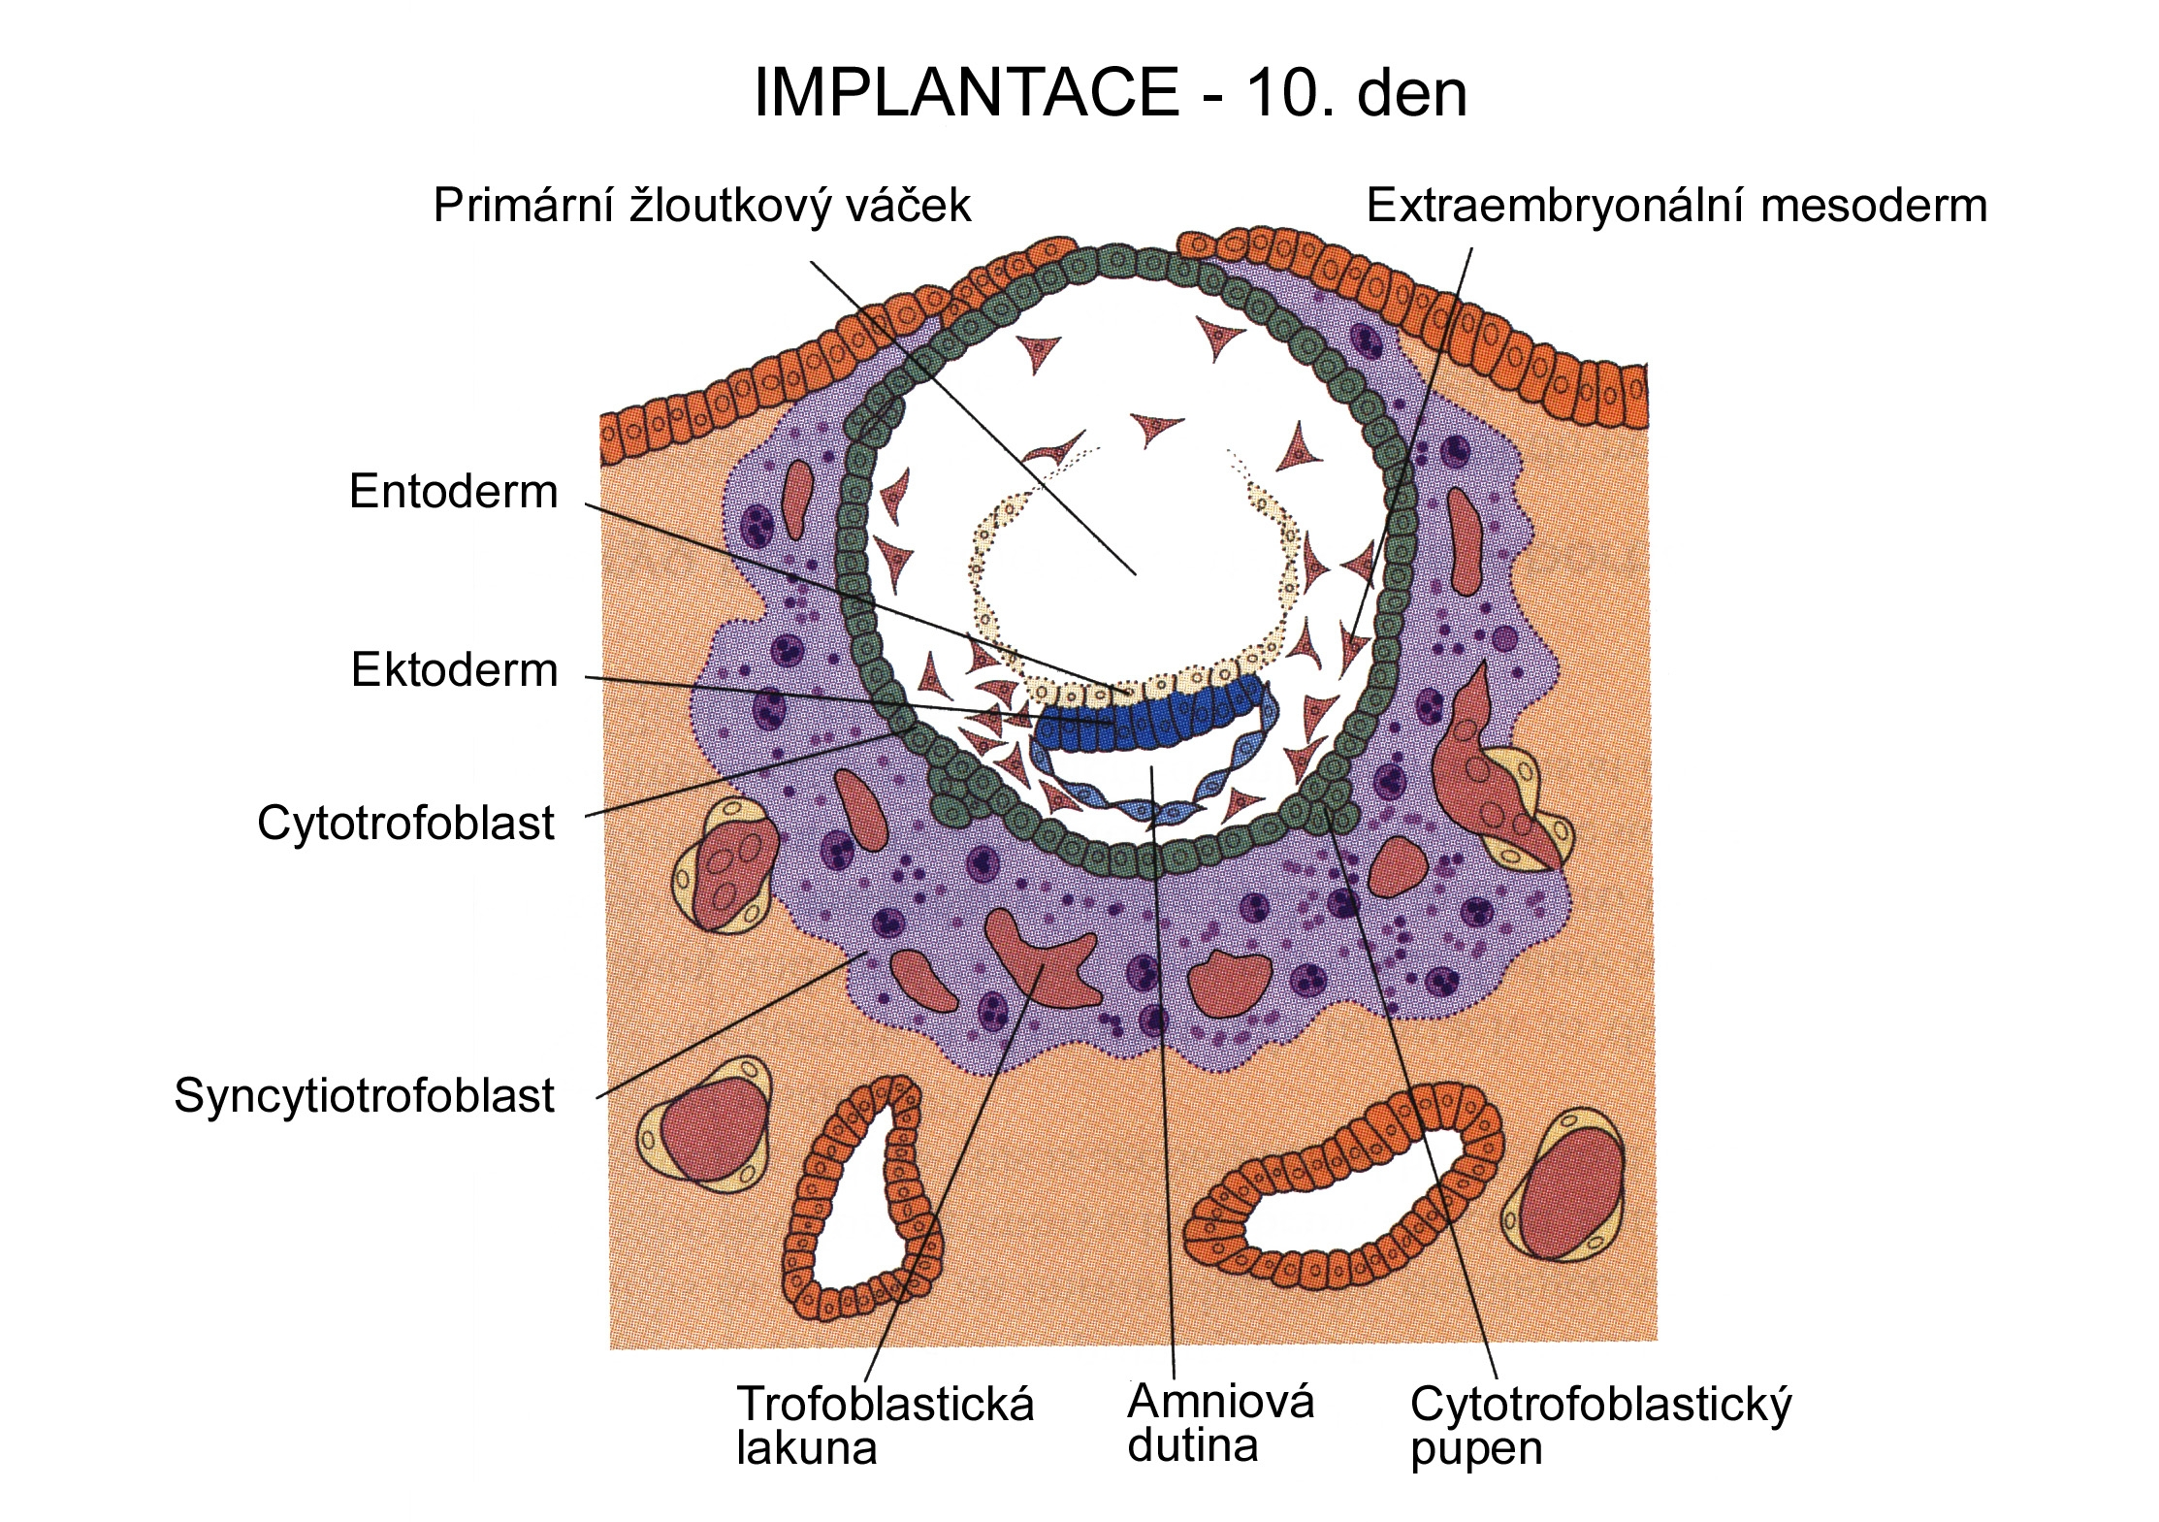
IMPLANTATION – DAY 10
Primitive (primary) yolk sac
Extraembryonic mesoderm
Heuser´s membrane
Hypoblast
Epiblast
Cytotrophoblast
Syncytiotrophoblast
Trophoblastic Amniotic Cytototrophoblastic
lacune cavity bud

Slide 11
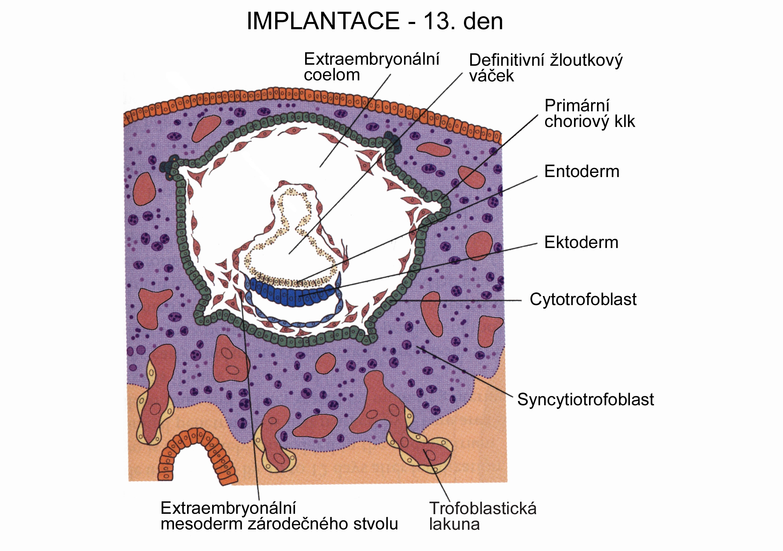
IMPLANTATION – DAY 13
Extraembryonic Definitive (secondary)
coelom yolk sac
Primary
chorionic villus
Hypoblast
Epiblast
Cytotrophoblast
Syncytiotrophoblast
Connecting stalk Trophoblastic lacune
(extraembryonic mesoderm) (with capillary outlet)

Slide 12
CLEAVAGE AND IMPLANTATION
MORULA
cleavage
BLASTOCYST
Blastocyst cavity
Syncytiotrophoblast
Polar bodies
Trophoblast
Embryoblast (ICM)
Mitotic spindle
within zygote
Extraembr.
mesoderm
Primitive
yolk sac
Hypoblast
Operculum
Epiblast
Extraembryonic
coelom
Cytotrophoblast
Chorion
Trophoblastic
lacunae
Chorionic cavity
Amniotic cavity
Definitive
yolk sac
ENDOMETRIUM
Connecting stalk
Germ disc
UTERINE GLANDS
Amnion

Slide 13
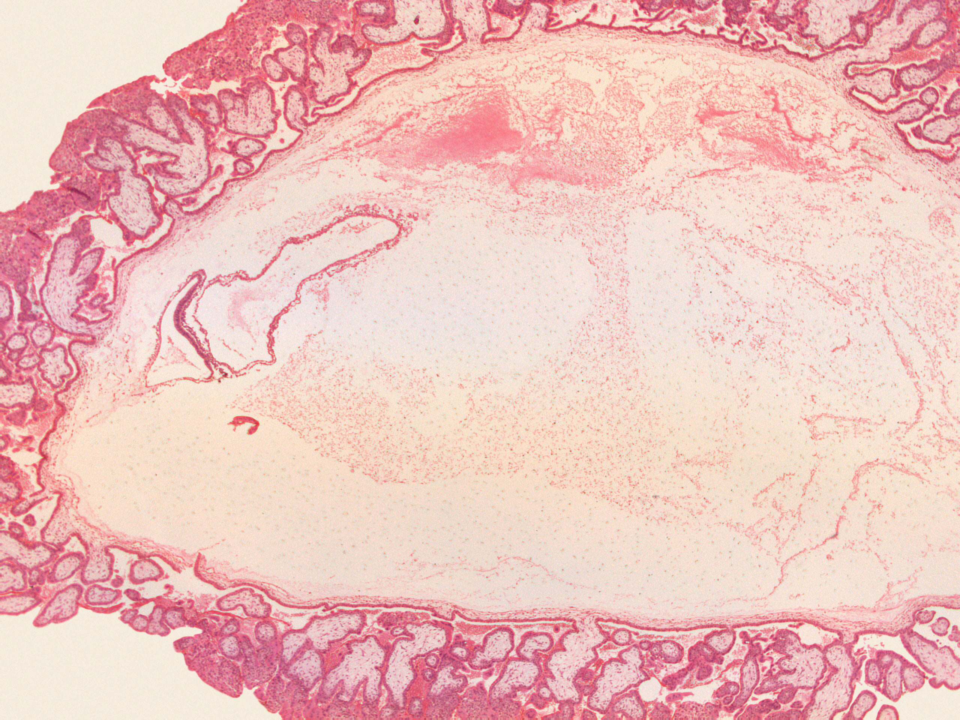
Chorionic villi
Chorionic cavity
ys
as
Connecting stalk
Trilaminar germ disc
Extraembryonic mesoderm

Slide 14
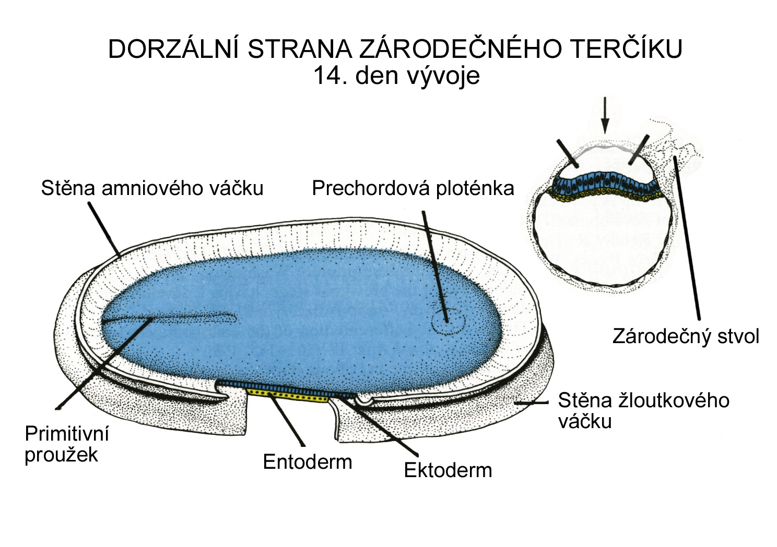
DORSAL SIDE OF GERM DISC – DAY 14
Wall of amniotic cavity Oropharyngeal membrane
Connecting stalk
Wall of yolk sac
Primitive
streak
Hypoblast Epiblast

Slide 15
Germ disc day 16
Mesoderm
Endoderm

Slide 16
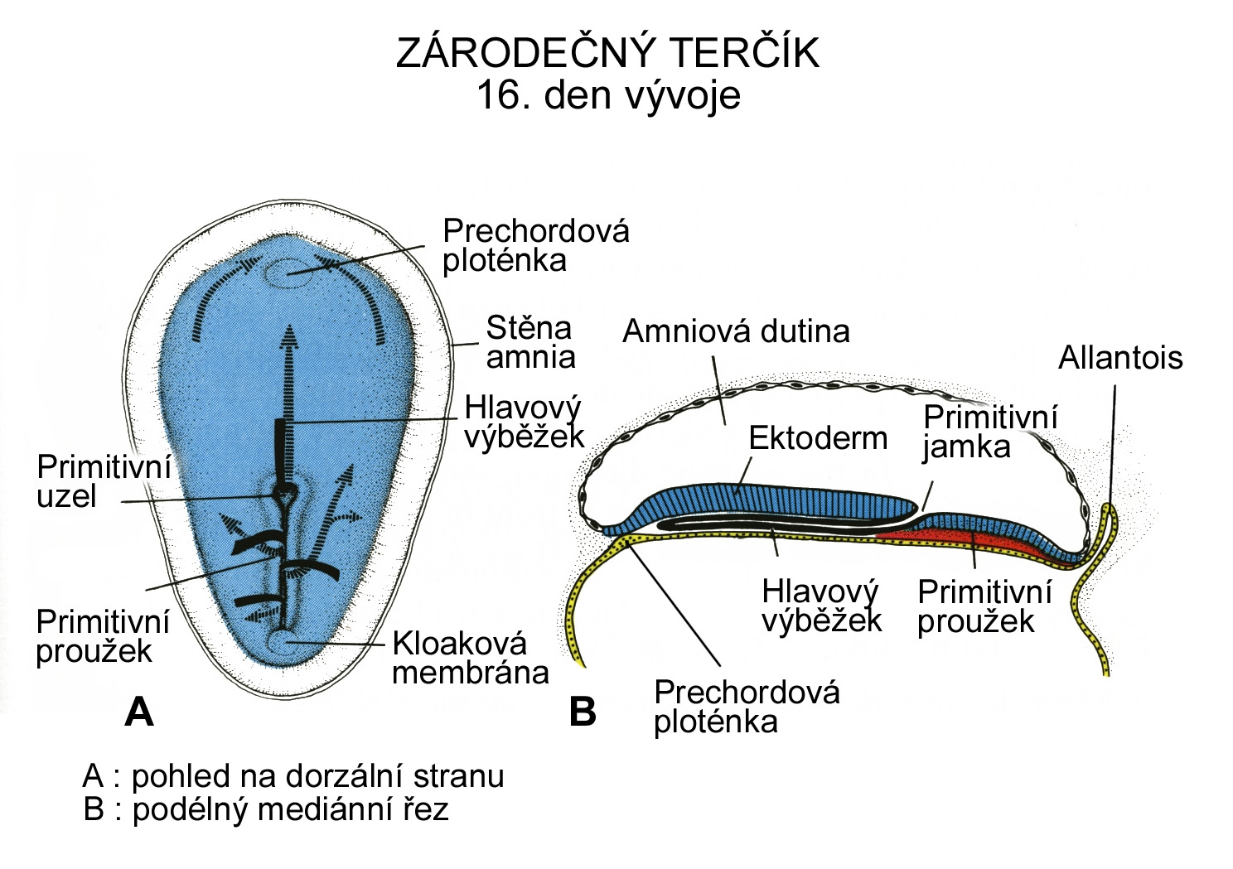
GERM DISC - DAY 16
A – view on dorsal side B – longitudinal section
Oropharyngeal membrane
Amniotic
wall
Amniotic cavity
Allantois
Notochordal
process
Ectoderm
Primitive
pit
Primitive
node
Notochordal Primitive
process streak
Primitive
Streak
Cloacal
membrane
Oropharyngeal membrane

Slide 17
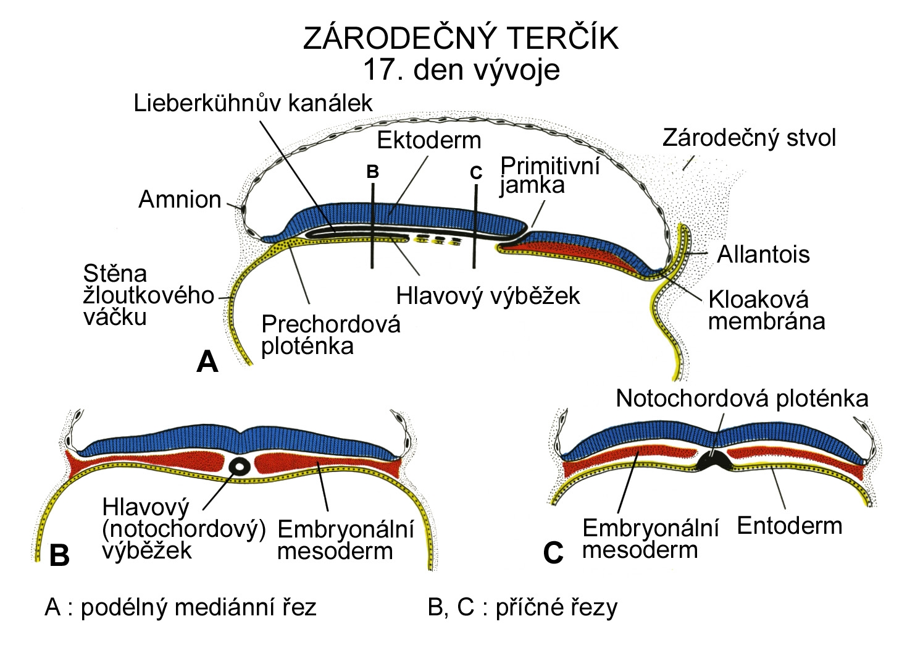
GERM DISC - DAY 17
Canal of Lieberkühn
Ectoderm
Connecting stalk
Amnion
Primitive pit
Allantois
Wall of yolk sac
Notochordal
process
Cloacal
membrane
Oropharyngeal membrane
Notochordal plate
Notochordal Embryonic
/head/ proces mesoderm
Embryonic Endoderm
mesoderm
A – longitudinal section, B, C – transversal sections

Slide 18
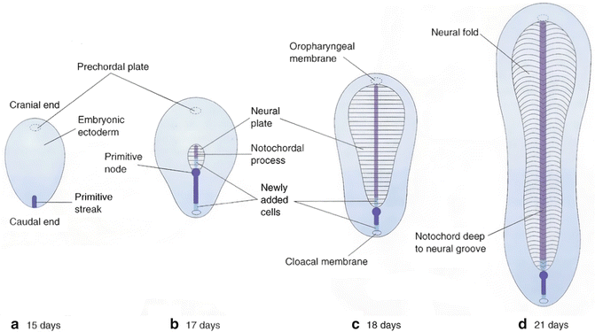

Slide 19
GENERAL EMBRYOLOGY I
Set of embryological schemes I
Atlas of Cytology and Embryology – pg. 71 – 79
Discussion
3 embryological schemes according to teacher instructions

