Slide 1
GENERAL EMBRYOLOGY 2
Folding of the embryo – 4th week of development
Development of extraembryonic structures – extraembryonic mesoderm, extraembryonic coelom, yolk sac, fetal membranes: amnion and chorion.
Development of the placenta. Anomalies of the placenta and umbilical cord.
Multiple pregnancy – arrangement of fetal membranes.
The length of pregnancy, calculation of delivery date.
Fetus position in the uterus – situs, positio, praesentatio, and habitus. The length and weight of fetus during i.u. development. The rule of Haase.
Mature and full-term fetus, marks of mature fetus.

Slide 2
4th week – folding of the embryo (flexion)
paraxial
somites
neural tube
intermediate
notochord
sclerotome (base of vertebral arch)
lateral
sclerotome (base of corpus vertebrae)
dermatome, myotome
aorta
3rd week
primitive gut
aorta
4th week
body of embryo
Differentiation of intraembryonic mesoderm

Slide 3
Mesoderm
paraxial
intermediate
lateral
amniotic cavity
aorta dorsalis
intercellular spaces
in lateral plate mesoderm
neural tube
intermediate mesoderm
(nephrotome)
somite
intraembryonic coelom
Mesoderm:
paraxial mesoderm – thickened region of mesoderm along neural tube
intermediate mesoderm (nephrotome) – in between paraxial and lateral mesoderm
lateral mesoderm – keeps sheet-like structure

Slide 4
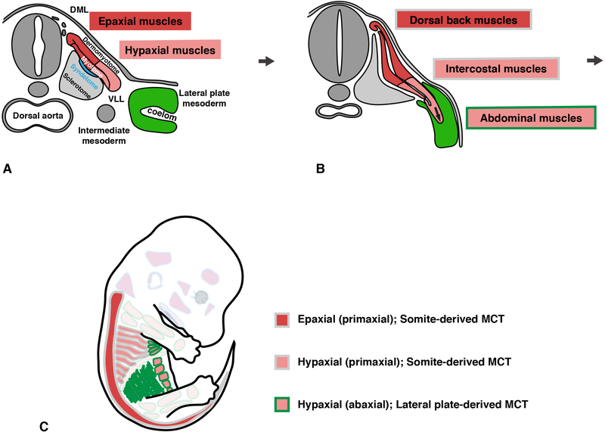
Differentiation of intraembryonic mesoderm – paraaxial (somites)
Somite
→ Dermatome, Myotome, Sclerotome

Slide 5
Differentiation of intraembryonic mesoderm – intermediate and lateral
Intermediate mesoderm
→ urinary system (kidney, ureter), genital system (gonads, ducts, accessory glands)
Lateral mesoderm (parietal and visceral layer)
→ dermis, hypodermis of ventral body parts, connective tissue and muscle of viscera,
serous membranes, blood and lymphatic vessels, spleen
Sefton EM, 2019
https://www.ncbi.nlm.nih.gov/pmc/articles/PMC6449175/

Slide 6
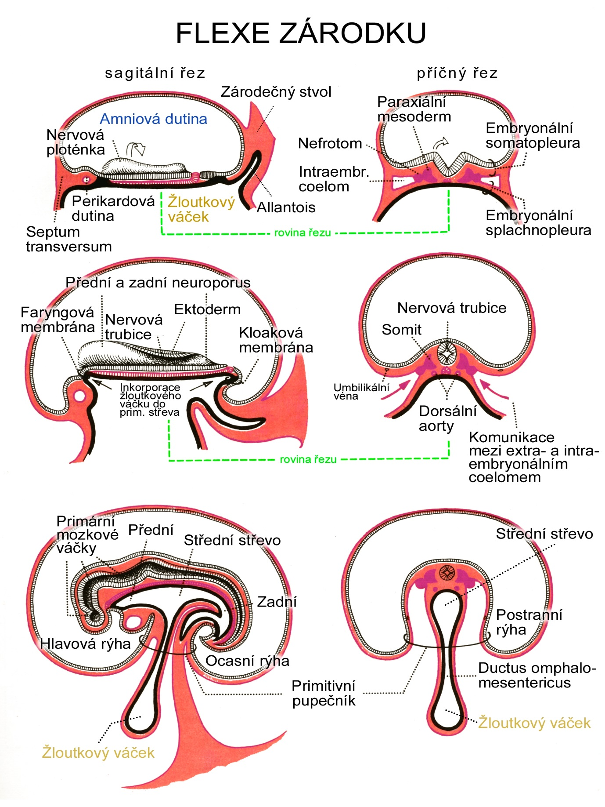
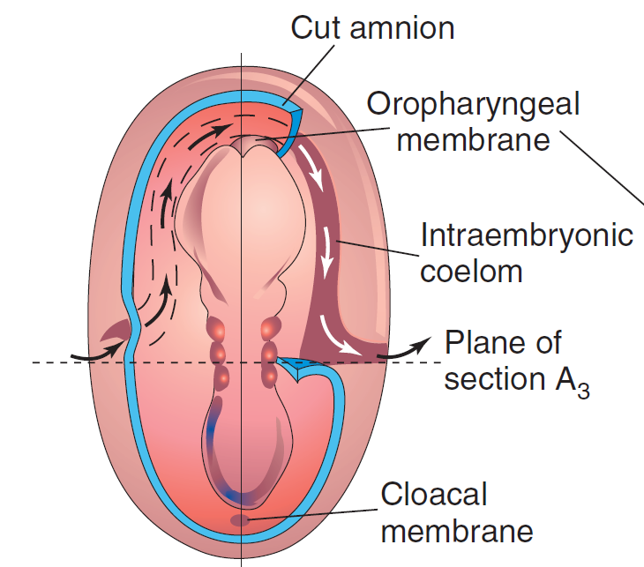
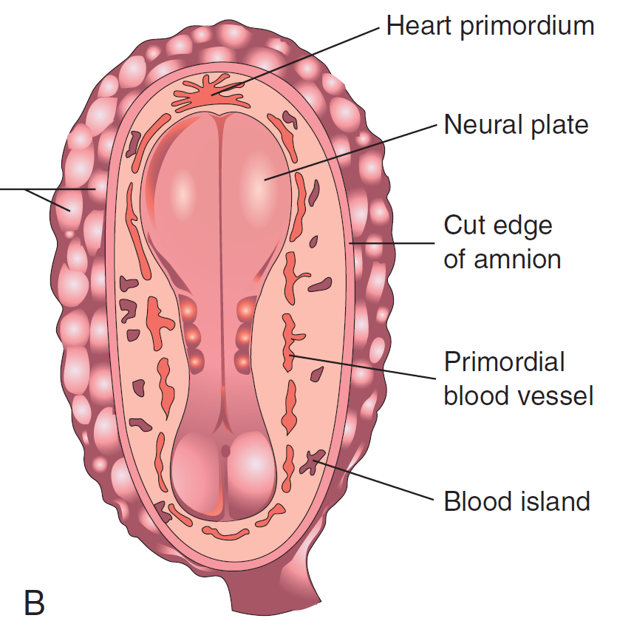
Connecting stalk
Paraxial
mesoderm
Amniotic cavity
EMBRYO FOLDING
Embryonic
somatopleura
Neural plate
Nephrotom
Intraembryonic
coelom
Intraembryonic coelom – horseshoe shape
Pericardial
cavity
Yolk sac
Allantois
Embryonic
splanchnopleura
Septum transversum
section plane
Anterior and posterior neuroporus
Oropharyngeal
membrane
Neural
tube
Ectoderm
Neural tube
Cloacal
membrane
Somite
incorporation
of yolk sac into
primitive gut
Umbilical
vein
Dorsal
aortae
Communication between
extra and intraembryonic
coelom
section plane
Heart primordium
Primary
brain
vesicles
Foregut
Midgut
Midgut
Hindgut
Lateral folds
Cranial (head) fold
Caudal (tail) fold
Ductus
omphalomesentericus
Primitive
umbilical cord
Yolk sac
Yolk sac
Moore et al., Before we are born, 2013, 8th ed.
Notes:
Flexe zárodku
6

Slide 7
Extraembryonic mesoderm
extraembryonic coelom
= chorionic cavity
yolk sac
parietal layer =
extraembryonic somatopleura
+ trophoblast → chorion
+ amniotic ectoderm → amnion
visceral layer =
extraembryonic splanchnopleura
+ extraembryonic endoderm → yolk sac
chorionic villi
primary – cytotrophoblastic buds
(day 10) covered with syncytiotrophoblast
secondary - with extraembryonic mesoderm (days 12-13)
tertiary – vascularized extraembryonic mesoderm (days 17-18)

Slide 8
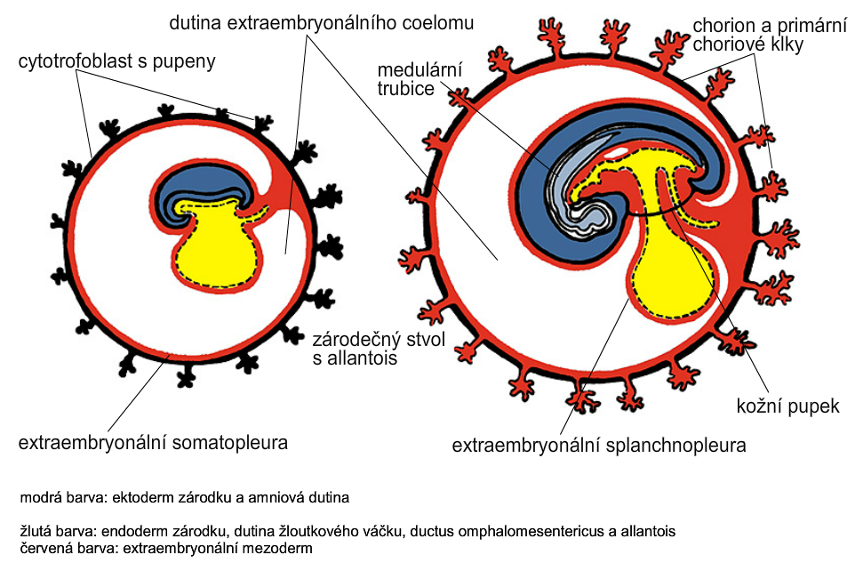
Yolk sac, amniotic sac, fetal membranes - amnion, chorion
extraembryonic coelom
(chorionic cavity)
chorion and
secondary chorionic villi
primary chorionic villi
neural tube
connecting
stalk
umbilical
cord
extraembryonic somatopleura
extraembryonic splanchnopleura

Slide 9
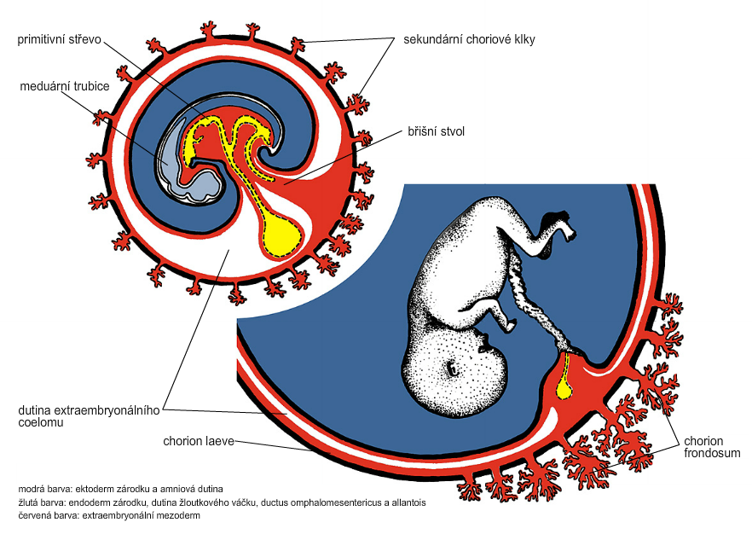
Development of fetal membranes
chorionic villi
Different growth of chorionic villi toward decidua basalis (partially decidua marginalis) and toward decidua capsularis causes division of chorion into parts:
CHORION FRONDOSUM (toward decidua basalis
– with villi) and CHORION LAEVE (smooth, without villi)
primitive gut
neural tube
connecting stalk
amniotic cavity
chorionic cavity
chorion
frondosum
chorion
laeve

Slide 10
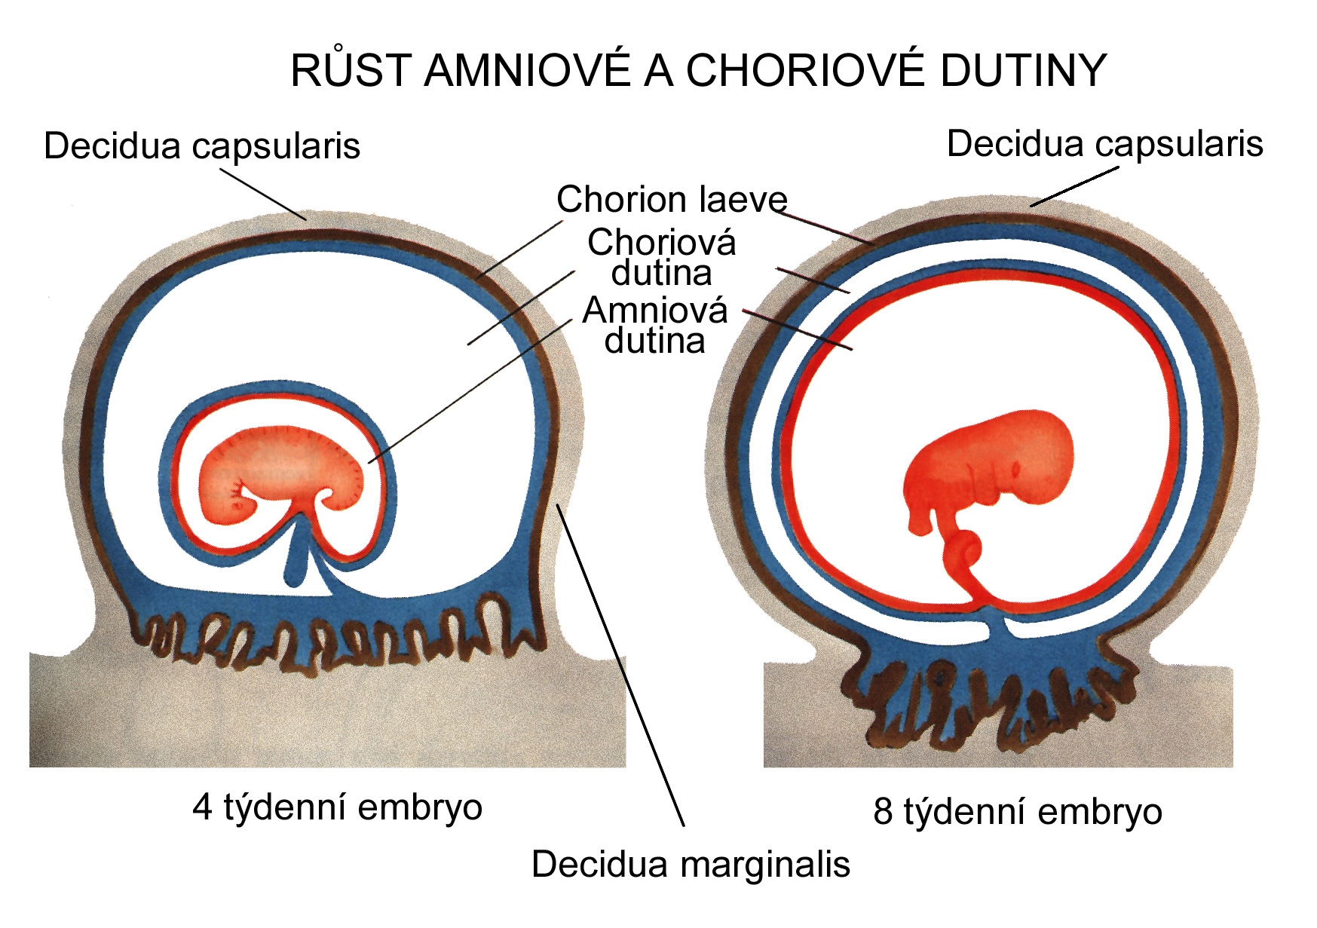
CHORION = extraembryonic mesoderm + cytotrophoblast + syncytiotrophoblast
AMNION = extraembryonic mesoderm + amniotic ectoderm
GROWTH OF AMNIOTIC AND CHORIONIC CAVITY
Chorionic cavity
decidua
basalis
capsularis
marginalis
parietalis
Amniotic
cavity
chorion frondosum
decidua basalis
chorion frondosum
4 weeks embryo
8 weeks embryo

Slide 11
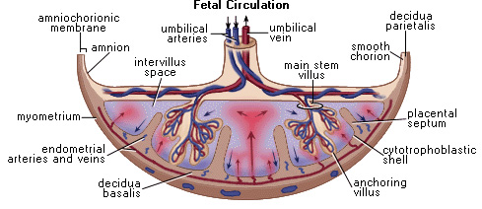
COMPARTMENTS OF PLACENTA:
 PARS FETALIS PLACENTAE – chorionic plate + chorionic
villi, intervillous space
 PARS MATERNA PLACENTAE = zona functionalis deciduae
basalis

Slide 12
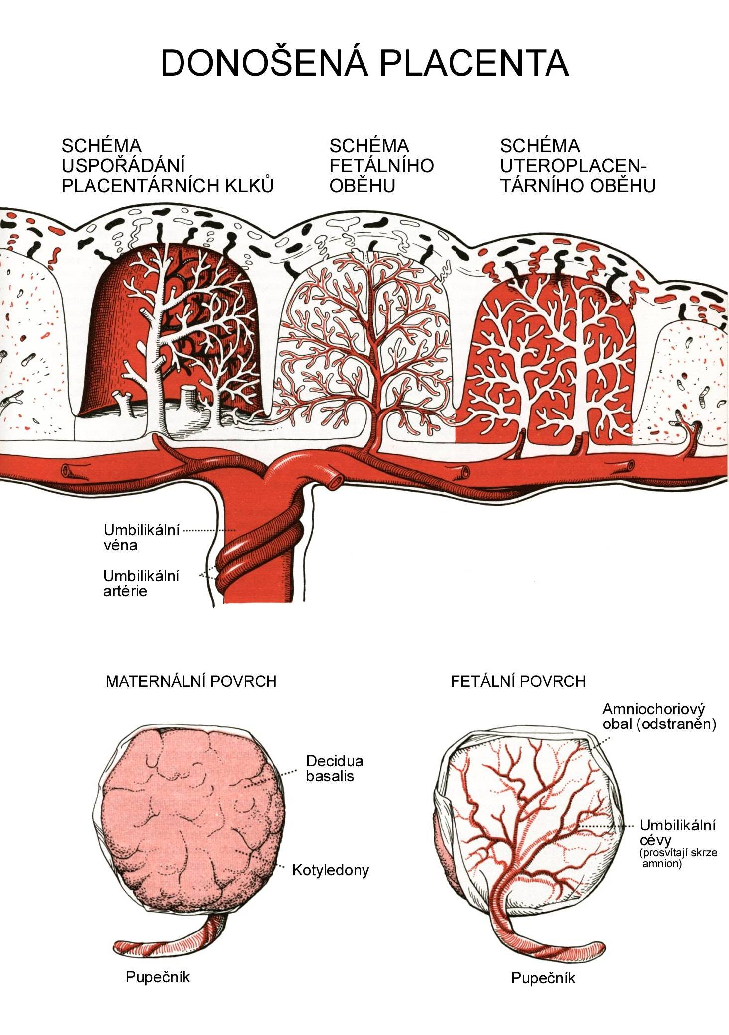
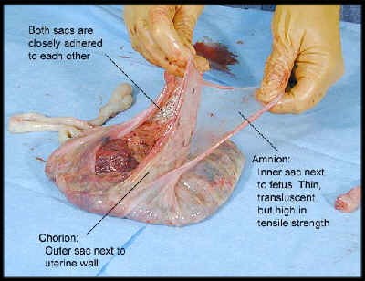
Human placenta
Full-term placenta
discoidalis
olliformis
hemochorialis
maternal surface
fetal surface
∅ 15-25 cm
width 2-3 cm
weight 500 g
15-20 cotyledons

Slide 13
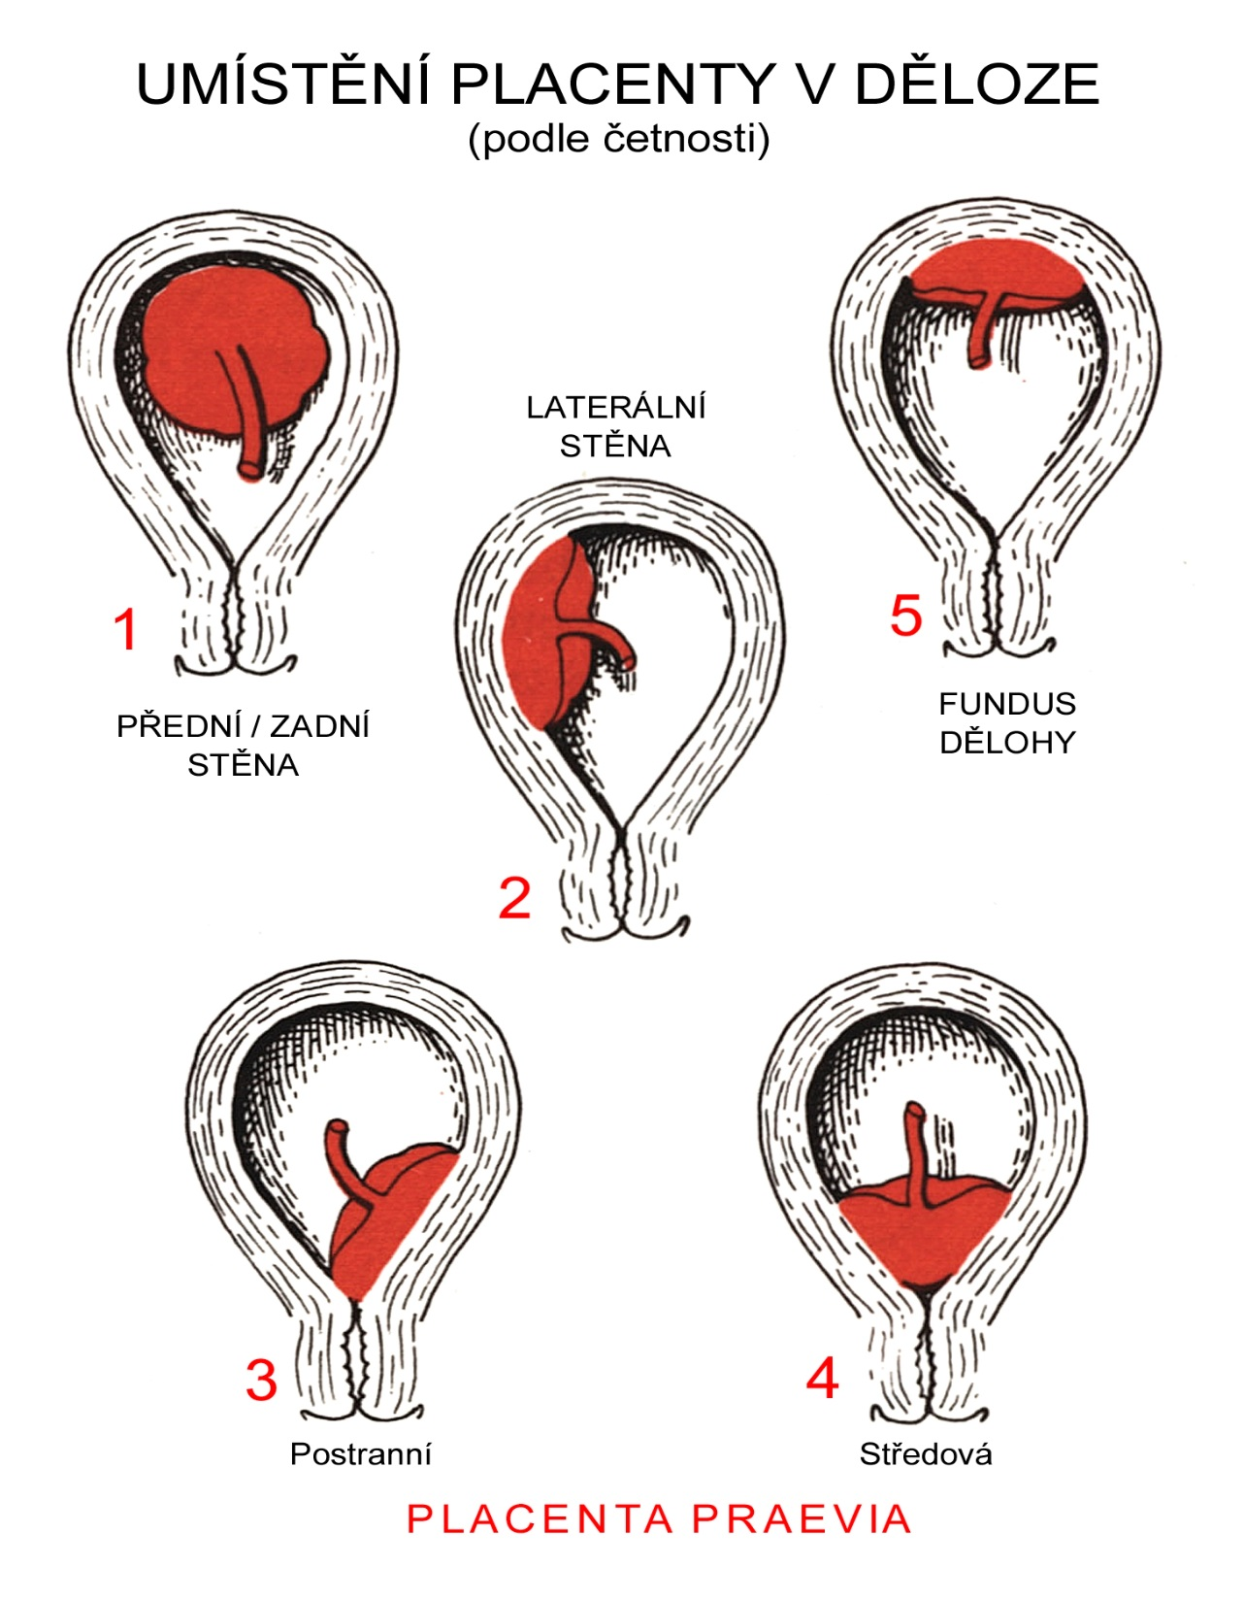
POSITION OF PLACENTA
IN UTERUS
normal
lateral
wall
ventral/dorsal
wall
uterine
fundus
anomaly

Slide 14
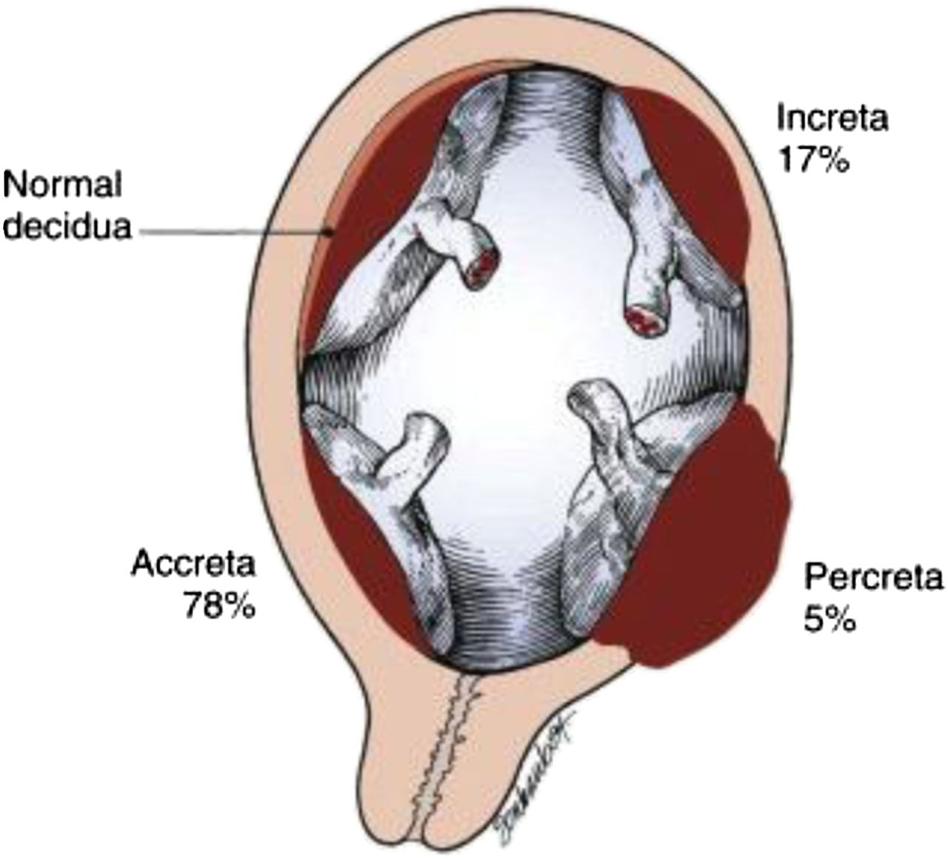
Anomalies of placenta
Anomalies of chorionic villi (1 : 100 pregnancies)
mola hydatidosa
chorionepitheliom
Anomalies in location:
placenta praevia (causes bleeding in week 28)
absolute indication to CS
placenta accreta (attached to myometrium)
placenta increta (grown into myometrium)
placenta percreta (grown through myometrium)

Slide 15
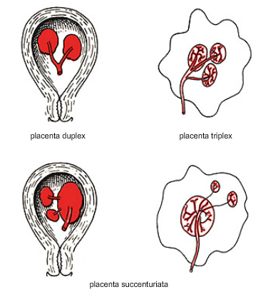
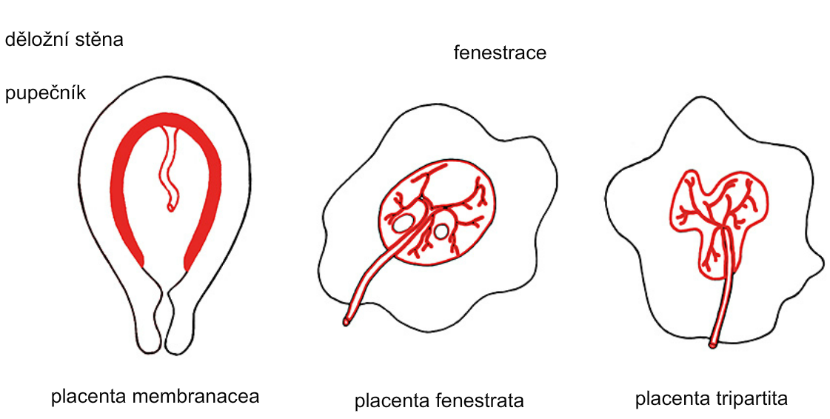
Anomalies of shape of placenta

Slide 16
Funiculus umbilicalis (HE, HES, AZAN)
50 – 60 cm long
1,5 – 2 cm wide
amniotic ectoderm on the surface
jelly-like connective tissue with umbilical vessels
ductus allantoideus
from APERIO
magn:2,5
vein
artery
artery
magn:2.5

Slide 17
Anomalies of umbilical cord
short (< 40 cm)
long (> 60 cm)
(danger of strangulation or formation of true knots)
- true and false knots
absence of 1 umbilical artery (hypotrophic fetus)
True knot
False knot

Slide 18
1
2
3
chorion laeve
Umbilical cord – placenta insertion
– insertio centralis
– insertio marginalis
– insertio velamentosa

Slide 19
Multiple pregnancy
twins 1:100
triplets 1:100²
quadruplets 1:100³
amniotic cavities
chorionic cavities

Slide 20
DIZYGOTIC TWINS
2 spermatozoa fertilize
2 oocytes
each embryo develops separately
(has its own amnion,
chorion, and placenta)
twins can be of different sexes
resemblance of twins as between siblings of different age
Dizygotic
separate amnion, chorion, placenta

Slide 21
TWINS
MONOZYGOTIC TWINS
1 spermatozoon fertilizes 1 oocyte
splitting of embryo occurs during the further development
arrangement of fetal membranes depends on stage on which splitting occurs
twins are always genetically identical and of the same sexes
dizygotic
monozygotic
34% 65%
1%

Slide 22
TWINS
MONOZYGOTIC separated
on stage of 2 blastomeres
dizygotic
monozygotic
each of 2 blastomeres creates 1 embryo
2 blastocysts are formed
they implantate separately
fetal membranes are as in dizygotic twins: separate amnion and chorion (diamniotic,dichorial), and own placenta
separate amnion, chorion, placenta

Slide 23
TWINS
MONOZYGOTIC separated
on stage of blastocyst
dizygotic
monozygotic
embryoblast divides into 2 cell clusters before creation of germ disc
trophoblast does not separate, remains common
fetal membranes: separate amnion (diamniotic), common chorion (monochorial) and common placenta
the most frequent (65 %)
separate amnion,
common chorion,
common placenta

Slide 24
MONOZYGOTIC separated on stage of bilaminar germ disc
TWINS
dizygotic
monozygotic
creation of 2 primitive streaks
fetal membranes are common – amnion, chorion, placenta (monochorial, monoamniotic)
conjoined „Siamese“ twins develop in case of incomplete separation
common amnion, chorion, placenta

Slide 25
Length of pregnancy
38 týdnů = 266 dnů
Fertilization |  | CONCEPTIONAL AGE | 38 weeks = 266 days
week 0 3 | 8 |  | 38
0 |  | 40
1st day of last | MENSTRUAL AGE | 40 weeks = 280 days
menstruation |  | = 10 lunar months
preembryo
embryo
fetus
Calculation of the expected date of delivery:
Date of the 1st day of the last menstruation + 9 calendar months + 7 days

Slide 26
Rule of Haase
determine the age of fetus according its length
AGE
(lunar month)
CRL*
(cm)
• 3.
• 4.
• 5.
• 6.
• 7.
• 8.
• 9.
• 10.
₃2
₄2
₅2
6x5 (l.m. x 5)
= 9 cm
(the second power of l.m.)
= 16 cm
= 25 cm
= 30 cm
= 35 cm
= 40 cm
= 45 cm
= 50 cm
*CRL = crown-rump length
1st month - 6-7 mm
2nd month – 2.5 cm

Slide 27
Fetal position in utero
During fetal development, fetus is placed in amniotic sac, which is filled with amniotic fluid. The space of this sac decreases due to the growth of fetus. Therefore, fetus takes up the smallest possible volume, especially in the 3rd trimester.
Four characters of fetus arrangement in uterus are followed up and determined before delivery:
Situs
Positio
Praesentatio
Habitus

Slide 28
Situs
relation: long axis of fetus body – long axis of uterus
longitudinal situs (parallel axes) - 99%
by head (caudally) or by pelvis
transversal situs
(perpendicular axes) - 1%
oblique situs - unstable, moves into longitudinal or transversal situs

Slide 29
Positio
relation: back (head) of fetus – uterine margin
Second ordinary
to the right, dorsally
First less ordinary
to the left, dorsally
2nd
1st
Second less ordinary
to the right, ventrally
First ordinary
to the left, ventrally

Slide 30
Praesentatio
relation: part of fetal body – aditus pelvis
vertex (most frequent)
forehead, face, occiput
(1 %)
pelvic end and feet
trunk, shoulder

Slide 31
Habitus
relation: parts of fetal body to one another
regular = flexion of head, chin on chest, limbs flexed in all joints, upper limbs crossed in front of the chest, lower limbs pressed to abdomen, fetus takes up the smallest possible volume
irregular = each other

Slide 32
Physiological fetus position in uterus
longitudinal situs by
head
first ordinary position
praesentatio by head (vertex)
regular habitus

Slide 33
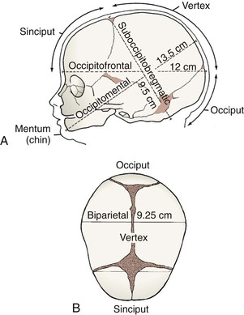
Marks of full-term fetus
Main characters
length (50-51 cm)
• weight (3,000-3,500 g)
diameters of the head in norm
♂ testes are descended in scrotum
♀ labia majora cover labia minora
Auxiliary characters
fetus is eutrophic, subcutaneous fat is well developed
skin – rests of lanugo on shoulders and back only
eyelashes, brow, hair (several cm) are developed,
nails overlap free end of fingers
skull bones are hard, major and minor fontanelles are palpable and separated from each other
newborn cries and moves

Slide 34
Mature and full-term fetus
Full-term fetus – relates to the length of pregnancy (menstrual age):
preterm (to 37th week)
full-term (38 – 40 weeks)
after term (more than 42 weeks)
Mature fetus – relates to level of development:
mature
- immature
Level of nutrition
hypotrophic
eutrophic (weight 3,000 – 3,500 g, length 50 - 51 cm)
hypertrophic

Slide 35
GENERAL EMBRYOLOGY 2
Set of embryological schemes II
Atlas of Cytology and Embryology – pages 76 – 81
Discussion
3 embryological schemes

