Slide 1
Cartilage Hyaline cartilage, elastic cartilage, and fibrocartilage Chondrocytes Extracellular matrix Bone Bone fibrillar and lamellar (compact, spongy) Osteocytes, osteoblasts, osteoclasts, osteoprogenitors Extracellular matrix (mineralization)

Slide 2
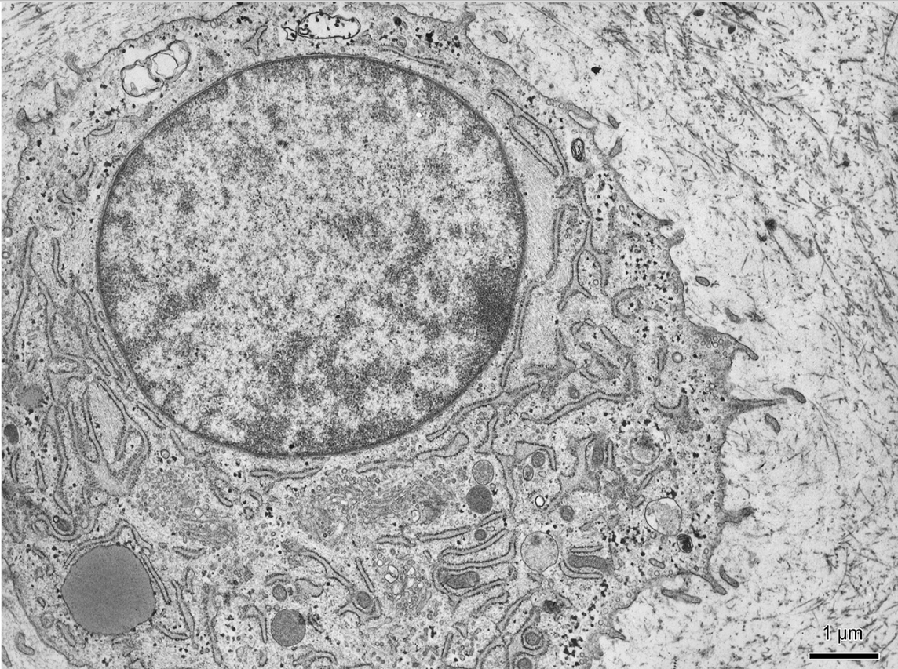
Chondrocyte

Slide 3
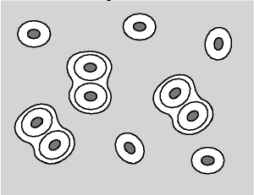
Hyaline cartilage - trachea (HE)
http://www3.delta.edu/

Slide 4
Elastic cartilage – auricula (HE)

Slide 5
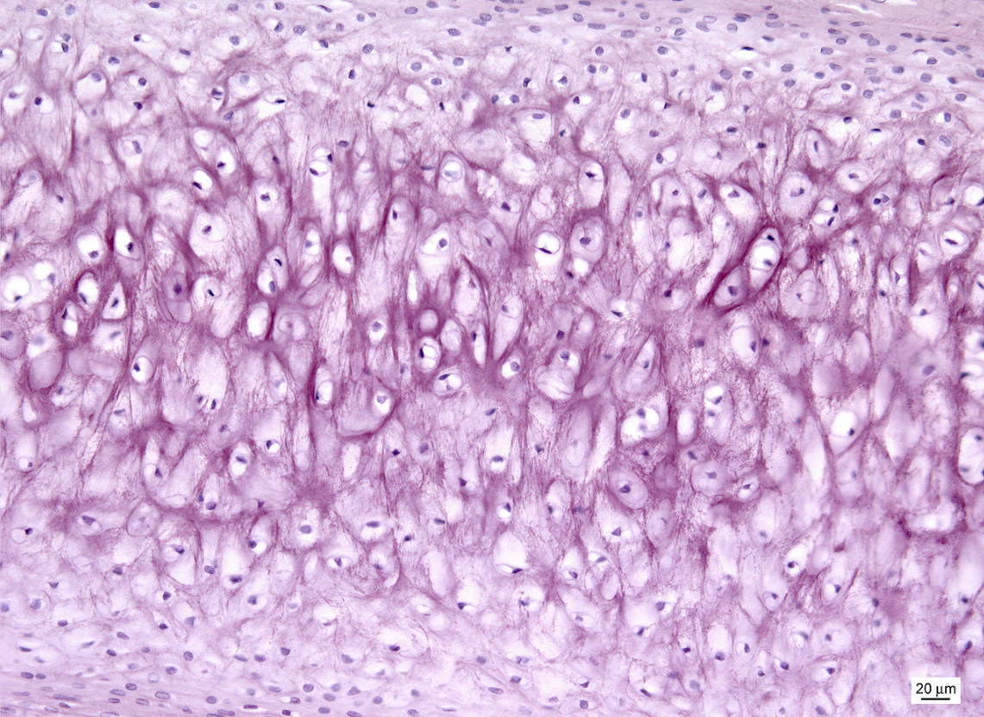
Elastic cartilage – elastic fibers (aldehyde fuchsin)
perichondrium

Slide 6
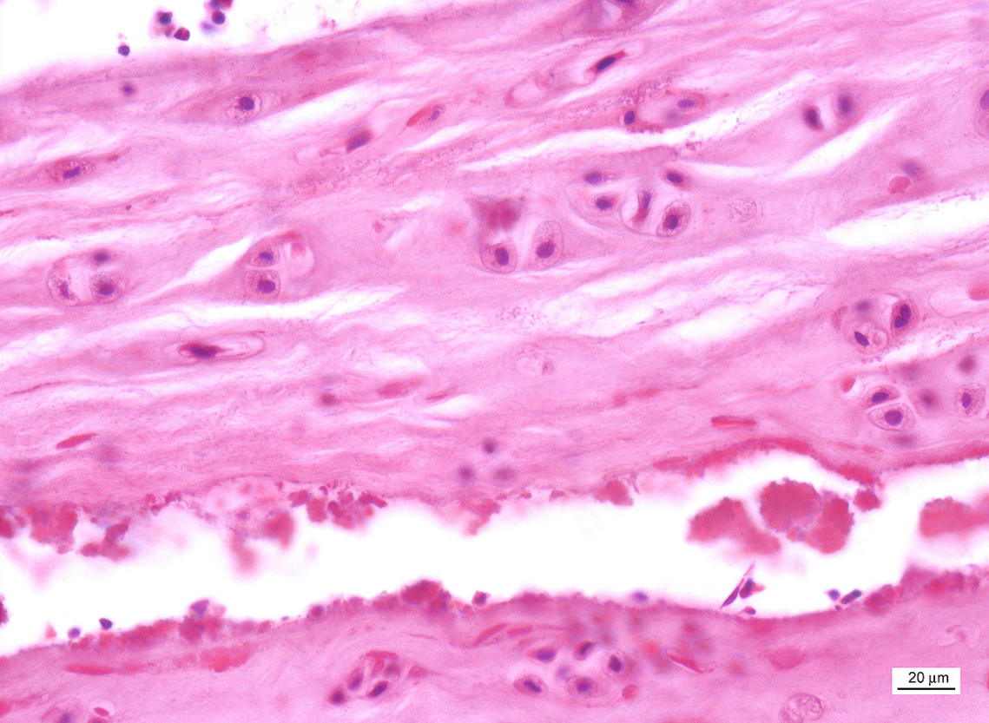
Fibrocartilage – intervertebral disc (HE)

Slide 7
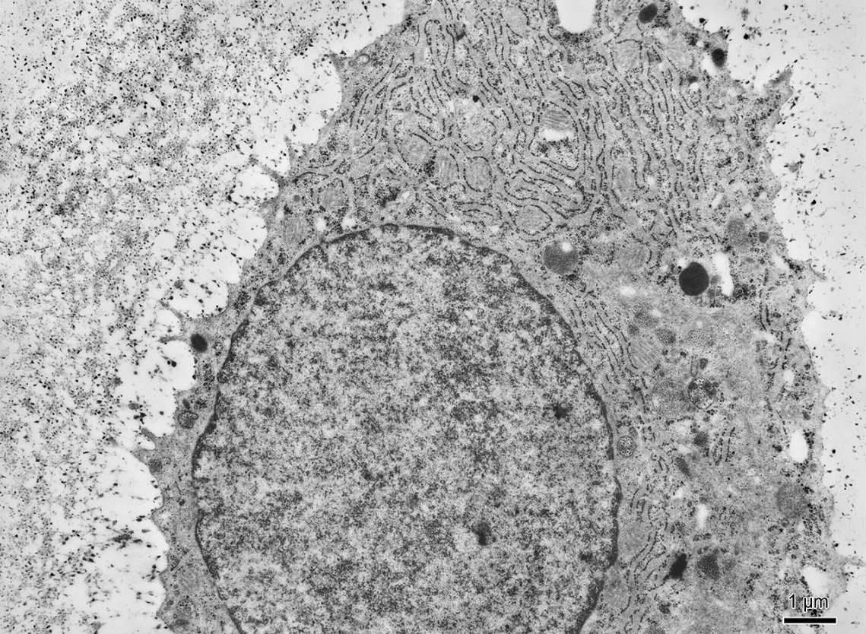
Osteoblast
osteoid
GER

Slide 8
Osteocyte

Slide 9
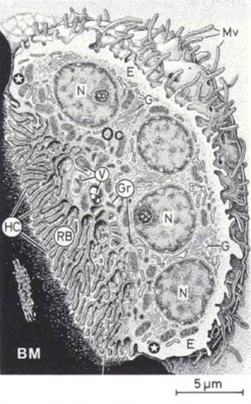
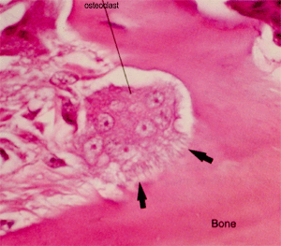
Osteoclast
www.studyblue.com
www.histology.leeds.ac.uk

Slide 10
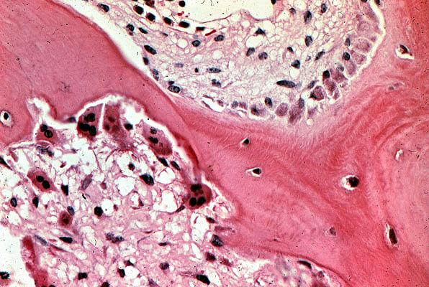
osteoblasts
osteoclasts
osteocytes

Slide 11
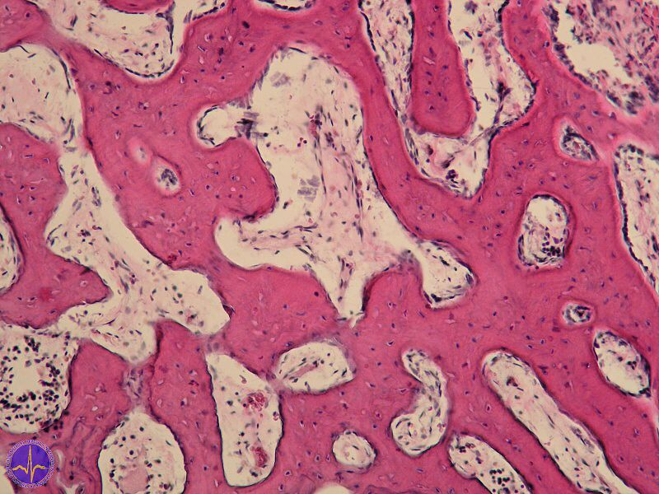
Fibrillar bone tissue

Slide 12
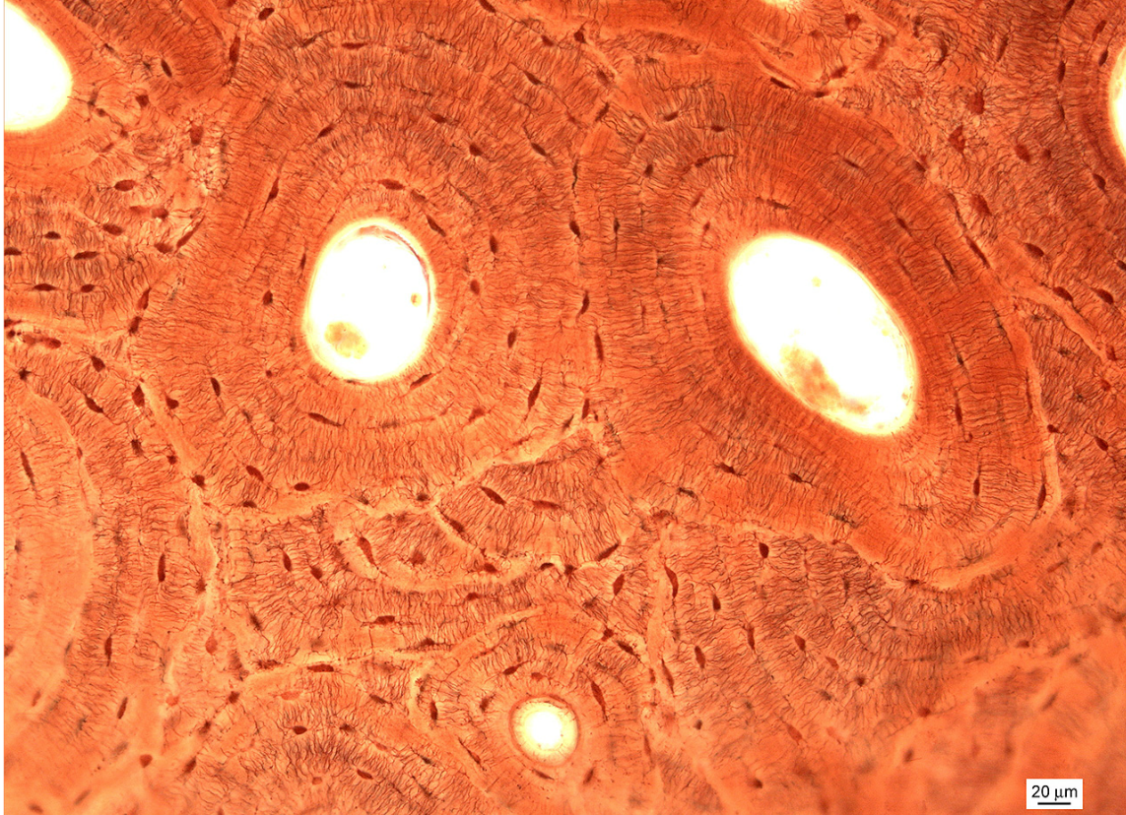
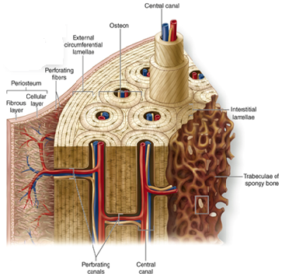
Lamellar bone tissue compact (Schmorl)
http://accessmedicine.mhmedical.com/

Slide 13
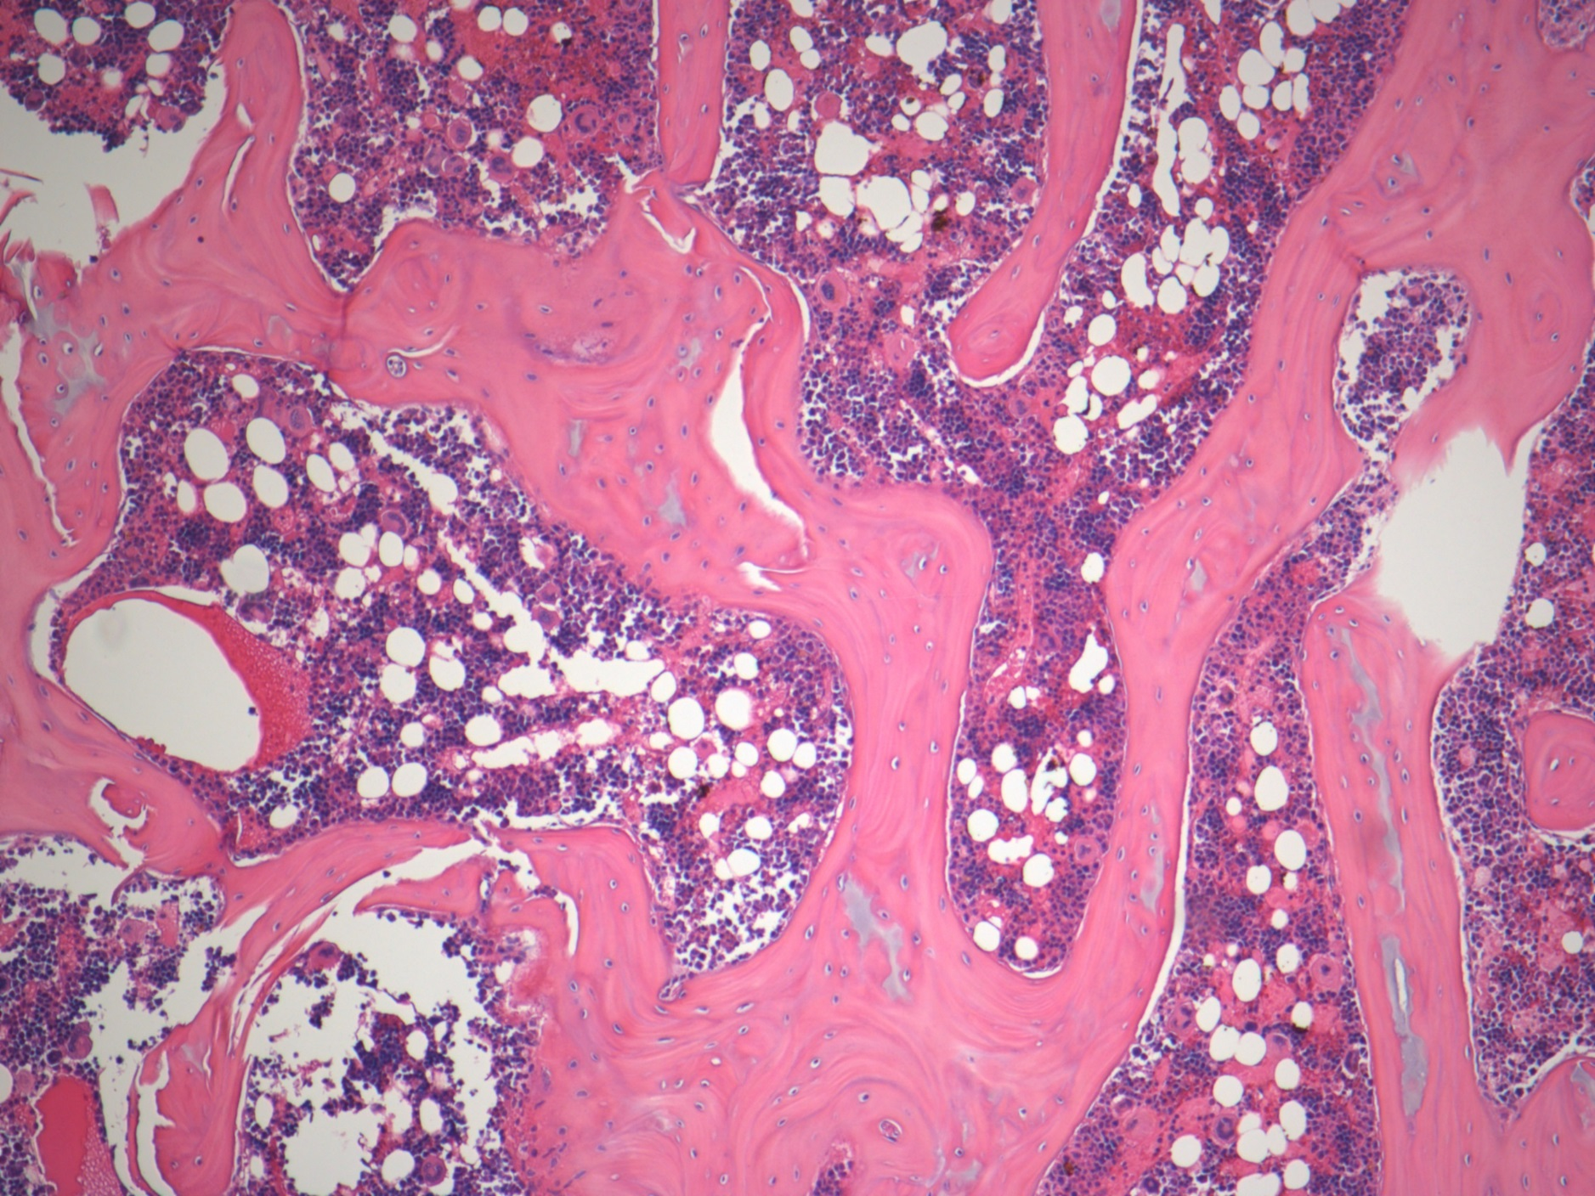
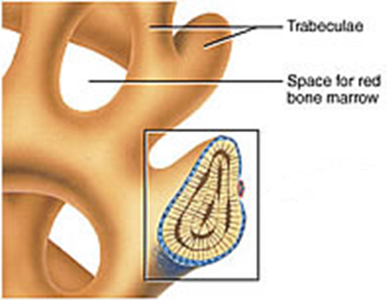
Lamellar bone tissue spongy (HE)
studydroid.com
imgkid.com

Slide 14
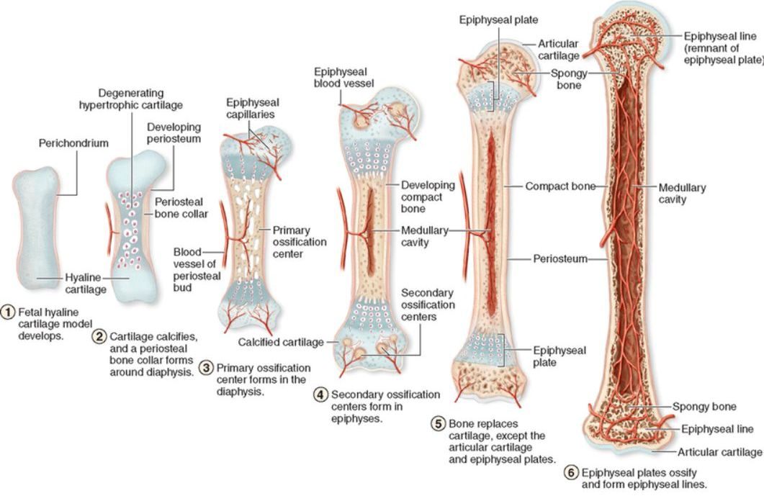
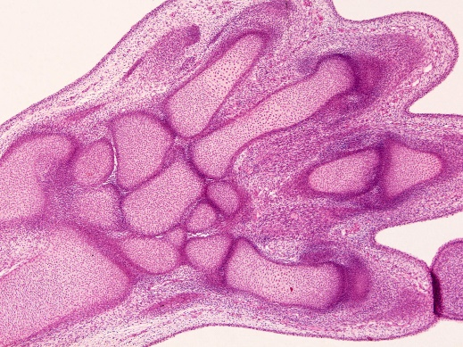
Endochondral ossification
hand, fetus, 8th week, model of hyaline cartilage (HE)

Slide 15
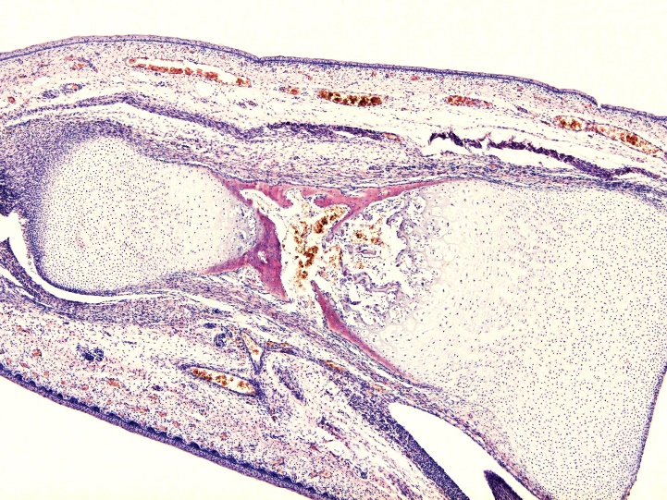
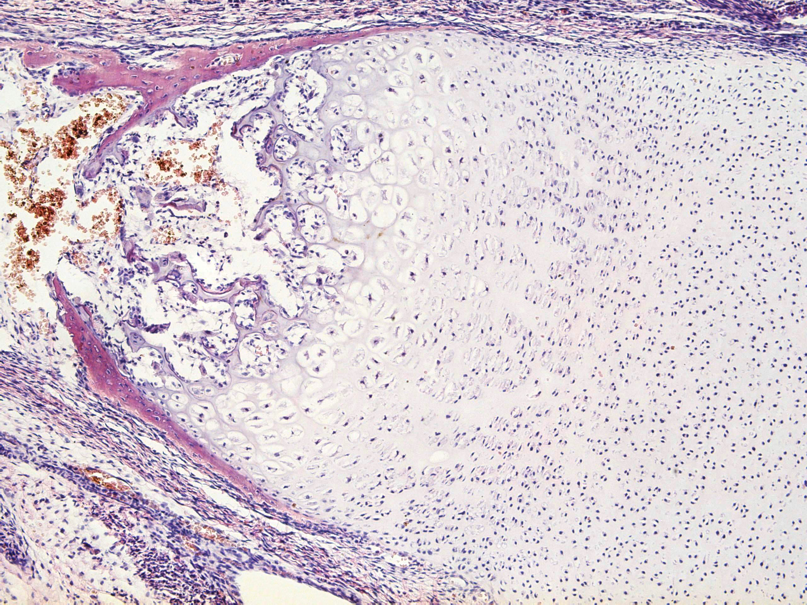
Endochondral ossification (HE)
os metacarpi (fetus, 4th month)
https://is.muni.cz/do/rect/el/estud/lf/ps15/atlas/web/index.html

Slide 16
Endochondral ossification (HES)
erosion line
ossification zone
calcification zone
hypertrophic zone
proliferating zone
reserve cartilage

Slide 17
CONNECTIVE TISSUE II – cartilage and bone
Slides:
Hyaline cartilage (27. Trachea)
Elastic cartilage (94. Auricula, 28. Elastic cartilage - orcein)
Lamellar bone (95. Bone – HE or Schmorl)
Endochondral ossification (96.)
Atlas EM:
pages 38 - 41

