Slide 1
EPITHELIAL TISSUE
according to the cell arrangement: sheet (membranous), trabecular, reticular
according to the function: covering, secretory, absorptive, respiratory, sensory, myoepithelial cells

Slide 2
Covering epithelium - classification
according to the number of cell layers and shape* of cells in the most superficial layer
Simple
Simple squamous
Simple cuboidal
Simple columnar
Pseudostratified columnar
Stratified
Stratified squamous (nonkeratinized)
Stratified squamous keratinized
(Stratified cuboidal)
Stratified columnar
Transitional
*cell membrane is usually not seen very well;
shape of nuclei helps us determine shape of cells
b.m.

Slide 3
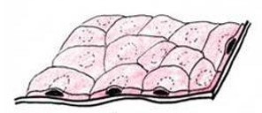
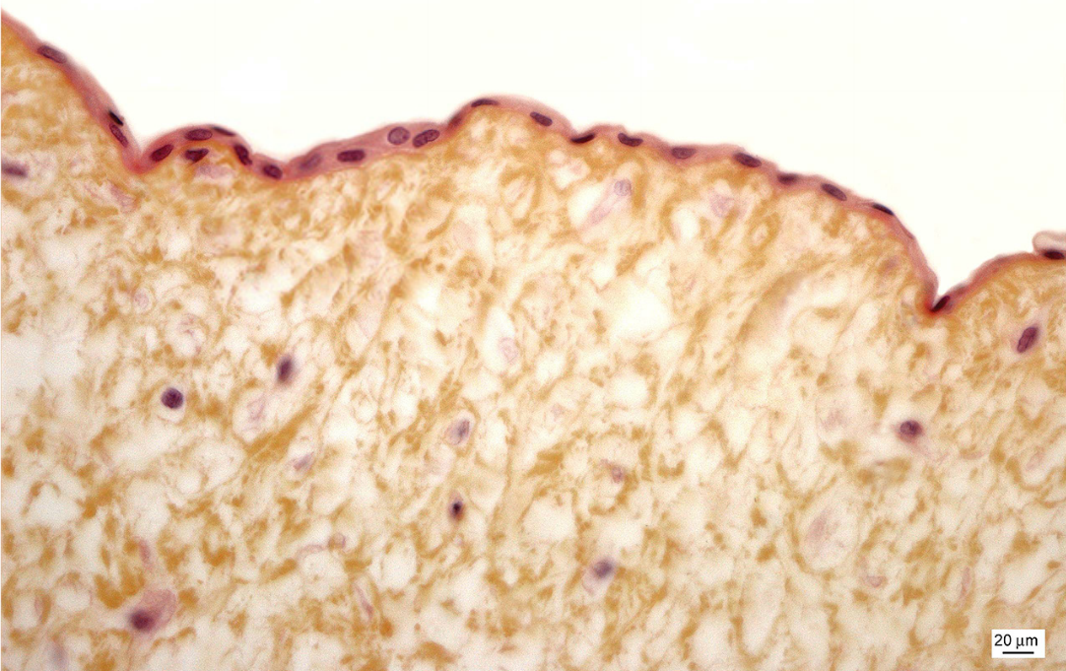
Simple squamous epithelium

Slide 4
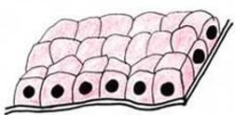
Simple squamous and simple cuboidal epithelium – kidney (cortex)
pt
pt
glo
dt

Slide 5
Simple squamous and cuboidal epithelium – kidney (medulla)

Slide 6
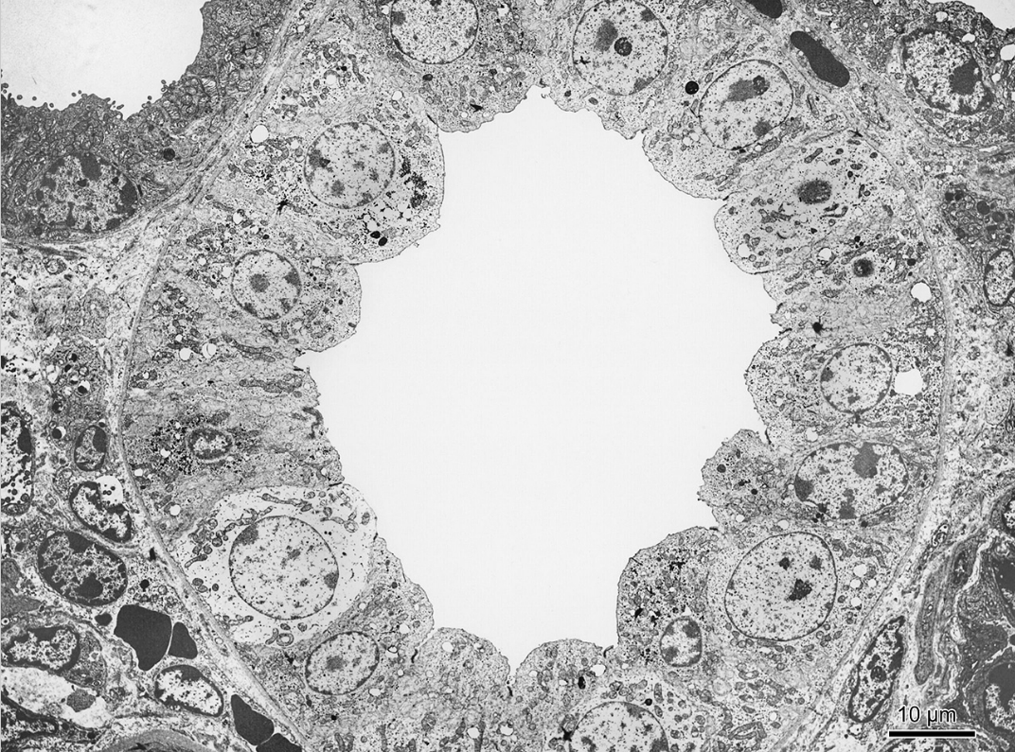
Simple low columnar epithelium - kidney

Slide 7
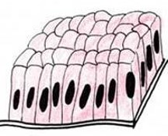
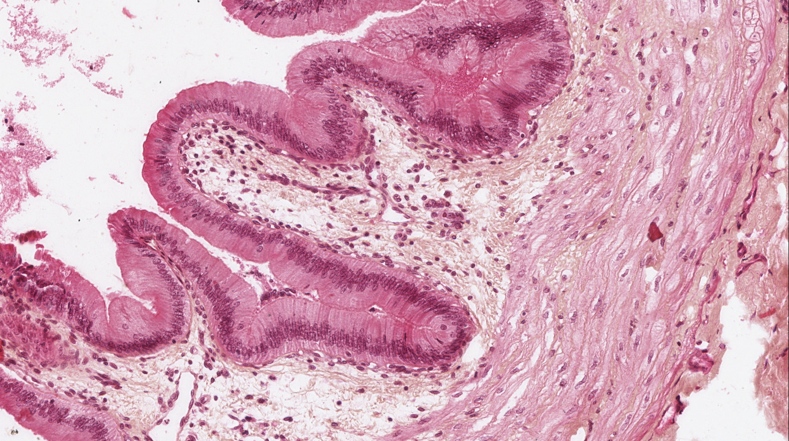
Simple columnar epithelium – vesica fellea
lamina propria
lumen
tunica muscularis - smooth muscle tissue

Slide 8
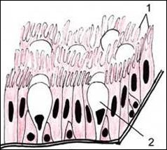
Pseudostratified columnar epithelium with cilia - trachea

Slide 9
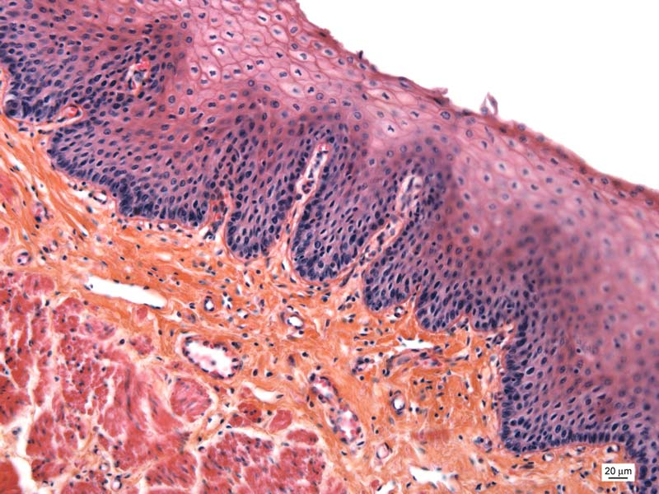
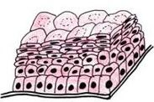
Stratified squamous epithelium - oesophagus

Slide 10
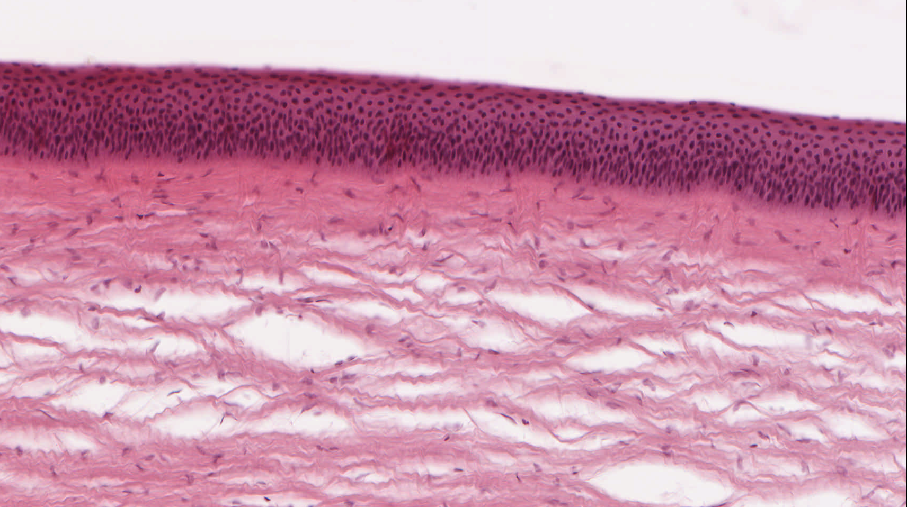
Stratified squamous epithelium - cornea

Slide 11
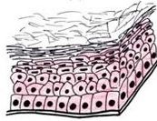
Stratified keratinized squamous epithelium - epidermis

Slide 12
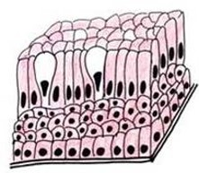
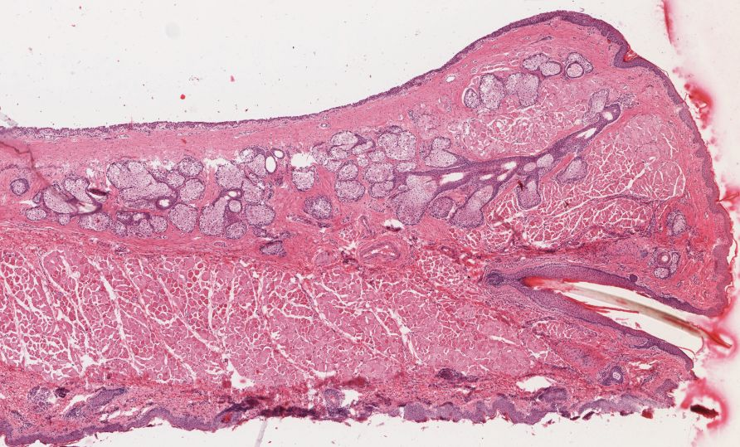
Stratified columnar epithelium (palpebra – conjunctiva)
gll
m

Slide 13
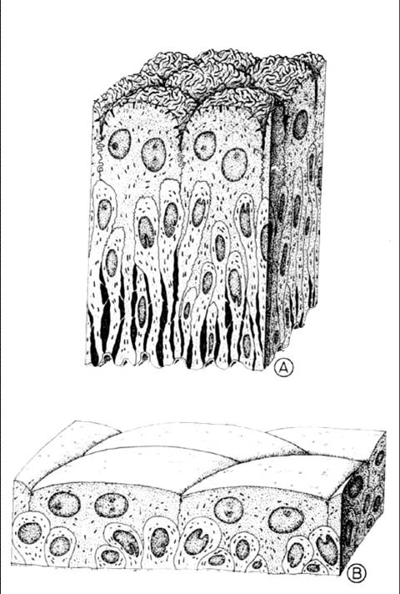
Transitional epithelium - ureter

Slide 14
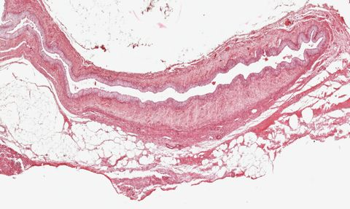
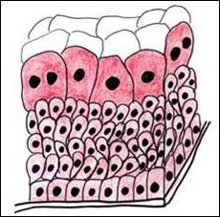
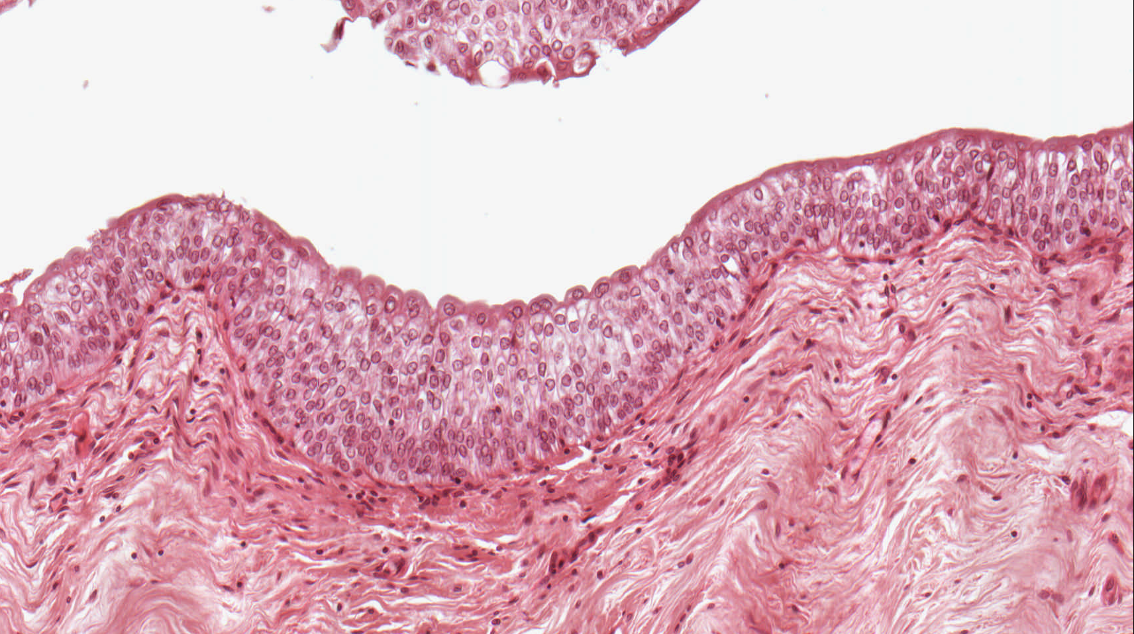
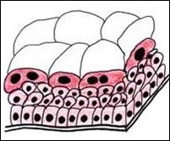
Transitional epithelium – calyx renalis

Slide 15
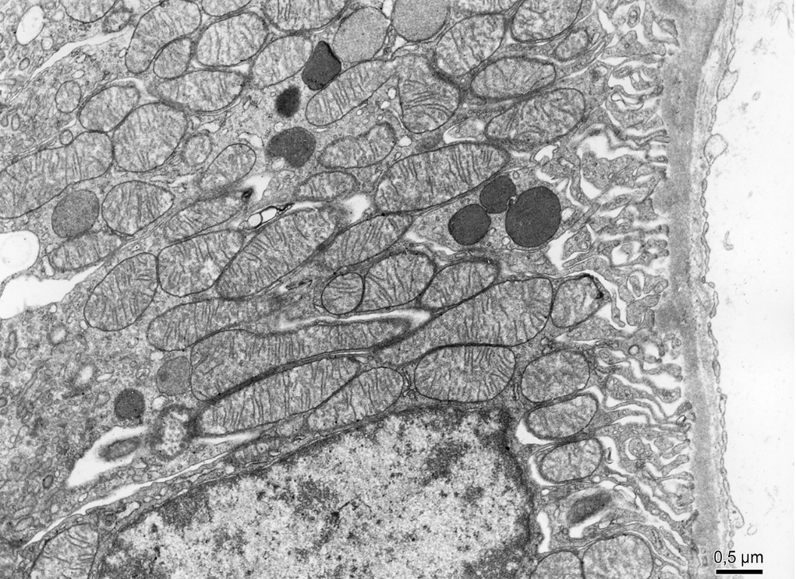
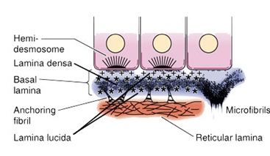
Basement membrane (0,5 - 1 μm)
lamina basalis
lamina fibroreticularis
lamina basalis

Slide 16
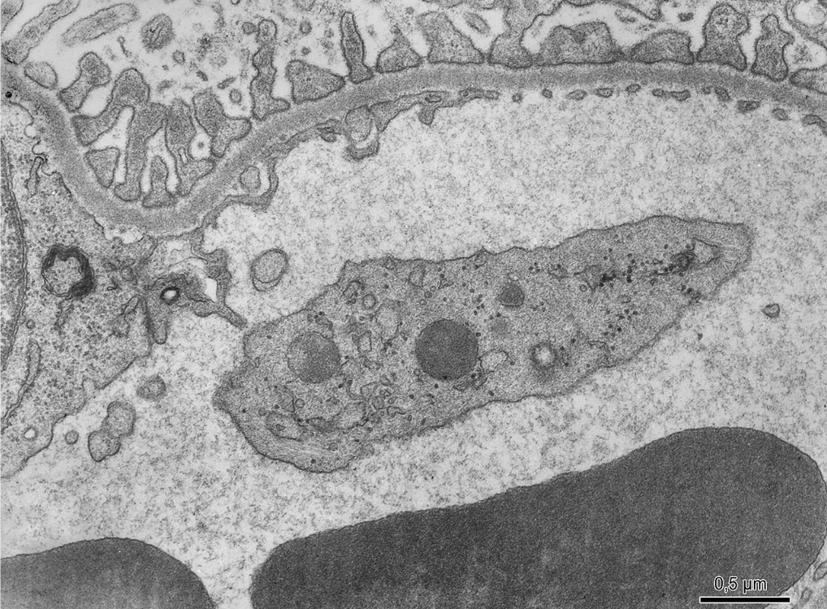
Glomerular basement membrane
epi
fused laminae basales of epithelial (podocyte) and endothelial cell
endo

Slide 17
EPITHELIAL TISSUE
Slides:
Simple squamous and cuboidal epithelium (30, 31. Ren)
Simple columnar epithelium (22. Vesica fellea)
Pseudostratified columnar epithelium with cilia (27. Trachea)
Stratified squamous (nonkeratinized) epithelium (11. Esophagus)
Stratified squamous keratinized epithelium (70. Skin from axilla)
Transitional epithelium (32. Renal calyx, 33. Ureter)
Stratified columnar epithelium (91. Palpebra)
Atlas EM:
Surface of epithelial cells – microvilli, brush border, striated border (16, 24-26, 62-63)
Surface of epithelial cells – cilia (20, 21, 23, 60)
Lamina basalis (26, 27, 57), basal labyrinth (27)
Simple low columnar epithelium (18)
Alveolar epithelium (55, 61)

