Slide 1
Glandular epithelium
Unicellular
Multicellular

Slide 2
Classification of glands
unicellular
extraepithelial
multicellular
alveolar serous
tubular mucous merocrine
tuboalveol. seromucous apocrine
holocrine
simple branched compound
exocrine
endocrine
intraepithelial

Slide 3
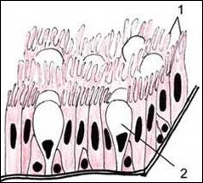
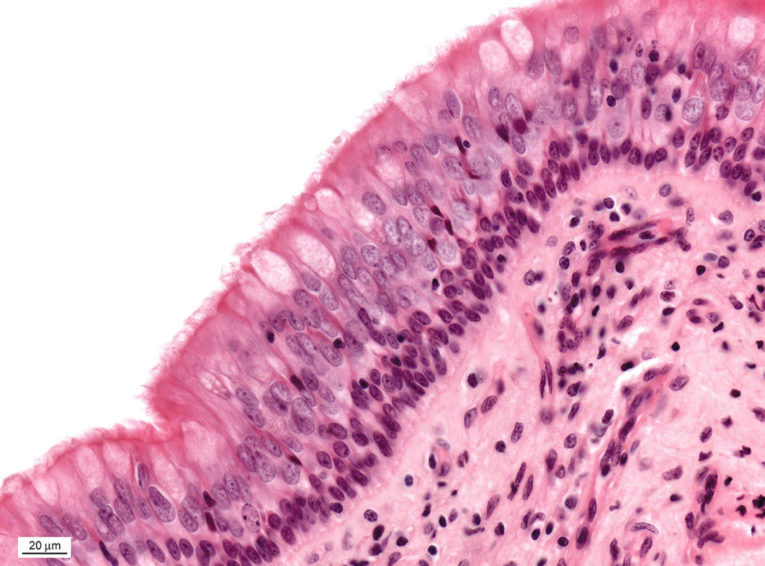
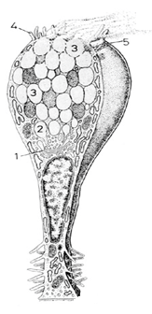
Unicellular glands intraepithelial – goblet cells (respiratory tract)
goblet cells

Slide 4
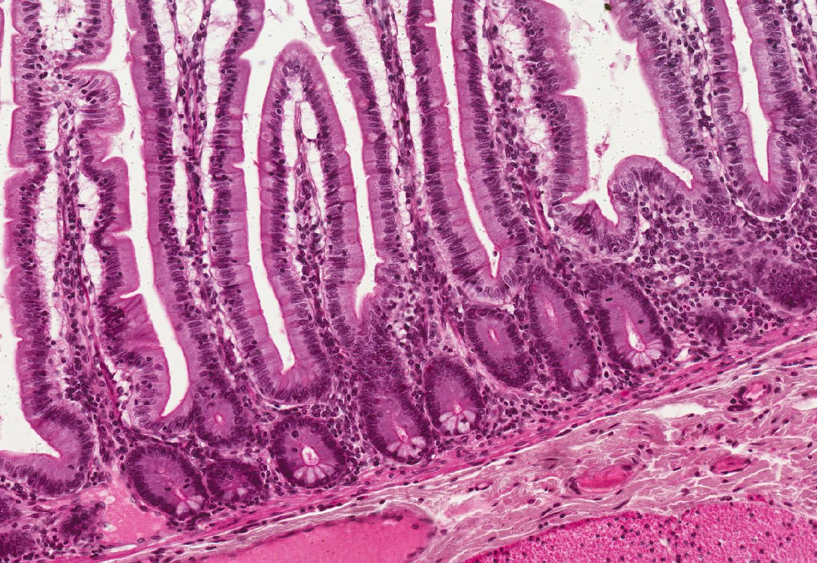
Unicellular glands intraepithelial (goblet cells and Paneth cells) – Intestinum tenue (jejunum)
villus
goblet cc
crypts of Lieberkühn
Paneth cc
lamina muscularis mucosae

Slide 5
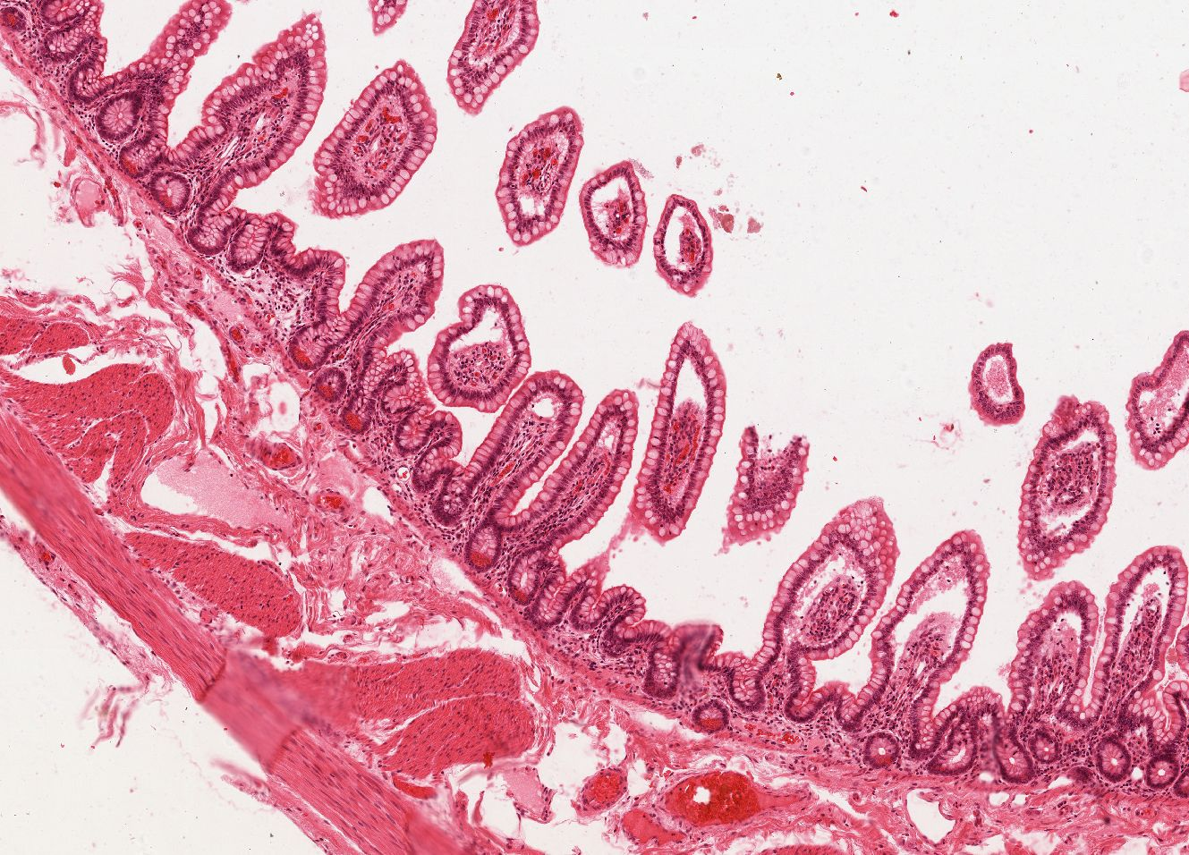
Unicellular glands intraepithelial (goblet cells and Paneth cells) – Intestinum tenue (ileum)
lamina muscularis mucosae
goblet cc
Paneth cc

Slide 6
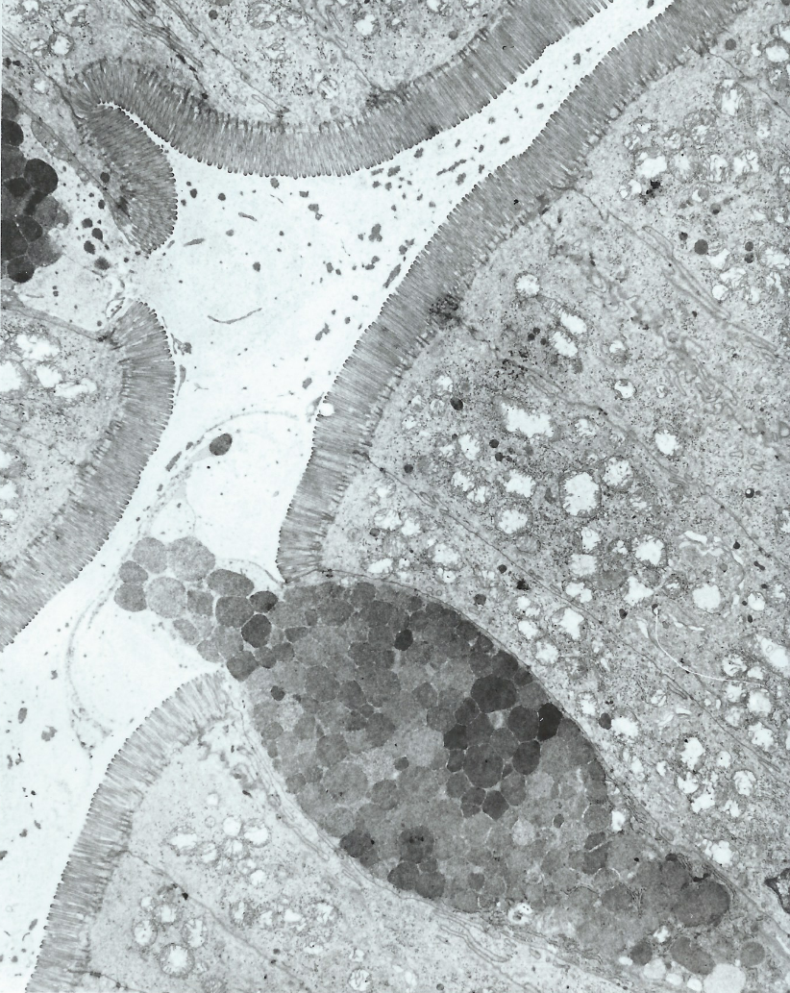
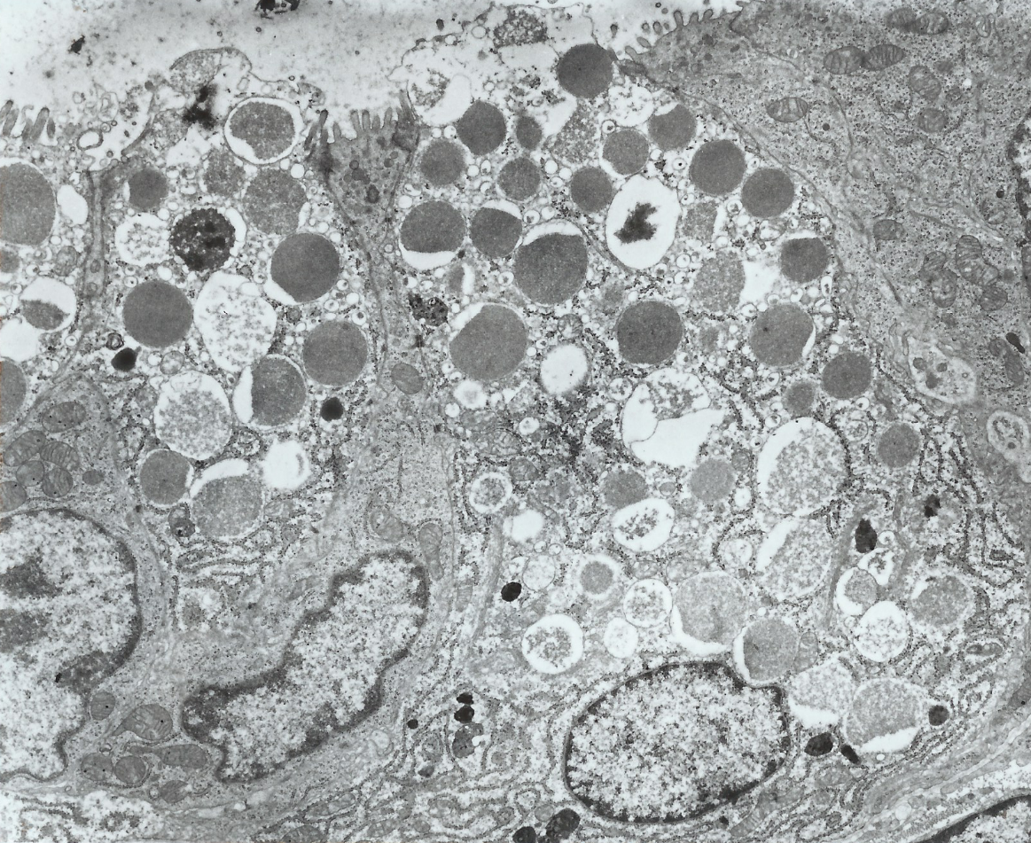
Goblet cells and Paneth cells - Intestinum tenue (TEM)
enterocytes
Paneth cells
goblet cell
stem cells of intestinal epithelium

Slide 7
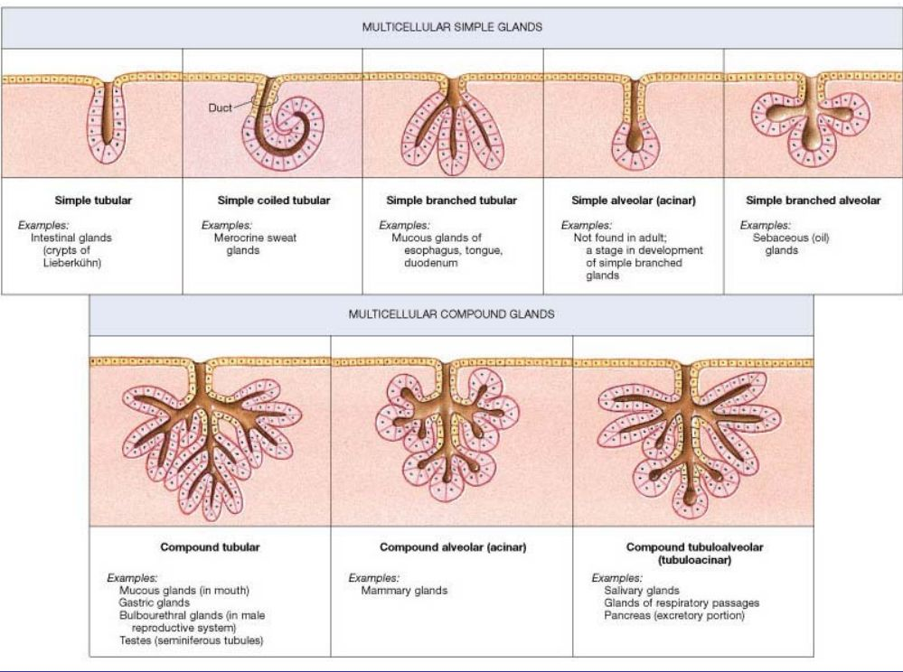

Slide 8
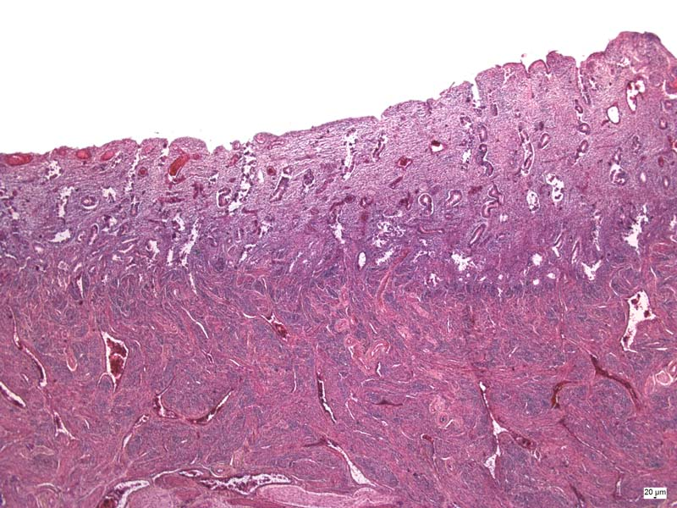
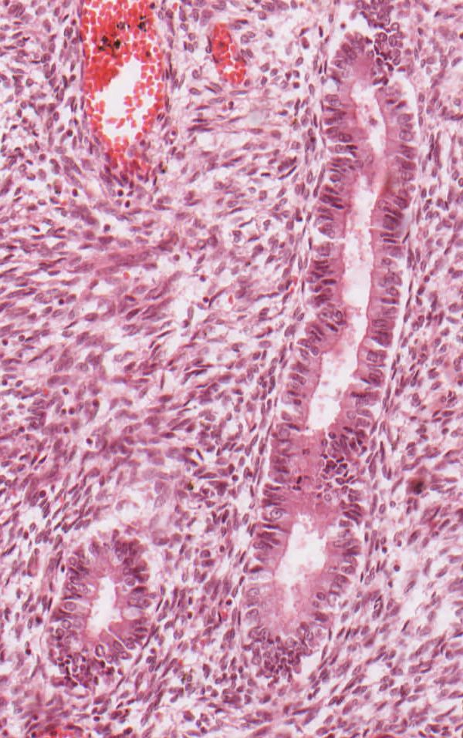
Simple tubular glands - gll. uterinae (Endometrium – proliferative phase)
endometrium
myometrium

Slide 9
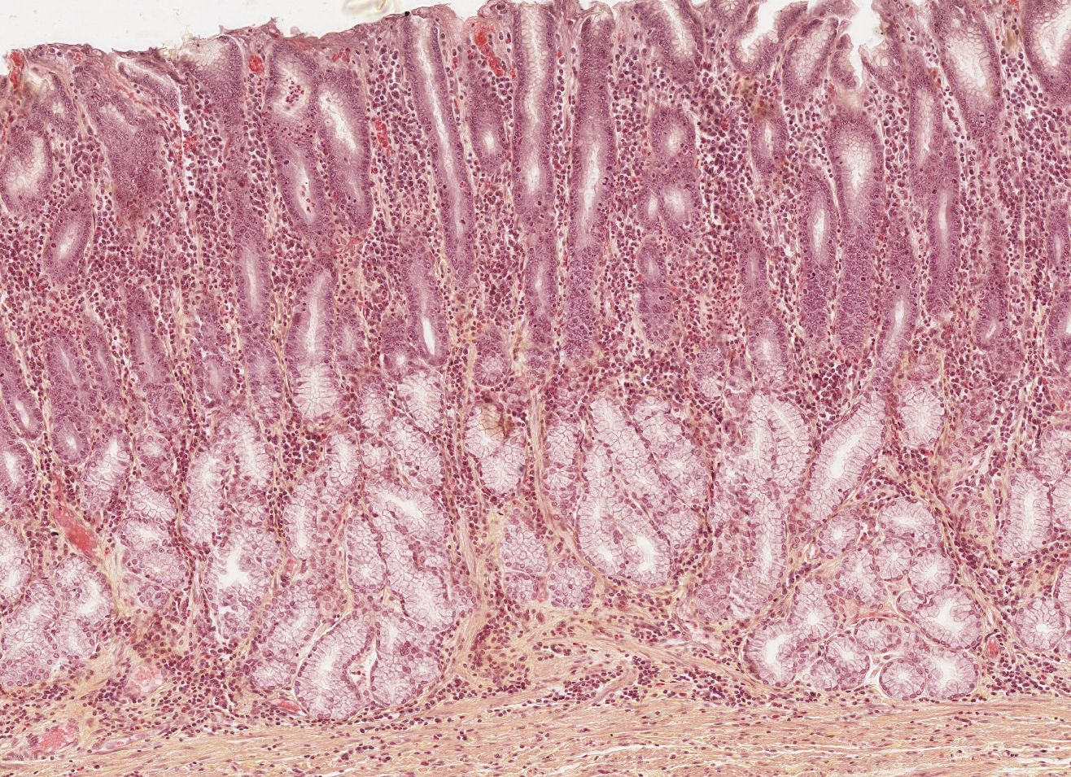
Branched tubular glands – gll. pyloricae (Pylorus, HES)
lamina muscularis mucosae

Slide 10
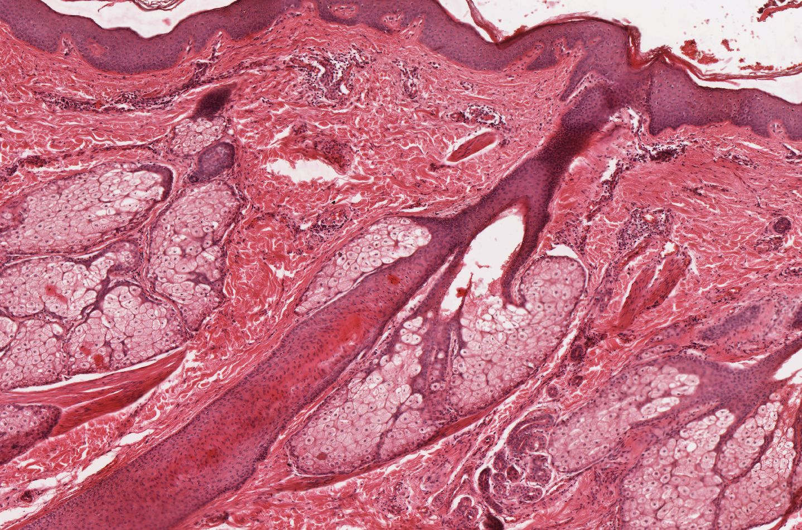
Branched alveolar (acinar) glands – gll. sebaceae (skin)

Slide 11
Compound alveolar (acinar) serous gland - Glandula parotis

Slide 12
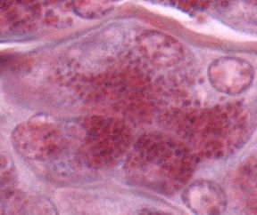
Compound alveolar (acinar) serous gland - Glandula parotis
serous acinus

Slide 13
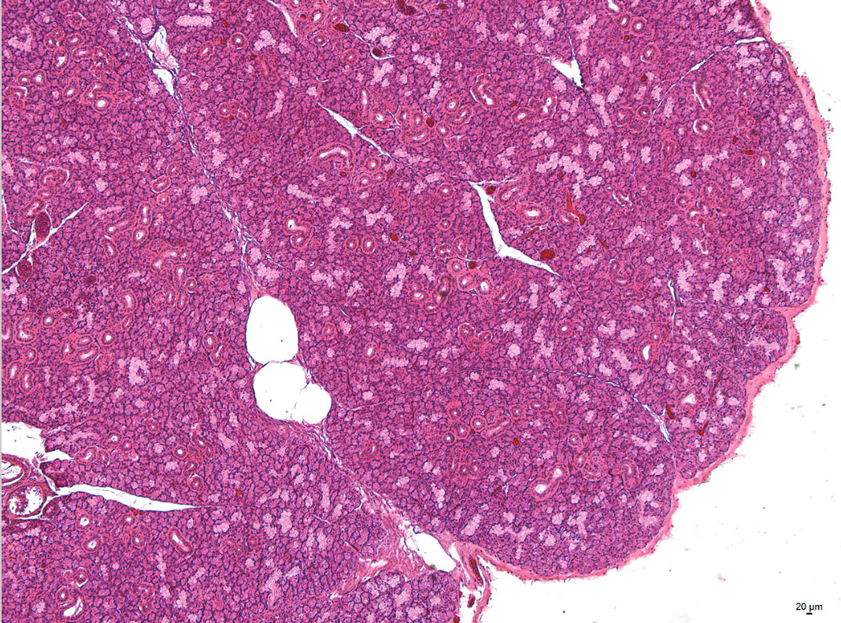
Compound tuboalveolar mixed gland - Glandula submandibularis

Slide 14
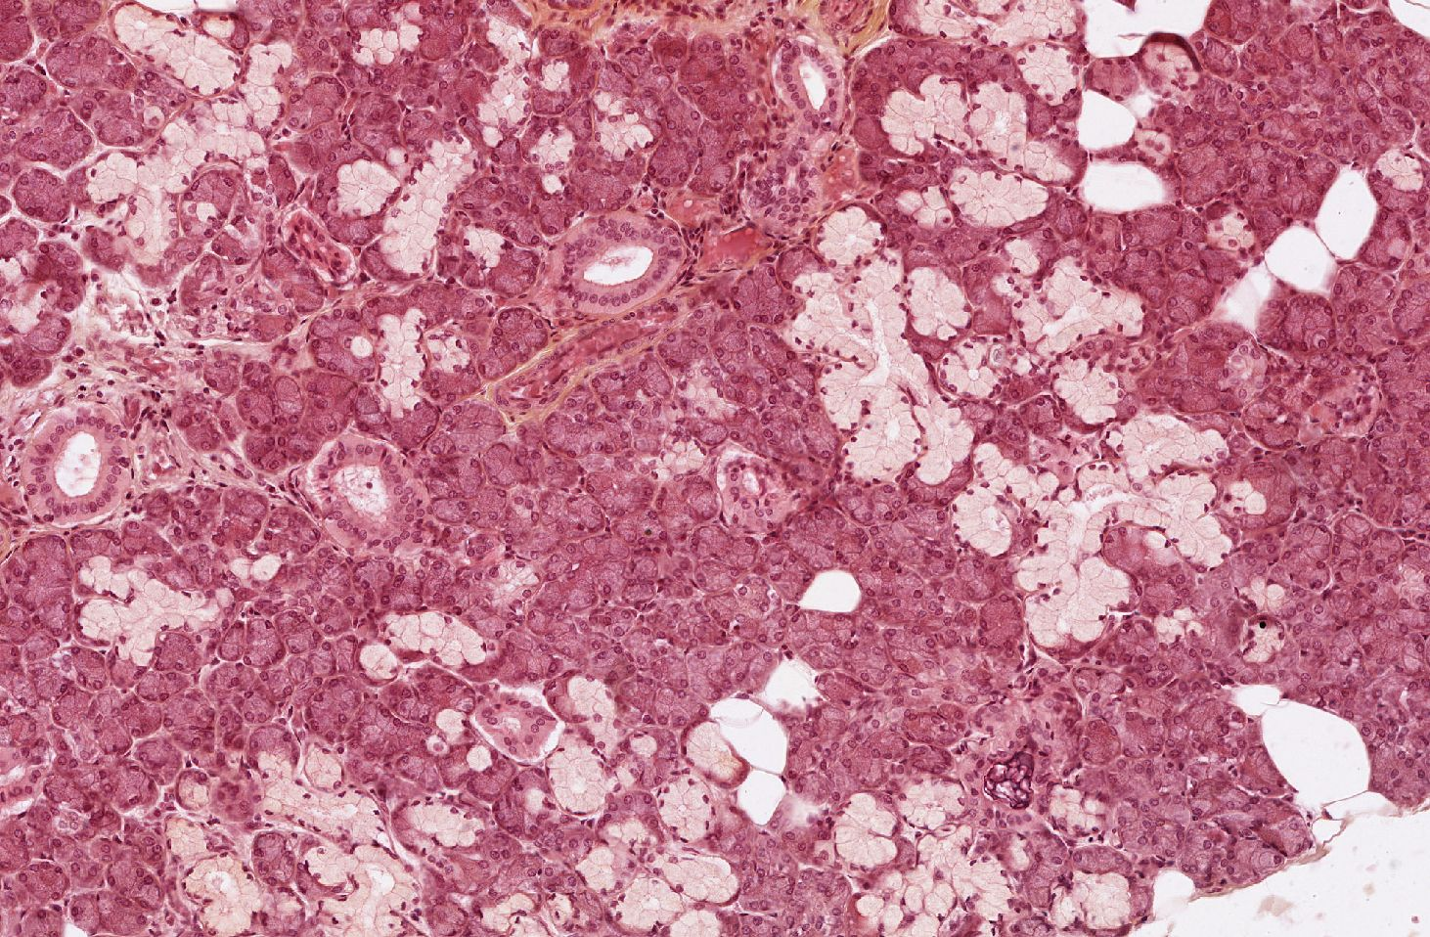
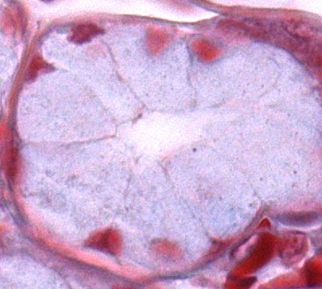
Compound tuboalveolar mixed gland - Glandula submandibularis
serous acinus
mucous tubule

Slide 15
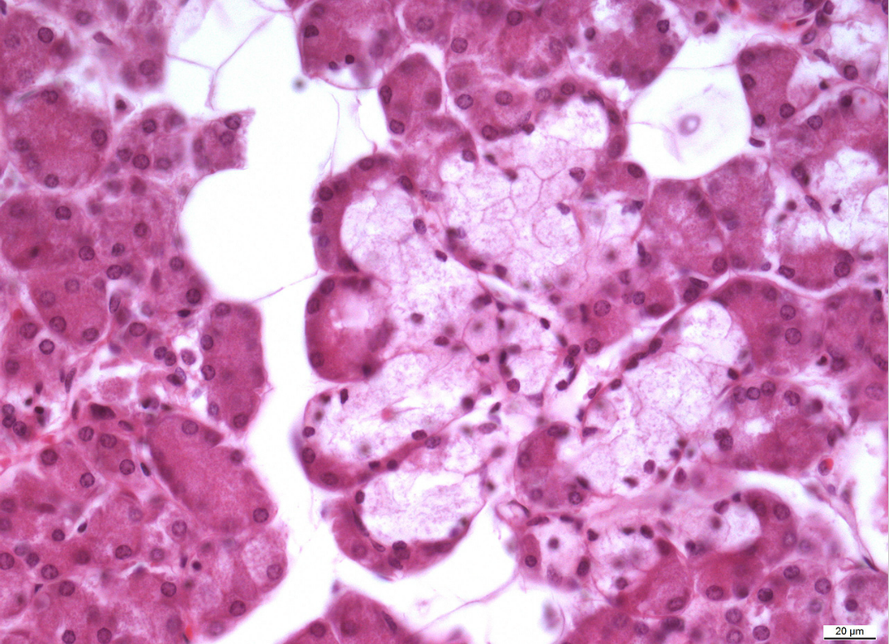
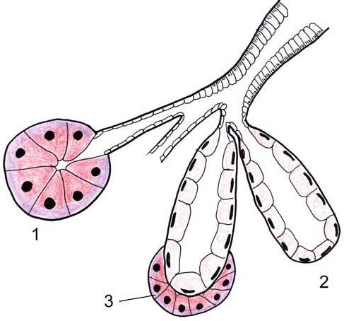
Compound tuboalveolar mixed gland - Glandula submandibularis
lunula of Gianuzzi

Slide 16
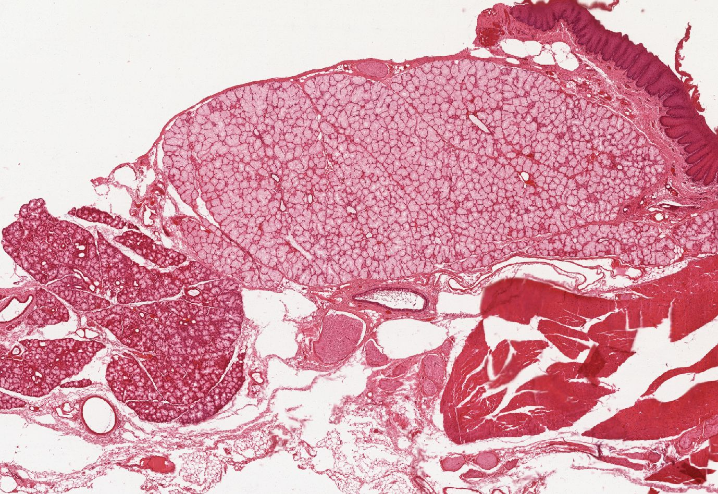
Compound tuboalveolar mixed gland - Glandula sublingualis

Slide 17
Glandular epithelium
Slides:
Cells of Paneth and goblet cells (16. Intestinum tenue)
Simple tubular glands (47. Uterus – proliferative phase)
Branched tubular glands (14. Pylorus)
Branched alveolar (acinar) glands – sebaceous glands (71. Skin with hair)
Compound alveolar (acinar) serous gland (8. Glandula parotis)
Compound tuboalveolar mixed gland (9. Glandula submandibularis)
Atlas EM:
Glandular cell of the exocrine pancreas (10, 65)
Endocrine cells of the pancreas (66)
Goblet cell in the intestinal epithelium (62, 63)
Paneth cell (64)

