Slide 1
Hereditary cancer syndromes
Jakub Trizuljak

Slide 2
Výstupy z učení
Student se naučí rozpoznat akutní život ohrožující stavy u diabetiků.
Student se naučí základní principy první pomoci u diabetiků.

Slide 3
Basic Dogmas of Oncology
I) Cancer is a genetic disease
Aberrant gene expression is a key step in the initiation, promotion and progression of the tumor
II) Carcinogenesis is a multistep process
Carcinogenesis is a multistep process involving alterations in at least two distinct classes of genes
III) Biological correlates of gene expression are identifiable
Genetic
information
DNA -> RNA
Molecular
structure
of protein
Biochemical
function
of protein
Symptoms
(Phenotype)

Slide 4
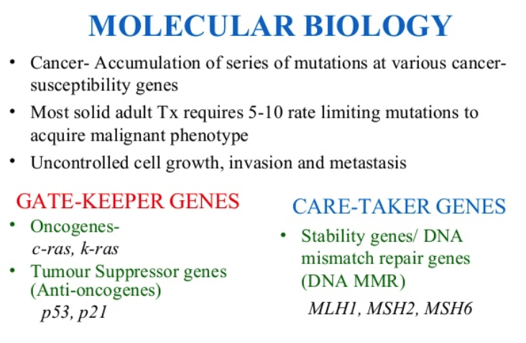
Hereditary cancer syndromes

Slide 5
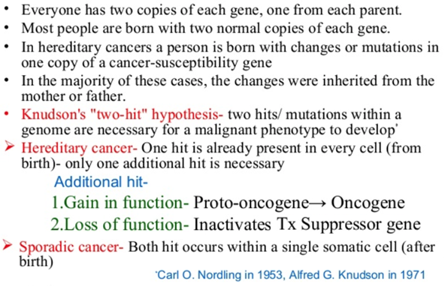
Hereditary cancer syndromes

Slide 6
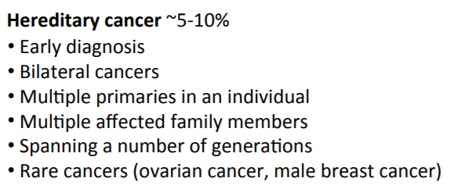
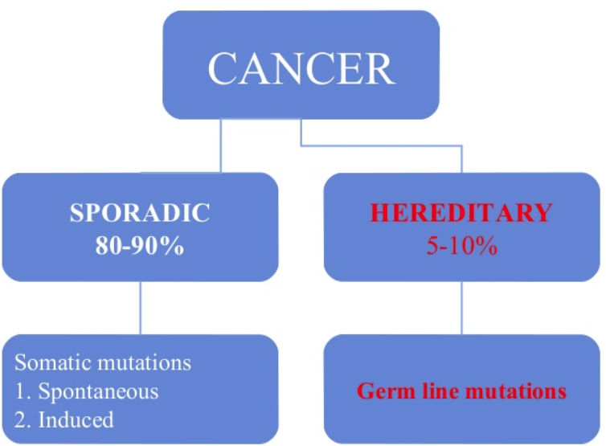
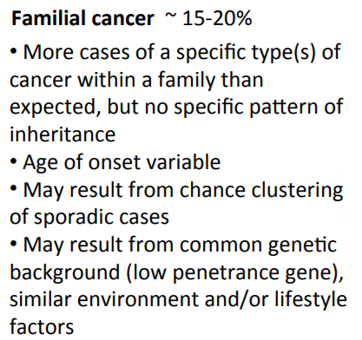

Hereditary cancer syndromes

Slide 7
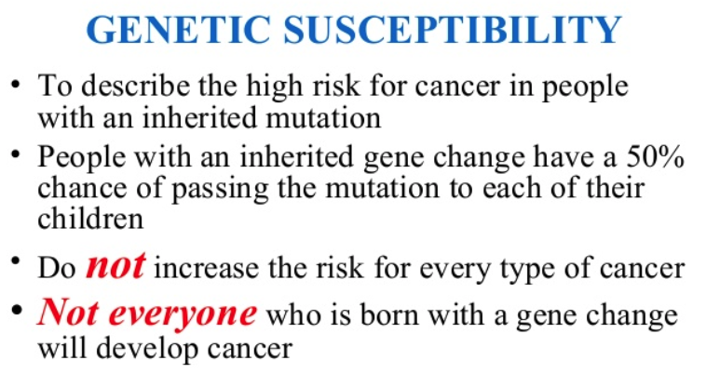
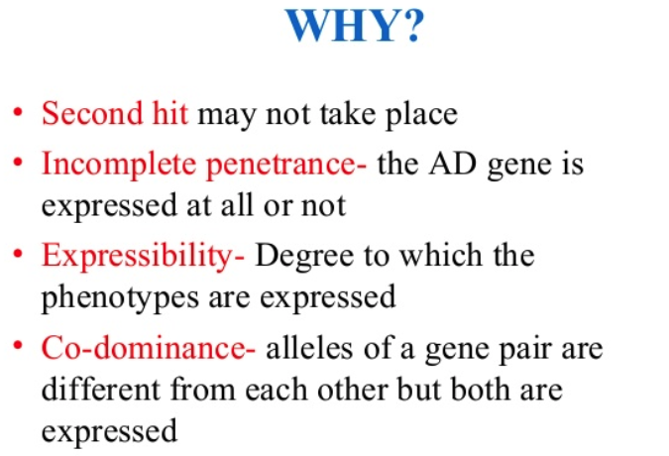
Hereditary cancer syndromes

Slide 8
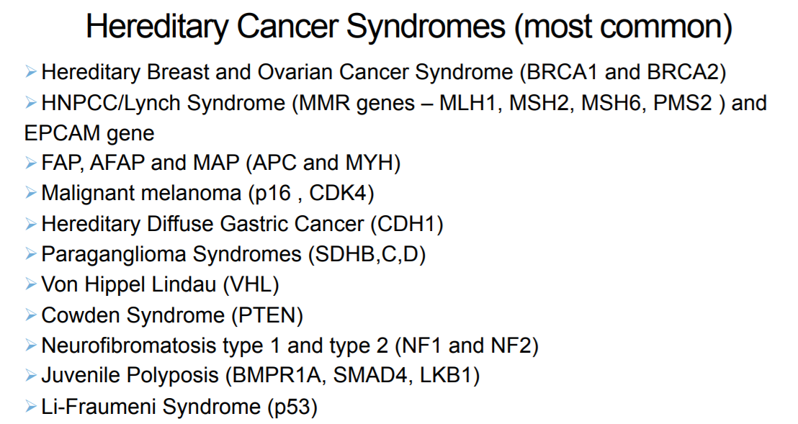
Hereditary cancer syndromes

Slide 9

Hereditary breast and ovarian cancer: HBOC

Slide 10
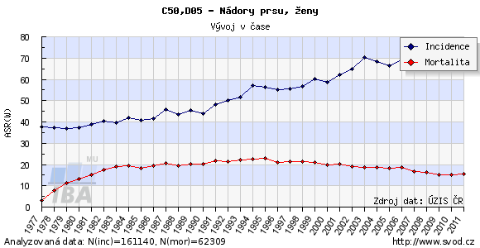
Breast cancer
the most frequent malignant cancer
in female patients from Czech Republic
rising incidence, declining mortality
5-10% of all breast carcinomas are hereditary

Slide 11
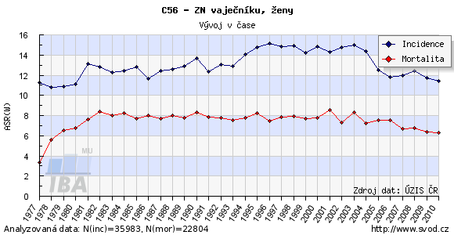
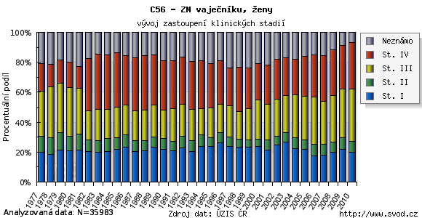
Ovarian cancer
ovarian, fallopian and primary peritoneal tumors make up to 15% of all malignant cancers in women
Czech Republic is on the čth palce in Europe in incidence
mortality is relatively high !!!
early tumors have good prognosis, however most cancers are diagnosed in stage III or IV

Slide 12
BRCA1 / BRCA2
germline BRCA1/2 mutations cause increased risk of malignancy
lifelong risk of breast cancer is 40-87% / 18-88%
breast cancer risk until 40 years is19% for BRCA1 mutation carriers, 12% for BRCA2 mutation carriers
lifelong risk of ovarian cancer is 22-65% / 10-35%
increased risk of other malignancies (endometrial cancer, cervix cancer, colorectal carcinoma, prostate and stomach cancer)

Slide 13
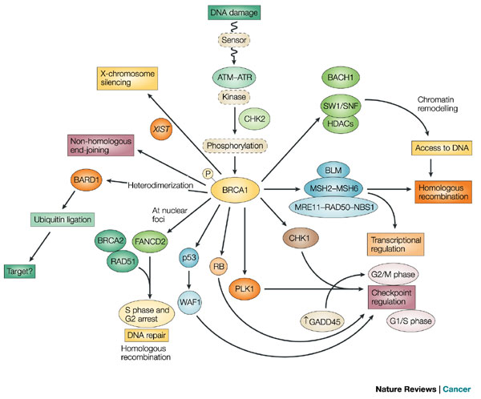
BRCA1/2 DNA cell pathways
Level of
DNA repair
cell cycle
apoptosis

Slide 14
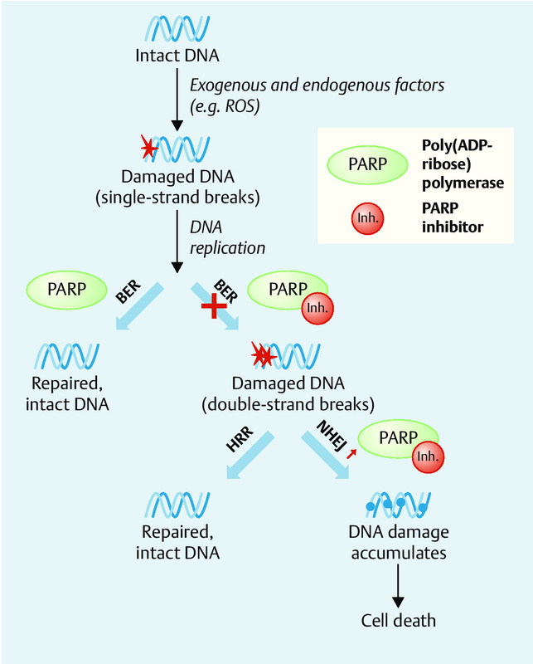

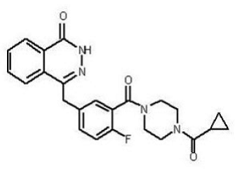
PARP inhibitors
Olaparib (Lynparza)

Slide 15
Other candidate genes
There are further candidate genes increasing risko of hereditary breast and ovarian cancer
ATM, APC, BARD1, BRIP1, CDH1, CHEK2, EPCAM, MLH1, MSH2, MSH6, MUTYH, NBN, PALB2, PMS2, PTEN, RAD50, RAD51C, RAD51D, STK11, TP53
Gene panels:
CZECANCA: CZEch CAncer paNel for Clinical Application
BRONCO- Brno ONCOlogical panel
more than 300 genes associated with cancer susceptibility

Slide 16
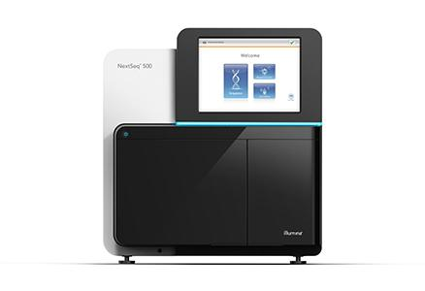
BRCA1/2 mutation screening
NGS – next generation sequencing
MLPA analysis of large mutations or deletions
comparison of detected mutations in databases,
in silico prediction

Slide 17
Example pedigree
AD mode of inheritance
ccurence of breast
/ ovarian cancer in younger pts.
occurence of neoplasms in every generation
Occurence of other malignancies
asymptomatic carriers! (incomplete penetrance)
Ca plic
fumator
+80 let
Ca ovaria
47l.
Ca prsu
52l.
Dissemin. Ca prostaty
1
6
Ca ovaria
53 let
Ca prsu
56 let
BRCA1
BRCA1

Slide 18
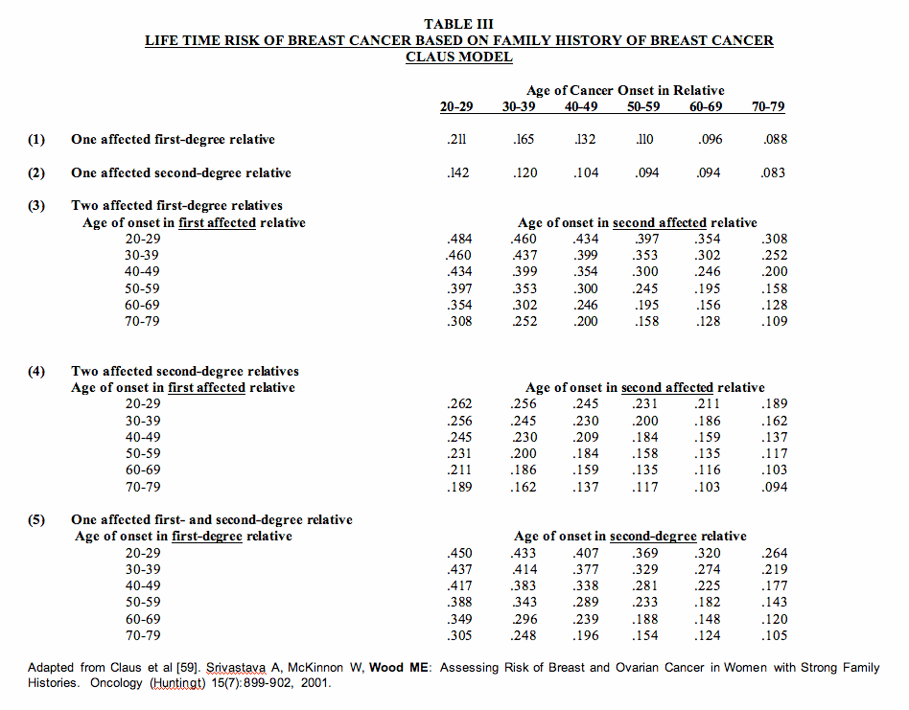
Empiric assessment of cancer risk - Claus model

Slide 19
Individual risk
assessment based on family history, age of onset in relative and character of found mutation
molecular genetic investigation is indicated by clinical geneticist
ossibility of preimplantation genetic diagnostics
Useful links:
http://www.omim.org
http://arup.utah.edu/database/BRCA/
http://cancer.sanger.ac.uk/cosmic

Slide 20
criteria for genetic testing
- sporadic form
According to NCCN, NICE, ESMO, SLGG
fallopian / ovarian / primary peritoneal cancer in any age
triple negative breast cancer (ER, PR, HER2 neg.) ˂60 years, medullary carcinoma almost always consistent with TNBC
unilateral breast cancer ˂45 years
(˂50 if no family history known)
two primary breast cancers, first ˂50 years or both ˂60 years
breast and pancreas cancer duplicity in any age
male breast cancer in any age

Slide 21
criteria for genetic testing
– familial form
According to NCCN, NICE, ESMO, SLGG
3 relatives
At least 3 direct relatives (including the proband ) with breast cancer in any age
2 relatives
2 direct relatives (including the proband) with breast cancer, at least one diagnosed ˂50 years, or both ˂60 years
Proband with breast cancer of any age and a direct relative with ovarian cancer, triple-negative breast cancer or medullar breast cancer, male breast cancer, pancreatic cancer or high/grade primary metastatic prostate cancer
Predictive testing of a known familial mutation above 18 yrs

Slide 22
Recommended screening of
mutation carriers
breast self-investigation since 18 years
clinical breast investigation by a specialist twice a year since 25 years or 10 years earlier than the first occurence of breast/ovarian cancer in relatives
25-29 let: MRI and ultrasound, twice a years
30-65 let: MRI a mammography, twice a year
gynecological investigation twice a year including transvaginal ultrasound
further investigations (onkomarkers, screening for other malignancies, eg. gastroscopy, colonoscopy)

Slide 23
Prophylactic surgery
bilateral prophylactic adnexectomy, at best in the age of 35-40 years in mutation carriers or immediately in elderly patients, possibility of hysterectomy is always considered (especially in BRCA1 mutation carriers)
bilateral prophylactic mastectomy at any time the patients asks, after consultation with oncologist and complex preventive investigations

Slide 24
Further considerations
chemoprevention – Tamoxifen
Tamoxifen use can protect i BRCA2 mutation carriers, but not in BRCA1 carriers: King et al., 2001
Tamoxifen increases survival by 1.8 years and quality adjusted survival by 2,7 years: Grann et al., 2002
role of oral contraceptives? Low dose COC possibly protects against ovarian cancer in BRCA1/2 carriers but its role in breast cancer is uncertain (probably no increased risk)
reprodukční rozhodnutí

Slide 25

The best protection is an early detection!
October is the breast cancer awareness month

Slide 26
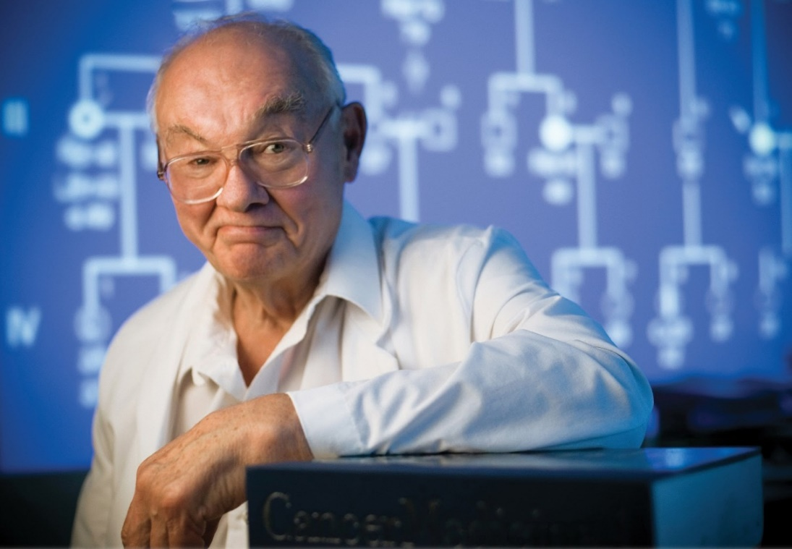
Hereditary nonpolypous colorectal carcinoma (NPCC)
Lynch syndrome
‘Hereditary factors in cancer: study of two large midwestern kindreds’,
Arch. Intern. Med., 1966
Research of several families with colorectal and other cancers in US states Michigan and Nebraska
Prof. Henry T. Lynch, MD. *1928 -

Slide 27
Lynch syndrome
the most frequent congenital predisposition to colorectal cancer
high penetrance, AD mode of inheritance
approximately 2-5% of all colorectal cancers
28-75% risk of colorectal cancer in men,
24-52% risk of colorectal cancer in women
Risk of other tumors: endometrial cancer, ovarian cancer in women, gastric cancer, urinary tract cancers, hepatobilary cancers, cancer of small intestine, brain tumors

Slide 28
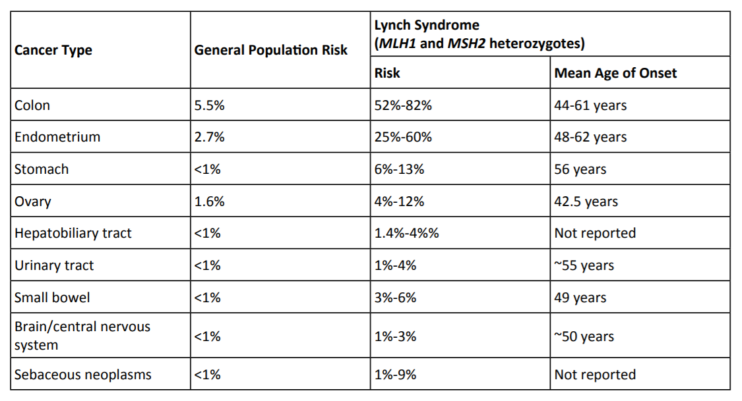
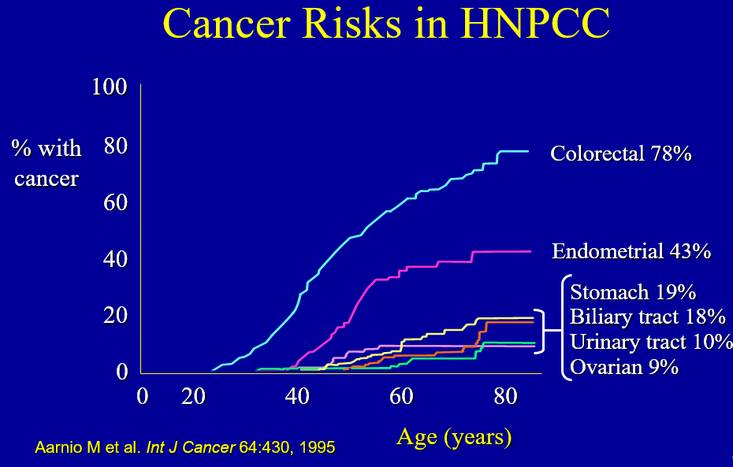
Lynch syndrome

Slide 29
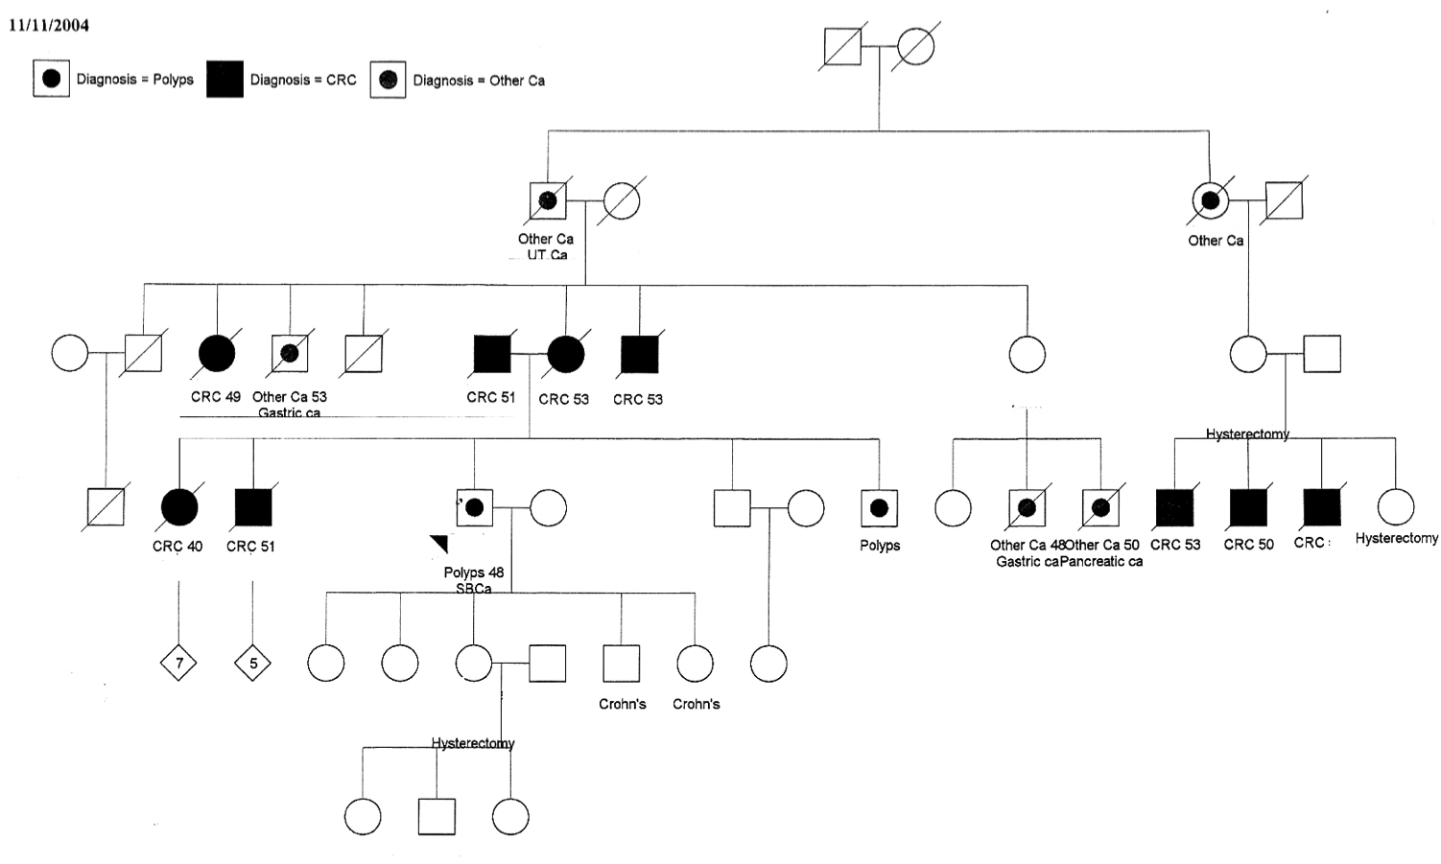

Slide 30
Example pedigree
Gastric Ca
Gastric Ca 62 yrs
+67 yrs
8
Gastric Ca
disseminated.
adenocarcinoma unknown origin
62 yrs
MSH6

Slide 31
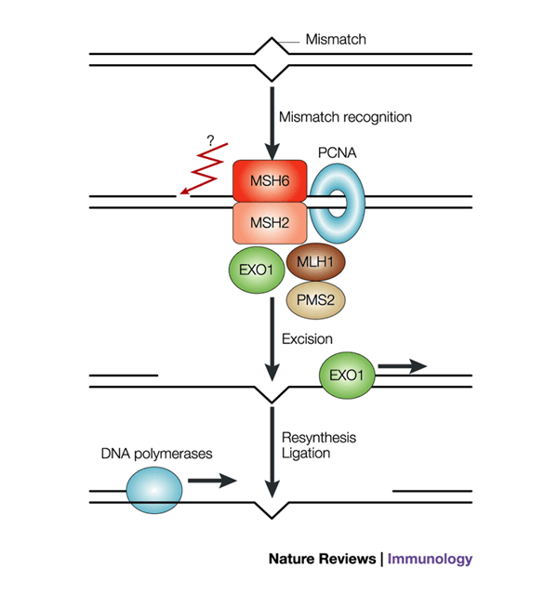
MLH1, MSH2, MSH6 and PMS2 genes
mismatch repair genes
system responsible for genetic stability in prokaryotes and eukaryotes
recognition of mismatch nucleotides, excision and repair by DNA polymerases

Slide 32
Indikation for mutation screening
MLH1, MSH2, MSH6, PMS2
Amsterdam criteria I/II
at least three family members with colorectal carcinoma
(or other tumor in HNPCC spectrum), one of thgem is a first degree relative to the other two
at least two generations affected
at least one patient younger than 50 years at the time of diagnosis
the tumor has been verified by pathologist
familiar adenomatous polyposis excluded

Slide 33
Dispenzarization of asymptomatic mutation carriers
total clinical examination by specialist once per year
coloscopy once per 2 years, starting at 20 years, or 10 years earlier than onset of cancer in the youngest affected relative
in women: gynaecological examination once per year, starting at
18 years, transvaginal USG + CA125 1/year starting at 20, 2/year starting at 35
aspiration biopsy of endometrium 1/year starting at 30
USG of the abdomen 1/year starting at 30
urine stick and sediment examination 1/year starting at 30
gastroscopy 1/3-4 years starting at 35
further examinations according to the family history and considerations of the attending clinician

Slide 34
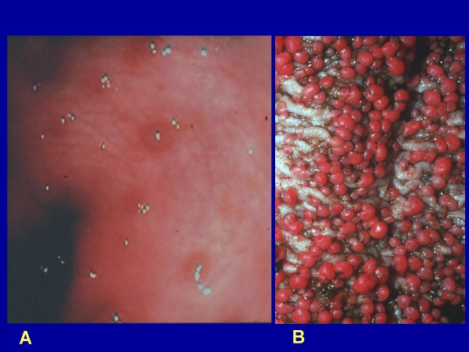
Familial adenomatous polyposis
Menzel, 1721: Multiple colorectal polypous lesions
Corvisart, 1824: Hypertrofic features in
a sample of a 22-year old man with more than 20 „protrusions“ of colon ascendens
Lockhart-Mummery, Dukes, 1925, Lancet: „Cancer and heredity“
Endoscopic findings in APC

Slide 35
Familial adenomatous polyposis
occurence of more than 100 adenomatous polyps of large intestine (or less in younger age)
onset of polyp formation around 15 years, at 35 years in 95% of patients
high risk of colorectal carcinoma, often multiple carcinomas, at a very early age
penetrance of the disease near 100% until 50 years!!!
APC gene – classical/attenuated form (AD),
MUTYH gene (MYH-asociated polyposis) (AR)
other associated malignacies (desmoid tumors, hepatoblastoma)

Slide 36
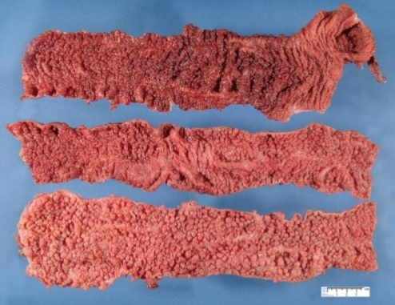
Macroscopic pathological sample of the large intestine affected by APC

Slide 37
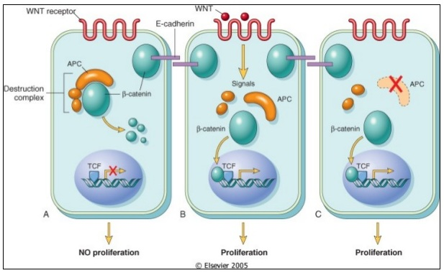
APC gene
tumor-supressor gene
Wnt/ beta-katenin signal pathway inhibition
plays a role in
cell adhesion, migration, chromosome segregation, apoptosis and neural differentiation

Slide 38
Indication for APC mutation screening
all forms of diffuse intestinal adenomatous polyposis
predictive testing can be performed at any age , even in children!
If there is a clinical suspicion for APC, all first degree relatives should undergo colonoscopy during the investigation og clinical (parents, siblings, in children aged 10-15 years sigmoideoscopy)

Slide 39
Dispensarisation of APC gene mutation carriers
sigmoideoscopy every 1-2 years, starting at 10-12 years, colonoscopy after formation of first polyps
If severe degree of polyposis is discovered, total colectomy or proctocolectomy is considered
gastroduodenoscopy starting at 25 years, according to clinical degree
USG investigation of abdomen 1/year in the first 10 years – heaptoblastoma screening
further investigations depending on family history

Slide 40
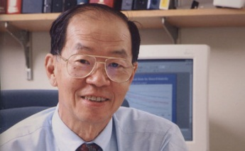

Li-Fraumeni syndrome
Joseph F., Fraumeni, Jr., MD. *1933 -
Frederick Pei Li, MD. 1940 - 2015
„Sarcomas of soft tissues, breast cancer and other neoplasms. A new familial syndrome?“ Ann Intern Med 1969

Slide 41
Li-Fraumeni syndrome
rare autosomal dominant cancer predisposition syndrome, 50% of individuals is affected by 40 years, up to 90% by 60 years of age
77% of malignancies belongs to these six types: breast cancer, sarkomas of soft tissues, osteosarcomas, brain tumors, adrenocortical carcinoma, and leukemias
increased frequency of other malignancies
classical LFS (TP53 gene mutations)
Li-Fraumeni-like syndrom (CHEK2 gene mutations)

Slide 42
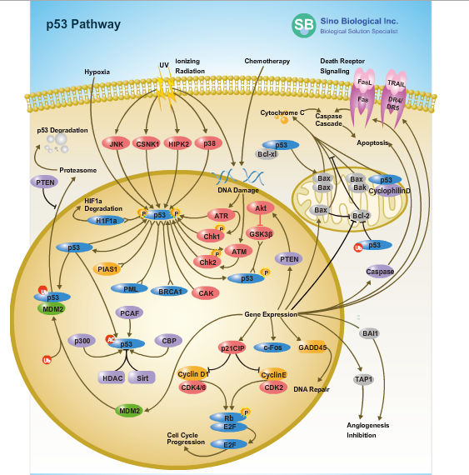
TP53 gene
„guardian of genome“
transcription factor responding to different forms of cellular stress
regulates target genes, inducing cell cycle arrest, apoptosis, DNA repair,, cell senescence and changes in metabolism
regulated by a list of
up- and downstream genes

Slide 43
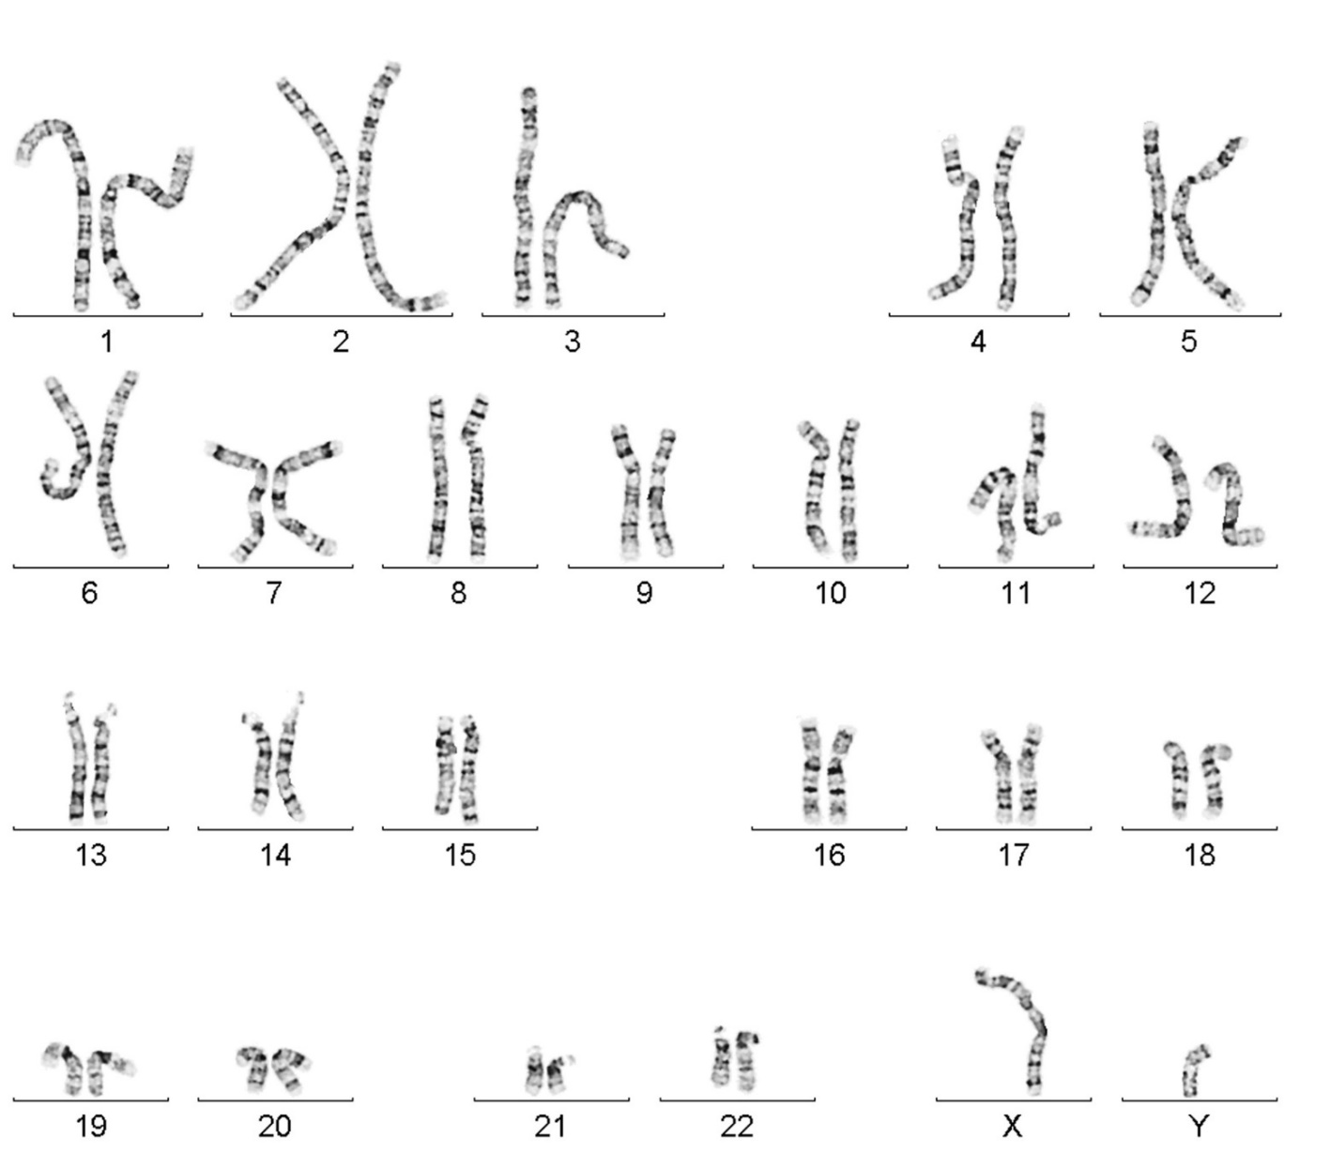
short arm of
chromosome 17

Slide 44
TP53 mutation screening criteria
(modified Li-Fraumeni syndrome criteria by Chompret)
proband with a tumor of the LFS spectrum under 46 years plus at least one first- or second degree rleative with a LFS-associated tumor
proband with multiple tu,mors, out of which at least two belong to the LFS-associated tumors, first of which was diagnosed under 46 years
Proband with adrenocortical carcinoma or a patient with breast cancer diagnosed under 36 years, without a BRCA1 or BRCA2 gene mutation, regardless of family history

Slide 45
Selected dysmorphic syndromes associated with increased risk of malignancies
Syndrome
Gene
Asociované neoplazie
Sotos syndrom
NSD1
leukemias, lymphomas
FANCA, FANCC, FANCD and other
hematological malignancies
(MDS, leukemias)
Fanconi anemia
Ataxia teleangiectasia
ATM
chronic lymfocytic leukemia, lymphomas of childhood
Nijmegen Breakage Syndrome
lymphomas (Burkitt lymphoma, DLBCL),
breast cancer
NBS
Bloom syndrome
BLM
Non-Hodgin lymphomas, breast cancer

Slide 46

Sotos syndrome

Slide 47
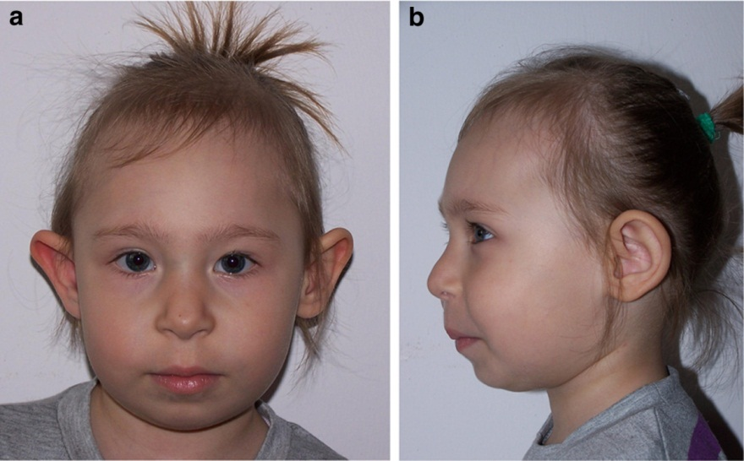
Nijmegen Breakage Syndrome

Slide 48

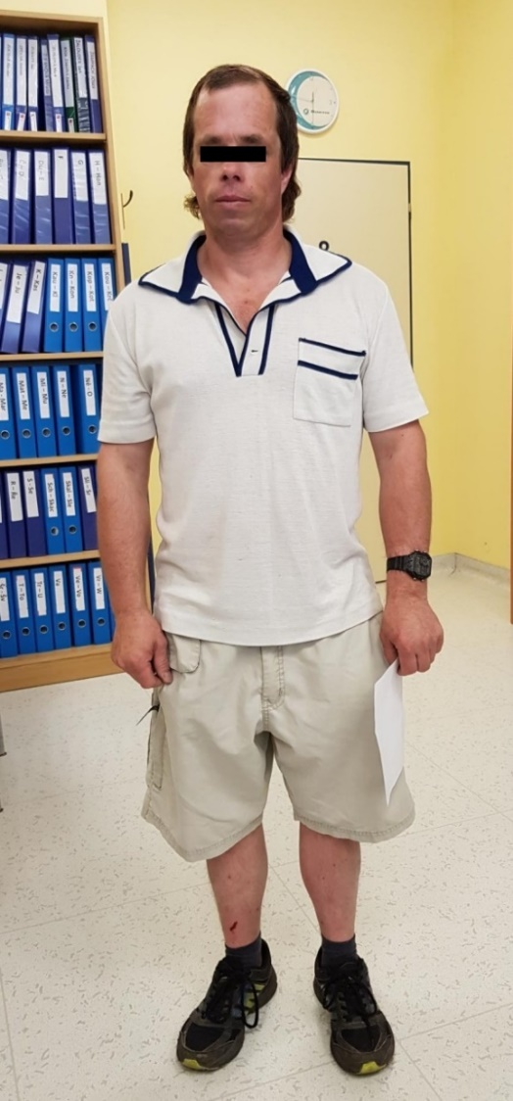
Bloom syndrome

Slide 49
?
?
Colorectal Ca Kidney Ca
Lung Ca
Obligate carriers
Bone tumor
Breast Ca
Affected patients
Recurrent lymphoma
Tested individuals

