Slide 1
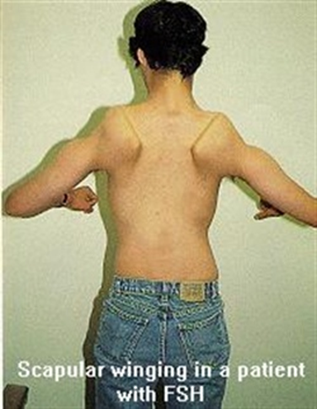
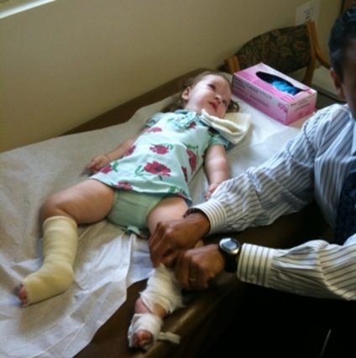
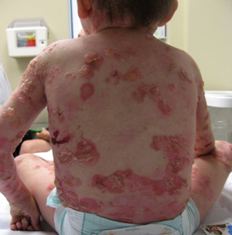
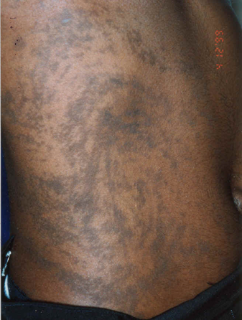
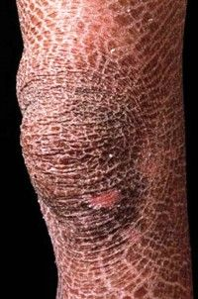
University Hospital Brno
Centre of molecular biology and genetics
Department of inherited genetic disorders
Molecular genetic diagnostics of monogenic diseases
Neuromuscular diseases
Epilepsies
Skin diseases
Connective tissue diseases
Metabolic diseases

Slide 2
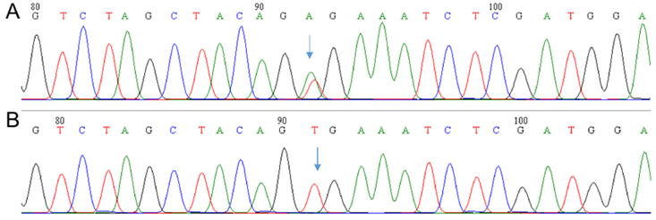
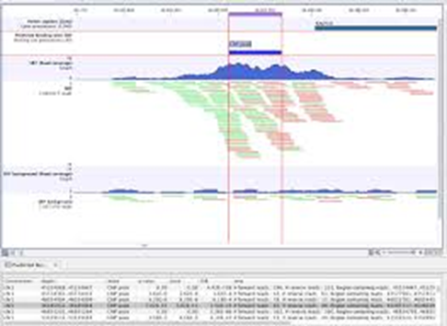
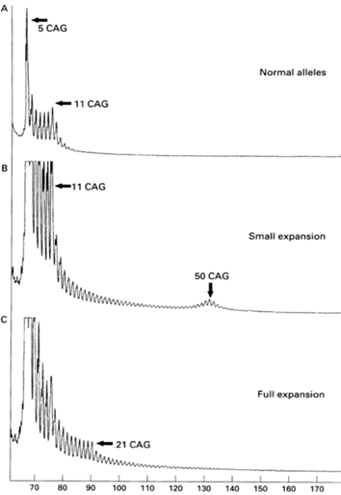
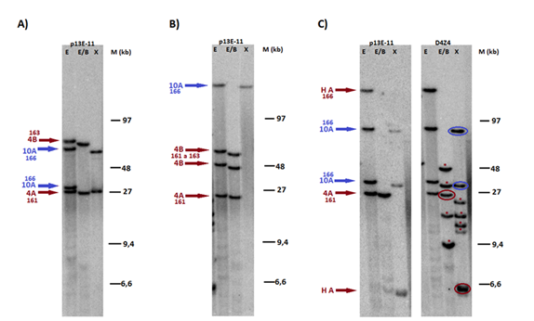
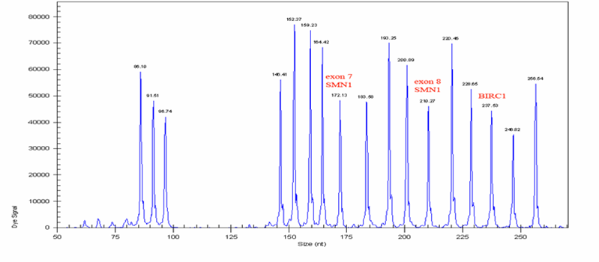
Methodological approaches used
Classic sequencing (identification of small scale variants)
Next generation sequencig (identification of small scale variants, large deletions/duplications)
Multiple ligation dependent probe amplification (identification of large deletions/duplications)
Repeat-primed PCR (identification of repeat expansions)
Southern blot and hybridisation (identification of repeat expansions/deletions)

Slide 3

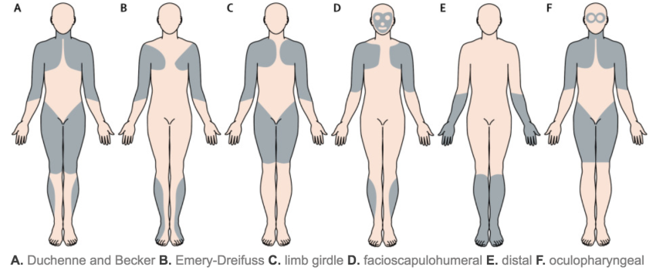
Two monogenic diseases for presentation of different approaches in molecular genetic diagnostics
Phenylketonuria – the disease in which the gene for molecular genetic diagnostics is determined on the basis of biochemical findings
Muscular dystrophy – the disease encompasing different types of muscular disorders; biochemical and other findings are mostly not specific enough for detemination of a specific types and so a gene for molecular genetic diagnostics

Slide 4
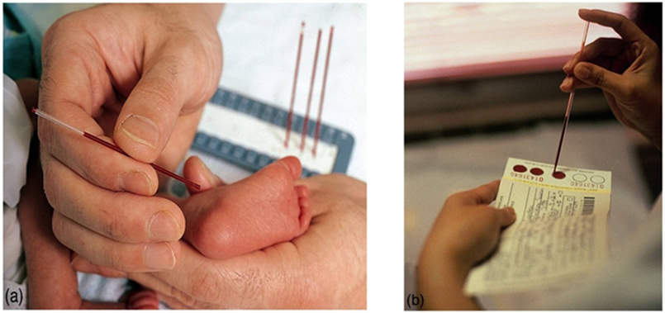
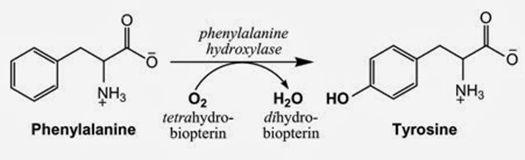
Phenylketonuria (PKU)
Diagnosed by newborn screening, on the basis of increased phenylalanine and the ratio phenylalanine/tyrosine
Increased Phe and Phe/Tyr is the indicator for DNA analysis of the PAH gene encoding the phenylalaninhydroxylase
In 98% of cases, two pathogenic variants in the PAH gene are identified.

Slide 5

Muscular dystrophies and myopathies
To date, 162 genes associated with clinical manifestation of muscular dystrophy/myopathy have been described.
Clinical, biochemical, pathological,…. findings are mostly not specific enough for selection of a gene for molecular genetic analysis
Which gene to analyse?
How was the question solved before – genes were analysed sequentially by classical DNA sequencing, starting with a gene with the most likely mutation occurence, in case of a negative result another gene was selected ….. TIME AND FINANCIALLY CONSUMING and only a certain number of selected genes were analysed.
How is the question solved now – all genes associated with the disease are analysed at the same time (in parallel) by next generation sequencing (NGS) … FAST AND RELATIVELY CHEAP

Slide 6
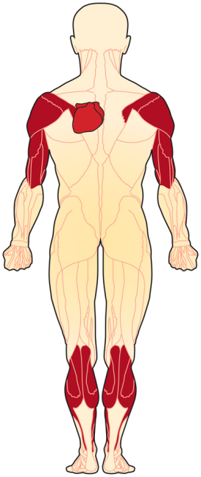
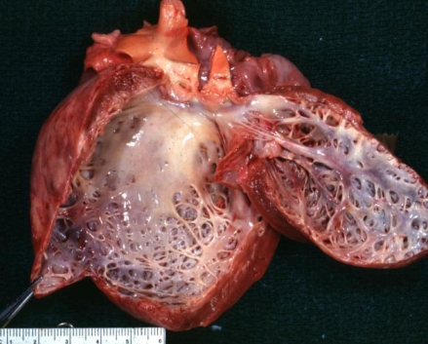
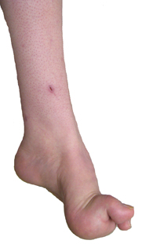
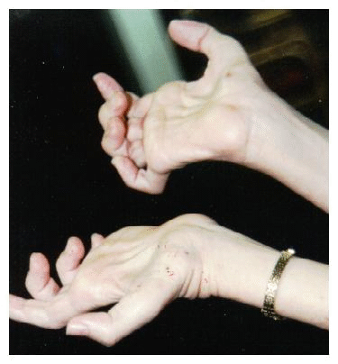
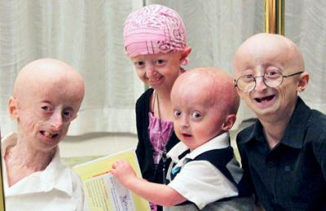
Muscular dystrophies/myopaties are characterised by clinical heterogeneity
Pathogenic sequence variants in 1 gene cause several types of muscle diseases; example: LMNA, lamin A/C (protein localised in nuclear envelope)
1. Cardiomyopathy, dilated, 1A 2. Charcot-Marie-Tooth disease, type 2B1 3. Emery-Dreifuss muscular dystrophy 2, AD 4. Emery-Dreifuss muscular dystrophy 3, AR 5. Hutchinson-Gilford progeria 6. Heart-hand syndrome, Slovenian type 7. Lipodystrophy, familial partial, 2 8. Malouf syndrome 9. Mandibuloacral dysplasia 10. Muscular dystrophy, congenital 11. Muscular dystrophy, limb-girdle, type 1B 12. Restrictive dermopathy, lethal
www.wikidoc.org/index.php/Dilated_cardiomyopathy
http://dxline.info/diseases/charcot-marie-tooth-disease
http://neuromuscular.wustl.edu/time/hmsn.html
http://scientia1.files.wordpress.com/2013/01/progeria.jpg
http://www.omim.org/

Slide 7
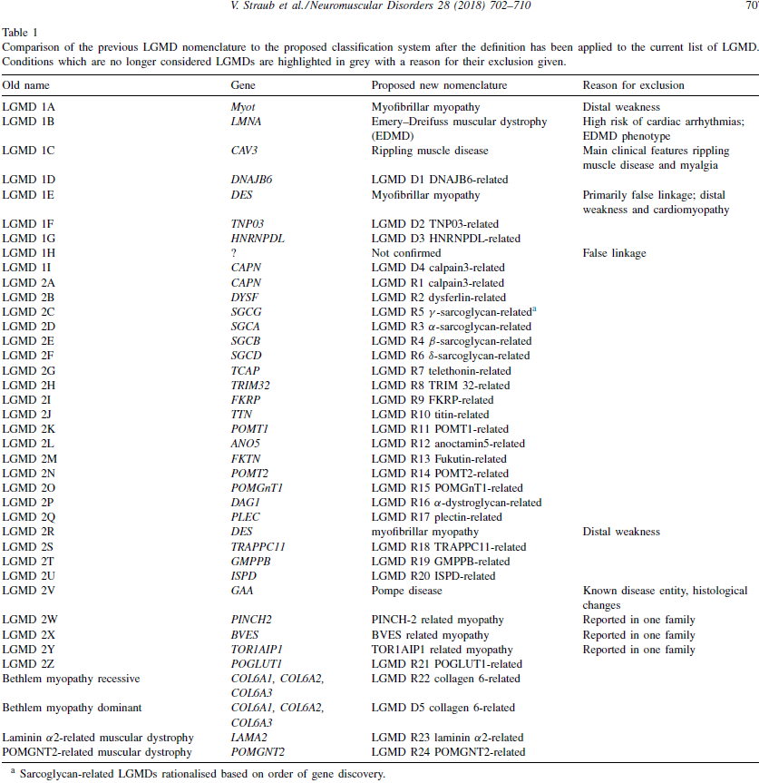
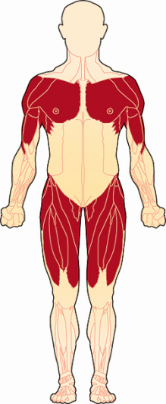
Muscular dystrophies/myopaties are characterised by genetic heterogeneity
One type of disease is caused by pathogenic variants in 1 from several possible genes
Example: LGMD – 29 genes associated with LGMD have been described so far.

Slide 8
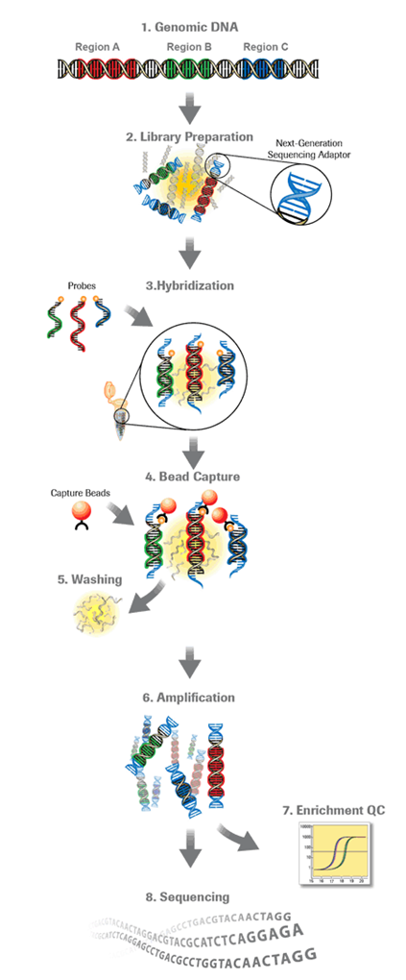
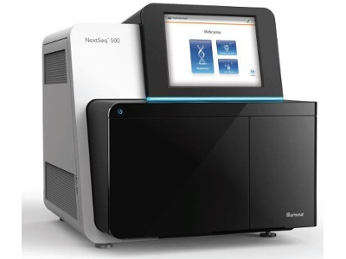
Molecular genetic diagnostic of muscular dytrophies /myopathies: targeted NGS is a rapid and cost-effective way to detect variants in selected sets of genes or gene regions.
Principle:
DNA samples are converted into sequencing libraries – DNA is randomly sheared into smaller fragments by mechanical or enzymatic methods, adapters for sequencing and multiplexing are added to DNA ends (multiplexing enables analysis of more DNA samples in one sequencing run)
Regions of interest within the library are captured using biotinylated oligonucleotide probes. These probes are designed to hybridize to regions of interest.
After hybridization of probes to fragmented DNA, streptavidin-bound magnetic beads are used to separate the probe-targeted fragment complex from other fragments that are not bound to probes.
Amplification of targeted regions
NGS of targeted regions

Slide 9
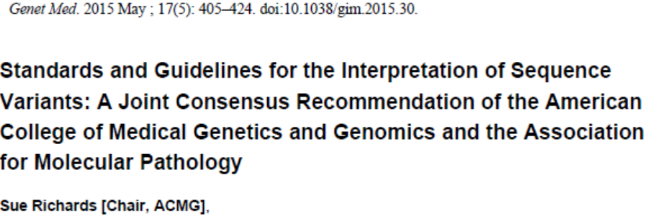
NGS generates a large number of sequence variants → these variants need to be interpreted → each identified variant should be assigned to one of five classes.
Benign sequence variants
Likely benign sequence varints
Sequence variants of uncertain significance
Likely pathogenic sequence variants
Pathogenic sequence variants

Slide 10

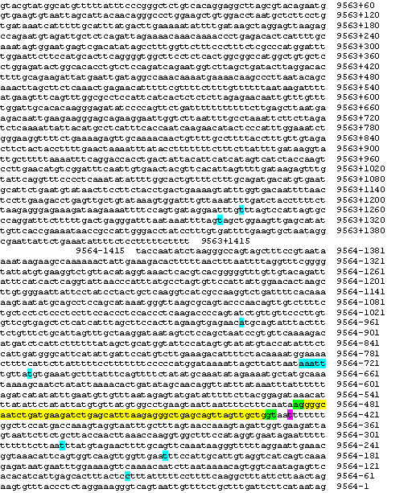
Case study: the need to combine DNA and mRNA diagnostics
Patient with suspected Duchenne muscular dystrophy (DMD gene, Xp21)
Pathological analysis: dystrophin deficiency in muscle tissue
Molecular genetic analysis:
DNA analysis: no pathogenic variants identified
mRNA analysis of the DMD gene: a pathogenic variant identified (the insertion of 53 nt. from intron 65 into mRNA)
On the basis of mRNA results, DNA analysis of intron 65 performed: pathogenic variant deep inside of the intron 65 identified; this results in insertion of a part of intron sequence into the dystrophin mRNA
c.9564-427T>G

Slide 11


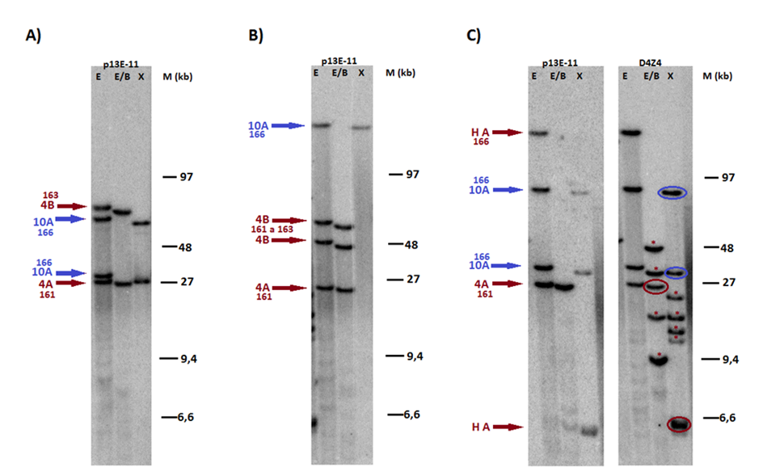
Muscular dystrophies/myopathies – molecular genetic diagnostics
Overall 162 genes
159 genes
2 genes
1 gene
MD1, MD2
FSHD
NGS
Identification of small scale pathogenic variants, large gene deletions / duplications
Repeat primed-PCR
Identification of repeat expansions
Souther blot + hybridisation
Identification of repeat deletions

Slide 12
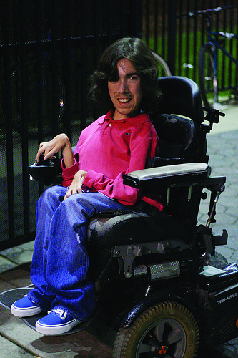
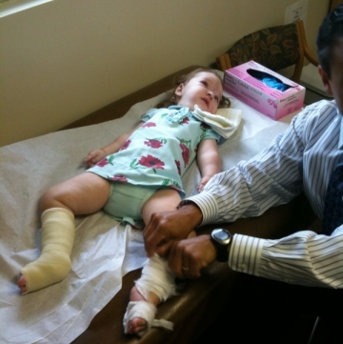
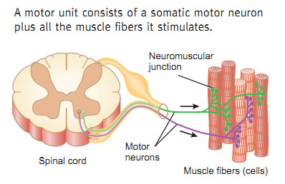
Spinal muscular atrophy (SMA)
Autosomal recesive disease
Incidence: 1 in 6,000 - 10,000 live births
Carrier frequency: 1 in 40 - 60
The second most frequent fatal disease with autosomal recesive inheritance (after cystic fibrosis)
Characterised by degeneration of alpha motor neurons

Slide 13
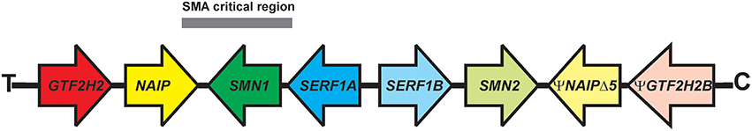
95% of SMA is caused by homozygous deletion of the SMN1 gene (Survival of Motor Neuron 1).
SMN1 is located on the chromosome region 5q12-5q13.38 containing 500-kb inverted duplication→ SMN1 has its almost identical copy – the SMN2 gene.
SMN1 and SMN2 are homologous to except for few nucleotides.
The is copy number variation of SMN1 and SMN2 in human genom.

Slide 14
Based on the age of onset and clinical course, 4 clinical types of SMA are distinguished:
Type I – characterised by severe muscle weakness and hypotonia at birth or within the first 6 months; death from respiratory failure occurs usually within the first 2 years.
Type II – first symptoms begin 6-18 months after birth and life expectancy is 2-30 years; patients are able to sit but unable to walk independently.
Type III - first symptoms are typically observed after 2 years of life; patients are able to walk but often are wheelchair-bound within or after adolescence.
Type IV - symptoms appear in adulthood; patients have mild motor impairment.

Slide 15
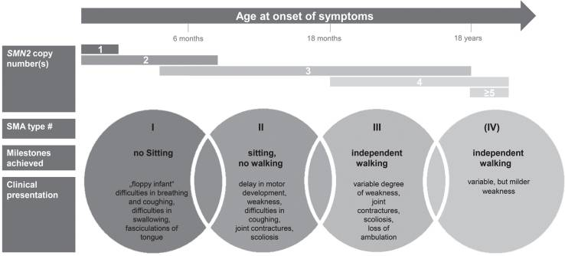
95% of SMA (regardless of the type) is caused by the homozygous deletion of the SMN1 gene.
Clinical severity is modified by copy number the SMN2 gene.
Clinical classification of SMA types according to onset, milestones achieved, and clinical presentation. Typically associated SMN2 copy numbers are displayed.
Schorling DC, J Neuromuscul Dis. 2020; 7(1): 1–13.

Slide 16
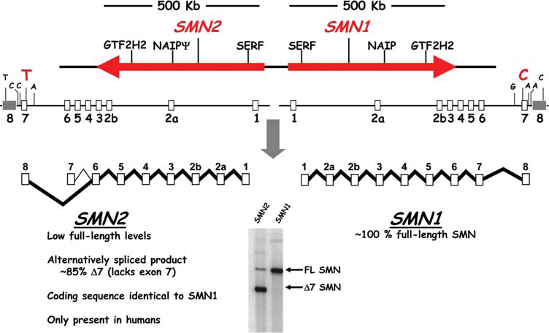
Human Molecular Genetics, 2010
SMN1: TTC (Phe)
SMN2: TTT (Phe)
SMN1 and SMN2 are located in close proximity on chromosome 5. Both SMN genes have 9 exons and encode an identical protein. Fundamental difference between SMN1 and SMN2 is a silent C→T substitution in exon 7 of SMN2, which results in a strong reduction of exon 7 inclusion during mRNA splicing. Consequently, 85% of the mature mRNA from SMN2 lacks exon 7 and encodes truncated unstable protein.

Slide 17
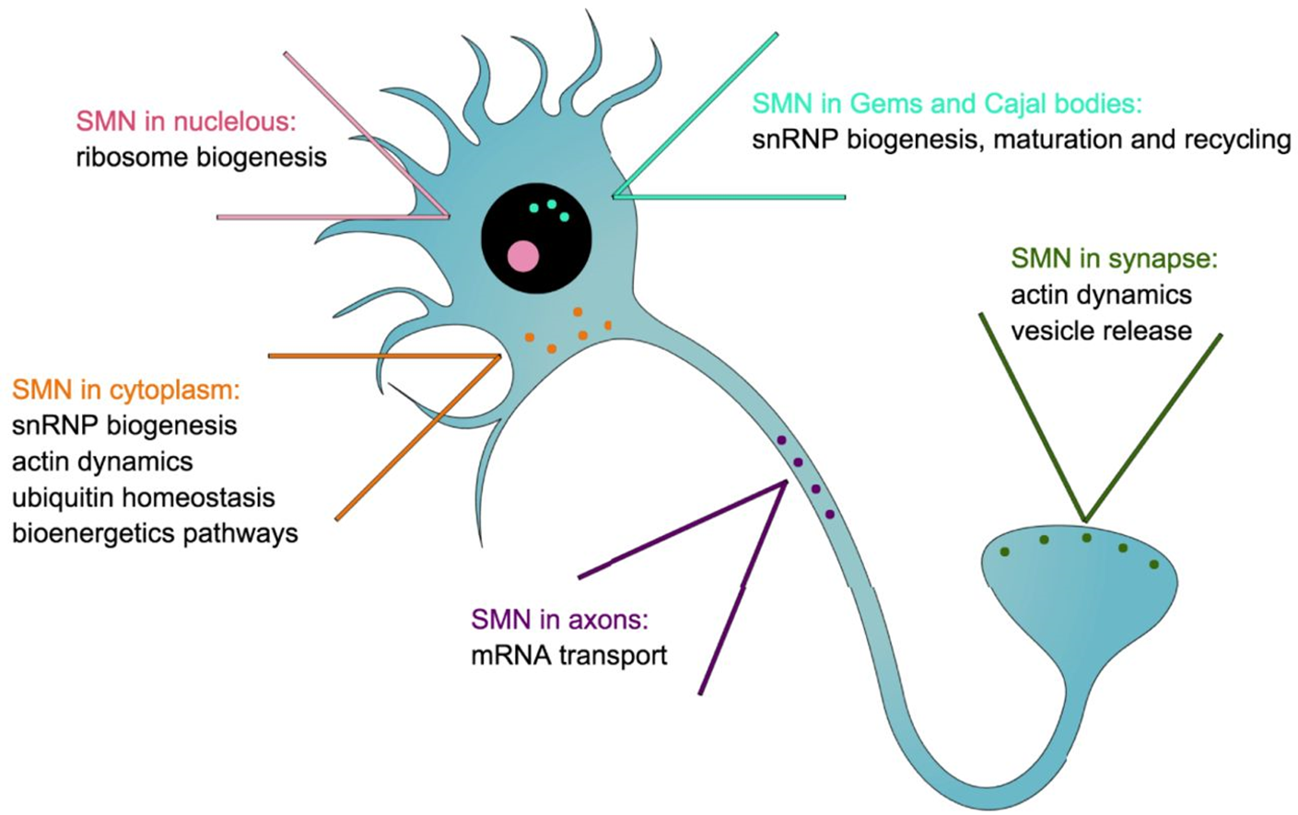
The SMN protein is expressed ubiquitously.
In motor neurons, SMN has several functions:
in cytoplasm - production of small nuclear ribonucleoproteins (snRNPs are active in recognizing and removing introns from pre-mRNA) and actin dynamics,
in nucleus - snRNP biogenesis,
in nucleolus - ribosome biogenesis,
in axons - mRNA transport and local translation,
in the synpase - actin dynamics and vesicle release.
Bowerman M. Dis. Model. Mech. 2017;10:943-954

Slide 18
Model for motoneuron degeneration in SMA
Motoneuron loss observed in post mortem analyses is preceded by functional degeneration of central synapses and neuromuscular junctions and subsequent axonal damage.
During disease progression those processes become less reversible. The complete loss of motoneuron is a irreversible change.
The beneficial effects of SMA therapies are dependent on disease duration at the time of intervention. Disease duration before treatment is critical and a delayed intervention leads to a less efficient rescue. The effect of SMA therapies is strongest in pre-symptomatic patients.
Hensel N. Frontiers in Neurology 2020 Vol 11

Slide 19
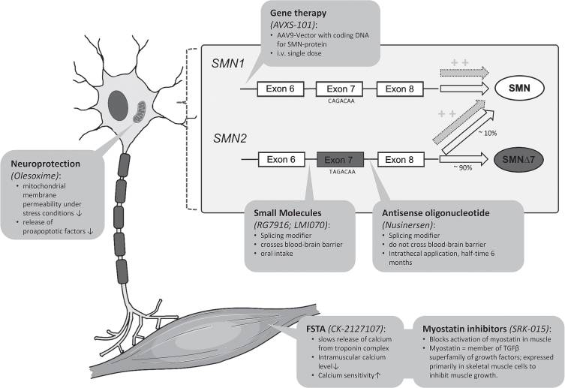
Figure summarizes SMA therapeutic approaches and illustrates the respective molecular mechanisms of action. Actual SMA therapeutic developments can be subdivided into therapies (1) modifying splicing of SMN2 (production of more amount of full length mRNA), (2) replacing the SMN1 gene, and (3) upregulating muscle growth.
Schorling DC, J Neuromuscul Dis. 2020; 7(1): 1–13.

Slide 20

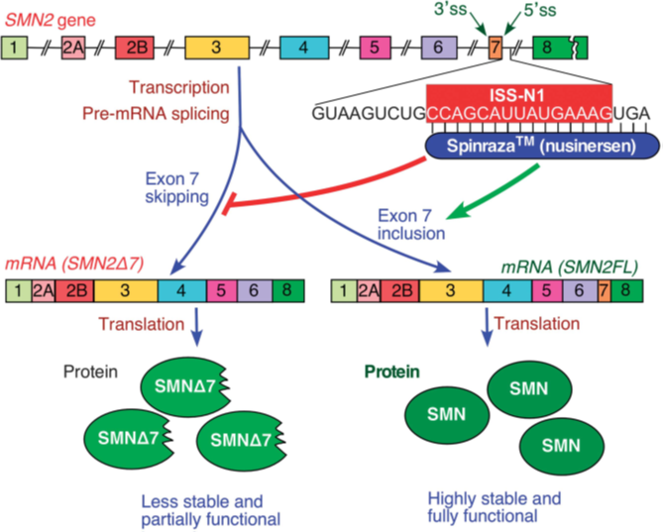
The first drug approved for SMA treatment was Spinraza (Nusinersen), an antisense-oligonucleotide (ASO) that enhances the inclusion of exon 7 in mRNA transcripts of SMN2.
Spinraza binds to an intronic splice-silencing-site in intron 7 of SMN2 and thereby suppresses the binding of other splice-factors.
This results in an increased proportion of SMN2-mRNA with included exon 7 and consecutively more functional full-length SMN protein.
Spinraza was approved by the Federal Drug Agency (FDA) in 2016.
Spinraza is administered intrathecally, does not cross blood-brain barrier.
Singh NN, Gene Therapy (2017) 24, 520–526

Slide 21
The most advanced approach in the treatment of SMA is gene therapy, which directly targets the dysfunctional SMN1 gene.
In 2019, the FDA approved Zolgensma (Onasemnogene Abeparvovec), an adeno-associated virus 9 (AAV9) delivering a cDNA which codes the full length SMN protein, as a gene replacement therapy.
Zolgensma (AVXS-101) was approved for intravenous application in patients with SMA under 2 years of age; intrathecal applications will be studied in children aged 2-6 years. The AAV9 crosses the blood-brain barrier which induces SMN expression in the CNS and in peripheral organs.
.
Schorling DC, J Neuromuscul Dis. 2020; 7(1): 1–13.

Slide 22
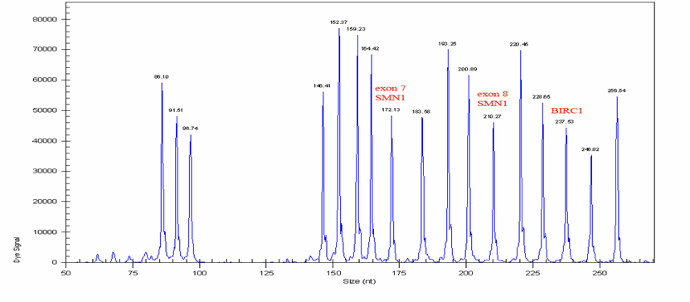
95% of SMA patients have homozygous deletion of the SMN1 gene.
5% of patients have deletion of the SMN1 gene on one chromosome and a small scale pathogenic variant on the second one.
The basic methodical approach in SMA molecular genetic diagnostics is MLPA (multiple ligation dependent probe amplification), which determines the copy number of SMN1 and SMN2 for identification:
patients with homozygous SMN1 deletion,
patients with heterozygous SMN1 deletion; subsequently SMN1 is sequenced for identification of second pathogenic variant,
heterozygous carriers of SMN1 deletion,
SMN2 copy number for determination of presumed SMA type and suitability of treatment.

Slide 23
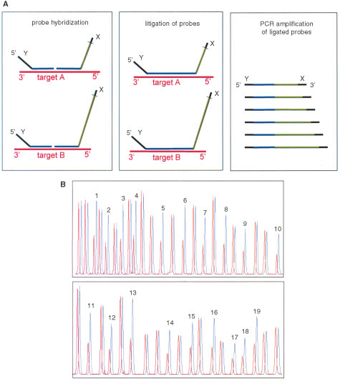
Multiplex Ligation-dependent Probe Amplification (MLPA)
Denatured genomic DNA is hybridised with a mixture of probes.
Each MLPA probe consists of two oligonucleotides. The two parts of each probe hybridise to adjacent target sequences and are ligated by a ligase.
All probe ligation products are amplified simultaneously by PCR using a single primer pair labeled with a fluorescence mark. The amplification product of each probe has a unique length.
Amplification products are separated by capillary electrophoresis.
Relative amounts of probe amplification products reflect the relative copy number of target sequences.

Slide 24
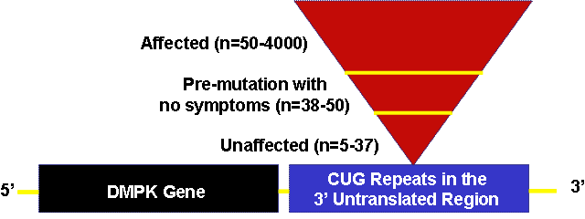
Myotonic dystrophy type 1; MD1
MD1 is caused by expansion of the CTG repeat in the 3’UTR of the dystrophia myotonica protein kinase gene (DMPK, 19q13.3),
AD inheritance
Individuals with 5 to 37 repeats are unaffected.
Individuals with 38-50 repeats carry the premutation. These individuals are asymptomatic. However, these repeats are unstable and can expand during meiosis. As a result, such individuals are at risk of having affected children.
~ 50 to 150 repeats are consistent with the mild adult-onset form of MD1,
~ 100 to 1000 repeats are consistent with the classic adult or childhood
onset form of MD1,
> 1000 repeats are consistent with the congenital form of MD1 and often
result in severe neonatal complications.

Slide 25
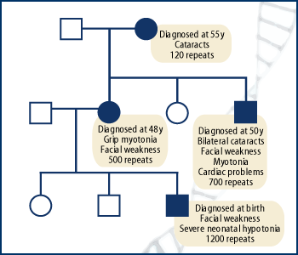
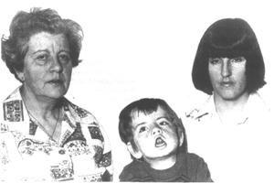
The expanded CTG repeat - dynamic mutation - the number of repeats tends to increase in size over generations.
Expansion of the CTG repeats commonly occurs during meiosis. As a result, children of affected individuals tend to have severe symptoms and earlier onset than their parents.

Slide 26
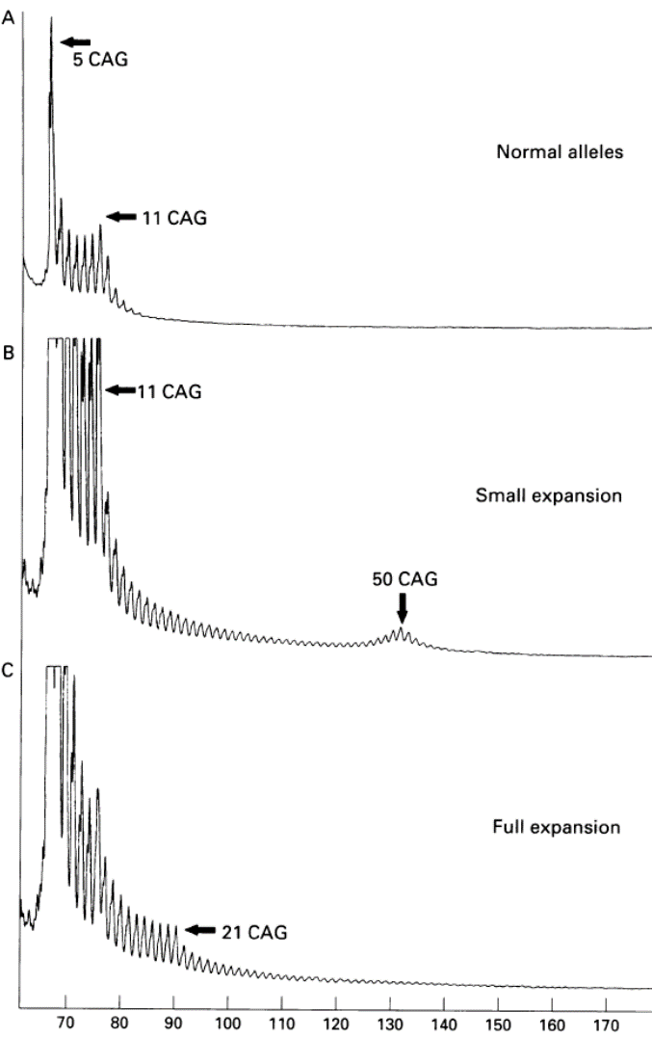
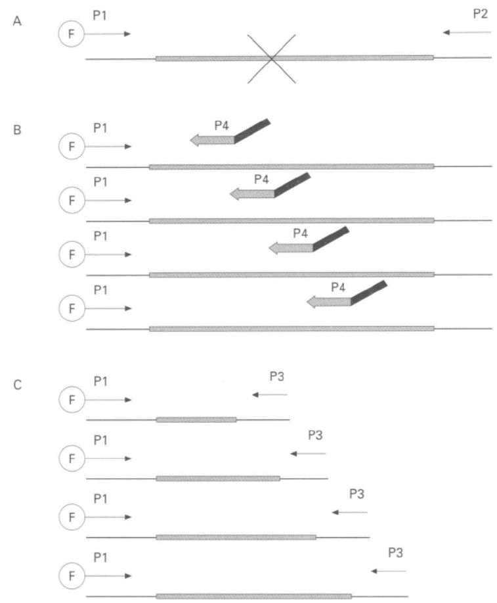
The repeat primed PCR (RP-PCR) uses three primers: one that is fluoresceinated and flanks the repeat region (P1-F), a second that is complementary to the repeat but carries a nonspecific tail sequence (P4), and a third that is complementary to the nonspecific tail sequence (P3). RP-PCR produces a characteristic profile of amplicons of increasing length, which differ by the length of a repeat unit (3 bp), but of diminishing yield. This profile enables the rapid identification of a pathogenic repeat.
(CAG)n repeat

Slide 27
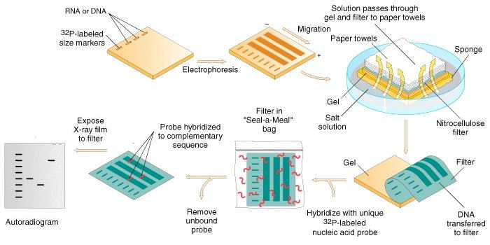
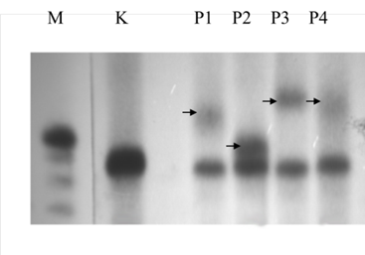
RP-PCR enables identification of a pathogenic repeat but not the size of the expansion.
The size can be determined by Southern blot a hybridizace.
DNA is
cleaved by a restriction endonuclease,
electrophoresed,
transfered to membrane (bounding of negative charged DNA to positive charged membrane is mostly used),
hybridised to a radioactive labeled probe,
after removing of a unbound probe autoradiography is performed

Slide 28
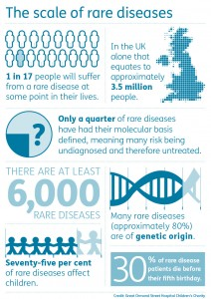
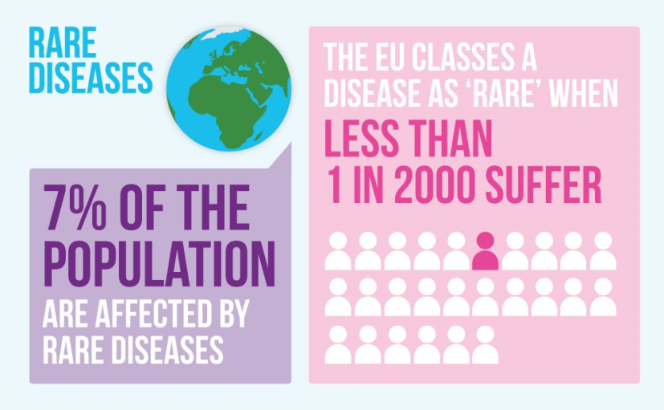
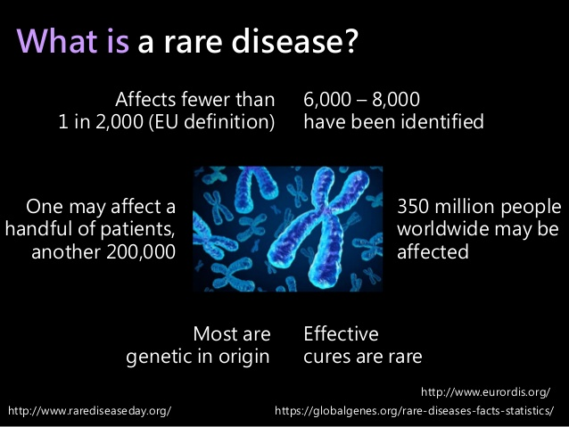
Molecular genetic diagnostics
the results must be interpreted with knowledge of the molecular nature of the disease and knowledge of the structure and function of encoded protein.
the results must be interpreted in relation to the patient 's phenotype and results of other patient examinations (biochemistry, pathology, NMR, EMG, etc.).
it is necessary to return to the results of already examined patients with an unconfirmed genetic diagnosis and test them with new techniques and perform new interpretations of the identified sequence variants.
it is necessary to participate in international quality control of DNA diagnostics for individual diseases.

