Slide 1
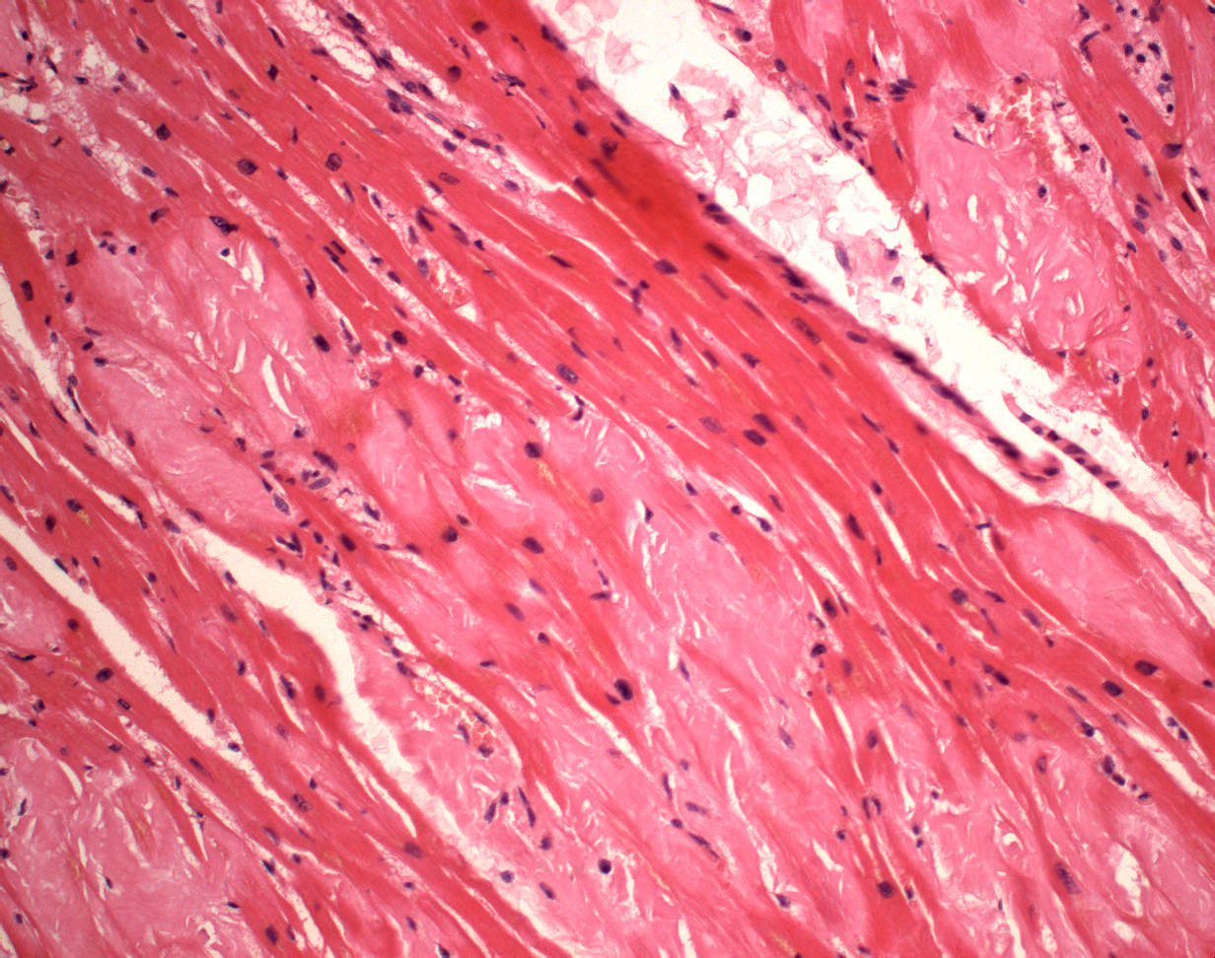
1. Myocardial amyloidosis
1
2
1
2
1 Normal cardiomyocytes
2 Pink masses of amyloid

Slide 2
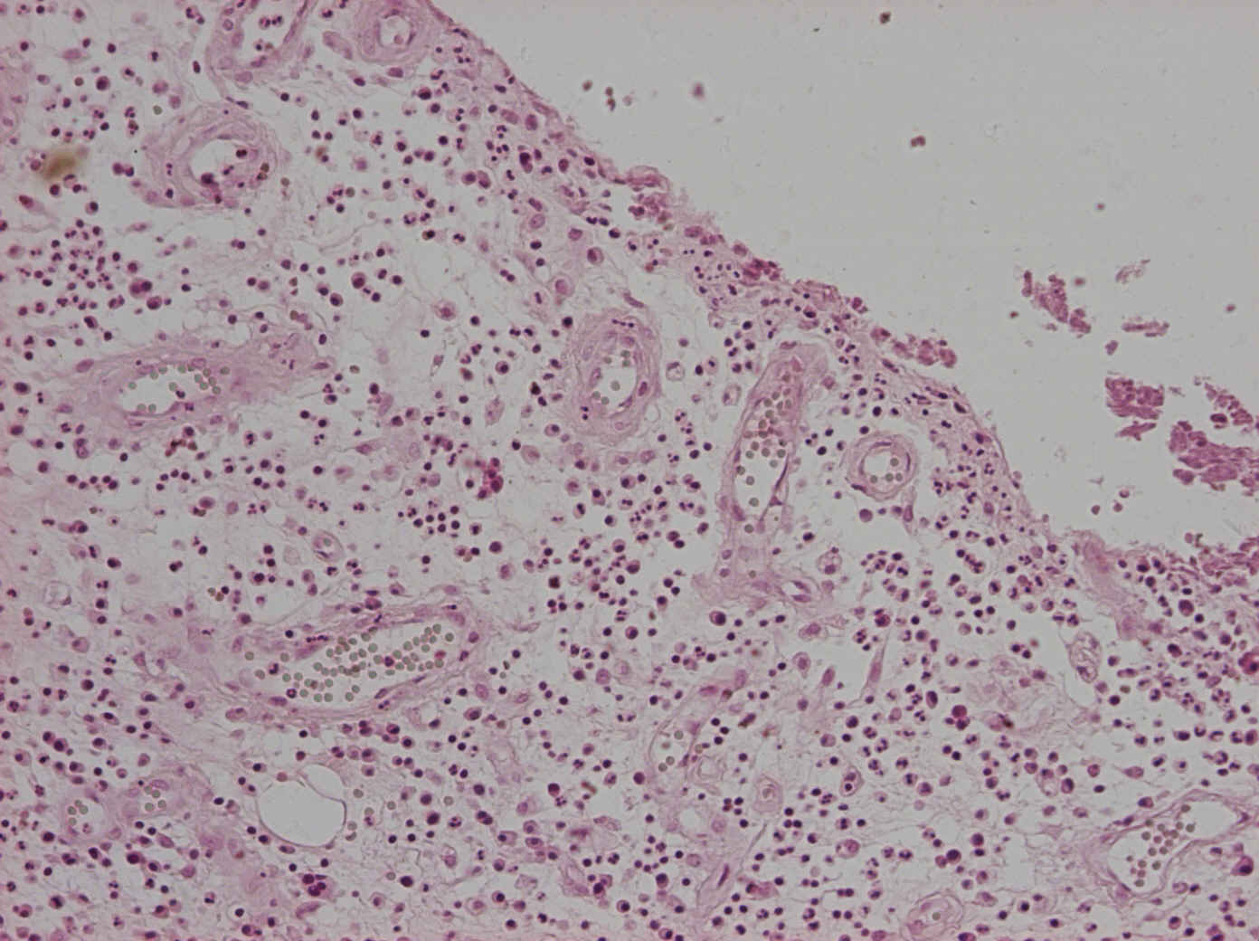
2. Granulation tissue
1
1
2
1
2
2
3
3
1 Surface
2 Proliferation of capillaries
3 Tissue with inflammatory cells

Slide 3
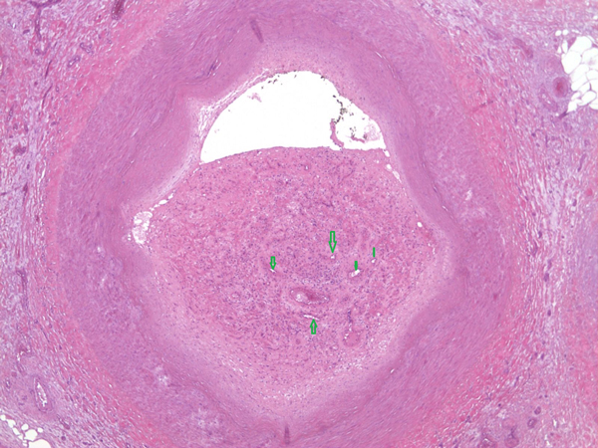
3. Organized thrombus
1
3
2
2
1 Arterial wall (a. tibialis ant.)
2 Capillaries
3 Structures of thrombus with collagen

Slide 4
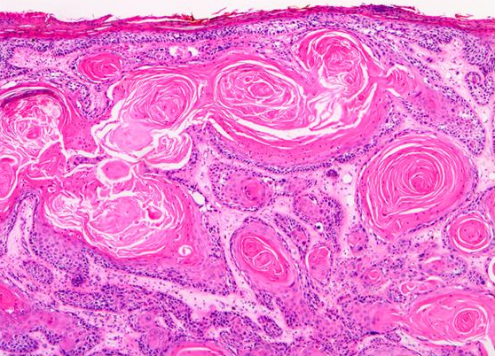
4. Squamous cell carcinoma
1
3
2
1 Cancroid pearls
2 Solid nests of tumorous keratinocytes
3 Stroma of the tumor

Slide 5
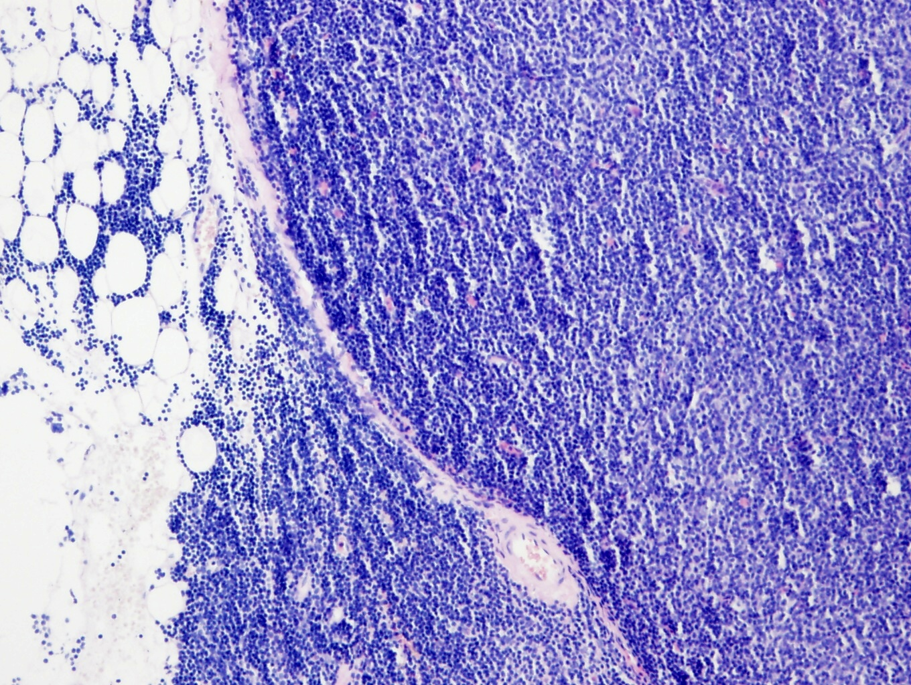
5. CLL/SLL
1
2
1 Diffuse infiltration in lymph node (mostly prolymphocytes and small lymphocytes – focally with pseudofollicles)
2 Infiltration of perinodal adipose tissue

Slide 6
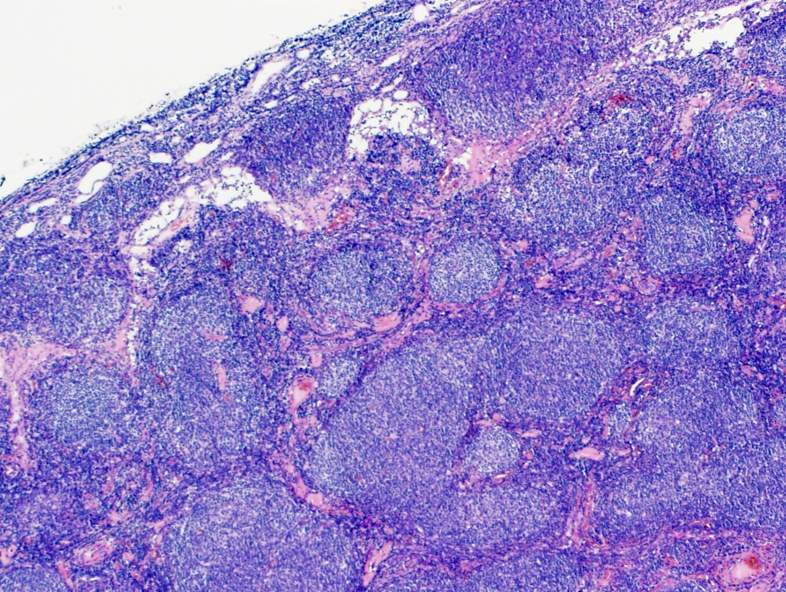
6. Follicular lymphoma
1
centroblasty
2
1
1
1 Nodules of neoplastic cells(centrocytes and centroblasts)
2 Dominantly non-neoplastic lymphocytes among nodules

Slide 7
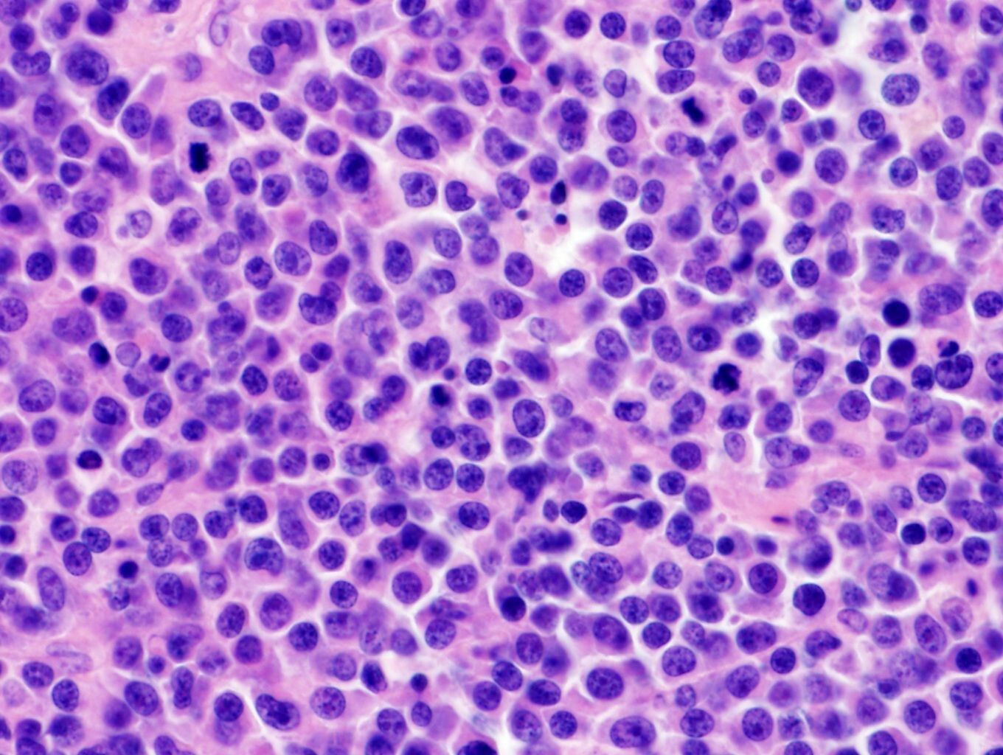
7. Diffuse large B-cell lymphoma (DLBCL)
1
1 Population of neoplastic cells (anaplastic centrocytes, centroblasts and immunoblasts)

Slide 8
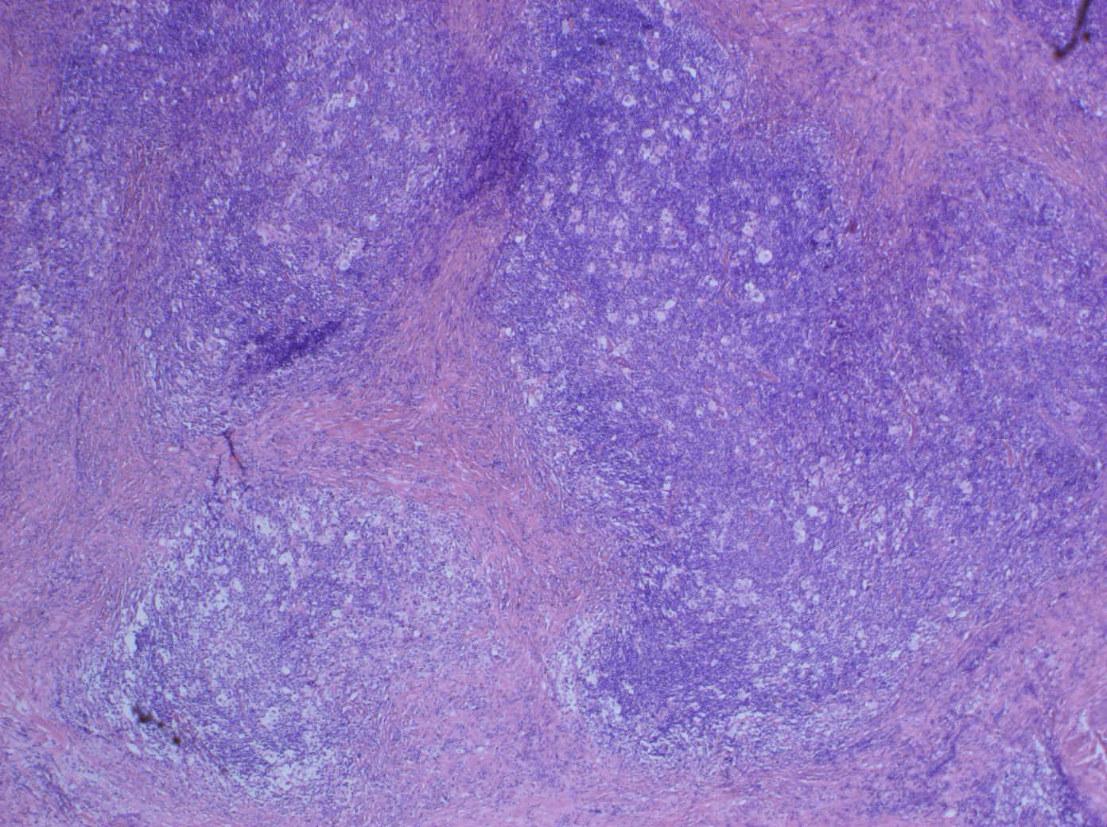
8. Hodgkin lymphoma, classical, nodular sclerosis
1
1 Lacunar cells in reactive non-neoplastic background

Slide 9
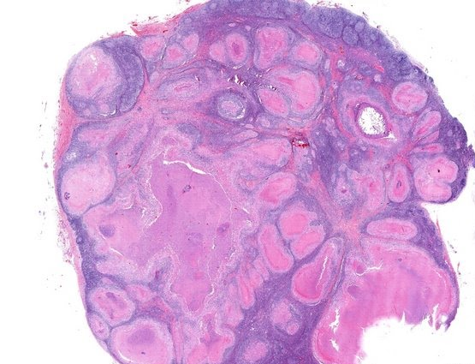
9. TBC lymphadenopathy
2
1
1 Tuberculous granulomas with central caseous necrosis
2 Remnant structures of lymph node with follicular hyperplasia with germinal centers

Slide 10
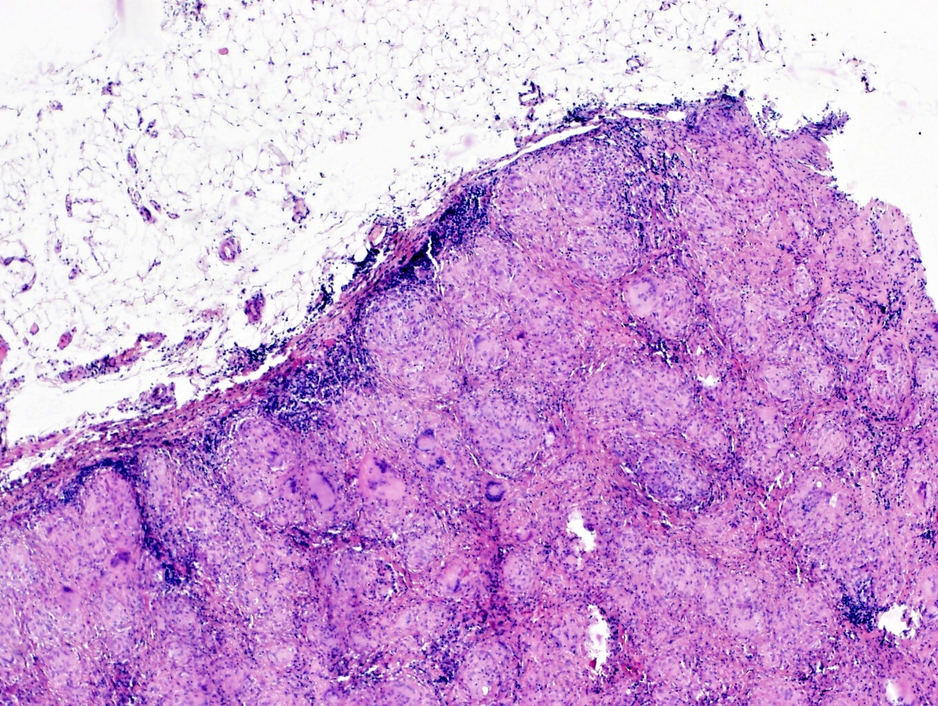
10. Sarcoidosis of lymph node
1
2
1
1 Non-caseous granulomas
2 Langhans cells

Slide 11
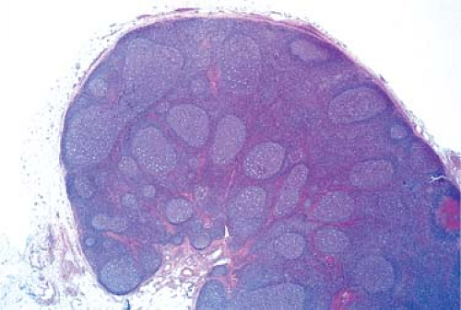
11. Reactive lympadenopathy
1
1 Structures of lymph node with follicular hyperplasia with germinal centers

Slide 12
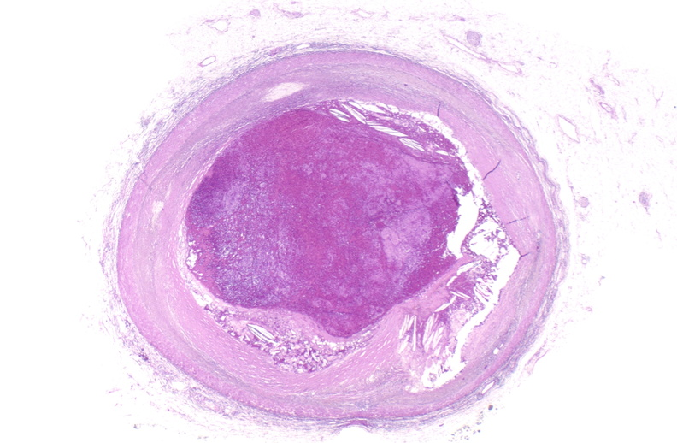
12. Atherosclerosis with mural thrombosis
3
2
1 Atheromatous plaque in intima
2 Cholesterol crystals
3 Organized thrombus
1

Slide 13
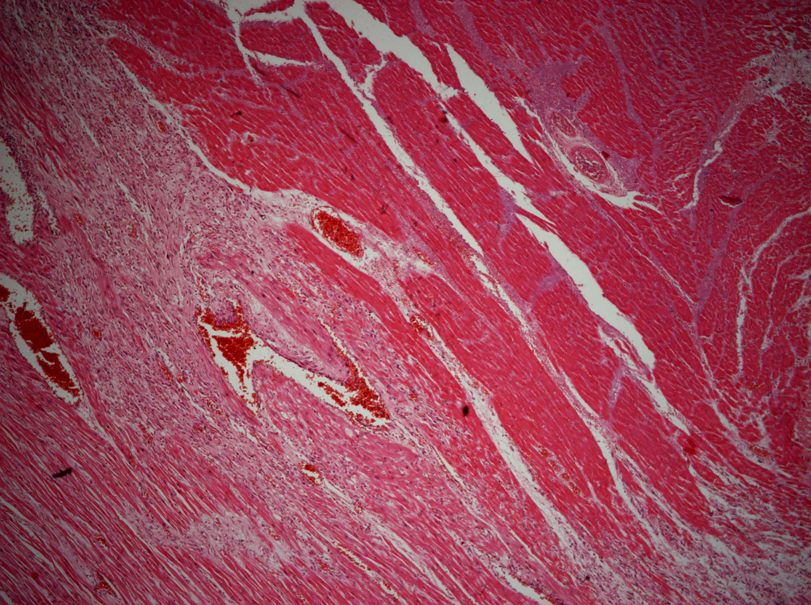
13. Myocardial infarction
1
3
1
2
1 coagulative necrosis
2 partial necrosis (myomalatia)
3 granulation tissue, inflammatory infiltrate

Slide 14
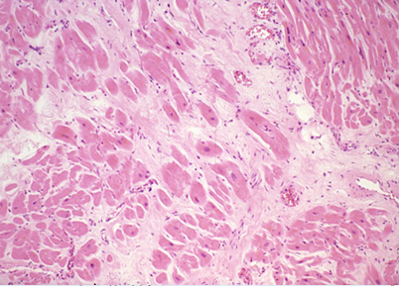
14. Dispersive myocardial myofibrosis
1
1
2
1 Myocardial replacement with low cellular collagen fibrosis
2 Hypertrofic cardiomyocytes

Slide 15
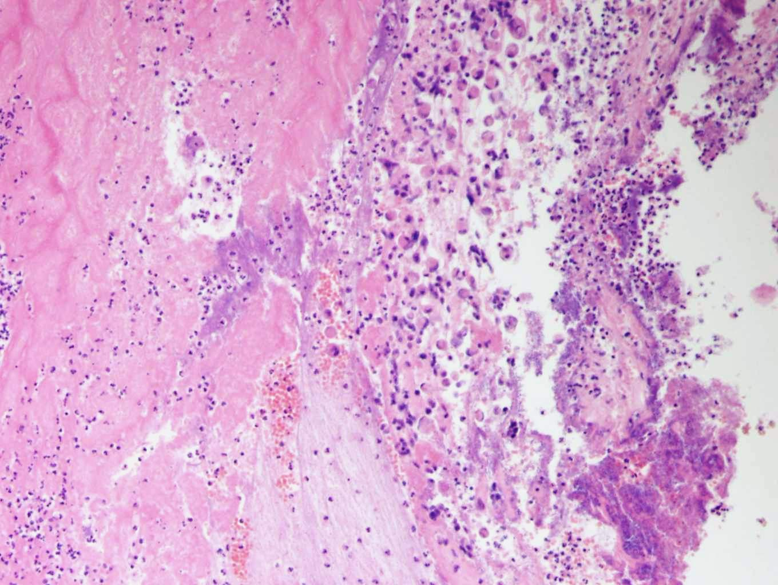
15. Acute infective endocarditis
2
3
1
1 Bacterial colonies
2 Thrombus
3 inflammatory infiltrate

Slide 16
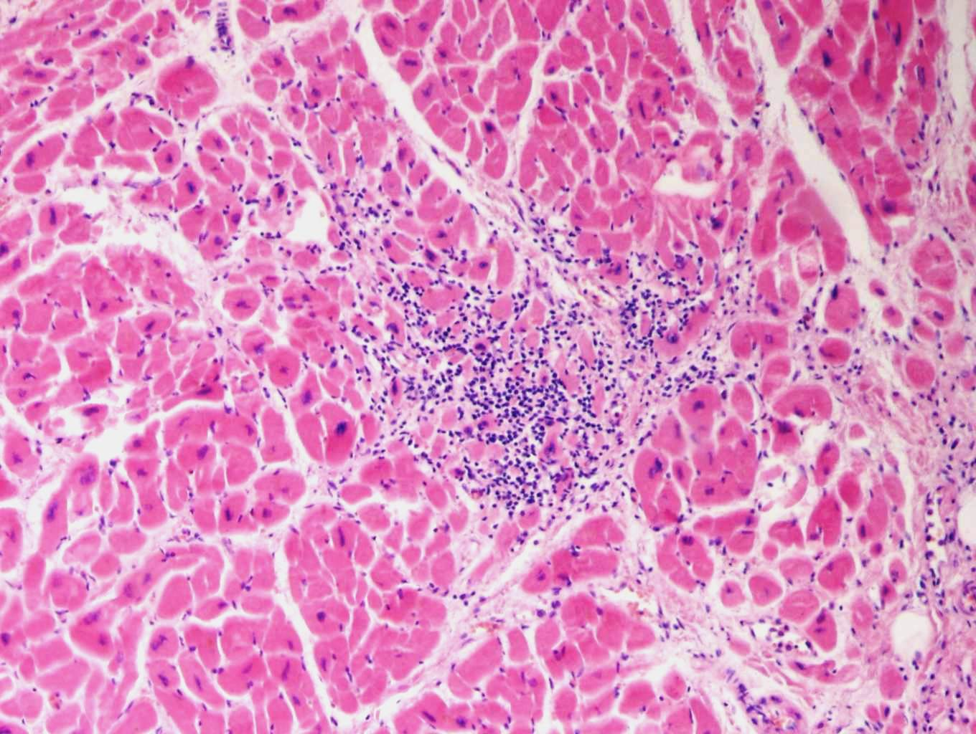
16. Viral myocarditis
1
2
1 Cardiomyocytes
2 Lymphocytic infiltrate in intersticium

Slide 17
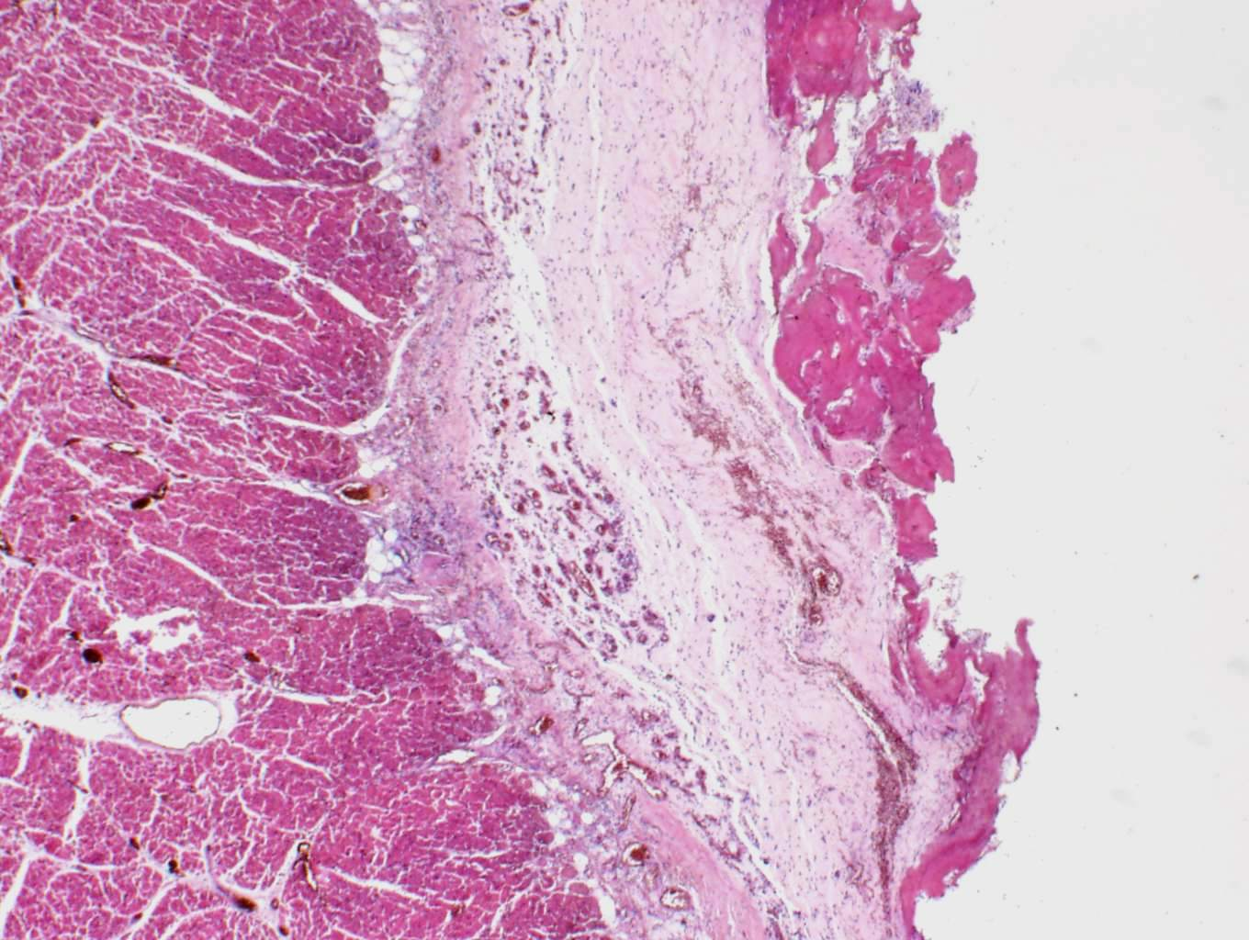
17. Fibrinous pericarditis
1
2
1
1 Fibrinous exudate (amorfous, eosinofilic masses)
2 Myocardium

Slide 18
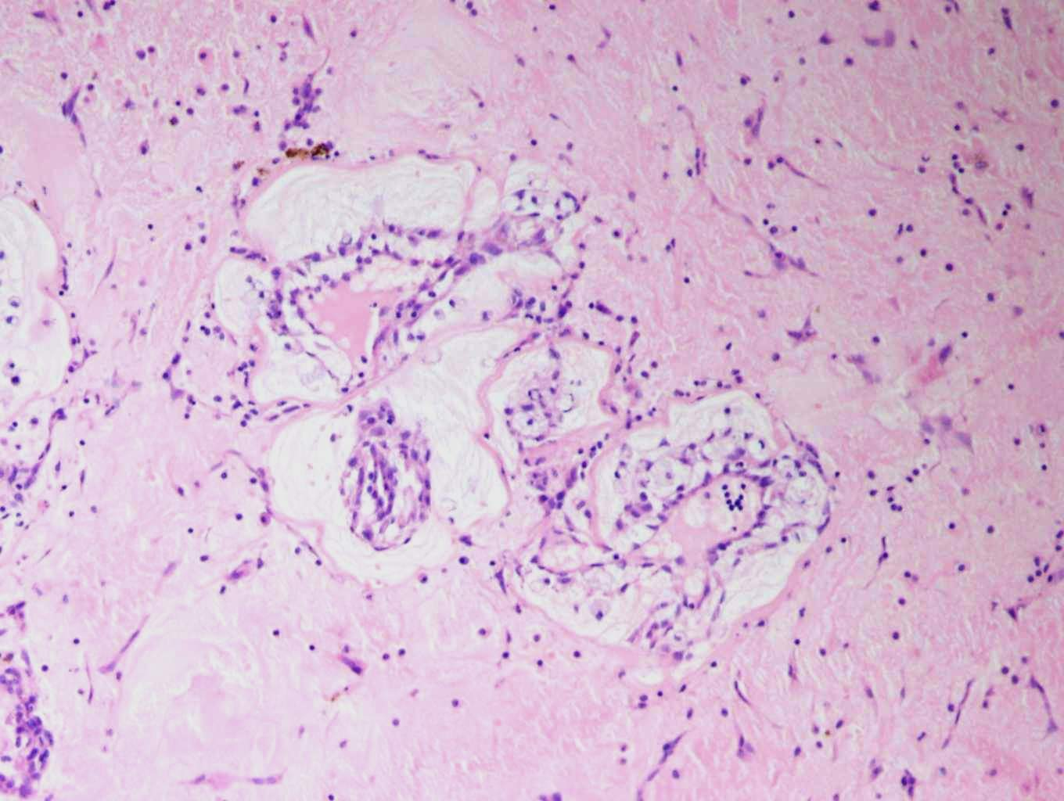
18. Myxoma of the left atrium
3
1
1
2
2
1 Stellate cells
2 Myxoid matrix
3 Deposits of hemosiderin

Slide 19

19. Polypous chronic rhinitis
1
2
3
1 Ciliated epithelium
2 Oedematous stroma with inflammatory infiltrate
3 Capillary

Slide 20
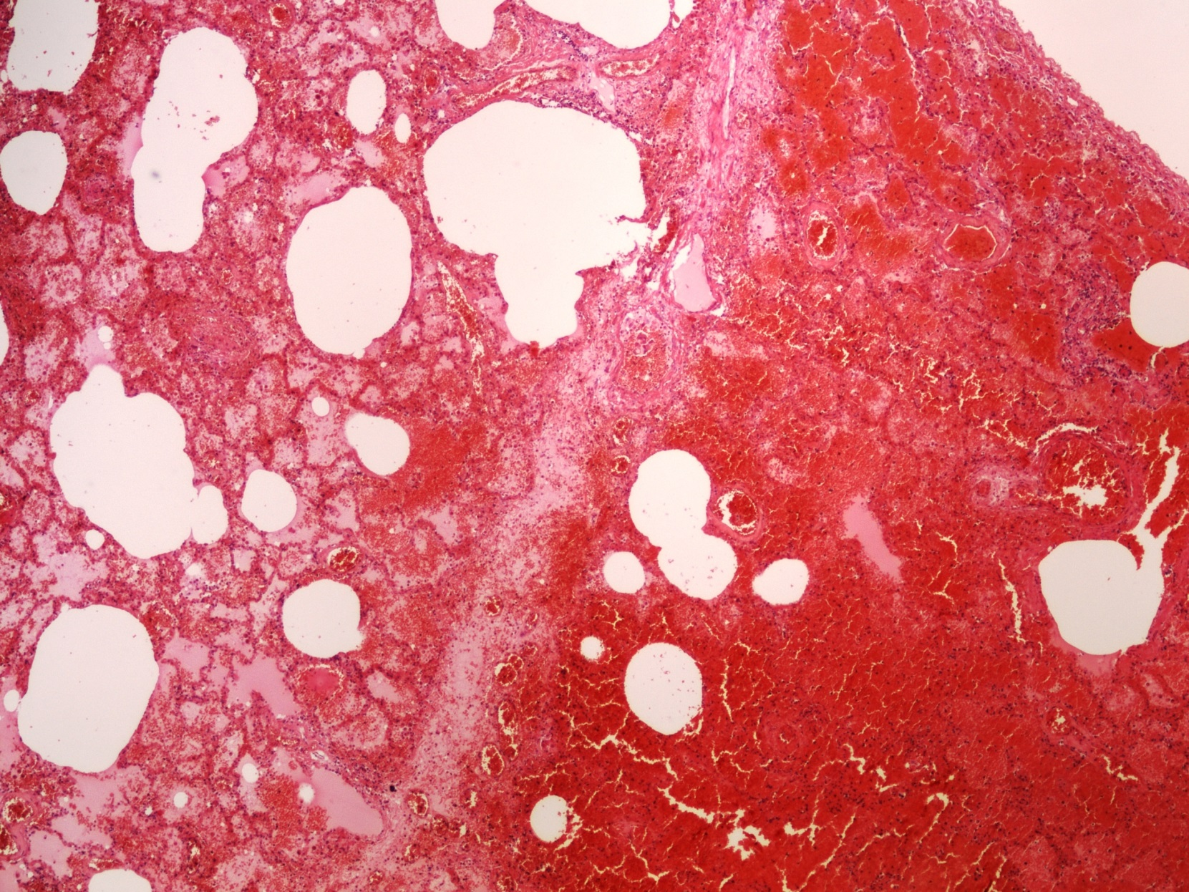
20. Hemorrhagic pulmonary infarction
1
1 Necrotic focus

Slide 21
21. Alveolar emphysema
2
1
2
1
1 Enlargement of airspaces with thinning and destruction of alveolar septa
2 Bronchiole with mucous secretions

Slide 22
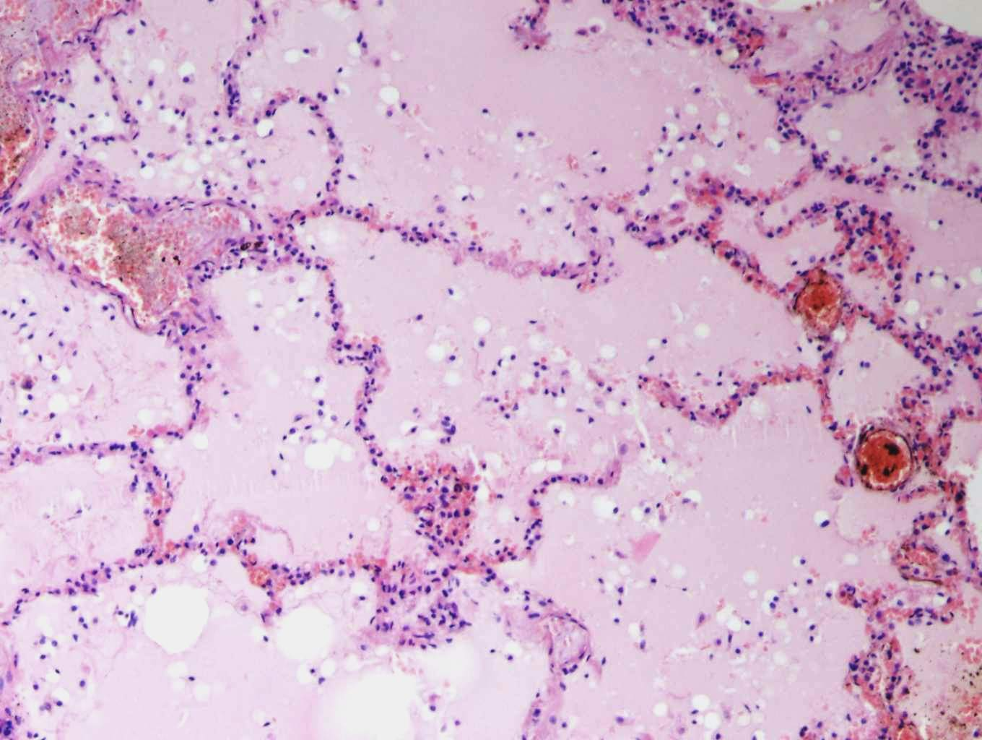
22. Alveolar oedema
1
3
2
1 Oedematic fluid
2 Dilated septa
3 Dilated capillary

Slide 23
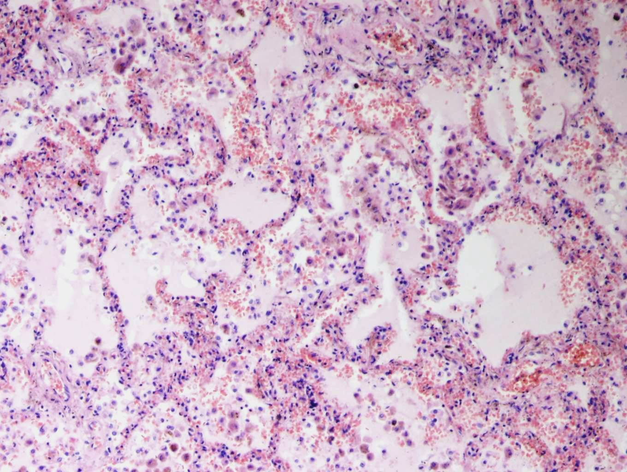
23. Chronic pulmonary venous congestion
2
3
1
1 Oedematic fluid
2 Enlarged hyperemic septa
3 Siderophages

Slide 24
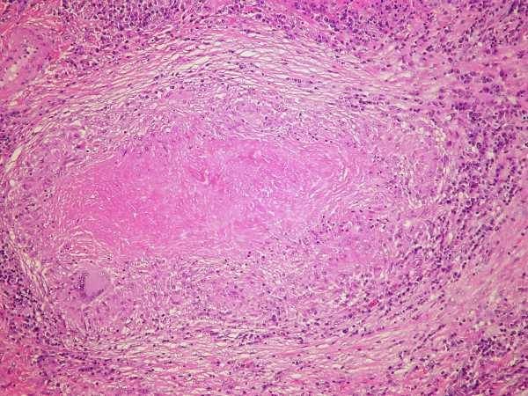
24. TBC granuloma of lungs
4
2
1
3
Caseous necrosis
Epithelioid macrophages
Langhans giant cells
Lymphocytes

Slide 25
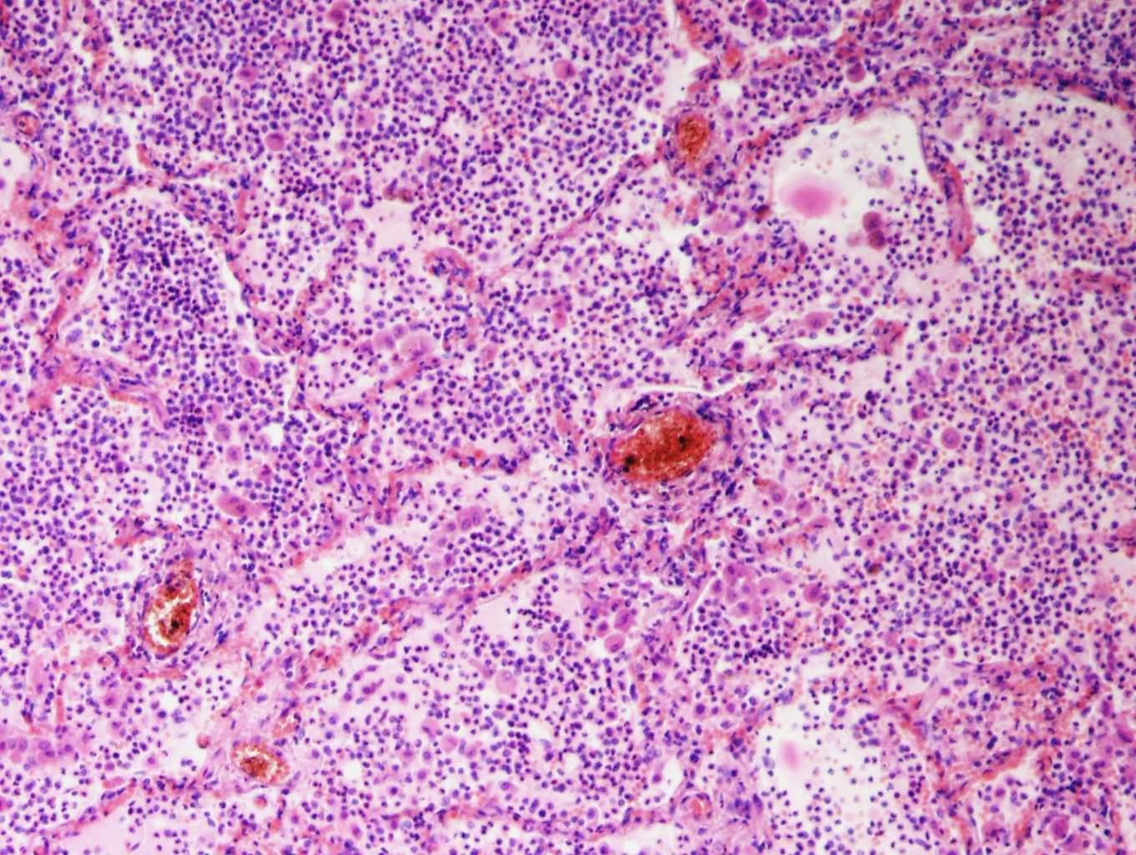
25. Purulent (abscessing) bronchopneumonia
2
1
2
1 Alveolar walls
2 Abscess with destruction of alveolar walls

Slide 26
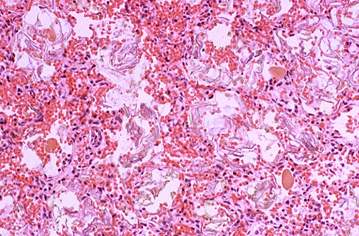
26. Amniotic fluid aspiration
1
1 Masses of keratin

Slide 27
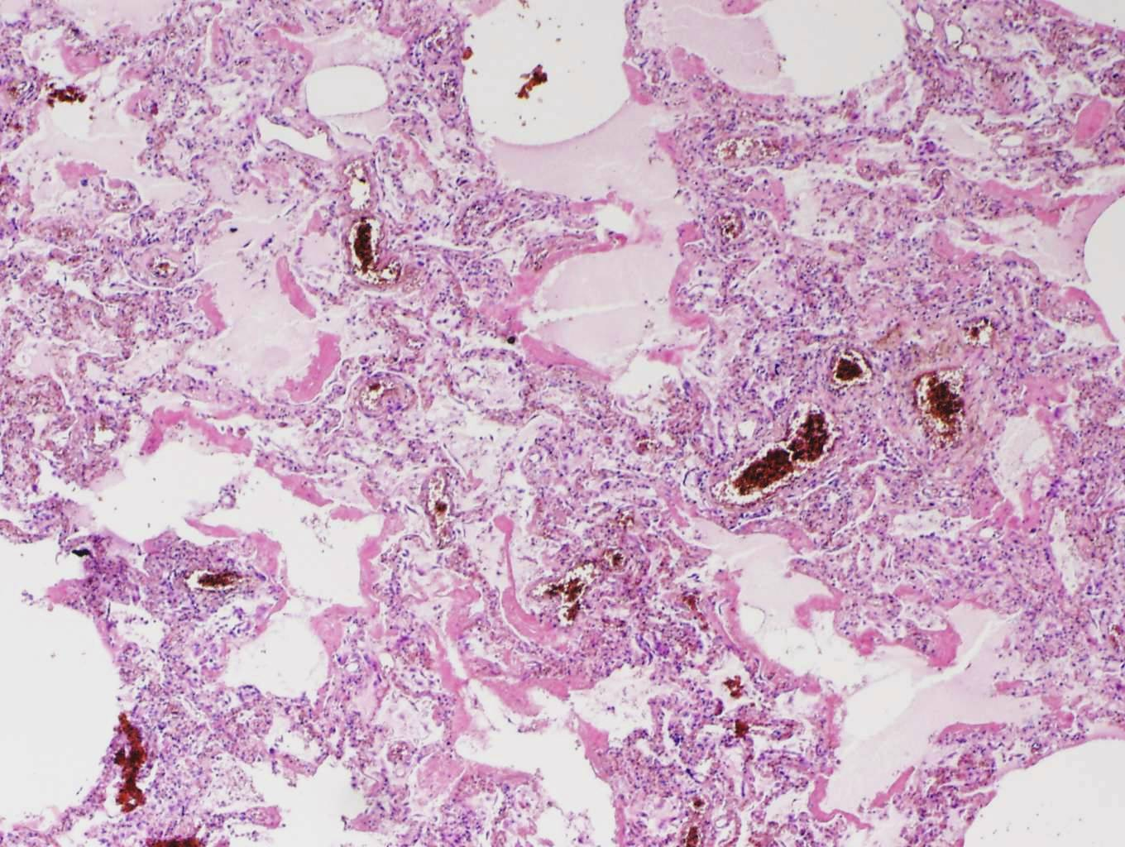
27. Diffuse alveolar damage (DAD/ARDS)
2
1
1
1 Hyaline membranes
2 Hyperemic septa

Slide 28
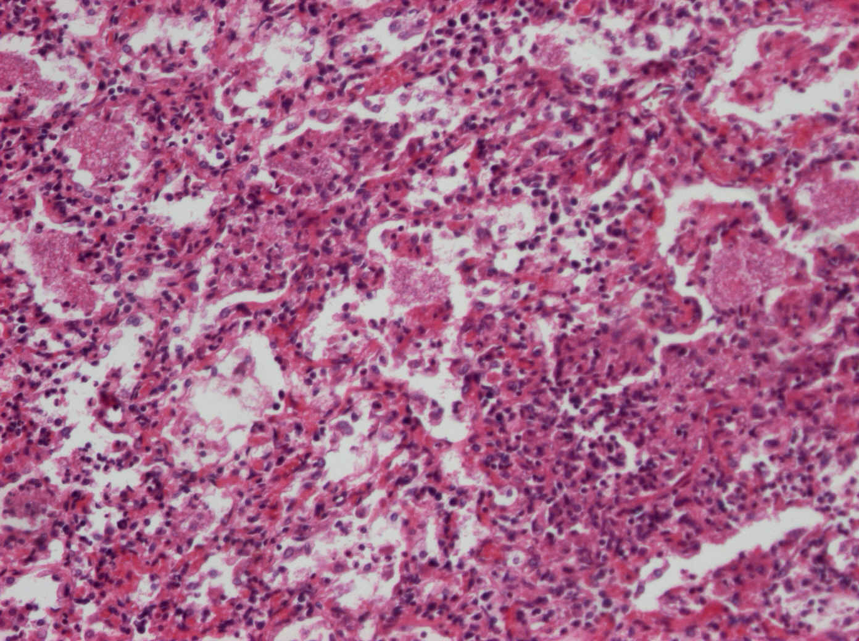
28. Pneumocystis pneumonia
2
1
1 Alveolar walls filled with monocellular infiltration
2 Bubbly eosinophilic material

Slide 29
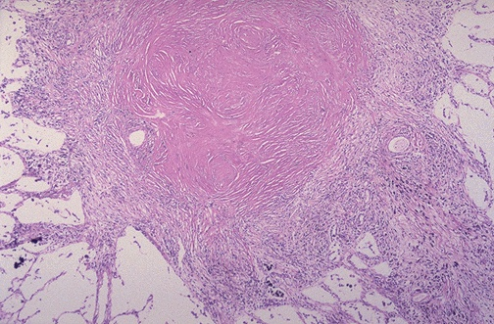
29. Silicosis of lungs
1
2
2
1 Fibrotic centre of the nodule
2 Perifocal emphysema

Slide 30
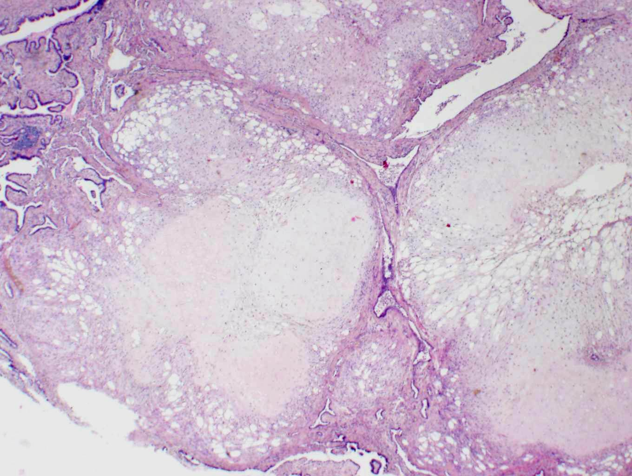
30. Pulmonary chondrohamartoma
3
2
1
1 Cartilage
2 Fat tissue
3 Tubular structures with respirátory epithelium

Slide 31
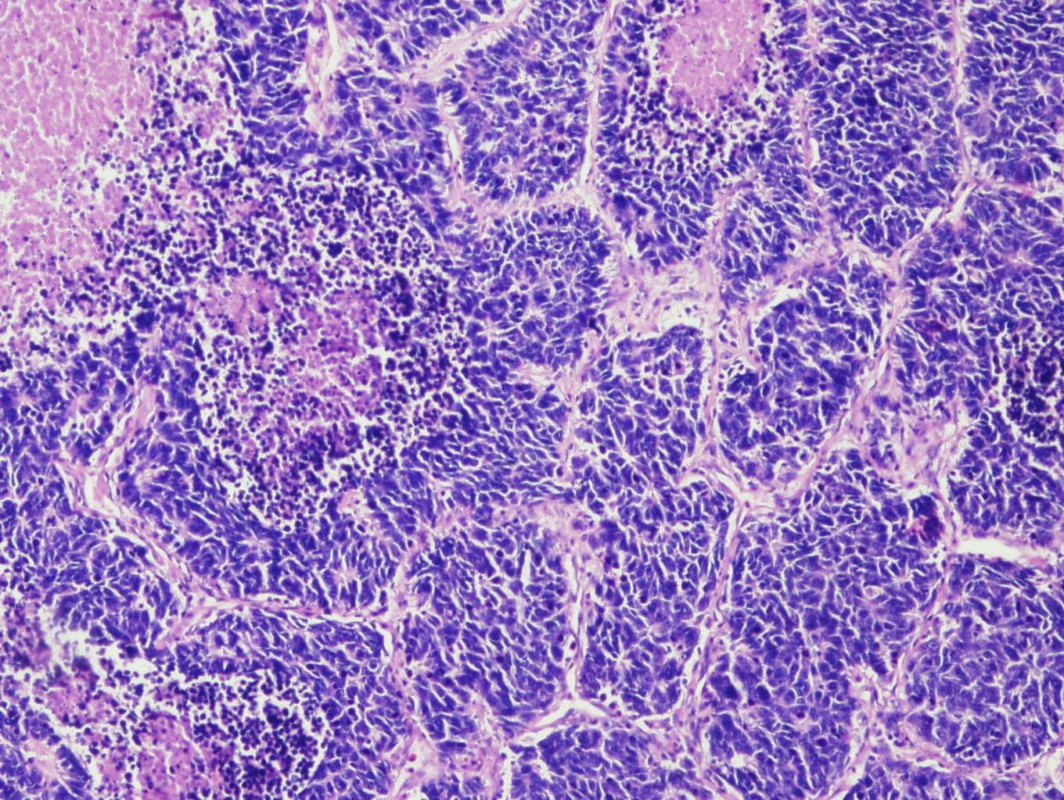
31. Small-cell lung carcinoma
2
3
1
1 Solid small cell infiltration
2 Necrosis
3 Fibrous stroma

Slide 32
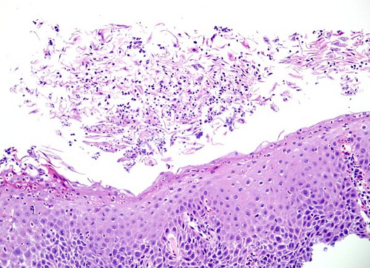
32. Mycotic oesophagitis
1
2
1 Superficial necrotic mucosa (mixed inflammatory infiltrate with a fungal hyphae)
2 Squamous epithelium of the esophagus

Slide 33
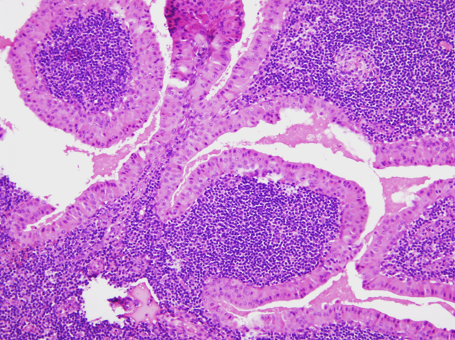
33. Warthin‘s tumor (cystadenolymphoma)
1
2
1 Double-layered epithelium
2 Lymphoid stroma

Slide 34
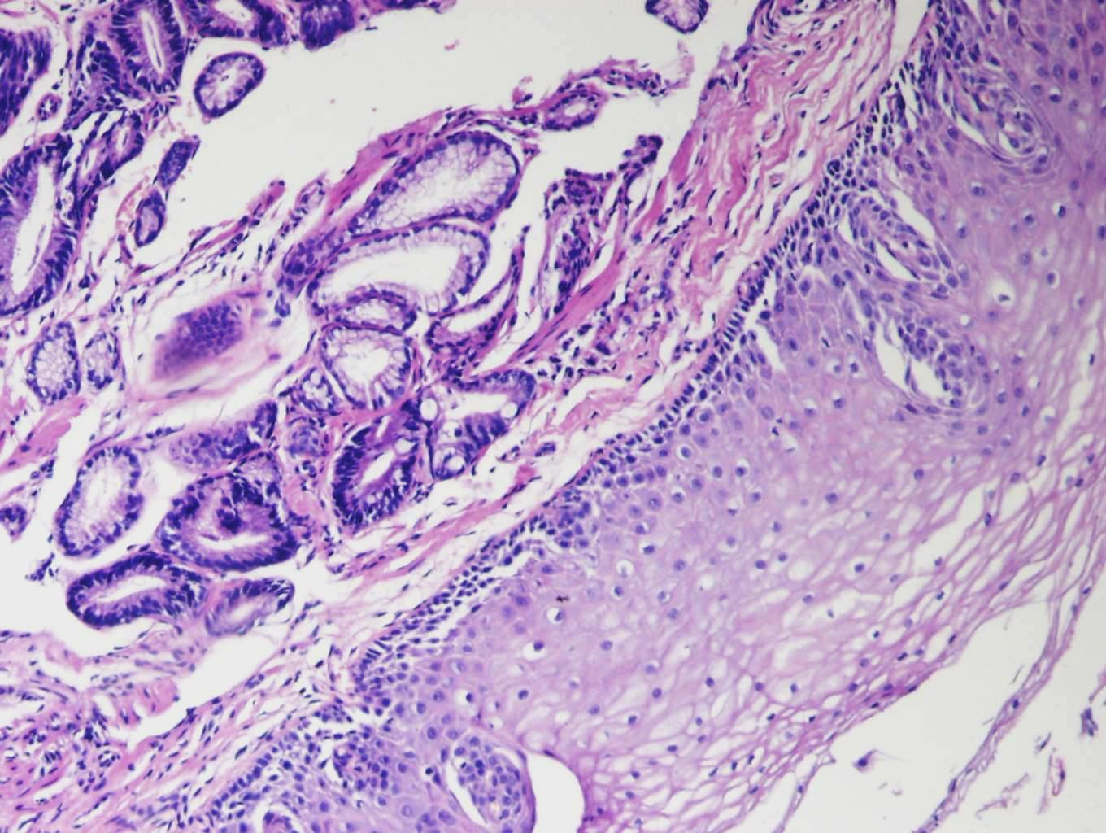
34. Barrett‘s oesophagus
1
2
3
1 Intestinal type of epithelium
2 Goblet cell
3 Squamous cell epithelium

Slide 35
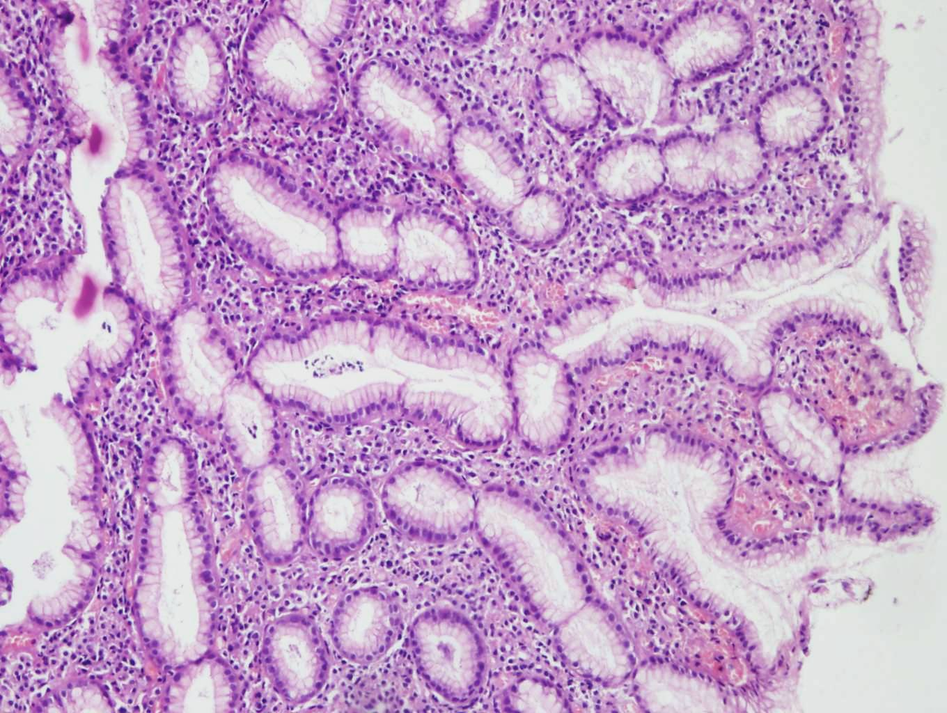
35. Chronic non-atrophic gastritis, associated with HP
1
2
1
1
1 Mixed inflammatory infiltrate in lamina propria mucosae
2 Gastric pit

Slide 36
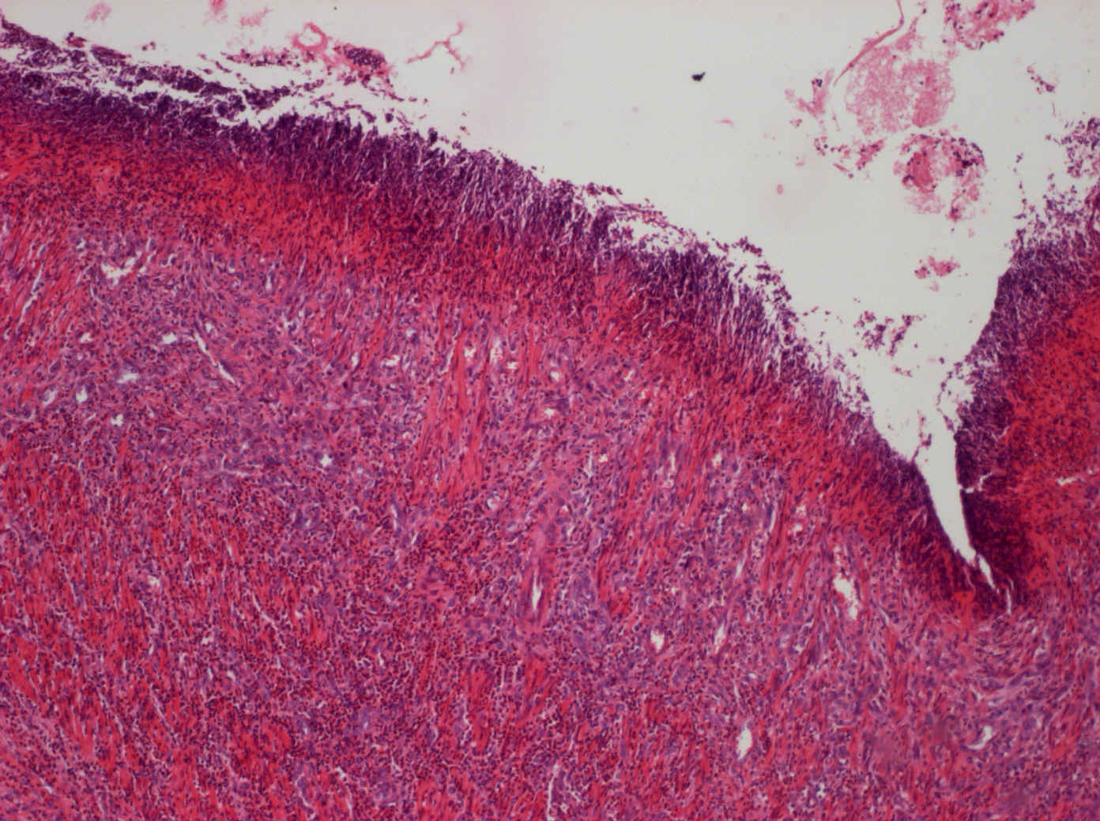
36. Chronic peptic ulcer of the stomach
1
4
3
2
3
1 surface – cell detritus
2 narrow capillary lumina (compressed by proliferating tissue)
3 granulation tissue with inflammatory infiltrate and fibrous tissue
4 fibrinoid necrosis
2

Slide 37
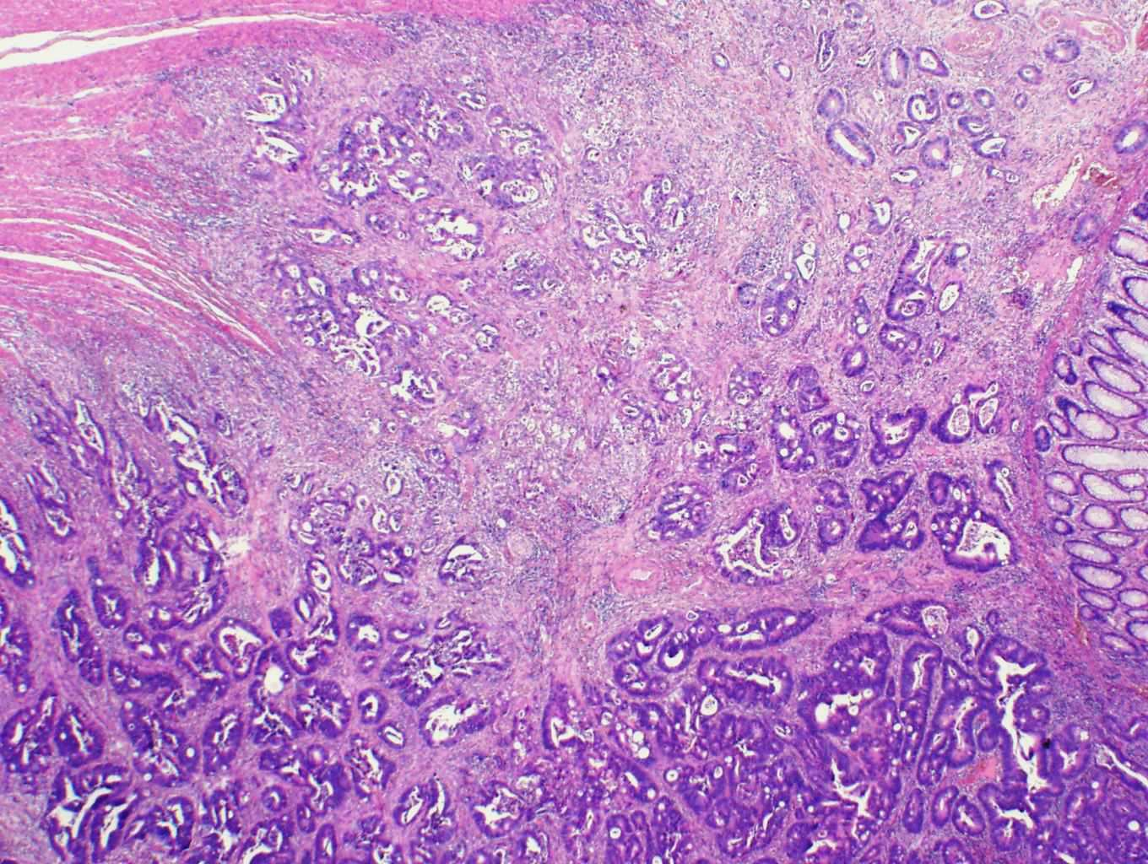
37. Adenocarcinoma of the colon (intestinal type)
1
1
2
1
3
Intestinal adenocarcinoma structures
Normal colonic epithelium
Muscularis propria

Slide 38
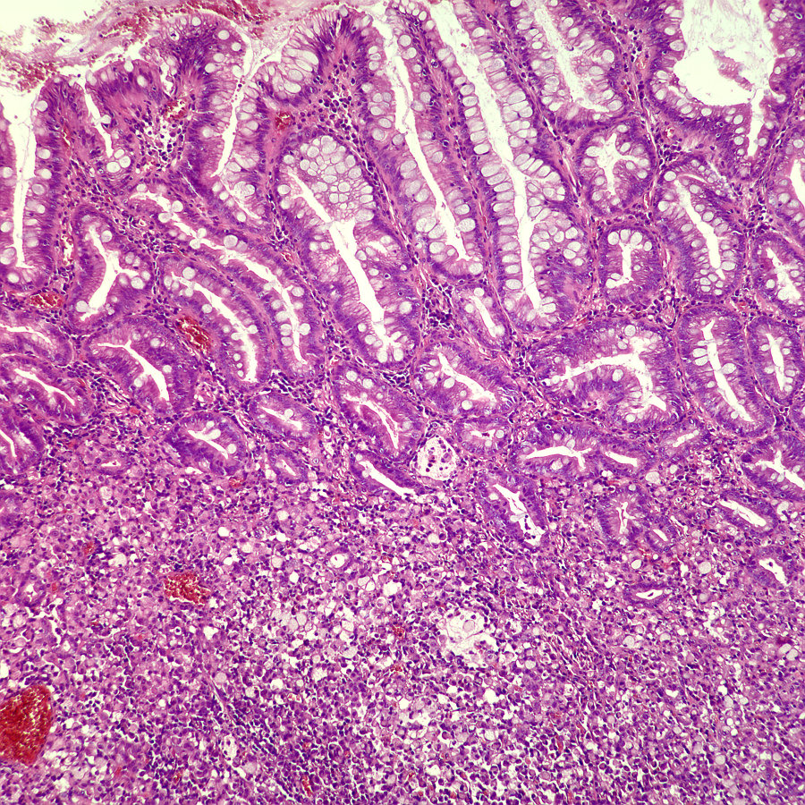
38. Gastric adenocarcinoma
(diffuse type)
1
2
1 Intestinal metaplasia of the mucosa
2 Diffuse infiltration with signet-ring cells

Slide 39
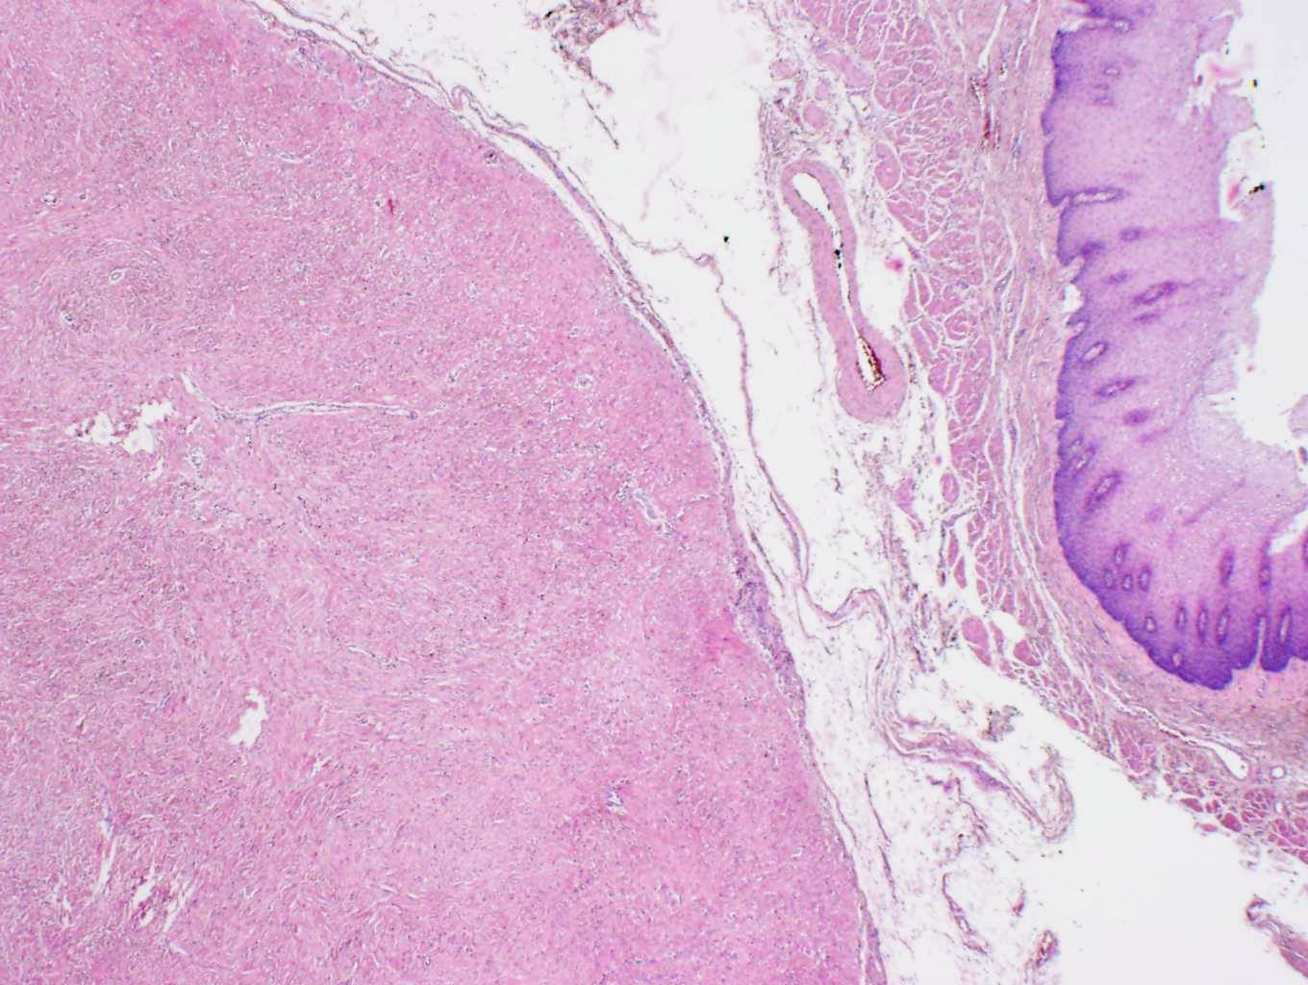
39. GIST
2
1
1 Spindle-cell type of GIST, low-malignant
2 Oesophageal wall

Slide 40
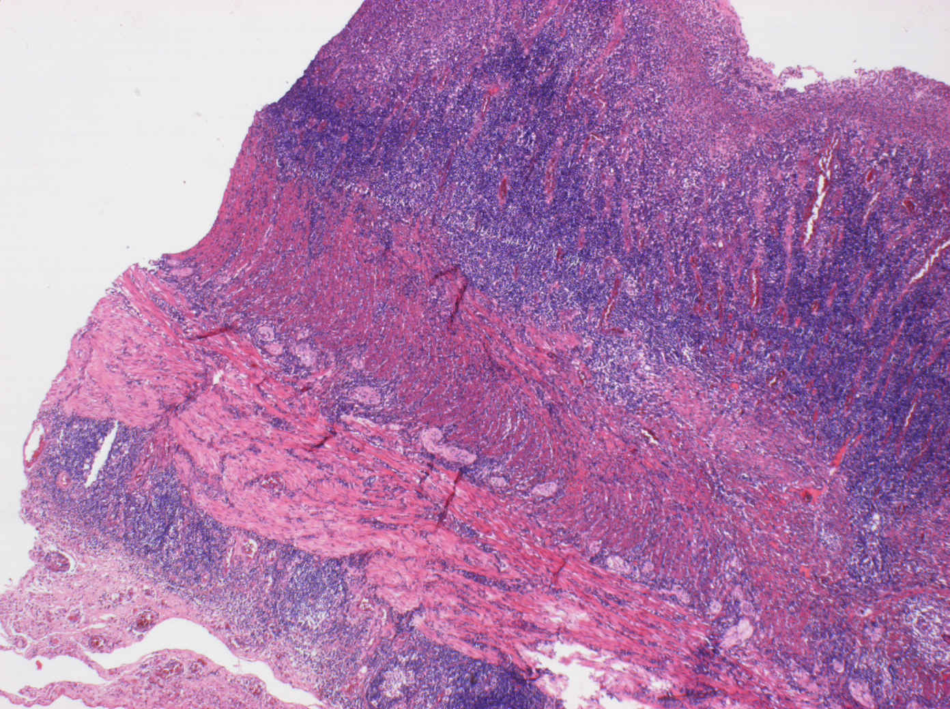
40. Crohn‘s disease
2
1
1
1
3
1 Transmural inflammatory infiltrate
2 Intestinal mucosa
3 Serosa

Slide 41
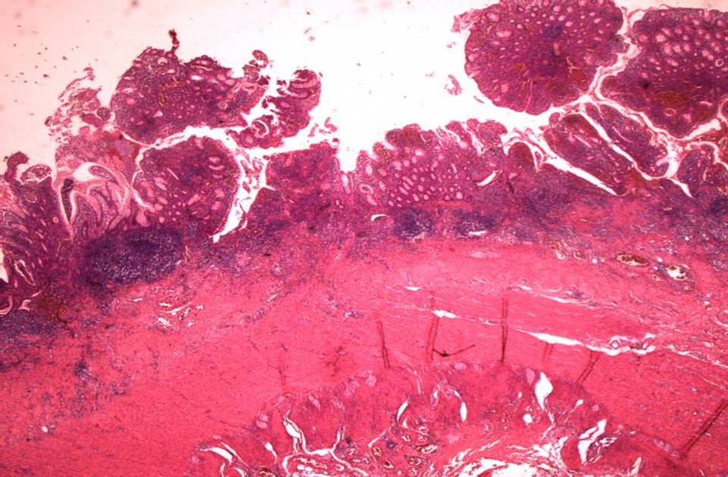
41. Ulcerative colitis
(superficial inflammatory infiltrate)
1
4
2
2
2
3
1 Mucosa with focal normal epithelium
2 Inflammatory infiltrate in the mucosa and submucosa
3 Muscularis propria
4 Mucosa ulceration

Slide 42
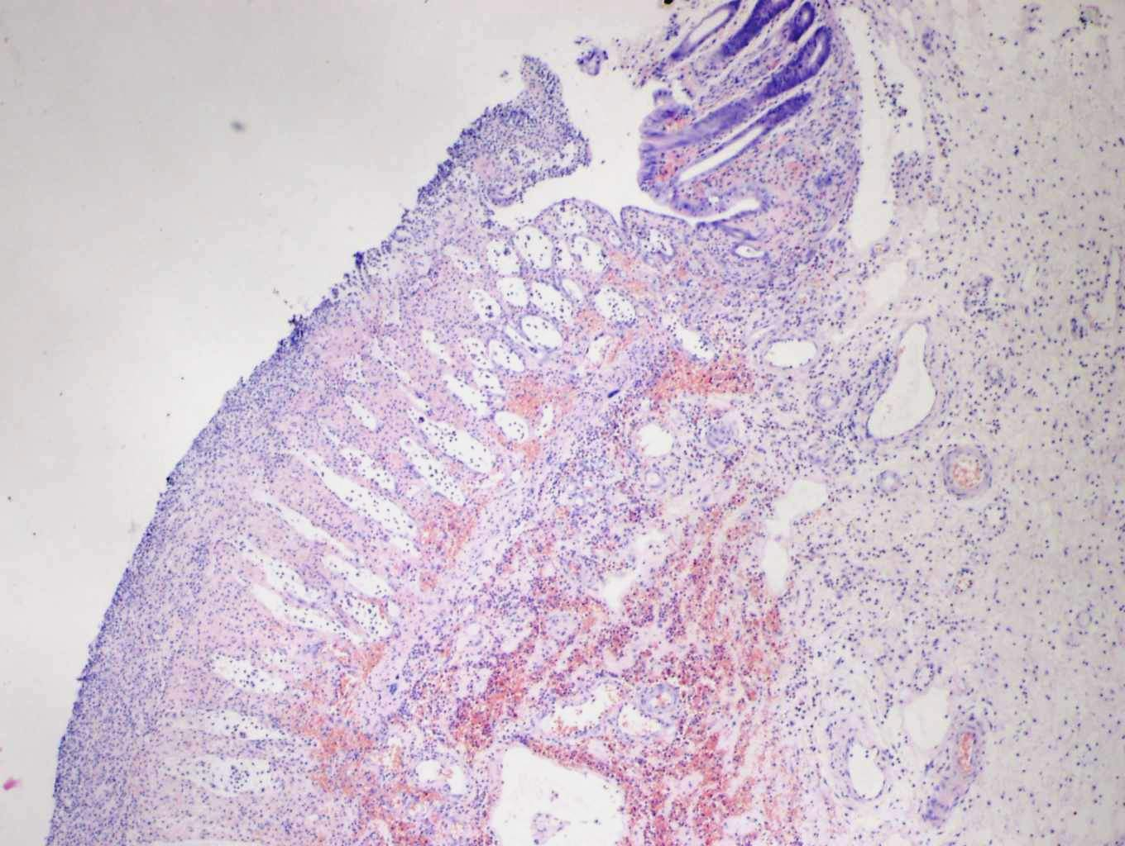
42. Pseudomembranous colitis
1
2
3
1 Mucosa with focally normal epithelium
2 Residual necrotic mucosa
3 Pseudomembrane

Slide 43
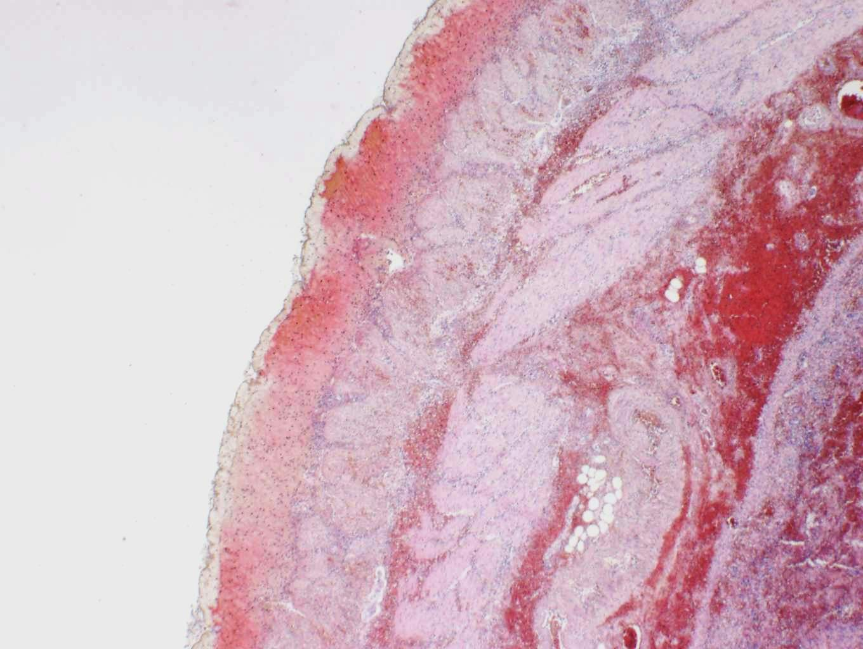
43. Hemorrhagic infarction of the intestine
1
1
1
1 Complete transmural hemorrhagic necrosis of the intestinal wall

Slide 44
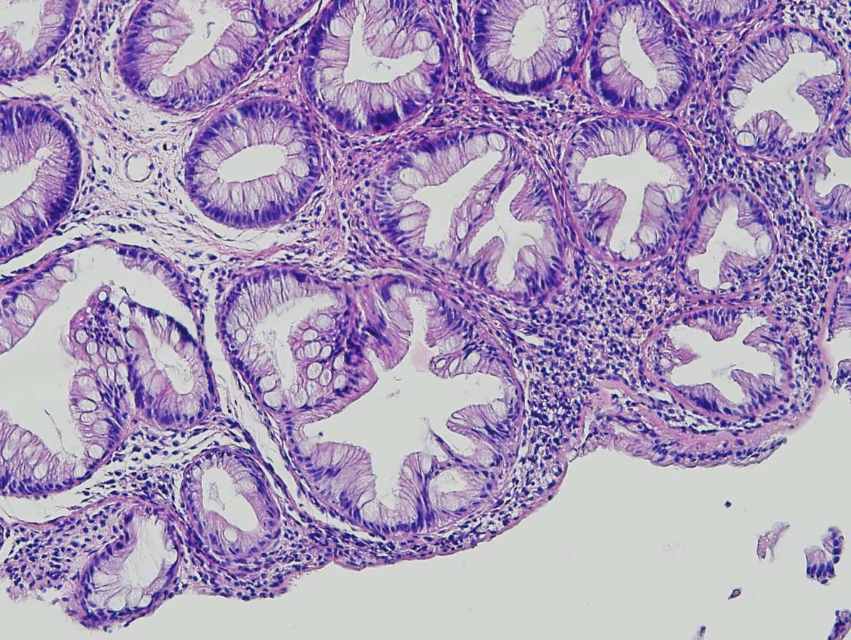
44. Hyperplastic polyp of colon
2
3
1
1 Hyperplastic serrated epithelium
2 Enterocytes
3 Goblet cells

Slide 45
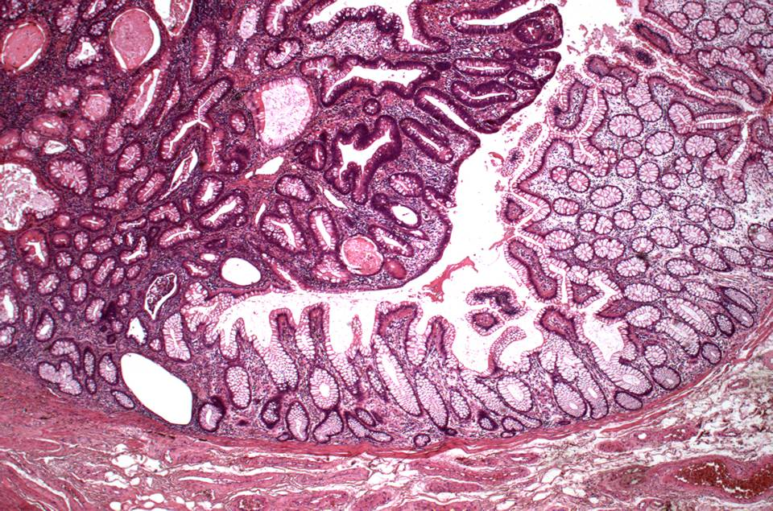
45. Tubular adenoma of colon with high-grade epithelial dysplasia
1
4
2
3
1 Tubular adenoma with low grade to high grade dysplasia
2 Border between dysplastic and normal epithelium
3 Lamina muscularis mucosae
4 Normal intestinal epithelium

Slide 46
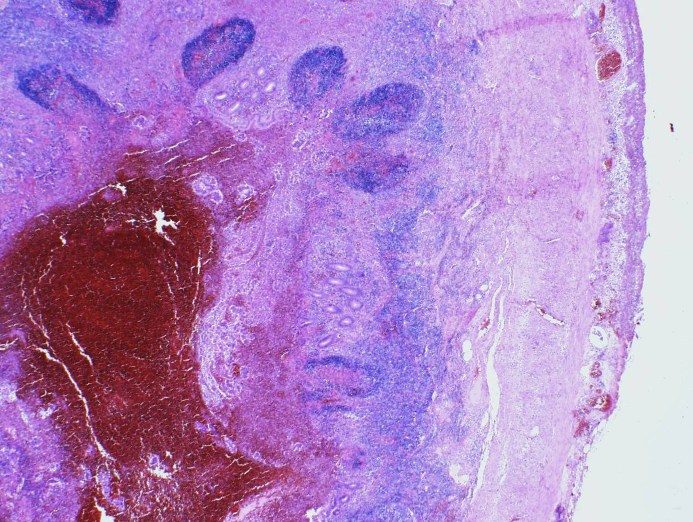
46. Phlegmonous appendicitis
1
3
3
2
3
1 Secondary lymphatic follicle in the submucosa
2 Intraluminal hemorrhage
3 Inflammatory infiltrate

Slide 47
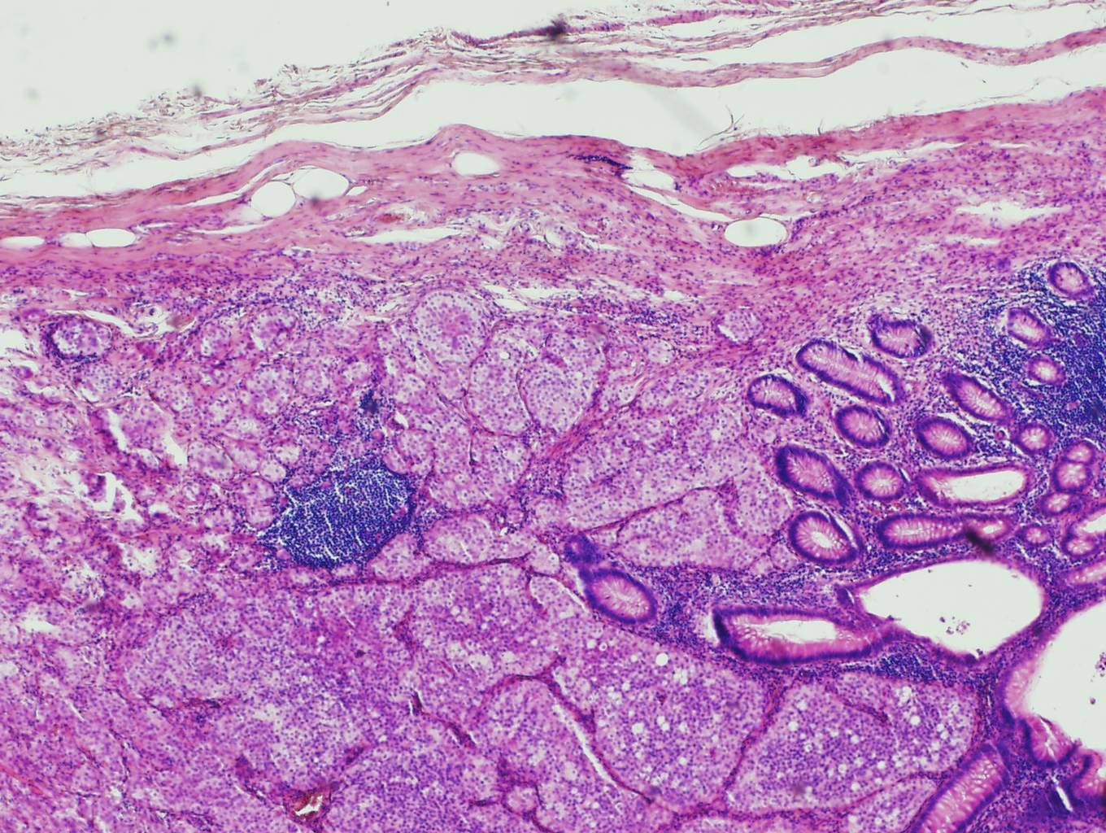
47. Neuroendocrine tumor (carcinoid) of the appendix
1
2
1
1 Trabecular/glandular neoplastic structures, cells with clear cytoplasm and round/ovlas-shaped nuclei
2 Appendiceal mucosa

Slide 48
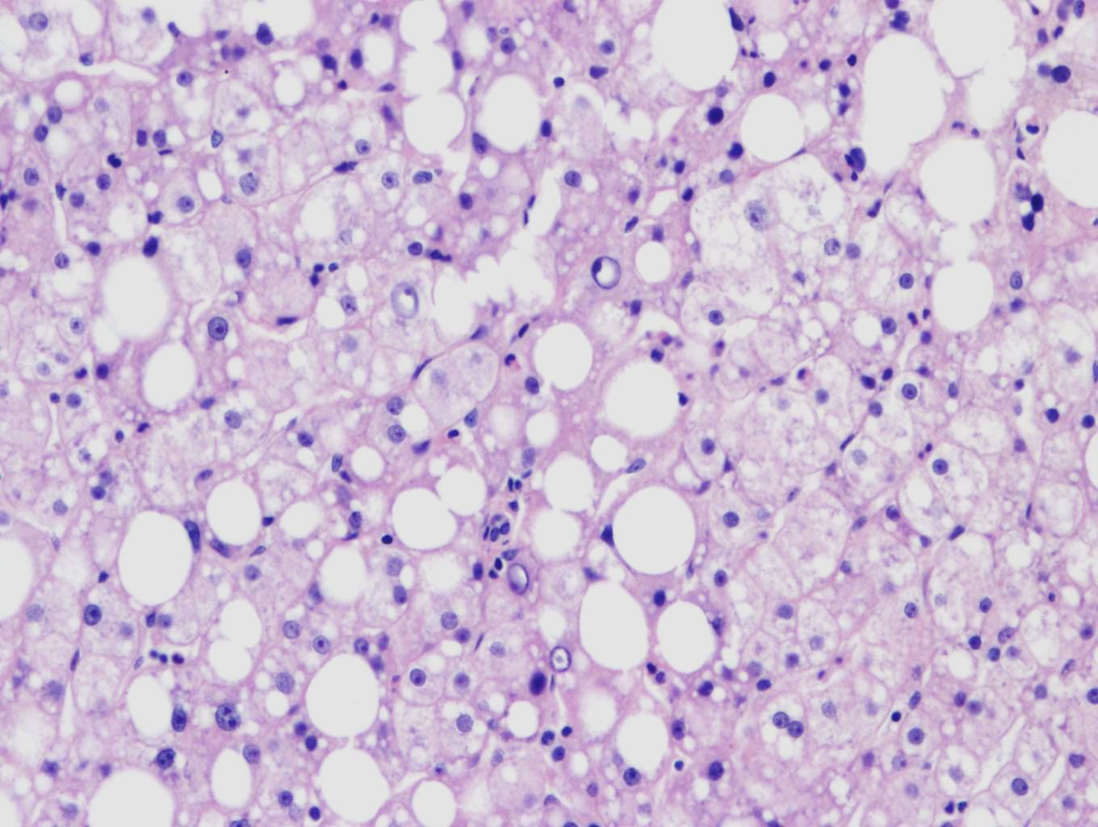
48. Steatosis of liver
1
1
2
1 Lipid vesicle in cytoplasm of
hepatocytes
2 Hepatocyte nucleus pushed to periphery

Slide 49
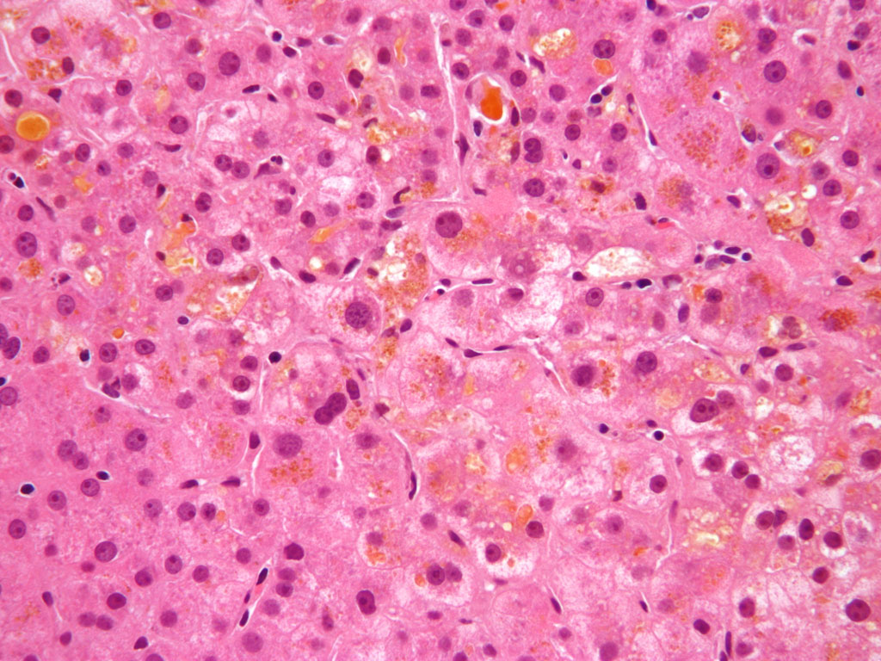
49. Cholestasis of liver
1
2
1 Bile accumulation
2 Bile in hepatocytes

Slide 50
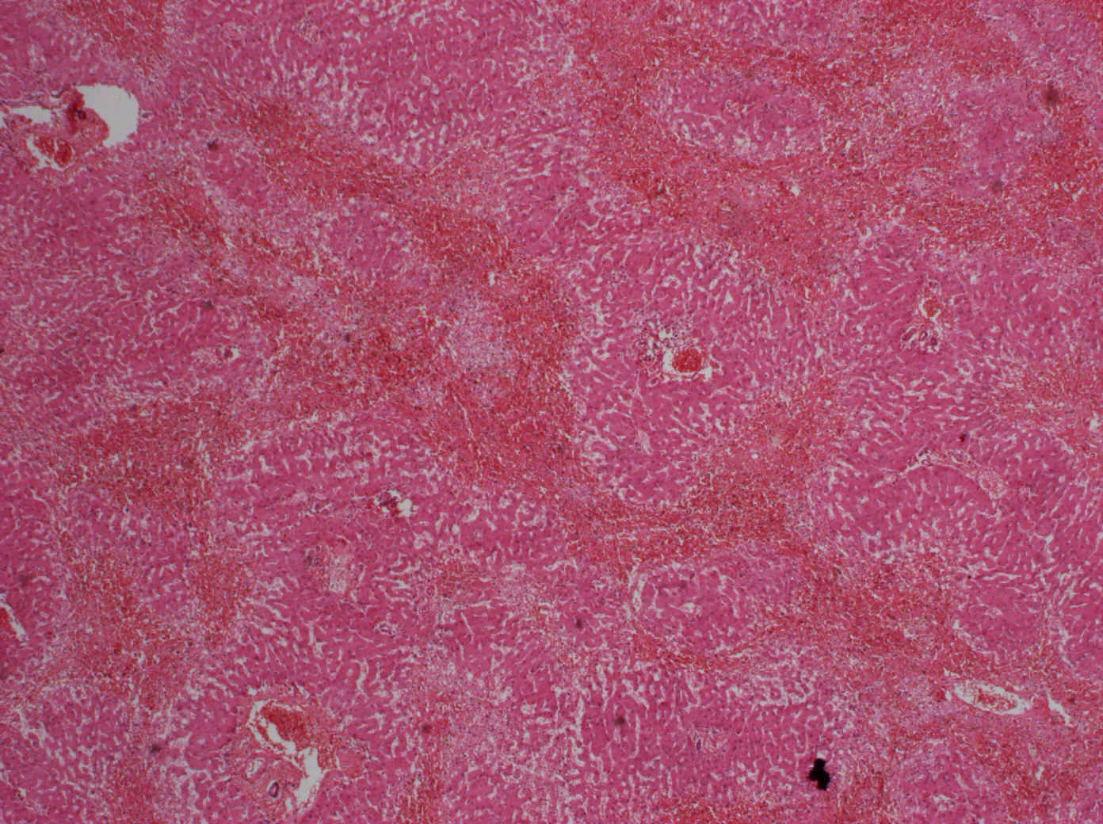
50. Hepatic venous congestion
2
1
1
2
1
1 Portal spaces
2 Congestive lines (severe congestion with hepatocyte necrosis)
„---“ pseudolobule: confluent remnants of 3 lobules, centrally portal space

Slide 51
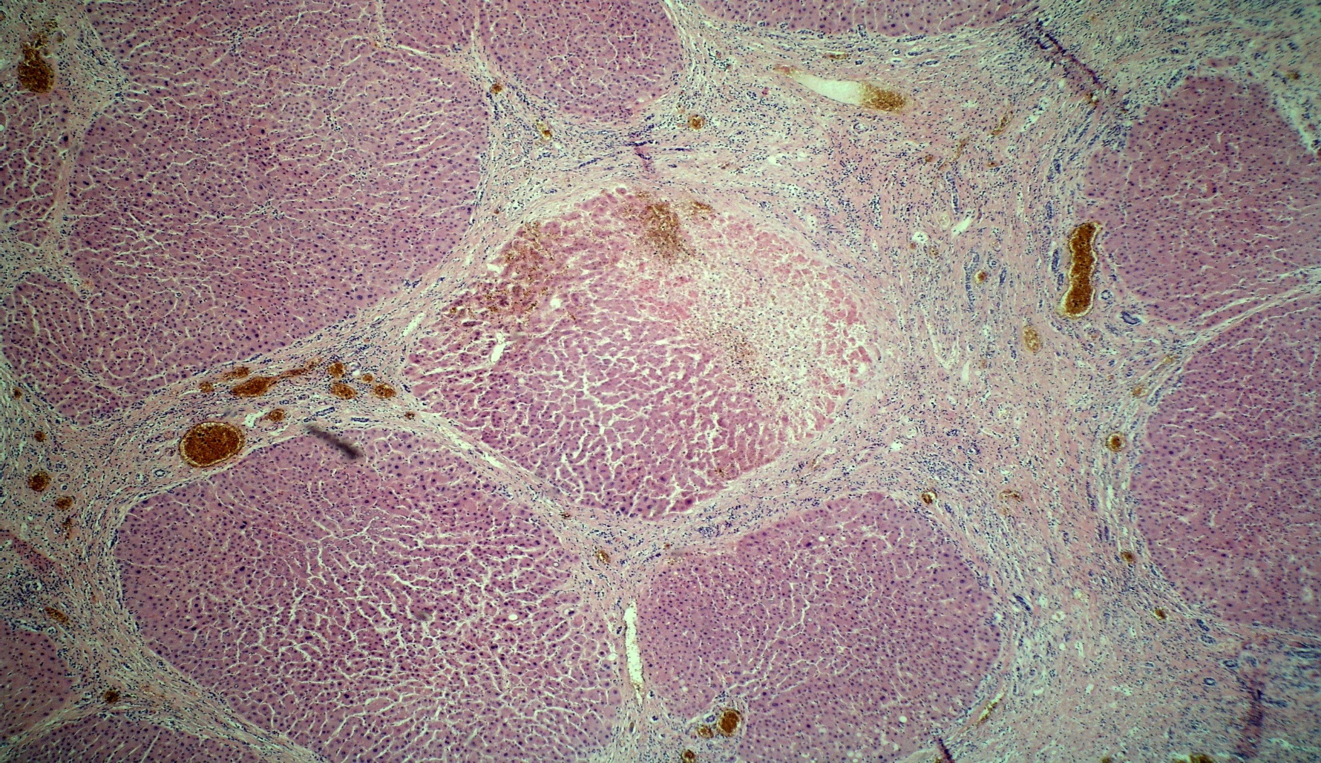
51. Cirrhosis of liver
2
1
1
2
1
1 Pseudolobules
2 Bridging septa with lymphocytic infiltrate
 Necrotic hepatocytes

Slide 52
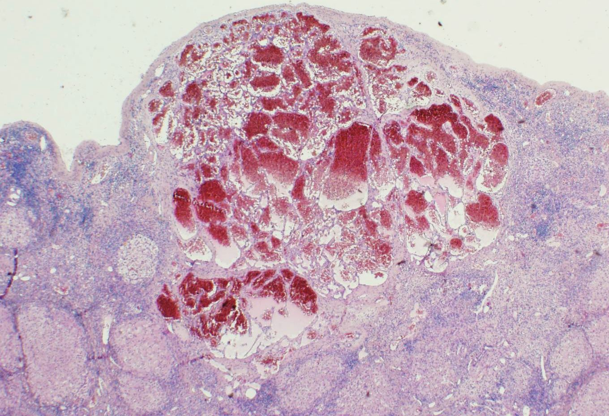
52. Cavernous haemangioma
(in micronodular liver cirrhosis)
2
2
3
2
1
1
1 Liver nodules
2 Dilated vascular spaces filled with red blood cells
3 Chronic inflammatory infiltrate

Slide 53

53. Hepatocellular carcinoma
1
2
1 Normal liver parenchyma
2 Cells of hepatocellular carcinoma – in here with pale cytoplasm, trabecular structure, with atypias and increased mitotic activity

Slide 54

54. Ductal adenocarcinoma of pancreas
1
1
3
2
1 Neoplastic ductal formations
2 Focal duct ruptures with macrophages and detritus in the lumen
3 Stromal desmoplasia

Slide 55

55. Colorectal adenocarcinoma metastasis into hepatic parenchyma
1
2
1
1 Tubular formations of colrectal adenocarcinoma
2 Liver parenchyma

Slide 56

56. Chronic active cholecystitis
1
2
3
1 single-cell layered cylindrical epithelium
2 neutrophilic granulocytes intraepithelially
3 chronic inflammatory infiltrate in lamina propria

Slide 57

57. Acute haemorrhagic pancreatitis
4
3
2
1 Necrosis
2 Demarcation with neutrophiles
3 Haemorrhagia
4 Adjacent pancreatic tissue
1

Slide 58

58. Hashimoto‘s thyroiditis
1
1
2
Follicles
Germinal centre
 Lymphoplasmocelllular infiltrate

Slide 59

59. Thyroid gland hyperplasia (Graves-Basedow disease)
1
1
2
Follicles depleted of colloid
Lymphocytic infiltrate
 Papillary formations

Slide 60

60. Multinodular goitre
1
1
1
Follicles filled with abundant colloid and flattening of the epithelium
 Fibrous septa

Slide 61

61. Follicular thyroid adenoma
1
1
2
1 Thyroid parenchyma with follicles
2 Adenoma
Fibrotic capsule (adenoma demarcation)

Slide 62

62. Papillary adenocarcinoma of thyroid gland
2
1
3
1
1 fibrotic capsule
normal thyroid parenchyma
Adenocarcinoma with cells with ground-glass nuclei
papillary formations

Slide 63

63. Pheochromocytoma
1
1
1
1 Solid alveoli (large cells with granulated cytoplasm)
capillarized stroma

Slide 64

64. Renal infarction
3
4
2
2
1
1 – coagulative necrosis
2 - peripheral hyperaemia
3 - arteriosclerotic blood vessel
4 - normal tissue

Slide 65

65. Pyelonefritida purulentní
1
1 Interstitial neutrophilic infiltration, tubuli filled with neutrophils

Slide 66

66. Acute glomerulonefritis (proliferative or crescentic)
1
1
1 Cellular crescents within the Bowman capsule

Slide 67

67. Diabetic glomerulopathy
1
2
1 Mesangial nodules
2 Diffuse expansion of mesangial matrix

Slide 68

68. Benign nephrosclerosis
1
3
2
1 Sclerotic glomerulus
2 Hypertrophy of the media and sclerosis of the intima of artery
3 Interstitial fibrotisation

Slide 69

69. Papillary urothelial carcinoma, low grade
1
2
1
Fused tumorous papillae
Fine fibrovascular stroma
Suburothelial fibrous tissue
3

Slide 70

70. Clear cell renal cell carcinoma (Grawitz tumor)
1
1 Large cells with clear granular cytoplasm (glycogen and lipid deposits)

Slide 71

71. Nephroblastoma (Wilms‘ tumor)
1
1 Triphasic combination of blastemal, stromal and epithelial cell types

Slide 72

72. Papillary renal cell carcinoma
1
2
1 Papillary formations
2 Stromal foamy macrophages

Slide 73

73. Benign prostatic hyperplasia
2
3
4
1
1 Enlarged prostate glands with preserved layer of basal cells
2 Intraluminal papillary proliferates
3 Corpora amylacea
4 Inflammatory cellulitis

Slide 74

74. Acinar prostatic adenocarcinoma
1
1
2
1 Small neoplastic glands without preserved layer of basal cells
2 Neoplastic acini growing between prostatic glands

Slide 75

75. Testicular seminoma
2
1
1 Tumor cells
2 Fibrotic septa with lymphocytic infiltrate

Slide 76

76. Squamous metaplasia with Nabothian cysts
3
2
1 Exocervical squamous
epithelium.
2 Endocervical mature columnar
epithelium.
3 Reserve cell hyperplasia covered by residual columnar cells
4 Dilated endocervical glands (Nabothian cysts)
4
4

Slide 77

77. Condyloma accuminatum
1
2
1 Hyperkeratosis, parakeratosis
2 Koilocytes

Slide 78

78. HSIL (High-grade CIN)
Diffuse cytonuclear atypia. Mitotic figure including atypical ones

Slide 79

79. Ectopic tubal pregnancy
2
1
3
1+2 Haematoma inside the wall of fallopian tube
3 Placental structures (cytotrophoblast, syncytiotrophoblast)

Slide 80

80. Endometrial polyp
2
1
1
1 Endometrial glands, focally dilated
2 Thick-walled arteries

Slide 81

81. Endometrioid adenocarcinoma
1
1
1 Cribriform glands with cellular atypia and increased mitotic activity

Slide 82

82. Leiomyoma uteri
1
1
1 Spindle smooth muscle cells, elongated nuclei with rounded ends („cigar shaped nuclei“), fascicular structure. No atypia/necrosis/mitosis.

Slide 83

83. Ovarian fibroma
1
1 Tumor composed of stromal fibroblasts

Slide 84

84. Mature teratoma (dermoid cyst)
3
4
1
2
1 Lumen of the cyst with keratinized epithelial cells
2 Epidermis
3 Sebaceous glands and hair follicles
4 Adipose tissue
3

Slide 85

85. Choriocarcinoma – metastasis in skin
1
1
2
1 Foci of necrosis and haemorrhage
2 Anaplastic syncytio- and cytotrophoblasts

Slide 86

86. Endometriosis (in navel)
2
1
2
3
1 Epidermis
2 Dermis
3 Endometrial glands with adjacent endometrial stroma

Slide 87

87. Ovarian serous cystadenoma
1
1 Columnar ciliated epithelium

Slide 88

88. Ovarian mucinous cystadenocarcinoma
1
1
1 Columnar mucinous epithelium with cytonuclear atypia and mitoses

Slide 89

89. Granulosa cell tumor
1
1
1 Call-Exner bodies

Slide 90

90. Fibroadenoma of mamma
1
1
1 Intracanalicular type: Slit-like newly formed ducts compressed by edematous stroma

Slide 91

91. Invazive carcinoma, NOS, of mamma (formerly known as invasive ductal cacrinoma)
2
1
1 DCIS
2 Cohesive neoplastic cells with only a few tubules

Slide 92

92. Invasive lobular carcinoma of mamma
1
1
1 Dyscohesive tumor cells forming single linear files („Indian file“)

Slide 93

93. Encefalomalatia (of older date)
1
2
3
1 Macrophages with intracytoplasmatic deposits of lipid products of myelin breakdown
2 Haemorrhagic infarction
3 Brain tissue

Slide 94

94. Purulent leptomeningitis
2
1
3
1 Brain tissue with oedema
2 Neutrophils
3 Dilated hyperaemic arteriol in pia mater

Slide 95

95. Glioblastoma multiforme
1
2
1 Pleomorphic tumor cells
2 Necrosis
Pseudopalisading cells around areas of necrosis

Slide 96

96. Meningeoma
2
1
1 Whorl formations of meningothelial cells
2 Psammoma bodies

Slide 97

97. Neurinoma/ Schwannoma
1
1
3
2
1 Antoni A
2 Antoni B (hypocellular, with myxoid degeneration)
3 Nuclear palisading

Slide 98

98. Lipoma
1
1 Mature adipocytes
fibrotic septum with hyperaemic capillary

Slide 99

99. Osteochondroma
1
4
2
1 Hyalinne cartilage
2 Enchondral ossification
3 Lamellar bone
4 Bone marrow
3

Slide 100

100. High-grade osteosarcoma
3
1
2
Neoplastic osteoid matrix
Neoplastic osteoblasts
Bone trabeculae

Slide 101

101. Giant-cell tumor of the bone
2
1
1 Mononuclear cells
2 Giand multinucleated cells (osteoklast-like)

Slide 102

102. Chronic purulent osteomyelitis
2
1
1 Bone trabeculae
2 Inflammatory infiltrate (mostly plasma cells and neutrophils)

Slide 103

103. Tophus in arthritis uratica
1
2
1 Urate crystals
2 Palisading histiocytes (giant cell granuloma)

Slide 104

104. Psoriasis
2
5
3
1
Acanthosis
Papillomatosis, papillary oedema
Hyperkeratosis, parakeratosis
Microabscesses
Dermal chronic inflammation
4

Slide 105

105. Verruca vulgaris
1
3
2
1 Hyperkeratosis
2 Parakeratosis
3 Papillomatosis

Slide 106

106. Seborrheic keratosis
3
1
2
1 Papillomatosis
2 “horn“ cysts with keratin masses
3 Acanthosis

Slide 107

107. Capillary hemangioma of the skin
2
1
1 Neoplastic capillaries...
2 …with erythrocytes

Slide 108

108. Basal cell carcinoma of the skin
1
1 Peripheral palisading of atypical basaloid cells

Slide 109

109. Compound pigmented naevus
1
2
1 Nests of melanocytes in dermoepidermal junction
2 Nests of melanocytes in the dermis

Slide 110

110. Malignant melanoma
2
1
1 Neoplastic melanocytes in the dermis with infiltration of adipose tissue
2 Focally increased melanin production

