Slide 1
Aim of the practicals
Basic of radiobiology
Model of acute radiation syndrome - blood form
Evaluation of the data obtained during practice on a model of acute radiation syndrome

Slide 2
Ionizing radiation
The radiation emitted by radioactive nuclides
Electromagnetic or corpuscular radiation, which causes the penetration of mass ionization (must have sufficiently high energy).
Energy is in the range of keV-MeV

Slide 3
Types of ionizing radiation
Corpuscular α, β, neutrons
electromagnetic γ

Slide 4
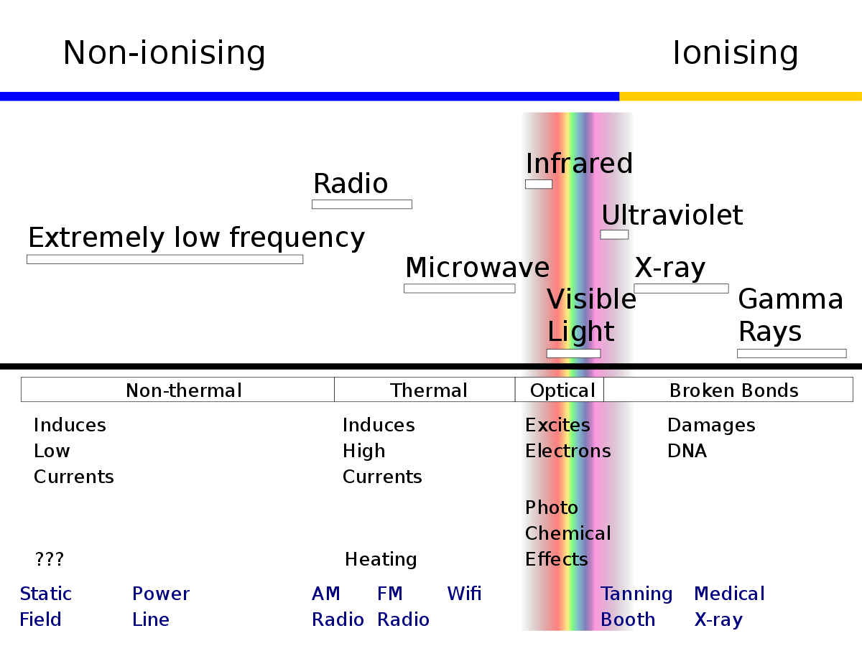
The energy spectrum of radiation

Slide 5
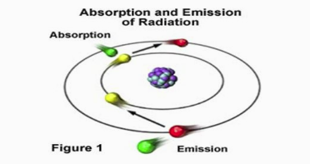
Ionization vs. excitation
M M⁺ + e⁻
M M^{excit}
Ionization = process of creating charged atoms
Excitation = atoms absorp energy without ionizazion. Orbital electrons are raised to next level.
Both types of interactions are very fast
Formed in a ratio of 1:2

Slide 6
Units
MeV, a unit of energy
Roentgen, a unit of exposure [C / kg dry air]
Becquerel, activity [s-1] ≈ Curie
Gray, dose [J / kg] ≈ rad
Sievert, dose equivalent [J / kg] ≈ rem

Slide 7
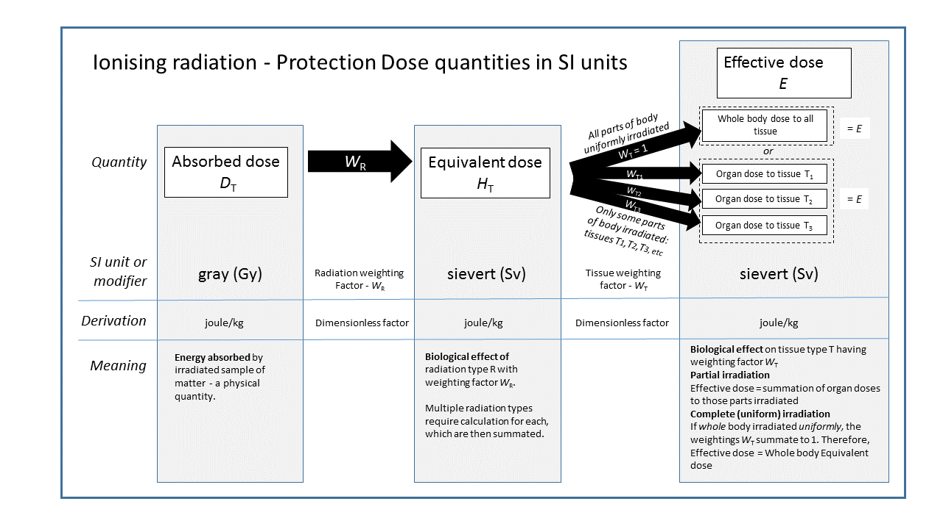
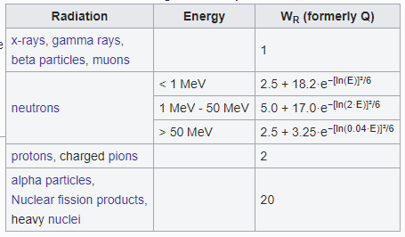
Units
Dose equivalent
= dose * constant WR
γ, β, X = 1
neutrons = 10
α = 20

Slide 8
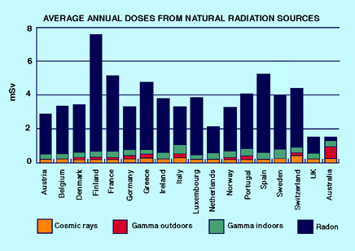
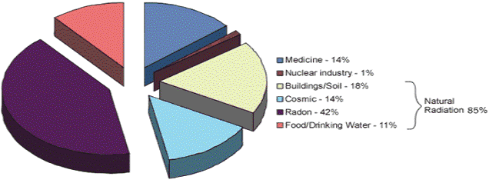
Sources of ionizing radiation?
Natural
space
exposure increases with altitude
solar
terrestrial sources
natural radioactive decay of radioisotopes (soil and rock)
Radon
gas, there is a decay of radium-226 (Uranium)
Artificial
medicine
diagnosis, therapy, sterilization
industrial
nuclear energy

Slide 9
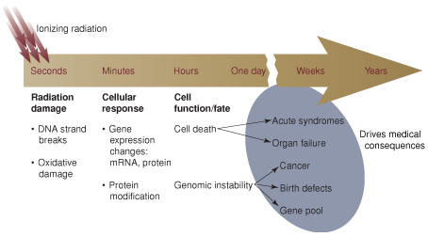
Biological effects of ionizing radiation
Direct ionizing = direct destruction of biomacromolecules
Indirectly (nondirect) effects = production of free radicals (radiolysis of water)

Slide 10
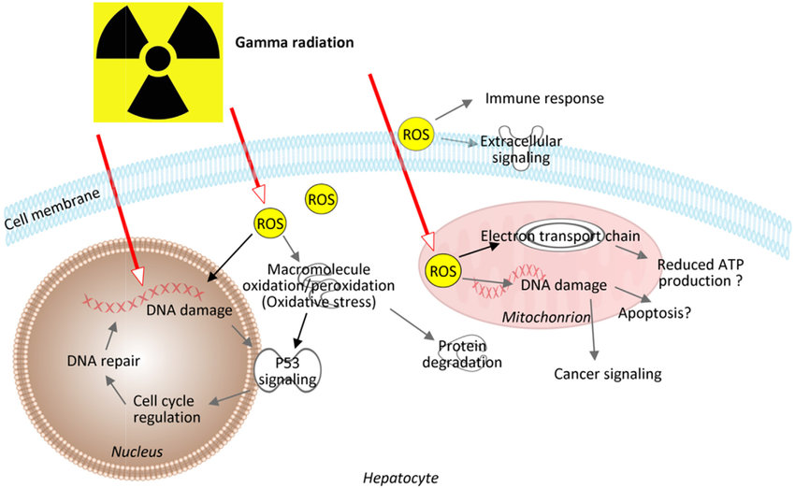
Chemical effect of ionizing radiation
Oxygen effect!!

Slide 11
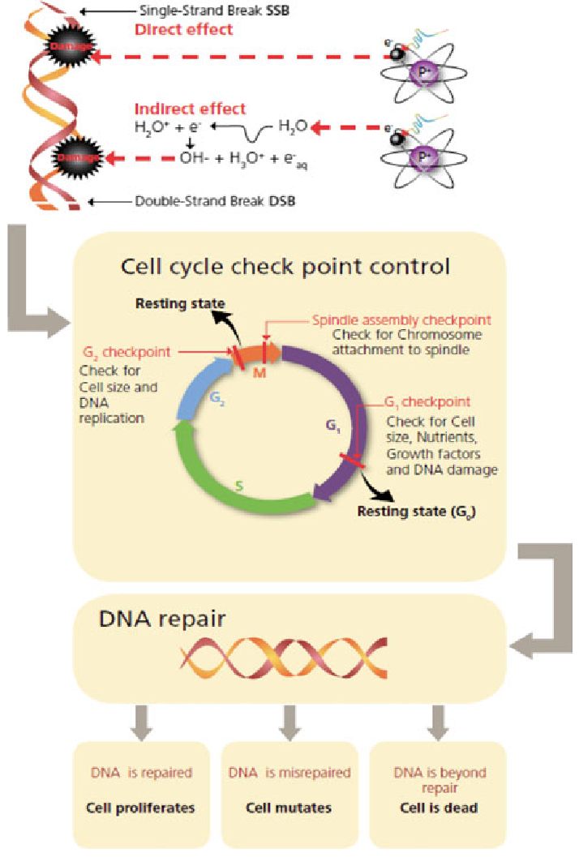

Slide 12
DNA damage
Very serious state
DNA damage is reflected in the synthesis of damaged proteins
DNA repair mechanisms
Reproductive ability of cells

Slide 14
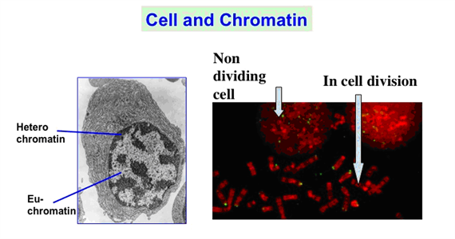
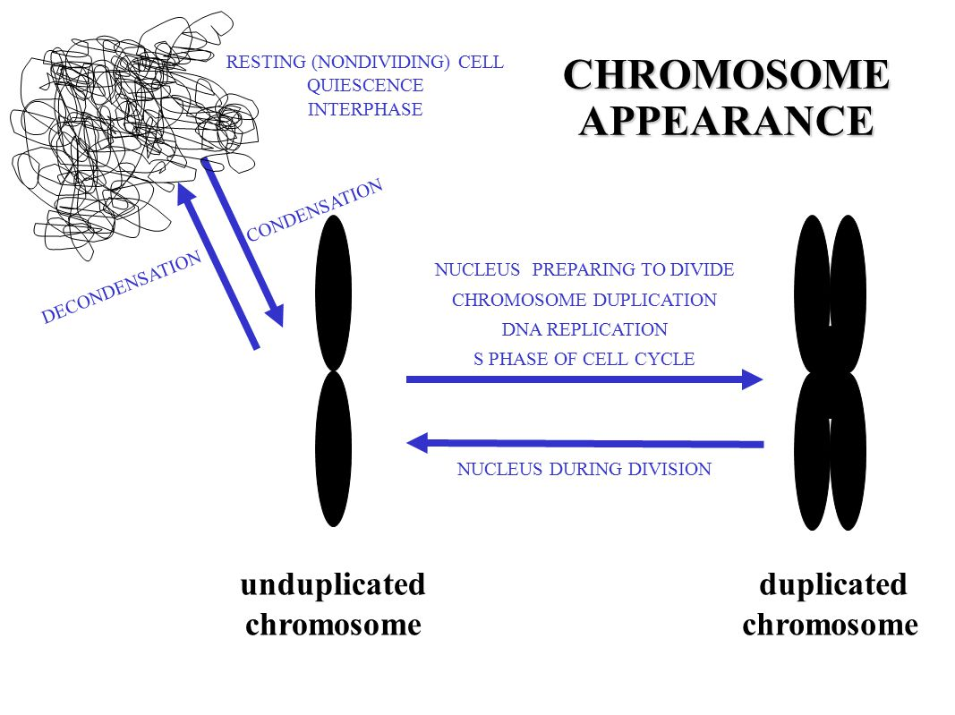

Slide 15
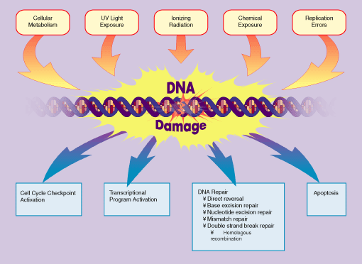
Mechanisms of DNA damage

Slide 16
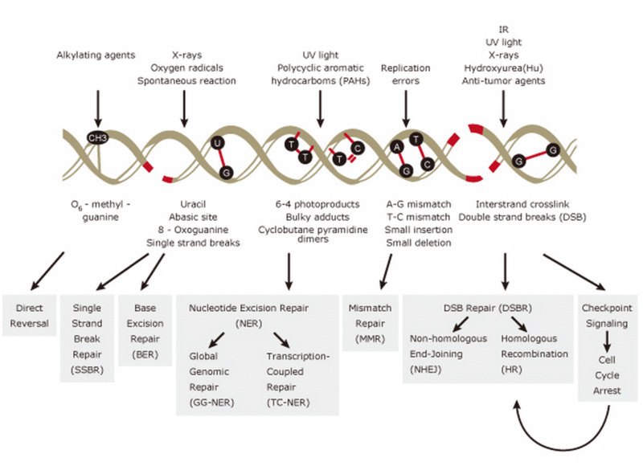
damage response enables life on earth as we know it

Slide 17
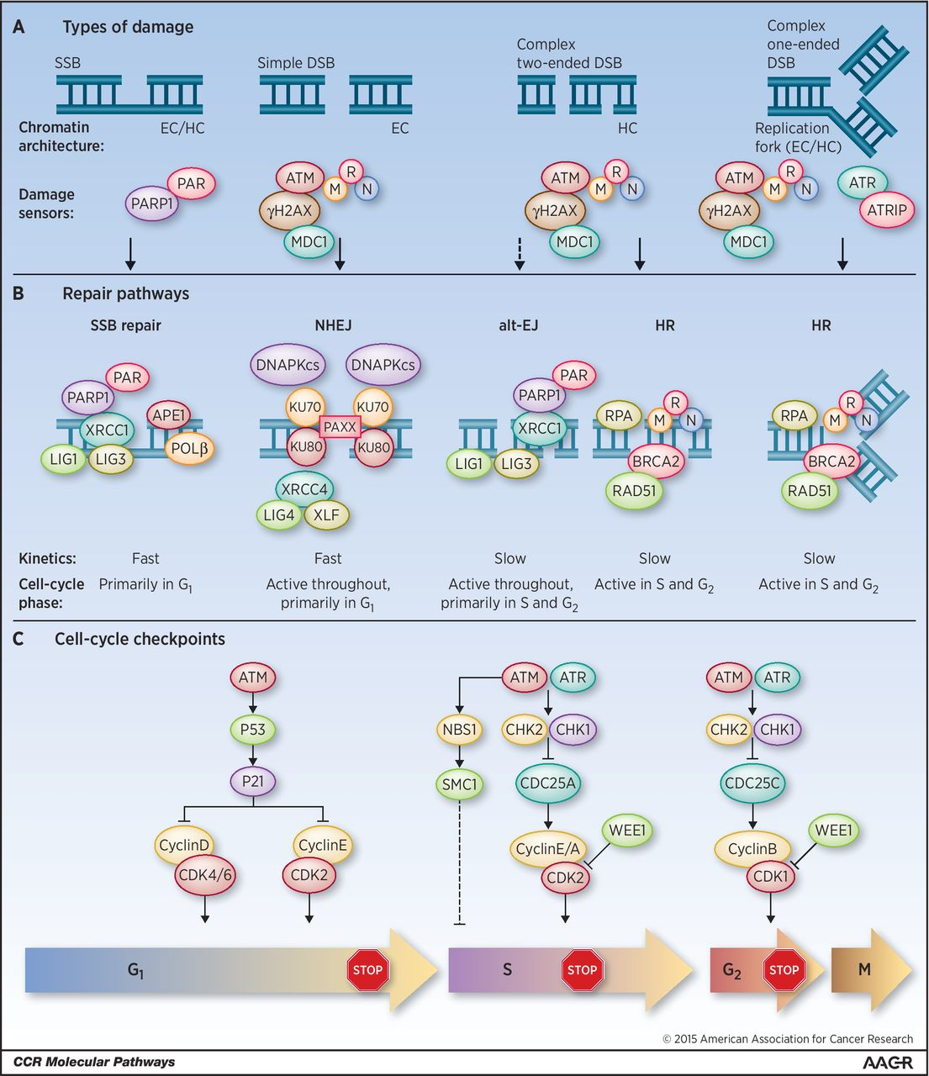

Slide 18
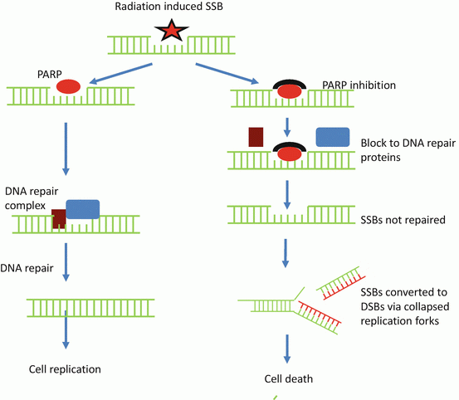

Slide 19
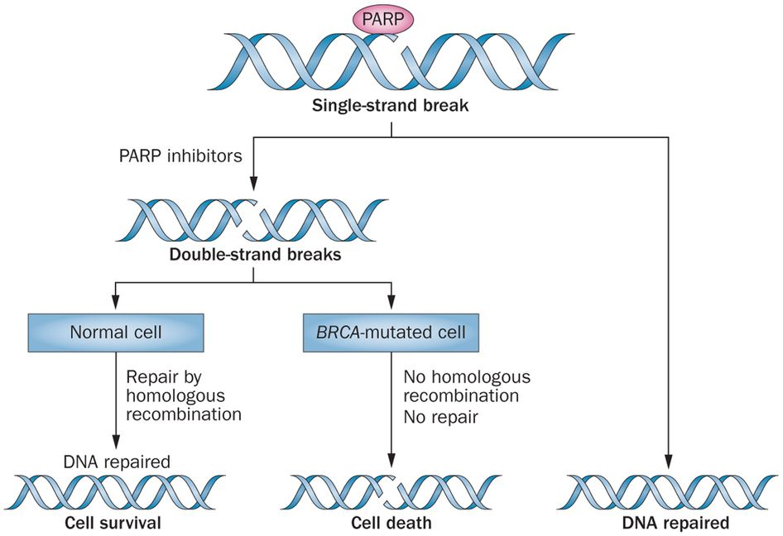

Slide 20
Repair mechanisms
Direct repair
Excision repair
Mismatch repair
SSB repair
(DSB repair)

Slide 21
Effects of ionizing radiation on the human body
Deterministic effects
Stochastic effects

Slide 22
Deterministic effects
There are those that will take effect after total body irradiation, or a tissue once
The dependence of the probability of occurrence of damage to an equivalent dose have the sigmoid character

Slide 23
Deterministic effects
Acute radiation sickness (radiation syndrome)
Local acute skin damage
Damage to fetus
Infertility
Lenticular opacities

Slide 24
Stochastic effects
They result from damage to a small number of cells
They can occur after a single exposure of sub-threshold dose or chronic radiation tissue or whole body

Slide 25
Character of biological effects
Deterministic
– severity dependent (“determined”) on the dose
– manifestation is specific
– effect only when exposure exceeded threshold
– damage of large amount of cells
– onset rather close to the exposure (short latency)
– types:
acute radiation syndrome
chronic post-radiation syndrome
cataract, radiation dermatitis,
damage of the foetus in utero
sterility
Stochastic
– probability increases with the dose (not the severity!)
– manifestation non-specific
– gradual increase of the risk without “safe” threshold
– damage of the single cell enough to cause effect
– manifestation delayed (typically years)
– types:
somatic mutation - cancer
leukemias, thyroid, lung, breast, bones
germinative mutation (oocyte, sperm cell)

Slide 26
Acute radiation syndrome
affecting the hematopoietic, gastrointestinal system and cerebrovascular
timing, extent and severity graded according to the dose - deterministic effect!!
from several hours to several months after exposure

Slide 27
Acute radiation syndrome
Haematopoetic syndrome (> 1GY)
GI syndrome (> 10Gy)
early (hours) - nausea, vomiting, diarrhea
late (days) - loss of intestinal integrity
malabsorption, dehydration, toxemia / sepsis, ileus, bleeding
Cerebrovascular syndrome (tens of Gy)
headache, cognitive impairment, disorientation, ataxia, convulsions, fatigue and hypotension
Cutaneous
erythema, burns, edema, impaired wound healing

Slide 28
Hematopoetic syndrome
bone marrow irradiation (> 1GY) leads to an exponential cell death - haematological crisis
marrow hypoplasia to aplasia + peripheral pancytopenia (infection, bleeding)
subpopulation of stem bb is selectively more radioresistant, (probably due to predominance bb. stage in Go)
necessary for regeneration
anemia is the result of late (erythrocytes ~ 120 days)!
massive stress response (glucocorticoids) contribute to lymphopenia (cytolytic effect) and paradoxically delay the onset of granulocytopenia (release stocks. granulocytes from the spleen)

Slide 29
Therapeutic effects of ionizing radiation
Teleterapy (⁶⁰Co)
Contact therapy (³²P, ⁹⁰Sr)
Brachytherapy (⁶⁰Co, ¹³⁷Cs)
Endotherapy (Na¹³¹I)
Radioimunotherapy

Slide 30
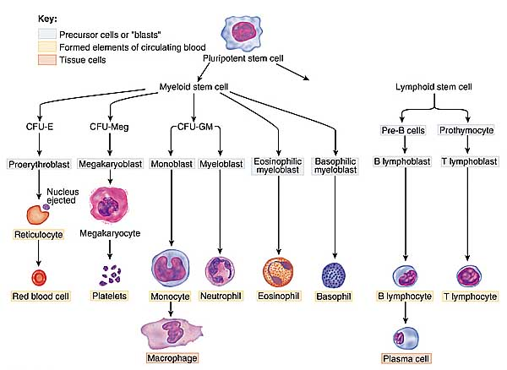
Hemopoesis

Slide 32
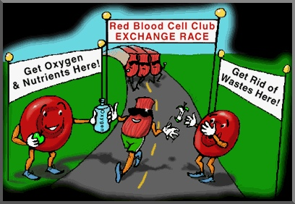

Slide 33
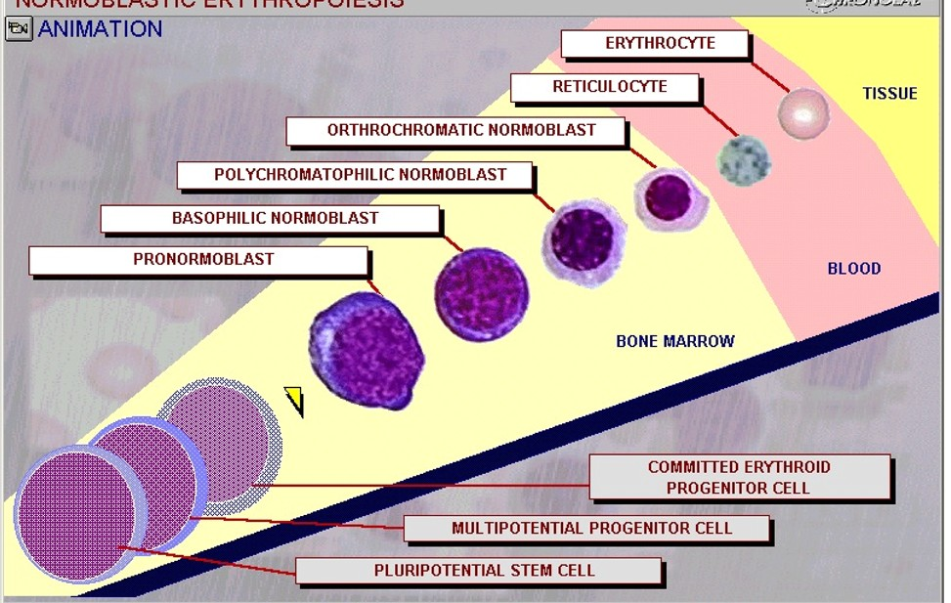
Erythropoiesis
http://www.noblesmedart.com/morph.mov

Slide 34
Erythropoiesis
Erythropoiesis is the development of mature red blood cells (erythrocytes).
Like all blood cells, erythroid cells begin as pluripotential stem cells.
The first cell that is recognizable as specifically leading down the red cell pathway is the proerythroblast .
As development progresses, the nucleus becomes somewhat smaller and the cytoplasm becomes more basophilic, due to the presence of ribosomes. In this stage the cell is called a basophilic erythroblast .
The cell will continue to become smaller throughout development. As the cell begins to produce hemoglobin, the cytoplasm attracts both basic and eosin stains, and is called a polychromatophilic erythroblast .
The cytoplasm eventually becomes more eosinophilic, and the cell is called an orthochromatic erythroblast .
This orthochromatic erythroblast will then extrude its nucleus and enter the circulation as a b . Reticulocytes are so named because these cells contain reticular networks of polyribosomes. As reticulocytes loose their polyribosomes they become mature red blood cells.

Slide 35
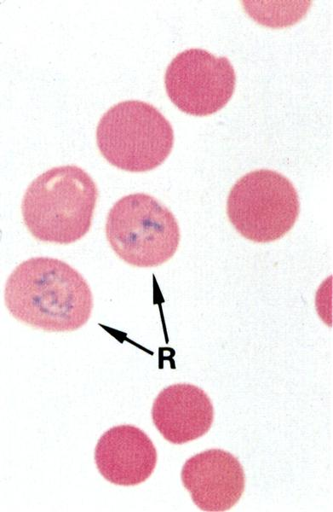
Reticulocyte

Slide 36
Reticulocytes
Reticulocytes are immature red blood cells, typically composing about 1% of the red cells in the human body.
Reticulocytes develop and mature in the red bone marrow and then circulate for about a day in the blood stream before developing into mature red blood cells.
Like mature red blood cells, reticulocytes do not have a cell nucleus.
They are called reticulocytes because of a reticular (mesh-like) network of ribosomal RNA that becomes visible under a microscope with certain stains such as new methylene blue.

Slide 37
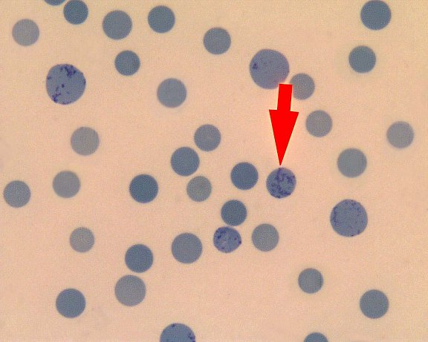

Slide 38
Classification of reticulocyte counts
Counting with imersion, magnification 100
Out of 1000 RBC in the moving viewing field, the number of RET will be counted
Normal counts RAT: app. 20 %o RET
Normal counts MAN: app 0.5-1.5% (5-15%o) RET
↑ number: increasing bloodforming (regeneration) ↓ number: inhibition of erythropoiesis

Slide 39
Differential leucocyte counts
Changes in WBC number (%)
Indication of infection, poisoning, leukemia, chemotherapy, alergic reaction
Normal WBC counts in man:
neutrophils 60-70% (incr. in bacterial infection)
lymphocytes 20-25% (incr. in viral infection)
monocytes 3-8 % (incr. in fungal/viral infection)
eozinophils 2-4 % (incr. in alergic reaction and parasital infect.)
bazophils <1% (incr. in alergic reaction)

Slide 40
Normal counts of WBC in rat
Number of WBC............cca 12.5 tis.mm-3
- neutrophil granulocytes 18 - 36% - eozinophil granulocytes 1 - 4% - bazophil granulocytes 0 - 1% - lymphocytes 62 - 75% - monocytes 1 - 6%

Slide 41
Blood smear
neutrophil „band“
neutrophil „segment“
monocyte
lymphocyte
eozinophil
bazophil
trombocyte

Slide 42
Praktikum I - design

Slide 43
Praktikum I – operační postup

Slide 44
Praktikum I - hodnocení

Slide 45
Výška = 0,1 mm
0,05 mm
0,2 mm

Slide 46
Viewing of smear
The stained smear will first be viewed at a low magnification and an area where white cells are not overlaid by red cells will be selected.
Using an immersion objective, a total of 100 WBC will be registered and identified as to their individual type.
The viewing field will be moved in order to count the prescribed number of leucocytes.

Slide 47
j.gumulec@med.muni.cz | @jarogumulec | www.med.muni.cz/masariklab

