Slide 1
Branches of Pharmacology
Decide in which branch of pharmacology texts belong.
Explain what the text is about and summarize what is the branch of pharmacology studying.
Notes:
Texty jsou v souboru Podobory_texty.doc na Medei.

Slide 2
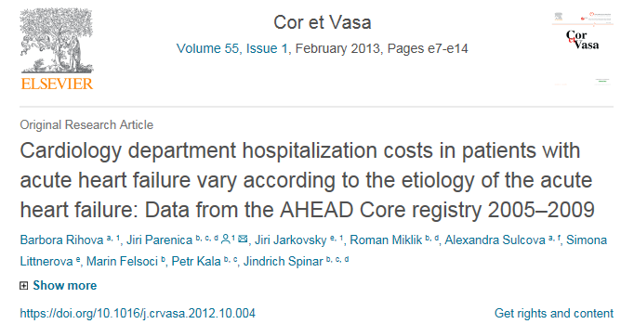
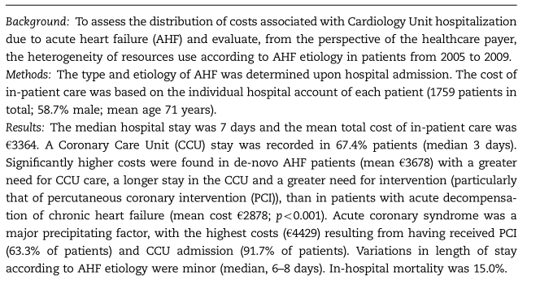
https://www.sciencedirect.com/science/article/pii/S0010865012001154?via%3Dihub
Notes:
Farmakoekonomika

Slide 3
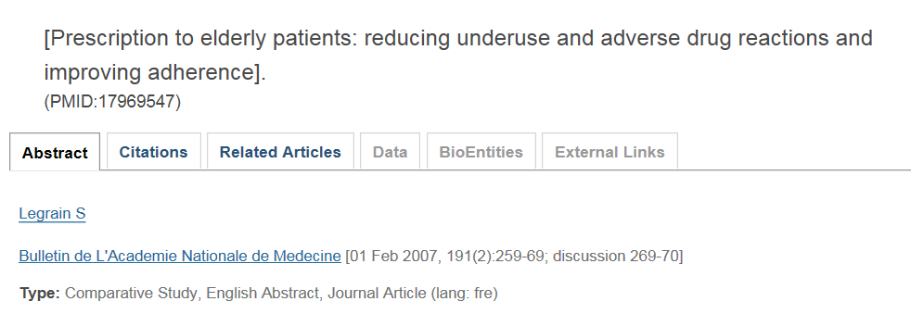
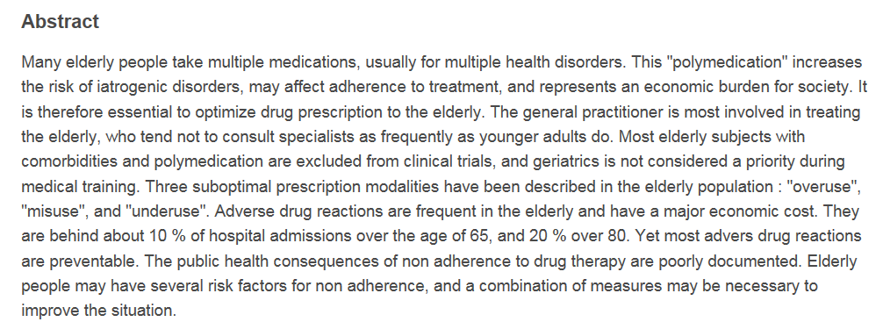

Slide 4
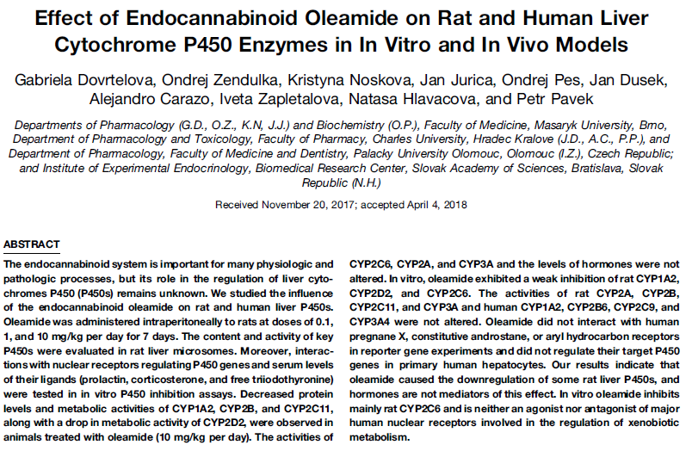
http://dmd.aspetjournals.org/content/dmd/46/6/913.full.pdf
Notes:
Experimentální farmakologie (preklinická), resp. farmakokinetika

Slide 5
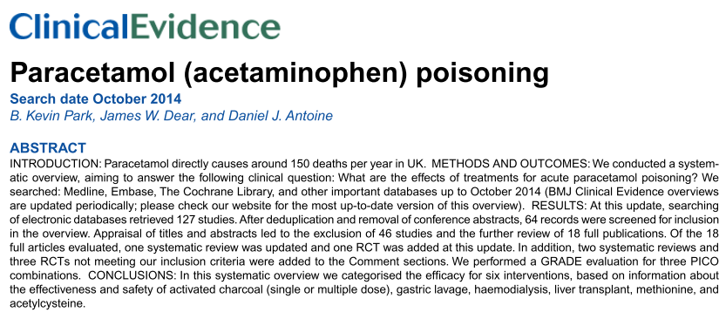
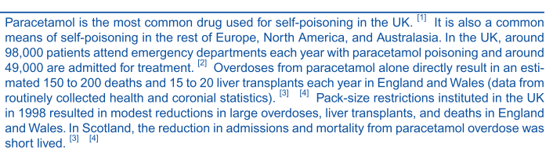
https://www.ncbi.nlm.nih.gov/pmc/articles/PMC4610347/pdf/2015-2101.pdf
Notes:
Farmakovigilance

Slide 6
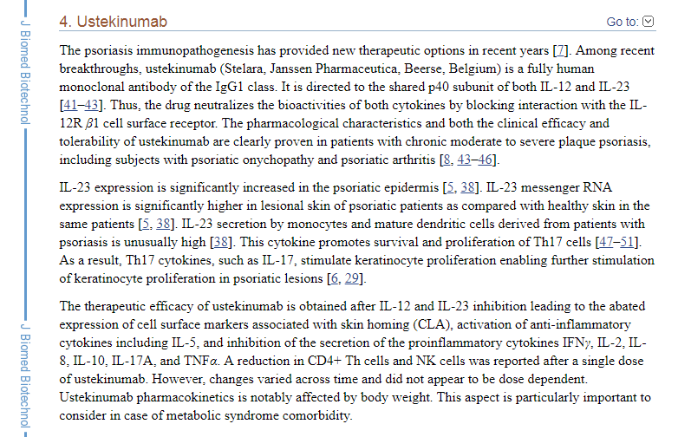
https://www.ncbi.nlm.nih.gov/pmc/articles/PMC3384985/
Notes:
Farmakodynamika

Slide 7
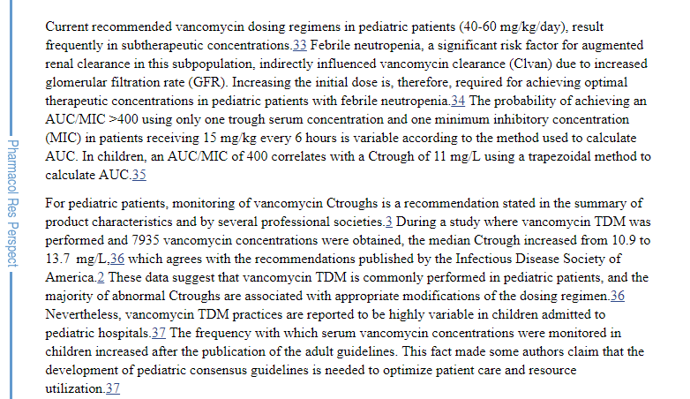
https://www.ncbi.nlm.nih.gov/pmc/articles/PMC6113434/
Notes:
Klinická farmakokinetika

Slide 8
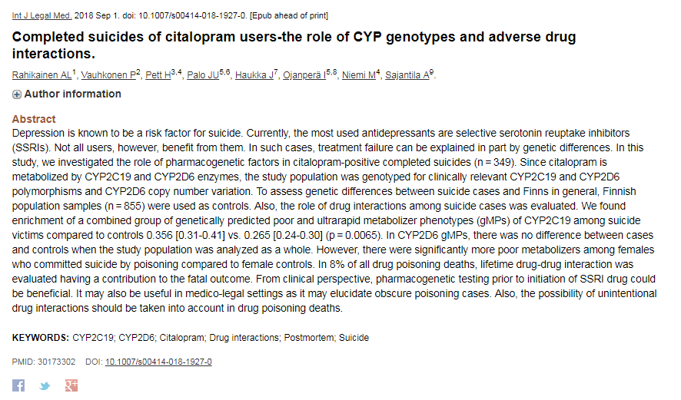
https://www.ncbi.nlm.nih.gov/pubmed/30173302
Notes:
Farmakogenetika

