Slide 1


GLUCOCORTICOIDS
Department of Pharmacology MF MU

Slide 2
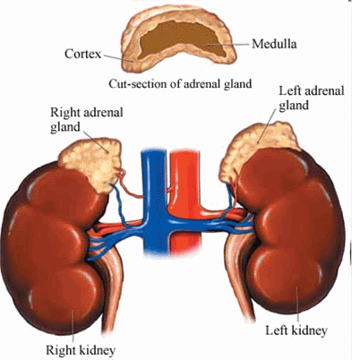
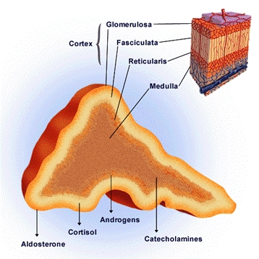

Suprarenal glands - anatomy

Slide 3
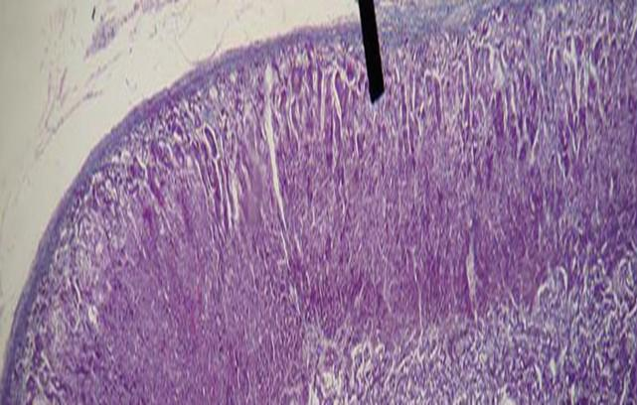
Adrenal cortex - physiology
Zona glomerulosa – mineralocorticoids production - aldosteron 10 – 15% of tissue, controlled by ATII a K⁺.
Zona fasciculata 75% of tissue, controlled by ACTH, „stock“ of cholesterol, its releasing and transformation to cortizol = main human glucocorticoid.
Zona reticularis 10 – 15 % of tissue – androgens, gestagens, cortisol production.
Zona glomerulosa
Zona fasciculata
Zona reticularis

Slide 4
Steroid hormones biosynthesis - biochemistry
Cholesterol
20,22 desmolase
Pregnenolone
17α hydroxylase
Progesterone
17α-OH - pregnenolone
17α hydroxylase
3β - dehydrogenase
17α-OH - progesterone
TRILOSTAN
DHEA
21-β hydroxylase
11- deoxycorticosterone
11 - deoxycortisol
androstendion
other 17 - ketosteroids
METYRAPON
11-β hydroxylase
corticosterone
Hydrocortisone = cortizol
estrone
testosterone
aldosterone
cortizon
estradiol
dihydrotestosterone
Precurzors
Mineralocorticoids
Estrogens
17 ketosteroids
Intermediate products
Glucocorticoids
Androgens

Slide 5
Glucocorticoids - regulation
pain
stress
ADH
pyrogens
histamine
↓ BP
↓ glycaemia
+
+
+
+
+
+
+
hypothalamus
-
CRH
corticoliberine
+
hypophysis
-
+
ACTH
corticotropine
suprarenal gland
+
cortisol

Slide 6
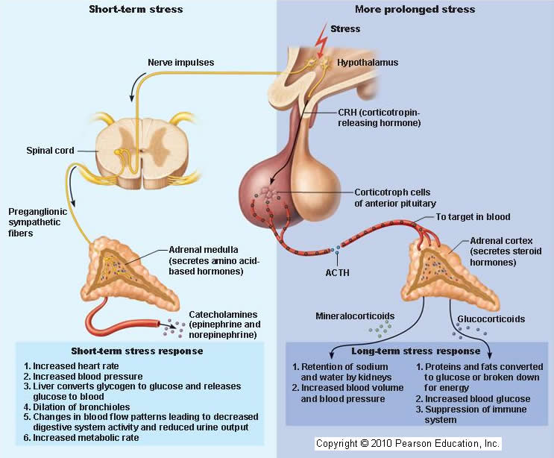

Slide 7
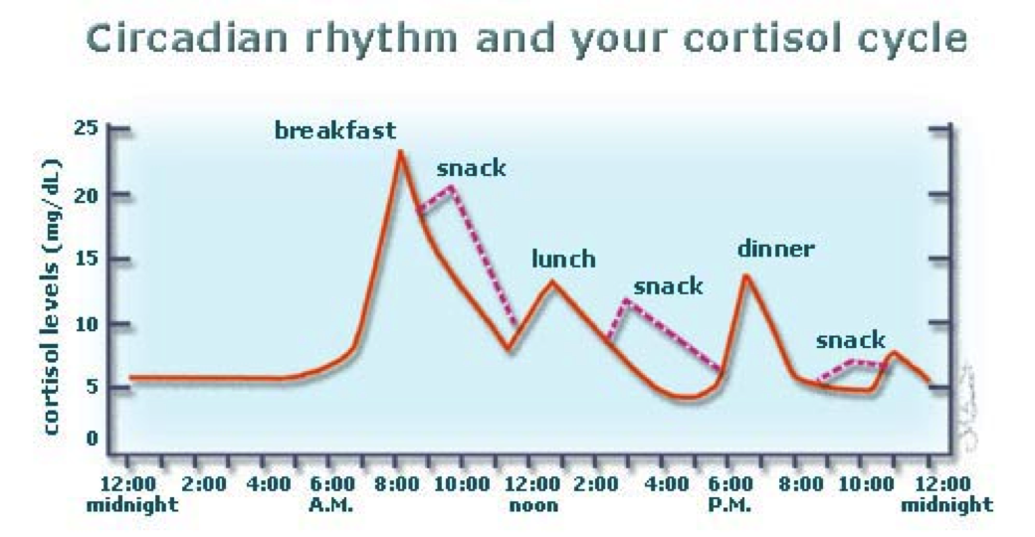
Endogenous and exogenous cortisol secretion
Resting – 20 – 25 mg/24 hours
Stress: 10 times higher
Maximum: 6 – 8 hours a.m.
Exogenous corticoids usage – endogenous secretion downturn

Slide 8
Mechanism of action in cellular level
Specific
Glucocorticoid
Receptor-hormon komplex
Receptor
Receptor in cytoplasma – slower efekt

Slide 9

Mechanism of action in cellular level
Specific
Change of proteosynthesis
Notes:
Protein může působit již uvnitř buňky.

Slide 10
Glucocorticoids
influence sugar, fat and protein metabolism
have anti-inflammatory and anti-allergic effect
have immunosuppressive effect (in many branches – in next slides)
have antiproliferative effect
hydrocortisone (cortizol)

Slide 11
GCs and sugar, fat and protein metabolism
reduced glucose uptake and reduced glucose utilisation in the cell
Proteolysis, tissue
proteins = aminoacids decomposition of tissue proteins ↑ gluconeogenesis
catabolism (glucose formation from non sugar residues)
↑ glycaemia
Connective tissue
muscle atrophy
fibroblasts growth stopping ↑ of insulin secretion
↓osteoblasts, ↑osteoclasts
↓collagen synthesis
↓Ca resorption from intestine,
kidneys (osteoporosis)
↑ storage of glycogen in the liver lipogenesis support, lipolysis inhibition
fat deposition, redistribution,
↑glycerol, aminoacids in blood
Fats: ↑ lipolysis, facilitation of lipid absorption, fat redistribution

Slide 12
Other effects
CNS: Euphoria / psychotic disorder after high doses / depression
GIT: Increasing formation of HCl and pepsin in the stomach
BLOOD: ↑ Tro, Ery, circul. ↓lymfocytes, ↓eosinofils
LUNGS: ↑ formation of pulmonary surfactant
HCl – hydrochloric acid

Slide 13
GCs and congenital developmental defects
GK and ions
Permissive effect to:
- Development of organs of the fetus
- Development and maturation of intestinal enzymes
- Increases the synthesis of surfactant in the lungs of the fetus
- Suppresses bone growth
Ions
- Decreased calcemia
- Increased potassium loss
- Sodium and chloride retention

Slide 14
Regulatory effects
Negative feedback on the hypothalamus and the anterior lobe of the pituitary gland
reduced release of endogenous glucocorticoids
Vasotropic - GCs - vasoconstriction, decrease of permeability of vessels, suppression of edema
At cell level:
in place of acute inflammation: decrease in migration and leucocyte activity
in place of chronic inflammation: decrease proliferation of blood vessels and fibrosis
In place of lymphoid tissue: decrease B and T lymphocyte expansion
Towards the mediators of inflammation and immunological reaction:
Decrease of cytokine production and activity, decreased synthesis of PGs

Slide 15
Anti-inflammatory – cascade inhibition of AA
glucocorticoids
Membrane phospholipids
lipocortins
Phospholipase A2
Inh. 5-LOX - antileukotriens
Arachidonic acid
A-A
NSAID
lipoxygenase
PROSTAGLANDINS
PROSTACYCLINS
THROMBOXANS
cyclooxygenase
LEUKOTRIENS
eikosanoids
Fagycytosis mobilisation
Blood vessel permeability change
Inflammation
inflammation

Slide 16
Anti-inflammatory effect
AA cascade inhibition
Migration and leucocyte function disruption
Antibody production reduction
All types of inflammation regardless of origin!
(aseptic, viral, bacterial, parasitic….)

Slide 17
Anti-inflammatory effect
Decreased histamine release from basophils
Inhibition of the formation of inflammatory mediators and allergic reactions (cytokines, complement components, kallikrein ...)

Slide 18
Immunosupressive effect
Inhibition of antigen recognition
Inhibition of the effector phase of the immune response (cell lysis)
! CAUTION:
Inhibition CELL MEDIATED immunity
ANTIBODY immunity is affected significantly less and in GSc higher doses

Slide 19
Anti- proliferative effect
Block cell cycle
Induction of differentiation
GCs - lymphocyte disintegration (acute and chronic lymphocytic leukemia, lymphomas, myelomas)

Slide 20
Effect and equipotent doses of CSs
Substance | Equip.dose | Anti infl. effect | Mineral. effect
Cortisol | 20 mg | 1 | 1
Cortisone | 25 mg | 0,8 | 0,8
Prednisone | 5 mg | 4 | 0,8
Prednisolone | 5 mg | 4 | 0
Methylpredn. | 4 mg | 5 | 0
Triamcinolone | 4 mg | 5-10 | 0
Dexamethasone | 0,75 mg | 25 | 0
Bethametasone | 0,6 mg | 25 | 0
Fludrocortisone | - | 10 | 125

Slide 21
Systemically administered GCs
1-4 times efficient than cortisol
  prednisolone, prednisone
  hydrocortisone
5-15times efficient than cortisol
  methylprednisolone (Solu-Medrol)
  triamcinolone
  paramethasone
  fluprednisolone
approx 30times efficient than cortisol
  bethametasone
  dexamethasone
Short term acting
Medium term acting
Long term acting
(stronger axis supression)

Slide 22
Glucocorticoids therapeutical regimen types
Short term application of high doses
A) single (2-4 g methylprednisolone)
Polytraumatas, septic, toxic shock
Hydrocortisone 30 mg / kg
B) repeated (methylprednisolone, hydrocortisone, dexamethasone)
Anaphyl. shock, status asthmaticus, hypoglycemic coma ...
Duration up to 48 hours
Exceptionally up to 7 days

Slide 23
Glucocorticoids therapeutical regimen types
C) Pulse therapy
Short-term infusions for several days
Originally in transplant rejection
Today predominantly in immune-mediated diseases resistant to
standard therapy
D) Prolonged therapy
In most branches
Primarily for anti-inflammatory and immunosuppressive effects
Dosage and length depends on the current status of the patient
Strength differences, duration and frequency of adverse effects
No hydrocortisone with respect to mineralocorticoid activity

Slide 24
Glucocorticoids – adverse events
Before therapy start:
potential infection elimination
fasting glycaemia
diabetes compensation
preventive application of D vitamine
anti-ulcer treatment
Notes:
24

Slide 25
Glucocorticoids – adverse events
During the therapy:
DM monitoring compensation
monitoring of mental state
myopathy and osteporosis prevention (K, Ca, rehab., exercise)
thromboembolic prevention
consultation the centre for growth hormone treatment in pediatric medicine

Slide 26
Glucocorticoids – adverse events prevention
Prevention
- Application of the lowest effective dose
- If possible local applications
- Combination with other drugs
- Circadian therapy / alternating therapy
- Minimizing the use of depot medication (circadian rhythm disruption, local
trophic changes after application)
Notes:
26

Slide 27
Glucocorticoids – adverse events
^{Immunosuppression}
- ↑ susceptibility to infections, activation of latent infections
^{- Slow wound healing}
- Even with local administration
Supression of endogenous glucocorticoid production
- Acute inadequacy when suddenly discontinuing higher doses
- Prevention = complete therapy by gradual dose reduction
^{Osteoporosis}
- Risk only for chronic therapy
^{- Densitometric examination}
^{Mineralocorticoid effect}
^{- Water retention and Na +}
^{- ↑ BP, loss of K +}

Slide 28
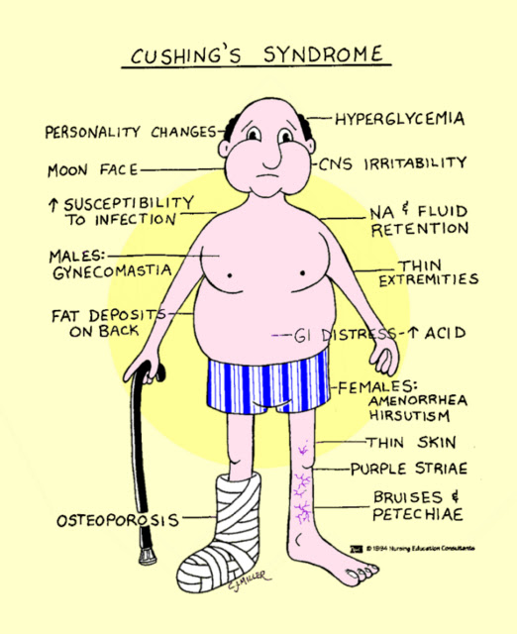
Glucocorticoids – adverse events
Hyperglycemia, steroidal diabetes
Muscle weakness, myopathy, atrophy
Psychotropic effects
Insomnia, motor agitation, vertigo, euphoria, depression
Psychic habit
GIT
Exacerbation of gastric ulcer
Intestinal perforation, acute pancreatitis
KVS
- HT, atherosclerosis, cardiomyopathy, ↑ coagulopathy, arrhythmia

Slide 29
Glucocorticoids – adverse events
Eye
Induction of glaucoma (↑ intraocular pressure)
Corneal ulceration in keratitis herpetica
Endocrine
Growth inhibition in children (therapy longer than 6 months)
Amenorrhea, potency and libido decrease
Skin
Atrophy
Intradermal bleeding
Acne, hirsutism

Slide 30
Glucocorticoids – interactions
Prednisone reduces the plasma levels of salicylates and oral anticoagulants.
The effect of prednisone is reduced by barbiturates, phenytoin, rifampicin.

Slide 31
Routes of administration
p.o.
i.v.
i.m.
s.c.
inhalatory
ointment/cream
eye/nose drops
intraarticularly

Slide 32
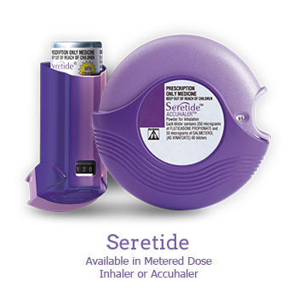
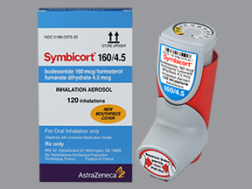
Inhalation GCs in asthma treatment
The most effective preventative antiasthmatics
Improve pulmonary function, reduce bronchial hyperreactivity, reduce exacerbations, improve quality of life
Beclomethasone dipropionate, budesonide, fluticasone propionate
Inhaled corticosteroids have a better safety profile than oral
Fixed combination - fluticasone + salmeterol (Seretide Discus)
- budesonide + formoterol (Symbicort Turbuhaler)

Slide 33
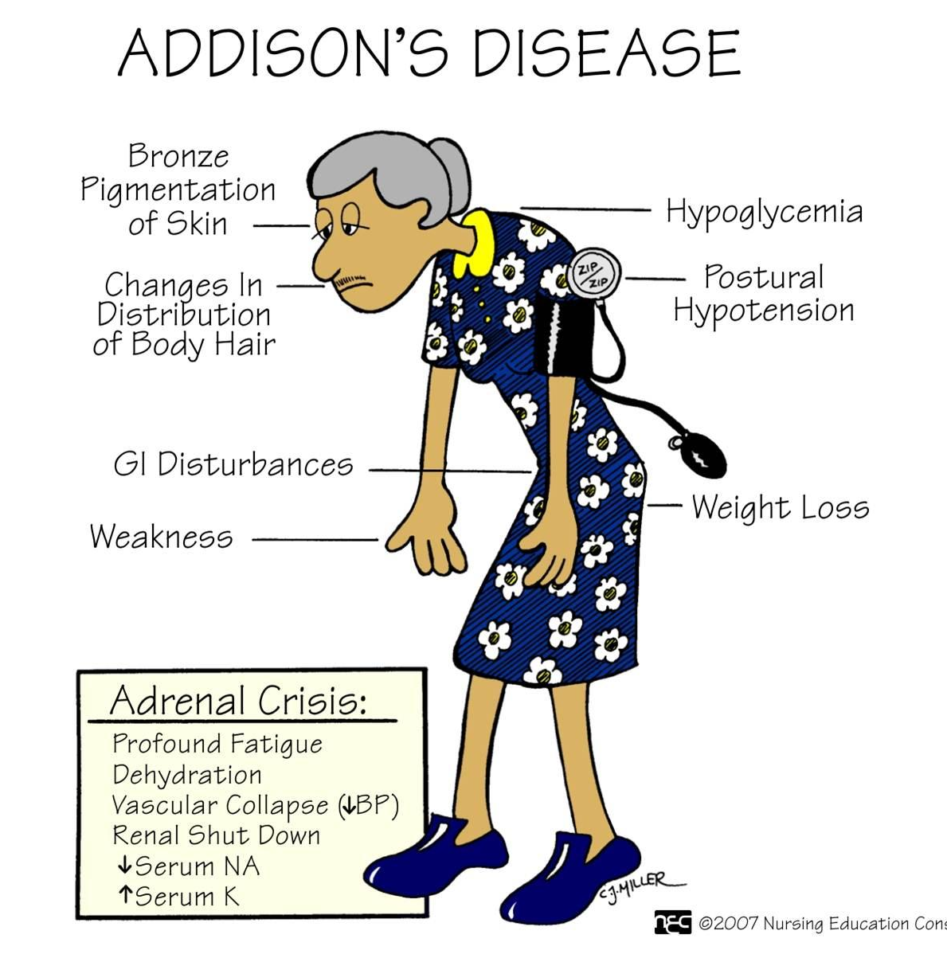
Therapeutic indications
PHYSIOLOGICAL (low) DOSES
insufficiency: cortisol + fludrocortison (mineralokortikoid)
I: Addison’s disease

Slide 34
Therapeutic indications
Higher doses
Diseases of connective tissue, rheumatological diseases and collagenoses
Severe forms of allergic reactions
Non-infectious inflammatory diseases of the eye
Severe skin disorders
Haematological diseases
Malignant diseases
Conditions after organ transplantation
Inflammatory gastrointestinal disease
Non-inflammatory respiratory disorders
Immunalternative disease in neurology

Slide 35
Acute rejection in transplant organs
Sudden deterioration of graft function on immune basis
It occurs in the first three months
Diagnosis of rejection - biopsy and histology result
Therapy:
Pulse treatment of corticosteroids 250 - 500 mg of methylprednisolone 3 - 5 days leading to a graft stabilisation in majority of patients
In case of corticoresistance - antithymocytic globulin

Slide 36
Corticoids in clinical practice

Slide 37
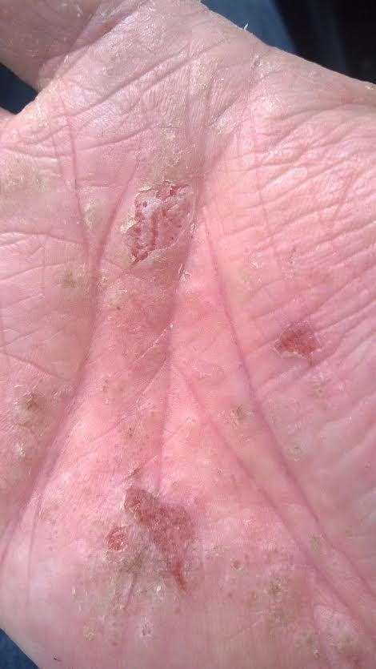
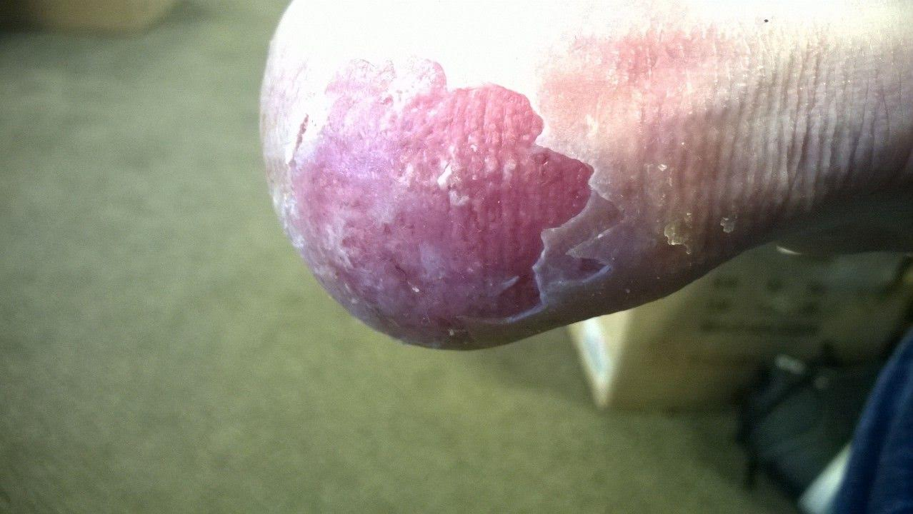
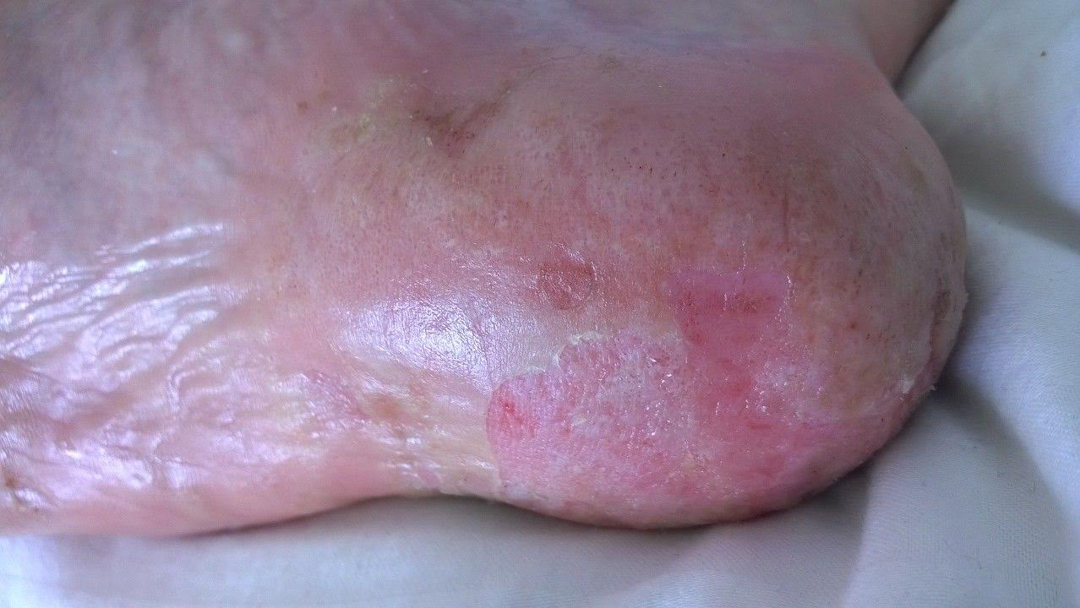
Skin diseases
Eczema dyshidroticum, before therapy
Hand-foot syndrom
Man 35 years old
2 – 3 years of hands eczema
Status of treatment with local corticosteroids for 2 years
Extreme impact on quality of life!

Slide 38
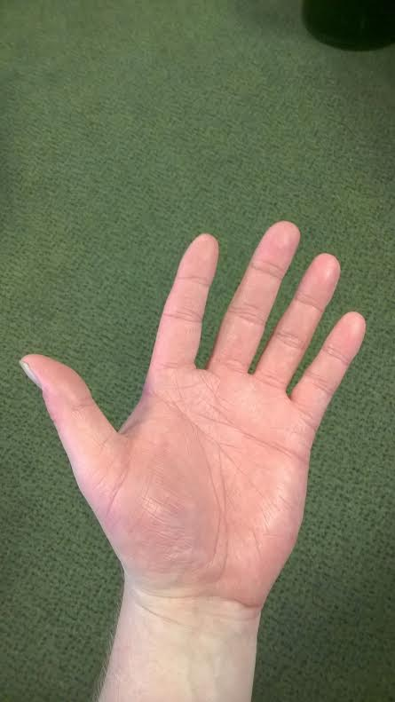
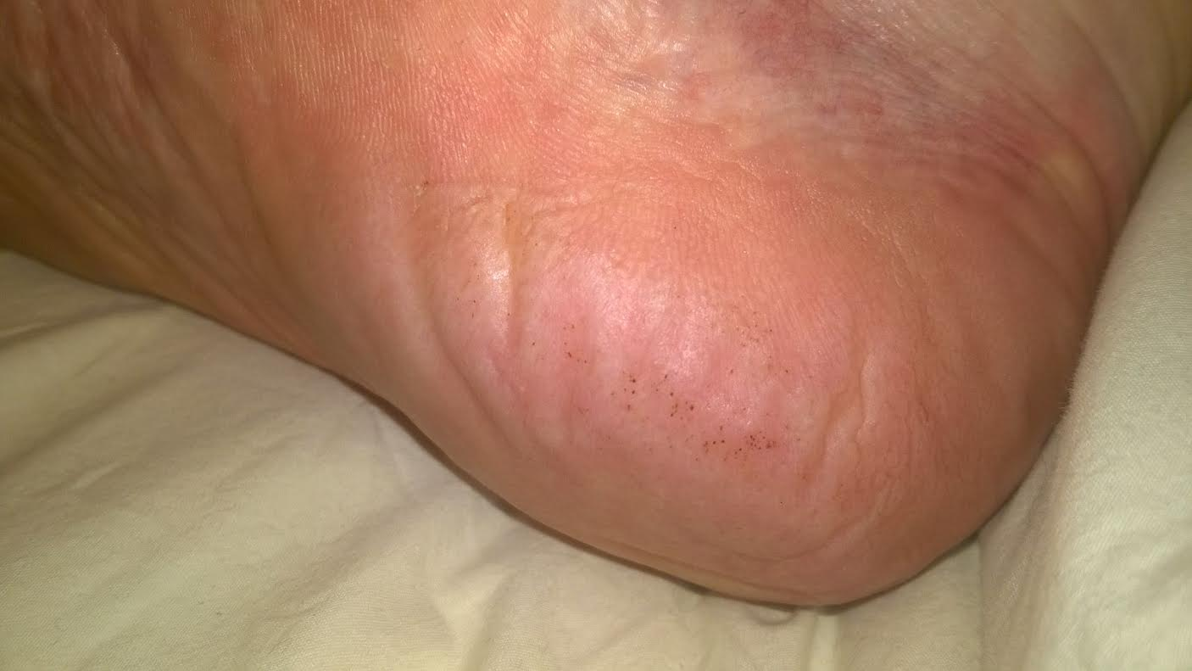
Skin diseases
Eczema dyshidroticum, after therapy
Prednison 50 mg / daily – 1 month
Proton pump inhibitors
Effect after 1 week of systemic therapy, but:
Severe AE:
Sleep disturbances
Depression
Hypertension
(repeatedly 160/110)
withadrawal
Next strategy?
Immunosupressants?

Slide 39
MINERALOCORTICOIDS

Slide 40
The main endogenous mineralocorticoid is aldosterone.
Its chief action is to increase Na⁺ reabsorption by the distal tubules in the kidney, with a concomitant increase in excretion of K⁺ and H⁺.
An excessive secretion of mineralocorticoids: marked Na⁺ and water retention, with increased extracellular fluid volume and sometimes hypokalaemia, alkalosis and hypertension
Decreased secretion: Addison’s disease, Na⁺ loss, marked decrease in extracellular fluid volume

Slide 41
Mechanism of action
Like other steroid hormones, aldosterone acts through specific intracellular receptors of the nuclear receptor family.
Unlike the glucocorticoid receptor, which is present in most cells, the mineralocorticoid receptor is restricted to a few tissues (kidney and the transporting epithelia of the colon and bladder).

Slide 42
Fludrocortisone is given orally to produce a mineralocorticoid effect.
increases Na+ reabsorption in distal tubules
increases K+ and H+ efflux into the tubules
acts on intracellular receptors that modulate DNA transcription, causing synthesis of protein mediators
is used together with a glucocorticoid in replacement therapy

Slide 43
Clinical use of mineralocorticoids
The main clinical use of mineralocorticoids is in replacement therapy of patients with Addison’s disease.
The most commonly used drug is fludrocortisone (p.o.) to supplement the necessary glucocorticoid replacement.

