Slide 1
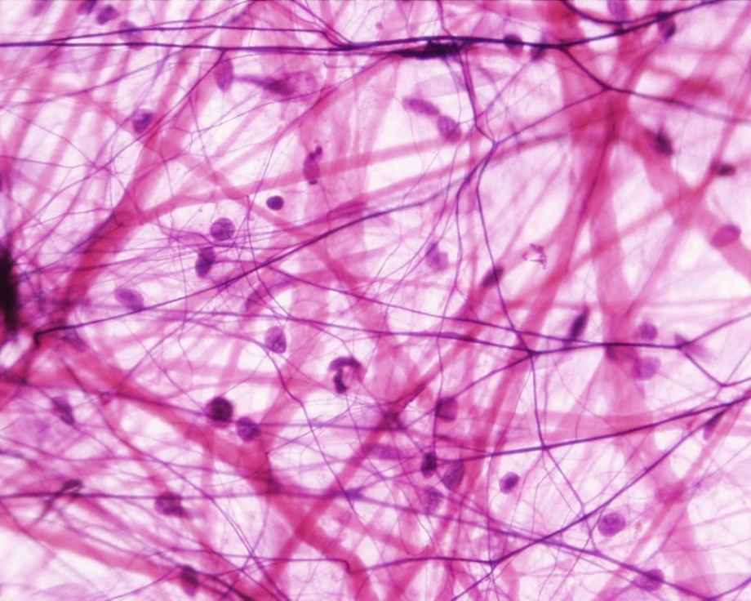
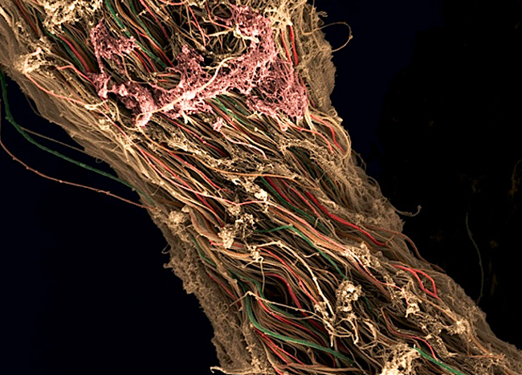
Connective tissue I
2024
Connective tissue proper
Petr Vaňhara
pvanhara@med.muni.cz

Slide 2
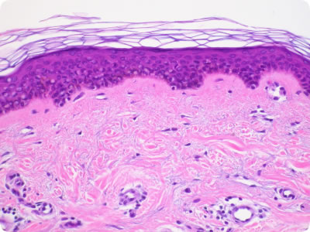
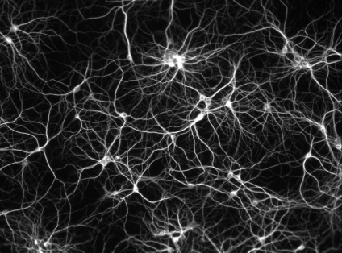
CONTEMPORARY TISSUE CLASSIFICATION
Tissue classification is based on morphology and function:
Continual, avascular layers of cells with different function, oriented to open space, with specific junctions and minimum of ECM and intercellular space.
Derivates of all three germ layers
Epithelial tissue
Myofibrils → contraction
Mesoderm – skeletal muscle, myocard, mesenchyme – smooth muscles
Muscle tissue
Nerve tissue
Neurons and neuroglia
Reception and transmission of electric signals
Ectoderm
Connective tissue
Dominant extracellular matrix
Connective tissue, cartilage, bone…
Mesenchyme

Slide 3
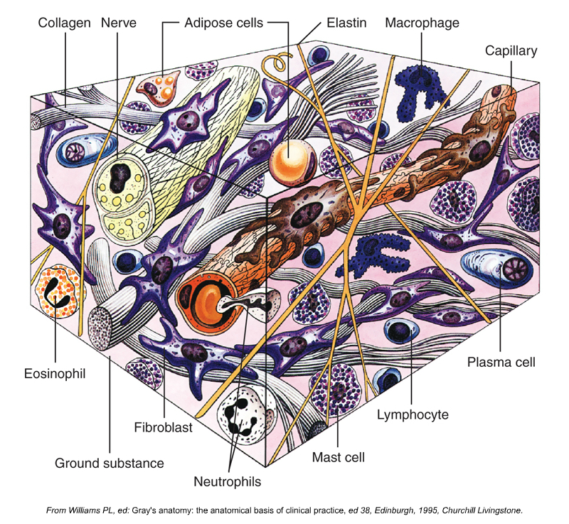
CONNECTIVE TISSUE
Various functions of connective tissues depend on its mechanical and biological properties
surrounds other tissues and provides structural support
compartmentalization
physical-chemical environment
nutrition
innervation
immunological support
storage of energy
cell signaling and tissue regeneration

Slide 4
GENERAL COMPOSITION OF CONNECTIVE TISSUE
All tissues are composed of cells and extracellular matrix
In connective tissue, the ECM is dominant
Cells
Permanent and temporary cell populations
fibroblasts/myofibroblasts
immune cells
phagocytes
adipocytes
adult stem cells
specialized cells of cartilage
(chondroblasts/chondrocytes)
specialized cells of bone
(osteoblasts/osteocytes/osteoclasts)
ECM
Fibrous component
collagen fibers (prototypically col. I, II)
reticular
elastic
Amorphous component (ground substance)
Complex matrix consisting of
glycosaminoglycans
glycoproteins
proteoglycans
Specific composition and properties is dependent on the tissue type
(connective × ligament × cartilage × bone)

Slide 5
GENERAL CLASSIFICATION OF CONNECTIVE TISSUE
Connective tissue (proper)
Embryonic c.t.
Adult c.t.
Mesenchyme
Mucous
Loose (areolar)
Dense
Irregular
Regular
Specialized
Reticular
Adipose
Elastic

Slide 6
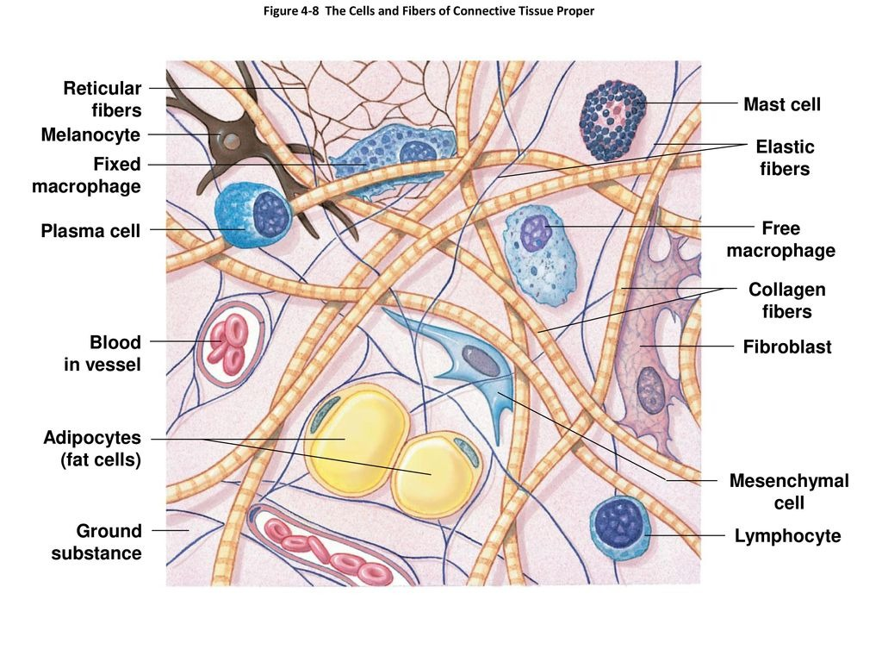
CELLS OF CONNECTIVE TISSUE PROPER
Cells of c.t. proper
Permanent
Fibroblasts/fibrocytes/myofibroblasts
Adipocytes
Adult stem cells
Transiet (migratory)
Macrophages of c.t. /histiocytes)
Mast cells
Plasma cells
Lymphocytes, granulocytes
…

Slide 7
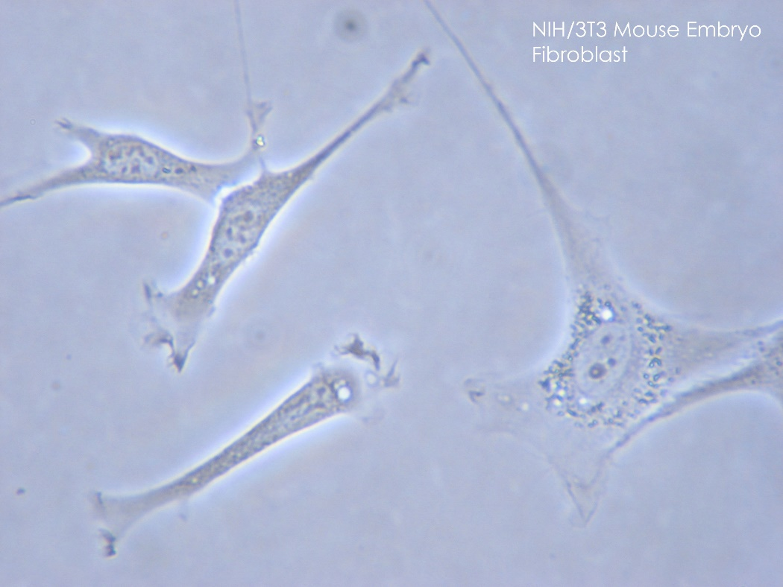
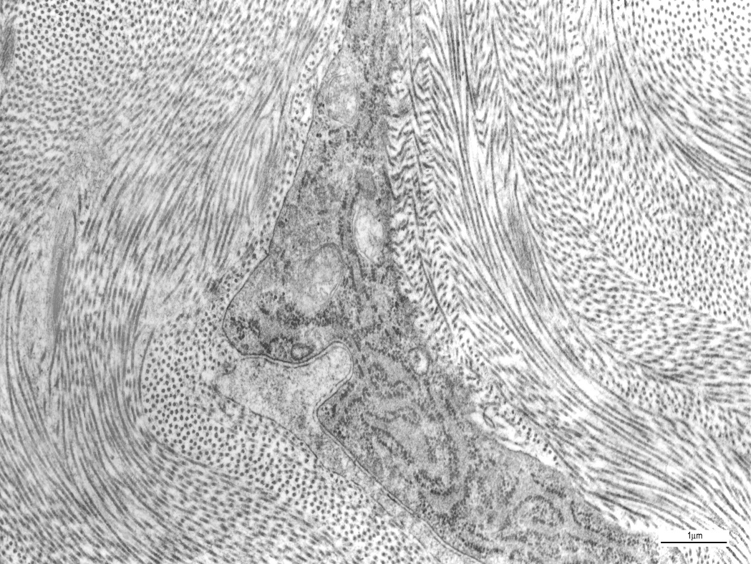
CELLS OF CONNECTIVE TISSUE PROPER
Fibroblasts
Principal c.t. cells
ECM producers
Originate from mesenchyme and resides in the c.t. permanently
Lack typical epithelial polarity
Migration
Fibrocyte ↔ fibroblast
Myofibroblasts
Different tissues contain fibroblasts with different biological properties

Slide 8
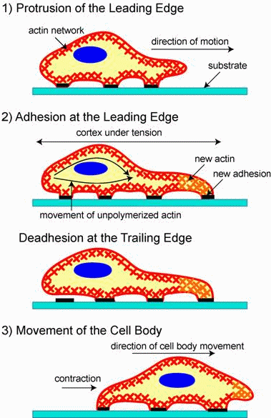
CELLS OF CONNECTIVE TISSUE PROPER
Migration of fibroblasts

Slide 9
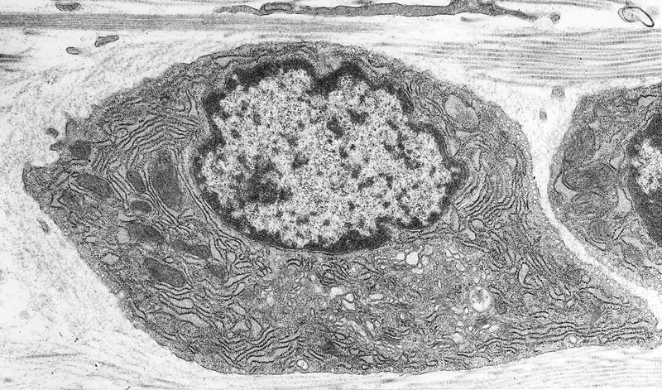
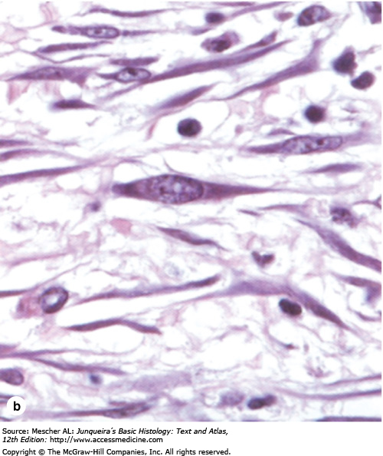
CELLS OF CONNECTIVE TISSUE PROPER
https://www.sciencephoto.com/media/1232046/view/fibroblast-tem

Slide 10
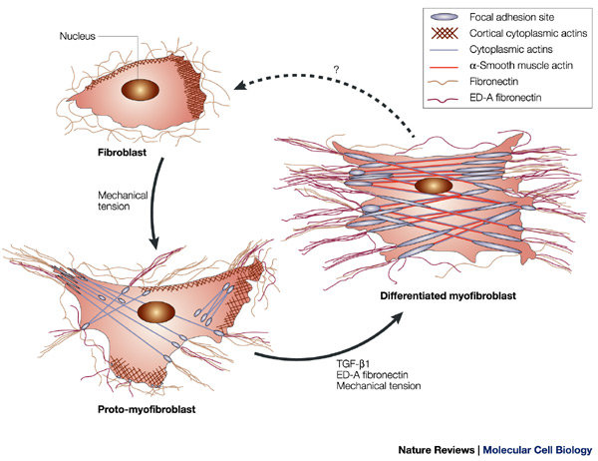
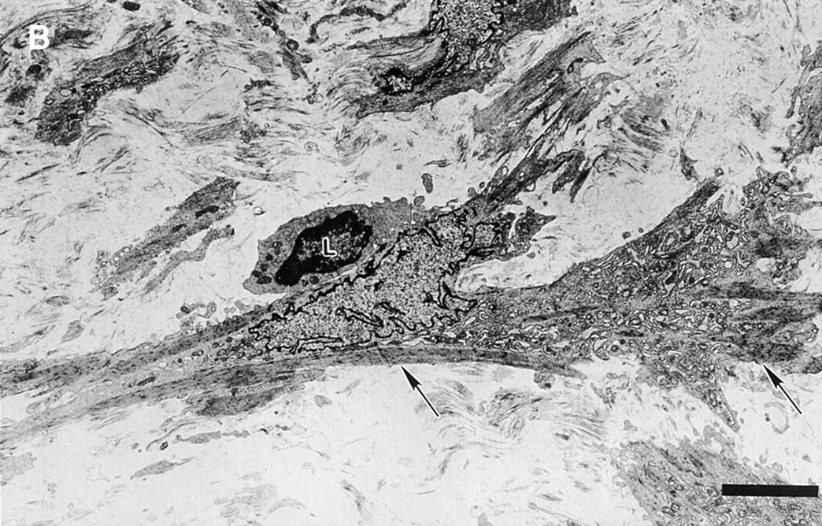
CELLS OF CONNECTIVE TISSUE PROPER
DOI: 10.1038/nrm809
Myofibroblasts
Features of fibroblasts and smooth muscle cells
Contractile cellular structures composed of actin microfilaments and myosin
Wound closure and healing
10.1164/ajrccm.161.5.9903102

Slide 11
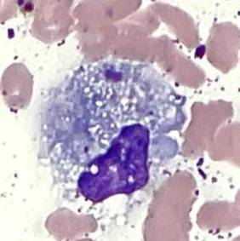
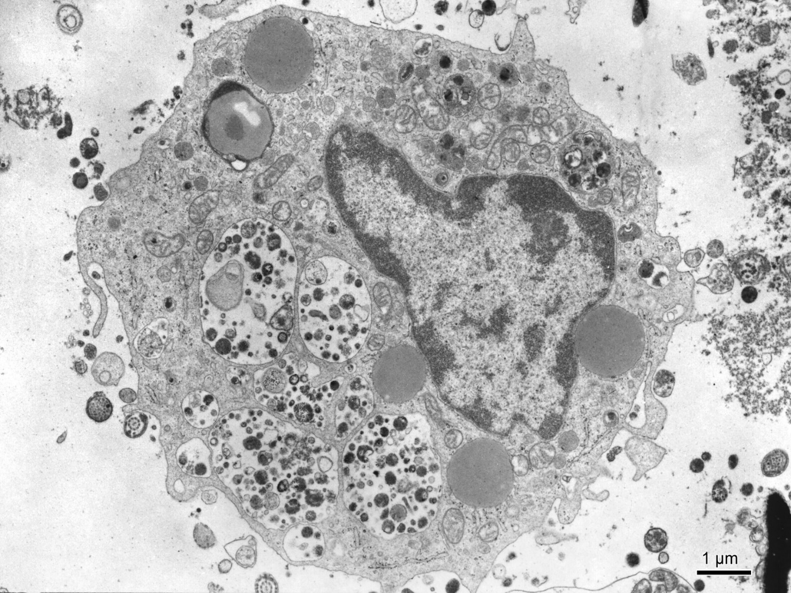
CELLS OF CONNECTIVE TISSUE PROPER
Macrophages
Histiocytes
Derived from circulating monocytes (monocyte-macrophage mononuclear system)
Phagocytosis
Immunomodulation

Slide 12
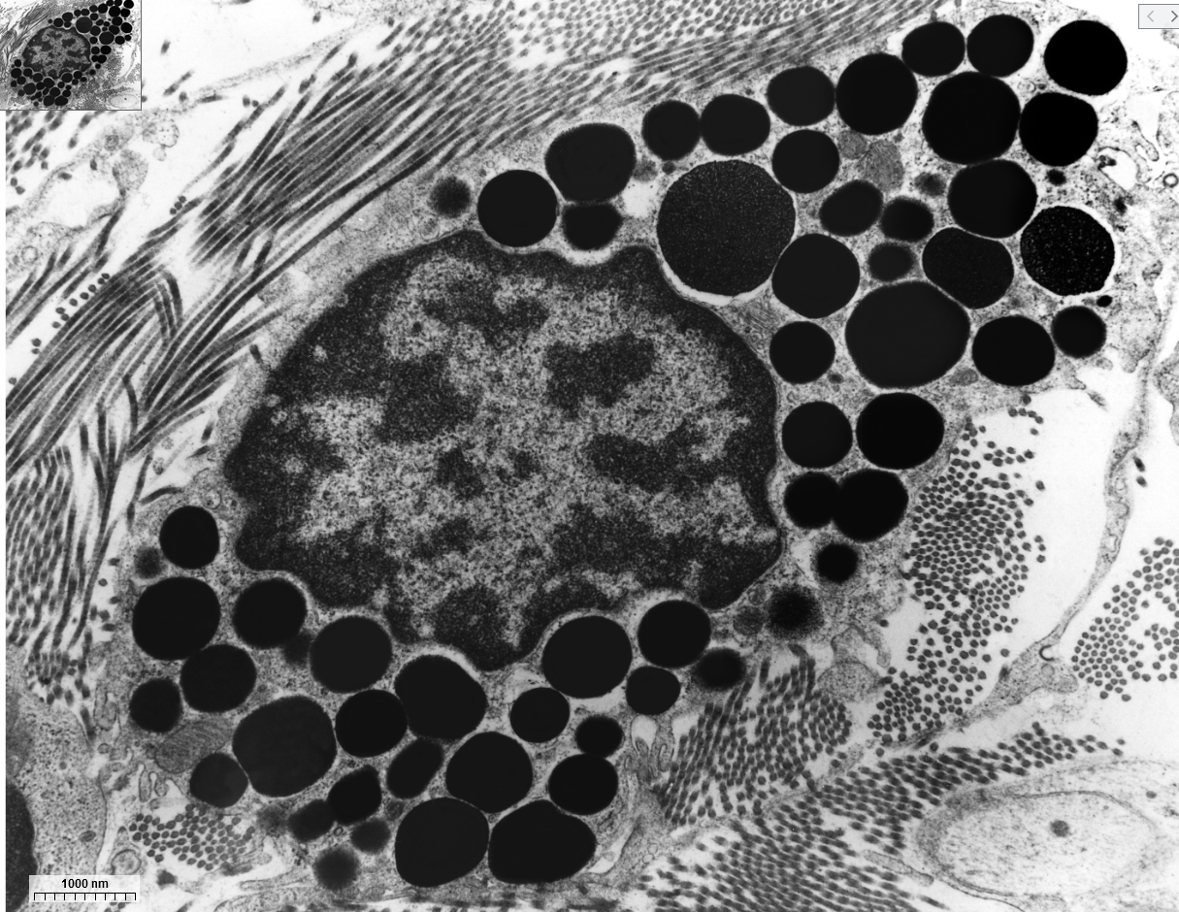
CELLS OF CONNECTIVE TISSUE PROPER
Mast cells
Large, oval, 20-30μm
Similar to other leukocytes with granules, but it is tissue resident
Granules
heparin
histamine
serine proteases (inflammation regulators)
eosinophil and neutrophil chemoattractants
leukotriens
Perivascular and mucosal mast cells
T. Clark Brelje and Robert L. Sorenson, Minneapolis, Minnesota, USA.
Mediators of immediate hypersensitivity reaction

Slide 13
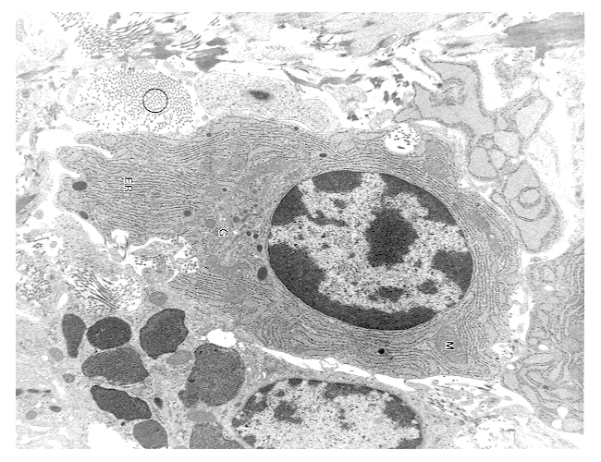
CELLS OF CONNECTIVE TISSUE PROPER
Plasma cells
Large, ovoid cells
derived from B-lymphocytes
Basophilic cytoplasm – RER
Clockface nucleus (alternating heterochromatin and euchromatin)
Produce antibodies (immunoglobulins)
Short lifespan (10-20 days)
T. Clark Brelje and Robert L. Sorenson, Minneapolis, Minnesota, USA.
https://www1.udel.edu/biology/Wags/histopage/histopage.htm

Slide 14
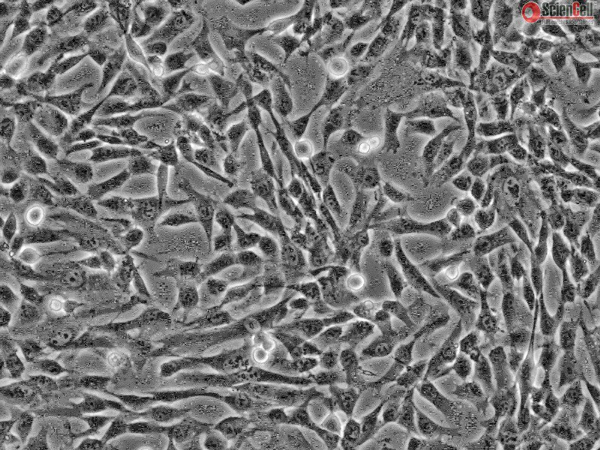
CELLS OF CONNECTIVE TISSUE PROPER
Mesenchymal stem (stromal) cells
Mesenchymal origin
Adult tissues
Differentiate to many cells of CT

Slide 15
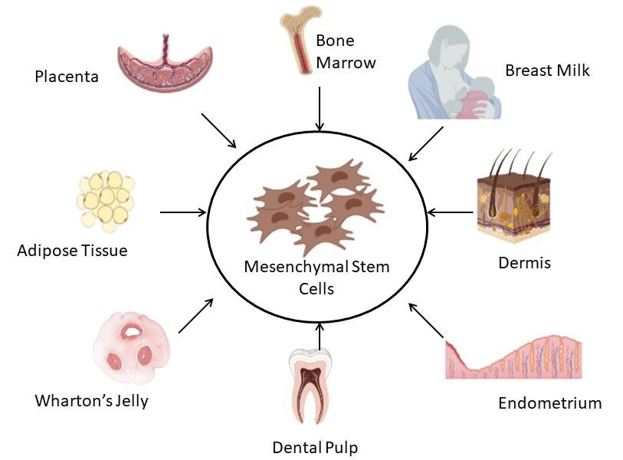
DERIVATIVES OF MESENCHYME
Mesenchymal stem (stromal) cells
Mesenchymal stem cells are different in different tissues

Slide 16
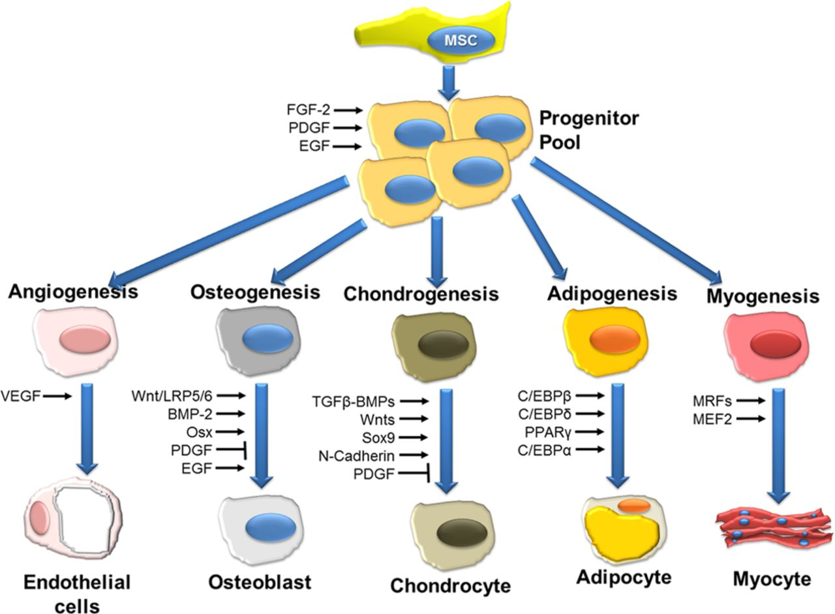
CELLS OF CONNECTIVE TISSUE PROPER
Mesenchymal stem (stromal) cells
Mesenchymal stem cells are important tools for tissue engineering and understanding tissue biology

Slide 17
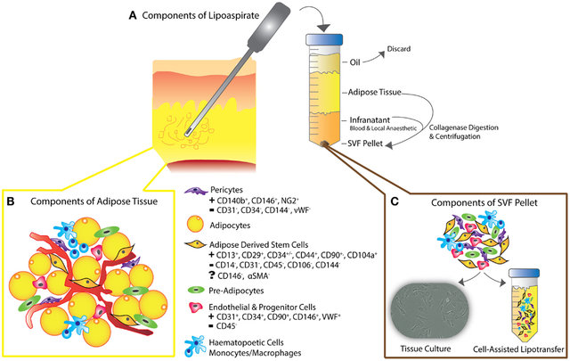
MESENCHYMAL STEM CELLS – CLINICAL CONTEXT
DOI: 10.3389/fsurg.2015.00001

Slide 18
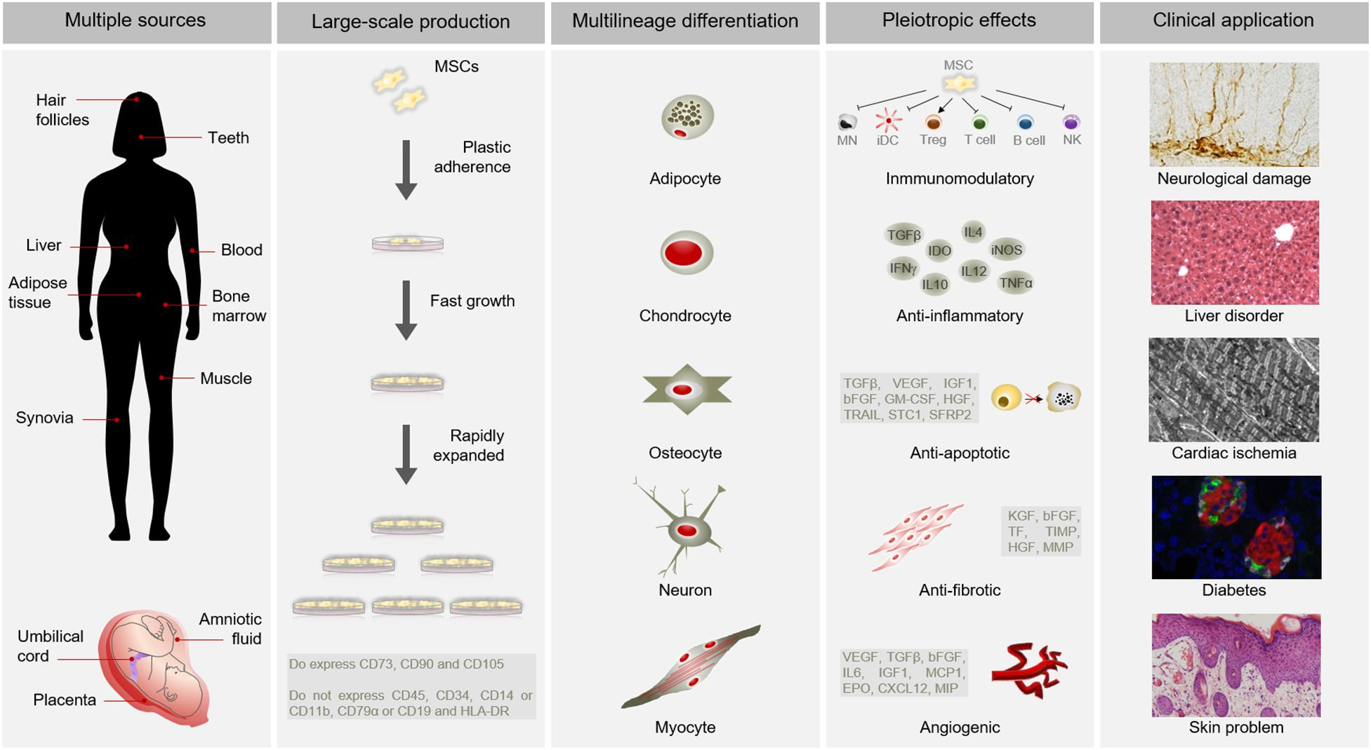
POTENTIAL APPLICATIONS OF MESENCHYMAL STEM CELLS
https://doi.org/10.3389/fbioe.2020.00043

Slide 19
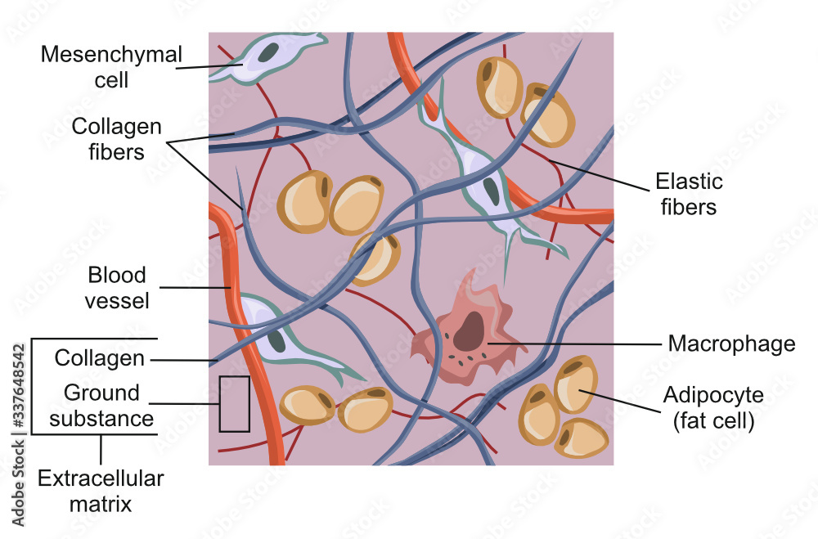
ECM OF CONNECTIVE TISSUE PROPER
ECM = fibers + ground substance

Slide 20
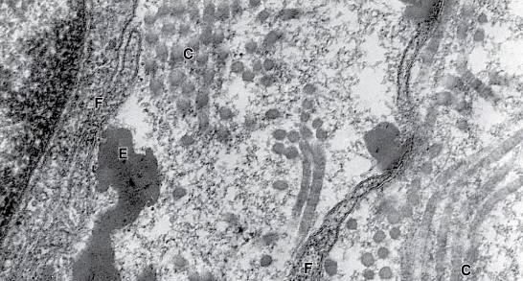
ECM OF CONNECTIVE TISSUE PROPER
Composition of ECM determines biochemical and biophysical properties of c.t.
ECM of connective tissue is produced by fibroblasts (or chondrocytes, osteoblasts).
However, specific ECM can be produced by virtually any cell of our body (eg. epithelial and muscle cells producing basal lamina).

Slide 21
ECM OF CONNECTIVE TISSUE PROPER
Extracellular matrix
Fibrous component
Collagen fibers (e.g. col. I, II)
Reticular
Elastic
Amorphous component (ground substance)
Complex matrix consisting of
Glycosaminoglycans
Glycoproteins
Proteoglycans

Slide 22
ECM OF CONNECTIVE TISSUE PROPER
Fibers

Slide 23
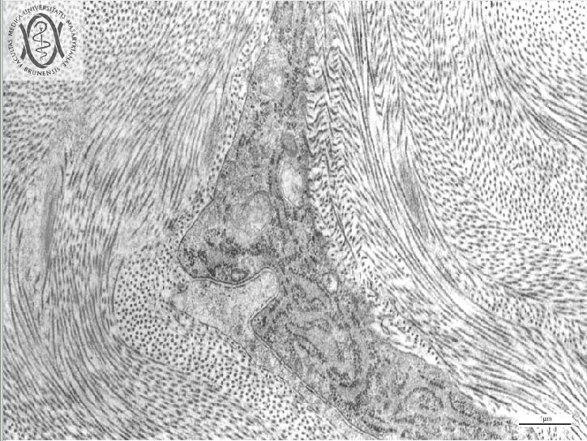
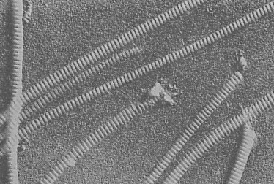
EXTRACELLULAR MATRIX – FIBROUS COMPONENT
Collagen fibers
family of fibrous proteins encoded by >35 genes
polymer – subunit = procollagen and tropocollagen; triple helix
different structural and mechanical properties (strength, elasticity, pliability…)
most abundant protein in human body ( 30% dry weight)

Slide 24
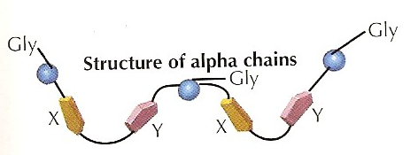
EXTRACELLULAR MATRIX – FIBROUS COMPONENT
Collagen synthesis
Polyribosomes bind to RER and synthetize peptide chains α1 a α2 (~250 AA, 28kDa)
In RER peptide chains are modified (hydroxylation of proline and lysine – co-factor vitamin C)
Chains assemble into triple helix - procollagen
In GA, procollagen is further modified and secreted from cells

Slide 25
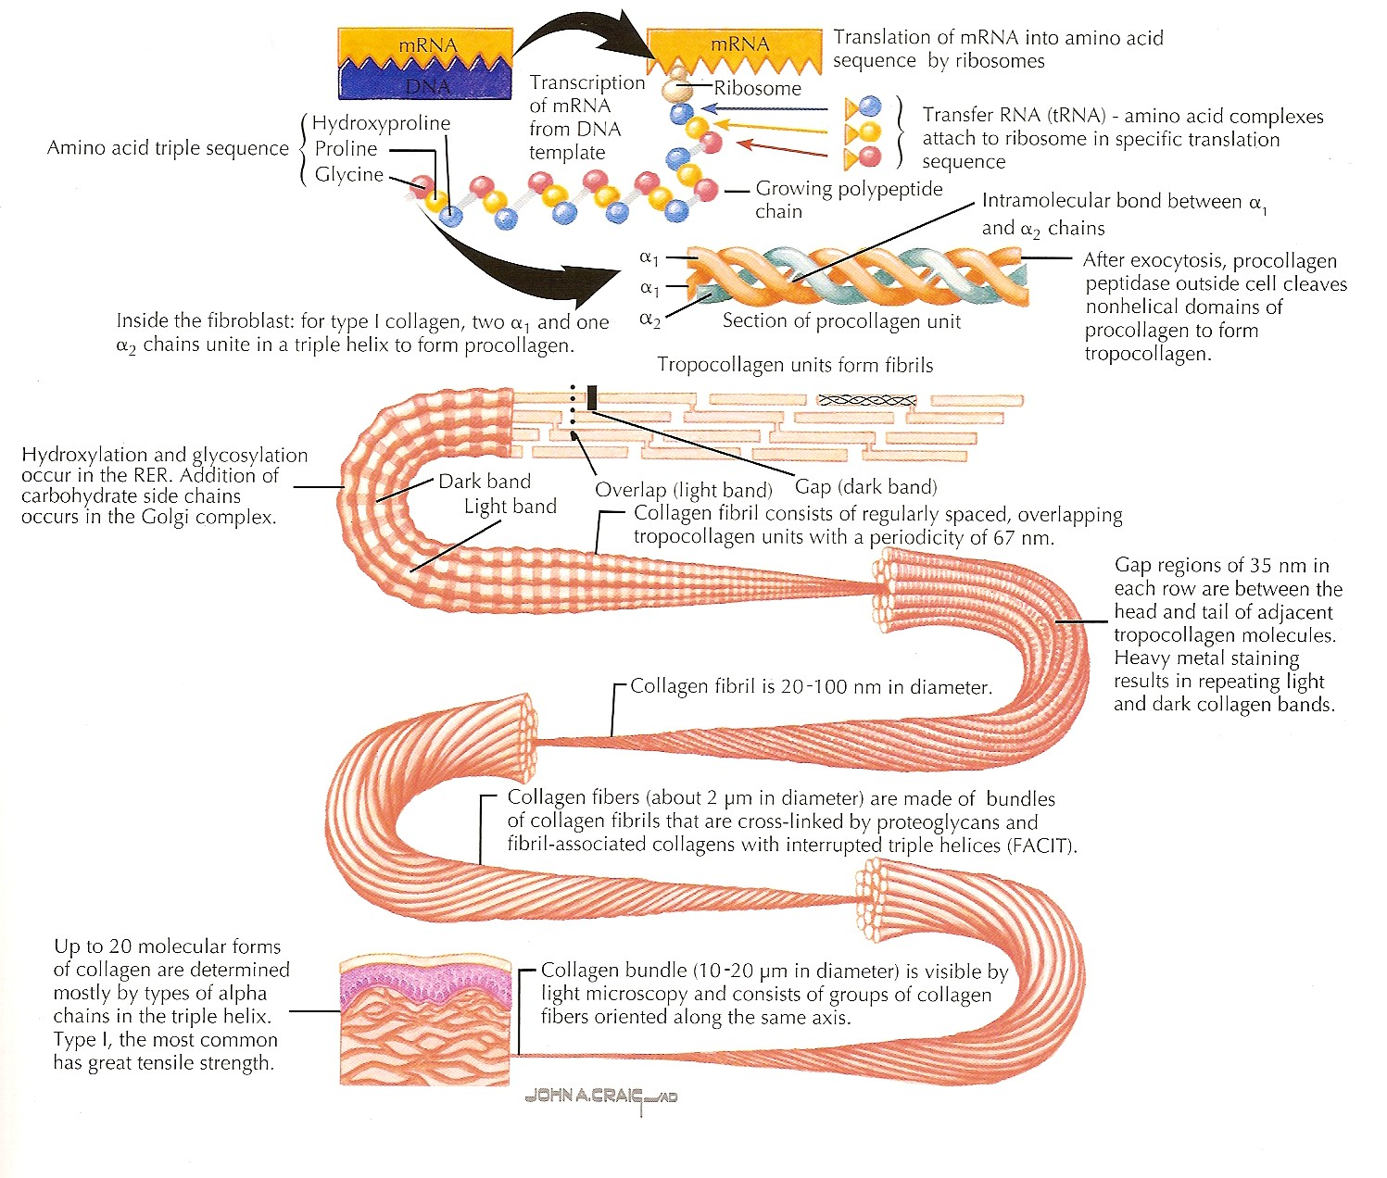
EXTRACELLULAR MATRIX – FIBROUS COMPONENT
Collagen synthesis
Procollagen is then modified to tropocollagen (by procollagenpeptidase)
Tropocollagen is organized to higher fibrillar structures in ECM (fibrils, fibers)
Individual collagen molecules are connected (lysyloxidases)
further study: https://www.ncbi.nlm.nih.gov/books/NBK507709/

Slide 26
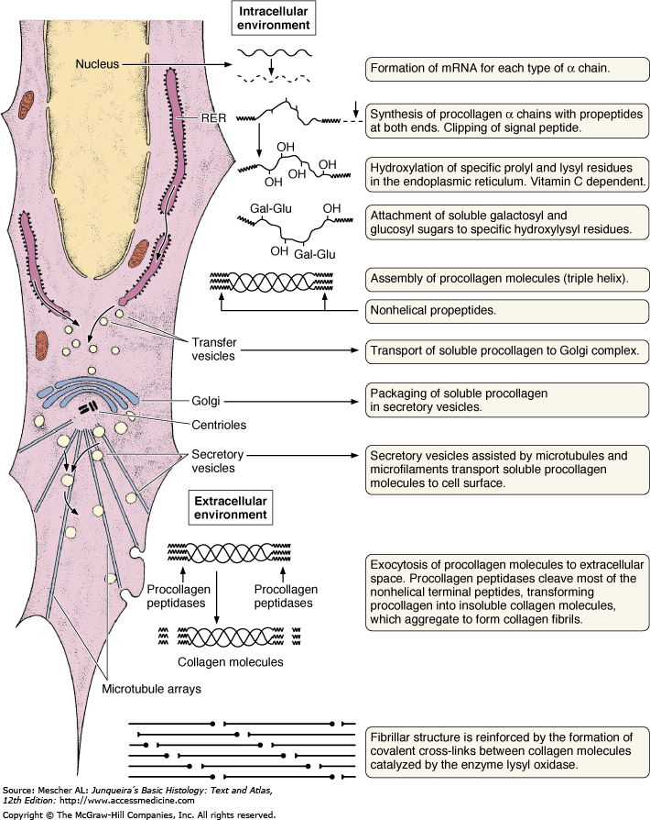
EXTRACELLULAR MATRIX – FIBROUS COMPONENT
Collagen synthesis

Slide 27
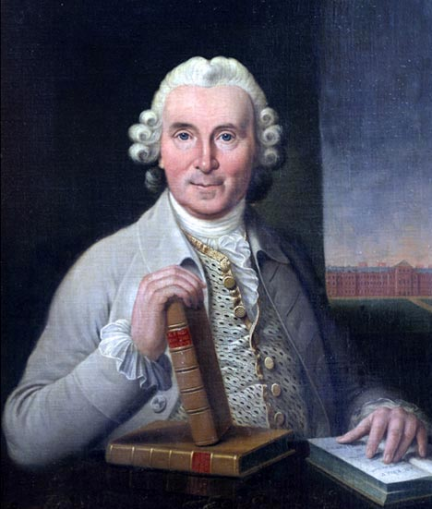
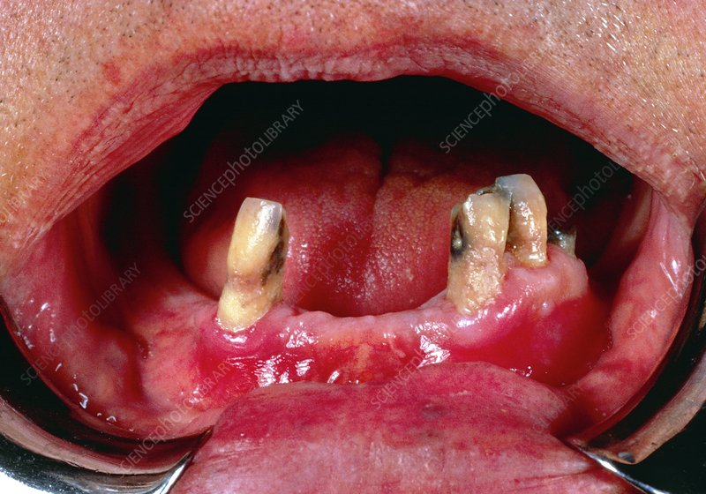
CLINICAL CONTEXT
James Lind 1747
Autor: BIOPHOTO ASSOCIATES/SCIENCE PHOTO LIBRARY

Slide 28
COLLAGEN FAMILY
Type | Localization | Structure | Main function
I | Bone, tendons, meniscus, dentin, dermis, capsules of organs, loose CT 90% of type I | Fibrils (75nm) – fibers (1-20μm) | Resilience in pull
II | Hyaline and elastic cartilage | Fibrils (20nm) | Resilience in pressure
III | Skin, veins, smooth muscles, uterus, liver, spleen, kidney, lung | Like I, high content of proteoglycans and glycoprotiens, reticular network | Shape formation
IV | Basal lamina of epithelium and endtohelium, basal membranes | No fibrils or fibers | Mechanical support
V | Lamina of muscle cells and adipocytes, fetal membranes | Like IV
VI | Interstitial tissue, chondrocytes – adhesion |  | Connecting dermis and epidermis
VII | Basal membrane of epithelium
VIII | Some endothelia (Cornea)
IX, X | Growth plate, hypertrophic and mineralized cartilage |  | Growth of bones, mineralization

Slide 29
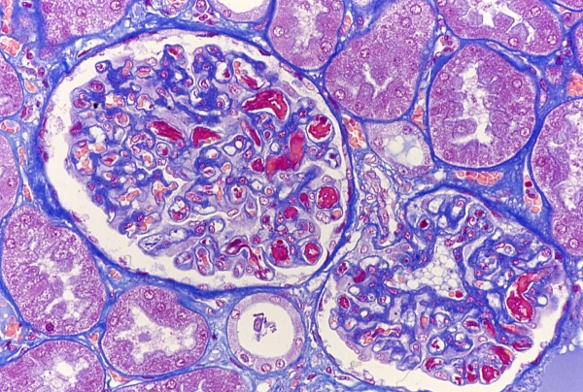
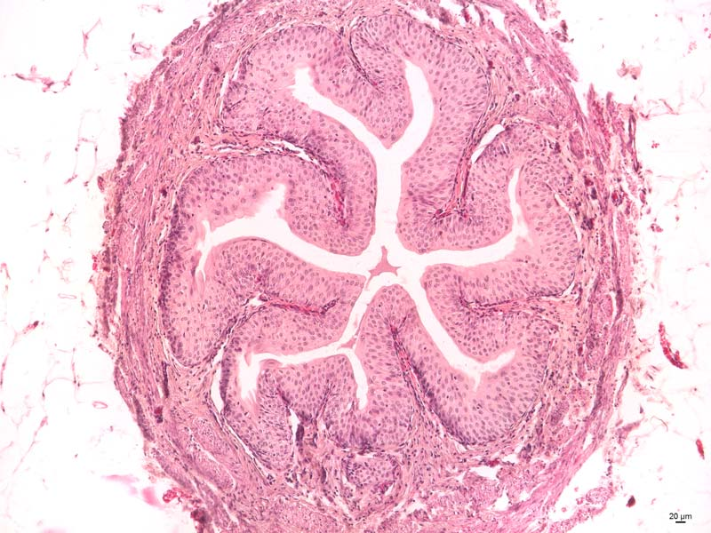
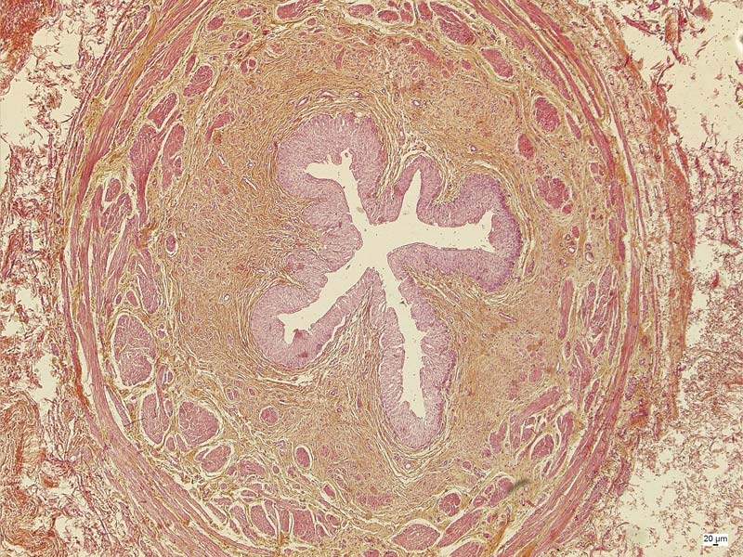
COLLAGEN IN LIGHT MICROSCOPE
AZAN
HE
HES

Slide 30
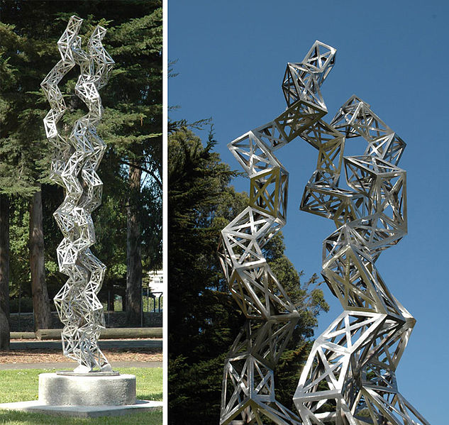
COLLAGEN IN ART
Julian Voss-Andreae
"Unraveling Collagen"
2005
Orange Memorial Park Sculpture Garden, City of
South San Francisco, CA

Slide 31
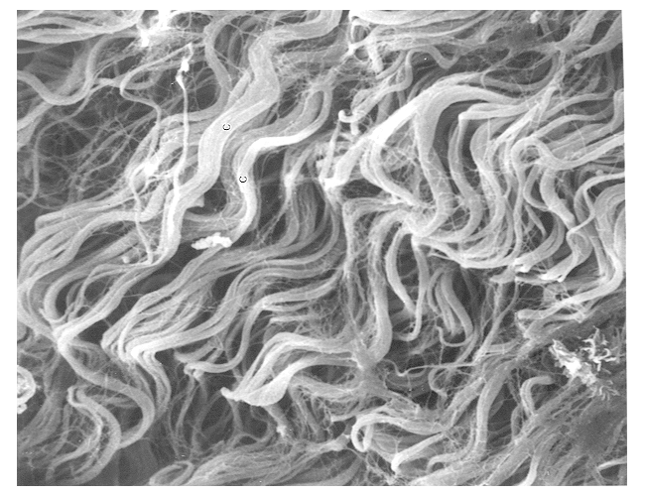
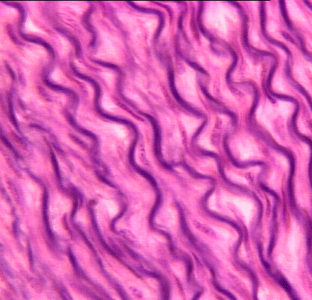
EXTRACELLULAR MATRIX – FIBROUS COMPONENT
Elastic fibers
less abundant than collagen
polymer – tropoelastin
minimal tensile resistance, loss of elasticity if overstretched
reduction of hysteresis = allow return back to original state after mechanic change
staining – orcein, aldehyde fuchsin

Slide 32
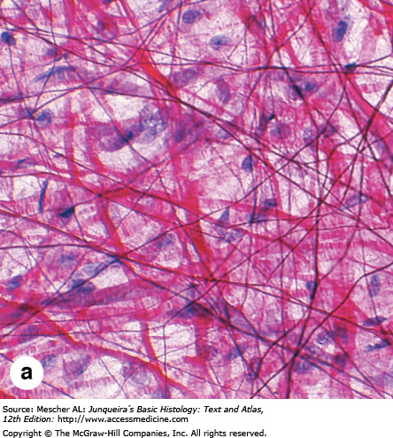
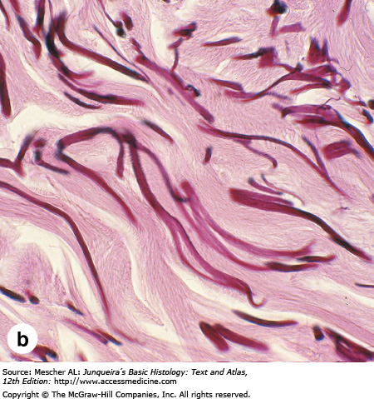
EXTRACELLULAR MATRIX – FIBROUS COMPONENT
Elastic fibers
Elastin
Collagen

Slide 33
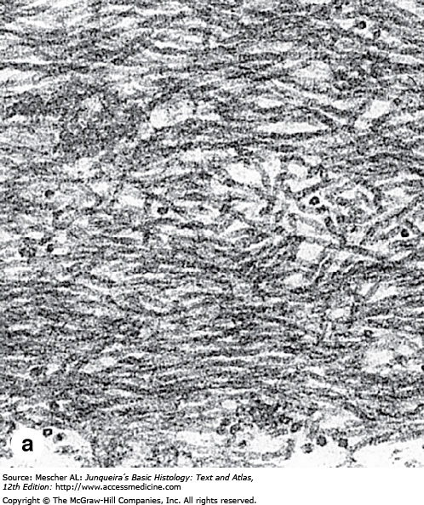
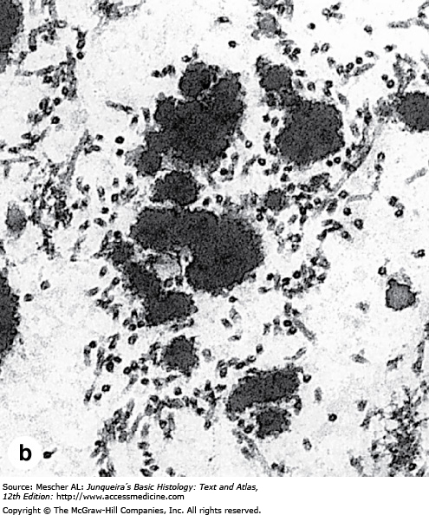
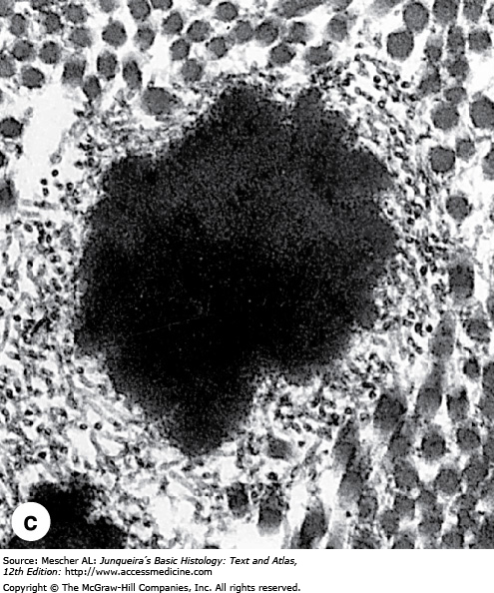
EXTRACELLULAR MATRIX – FIBROUS COMPONENT
Elastic fibers
Fibrillin
Elastin
Elastin
Similarly to collagen, elastin precursors are secreted and polymerize
Deposition of elastin aggregate along fibers of protein fibrillin
Amount of fibrillin (nonelastic) and elastin (elastic) determines elasticity of CT

Slide 34
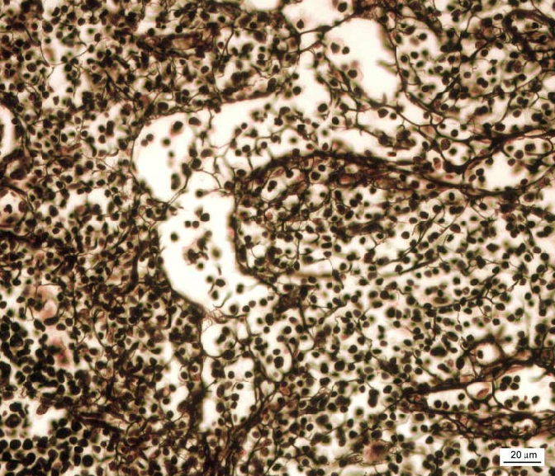
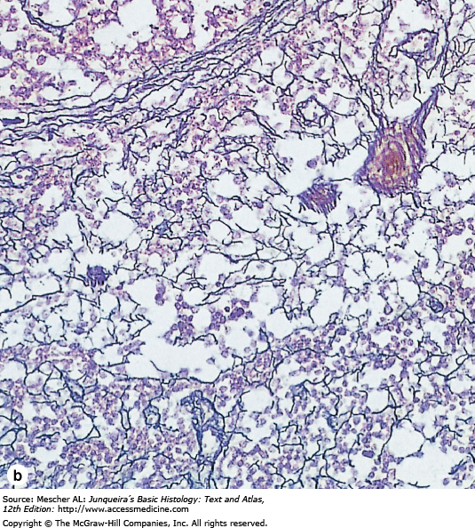
EXTRACELLULAR MATRIX – FIBROUS COMPONENT
Reticular fibers
collagen 3D meshwork
bone marrow, spleen, lymphatic nodules
microenvironment for e.g. hematopoietic stem cells and progenitors

Slide 35
RETICULAR CONNECTIVE TISSUE

Slide 36
ECM OF CONNECTIVE TISSUE PROPER
Ground substance

Slide 37
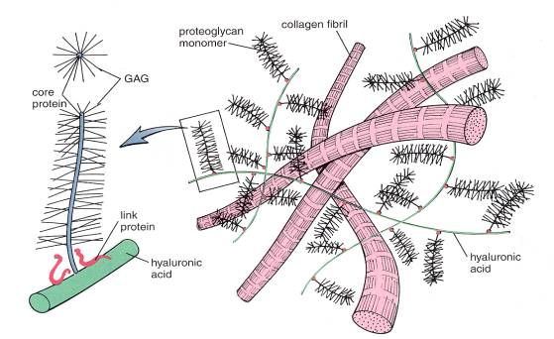
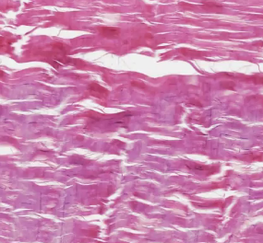
EXTRACELLULAR MATRIX – GROUND SUBSTANCE
Ground substance
Amorphous extracellular matrix
Colorless, transparent, homogenous substance consisting of: glycosaminglycans, proteoglycans and structural glycoproteins

Slide 38
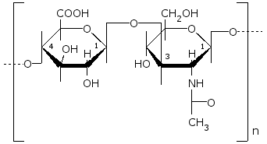
EXTRACELLULAR MATRIX – GROUND SUBSTANCE
Glycosaminoglycans (GAGs)
linear polysaccharides composed of two disaccharide subunits
– uronic acid and hexosamine
glucuronic or iduronic acid
glucosamin or galactosamin

Slide 39
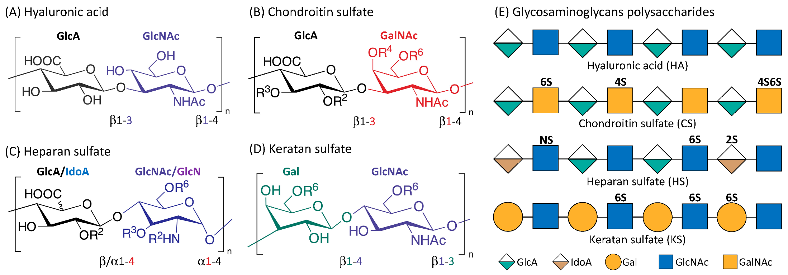
EXTRACELLULAR MATRIX – GROUND SUBSTANCE
Glycosaminoglycans (GAGs)
linear polysaccharides composed of two disaccharide subunits
– uronic acid and hexosamine
https://doi.org/10.3390/cancers15010266

Slide 40
EXTRACELLULAR MATRIX – GROUND SUBSTANCE
Glycosaminoglycans (GAGs)
bind to proteins (except for hyaluronic acid)
Glycosaminoglycan | Localization
Hyaluronic acid | Umbilical cord, synovial fluid, fluid of corpus vitreum, cartilage
Chondroitinsulfate | Cartilage, bone, cornea, skin, notochord, aorta
Dermatansulfate | Skin, ligaments, adventitia of aorta
Heparansulfate | Aorta, lungs, liver, basal membranes
Keratansulfate | Iris, cartilage, nucleus pulposus, anulus fibrosus

Slide 41
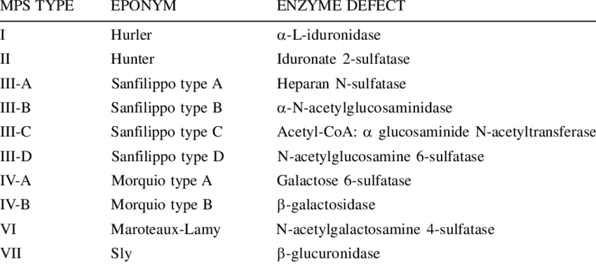
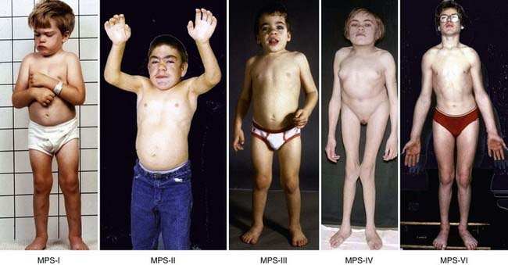
CLINICAL CONTEXT
glycosaminoglycans = acid mucopolysaccharides (polysaccharides rich in hexosamines)
group of rare genetic diseases – mucopolysaccharidoses
autosomal recessive disease caused by mutation in genes coding for enzymes of GAG metabolism
broad spectrum of problems
typical symptoms – craniofacial dysmorphia, cardiomyopathy, splenomegaly, slow growth and psychomotor development

Slide 42
EXTRACELLULAR MATRIX – GROUND SUBSTANCE
Proteoglycans
protein core + dominant linear saccharide component
proteoglycan aggregates
water-binding, volume dependent of hydratation
aggrecan (cartilage)
syndecan
fibroglycan

Slide 43
EXTRACELLULAR MATRIX – GROUND SUBSTANCE
Structural glycoproteins
dominant protein + branched saccharide component
interaction between cells and ECM
fibronectin – connects collagen fibers and glykosaminoglycans, cell adhesion and migration
laminin – basal lamina – epithelial integrity
chondronectin – cartilage – adhesion of chondrocytes to collagen
human mesenchymal stem cells (MSC), BD, Alexa Fluor® 488 Mouse Anti-Fibronectin

Slide 44
EXTRACELLULAR MATRIX – GROUND SUBSTANCE
Glycoproteins vs. proteoglycans

Slide 45
COMPOSITION OF ECM

Slide 46
COMPOSITION OF ECM
Cell – ECM interactions

Slide 47
HISTOLOGICAL CLASSIFICATION OF CT PROPER
Embryonic:
Embryonic mesenchyme and mucous c.t. (Wharton’s jelly) of umbilical cord
Postnatal (adult):
Loose collagen c.t. (areolar, interstitial)
Dense collagen regular and irregular c.t.
Elastic c.t.
Reticular c.t.
Adipose c.t.
Embryonic mesenchyme
Wharton’s jelly

Slide 48
HISTOLOGICAL CLASSIFICATION OF CT PROPER
Loose collagen c.t.
Most abundant type of CT
Rich vascularization and innervation
Walls of hollow organs, interstitium, mucosal and submucosal CT
Permanent fibroblasts, macrophages (histiocytes), occasionally adipocytes
Other transient cell types (leukocytes)
Collagen and elastic fibers
Amorphous ground substance is dominant
http://medsci.indiana.edu/a215/virtualscope/docs/chap2_1.htm

Slide 49
HISTOLOGICAL CLASSIFICATION OF CT PROPER
Dense collagen c.t.

Slide 50
HISTOLOGICAL CLASSIFICATION OF CT PROPER
Elastic c.t.
Lig. flava
HE 50X
Weigert, 50X
Elastic membranes of aorta

Slide 51
HISTOLOGICAL CLASSIFICATION OF CT PROPER
Reticular c.t.
Niche for immune cells

Slide 52
HISTOLOGICAL CLASSIFICATION OF CT PROPER
Adipose c.t.
Adipocytes, fibroblasts, reticular, collagen and elastic fibers, capillaries
White and brown adipose tissue

Slide 53
HISTOLOGICAL CLASSIFICATION OF CT PROPER
White adipose c.t.
rich vascularization
unilocular adipocytes with only one lipid droplet
endocrine activity - leptins (adipokinins)
10.1038/s42255-019-0095-y

Slide 54
HISTOLOGICAL CLASSIFICATION OF CT PROPER
Brown adipose c.t.
small cells with numerous fat droplets
typical localization – between shoulder blades, axilla, mediastinum, around kidneys, pancreas, small intestine
fetus and children up to 1st year of life
fast source of energy

Slide 55
EMBRYONIC ORIGIN OF CONNECTIVE TISSUE
Mesenchyme
Mesenchyme = loose tissue between germ layers
Complex network of small, undifferentiated star- or spindle-shaped cells
Jelly-like amorphous ground substance rich in hyaluronic acid
Origin in mesoderm (=germ layer) or neural crest
Trilaminar germ disc
http://www.mun.ca/biology/desmid/brian/BIOL3530/DB_Ch02/DBNModel.html

Slide 56
EMBRYONIC ORIGIN OF CONNECTIVE TISSUE
C.t. derivatives of mesenchyme
Mesenchyme
Connective
Cartilage
Bone

Slide 57
MESENCHYME
Mesenchyme as embryonic c.t. and a cellular phenotype
Embryonic mesenchyme – undifferentiated embryonic cell population
Term from embryology
Mesenchymal phenotype – set of cell properties: ECM production and remodeling, migration, absence of epithelial polarity and intercellular junctions
Term from cell biology
https://doi.org/10.1172/JCI39104.

Slide 58
SUMMARY OF CONNECTIVE TISSUE
Collagen | Structure | Function and distribution
Loose collagen CT | Abundant ground substance, collagen fibers with random arrangement | Microvascularisation Innervation
Irregular dense collagen CT | Few ground substance, few cells, many collagen fibers, random arrangement | Mechanically resistant organ capsules
Regular dense collagen CT | Tightly arranged collagen fibers with fibroblasts intercalated between them | Part of musculoskeletal system. Tendons, ligaments
Embryonic
Mesenchyme | Undifferentiated cells uniformly dispersed in ground substance, few collagen fibers | Undifferentiated progenitors
Wharton’s jelly | Viscous amorphous matrix with collagen fibers. ECM-producing stromal cells with MSC properties. | Matrix of umbilical cord
Special
Reticular CT | Network of collagen III fibers and reticular cells | Support of hematopoietic and lymphatic cells
Elastic | Rich in elastic fibers | Lig. flava, lig. vocale. Lung interstitium, flexible support to elastic arteries and aorta
Adipose | Adipocytes | Energy storage (white fat), heat production (brown fat)
Cartilage | Chondroblasts, chondrocytes | Mechanical support
Bone | Osteoblasts, ostecoytes, osteoclasts | Mechanical support, calcium and phospate metabolism
Blood | See lecture on blood & hematopoiesis this semester

Slide 59
FURTHER STUDY
http://www.histology.med.muni.cz
pvanhara@med.muni.cz
Thank you for attention

