Slide 1
Evidence-Based Dentistry
Dental Public Health I

Slide 2
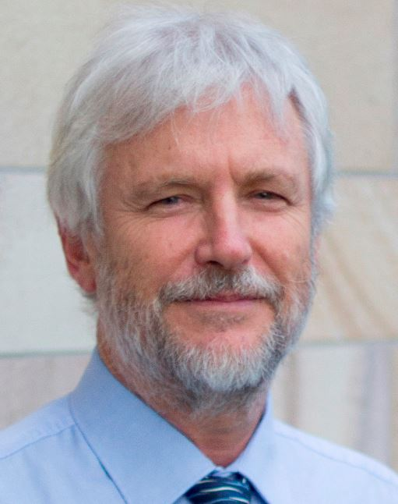
“Can a physician practice medicine without knowing EBM?”
“In medicine, we are continually making decisions, and if medicine is to be a science or a ‘‘learned’’ profession, we need to think critically about HOW and WHY we make those decisions.”
=
Prof. Paul Glasziou, MBBS, PhD
Why is evidence-based medicine important?

Slide 3
Evidence-based medicine (EBM) is the conscientious, explicit and judicious use of current best evidence in making decisions about the care of individual patients.
Evidence based medicine: what it is and what it isn't

Slide 4
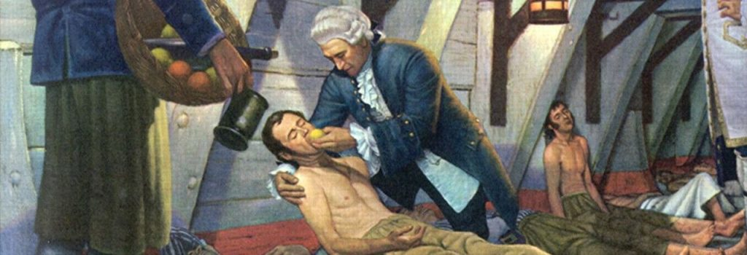
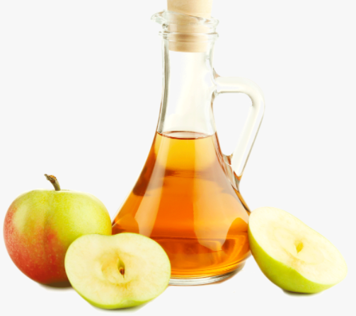
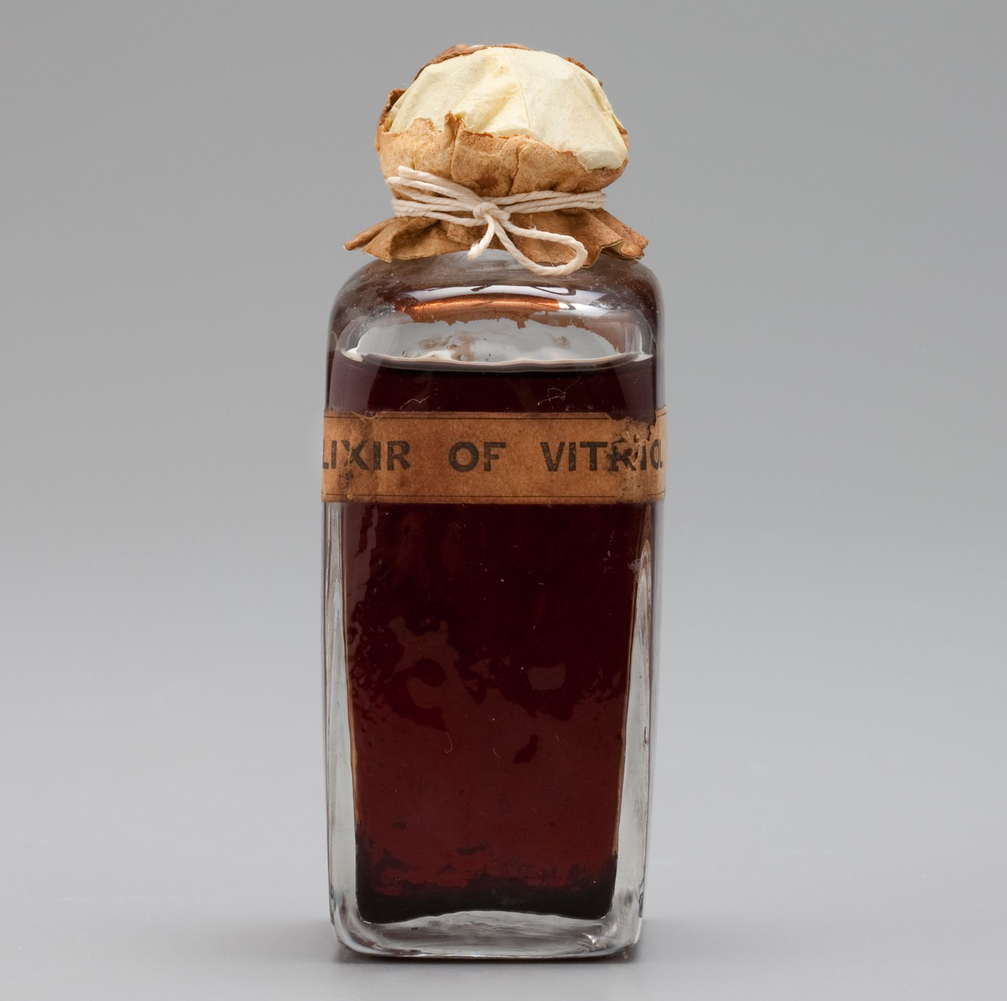
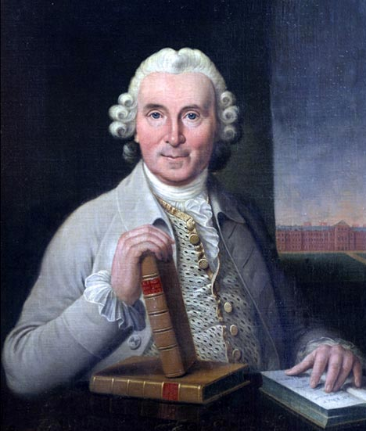
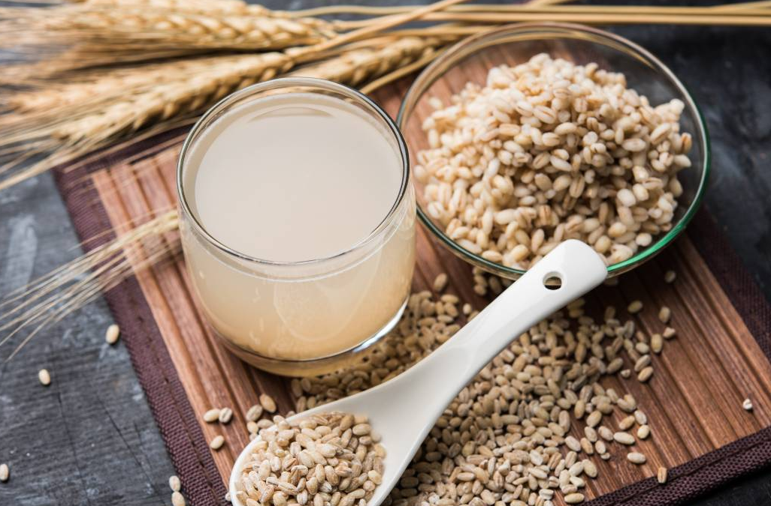
EBM Champions
Cider
n = 2
Elixir of vitriol
n = 2
James Lind (1716 – 1794)
Scottish naval surgeon.
Revered for conducting the first-ever clinical trial in history.
Concluded that scurvy can be cured by citrus fruits rich in Vitamin-C. How?
Vinegar
n = 2
Seawater
n = 2
Barley water
n = 2
Orange & Lemon
n = 2

Slide 5
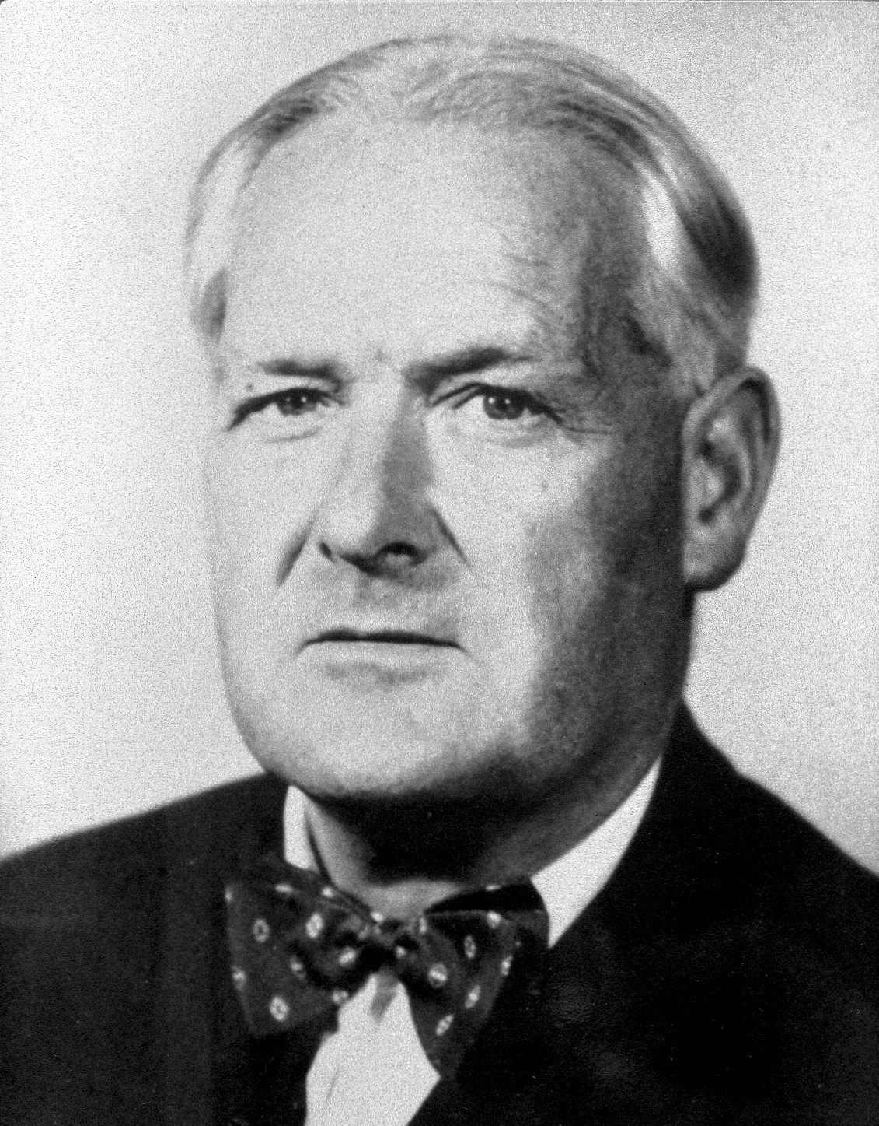
EBM Champions
Bradford Hill (1897 - 1991)
English epidemiologist and statistician.
Laid down the criteria of causal relationship between presumed cause (exposure) and an observed effect (outcome).
Hill’s criteria represent the cornerstone of causality in medicine till today. Define?

Slide 6
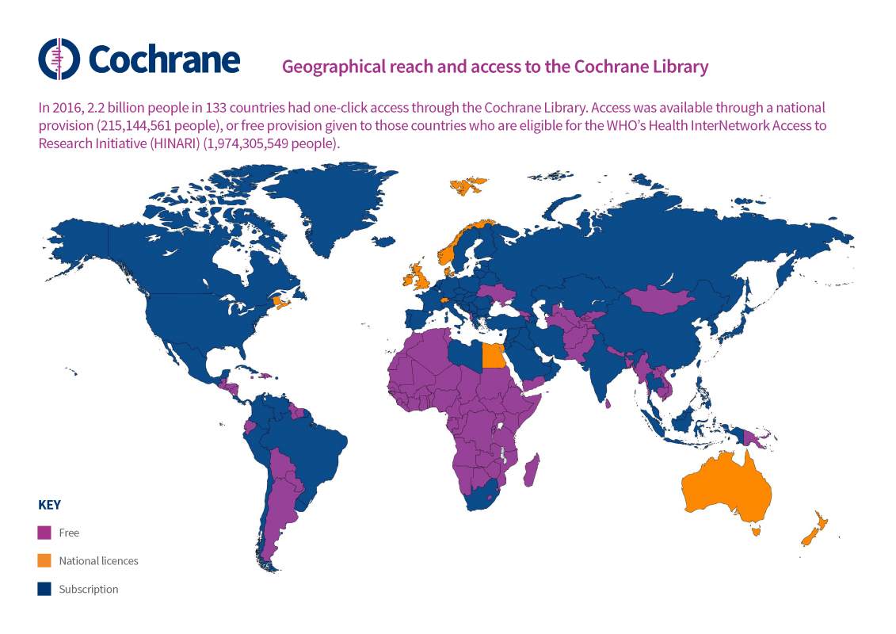
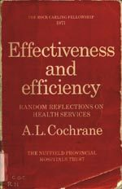
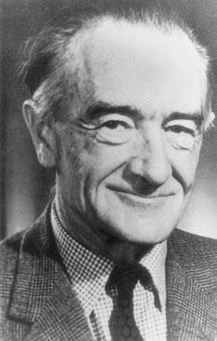
EBM Champions
Archie Cochrane (1909 - 1988)
Scottish physician and clinical epidemiologist.
Known for his advocacy for use of randomized control trials in guiding the clinical practice.
His seminal book “Effectiveness and Efficiency: Random Reflections on Health Services”.
His efforts led to the establishment of Cochrane Collaboration in 1993.

Slide 7
EBM Champions
Prof. Alan Pearson
Founder of Joanna Briggs Institute (JBI).
Prof. Gordon Guyatt
The most cited scholar in EBM!
Prof. Holger Schünemann
Founder of GRADE.

Slide 8
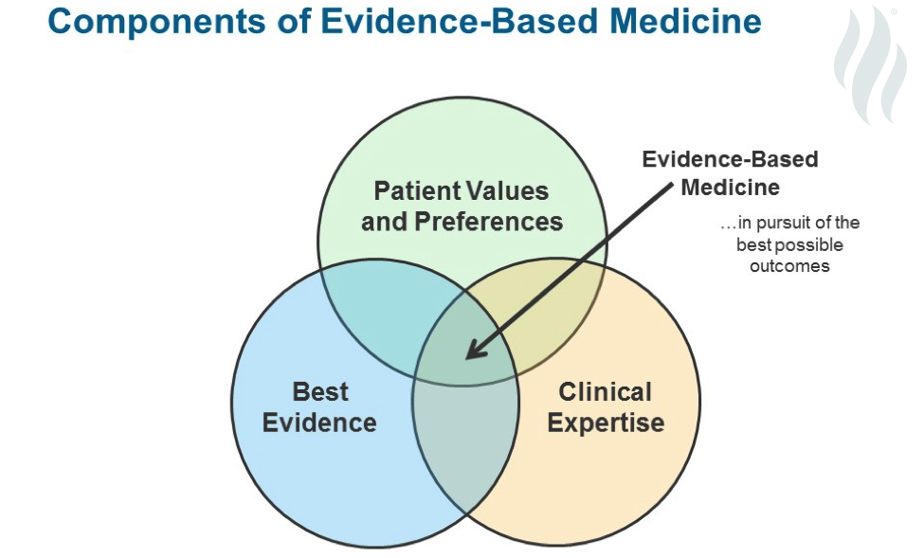
Evidence-based Medicine
“conscientious, explicit, and judicious use of current best evidence in making decisions about the care of individual patients”

Slide 9
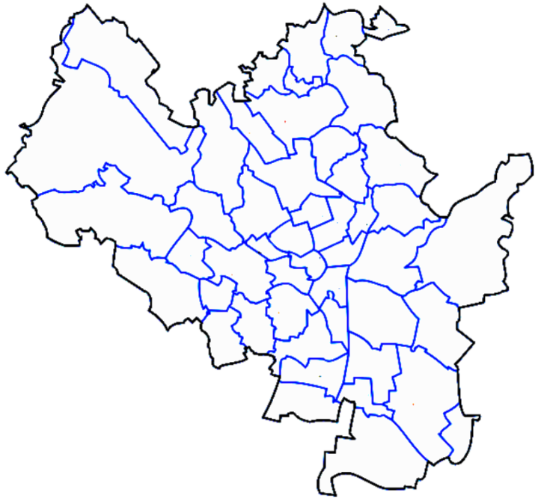
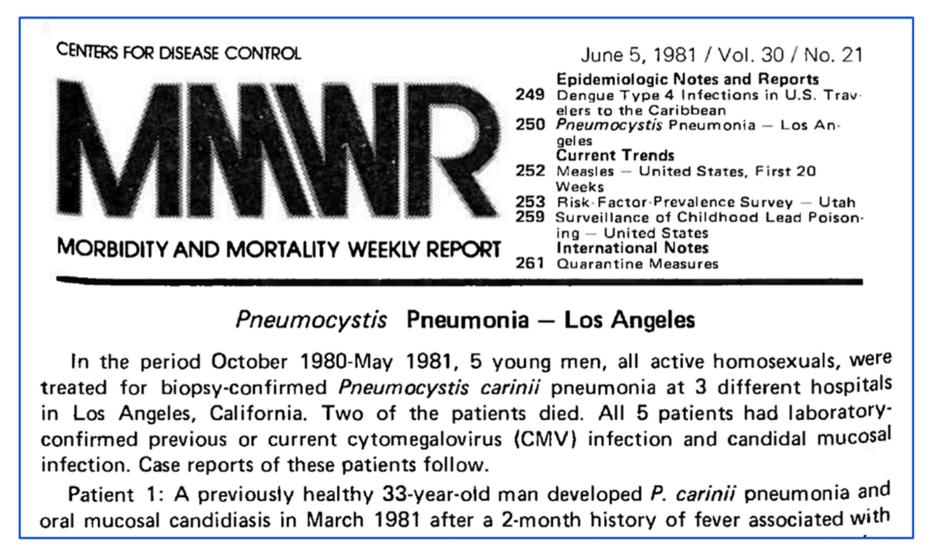
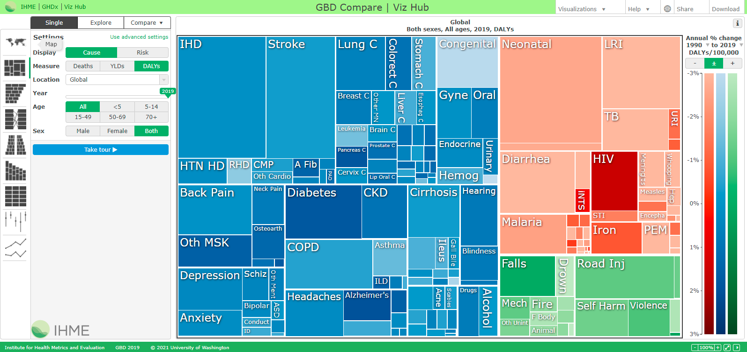
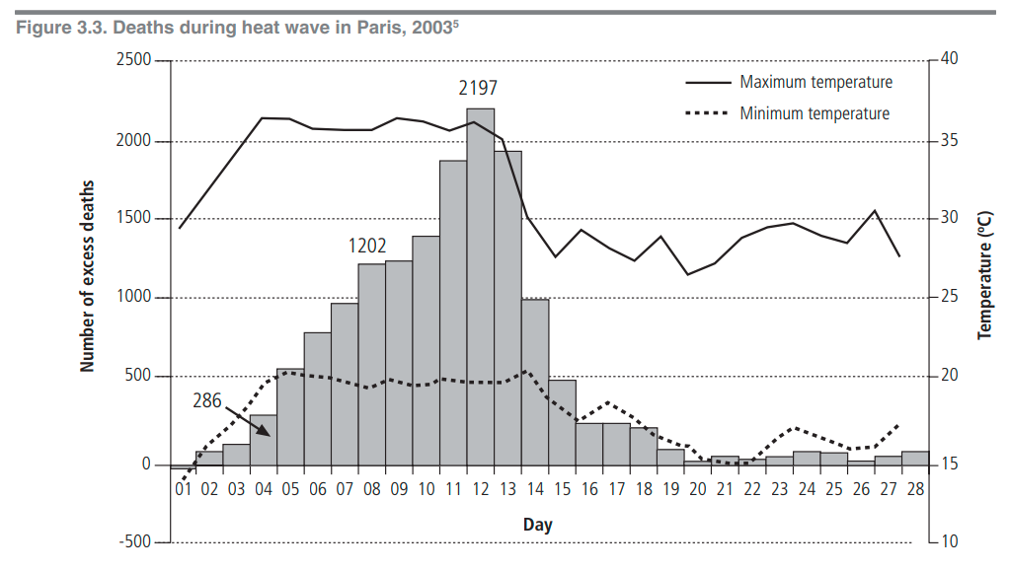
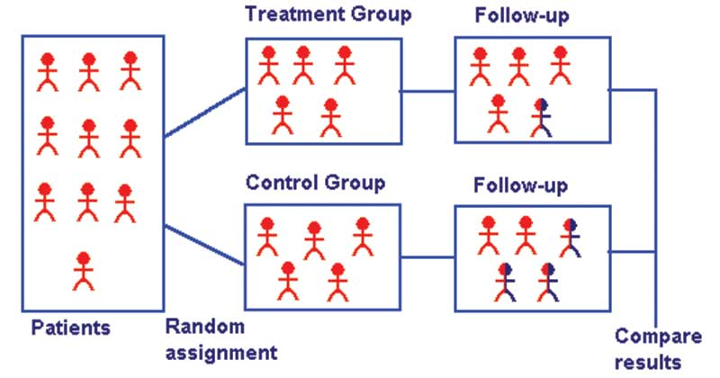
Expert Opinions / Surveillance Studies / Ecological Studies
Exposed
CVD
Non
exposed
Exposed
Healthy
Systematic
Reviews
& Meta-Analyses
Non
exposed
Clinical Trials
Hierarchy of Evidence
CERTAINTY
Lung
Cancer
Cohort Studies
Smoker
Survival
Case-control Studies
Lung
Cancer
Cross-sectional Studies
Non-smoker
Survival
Case Reports / Case Series

Slide 10
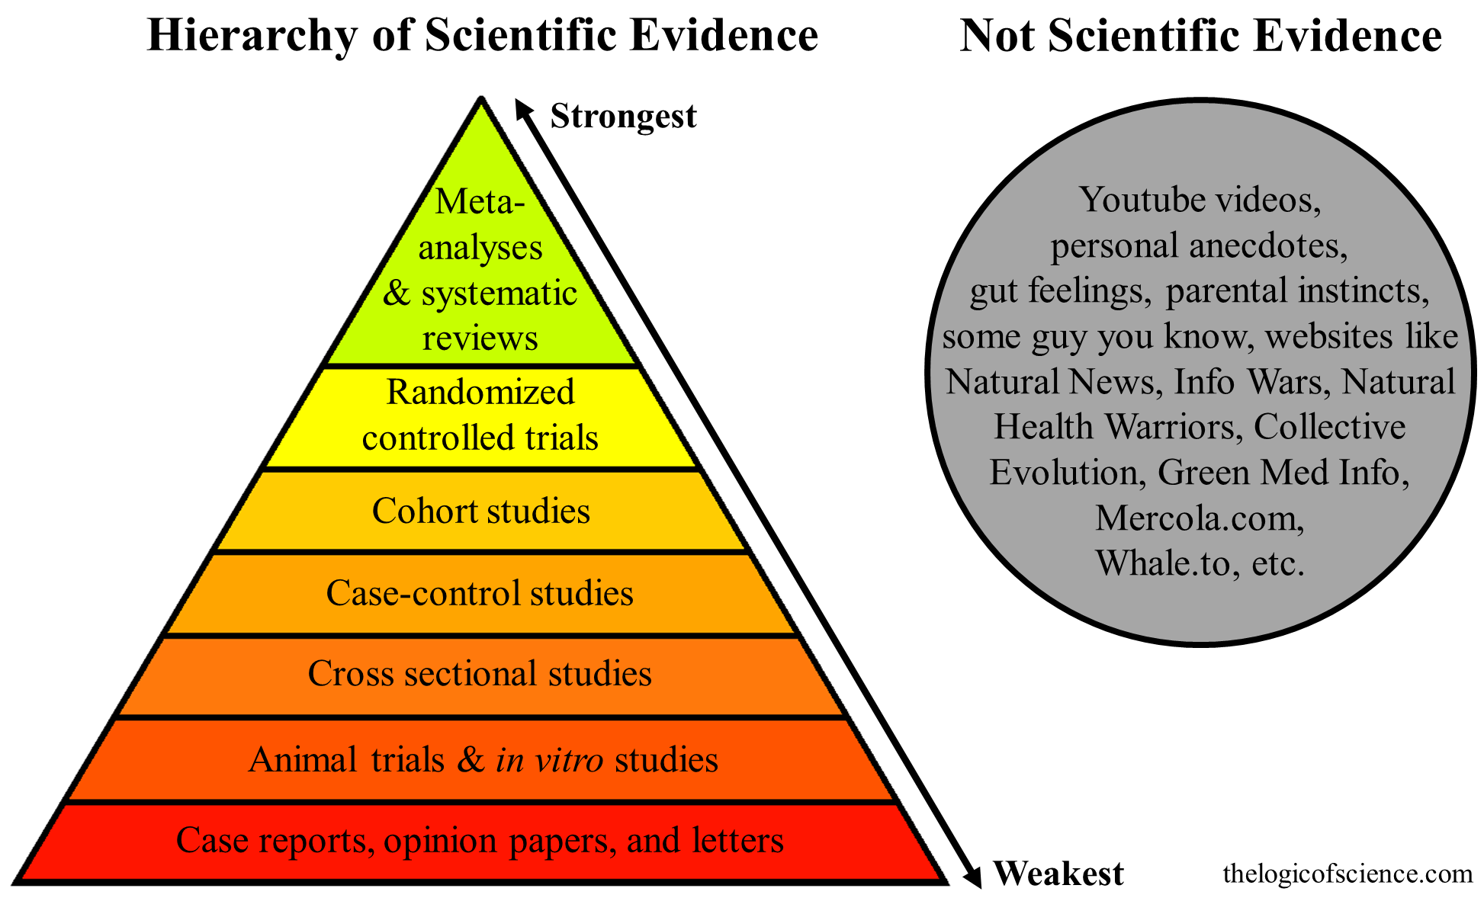
Systematic Review
Systematic reviews are rigorous reviews of the evidence bearing on specific clinical questions.
They are “systematic” because they summarize original research following a scientifically based plan that has been decided on in advance and made explicit at every step.

Slide 11
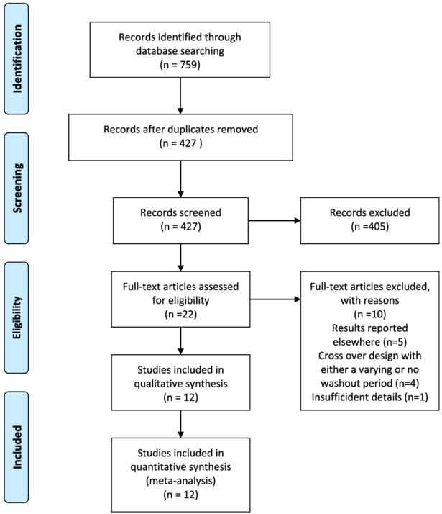
Systematic Review
The workflow of systematic reviews can be summarised using the Preferred Reporting Items for Systematic Reviews and Meta-Analyses (PRISMA) flow diagram.
The quality of the evidence obtained by SR is proportionate to the quality of the individual (primary) trials included.

Slide 12
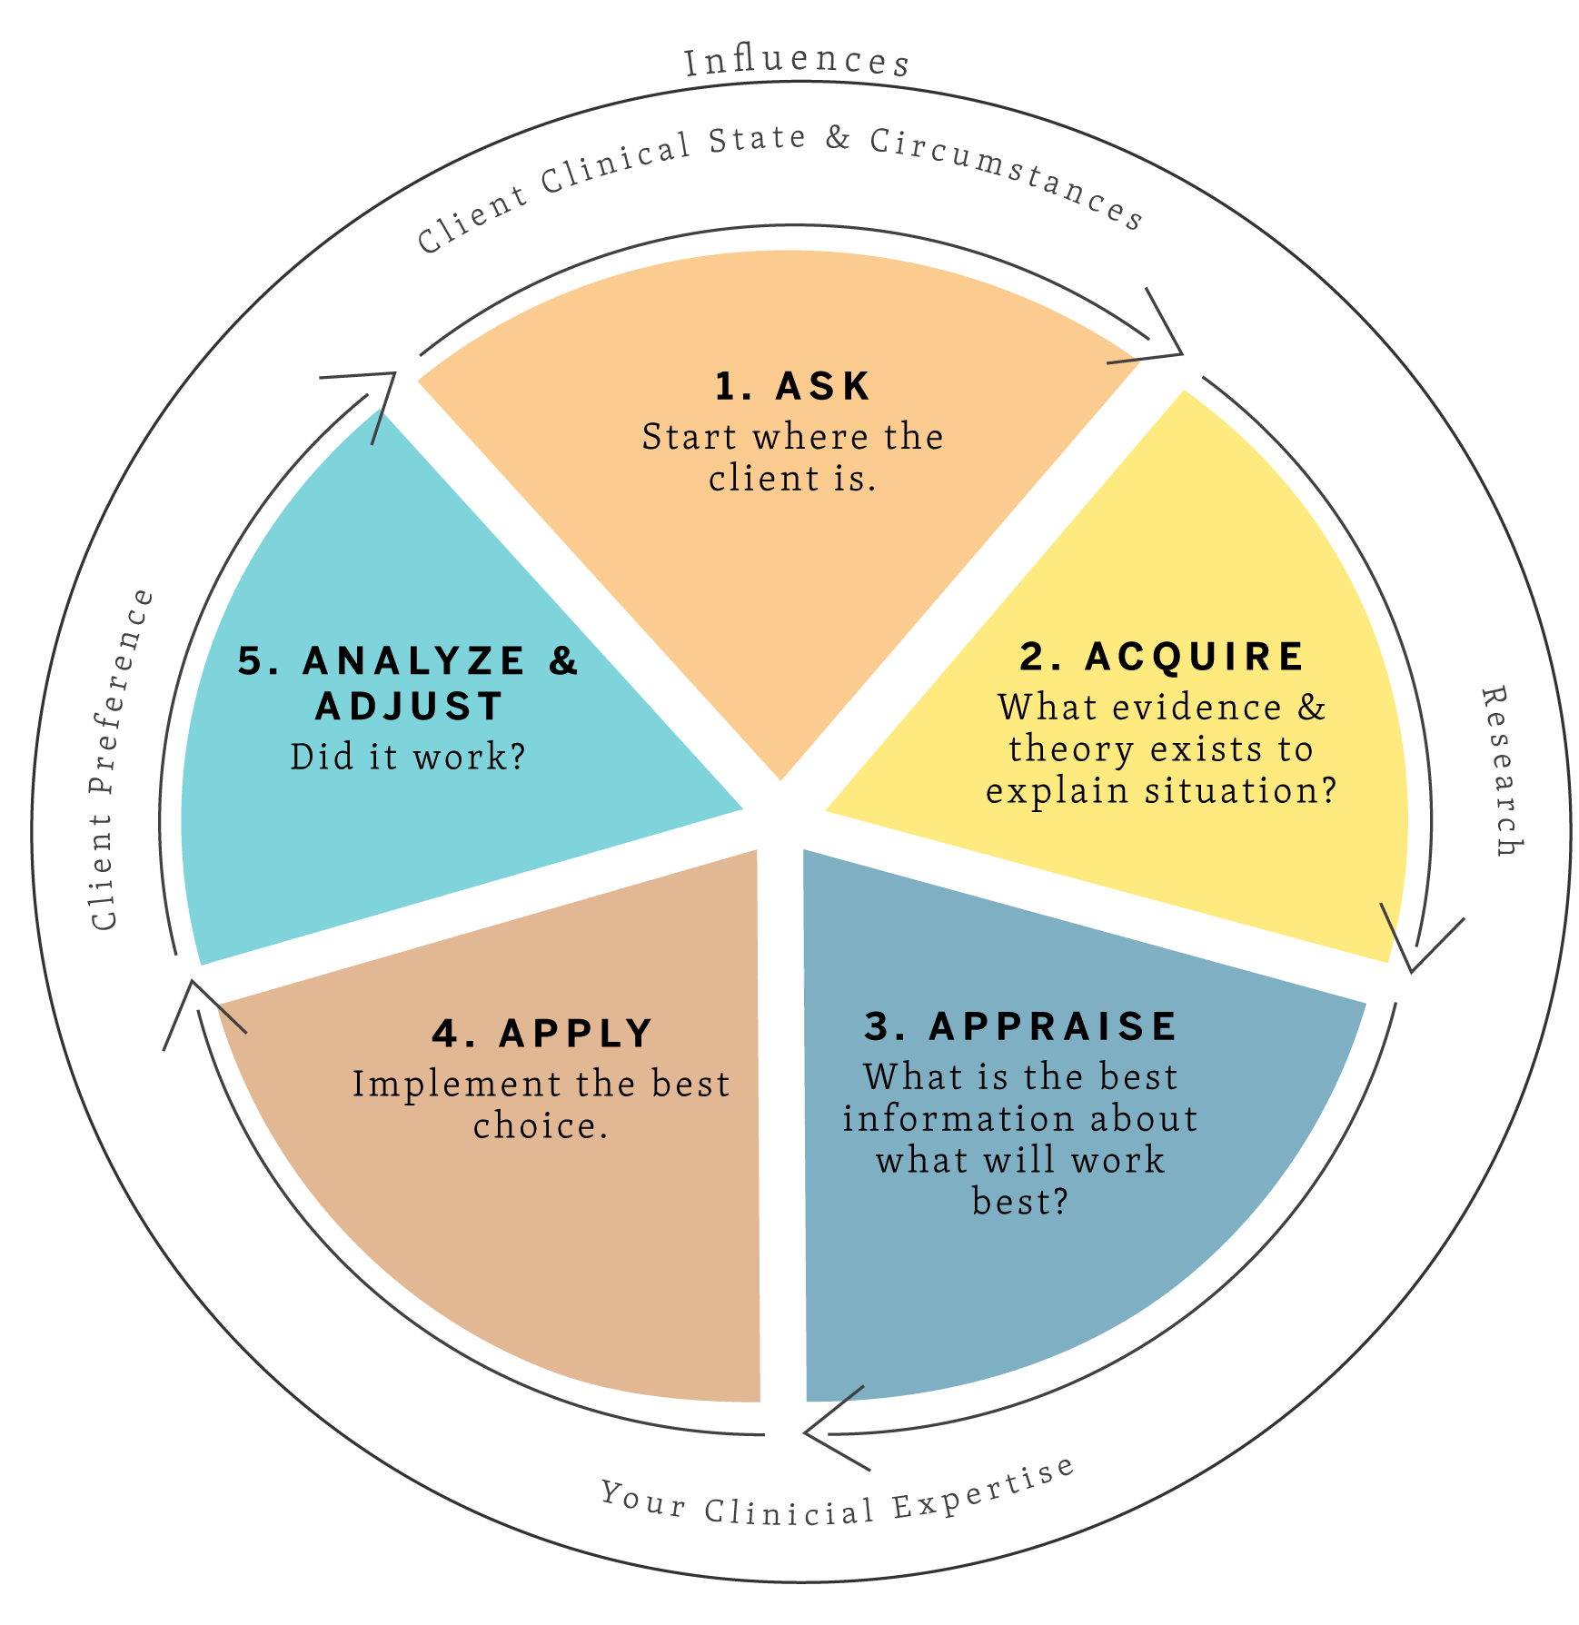
EBM Approach
The general steps (5 A) of EBM are as follows:
Ask: Generate Clinical Question
Acquire: Find Best Evidence
Appraise: Critical Appraisal
Apply: Apply the Evidence
Analyse: Evaluate

Slide 13
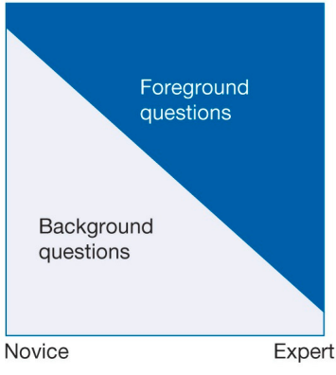
Generate Clinical Question
The initial step in the practice of EBM involves the meticulous formulation of clinical questions. This skill is indispensable for physicians committed to employing EBM.
Medical questions can be categorised into two primary types: 'background questions', commonly posed by medical students and those new to a subject, and 'foreground questions', which are more specific and arise during problem-solving or in-depth research.
It is crucial to dissect the clinical question into its essential elements, such as PICO framework (Patient, Intervention, Comparison, Outcome).
Background
Question
Foreground
Question
Clinical
Question

Slide 14
Generate Clinical Question
Background
Question
Foreground
Question
Clinical
Question
Background Question: What is hypertension and how is it managed in adults?
This type of question often provides foundational knowledge and is typical of those who are new to the subject matter. It is broad and usually seeks general information.
Foreground Question: What is the efficacy of thiazide diuretics compared to beta-blockers in lowering blood pressure in adults with hypertension?
Foreground questions are more specific and are usually asked when a clinician is seeking to make decisions about a specific patient's care. They often include comparisons between different interventions.
Clinical Question: Patient (Adults diagnosed with hypertension); Intervention (Thiazide diuretics); Comparison (Beta-blockers); Outcome (Reduction in systolic and diastolic blood pressure)
In adults diagnosed with hypertension, how effective are thiazide diuretics compared to beta-blockers in reducing systolic and diastolic blood pressure?

Slide 15
Clinical Questions
Types of
Effectiveness
Diagnostic Test Accuracy
Etiology & Risk Factor
Prevalence & Incidence
Qualitative
Population
Intervention
Comparison
Outcome
P I C O
P I R D
P E O
Co Co Pop
P I Co
Population
Index Test
Reference Test
Diagnosis
Population
Exposure
Outcome
Condition
Context
Population
Phenomena of Interest
Population
Context

Slide 16
Exercise I
P = female patients with depression
I = physical exercise
C = antidepressants
O = reduced depression
Clinical Question
How does the use of exercise compared to medication help in treating depression in middle-aged women?
Isobel is a 40 year old woman who asks you for advice on natural ways of resolving her depression. She's particularly interested in whether she'd gain any benefits to her mental health from exercising.

Slide 17
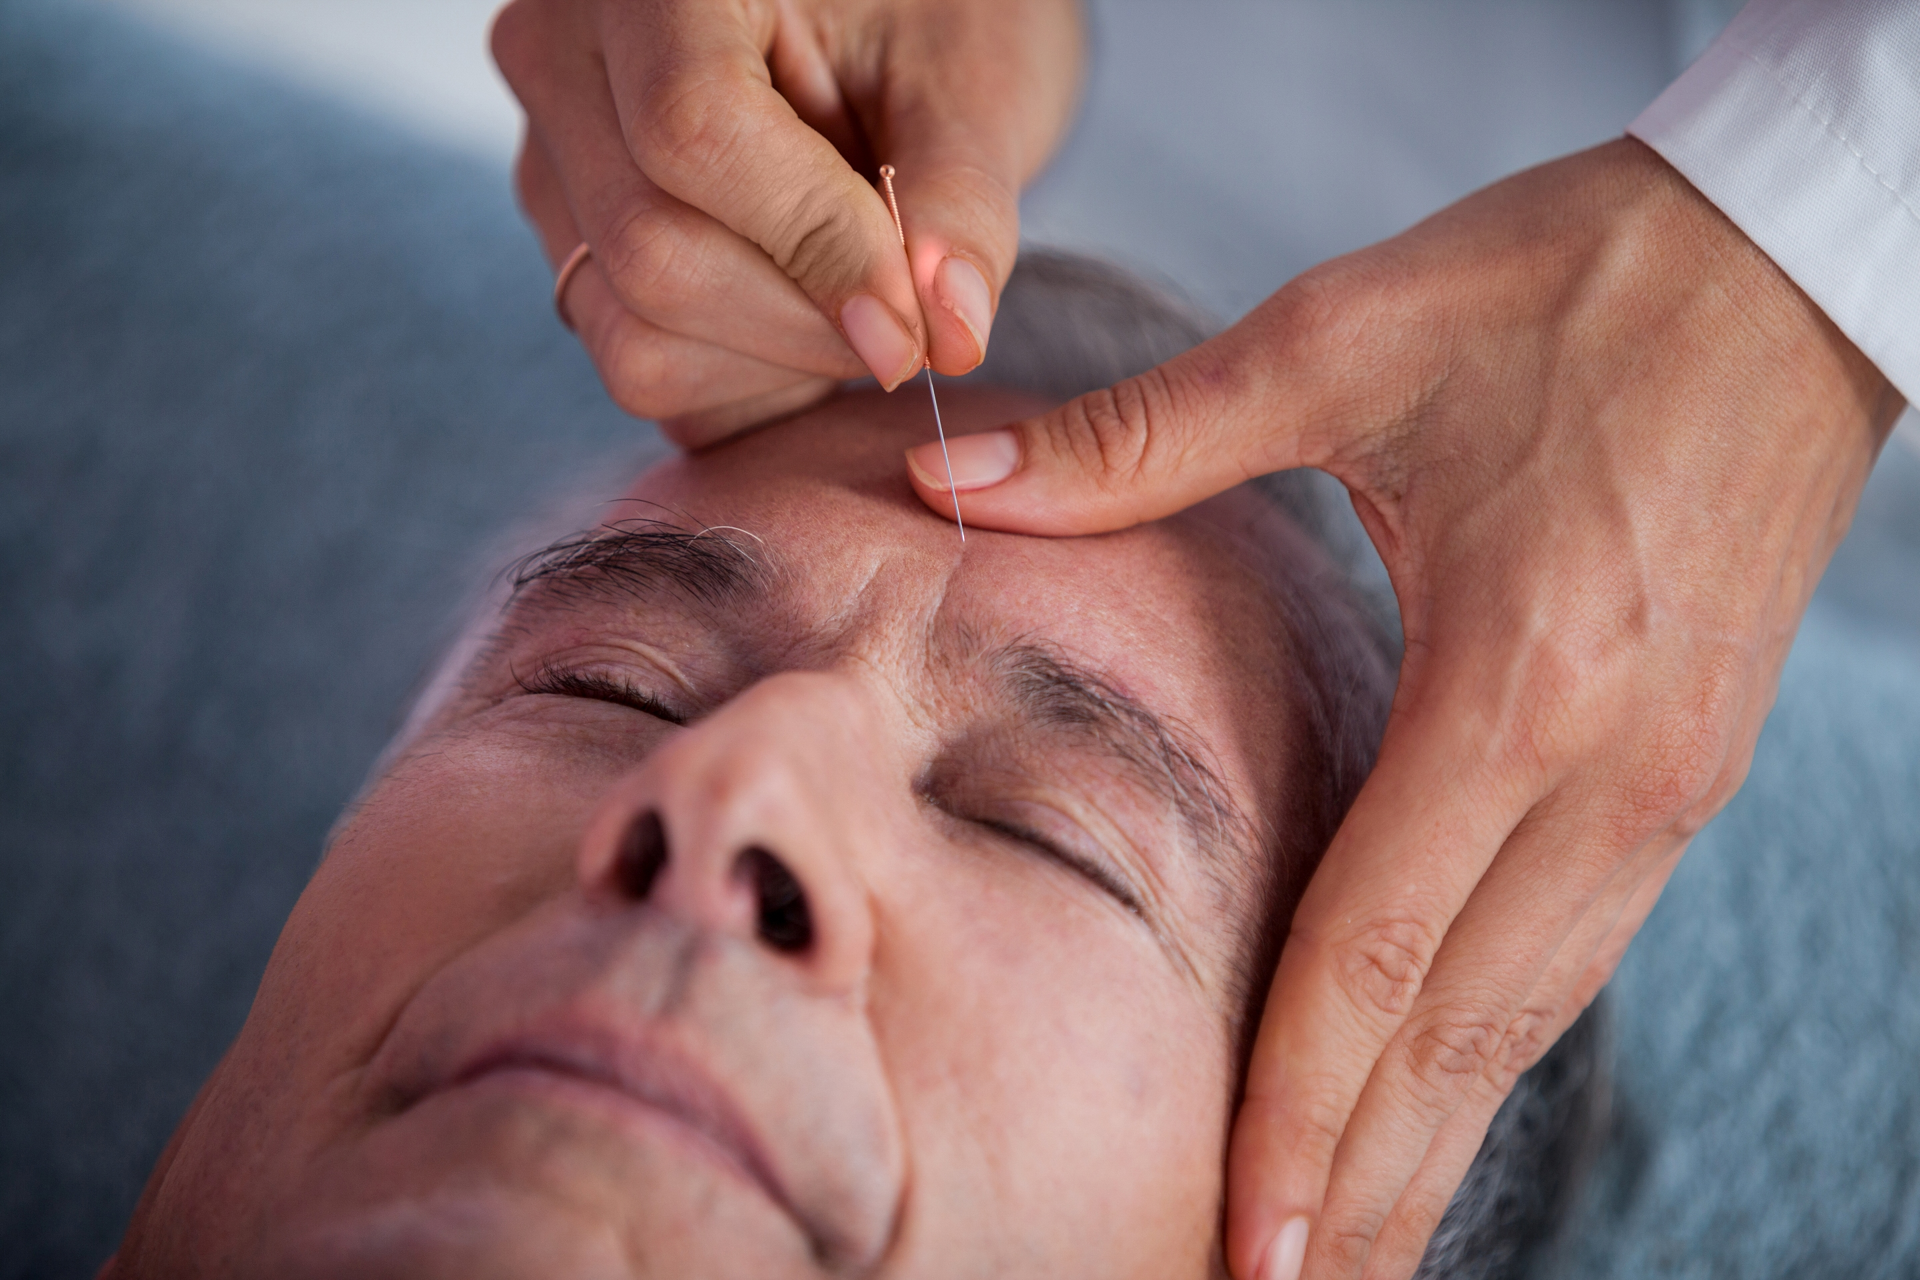
P = male stroke survivors
I = acupuncture
C = standard stroke therapy (e.g. antihypertensive meds)
O = improved recovery
Exercise II
Clinical Question
How effective is acupuncture in improving mobility in elderly male stroke patients in comparison to standard stroke therapy?
Fred is 72, and is undertaking therapy for recovery from a stroke which affected his mobility. His daughter is a strong advocate of acupuncture, and has suggested he ask about it at his next appointment with you.

Slide 18
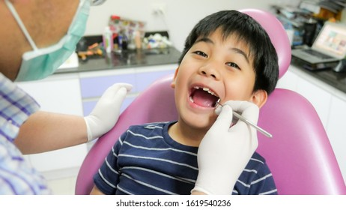
Exercise III
P = children with deciduous teeth
I = xylitol gum
C = normal gum
O = lower caries incidence
Clinical Question
Do children with deciduous teeth who consume xylitol chewing gum, compared to children who do not, have lower incidence of dental caries?
A 10-year-old boy had an appointment with the dentist for treatment of his caries. After the completion of the visit, the father asked the dentist: “Doctor, we see a lot of ads about sugar-free chewing gums. Are they good for my child?”.

Slide 19
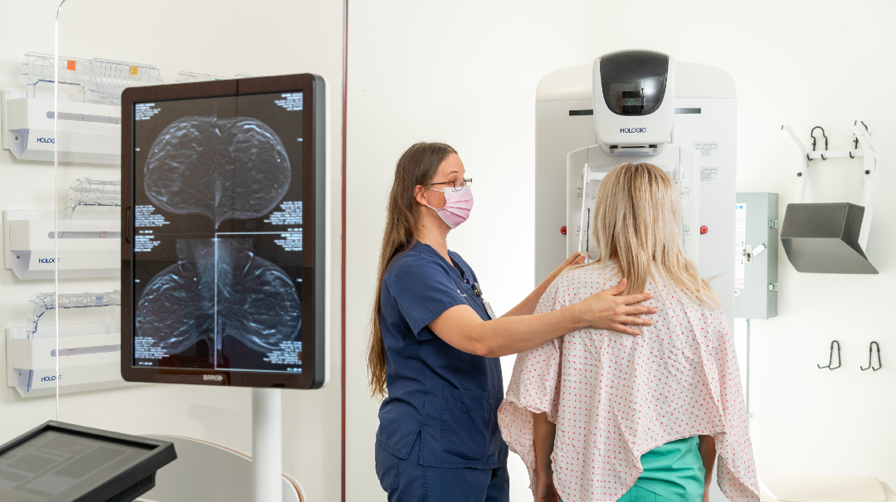
Exercise IV
P = middle age females
I = annual mammogram
R = triennial mammogram
D = breast cancer
Clinical Question
Is a yearly mammogram more effective in detecting breast cancer compared with a mammogram every 3 years in women under age 50?
Sarah is a 49 year old woman who asks you for advice whether to undertake a yearly mammogram instead of every 3 years to be assured regarding her risk of developing breast cancer.

Slide 20
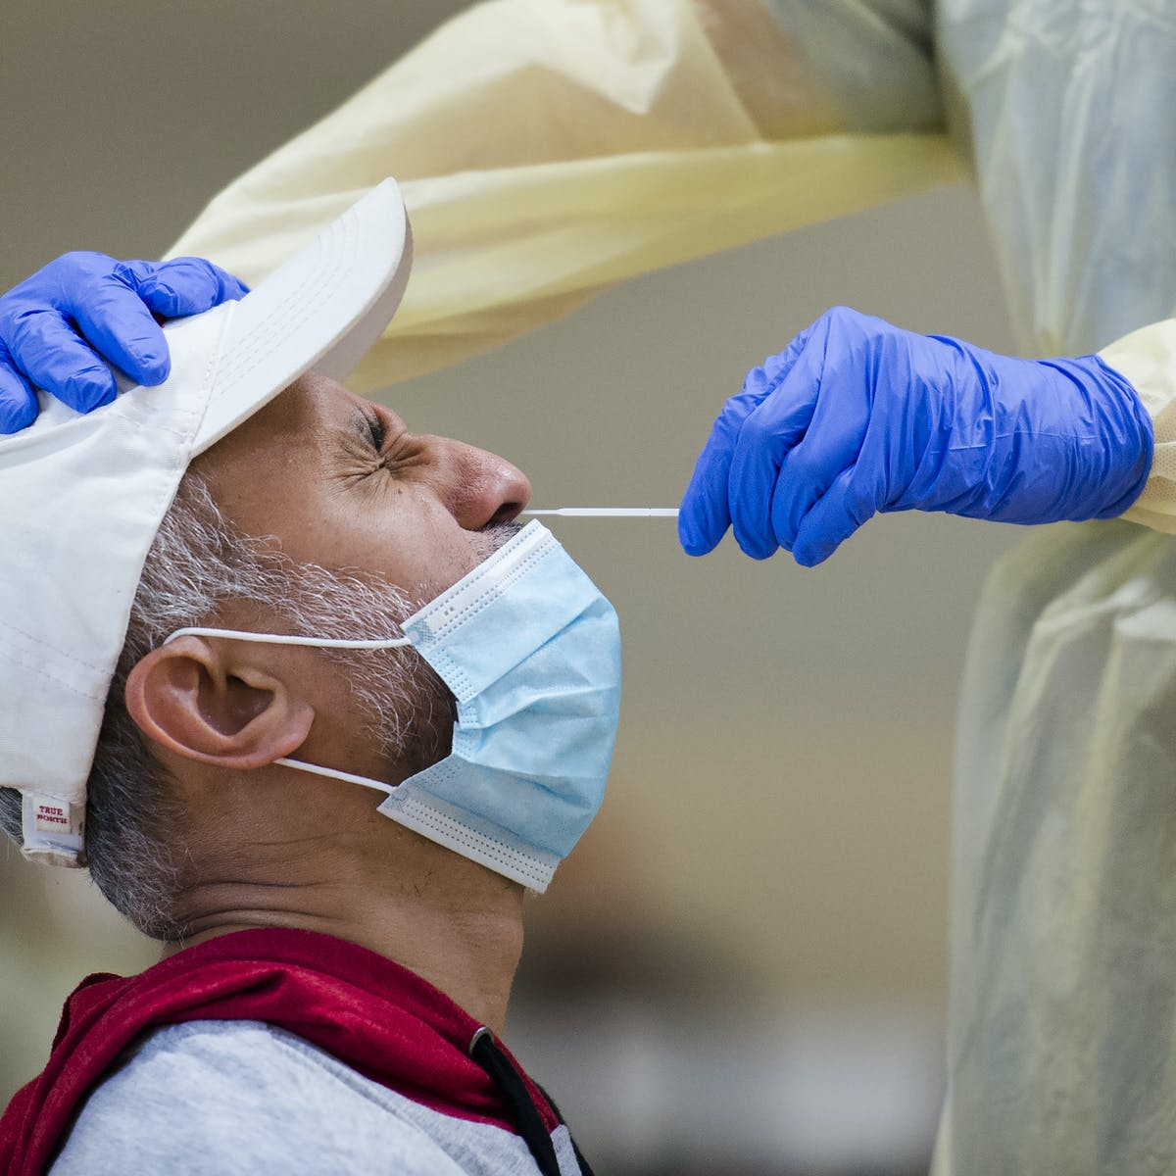
Exercise V
P = healthy population
I = salivary PCR
R = nasopharyngeal PCR
D = COVID-19 infection
Clinical Question
Is salivary PCR accurate in detecting SARS-CoV-2 compared to nasopharyngeal PCR in health individuals?
Considering the invasiveness of nasopharyngeal samples harvested to test for COVID-19 positivity, salivary samples were proposed as a less invasive technique. Last year, public health researchers had been challenged by this situation due to lack of evidence regarding the accuracy of salivary samples.

Slide 21
BREAK

Slide 22
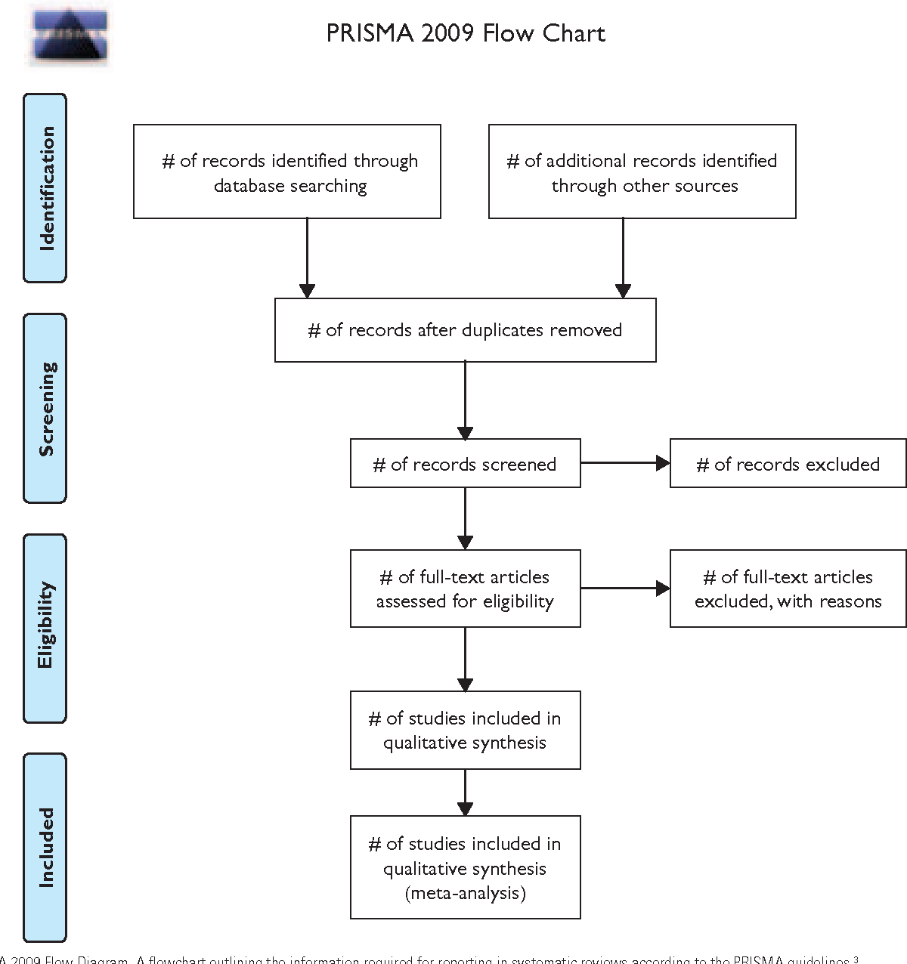
PRISMA Preferred Reporting Items for Systematic Reviews and Meta-Analyses

Slide 23
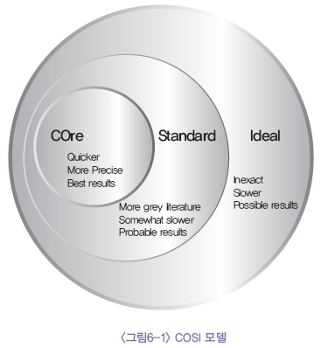
Find Best Evidence
What is good evidence?
Where to find it?
The conditions for the evidence acquired in EBM are that the evidence should be attainable, obtained externally from research, up-to-date, timely, of high quality, applicable to individual patients, and appropriately the best.
The U.S. NLM provides the scope for a literature survey, which is the COSI (Core, Standard, Ideal) model.

Slide 24
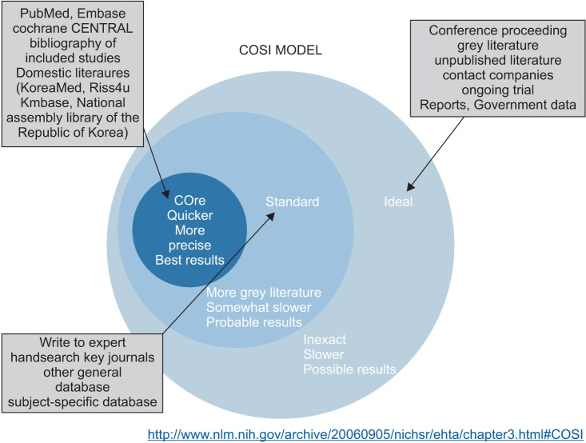
Find Best Evidence
The term "core" means the essence of a literature survey, which is the minimal database required to find the best results rapidly and simply. Therefore, the "core" database is what must be searched. The group of "core" databases includes MEDLINE, EMBASE, and CENTRAL.
The term "standard" represents the standard scope of a literature survey, includes a manual search of core journals and the search of databases that are not "core" (DARE, CINAHL, and PsycINFO).
The "ideal" part includes conference proceedings, grey literature, unpublished articles, and clinical trials currently in process.

Slide 25
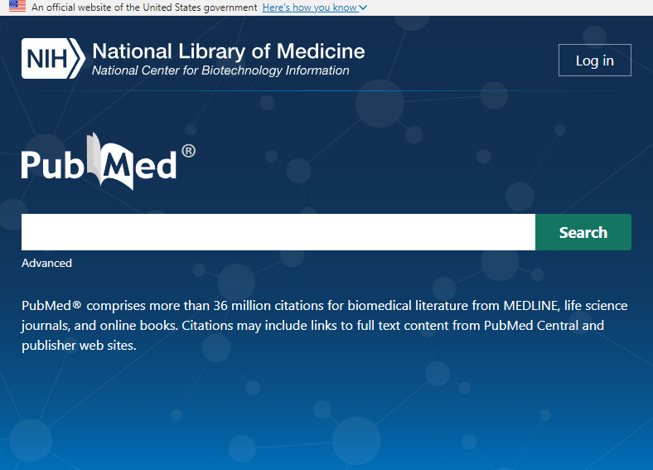
Find Best Evidence
PubMed® is a free search engine launched in January 1996 by the National Library of Medicine (NLM) at the National Institutes of Health (NIH).
PubMed provides +36 million citations for biomedical literature from MEDLINE, life science journals, and online books.
It covers fields such as biomedicine and health, encompassing portions of the life sciences, behavioural sciences, chemical sciences, and bioengineering.
The database is updated daily with new literature and links to full-text articles when available.

Slide 26
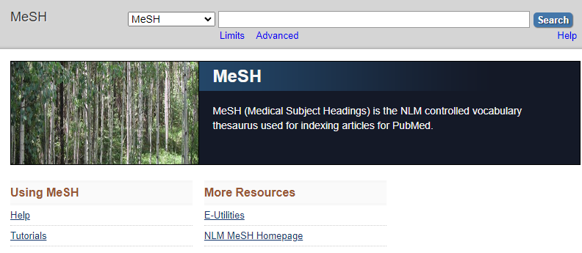
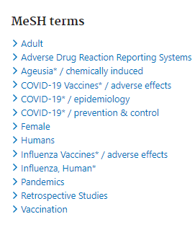
Find Best Evidence
pubmed.ncbi.nlm.nih.gov
ncbi.nlm.nih.gov/mesh
Search Engine: At its core, PubMed is a free search engine that facilitates the search of the MEDLINE database.
MeSH Terms: It uses Medical Subject Headings (MeSH), a comprehensive controlled vocabulary, to index articles for more precise searching.
Filters and Tools: Users can filter results by various criteria such as publication date, age, author, journal, and article type. Advanced search tools allow users to build complex search strategies.

Slide 27
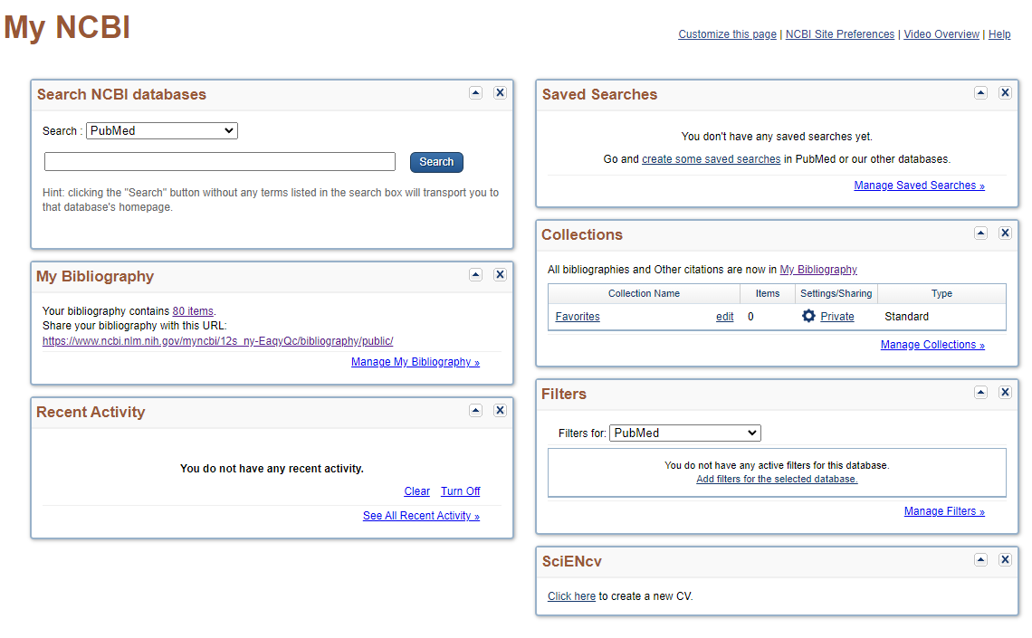
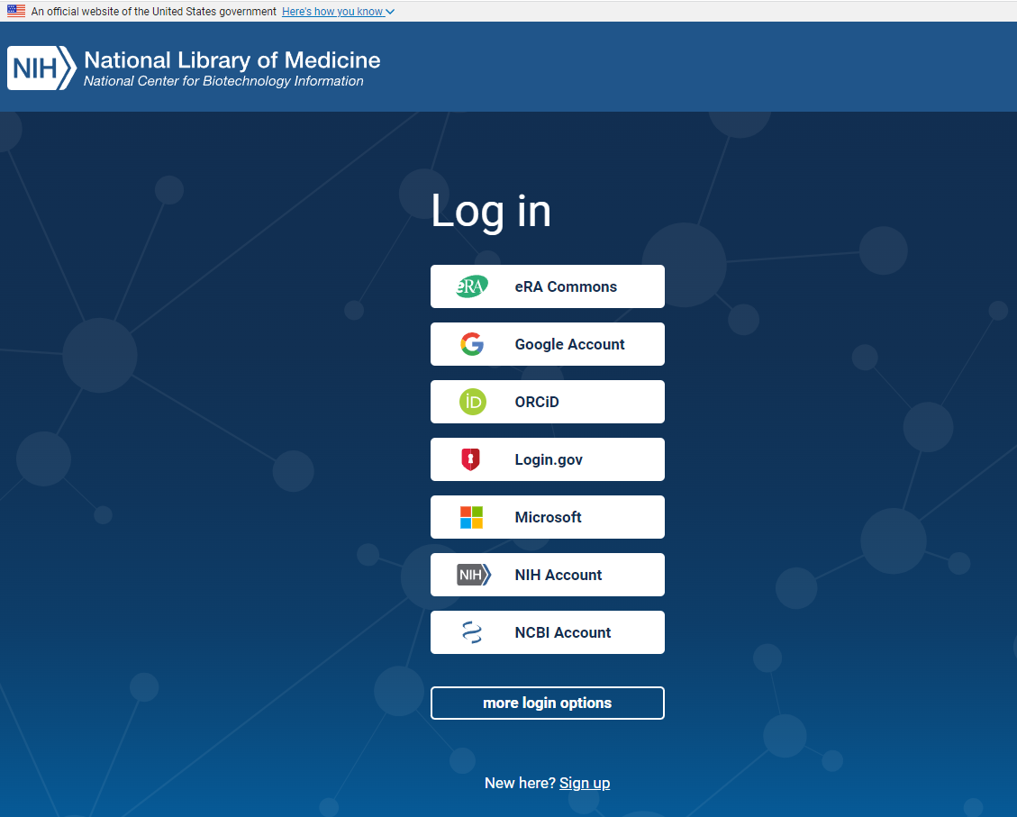
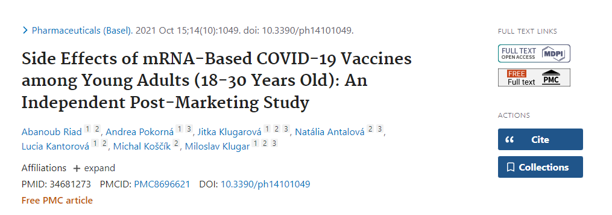
Find Best Evidence
My NCBI: A personal account feature called My NCBI allows users to save searches, set up search alerts, and customize display settings.
LinkOut: This service provides links to full-text articles at journal websites and other related databases.
PubMed Central (PMC): A free archive of biomedical and life sciences journal literature at the NIH.

Slide 28
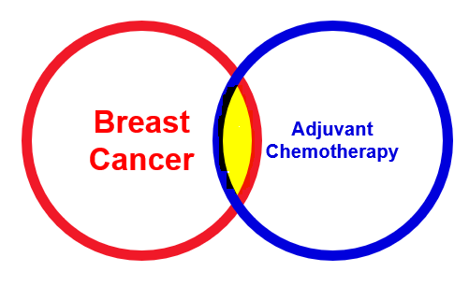
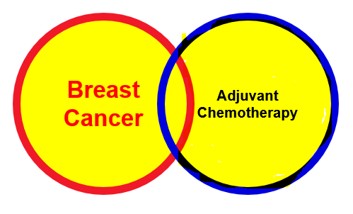
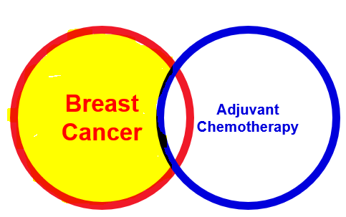
Find Best Evidence
AND
Breast
Cancer
Adjuvant
Chemotherapy
Search Strategy
OR
Breast
Cancer
Adjuvant
Chemotherapy
Before building a search strategy, you should develop a robust clinical question following the PICO framework.
Boolean Operators:
AND to narrow your search (e.g., diabetes AND hypertension).
OR to broaden your search and include synonyms or related terms (e.g., myocardial infarction OR heart attack).
NOT to exclude terms (e.g., infection NOT surgical).
NOT
Breast
Cancer
Adjuvant
Chemotherapy

Slide 29
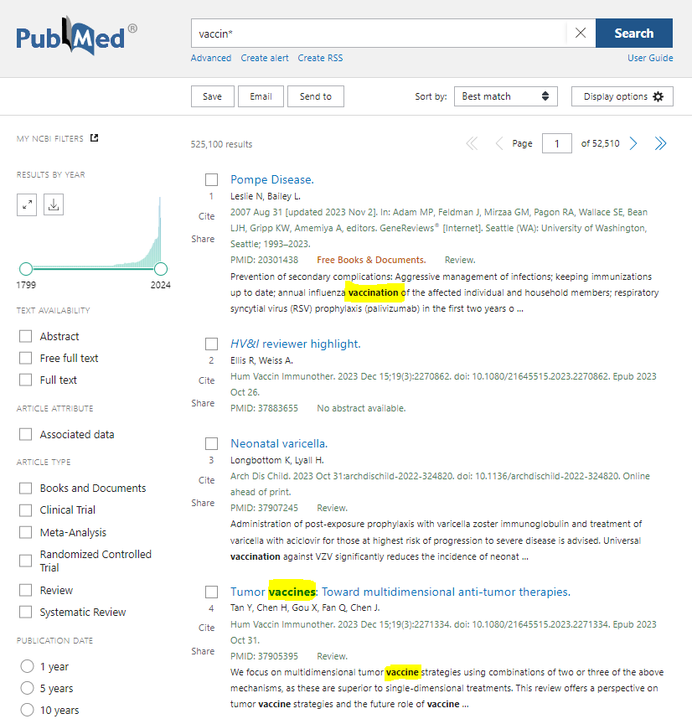
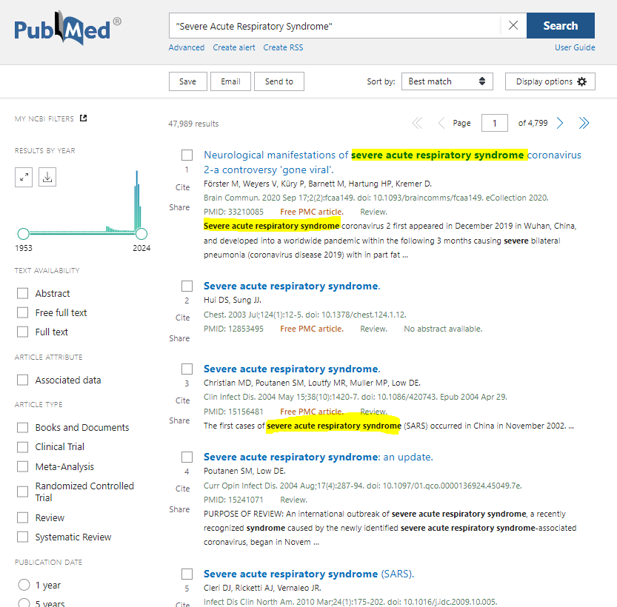
Find Best Evidence
Search Strategy
Truncation: use an asterisk to search for multiple word endings (e.g., vaccin* retrieves vaccine, vaccines, vaccination).
Phrase Searching: enclose phrases in quotation marks to search for exact phrases (e.g., "acute myocardial infarction").
MeSH Terms: utilize Medical Subject Headings (MeSH) to find articles that are about the subject, regardless of the terms used by the authors (e.g., MeSH term "Neoplasms" for cancer-related searches).
Filters and Limits: apply filters for publication date, article type, age, language, etc., to refine your search.

Slide 30
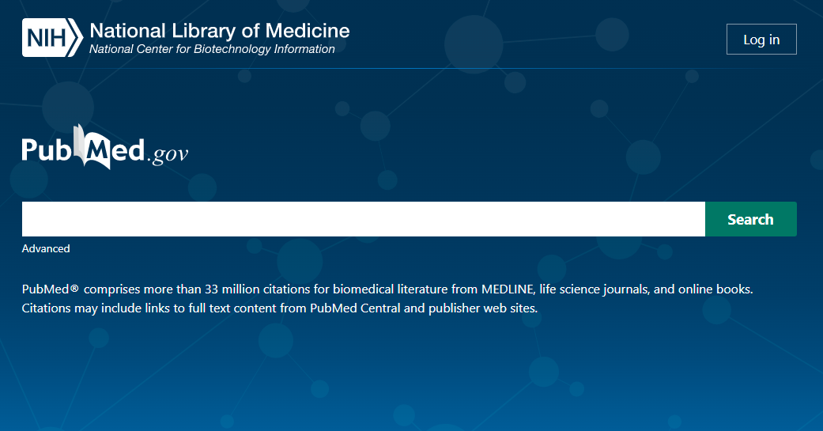
Search Strategy
P = COVID-19 patients
I = corticosteroids
C = no corticosteroids
O = clinical improvement
(
COVID-19 OR SARS-CoV-2 OR 2019-nCoV OR coronavirus disease OR severe acute respiratory syndrome
)
AND
(
corticosteroid OR corticoid OR prednisolone OR meticortelone OR dexamethasone OR cortisol
)
https://www.cochranelibrary.com/cdsr/doi/10.1002/14651858.CD014963/appendices#CD014963-sec-0133

Slide 31
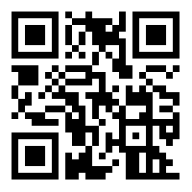
Exercise VI
Build a draft search strategy using the Boolean operators!
Search Strategy
The effect of antibiotics with potential antiviral and anti‐inflammatory properties are being investigated in clinical trials as treatment for COVID‐19. The use of antibiotics follows the intention‐to‐treat the viral disease and not primarily to treat bacterial co‐infections of individuals with COVID‐19.
P = COVID-19 patients
I = antibiotics
C = placebo
O = clinical improvement
Aim: to assess the efficacy and safety of antibiotics compared to each other, no treatment, standard of care alone, placebo, or any other active intervention with proven efficacy for treatment of COVID‐19 outpatients and inpatients.

Slide 32
Exercise VI
Search Strategy
P = COVID-19 patients
I = antibiotics
C = placebo
O = clinical improvement
(
COVID-19 OR SARS-CoV-2 OR 2019-nCoV OR coronavirus disease OR severe acute respiratory syndrome
)
AND
(
antibio* OR antimicrobi* OR penicillin* OR cephalospor* OR Amoxi* OR Azithromycin
)
https://www.cochranelibrary.com/cdsr/doi/10.1002/14651858.CD015025/appendices#CD015025-sec-0117

Slide 33
BREAK

Slide 34
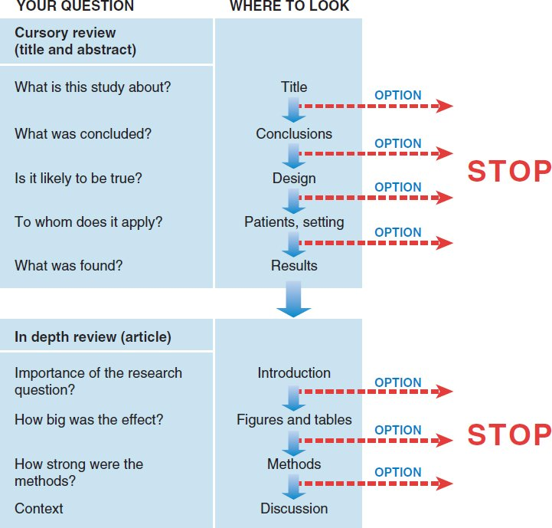
Screening
Approaches to streamlined reading vary.
It is a good idea to at least survey the titles and abstracts of all articles in an issue to decide which articles matter most to you.
For those that do, you might read more deeply, adjusting the depth as you go.

Slide 35
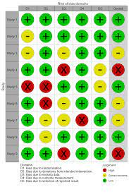
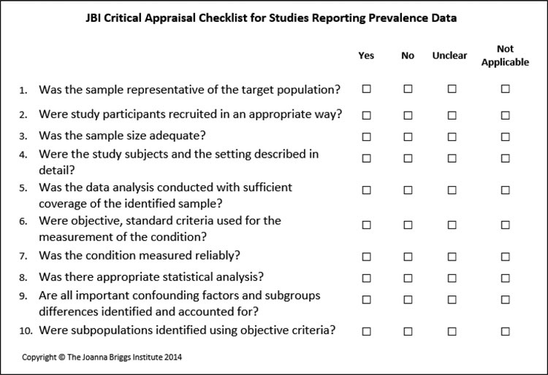
Critical Appraisal
Once the literature has been surveyed, appropriate literature should be selected and the quality and usefulness of the literature should be appraised.
Appraisal of the quality of literature enables decisions to be made regarding whether to accept the conclusions drawn.
Tools of appraisal are classified as scoring system or checklist system, e.g. RoB 2.0, ROBINS-I, JBI Checklists
Checklists of critical appraisal are composed of signalling questions, each question is related one or more sources of potential bias.

Slide 36
Critical Appraisal

Slide 37
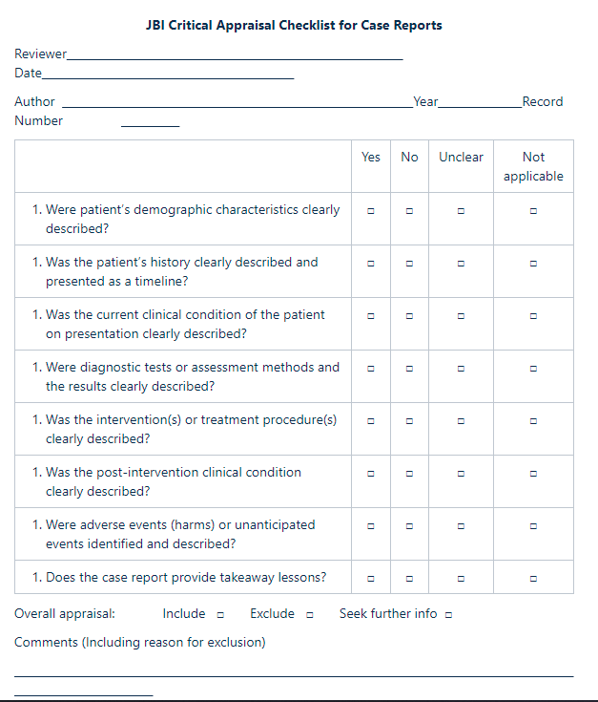
Critical Appraisal Tools
RoB 2.0
JBI Checklists
etc

Slide 38
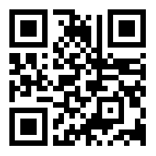
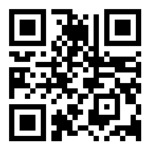
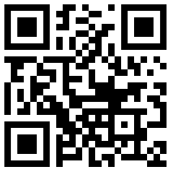
Exercise VII
Critical Appraisal
Critical Appraisal
Each student will assess one of the following studies (10 minutes)
Case Report No. 1
(Amorim dos Santos et al. 2020)
Case Report No. 2
(Chaux-Bodard et al. 2020)
Case Report No. 3
(Helmi et al. 2013)

Slide 39
Evidence Synthesis
Qualitative Synthesis
Thematic analysis refers to the various processes of reading texts and refining the findings into key ‘themes’.
Meta-ethnography is a qualitative synthesis technique which involves: a) the mapping of key themes and concepts across studies (which may parallel a thematic analysis approach); b) the identification and resolution of any contradictions, and c) the building of a general interpretation based on the data.
Quantitative Synthesis
Meta-analysis is a quantitative, formal, epidemiological study design used to systematically assess the results of previous research to derive conclusions about that body of research.

Slide 40
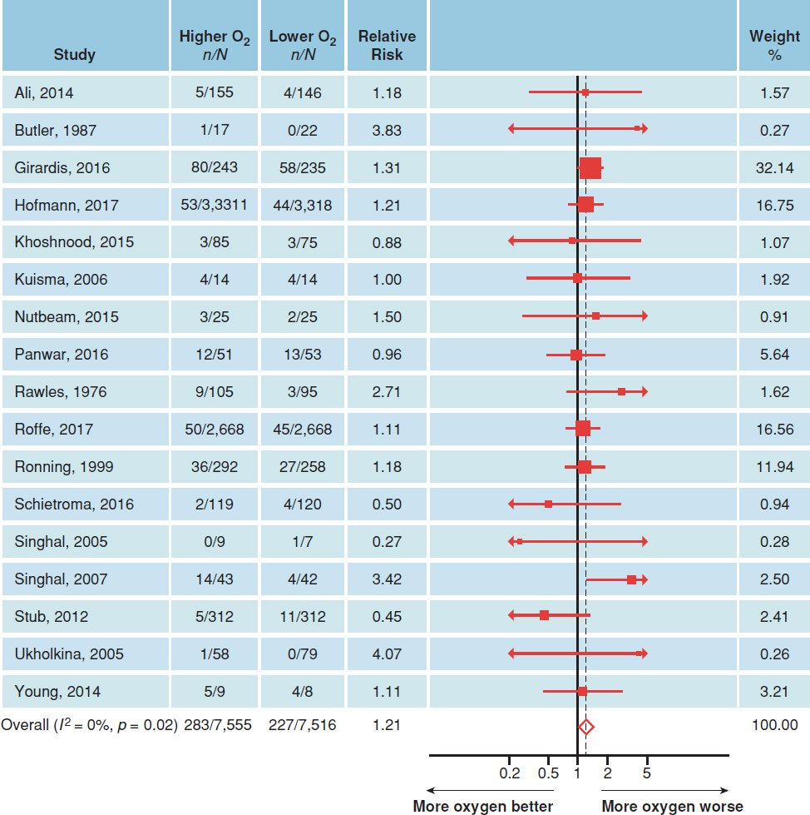
Meta-Analysis
Forest Plot
How to read?
https://s4be.cochrane.org/blog/2016/07/11/tutorial-read-forest-plot/

Slide 41
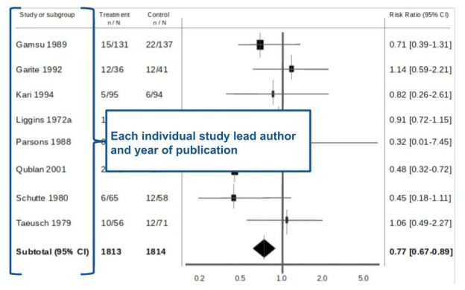
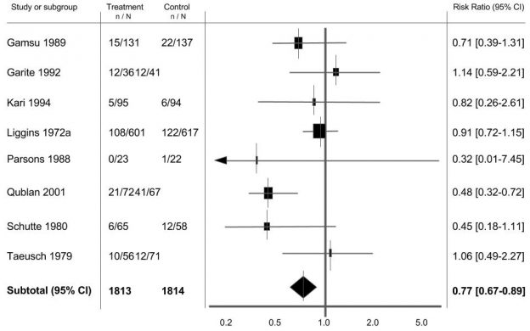
Meta Analysis
https://s4be.cochrane.org/blog/2016/07/11/tutorial-read-forest-plot
How to interpret forest plot?

Slide 42
Meta Analysis
How to interpret forest plot?
https://s4be.cochrane.org/blog/2016/07/11/tutorial-read-forest-plot

Slide 43
Meta Analysis
How to interpret forest plot?
https://s4be.cochrane.org/blog/2016/07/11/tutorial-read-forest-plot

Slide 44
Exercise VIII
Forest Plot
refers to …. ?
refers to .... ?
… is the study with the highest weight.
… is a study without significant effect size.
The overall effect size is …
Treatment or control?
Fixed-effect or random-effect model?

Slide 45
Exercise VIII
Forest Plot
refers to …. ?
refers to .... ?
… is the study with the highest weight.
… is a study without significant effect size.
The overall effect size is …
Treatment or control?
Fixed-effect or random-effect model?

Slide 46
GRADE
Grading of Recommendations, Assessment, Development and Evaluations (GRADE) is a systematic approach to rating the quality of evidence and the strength of recommendations.
GRADE considers various factors such as study design, consistency, directness, precision, and publication bias.

Slide 47
GRADE
Grading of Recommendations, Assessment, Development and Evaluations (GRADE) is systematic approach to rating the quality of evidence and the strength of recommendations.

Slide 48
Apply the Evidence
Getting evidence into practice is not necessarily straightforward, with a simple estimate of the time it takes from evidence being created to its use in practice being 17 years.
How to bridge the gap between the evidence and the translation (or uptake) of research into clinical practice has been a point of ongoing debate over the years
The questions that we should ask before the decision to apply the results of the study are:
Are the participants in the study similar enough to my patient?
Is the treatment available and is health care system prepared to fund it?
What alternatives are available?
Do the potential side effects of the drug or procedure outweigh the benefits?
Are the outcomes appropriate to the patient? Does the treatment conflict with the patient’s values and expectations?

Slide 49
Evaluate
The final step of EBM is the evaluation.
During this process it is important to assess whether certain evidence, which is applied to the patient, caused changes to better and that to the extent that it is confirmed by research.
If the data differ significantly, it would be necessary to investigate why some patients did not respond to the changes introduced in the expected way and what can be done to change it.

Slide 50
EBP Limitations
EBP itself displays three of the shortcoming of medical sciences:
a shortage of coherent and consistent evidence;
difficulties in applying global evidence to an individual patient;
and barriers to the practice of high quality clinical care
There are three further limitations particular to EBP itself:
the need to possess searching and critical appraisal skills;
the limited time clinicians have to develop and practise these skills;
and the resources to allow immediate access to information in clinical settings are few
50

Slide 51
EBD Resources
Cochrane: Oral Health
51

Slide 52
EBD Resources
ADA: Center for EBD
52

Slide 53
EBD Resources
https://www.journals.elsevier.com/journal-of-evidence-based-dental-practice
53

Slide 54
EBD Resources
https://www.cebd.org/
https://www.nature.com/ebd
https://www.springer.com/gp/book/9783319457314
54

Slide 55
THANK YOU
abanoub.riad@med.muni.cz
Office Consultation (A21/315)

