Slide 1
Airway management
Anestezie II
neexistuje 100% jistota predikce
neopakuj znovu a znovu to samé ….

Slide 2
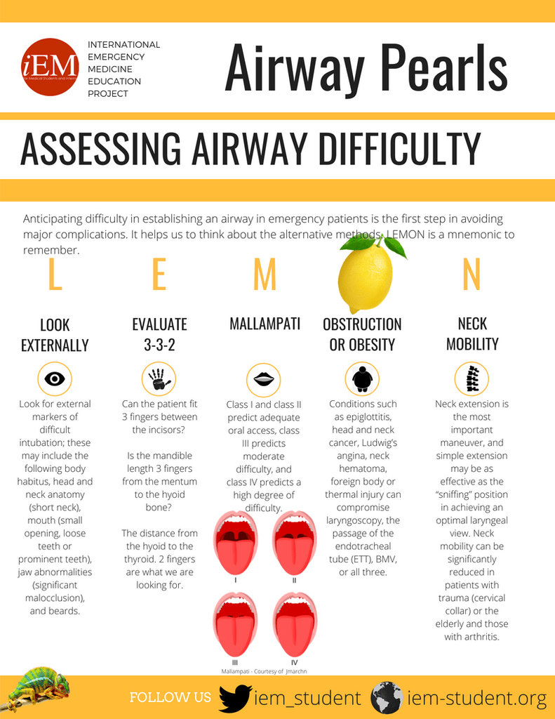
mnemotechnické pomůcky

Slide 3

Predikční skóre - ICU
Mallampati III or IV | 5
Apnoea (Obstructive Sleep) | 2
Cervical Spine Reduced Mobility | 1
Opening Mouth <3 cm | 1
Coma | 1
Hypoxia | 1
Anesthesiologist Not Trained | 1
≥3

Slide 4
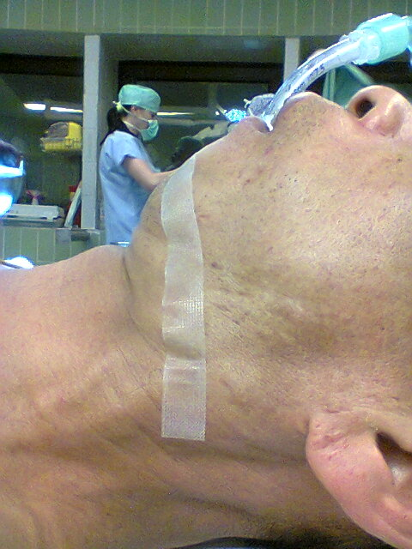
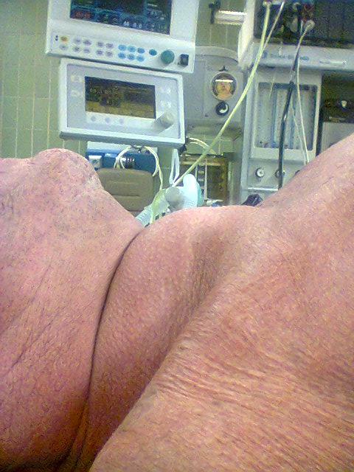

Slide 5
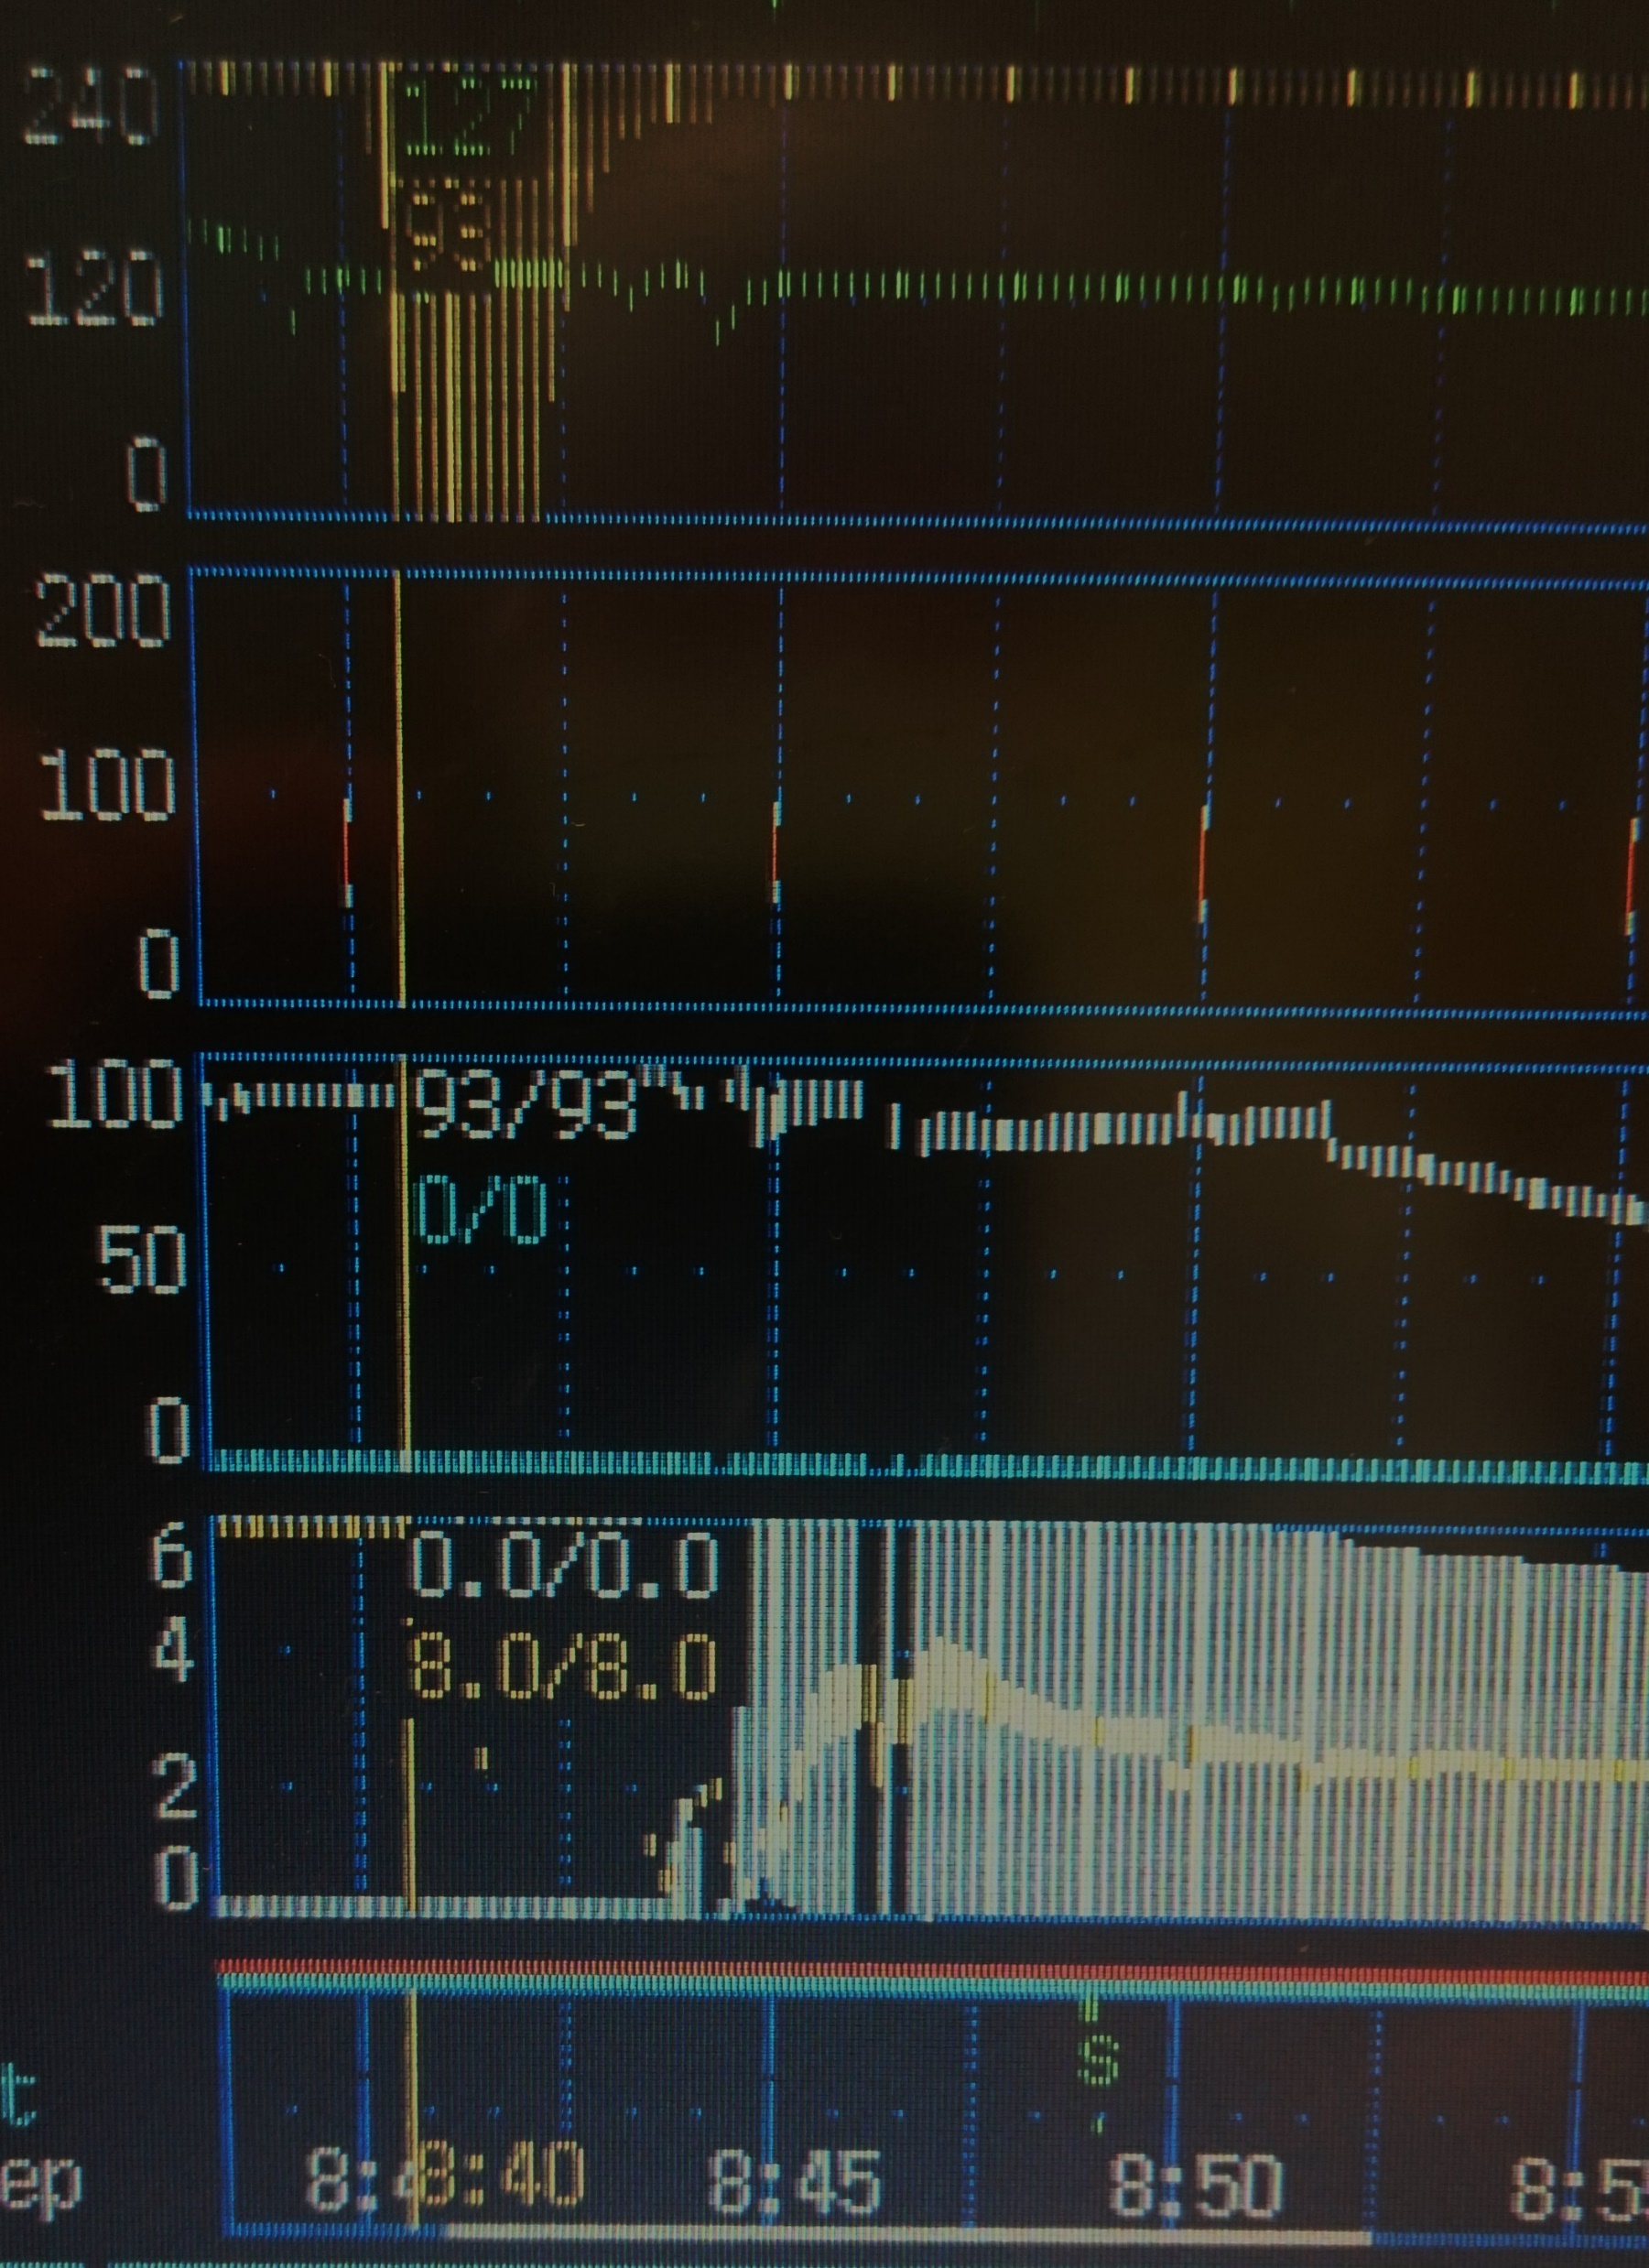
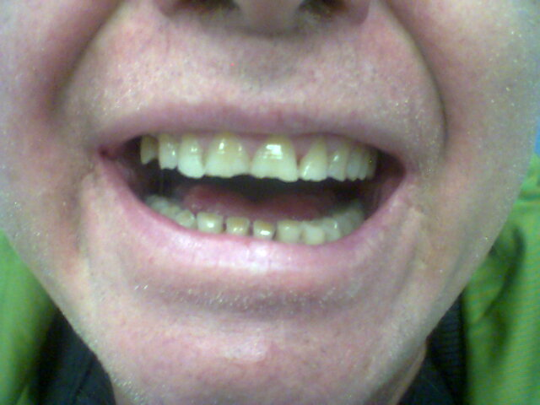

Slide 6
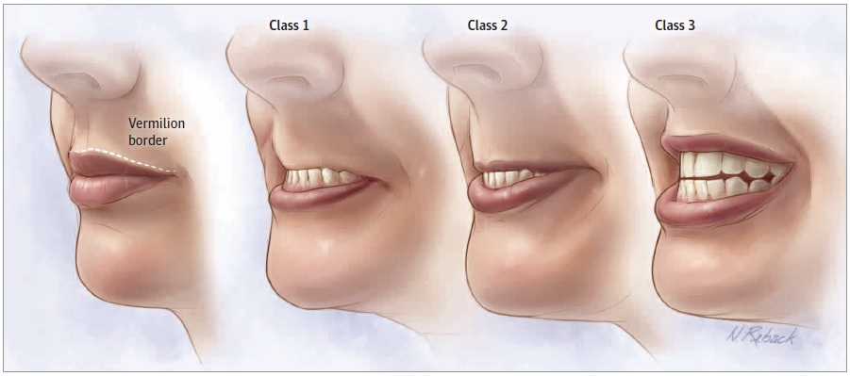
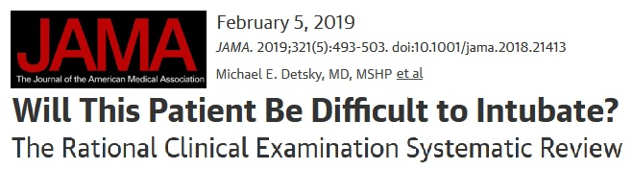
The Lip Bite test
Lipbite test
Likelihood ratio 14

Slide 7
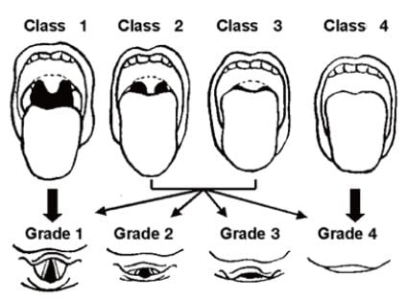
Mallampati
Cormack-Lehane score

Slide 8
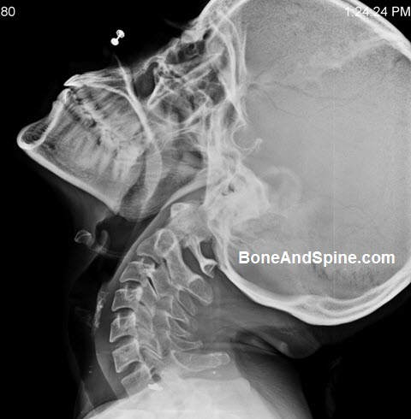
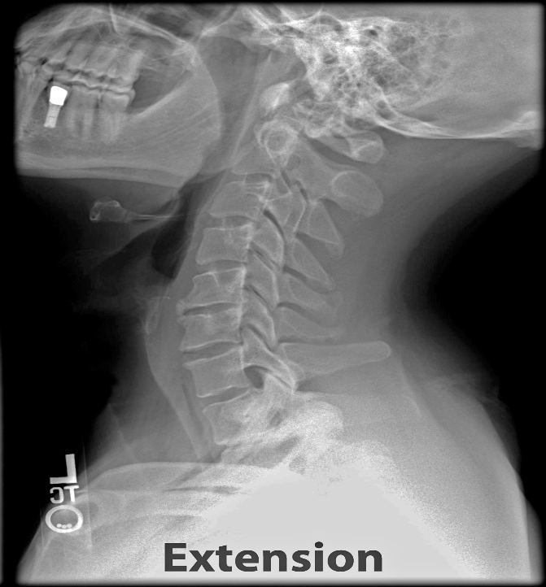
Cervical mobility
Head in neutral position.
Use index 2 index fingers:on chin and nape
Extension of neck
Read the position of fingers
Result:
Normal bend
slightly limited = fingers horizontal
significantly reduced bend

Slide 9
vzdálenosti
3-3-2

Slide 10
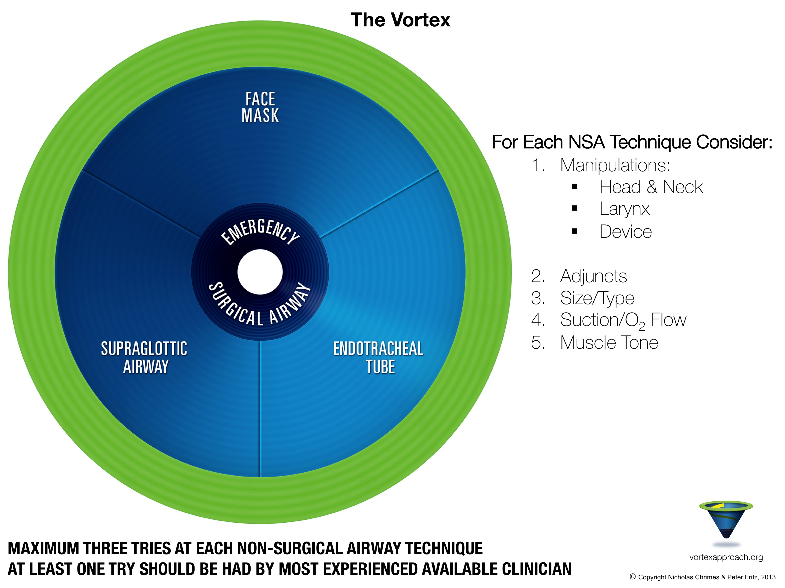

Slide 11
