Slide 1
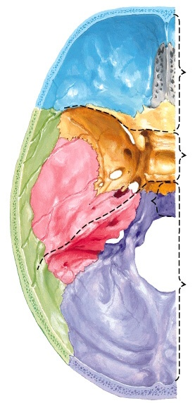
Cranical Fossa
Anterior
Anterior
Frontal lobes of cerebrum
Middle
Temporal lobes of cerebrum
Posterior
Cerebellum and Brainstem

Slide 2
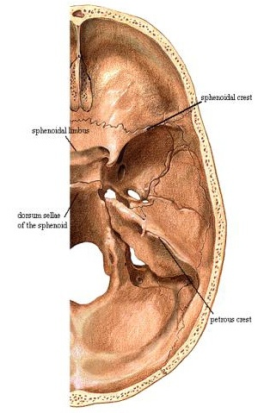
Cranial Fossa
Anterior cranial fossa -- frontal lobes
Middle cranial fossa -- Temporal lobes
Posterior cranial fossa -- Cerebellum and
brain stem

Slide 3
Occipital bone Petrous part of temporal bone Parietal bone
Posterior Cranial Fossa

Slide 4
Greater wing of sphenoid bone Petrous and squamous part of temporal bone Parietal Bone
Middle Cranial Fossa

Slide 5
Lesser wing of sphenoid bone Orbital plates of frontal bone Cribriform plates of ethmoid bone Crista galli
Anterior Cranial Fossa

Slide 6
Crista Galli Cribriform Plates
Cranial Fossae

