Slide 1
Joints and ligaments of the Thorax and the Back
Stelios Valerkos

Slide 2
Joints and Ligaments of the Thorax
Costal cartilage
Radiate sternocostal ligaments
Angle of sternum
Sternocostal joint
Xiphisternal joint

Slide 3
Costal cartilage
A bar of hyaline cartilage that
attaches a rib to the sternum
in the case of true ribs, or to
the rib immediately above in
the case of the upper false ribs.
Costal cartilages of ribs 1-7
connect to the sternum;
costal cartilages of ribs 8-10
connect to the costal
cartilage of rib 7; costal
cartilages of ribs 11 & 12 do not
articulate anteriorly
but end in the muscles of the
abdominal wall

Slide 4
Radiate sternocostal ligaments
Fibrous bands that cross
from the sternal end of the
costal cartilage to the
ventral part of the sternum.
These ligaments connect the
costal cartilages of ribs 1-7
with the sternum on both
the anterior and posterior
surfaces of the
sternocostal articulation

Slide 5
Angle of sternum
The angle formed by the
articulation between the
manubrium and the body of
the sternum. The cartilage
within this joint usually does
not become ossified until old
age; the angle formed by this
articulation is also called the
angle of Louis; the sternal
angle marks the level of the
second costal cartilage from
which all other ribs are
counted

Slide 6
Sternocostal joint
The articulations that
connect the costal
Cartilages with the
Sternum. The sternocotal
joints are arthrodial joints,
with the exception of the
first, inwhich the cartilage
Is directly united with the
sternum, and which is,
therefore, a synarthrodial
articulation.

Slide 7
Xiphisternal joint
located near the bottom
of the sternum, this
articulation connects
The xiphoid process
with the body of the
sternum.
Xiphisternal joint

Slide 8
Joints and Ligaments of the Back
Anterior longitudinal ligament
Interspinous ligaments
Intervertebral disks
Ligamenta flava
Nuchal ligament
Posterior longitudinal ligament
Supraspinous ligaments
Zygapophyseal joint

Slide 9
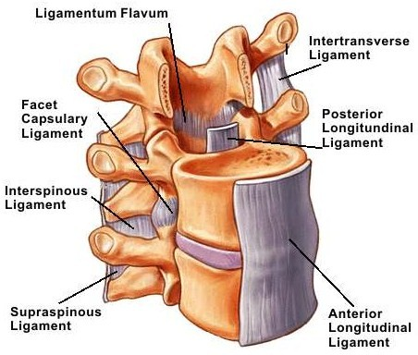
Anterior longitudinal ligament
A ligament that runs down the
anterior surface of the spine.
It traverses all of the vertebral
bodies and intervertebral discs.
It lies directly posterior to the
thoracic and abdominal viscera.
Detailed information about the
spine can be found here.

Slide 10
Interspinous ligaments
Also known as the interspinal
ligaments, they connect the
spinous processes of two adjacent
vertebra; They meet the ligamenta
flava in front and the supraspinal
ligament behind. They are narrow
and elongated in the thoracic region;
broader, thicker, and quadrilateral
in form in the lumbar region; and
only slightly developed in the neck

Slide 11
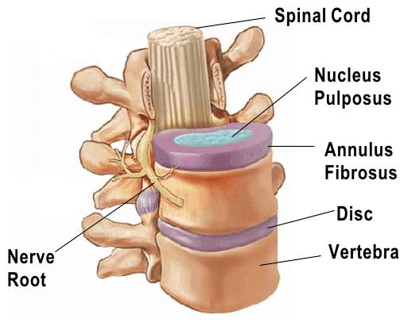
Intervertebral disks
A fibrocartilaginous disk between
adjacent vertebral bodies.
it is composed of two parts:
an outer anulus fibrosus and an
inner nucleus pulposus; the nucleus
pulposus is the remnant of the
notochord; the intervertebral disks
are important shock absorbers
between vertebrae. Detailed
information about the intervertebral
disc can be found here.

Slide 12
Ligamenta flava
They connect the laminae of adjacent
vertebrae, all the way from the axis to
the first segment of the sacrum (C2 to S1).
They are best seen from the interior of
the vertebral canal; when looked at from
the outer surface they appear short, being
overlapped by the laminae.
The ligamentum flavum is penetrated by
the needle during spinal tap; the word
flavum is derived from the Latin word flavus,
which means "yellow" a reference to the
predominance of yellow elastic fibers which
gives this ligament its grossly visible color.

Slide 13
Nuchal ligament
Also known as the paxwax ligament, this is a midline ligament that extends posteriorly from the spinous processes of cervical vertebraeand extends from the base of the skull to the 7th cervical vertebraa syndesmosis; it provides muscle attachments to the cervical spinous processes without the necessity of long spinous processes that would hinder extension of the neck. Detailed information about the spine can be found here.

Slide 14
Posterior longitudinal ligament
A ligament that is situated within the vertebral canal and courses from superior to inferior along the posterior surfaces of all vertebral bodies; it is broader above than below, and thicker than in the cervical and lumbar regions.

Slide 15
supraspinous ligaments
They are strong fibrous cords
that connect the tips of the
Spinous processes of thoracic
and lumbar vertebrae
The supraspinous ligament
begins at the C7 vertebra and
ends at the mid-sacral segmental
level; it serves as a muscle
attachment site; between the
spinous processes it is
continuous with the interspinal
ligaments.

Slide 16
Zygapophyseal joint
They are located between
the superior articular
process of one vertebra and
the inferior articular process
of the vertebra directly
above it. There are two
facet joints in each spinal
motion segment.

