Slide 1
Dental anaesthesia
By Ebrahim Patel

Slide 2
Intraosseous intraligamentary intrapulpal infraorbital buccal abscess and space

Slide 3
Intraosseous anesthesia

Slide 4
Intraosseous anesthesia
What is Intraosseous anesthesia?
technique is one whereby teeth are anesthetized by injecting local anesthetic solution directly into the cancellous bone spaces around the tooth.

Slide 5
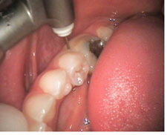
The first step –
Drill a small hole through the soft tissue and cortical bone to a depth of 5 – 8mm

Slide 6
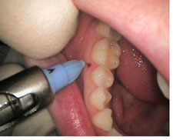
The second step - inserting a needle to the same depth and manually injected the desired volume of anesthetic solution into the cancellous bone

Slide 7
Advantages for the Clinician • When anesthetic solution is delivered into cancellous bone, excellent pulpal anesthesia is obtained, even in patients with irreversible pulpitis or hypersensitive teeth. • Intraosseous Anesthesia saves valuable time because there is no delay between injection and effect. Work on the tooth can commence in less than 30 seconds after the injection. • The Clinician will find patients to be very appreciative of the absence of pain and numbness.
Advantages for the patient • The patient experiences minimal pain during the dental procedure itself, and on leaving the dental office there will be no balooning of soft tissues and a much lessened feeling of numbness. • If an extraction is required, the patient is often spared the need for an unpleasant palatal injection. • Postoperative pain is rare.

Slide 8
Intraligamentary anesthesia

Slide 9
Intraligamentary anesthesia
What is Intraligamentary anesthesia?
- universally used technique consists of injecting the anesthetic into the ligament surrounding the tooth.
- The diffusion does not stop in the ligament and carries on through the lamina dura of the alveolar into the surrounding tooth.

Slide 10
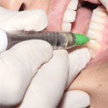
1st step (after decontamination of the sulcus where the anesthesia is to be performed using an ultrasonic scaler) :
Perform an anesthesia of the attached mucosa at the base of the papilla with a special intraligamentary needle (30 G - 9 mm).
This anesthesia of the mucosa allows you to numb the surface of the ligament into which the needle will be penetrated.

Slide 11
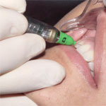
2nd Step:
The penetration of the ligament is performed with the same needle, generally distally to the tooth concerned. Indeed, teeth have a natural tendency to incline mesially. The ligament will therefore be physiologically more open distally than mesially.
The penetration into the ligament is obtained by "sliding" along the side of the tooth, parallel to it's axe having taken the care of determining support points which will prevent the needle from twisting.
The injection of one quarter of a cartridge maximum must be performed very slowly to always stay below the pain threshold.

Slide 12
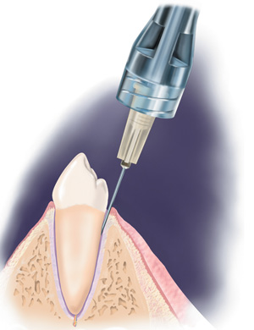
Advantages of intraligamentary anesthesia
Immediate anesthesia of one tooth.
Very small quantity of anesthetic
No soft-tissue numbness
No risk of post-anesthetic biting
Mainly insignificant post-anesthetic side effects

Slide 13
Intrapulpal anesthesia

Slide 14
Intrapulpal anesthesia
In about 5 to 10% of mandibular posterior teeth with irreversible pulpitis, supplemental injections, even when repeated, do not produce profound anesthesia; pain persists when the pulp is entered. This is an indication for an intrapulpal injection.

Slide 15
When pulp chamber has been exposed and treatment can´t proceed
Technique - a small needle is inserted into the pulp chamber until resistance is encountered → injected under pressure
As the injection starts there will be a brief moment of intense discomfort

Slide 16
Infraorbital anesthesia

Slide 17
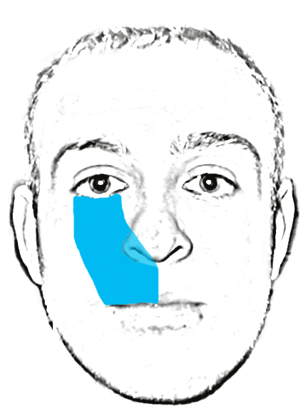
The infraorbital nerve block is often used to accomplish regional anesthesia of the face. The procedure offers several advantages over local tissue infiltration. A nerve block often achieves anesthesia with a smaller amount of medication than is required for local infiltration. In addition, unlike local tissue infiltration, nerve blocks can provide anesthesia without causing tissue distortion. Therefore, the infraorbital nerve block is a convenient alternative for situations such as facial lacerations in which tissue distortion would be unacceptable.
The infraorbital nerve supplies sensory innervation to the lower eyelid, the side of the nose, and the upper lip. Since the infraorbital nerve provides a considerably large area of sensory innervation, it is a prime candidate for a regional nerve block. A successful infraorbital nerve block provides anesthesia for the area between the lower eyelid and the upper lip.

Slide 18
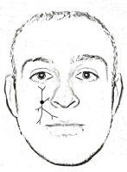
Anesthetize the maxillary premolars, canine, incisors, corresponding buccal alveolar bone and gingiva, also the terminal branches of infraorbital nerve (lower eyelid, external nose tissue, upper lip, the anterior aspect of the maxillary sinus)

Slide 19
Technique:
Palpate infraorbital foramen extra extra-orally and place thumb or index finger on region
• Retract the upper lip and buccal mucosa
• Area of insertion is the mucobuccal fold of the 1 1st premolar/canine area
• Contact bone in infraorbital region
• Inject 0.9 0.9-1.2cc of local anesthetic

Slide 20
Buccal nerve blcok

Slide 21
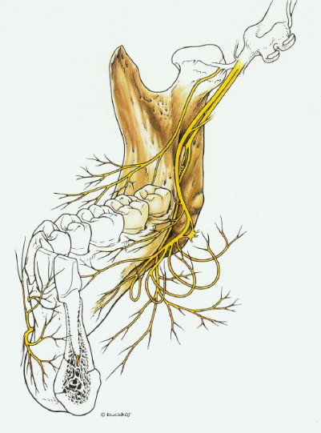
Buccal nerve arises in infrtemporal fossa and crosses anterior border of ramus to give multiple branches
Supplies buccal gingiva and mucosa
Buccal nerve
Inferior alveolar nerve
Mental nerve
Lingual nerve

Slide 22
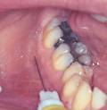
Technique - anterior ramus of the mandible at the level of the mandibular molar occlusal plane in the vicinity of the retromolar fossa

Slide 23
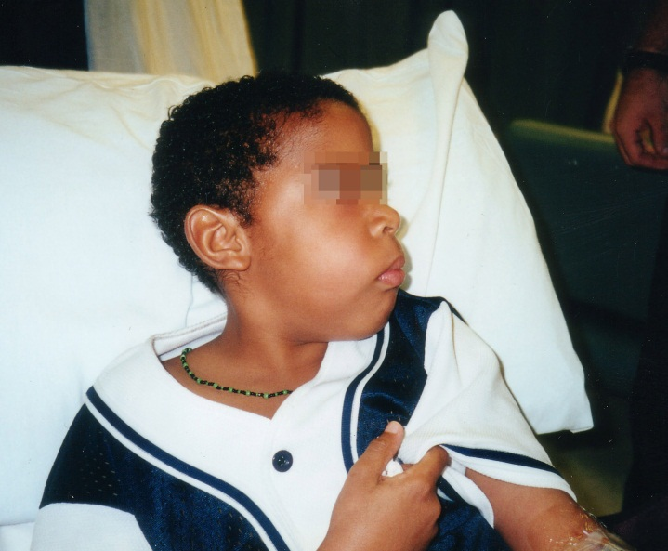
Buccal abscess

Slide 24
A dentoalveolar abscess is an acute lesion characterized by localization of pus in the structures that surround the teeth. Most patients are treated easily with analgesia, antibiotics, drainage, and/or referral to a dentist or oral-maxillofacial surgeon. However, the physician should be aware of potential complications of simple dentoalveolar abscess.

Slide 25
Localized pain and swelling (may progress over a few hours to days)
Thermal sensitivity (periapical abscess): This is thought to occur secondary to exposure of the dentine to the external environment as a result of enamel loss or gingival recession.
Fever
Gingival bleeding (on occasion with periodontal abscess)
Decreased intake of fluid, food, or both

Slide 26
Medical Care In patients with dental abscess, assess the airway upon respiratory distress, oropharyngeal tissue swelling, or inability to handle secretions; then, secure the airway via endotracheal intubation or tracheostomy. Properly collect specimen for Gram stain and aerobic and anaerobic cultures. Administer empiric antibiotic therapy if necessary. Administer analgesia. Hydrate the patient.

Slide 27
Thank you for your attention
☺
☺
☺
☺
http://www.stabident.com/advantages.html
http://www.slideshare.net/syedsadatullah/alveolar-bone
www.wikipedia.org
http://www.dentalhitec.com/web3/en/intraligamentary-anesthesia_p_66.html

