Slide 1
Posterior and Superior Alveolar Block
By Alexia Giapisikoglou

Slide 2
Posterior Superior Alveolar
arise from the trunk of the maxillary nerve just before it enters the infraorbital groove
Technique:
- area of insertion is at the height of the mucobuccal fold b/n 1st and 2nd molar
Angle at 45° superiorly and medially
No resistance should be felt
Insert about 15-20mm
ALWAYS aspirate

Slide 3
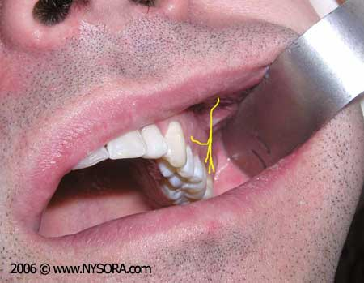

Slide 4
Middle Superior Alveolar
involves pulpal anesthesia of first and second premolars and mesiobuccal root of first molar, buccal soft tissues and bone over same teeth
Indications:
Anesthesia of maxillary premolars and
Infraorbital nerve block failure
Contraindications:
Inflammation in the area
MSA is present only 28% of time

Slide 5
Middle Superior Alveolar
Technique:
- between first and second premolar
-ALWAYS aspirate

Slide 6
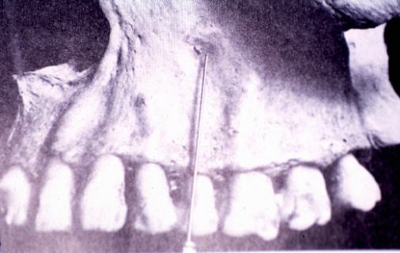

Slide 7
Complications
hematoma (= is a localized collection of blood outside the blood vessels)
Positive aspiration (need to remove the needle and try again)

Slide 8
Abscesses
= exudate enclosed in the tissues of the jaw bone at the apex of the infected tooth’s root
Originates: from bacterial infection that has accumulated in soft, usually dead, dental pulp (eg. Failed root canal treatment)
Symptoms: 1.continuous pain,
2.affected tooth by pressure
3. or diff. in temperatures
4. may perforate bone and create local facial swelling

Slide 9
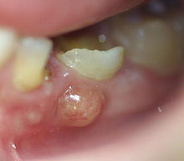
Abscesses
TYPES:
Gingival abscess: involves only gum tissue
Periapical abscess: starts at apex of root
Periodontal abscess: starts in pocket of gingiva over 3mm
TREATMENT: use of antibiotics and if the tooth can be restored root canal therapy should be performed

Slide 10
Infection of maxillary sinus
The sinuses are composed of air: when swollen, the increased pressure in the sinus cavity => pain
when inflammation => difficult to breath from nose
origin: virus, bacteria, inflammation
Symptoms: toothache, migraines, feelings of pressure, fever, swelling around the eye

