Slide 1
TMJ
By Aneta Dolezal and Alexia Giapisikoglou

Slide 2
Definition
= joint of the jaw and is referred to as TMJ.
two TMJs, one on each side, working in unison.
name is derived from the two bones which form the joint:
    articulation between condylar head of mandible and the anterior part of the glenoid fossa of the temporal bones

Slide 3
Features
articulating surface of TMJ is NOT formed of hyaline cartilage but of a sturdy avascular fibrous layer
it is the only synovial joint in the human body with an articulating disc which is present between the joint surfaces of cranium and mandible.(this makes the TMJ a double joint)
Movements can be rotational or translational

Slide 4
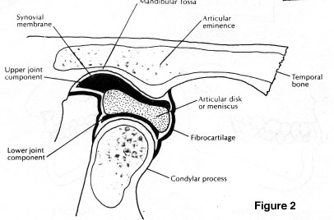

Slide 5
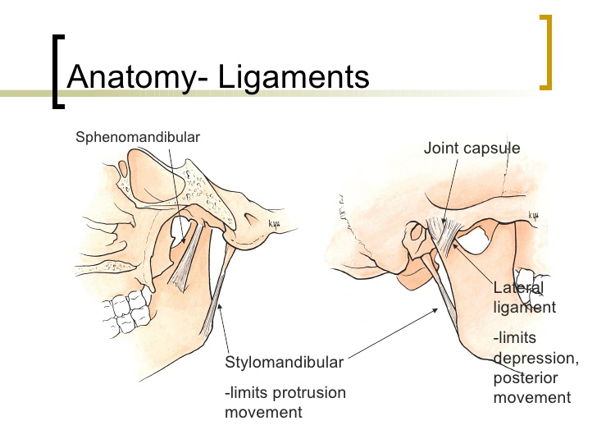
Ligaments
Lateral temporomandibular ligament
Sphenoparietal ligament
Stylomandibular ligament
Stylohyoid ligament

Slide 6
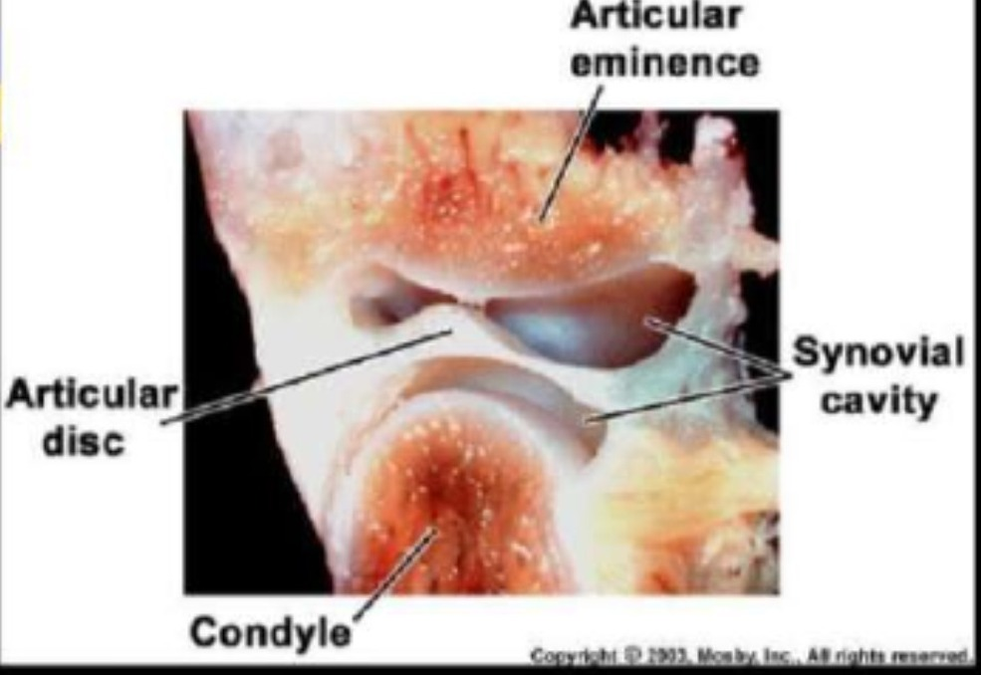
Synovial tissue

Slide 7
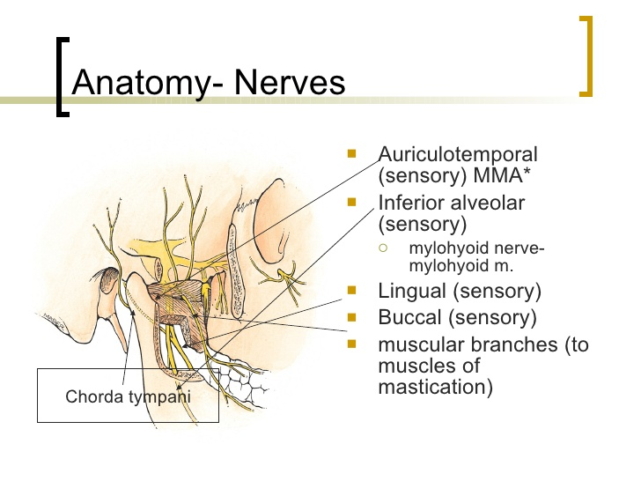
Innervation
Sensory innervation:
  Originates from trigeminal nerve (CNV)
    auriculotemporal and masseteric branches of mandibular branch of V

Slide 8
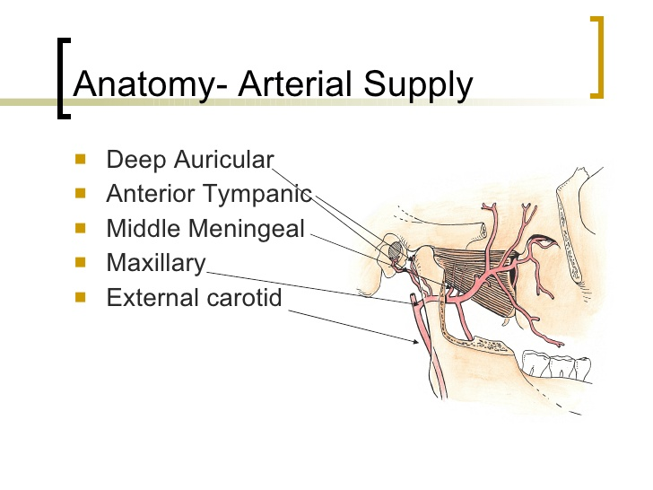
Vascularization
Branches of ECA:
  superficial temporal branch
  Deep auricular artery
  Anterior tympanic artery
  Ascending pharyngeal
  Maxillary artery

Slide 9
Muscles of Mastication
masseter:
O: superficial head : zygomatic process of maxilla and Inf. Border of Anterior 2/3 of zygomatic arch
deep head: inner aspect of zygomatic arch and posterior 1/3
I: superficial head: angle of mandible and lower portion of lateral aspect of ramus
deep head: upper portion of lateral aspect of ramus
F: elevation and protrusion
Innerv: masseteric nerve (mandibular nerve)

Slide 10
Temporalis
O: lower temporal line of skull, temporal fossa, overlying temporal fascia
I: coronoid process of mandible, anterior border of ramus of mandible
F: to maintain resting tonus- elevation, retrusion
Innerv: deep temporal nerve (mandibular nerve)

Slide 11
Medial Pterygoid
O: pterygoid fossa, medial surface of lateral lamina of pterygoid process, pyramidal process of palatine bone
I: inferior margin of mandible, pterygoid tuberosity
F: closees jaw- elevation
Innerv: Nerve to Medial Pterygoid (Mandibular N.)

Slide 12
Lateral pterygoid
O: lower head:lateral surface of lateral pterygoid plate
superior head: infratemporal surface of greater wing of sphenoid
I: fibers are directed laterally and backwards into the front of the pterygoid plate
F: depress, protrusion, move mandible from side to side
Innerv: Mandibular N.

Slide 13
