Slide 1
Anterior superior alveolar nerve block
The anterior superior alveolar (ASA) nerve block is a local anaisthisia that anesthetizes the maxillary canine, the central and lateral incisors, and the mucosa above these teeth, with occasional crossover to the contralateral maxillary incisors.

Slide 2
Landmarks:We locate the mucobuccal fold where it intersects with the apex of the canine tooth by retracting the membrane with gauze or our finger and pulling it out and down.
Technique:While retracting the lip, insert the needle into the intersection of the mucobuccal fold and the apex/center of the canine at a 45-degree angle, advancing the needle approximately 1-1.5 cm.
Aspirate.
Slowly inject 2 mL of local anesthetic and massage for 10-20 seconds.

Slide 3
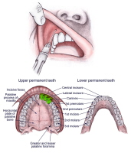
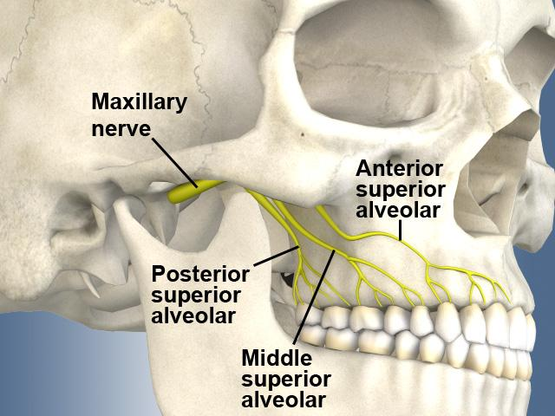
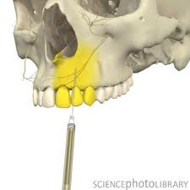

Slide 4
Infraorbital nerve block
An infraorbital nerve block, which branches from the maxillary nerve, anesthetizes the lower eyelid, upper cheek, part of the nose, and upper lip.
Landmarks: Externally, the intraorbital foramen is just medial to the intersection of a vertical line from the pupil (when midline) to the inferior border of the infraorbital ridge. Internally, the intraorbital foramen is approached at the intersection of the mucobuccal fold and the junction of premolars 1 and 2.

Slide 5
Technique:Place the index finger of the nondominant hand over the infraorbital foramen and retract the cheek with the thumb. Insert the needle into the mucobuccal fold at junction of premolars 1 and 2. Direct the needle parallel to the long axis of premolar 2, palpating its location as the needle is advanced until it is adjacent to the infraorbital foramen (approximately 1.5-2 cm).
Aspirate and then inject 2-3 mL of local anesthetic while holding firm pressure with the index finger over infraorbital ridge to prevent ballooning of lower eyelid. Massage for 10-20 seconds in order to help the anesthetic to spread.

Slide 6
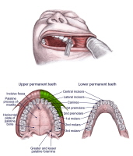
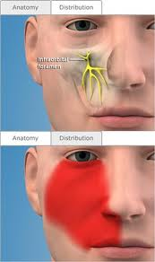
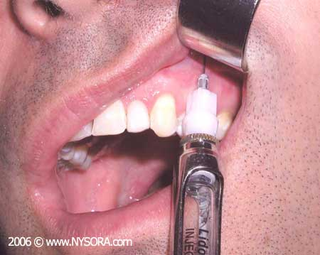

Slide 7
Masseteric space
Is located inferior to the zygomatic arch, superior to the caudal margin of mandible anterior and below the ear and posterior to the anterior margin of masseter muscle.
The deepest part of the parotid region is the parotid bed and houses the deep part of the parotid gland which fills the small space between the neck of the condyle of the mandible and the mastoid process. Other structures forming the floor of this space are the :styloid process, styloid muscle, stylopharyngeus muscle and posterior belly of digastric muscle.

Slide 8
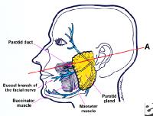
Contains: parotid gland, parotid duct, auriculotemporal nerve and otic ganglion and is covered by the parotideomassteric fascia and masseteric muscle.
Infection of the masseteric region or adjascent region can cause edema of the masseteric muscle.

Slide 9
Pterygomandibular region
Is located: lateraly to the ramus of mandible, medialy to the lateral surface of medial pterygoid muscle, posterior to the parotid gland, anterior to the pterygomandibular raphe and anterior to the lateral pterygoid muscle.
Contains: lingual nerve, mandibular nerve, inferior alveolar artery and mylohyoid nerve and vessels.

Slide 10
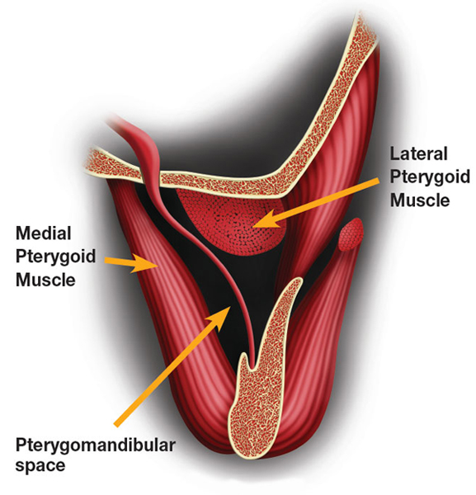
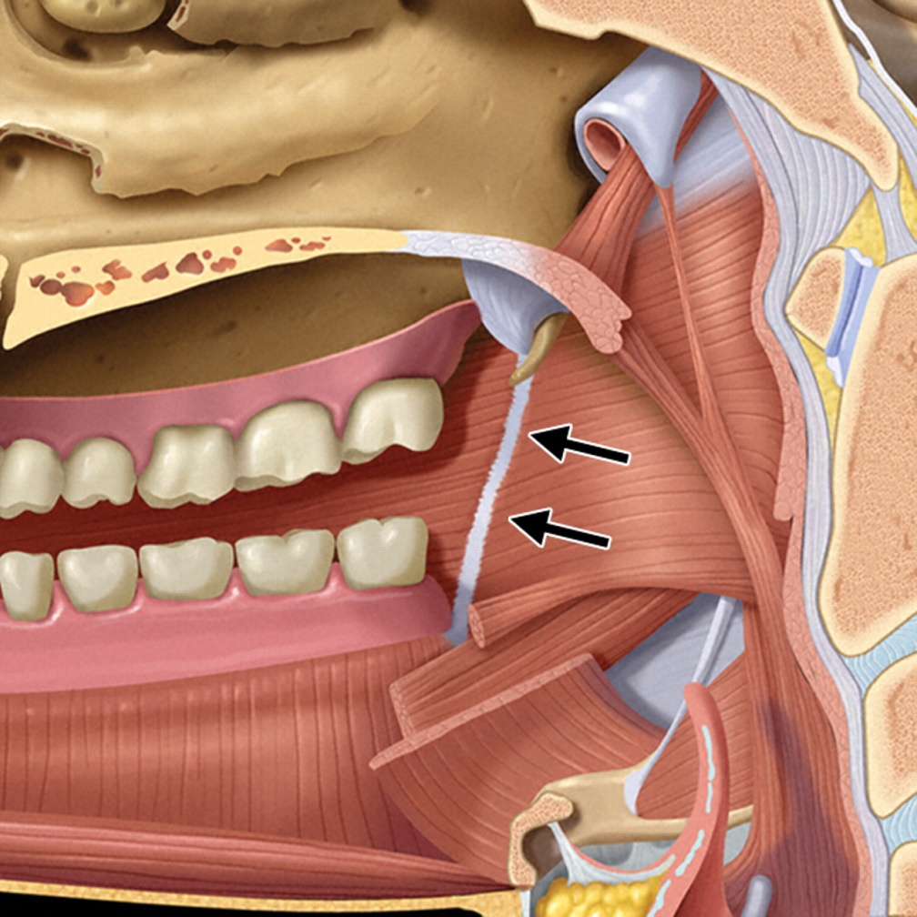

Slide 11
The situation most frequently responsible for involvement of this space into infection, is the pericoronitis related to the mandibular third molar. Infection can also be produced by a contaminated needle used for an inferior alveolar nerve block. Infection, at times can originate from a maxillary third molar, following a posterior superior alveolar nerve block injection.

Slide 12
Clinical Features
no much swelling of face
Trismus
tenderness over the area
dysphagia may be present
medial displacement of lateral wall of pharynx
redness & edema over 3 molar area
midline of palate might be displaced to affected side, uvula swollen & difficulty in breathing.

