Slide 1
Ludwig‘s Angina
Aneta Dolezal, Nov. 2012

Slide 2
Definition
Aka Angina ludovici, angina maligna, M. Strangularis
Named after German Wilhelm Friedrich von Ludwig in 1836
Rapidly expanding inflammation of the submandibular, submental and sublingual smooth connective tissue
Bloating can cause obstruction of upper airways
→ potentially life threating !

Slide 3
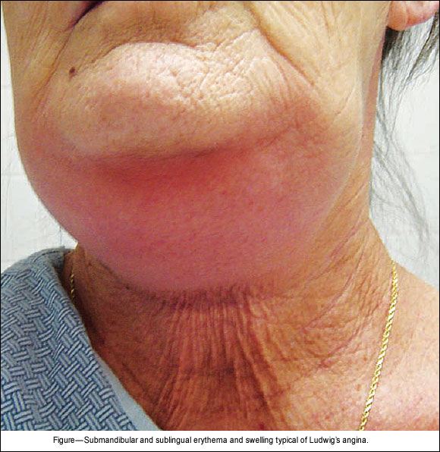
Symptoms
Fever, pain, chills, soreness along the chin
Pus is not produced, oedema appears as result of extracellulary exudate
Tongue is displaced on the palatina which forces the mouth open
Further:
Neck swelling, dysphagia, breathing difficulties can lead to life threating situation

Slide 4
Causes
Bacterial infection incl.: Streptococci, staphylococci, gram-neg., anaerobic organism
Infection starts usually at the lower molars (3rd)
Mainly observed in patients with impaired immunity such as: immuncomprimised (chemo therapy, cortisol treatment) malnutrition, diabetes etc.
Also seen in patients after lingual frenulum piercing procedure.

Slide 5
Treatments
Airway monitoring is mandatory
Nasotracheal tube for ventilation. CAVE: Tracheostomy is not indicated, to keep the infection from spreading further
Parenteral antiobiotics: high dose Penicillin G or Clindamycin
Incision and drainage of the oedema

Slide 6
Summary
Potentially life threating infection
Mostly seen in immuncomprimised patients
Symptons lead from pain, bleeding, fever to severe swelling of the neck and airway obstruction.
Airway maintenance is compulsory
High dosed antiobiotics, surgical incision and drainage

Slide 7
Thank you for your attention

