Slide 1
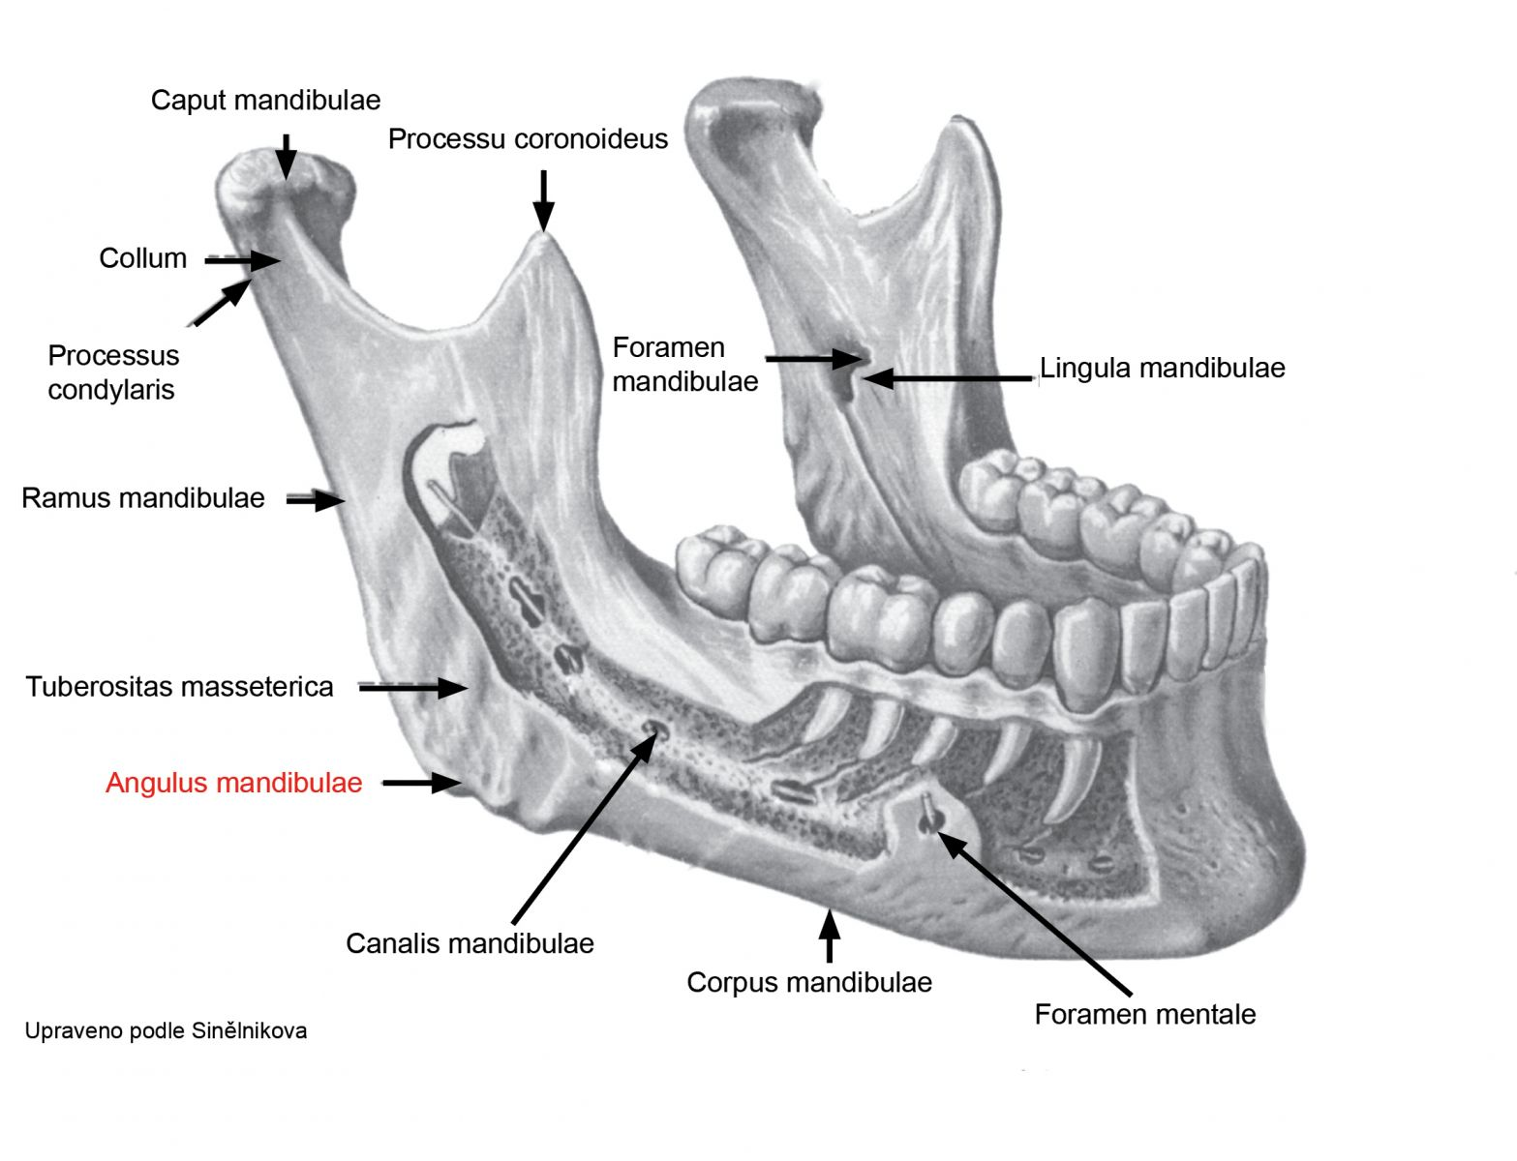
Angulus mandibulae

Slide 2
Condylus humeri, fossa olecrani

Slide 3
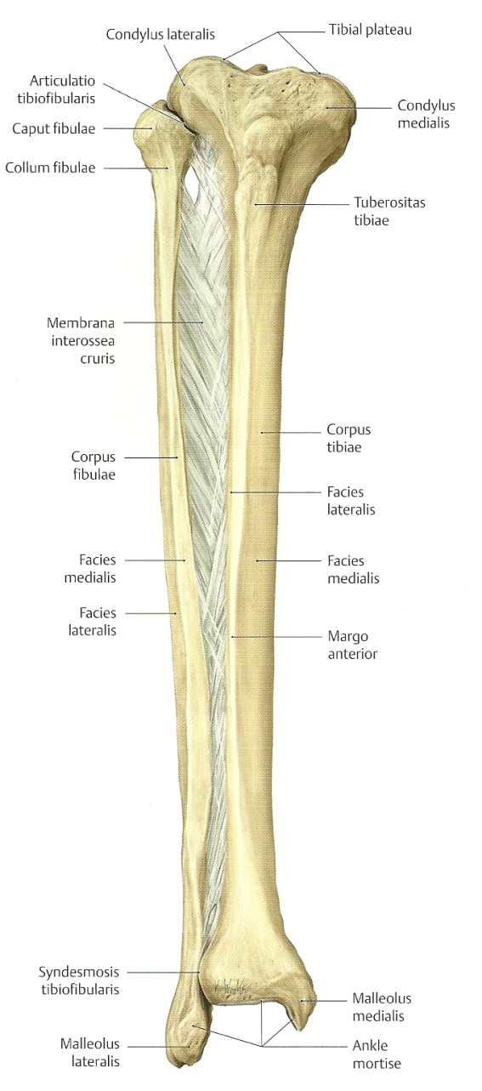
Collum fibulae

Slide 4
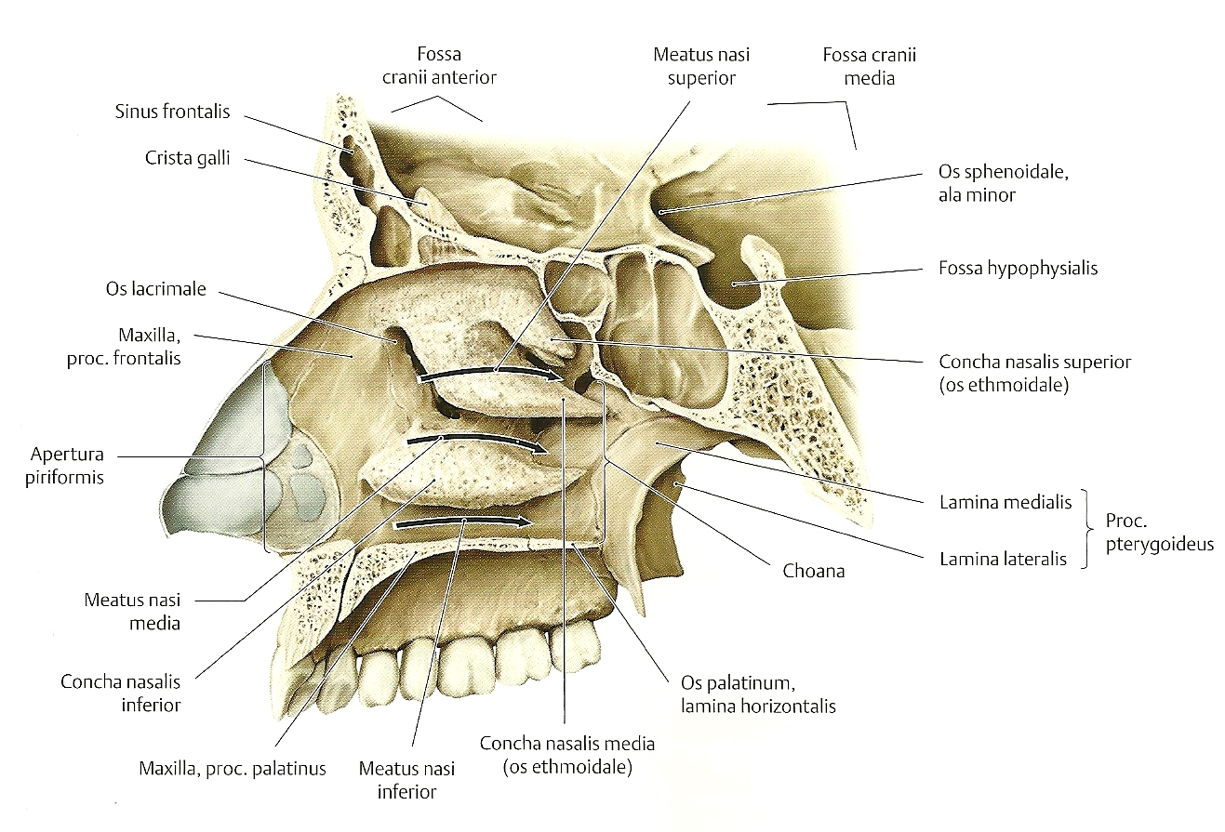
Concha nasi media

Slide 5
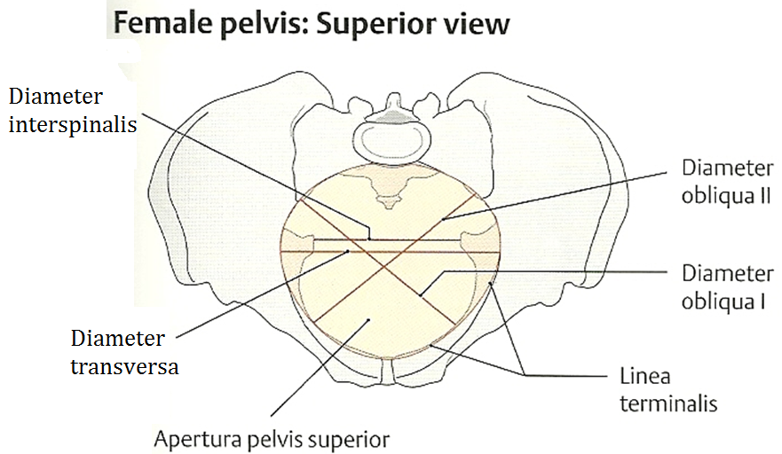
Diameter obliqua, transversa

Slide 6
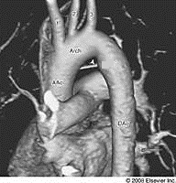
Isthmus aortae

Slide 7
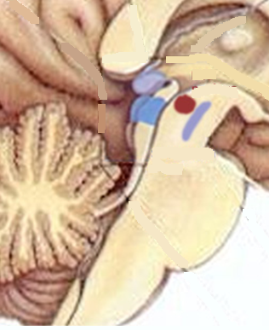
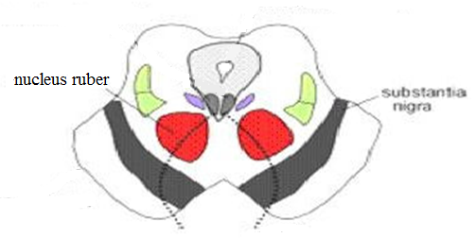
Nucleus ruber

Slide 8
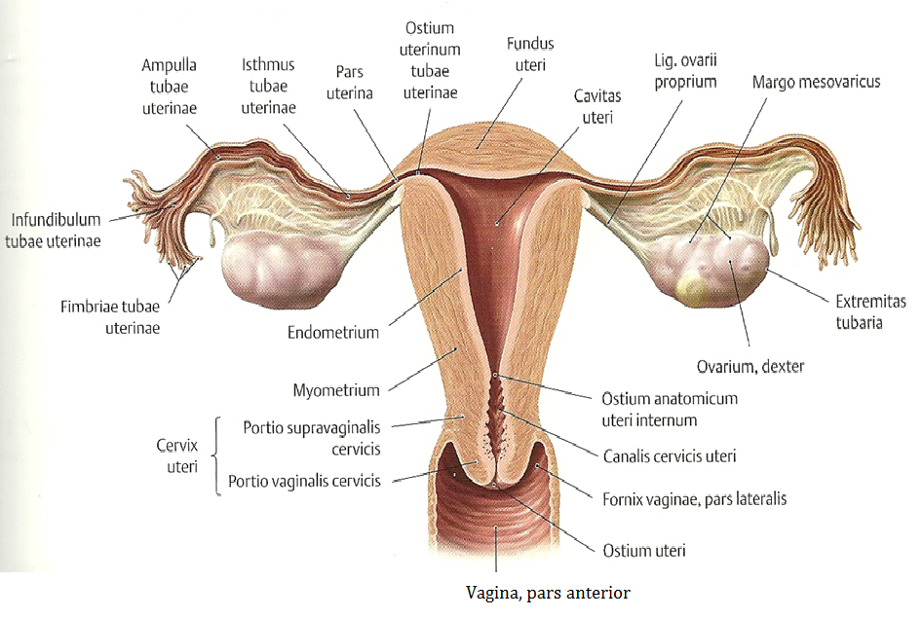
Ostium uteri

Slide 9
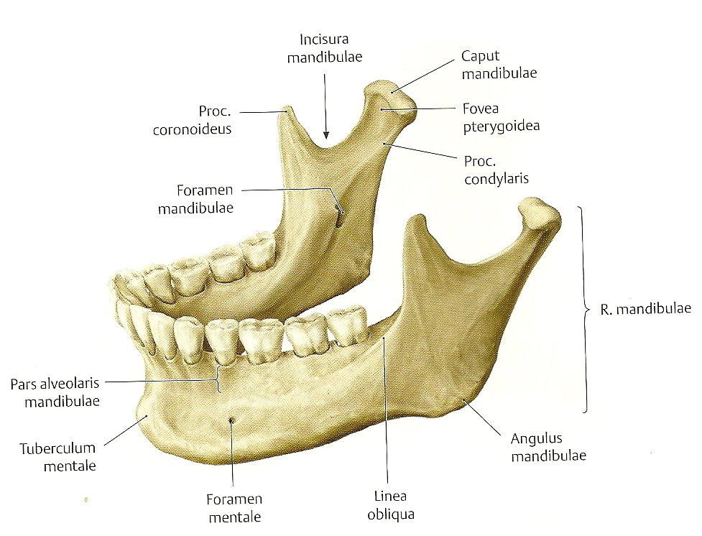
Ramus mandibulae

Slide 10
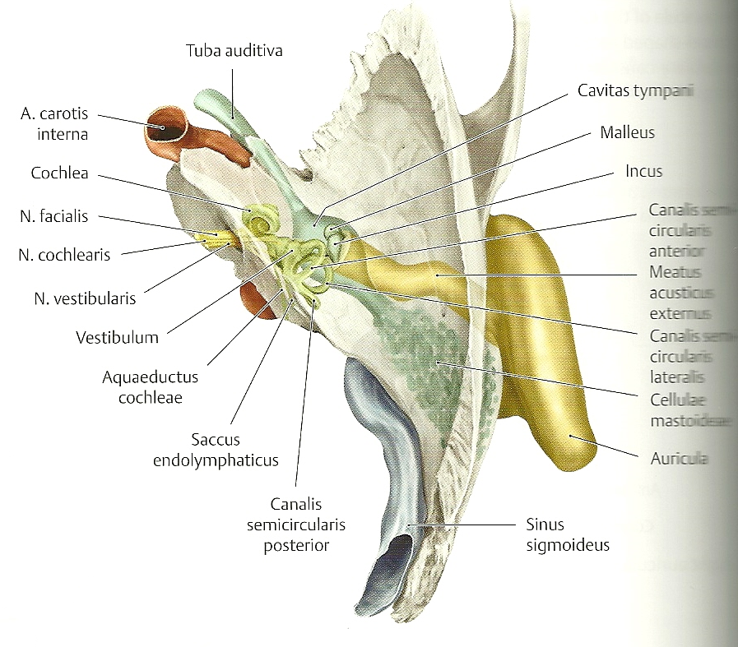
Tuba auditiva

Slide 11
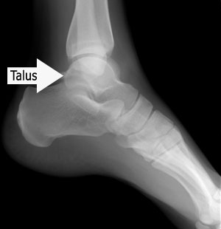
TALUS

Slide 12
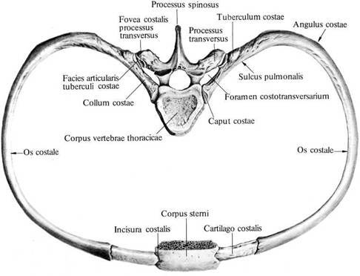
Tuberculum costae, Angulus costae

Slide 13
Collum radii

Slide 14
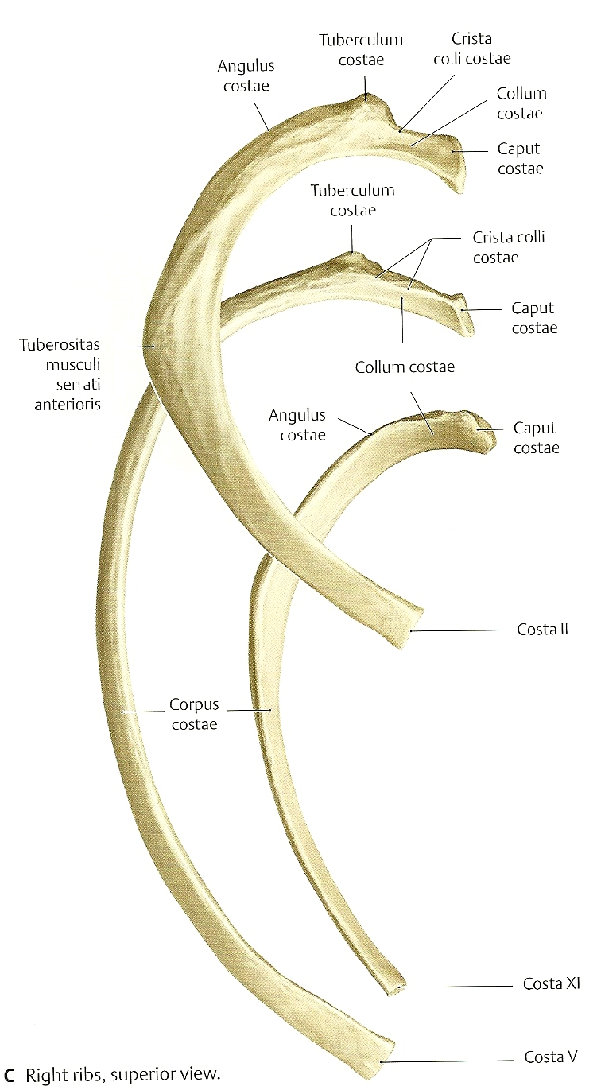
Crista colli costae

Slide 15
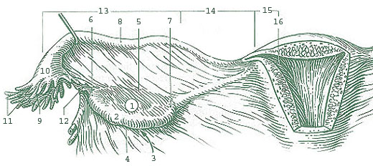
ISTHMUS TUBAE UTERINAE

Slide 16
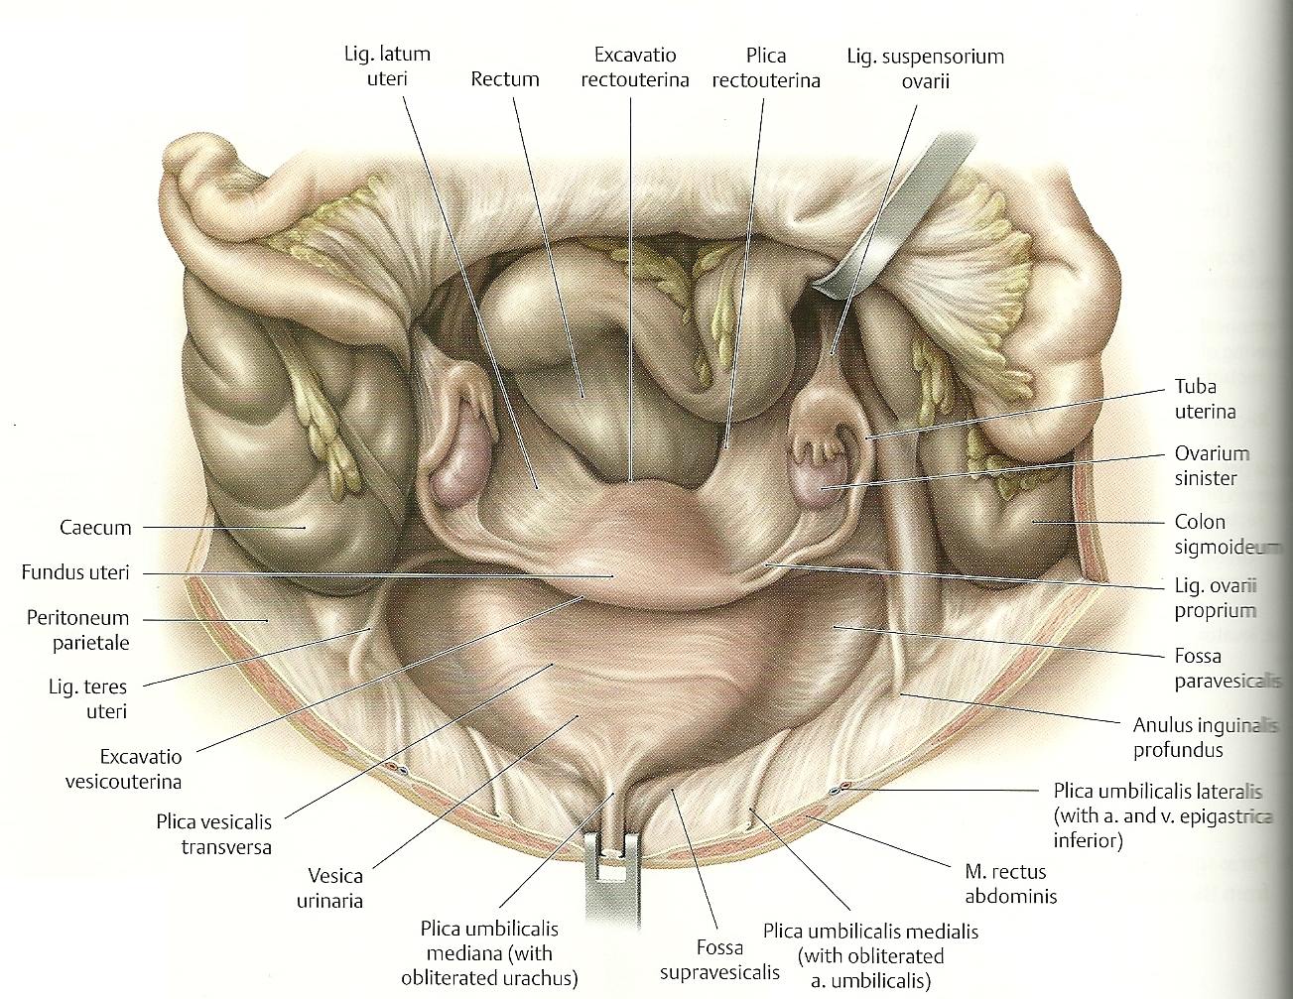
LIGAMENTUM LATUM UTERI

Slide 17
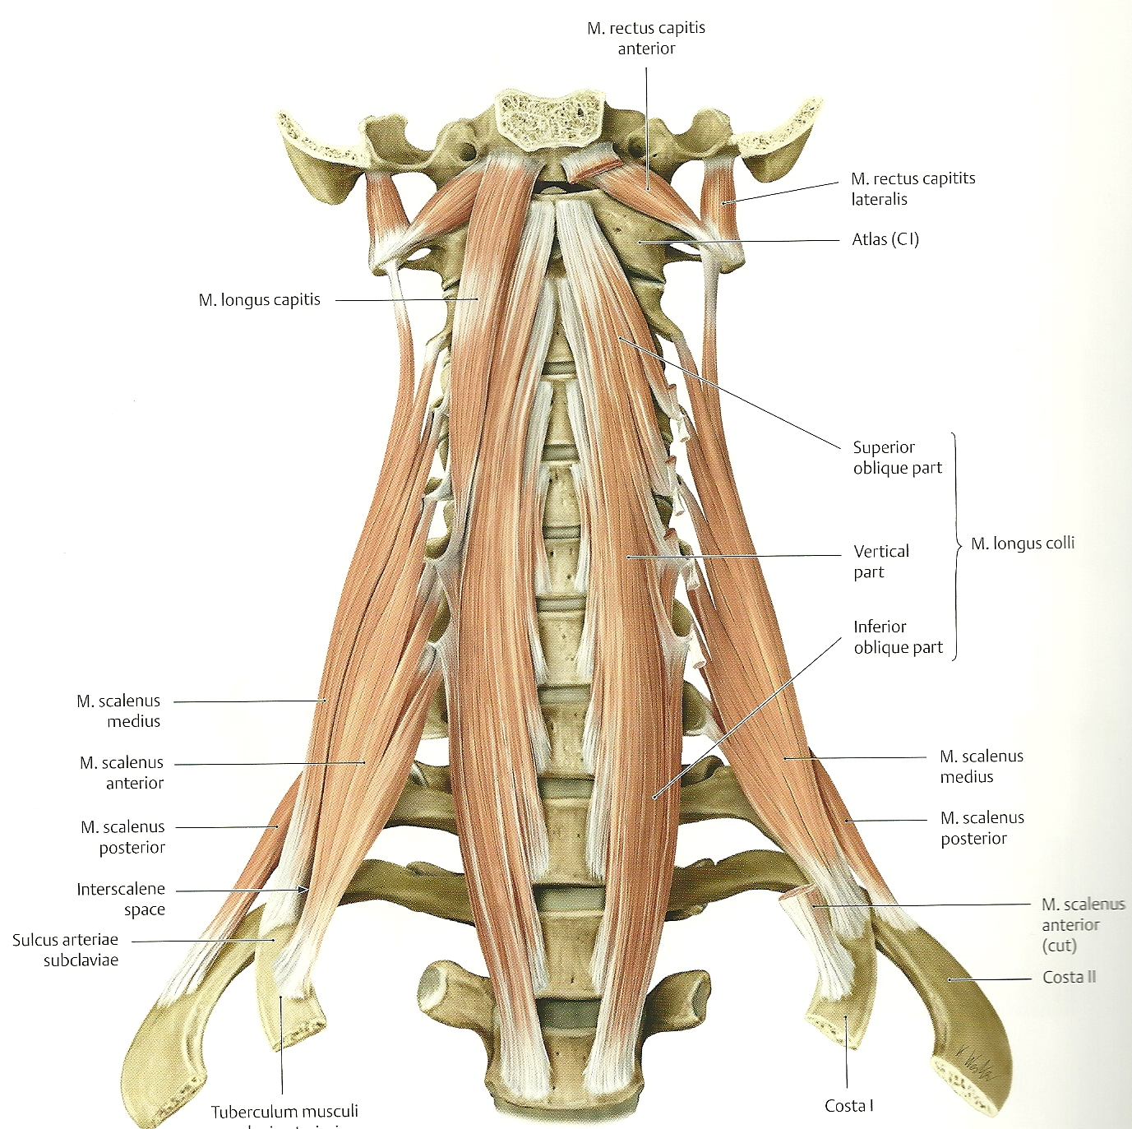
Musculus longus colli

Slide 18
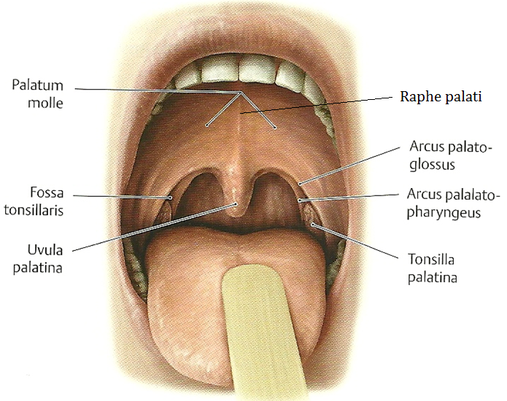
Raphe palati

Slide 19
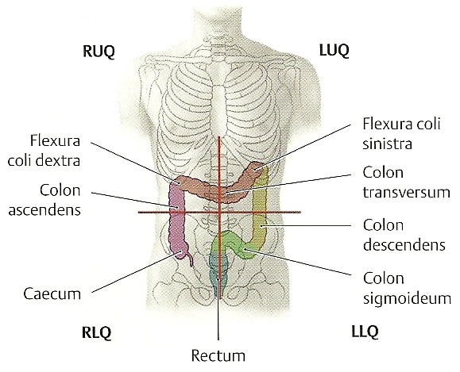
Colon transversum

Slide 20
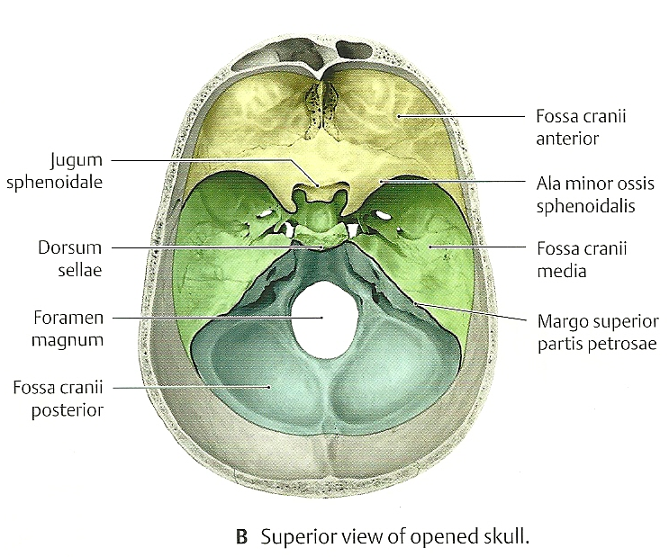
Fossa cranii media

