Slide 1
Treatment of ischemic heart disease – coronary artery disease (CAD) Regina Demlova

Slide 2
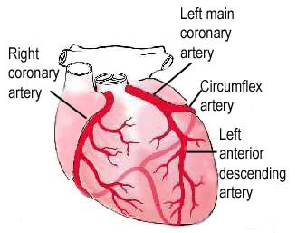
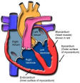
Ischemic heart disease
Group of diseases with the presence of myocardial ischemia, which occurs on the basis of the pathological process in the coronary vessels.
Reducing the flow in coronary arteries>>> ischemia

Slide 3
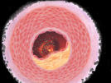
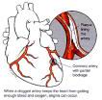
Ischemic heart disease
The cause
Organic - atherosclerosis (95%), thrombus, embolism, arteritis, etc.
Functional - coronary spasm
Combined
Atherosclerotic plaque>> reduce the flow>> ischemia

Slide 4
Ischemic heart disease
unstable AP nonQIM QIM
(cTnI < 0,4 ug/l) (cTnI >0,4 ug/l) (cTnI > 0,4ug )
Notes:
4

Slide 5
Ischemic hearth disease
Risk factors:
Should not be influenced - age, gender, family history
Should be influenced - hypertension, hyperlipoproteinaemia, smoking, stress, obesity, physical inactivity, dietary habits

Slide 6
Ischemic hearth disease
Classification:
acute (unstable) - acute myocardial infarction, unstable angina, sudden death
chronic (stable) - angina pectoris (exertional, mixed, variant), silent ischaemia, arrhythmic forms

Slide 7
Ischemic hearth disease
Angina pectoris:
Most frequent clinical manifestations of IHD - caused by the myocardial ischemia, in which the patient has chest pain (stenocardia).
Imbalance between myocardial oxygen supply and demand

Slide 8
Angina pectoris
Main cause:
atherosclerotic plaque in coronary artery
lumen stenosis lower than 50% - insignificant lumen stenosis above 50% - a significant lumen stenosis above 95% - critical

Slide 9
Angina pectoris
Classification of severity: I. stenocardia provoked by extraordinary exertion II. stenocardia provoked more than usual exertion III. stenocardia provoked by regular exertion stenocardia IV. stenocardia provoked by minimal exertion or at rest

Slide 10
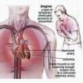
Angina pectoris
Clinical picture:
constringent pain with / without feeling a lack of breath, pain with the propagation to the back, neck, shoulders, upper extremities.
Usually it is a link to the previous load (walking, stress, food, ....) Typically takes a few minutes and gradually subsides after removal causing torque.

Slide 11
Angina pectoris
Diagnosis: History - family, personal, pharmacological, social..
Problems - duration, time from first occurrence of pain, frequency, repetition, connection to the load, etc.
Complete clinical examination, exclusion of non-cardiac etiology problems (nerve, muscle, gastrointestinal, pulmonary, other ... ..)
Laboratory signs - Troponin-I, CK-MB

Slide 12
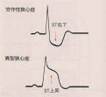
Angina pectoris
Diagnostic procedures:
ECG – at rest and during exercise, 24-hour ambulatory monitoring, during of angina found in a typical case of ECG changes (depression / ST segment elevation), between angina symptoms ECG is negative.

Slide 13
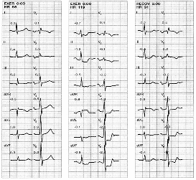
Ergometer stress test

Slide 14
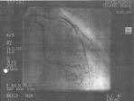
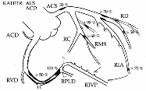
Angina pectoris
Diagnostic procedures:
Echocardiography: at rest and during the exercise
Coronary angiography – used to directly view the coronary field using a contrast agent injected into coronary arteries, allowing accurate identification of narrowing or occlusion vessel, its significance, may be determined by the residual flow of the affected artery

Slide 15
Treatment of CAD
Objective:
to improve the quality of life
to improve patient prognosis
Methods:
1st: stopping or slowing progress of atherogenesis 2nd: improve the flow of ischemic myocardium 3rd: prevention of vascular thrombus occlusion

Slide 16
Treatment of CAD
nonpharmacologic - lifestyle changes
pharmacological - drug therapy
intervention - PTCA with / without stent - surgical revascularization

Slide 17
Treatment of CAD
Non-pharmacological:
Motion mode - aerobic (running, swimming, cycling, ....) Dietary measures - change in eating habits (limit saturated fats, increase the proportion of unsaturated fats, fish, vegetables, fruits) Abstinence of smoking, alcohol in moderation Mental relaxation - sports, culture, yoga, psychotherapy Control of diabetes and hypertension

Slide 18
Treatment of CAD
Interventions:
Percutaneous transluminal coronary angioplastic (PTCA)
The principle consists from delivery of a catheter (thin tube - at the end of the cylindrical balloon) into the narrowed or closed coronary artery and the balloon expands narrow blood vessels.
The next step may be followed by stent (metallic reinforcement) in place of the previous narrowing.

Slide 19
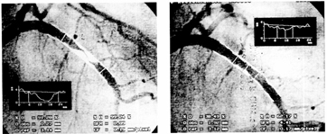
Critical stenosis of the left coronary artery solved successfully by PTCA with stent implantation.

Slide 21
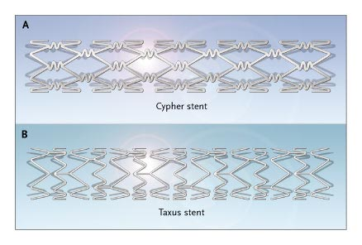

Slide 22
Drug-eluting stents – DES
a peripheral or coronary stents (a scaffold) placed into narrowed, diseased peripheral or coronary arteries that slowly releases a drug to block cell proliferation.
The stent is usually placed within the peripheral or coronary artery by an Interventional cardiologist or Interventional Radiologist during an angioplasty procedure.

Slide 23
Drug-eluting stents – DES
Cypher sirolimus
Taxus paclitaxel
Biomatrix, Nobori biolimus
Xience everolimus
Endevour tacrolimus

Slide 24
Treatment of CAD
Methods of interventional treatment:
Surgical revascularization
Coronary artery bypass is the process of restoring the flow of blood to the heart. The surgical procedure places new blood vessels around existing blockages to restore necessary blood flow to the heart muscle.

Slide 25
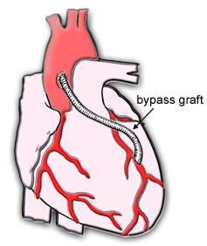
Critical stenosis of the left coronary artery bypass solved successfully by surgery.

Slide 26
Treatment of CAD
Methods of pharmacological treatment:
1st: stopping or slowing progress of atherogenesis 2nd: improve the flow of ischemic myocardium 3rd: prevention of vascular thrombus occlusion

Slide 27
Methods of pharmacological treatment:
1st:
stopping or slowing progress of atherogenesis
control of risk factors:
- correction of BP – antihypertension th.
- corrections of lipids – hypolipidemics
- DM – glucose control - antidiabetics

Slide 28
Methods of pharmacological treatment:
2nd:
improve the flow of ischemic myocardium
smooth muscle relaxation of coronary artery stenosis slowing the heart rate - a reduction of metabolic demands reduction of myocardial contractility - improving coronary perfusion
nitrates, beta-blockers, Ca-channel blockers, If-channel blockers

Slide 29
Methods of pharmacological treatment:
3rd:
Prevention of vascular thrombus occlusion
Antiplatelet/anticoagulants, such as aspirin or warfarin

Slide 30
Treatment of CAD
Methods of pharmacological treatment:
1st: stopping or slowing progress of atherogenesis 2nd: improve the flow of ischemic myocardium 3rd: prevention of vascular thrombus occlusion

Slide 31
Hypolipidemics
Statins: inhibition of HMGCoA (3-OH-3 CH3 glutaryl coenzyme A) reductase.
Fibrates: activate lipoprotein lipase, reduces VLDL and increase HDL
Ezetimibe: blocks absorption of Cholesterol in the intestine
Niacin: blocking the breakdown of adipose tissue (inhibition of lipolysis)
Resin: inhibiting resorption of bile acids

Slide 32
Treatment of CAD
Methods of pharmacological treatment:
1st: stopping or slowing progress of atherogenesis 2nd: improve the flow of ischemic myocardium 3rd: prevention of vascular thrombus occlusion

Slide 33
Methods of pharmacological treatment:
2nd:
I . improve the flow and perusion of ischemic myocardium - smooth muscle relaxation of coronary artery stenosis
II . Reduce its metabolic demand - slowing the heart rate reduction of myocardial contractility
I+II : nitrates, Ca-channel blockers
II : beta-blockers + If-channel blockers

Slide 34
Nitrates
Nitroglycerin was synthesized by the chemist Ascanio Sobrero in 1847
Nitroglycerin is converted to nitric oxide in the body by mitochondrial aldehyde dehydrogenase
NO - nitric oxide - identical to the 'endothelium-derived relaxing factor' (EDRF) - is a natural vasodilator ( stimulation of guanylate cyclase of smooth muscle - relaxation-vasodilatation)

Slide 35
Endothelial cell
NO
= nitric oxid
Enzymatic step – reaction with tissue sulfhydryl (-SH) groups
Nitrates
guanylate cyclase → ↑cGMP ↑
↓
relaxation - vasodilitation
Smooth muscle

Slide 36
Nitrates
Effects: local x systemic
LOCAL: the direct effect on coronary artery tone - dilation of coronary arteries
SYSTEMIC:
venorelaxation – consequent reduction in central venous pressure – reduce preload
Relaxation of lareger muscular arteries – reduce afterload

Slide 37
Nitrates
Adverse reactions:
headache, orthostatic hypotension,
onset of tolerance (possibly partly because of depletion of free –SH groups), mainly longer-acting drugs

Slide 38
Nitrates
Representatives:
Nitroglycerin (glyceryl trinitrate)
- rapidly inactivated by hepatic metabolism
well absorbed from the mouth – is taken as a tbl. under the tongue or sublingual spray – effects within few minutes
Effectiveduration of action app. 30 minutes
Well absorbed through the skin – transdermal patch

Slide 39
Nitrates
Representatives:
Isosorbite 2-mononitrate (ISMN) longer acting – half-life app. 4 hours , the same farmacological action
I: prophylaxy twice daily (morning, lunch time – to avoid tolerance)
Isosorbit 2,5-dinitrate (ISDN) - iv
Molsidomin (does not produce tolerance, use of overnight)

Slide 40
Beta - blockers
Prophylaxis of angina
Treating the patients with unstable angina
slowing the heart rate and reduction of myocardial contractility

Slide 41
Beta - blockers
Competitive antagonists (intrinsic activity = 0) or partial agonists (ISA - intrinsic sympathomimetic activity)
Non-selective or cardioselective (primary blocs of b₁ receptors)

Slide 42
classification
Non-selective (β₁ + β₂)
propranolol
(Cardio)selective (β₁)
metoprolol
Non-selective with ISA (β1 + β2) S ISA
pindolol
(Cardio)selective (β₁) with ISA
acebutolol
Combining α + β blocade =
β-blockers of II.generation
labetalol

Slide 43
Beta blockers
Indication: angina pectoris, hearth failure with titration
tacharrhytmia, glaukom
Contraindication:
absolute: AV block (grade 2 or 3), asthma,

Slide 44
Adverse events
Bronchoconstriction
Bradycardia
Hypoglycaemia
Fatique

Slide 45
I_{f} blockers –SA node
Heart rate is determined by spontaneous electrical pacemaker activity in the sinoatrial node controlled by the I_{f} current (f is for "funny", so called because it had unusual properties compared with other current systems known at the time of its discovery)

Slide 46
I_{f} blockers –SA node
Ivabradine acts on the I_{f} ion current, which is highly expressed in the sinoatrial node. I_{f} is a mixed Na⁺–K
I_{f} is one of the most important ionic currents for regulating pacemaker activity in the sinoatrial (SA) node.

Slide 47
Ivabradine (PROCORALAN)
selectively inhibits the pacemaker I_{f} current in a dose-dependent manner. Blocking this channel reduces cardiac pacemaker activity, slowing the heart rate and allowing more time for blood to flow to the myocardium.

Slide 48
Ivabradine – indication :
I: Symptomatic treatment of chronic stable angina pectoris in coronary artery disease adults with normal sinus rhythm.
in adults unable to tolerate or with a contra-indication to the use of beta-blockers
- or in combination with beta-blockers in patients inadequately controlled with an optimal beta-blocker dose and whose heart rate is > 60 bpm.

Slide 49
Calcium-channel blockers (CCB)
works by blocking voltage-gated calcium channels in cardiac muscle and blood vessels.
↓ intracellular calcium leading to ↓ cardiac contractility
In blood vessels ↓ vascular smooth muscle and therefore ↑ vasodilation. Vasodilation decreases total peripheral resistance.

Slide 50
Calcium-channel blockers (CCB)
3 chemically distinct classes:
Phenylalkylamines
Benzothiazepines
Dihydropyrimidines
-

Slide 51
Non DHP CCB
Phenylalkylamine: verapamil
Preferentially affects Ca-channel in hearth
Indications: antiarrhytmics
Contraindications: absolute: AV block (grade 2 or 3), heart failure relative: bradycardia below 50/min, concomitant with BB

Slide 52
Non DHP CCB
Benzithiazepiny : diltiazem
Affects both Ca-channel in hearth and in vessels
Indications: angina pectoris
Contraindications: absolute: AV block (grade 2 or 3), heart failure relative: bradycardia below 50/min, concomitant with BB

Slide 53
DHP CCB
Dihydropyridine CCB
Indications: elderly - angina pectoris, coronary disease of lower extremities, atherosclerotic carotid disability Contraindications: relative: tachyarrhythmias, heart failure

Slide 54
Calcium-channel blockers (CCB)
Class
1st generation
2nd generation
Fenylalkylamines Benzothiazepines Dihydropyridines
Verapamil Diltiazem Nifedipin
Verapamil SR Diltiazem SR Nifedipin GITS Isradipin SRO Felodipin Nitrendipin Nilvadipin Nisoldipin Nimodipin Amlodipin Lacidipin

Slide 55
Calcium-channel blockers (CCB)
ADRs: results from vasodilation and the effect on the conduction system
headache, orthostatic hypotension, palpitations, swollen ankles,
AV block non-DHP in combination with beta-blockers, significant bradycardia

Slide 56
Combination of antianginous drugs
Nitrates + beta-blockers – a suitable combination
Nitrates + CCB – need BP corrections
Beta-blockers+ CCB – a suitable, but ! AV block non-DHP in combination with beta-blockers, significant bradycardia

