Slide 1
How do we build basic medical terms?
1 costa (f.) + verus, a, um ⇒
costa vera
noun in nomivative adjective in nominative
Both the noun and adjective are on the same level – they must be in the same case.
Ex. 2, p.7

Slide 2
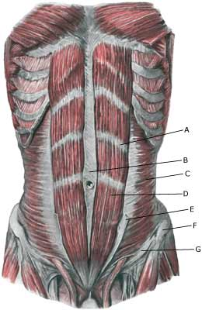
Linea alba

Slide 3
2 fractura + costa (like vena)
fractura
costae
noun in nominative noun in genitive
The noun costa is subordinate to the noun fractura – the second noun must be in genitive.

Slide 4
spina + scapula
therapia + hernia
ruptura + vena
fractura + ulna
cura + diabetes
magistra + farmacia

Slide 5
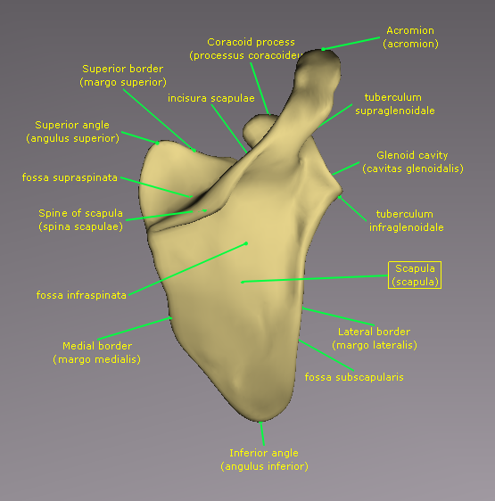
Spina scapulae

Slide 6
What will happen if we connect terms in 1) and 2) with prepositions?
1 prope + costa vera ⇒
prope costam veram
noun in accusative adjective in accusative
Both the noun and adjective must be changed in accusative after the preposition prope.

Slide 7
propter + anaemia perniciosa
in (position) + bursa subcutanea
in (position) + vertebra thoracica (pl.)
cum + dyspnoe acuta
sine + fractura complicata (pl.)
in (direction) + aqua destillata
ad + lagoena fusca

Slide 8
2 propter + fractura costae
propter fracturam costae
noun in accusative noun in genitive
The first noun must be changed in accusative, the second noun must stay in genitive.

Slide 9
cum + fractura ulnae
in (direction) + spina scapulae
prope + rima palpebrarum
sub (position) + columna vertebrarum
propter + insufficientia valvularum
sine + therapia herniae

Slide 10
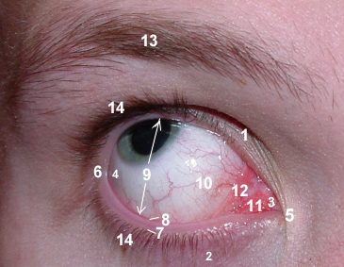
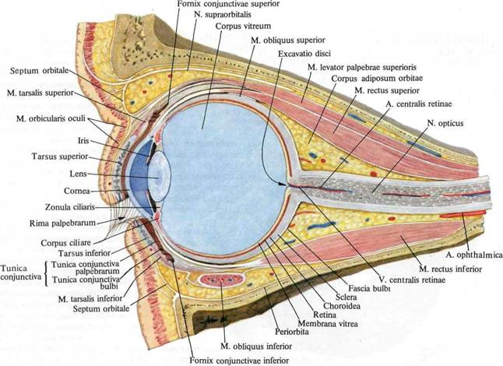
Rima palpebrarum

Slide 11
Formation of multiple-word medical terms
insufficientia – valvula – aorta ⇒
insufficientia
valvulae
aortae
nom. gen. gen.

Slide 12
tunica + serosus, a, um + vesica +felleus,a,um
tunica serosa
vesicae felleae
nom. nom. gen. gen.

Slide 13
plica (pl.) – palatinus, a, um – transversus, a, um
vena – profundus, a, um - lingua
causa – anaemia – perniciosus, a, um
fractura – complicatus, a, um – clavicula – dexter, a, um
therapia – chirurgicus, a, um – tonsilla (pl.) – palatinus, a, um

Slide 14
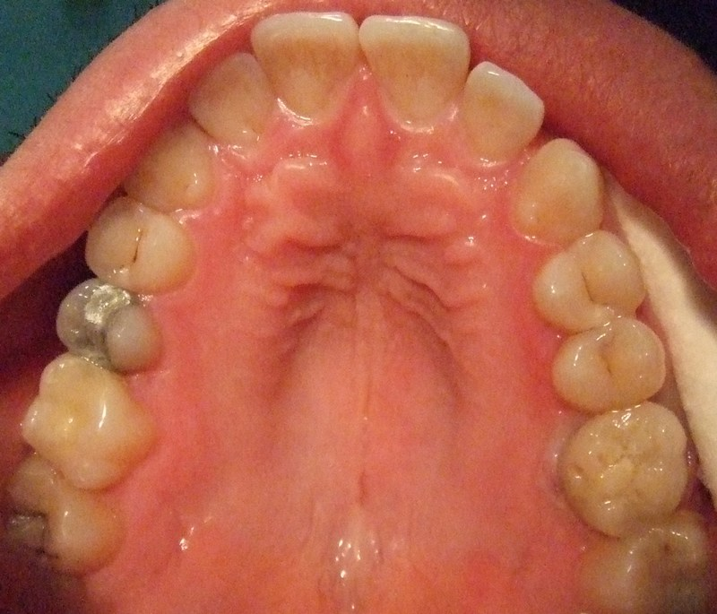
Plicae palatinae transversae

Slide 15
Determine the case and number of every single noun/adjective in the following terms:
Tonsillae palatinae
In tuba auditiva
Prope medullam oblongatam
Therapia herniae chirurgica
Fracturae vertebrarum thoracicarum
Fractura fibulae aperta

Slide 16
Translate into English:
Fascia lata
Glandula gastrica
Glandula thyroidea
Tunica mucosa
Vena cava
Substantia alba, substantia grisea
Medulla oblongata
Arteria iliaca interna
Chole in vesica fellea

Slide 17
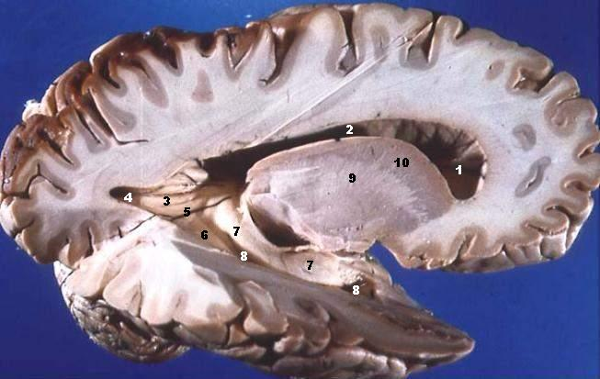
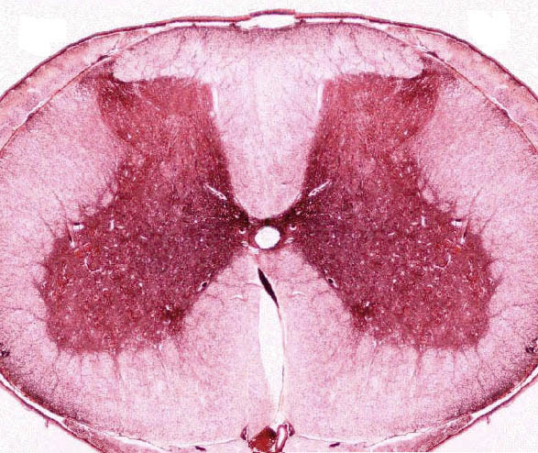
Substantia alba, substantia grisea

Slide 18
Propter pneumoniam
Sine allergia
Dyspnoe periculosa
Cura epilepsiae
Cera alba
Pasta in scatula

Slide 19
Translate into Latin:
Palatal tonsils
False ribs
Thoracic vertebrae
Internal iliac artery
Near to the prolongation of the spinal cord

Slide 20
In the profound artery (position, situation)
Fissure of the eyelids
Little hollow of the shoulder blade
Mucous membrane of the gall bladder

Slide 21
Difficult breathing
The causa of diphtheria
Rupture of the wide fascia
Fracture of a true rib
After systole and diastole

Slide 22
With diabetes
Surgical therapy of hernia
Open fracture of the collar bone
Because of insufficiency of a valve in a vein
A bottle of distilled water

