Slide 1
Fill in the table:
nom. sg. | gen. sg. | gender | declension | example
pylorus
 | suturae
acromion
 | diametri
diabetes
 | ophthalmi
uterus
 | membranae
raphe
 | tuberculi
cancer
 | ventriculi
lingua
 | antagonistae

Slide 2
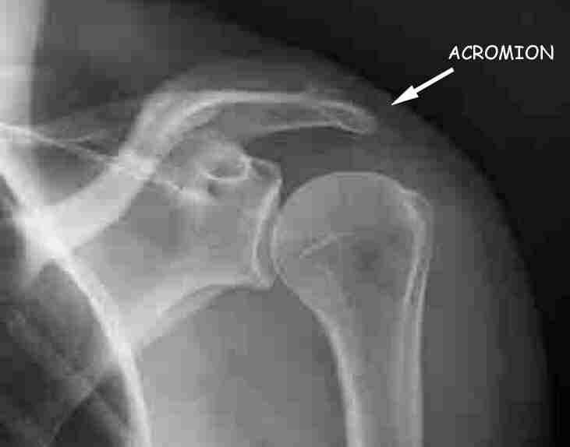
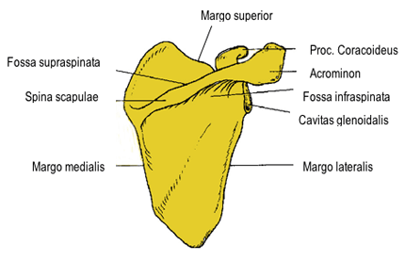
Acromion

Slide 3
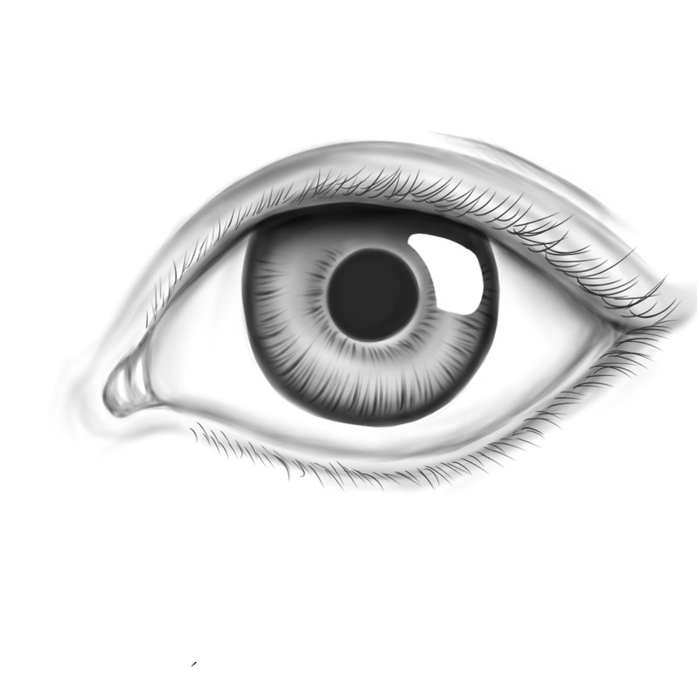
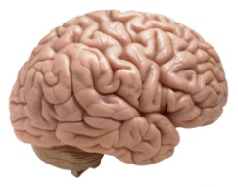
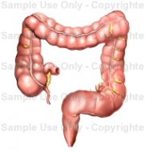
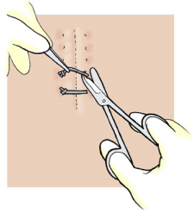
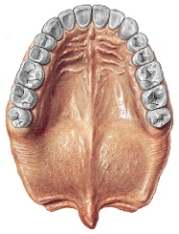
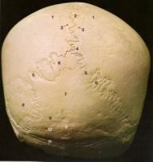
Give Latin and Greek equivalents to the following terms, give genitive of singular and gender:
picture | Latin equivalent | Greek equivalent | gen. sg. | gender

Slide 4
a) What is the gender of nouns in the left circle? b) Match the nouns with the adjectives in correct forms:
ligamentum
palatum
glandula
nervus
morbus
ramus
diameter
oculus
medicamentum
fractura
complicatus, a, um
novus, a, um
thyroideus, a, um
transversus, a, um
dexter, a, um
vagus, a, um
sinister, a, um
acutus, a, um
durus, a, um
latus, a, um

Slide 5
Form plural:
costa vera
morbus chronicus
remedium compositum
musculus transversus
diameter obliqua
ramus externus
methodus nova

Slide 6
Give opposites to the terms in red ink in the previous slide.

Slide 7
Form gramatically correct medical terms:
cancer + colon
magister + pharmacia
fractura + digitus
ruptura + ligamentum
morbus + organum
bulbus + oculus

Slide 8
Change in plural the tems in red ink in the previous slide.

Slide 9
Form gramatically correct medical terms:
ligamentum latum + uterus
fissura transversa + cerebrum
fractura complicata + humerus
membrana interossea + antebrachium
tunica mucosa + vesica fellea
anomalia congenita + bulbus oculi

Slide 10
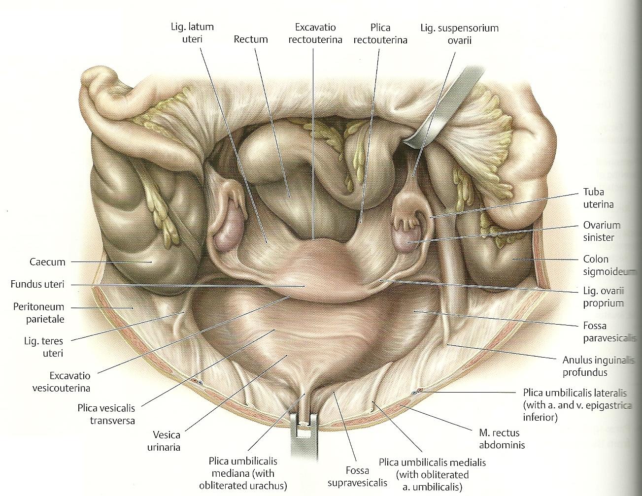
LIGAMENTUM LATUM UTERI

Slide 11
Fill in the table according the the example:
NOUN | DECLENSION | EXAMPLE | TERM
arteria | 1st | vena | per arteriam
cranium |  |  | ad ________
vitrum |  |  | in (x) ________
morbus |  |  | post ________
talus |  |  | sub (x) ________
aegrotus |  |  | pro ________
cancer |  |  | propter ________
ophthalmos |  |  | in (⇨) ________
tonsilla |  |  | sub (⇨) ________
diabetes |  |  | propter ________

Slide 12
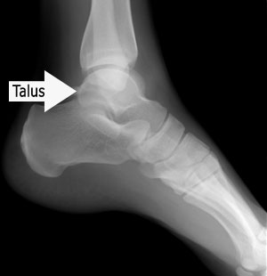
Talus

Slide 13
Join the words in brackets with the prepositions:
propter (diabetes mellitus)
post (morbus acutus)
in (x) (glandula thyroidea)
ante (periodus longa)
post (fractura costae verae)
propter (fissura palati congenita)

Slide 14
Fill in correct endings:
Icterus neonat____
Fractura antebrachi____ complicat____
Morbus chronic____ intestin____ crass____
Ruptura ven____ cerebr____
Cura diabet____ mellit____
Ruptura medull____ oblongat____
Sutura crani____
Medicamenta pro adult____ (pl.)

Slide 15
Translate into English:
Digitus medius
Intestinum crassum
Angulus costae
Palatum osseum
Collum scapulae
Nucleus ruber
Fossa olecrani
Tuberculum calcanei
Colon sigmoideum
Septum nasi

Slide 16
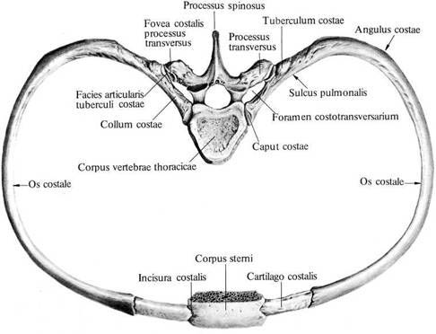
Angulus costae

Slide 17
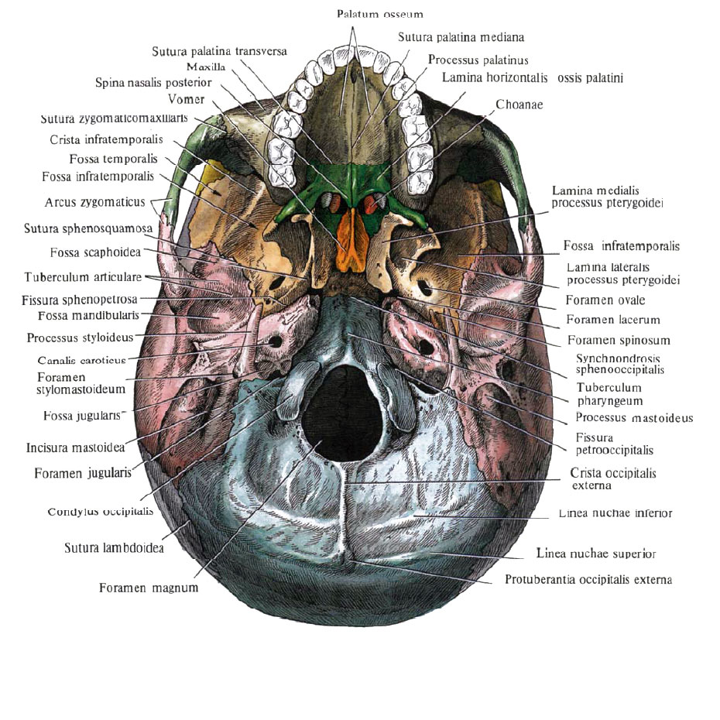
Palatum osseum

Slide 18
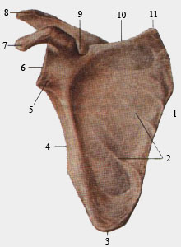
Collum scapulae

Slide 19
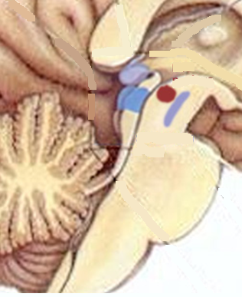
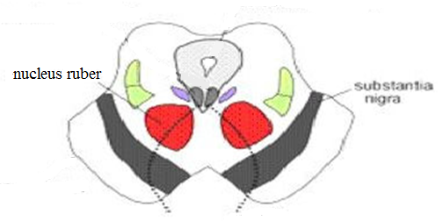
Nucleus ruber

Slide 20
Fossa olecrani

Slide 21
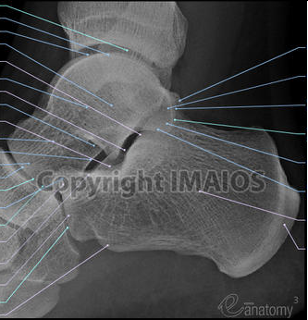
Tuberculum calcanei

Slide 22
Determine the case and number of every single noun/adjective in the following terms:
Mebrana interossea antebrachii
In ligamento carpi radiato
Organa oculi accessoria
Prope ostium pharyngeum tubae auditivae
Fracturae digitorum mediorum
Sub ramo dextro venae portae

Slide 23
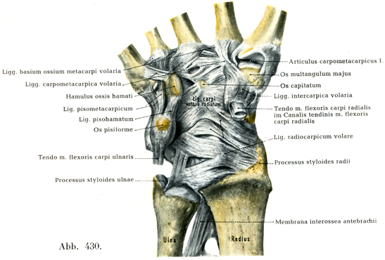
Ligamentum carpi radiatum

Slide 24
Underline all forms in accusative/ablative of singular:
Post fracturam complicatam colli humeri
Propter cancrum ventriculi
Sine ruptura ligamenti interossei
Sub signo veneni
Per rectum
Unguentum glycerini
Extractum belladonnae

Slide 25
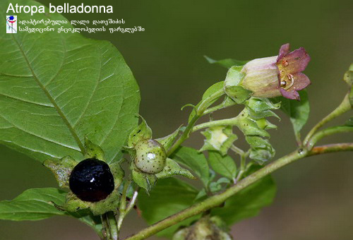
Belladonna

Slide 26
Translate into Latin:
Acute ascites
Muscles of the back
Branches of nerves
Left lobe of the thyroid gland
Congenital fissure of the palate
Rupture of the wide ligament of the uterus
Without any cause of the disease
Under the sign of poison
Before bleeding into the brain

