Slide 1
a) Give gen. sg., gender and example of the following nouns: b) Underline the genitive stem:
nom. sg. | gen. sg. | gender | example
tendo
ulcus
crus
radix
regio
vulnus
encephalitis
pollex
melanoma
ureter
latus

Slide 2
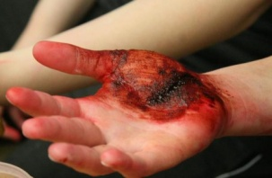
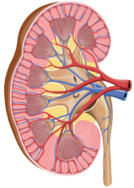
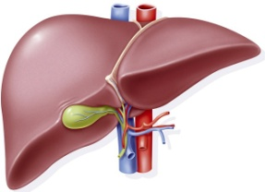
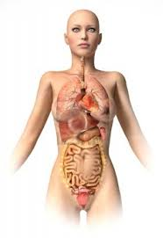
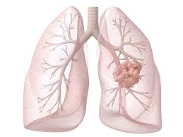
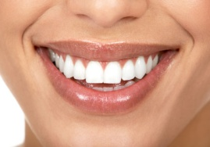
Give Latin and Greek equivalents to the following terms, give gen. sg. and gender:
picture | Latin equivalent | Greek equivalent | gen. sg. | gender

Slide 3
Form grammatically correct terms:
cortex – ren
iris – oculus
musculi – cervix
caput – femur
cavitas – thorax
vestibulum – larynx
margo – lingua
apex – cor
luxatio - crus
cervix – uterus
pulpa – lien
cortex – cerebellum
radix – nasus
dorsum – pes
commotio – cerebrum
vasa – vasa (pl.)
saccarum – lac

Slide 4
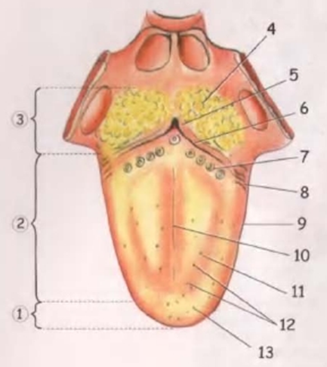
Margo linguae

Slide 5
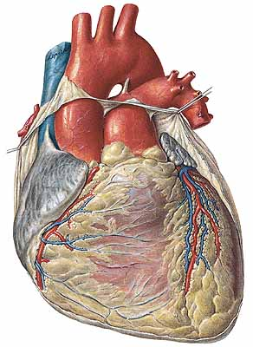
Apex cordis

Slide 6
a) What is the gender of the nouns in the left circle? b) Match the nouns with the adjectives in correct forms:
articulatio
os
cartilago
femur
foramen
tumor
solutio
dolor
pollex
corpus
vulnus
chronicus, a, um
dexter, tra, trum
longus, a, um
thyroideus, a, um
sinister, tra, trum
nutricius, a, um
physiologicus, a, um
punctus, a, um
sacroiliacus, a, um
malignus, a, um
alienus, a, um

Slide 7
Fill in a missing noun which matches all of the three adjectives/nouns:
____________ fractum
longum
sacrum
____________ luteum
humanum
alienum
____________ sectum
scissum
sclopetarium
____________ rotator
adductor
masseter

Slide 8
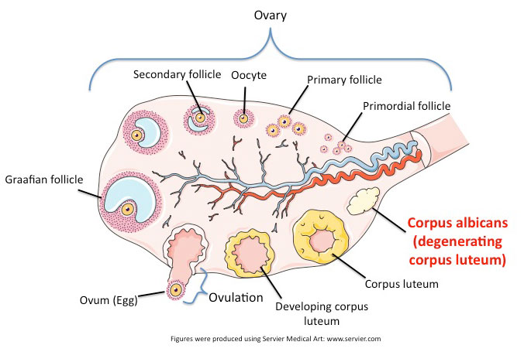
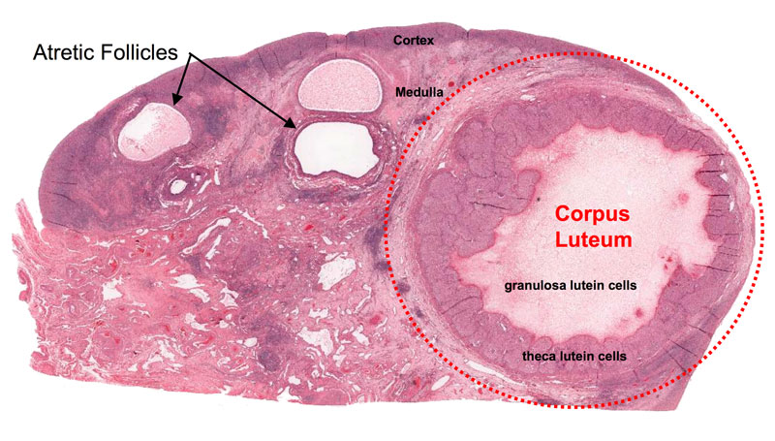
Corpus luteum

Slide 9
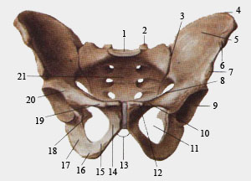
Articulatio sacroiliaca

Slide 10
a) What is the example of every single noun/adjective in the following terms? b) Form gen. sg. and nom. pl.:
Foramen nutricium
Femur fractum
Dolor chronicus
Musculus adductor
Vulnus contusum
Tumor benignus
Injectio subcutanea

Slide 11
Form gramatically correct medical terms:
morbus infectiosus + abdomen
dolor acutus + caput
cavitas + septum nasi
operatio + cervix uteri
corpus + vertebra thoracica
fractura + os sacrum

Slide 12
Match the terms in brackets with prepositions:
per (os)
pro (injectio subcutanea)
cum (vulnus sectum)
ad (cavitas nasi)
contra (ulcus ventriculi)
post (operatio carcinomatis)
inter (phalanges digitorum)
sub (x) (lobus dexter pulmonis)

Slide 13
a) Underline all nouns of the third declension: b) Circle all expressions which are on the same syntactic level in each term:
Lobus hepatis dexter
Regiones corporis humani
Musculus obliquus externus abdominis
Musculus adductor pollicis
Musculus extensor hallucis longus
Tunica mucosa cavitatis oris
Cartilago septi nasi
Vasa sanguinea retinae
Corpus adiposum orbitae

Slide 14
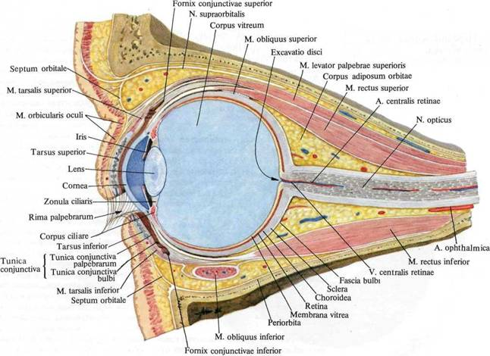
Corpus adiposum orbitae

Slide 15
Corpus alienum in cavitate nasi
Ulcus duodeni perforatum
Vulnera scissa digitorum
Vulnus contusum cum oedemate
Vulnus morsum malleoli
Sanatio vulneris sclopetarii per primam intentionem
Excisio tumoris benigni
Luxatio coxae lateris sinistri congenita
Tumor malignus lobi medii pulmonis dextri

Slide 16
Mixtura pro injectione
Tabulettae per os
Medicamentum contra dolorem

Slide 17
Fill in missing endings:
Luxatio articulation______
Post operation______ irid______
Vitium acquisit______ ren______
Injectio contra dolor______ acut______
Fractura complicat______ femor______ sinistr______
Periculum carcinomat______ cervic______ uter______
Medicamentum pro colitid______ acut______
Operatio tumor______ benign______ in cavitat______ or______
Sanatio encephalitid______ per secund______ intention______
Dolor______ (pl.) capit______ post commotion______ cerebr______

Slide 18
Translate into Latin:
Rupture of a tendon
Ruptures of tendons
Fracture of a vertebral body
Fractures of vertebral bodies
Stab wound in the abdominal region
Stab wounds in the abdominal region
Acute pain in the abdomen
Acute pains in the abdomen
Operation of a malignant tumor of the uterus
Operations of malignant tumors of the uterus
Wound after excision of a melanoma in the region of the back
Wounds after excisions of melanomas in the region of the back

Slide 19
Give opposites:
Tumor malignus
Cavitas thoracis
Dura mater encephali
Pes dexter
Medulla ossium flava
Vitium congenitum
Sanatio per primam intentionem

Slide 20
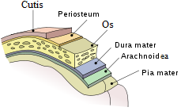
Dura/pia mater encephali

