Slide 1
a) Give gen. sg., gender and example of the following nouns: b) Underline the genitive stem:
nom. sg. | gen. sg. | gender | example
diaphragma
unguis
sectio
febris
calcar
apex
hypophysis
vulnus
mors
cochlear
cirrhosis

Slide 2
Form grammatically correct terms:
axis – pelvis
calcar – avis
sulci – cutis
basis - cranium
canalis – cervix
fossa – hypophysis
mons – pubes
basis – os
radix – unguis
isthmus – fauces
rete – testis/testes
pulpa – dens/dentes
epithelium – lens/lentes

Slide 3
Axis pelvis

Slide 4
Calcar avis

Slide 5
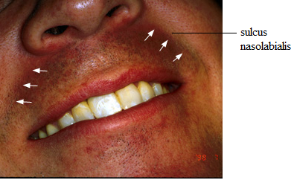
Sulci cutis

Slide 6
Fossa hypophysialis

Slide 7
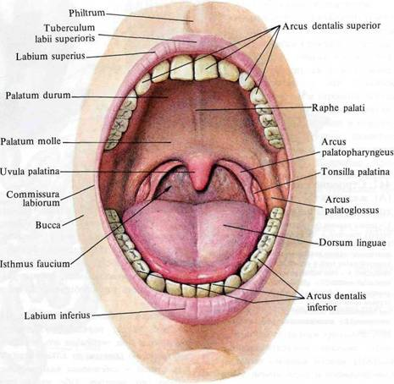
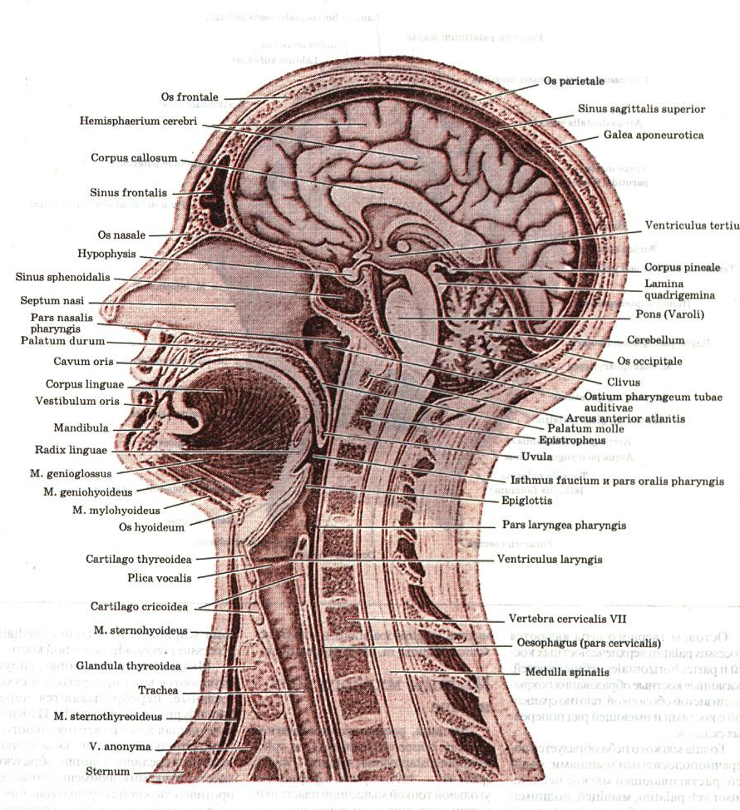
Isthmus faucium

Slide 8
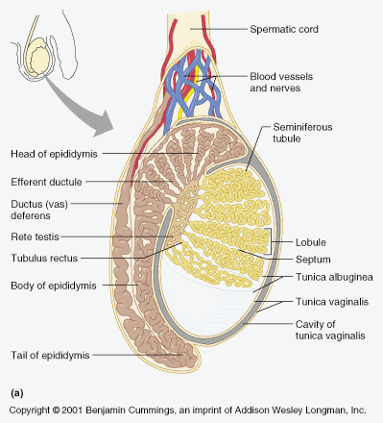
Rete testis

Slide 9
cirrhosis – hepar
melanosis – colon
stenosis – ostium
sclerosis – arteria/arteriae
emesis – gravida/gravidae
dolor - pes
dosis - medicamentum

Slide 10
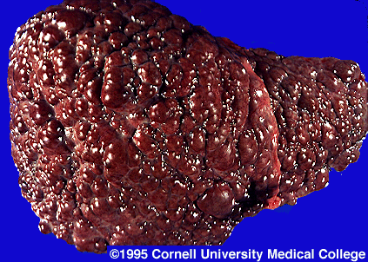
Cirrhosis hepatis

Slide 11
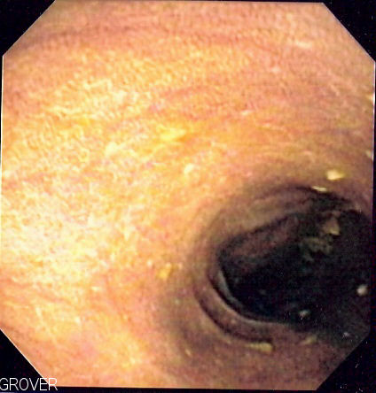
Melanosis coli

Slide 12
Change the terms in red ink in plural (see slides 2 and 9):

Slide 13
a) Decide what the gender of the nouns in the left circle is? b) Match the nouns with the adjectives in correct forms:
canalis
auris
nephrosis
dens
symphysis
rete
mors
febris
continuus, a, um
chronicus, a, um
pubicus, a, um
palatinus, a, um
clinicus, a, um
venosus, a, um
incisivus, a, um
medius, a, um

Slide 14
Change in plural all terms which occur in pairs/plural (see the previus slide):

Slide 15
Canales palatini

Slide 16
Auris media

Slide 17
Match the terms dens incisivus, dens caninus and dens deciduus with the numbers in the picture. Use sg. or pl. as needed.

Slide 18
Connect the term extractio with the terms from the previous slide both in sg. and pl.
extractio | singular | plural

Slide 19
Match the terms with the preposition in:
 | direction | position
canalis palatinus canales palatini
auris media aures mediae
nephrosis chronica
dens incisivus dentes incisivi
symphysis pubica
rete venosum
febris continua

Slide 20
Form meaningfull phrases:
basis + os + sacer, cra, crum
canalis + cervix + uterus
sclerosis + arteria (pl.) + coronarius, a, um
calculosis + vesica + felleus, a, um
stenosis + ostium + venosus, a, um
margo + liber, era, erum + unguis
pars + thoracicus, a, um + systema + autonomicus, a, um
thrombosis + vena (pl.) + in + regio + crus + sinister, tra, trum

Slide 21
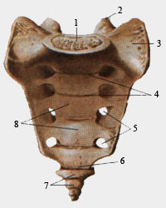
Basis ossis sacri

Slide 22
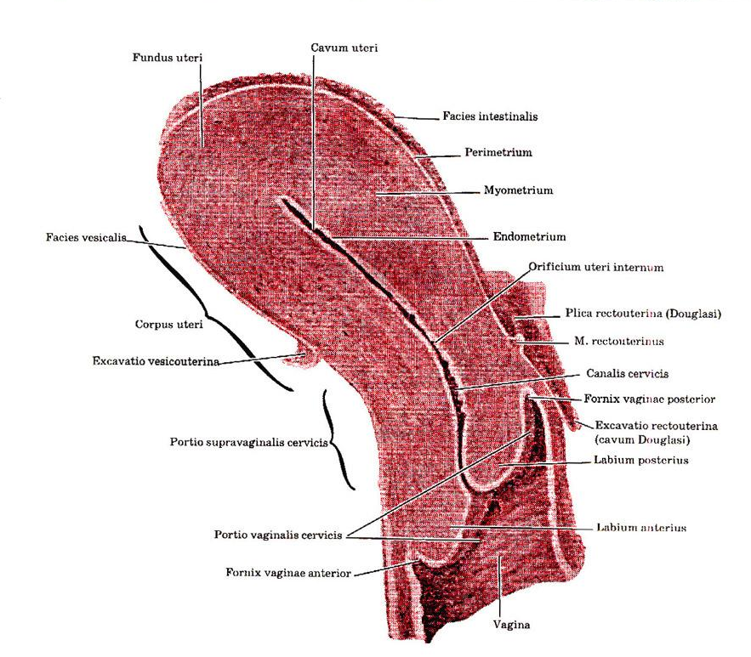
Canalis cervicis uteri

Slide 23
Join the terms in red ink with the expression sanatio (see slide 20):

Slide 24
Decide what the case and declension of every single noun are. Write down the nouns in the table on the next slide:
Aether pro narcosi
Cystes benignae corporis uteri
Myomata uteri cum prognosi bona
Haemodialysis propter functionem renum laesam
Metastases carcinomatosae pulmonum
In parte ossea tubae auditivae

Slide 25
 | 1st declension | 2nd declension | 3rd declension
nom. sg.
gen. sg.
accus. sg.
abl. sg.
nom. pl.
gen. pl.
accus. pl.
abl. pl.

Slide 26
Fill in the missing endings:
Symptomata tuberculos_____
Resectio radic_____ dent_____ incisiv_____
Sub calcar_____ av_____
Amputatio ped_____ dextr_____ cum narcos_____
Aether pro anaesthesi_____
Fractura pelv_____ cum haemorrhagi_____ in
cavitat_____ abdomin_____
Cochlear plen_____ mell_____ pro tuss_____
chronic_____
Rete venos_____ pi_____ matr_____ encephal_____

Slide 27
Translate into Latin:
Death on the operating table
Symptoms of carcinomatous metastases
Operation without narcosis
Lobes and parts of hypophysis
Free margins of nails
In acute fever
Milky teeth
Venous network of the eyeball
Medicaments against whooping cough

