Slide 1
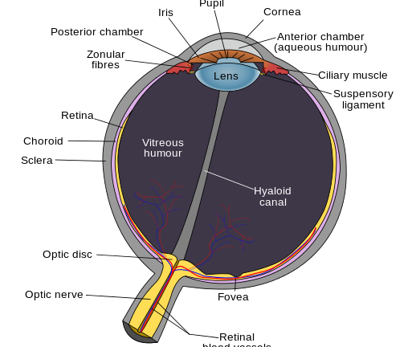
Anatomy of an eye

Slide 2
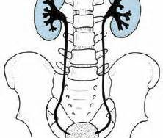
ren, renis, m
ureter, ureteris, m
vesica urinaria

Slide 3
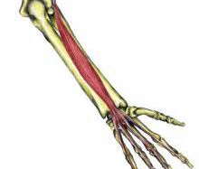
Musculus extensor digitorum
= muscle whose function is to extend the four fingers of the hand
*We have also other muscles with the same function: e.g. musculus extensor hallucis (of a toe), pollucis (of a thumb) etc.

Slide 4
Some other types of muscles
musculus rotator = a muscle that serves to rotate a part of the body – e.g. cervicis, thoracis, lumborum etc.
musculus abductor = muscle that causes movement away from the median plane of body (a vertical plane along the midline of the body dividing the body into right and left halves) – e.g. pollicis
musculus adductor = muscle that causes movement toward the median plane of the body

Slide 5
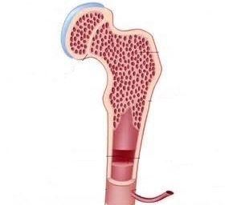
cartilago, inis, f
spongy bone containg medulla flava
compact bone containg medulla rubra
foramen nutricium

Slide 6
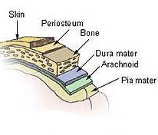
Layers covering the brain

Slide 7
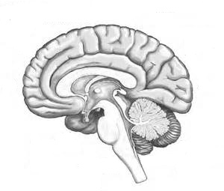
cerebrum, i, n
cerebellum, i, n
fissura transversa cerebri
hypophysis, is/eos, f
pons, tis, m
medulla oblongata

Slide 8
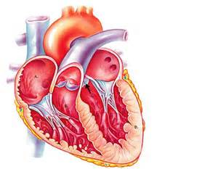
aorta, ae, f
vena cava superior
arteria pulmonaria
atrium sinistrum
atrium dextrum
valvula pulmonaria
ventriculus sinister
ventriculus dexter
apex cordis

Slide 9
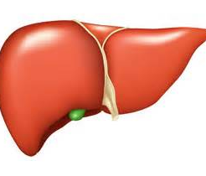
lobus hepatis dexter
lobus hepatis sinister
vesica fellea

Slide 10
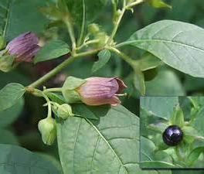
Belladonna
Belladonna has been used in herbal medicine for centuries as a pain reliever, muscle relaxer, and anti-inflammatory, and to treat menstrual problems, peptic ulcer disease, histaminic reaction, and motion sickness
It has a long history of use as a medicine, cosmetic, and poison. Before the Middle Ages, it was used as an anesthetic for surgery; the ancient Romans used it as a poison (the wife of Emperor Augustus and the wife of Claudius both were rumored to have used it for murder); and predating this, it was used to make poison-tipped arrows. The name "bella donna" is derived from Italian and means "beautiful woman" because the herb was used in eye-drops by women to dilate the pupils of the eyes to make them appear seductive.

Slide 11
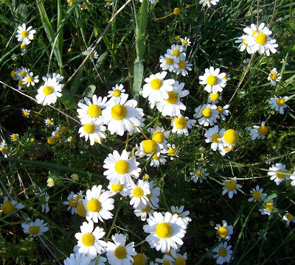
Chamomilla
used to treat alcohol withdrawal, asthma, bronchitis, colic, cough, hypersensitivity to pain, diarrhea, dysmenorrhea, ear infections, and teething.
The word chamomile comes from the Greek χαμαίμηλον (chamaimēlon) meaning "earth-apple",which is derived from χαμαί (chamai) meaning "on the ground„ and μήλον (mēlon) meaning "apple".It is so called because of the apple-like scent of the plant.

Slide 12
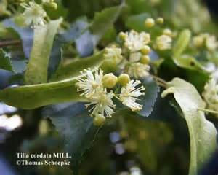
Flos tiliae
Linden flowers are used for colds, cough, fever, infections, inflammation, high blood pressure, headache (particularly migraine), and as a diuretic (increases urine production), antispasmodic (reduces smooth muscle spasm along the digestive tract), and sedative.

