Slide 1
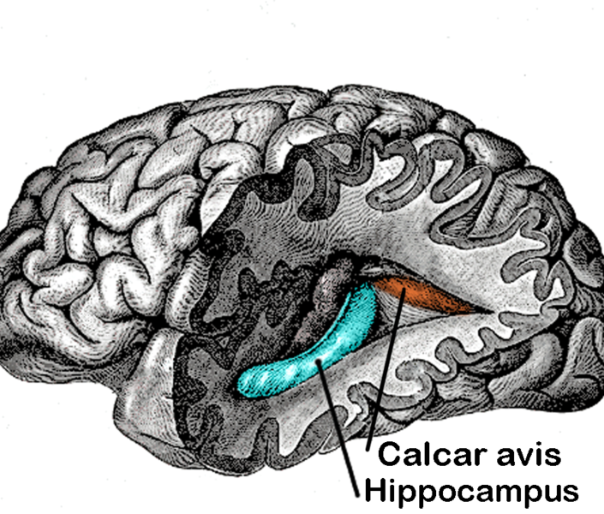
Calcar avis
a projection on the medial wall of the posterior horn of the lateral ventricle of the brain. It is associated with the lateral extension of the calcarine fissure. Also called hippocampus minor.

Slide 2
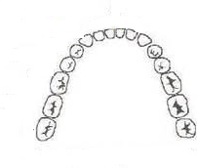
Dentes
dens incisivus
dens caninus
dens premolaris
dens molaris
dens sapientiae
*dens deciduus (child´s first teeth, also called dens lacteus)
x
dens permanens (adult tooth)

Slide 3
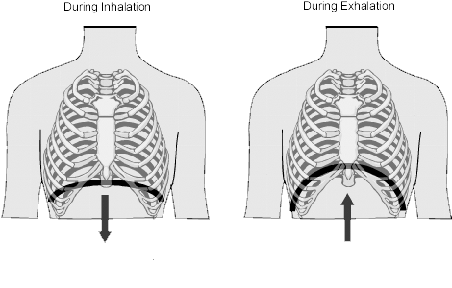
Diaphragm
1. the musculomembranous partition separating the abdominal and thoracic cavities and serving as a major muscle aiding inhalation.
2. any separating membrane or structure.

Slide 4
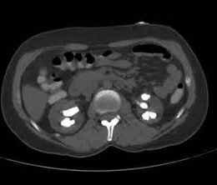
Calculosis
a condition characterized by the presence of calculi (stones). Called also lithiasis. It can be caused by an underlying abnormal excess of the mineral, e.g., with elevated levels of calcium (hypercalcaemia) that may cause kidney stones, dietary factors for gallstones etc.

Slide 5
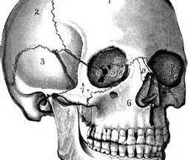
Synarthrosis
a bony junction that is immovable and is connected by solid connective tissue, comprising the fibrous joints and the cartilaginous joints (e.g. in the skull)

Slide 6
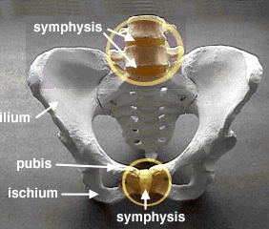
Symphysis
a type of joint in which the apposed bony surfaces are firmly united by a plate of fibrocartilage
*symphysis pubica = the line of union of the bodies of the pubic bones in the median plane.
* symphysis menti =
point in the front of the lower jaw where two halves of the jaw form the chin

Slide 7
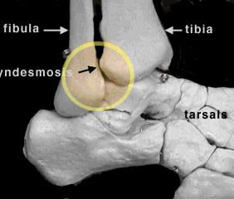
Syndesmosis
a fibrous union in which two bones are connected by interosseous ligaments

Slide 8
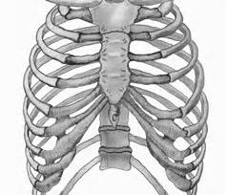
Synchondrosis
a cartilaginous joint creating a union between two immovable bones connected by hyaline cartilage, such as the synchondroses of the cranium, the pubic symphysis, the sternum, and the manubrium.

Slide 9
Diagnoses
Gestosis = hypertensive toxemic disorder of pregnancy - from Latin gesto, to carry, to bear + Greek -osis, condition
Nephrosis = any kidney disease characterized by purely degenerative lesions of the renal tubules
Metastasis = 1. transfer of disease from one organ or part of the body to another not directly connected with it, due either to transfer of pathogenic microorganisms or to transfer of cells; all malignant tumors are capable of metastasizing, 2. a growth of pathogenic microorganisms or of abnormal cells distant from the site primarily involved by the morbid process

Slide 10
Melanosis = 1. abnormally depositing of dark pigment, 2. staining of all body tissue with melanin in a form of carcinoma
  M. coli = black or dark brown discoloration of the mucosa of the colon, due to the presence of pigment-laden (not true melanin) macrophages within the lamina propria
Stenosis = an abnormal narrowing or contraction of a duct or canal, e.g. S. aortae, s. coronaria etc.
Sclerosis = an induration or hardening, especially from inflammation and in diseases of the interstitial substance; applied chiefly to such hardening of the nervous system or to hardening of the blood vessels

