Slide 1
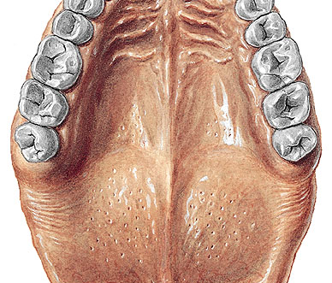
PLICA PALATINA TRANSVERSA
PALATUM DURUM
RHAPHE MEDIANA
VELUM

Slide 2
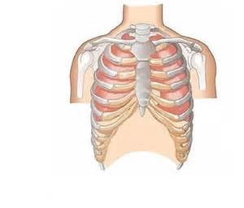
CLAVICULA
HUMERUS
COSTA VERA
STERNUM
COSTA SPURIA

Slide 3
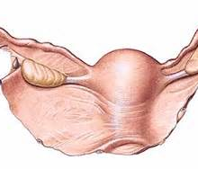
OVARIUM
UTERUS
LIGAMENTUM LATUM UTERI

Slide 4
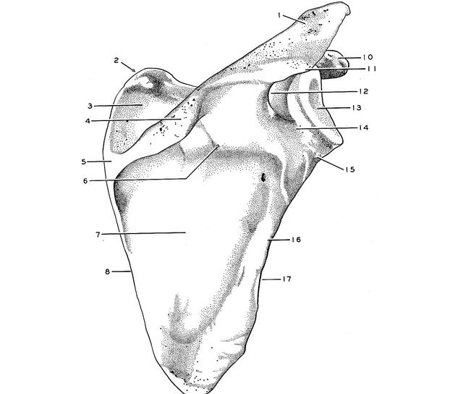
ACROMION
SPINA SCAPULAE
FOSSA SCAPULAE

Slide 5
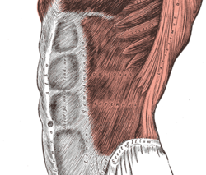
LINEA ALBA

Slide 6
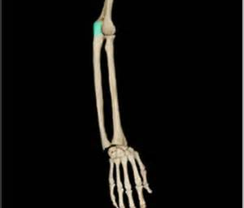
OLECRANON ULNAE
ULNA
RADIUS
DIGITI

Slide 7
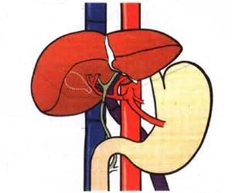
VENA CAVA INFERIOR
IECUR/HEPAR
VENTRICULUS
VENA PORTAE

Slide 8
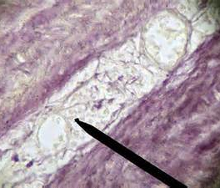
VASA VASORUM
small blood vessels that supply or drain the walls of the larger arteries and veins and connect with a branch of the same vessel or a neighboring vessel

Slide 9
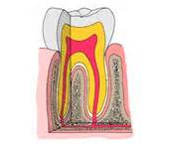
enamelum
dentinum
cementum

Slide 10
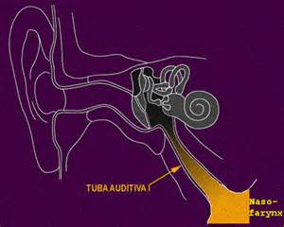

Slide 11
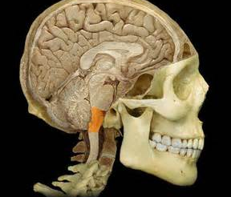
medulla oblongata

Slide 12
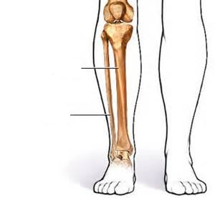
tibia
fibula

